Slide 1
Health, Safety & Environment
Quick Risk Prediction Training

Slide 2

HSE Technical Criteria
Can complete and train Quick Risk Prediction
Guidance Statement | Tell (Key Learning Points) | Show (Demonstrate)
Purpose of Quick Risk Prediction | Why do we do Quick Risk Predictions?
 | When is a Quick Risk Prediction supposed to be completed?
Completion of the QRP | Describe the steps of a Quick Risk Prediction | Execute a QRP and teach the team member or observer each step and why they are doing it.
Look for me for Key Learning Points
Notes:
The objective of this Training is to build your capability on Quick Risk Prediction and increase your understanding of a few key learning points.
After completion of this training, you should be able to:
Understand why we do Quick Risk Predictions
Know when a Quick Risk Prediction is supposed to be completed
Describe the 4 steps of a Quick Risk Prediction.

Slide 3
What is Quick Risk Prediction?
Quick Risk Prediction is a tool created to prompt everyone to evaluate risk before performing a non-standard task. Studies have shown that severe injuries typically happen because risks are not identified and mitigated prior to executing a task.
Notes:
What is Quick Risk Prediction?
Quick Risk Prediction is a tool created to prompt everyone to evaluate risk before performing a non-standard task. Studies have shown that severe injuries typically happen because risks are not identified and mitigated prior to executing a task.

Slide 4
Why Do We Do Quick Risk Predictions?
We do QRP to prompt everyone to STOP and THINK before executing planned and unplanned activities, This helps eliminate injuries because most of them can be prevented if hazards are assessed and risks are mitigated ahead of time.
Notes:
Why do we perform Quick Risk Predictions?
We do Quick Risk Predictions to prompt everyone to STOP and THINK before executing planned and unplanned activities. This helps eliminate injuries because most of them can be prevented if hazards are assessed and risks are mitigated ahead of time.

Slide 5
When Do We Do Quick Risk Predictions?
We do QRPs before high-risk activities, before unplanned activities and when factors have changed for a planned activity. There is no limit to its use.
Notes:
When Do We Do Quick Risk Predictions?
We do QRPs before high-risk activities, before unplanned activities and when factors have changed for a planned activity. There is no limit to its use.

Slide 6
When Do We Do Quick Risk Predictions?
QRP is required for the following:
When Safety Trigger is Red
High risk activities (red from risk grid, missing Job Plan or SOP)
Unplanned, break down or rebuild maintenance
Team member is new or unfamiliar with a task
Non-standard work (not normal production)
Non-routine Changeover
When using Fall Arrest and/or Fall Protection
Work on electrical components 50v and higher
Hot Work or grinding equipment
When machine guarding or barriers are removed
Work with Hazardous Chemicals
Permit Required Confined Space work
Hoisting Equipment
Notes:
When do we do Quick Risk Predictions?
There is no limit to when you can use the Quick Risk Prediction tool but QRP is REQUIRED for the following activities:
When Safety Trigger is deemed to be Red during a DDS (Daily Direction Setting) meeting.
Before performing high risk activities. For example activities that are red from risk grid or that are missing a Job Plan or SOP
Before unplanned activity, break down or rebuild maintenance
When a team member is new or unfamiliar with a task
When executing non-standard work meaning work that is not normal production
Before doing a non-routine Changeover
When using Fall Arrest and/or Fall Protection
When performing work on electrical components 50 volts and higher
When performing Hot Work or grinding equipment
When machine guarding or barriers are removed
When working with Hazardous Chemicals
When entering a permit Required Confined Space
When performing work involving hoisting equipment

Slide 7
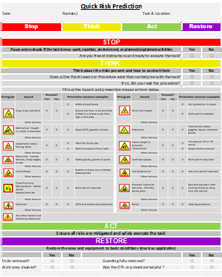
QRP Tool
The Quick Risk Prediction tool
contains 4 main sections:
Stop
Think
Act
Restore
Notes:
Now let’s review the Quick Risk Prediction form.
The QRP form contains 4 sections:
Stop
Think
Act
Restore
Let’s review each step in more detail.

Slide 8
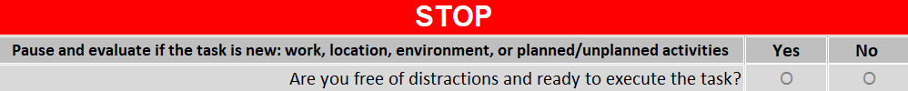
Step 1: Stop
Why do we perform this step?
We STOP to allow a person to take a beat, focus and clear their head before moving forward
Ask yourself:
Am I in the right frame of mind to do this task safely?
What is different this time?
What has changed this time?
Notes:
Step 1
Step 1 is called Stop.
We STOP to allow a person to take a beat, focus and clear their head before moving forward
During the Stop step, you will pause and think about the task you are about to perform. Visualize each step of the task and think if anything is different for this task:
Is this new work? For example: is there a new employee in this team or this is a new task you haven’t performed before?
Is this a new environment? For example: is the weather more humid today or is the floor wet?
Is this a planned activity where one or more factors have changed?
Is this an unplanned activity?
Also evaluate your mindset:
- Are you in the right frame of mind to do this task safely?
Are you in a rush?
Are you distracted?
Once you have thought the task through and placed yourself in a focused and clear mindset to perform the task, check the box accordingly. If you feel you are not able to focus and perform the task safely, contact your supervisor to develop an alternative plan.

Slide 9

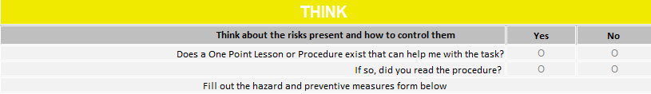
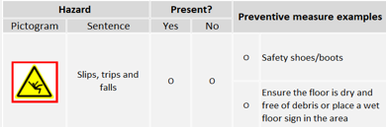

Step 2: Think
Why do we perform this step?
We use the THINK step to ensure we are utilizing existing procedures, to identify the hazards that might be present during execution of the task and to develop a plan to mitigate those hazards
Notes:
Step 2
Step 2 is called Think
We use the THINK step to ensure we are utilizing existing procedures, to identify the hazards that might be present during execution of the task and to develop a plan to mitigate those hazards.
During this step, you will obtain and review all procedures available for this task (OPL, job plan, etc). Once the review is complete, think about every single risk you will encounter while executing the task.
In the form:
Check that you have reviewed the procedure
Check the respective boxes for every risk potentially present in the task you are about to complete
Check the mitigation action to control each hazard
Make sure everyone involved in the work understands the plan and ensure that all mitigation measures are complete before starting the work.

Slide 10
Step 3: Act
Why do we perform this step?
We perform the ACT step to ensure we are executing the task while following the mitigation plan.
Notes:
Step 3
Step 3 is called Act.
We perform the ACT step to ensure we are executing the task while following the mitigation plan.
This is the step where you perform the work according to the plan. If any factors change, make sure to go back to assess risk and develop updated mitigation measures.

Slide 11
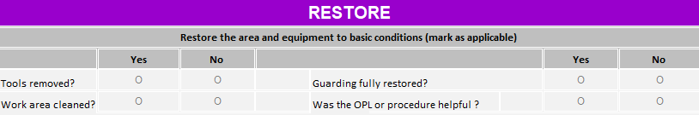
Step 4: Restore
Why do we perform this step?
We RESTORE back to basic conditions after completion to ensure we do not create a hazard for someone else
Notes:
Step 4
Step 4 is the Restore step.
We RESTORE back to basic conditions after completion to ensure we do not create a hazard for someone else.
Once the task is completed, make sure to double check the equipment and working area to ensure it is back to the original condition and free of hazards.
Check the appropriate boxes in the form and note any follow ups. If any inaccuracies are identified in the procedures, make sure to contact the appropriate resource to have the documentation updated.

Slide 12
QRP Example
Process info
Date
Name(s)
Task and Location
STOP
Take a moment to clear your head for the task ahead
THINK
Consider all the known hazards and what you can do if a hazard is present
ACT
Work your plan
RESTORE
Complete to ensure you don’t
miss anything
Notes:
This is an overview of the entire Quick Risk Prediction form.
At the top, you will enter information related to the team and the task such as name and location.
In the body of the document, you will enter information related to Stop, Think, Act and Restore as previously discussed.
Once the form is completed, return it to your plant’s QRP resource or to the QRP repository for analysis.

Slide 13
HSE Technical Criteria
Can complete and train Quick Risk Prediction
Guidance Statement | Tell (Key Learning Points) | Show (Demonstrate)
Purpose of Quick Risk Prediction | Why do we do Quick Risk Predictions?
 | When is a Quick Risk Prediction supposed to be completed?
Completion of the QRP | Describe the steps of a Quick Risk Prediction | Execute a QRP and teach the team member or observer each step and why they are doing it.
Do you feel you can explain why you do a QRP, execute a QRP and why you do each step?
Notes:
Now that the training is completed, you should have a better understanding of:
Why we do Quick Risk Predictions
When a Quick Risk Prediction is supposed to be completed
The 4 steps of a Quick Risk Prediction.
If you have questions related to any of the items covered, make sure to contact your supervisor.

Slide 14


