Slide 1
school re-openings: grave concerns/ Necessary Conditions
Victor Goode, Esq.
Interim NAACP Education Director
vgoode@naacpnet.org

Slide 2
Participant Learning Objectives
Participants will be able to identify 1 reason Black parents may be concerned about sending their children back to school at this time.
Participants will be able to identify 1 necessary pre-condition for schools to reopen.
If schools re-open, participants will be able to identify 1 demand for an alternative they should offer to parents.
Participants will be able to identify 1 structural reform issue .

Slide 3
Until recently, we focused on school closings
A recent NAACP nationwide poll of African Americans found 80% of those polled preferred to hold off on ending the shutdowns to assure their safety, ahead of boosting the economy.
Recent spikes in COVID-19 cases
New Mexico Idaho Arkansas Kansas California Georgia
Alabama South Carolina Florida Tennessee
Louisiana Texas Mississippi Delaware
* Blacks 13% of U.S. population, but 23% of COVID-19 deaths

Slide 4
What does CDC say about School Re-openings?
Leaves it up to State and Local Officials
CDC Indicators
CDC Toolkit for School Re-Opening decisions https://www.cdc.gov/coronavirus/2019-ncov/community/schools-childcare/Schools-Decision-Tree.pdf
CDC refuses to back away from their recommendations despite Trump criticism https://www.latimes.com/world-nation/story/2020-07-09/cdc-head-sticking-to-school-opening-guides-trump-criticized
Indicators based on symptoms
Indicators based on cases
Indicators based on hospital readiness
The above indicators do not mention the use of racially disaggregated data based on symptoms or based on cases.
The results of application of CDC indicators may vary from county to county within a State.

Slide 5
Black parents face a dilemma
Unit Action: Demand that Governors and school districts offer quality, public, non-charter, equally accessible on-line learning options
Send their children to school and risk them getting COVID-19, OR
Keep them at home and risk getting Juvenile Court summons and/or Children Protective Services opening an investigation.
Blacks already overrepresented in child welfare systems.

Slide 6
Structural Education Issues
Digital Divide
Literacy
School Funding/Access to Resources
How Black Students are Perceived, Treated, Taught, and Disciplined
Unit Action: Identify horror stories and take action to address!

Slide 7
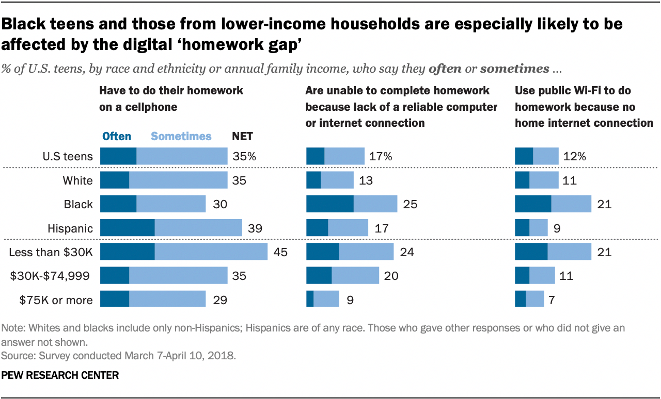

Slide 9
Literacy
Inadequate Literacy Among Black Student Test Takers
https://nces.ed.gov/nationsreportcard/pubs/stt2019/2020014.aspx
Unit Action--Demand that Governors and Districts re-evaluate the effectiveness of their approaches to addressing literacy. MI recently settled a “right to literacy” lawsuit. CO Area Conference NAACP raised questions about the State’s Literacy Plan. Youngstown, OH NAACP raised questions about ineffective efforts of local school board and now the State in educating Black students.

Slide 10
School Funding and Access to Resources
According to Ed Trust, in 14 states, the districts with the most students of color get less funding than districts with the lowest percentage of students of color.
In 27 states, districts with the highest poverty rates do not receive more funding to account for that increased need.
District underfunding at the state levels is exacerbated by the continuing efforts by Education Secretary DeVos to shift CARES Act funds to private schools, combined with Trump’s 2021 proposed Education Budget which would create a $5 billion tax credit to fund an Education Freedom Scholarship program for students to attend private schools, while cutting funds for dozens of programs that support disadvantaged students.
Students of color are more likely to go to schools with lower-quality facilities such as temporary, portable classrooms.
Black and Latino students account for close to 40 percent of high school students, but constitute just a quarter of students taking AP courses.
Students of color are more likely to be assigned to inexperienced, out-of-field, academically weaker, and less effective teachers than are other students.
Unit Actions—DE State Conference NAACP, PA State Conference NAACP, and New England Area Conference NAACP are challenging school funding under State Constitutions. A court recently ruled for DE State Conference against the County Defendants. Spring Valley, NY NAACP recently won voting rights suit against East Ramapo School Board.

Slide 11
How Black Students are Perceived, Treated, Taught, and Disciplined
This broad category of challenges ranges from curriculum standards to textbooks & instruction, e.g., Black History.
It includes student on student racial harassment, as well as staff on student mistreatment.
It may also include how Black parents and teachers are treated. Or how black students and fans must endure the school fight song, Dixie.
If you want to see how any public school or district is disciplining students, by race, go to the Civil Rights Data Collection. https://ocrdata.ed.gov/DistrictSchoolSearch
Unit action plans have ranged widely from lawsuits against districts where board selection schemes violate the voting rights of black voters to leveraging existing school desegregation cases to community organizing (e.g., Lean on Me Monday to tutor students at schools in danger of being closed) to voter registration and engagement to election protection to use of Title VI complaints to address an array of racially discriminatory actions. Unit Education Committee might also work with Unit Economic and Housing Committees to address school effects from broader redevelopment policies. Some units have worked to gain approval from State Boards of Education for Black History and Ethnic Studies Textbooks or Courses.

