Slide 1
We are Our Own
Worst Enemy
Lisa LaVan
District X Female Officials Rep (8 years)
Warren Area HS Girls Basketball Head Coach (15 seasons)

Slide 2
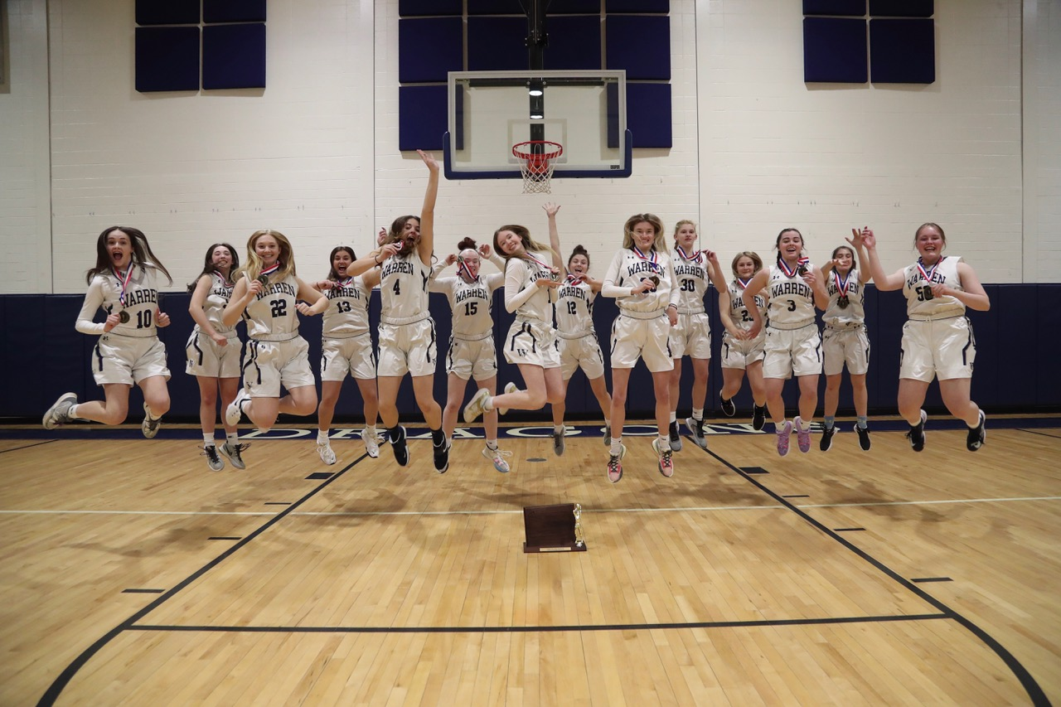
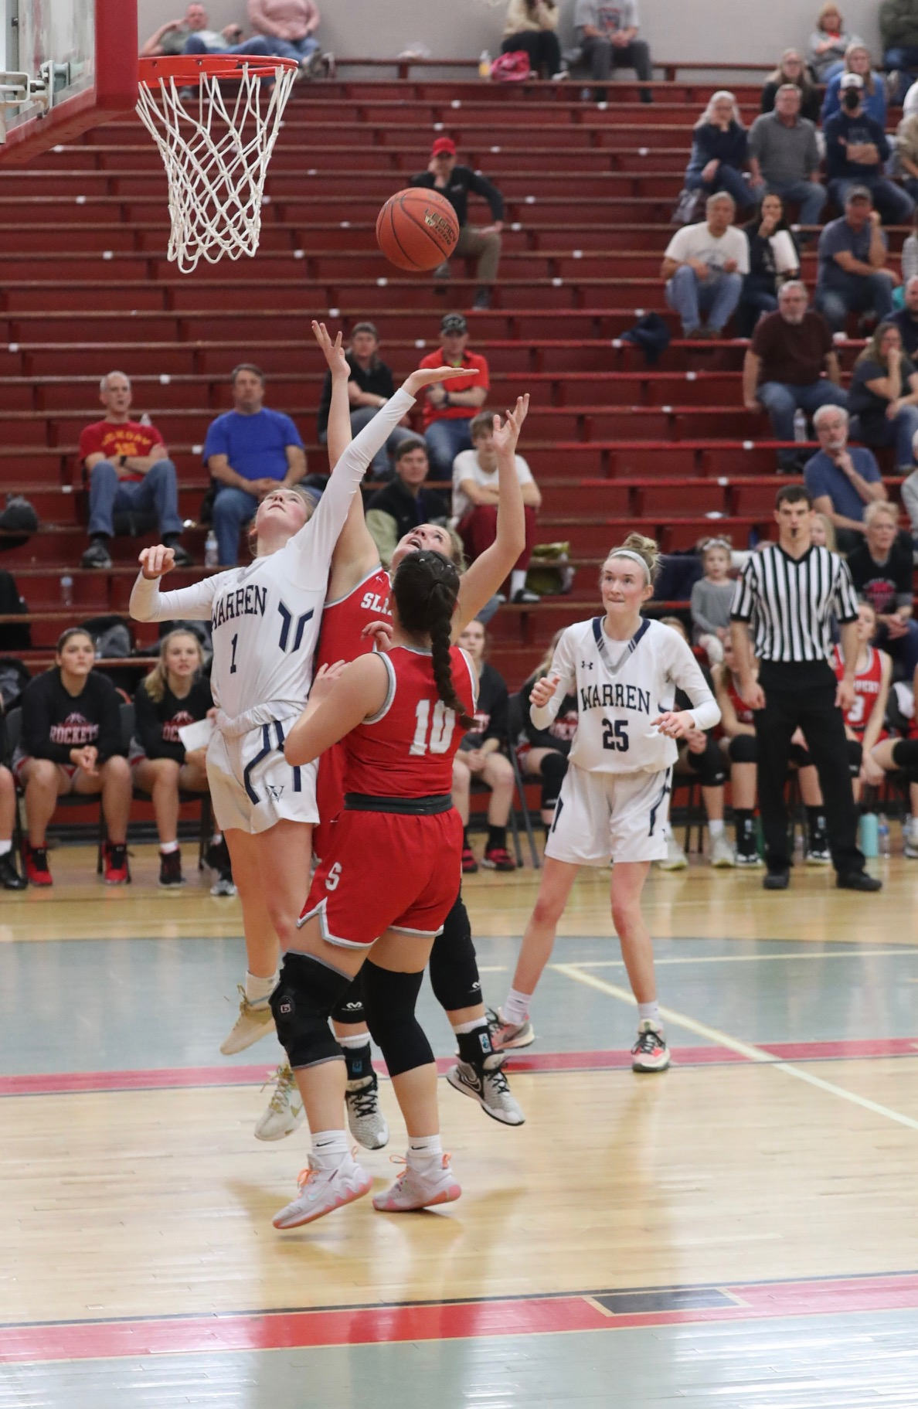
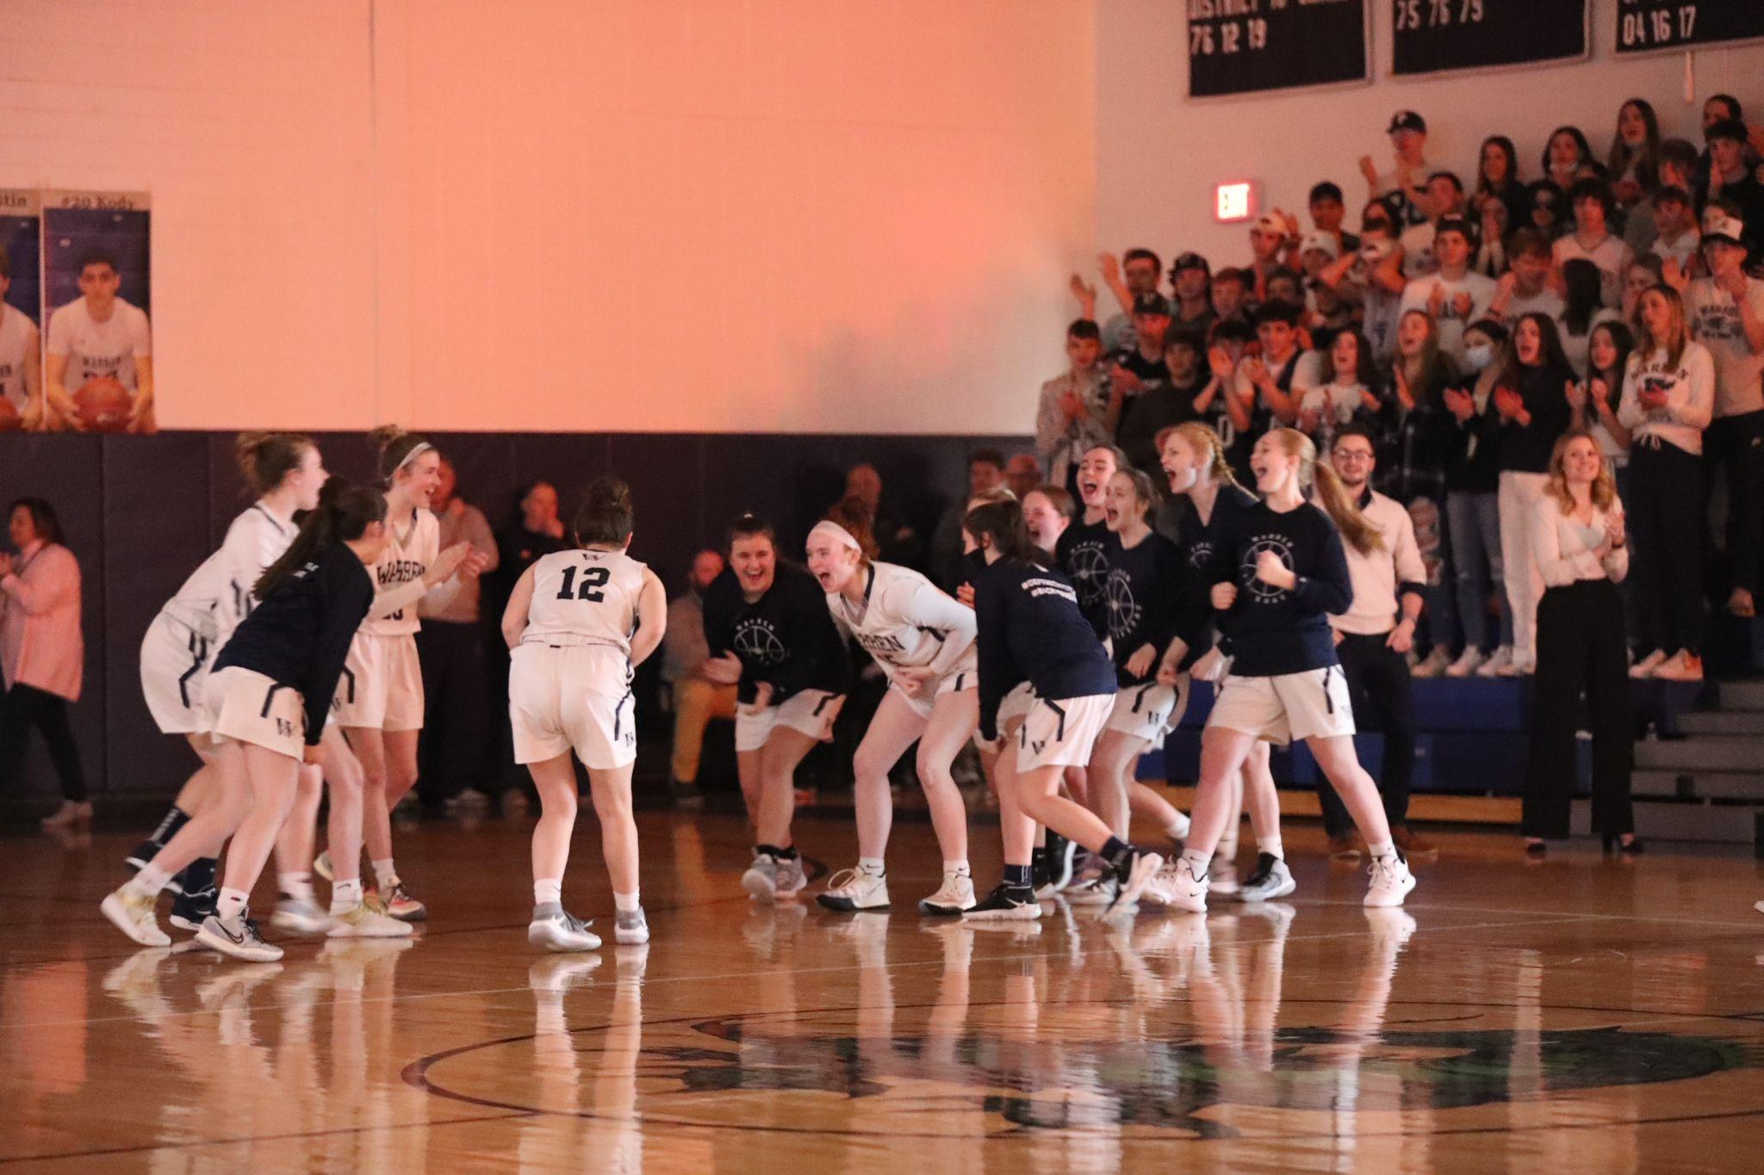
At the heart of why we do what we do…

Slide 3
We are the Guardians of Sportsmanship
It is our game
We should remain emotionless and take care of massive emotions
Control the what you can control (and we can control a lot)
We have the tools in our toolbox
  Warnings
  Technicals
  Ejections

Slide 4
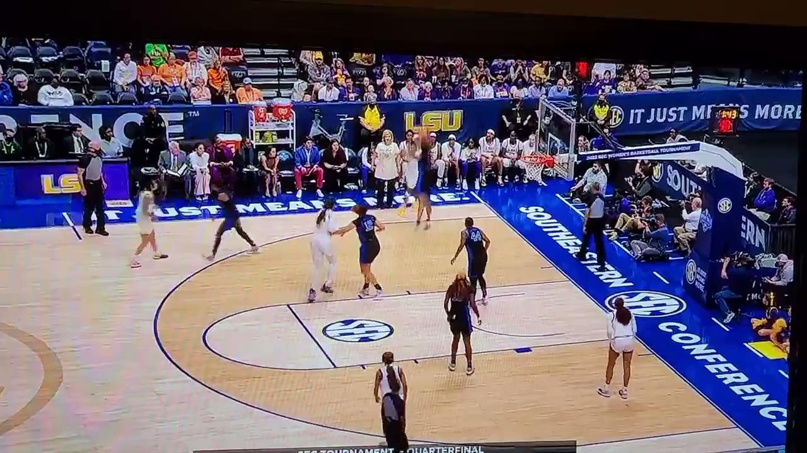
Why would we let this go?

Slide 5
What is the Big Deal?
She is showing massive emotions (negative)
She is out of her coaching box (and not coaching)
If you don’t take care of that… you opened the door for more (and worse)
It is a cycle, a habit take care of it so others don’t have to
We can control this and in turn the game is better
It is WHAT IS BEST FOR THE GAME (and the next game)
Younger officials, need to see we will take care of it

Slide 6

How long is the leash?

Slide 7
What would you have here?

Slide 8
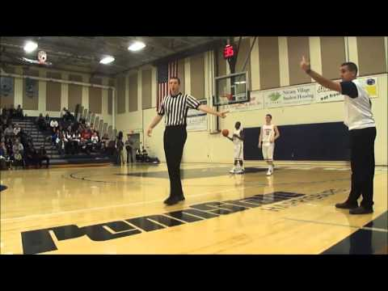
What about here?

Slide 9
Coaches say the darndest things…
Coach: ‘I didn’t even swear!’
  You don’t have to swear. It is how you display your emotions.
Coach: ‘I was reacting to my team, not your call.’
  ‘Actions meant to demean opposing contestants, teams, spectator and officials are not in the highest ideals…’
Coach: ‘I was talking to my team not you.’
  See above

Slide 10

What about here?

Slide 11
Taken Care of It

Slide 12
Thank you!
Lisa LaVan - 716-397-2521
lisalavan40@gmail.com
LWOME
Live While Others Merely Exist

