Slide 1



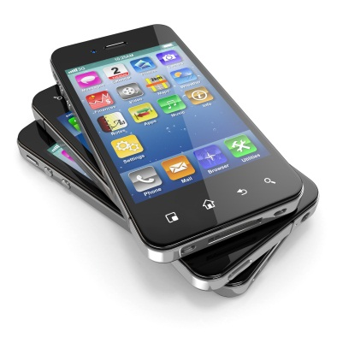
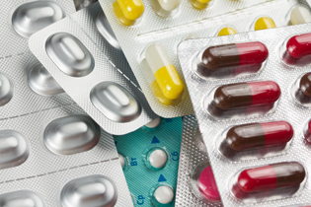
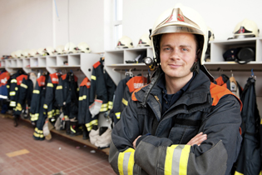

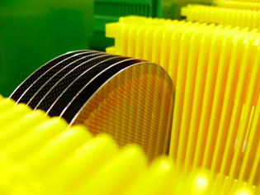
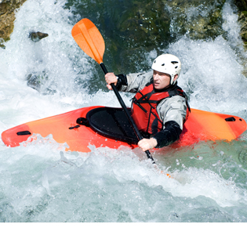
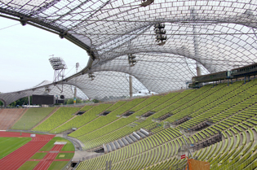
Societal Benefits of FluoroTechnology
Evan Laganis,^{1,2} Miguel Cardona, ³ Steve Korzeniowski,³ Jessica Bowman¹
¹FluoroCouncil, ²Asahi Glass Co, Ltd, ³The Chemours Company, LLC
OVERVIEW
FluoroTechnology is the use of fluorine chemistry to create any fluorinated product, including fluoropolymer products, fluorotelomer-based products, fluoro-surfactants and fluoro-surface property modification agents. When fluorine and carbon atoms join together, they create a powerful chemical bond. The use and manipulation of this bond gives FluoroTechnology its distinct properties of strength, durability, heat-resistance and stability. These properties are critical to the reliable and safe function of myriad products that industry and consumer rely on every day.
FluoroTechnology Benefits and Supported Industries
Safety: Workers, Consumers, Environment
  Chemical and Pharmaceutical Manufacturing
  Food Processing
  Personal Protection and Worker Safety
  Safety Equipment
  Healthcare/Hospitals
  Metal Plating
  Aerospace
  Wire & Cable in Buildings
  Paper and Packaging
Durability
  Building and Construction
  Industrial and Institutional Floor Care
  Cookware
  Paints and Coatings
  Outdoor Apparel/Equipment
  Leather (Footwear and Furniture)
  Carpet and other Home Textiles
Emissions Reduction/ (Alternative) Energy
  Automotive
  Oilfield and Mining
  Alternative Energy
Electronic Equipment
  Semiconductors and Electronics
Products that rely on FluoroTechnology are beneficial to a wide range of industries that are major job creators. Globally, the FluoroTechnology industry was a $19.7 billion business in 2013. Also in 2013, more than $1.2 trillion of global manufacturing output included FluoroTechnology in either the end product itself, or in its processing, supporting more than 625,000 jobs in the U.S. and Western Europe.
For more information, visit http://fluorocouncil.org/Applications
FLUOROTECHNOLOGY APPLICATIONS
Aerospace
High and low temperature chemical resistant tubes, hoses and fluid seals.
High and low temperature brake and hydraulic fluids used in aircraft control systems and brakes.
Ultra-high frequency wire and cable insulation necessary for navigation, fly-by-wire control and aircraft communications.
Unmatched oil/water, stain and soil protection, providing hygienic, longer lasting and lower-maintenance commercial aircraft interiors.
Firefighting foam that enables on-the-ground aircraft fires to be extinguished quickly to enable passenger evacuation.
Electronics
Transmission of high frequency signals on which most modern electronics are based.
Improved insulation, weatherability, transparency and water resistance for many key electronic products.
Smooth and smudge resistant touch screens.
Healthcare
Low-friction and clot-resistant coatings for catheters, stents and needles, improving patient comfort and safety, including in deep needle operations such as drug injections and biopsies.
Protein-resistant and sterile filters, tubing, o-rings, seals and gaskets for kidney dialysis machines and immuno-diagnostic instruments.
High dielectric insulators that are critical to the proper function of electronics that rely on high frequency signals - defibrillators, pacemakers and CRT, PET and MRI imaging devices.
High barrier against humidity in blister packaging for sensitive pharmaceuticals, extending the shelf-life for dry formulations like pills and powders.
Barriers in hospital gowns, drapes and divider curtains, providing life-saving protection against infections and transmission of diseases in hospitals.
Wall and floor paints that allow for the aggressive use of biocides for cleaning, helping to prevent infections in hospitals.
Automotive
Wire coatings that increase reliability of engine compartment wiring and gauges and improve auto safety by helping to reduce engine compartment fires.
Chemical and heat resistant gaskets and o-rings, improving reliability and the length of time between maintenance and service.
Cylinder head coatings and hoses that increase fuel efficiency and reduce fugitive gasoline vapor emissions.
Surface protection treatments protect automobile carpets and seats against stains, soil, oil and water.
Chemical and Pharmaceutical
Pipes, tanks, valve linings and hoses that provide resistance to high heat and chemical insult, improving safety, increasing equipment durability, and reducing maintenance costs.
Lubricants that provide chemical and thermal stability to allow use in high temperature reactions with aggressive liquids and solvents without product contamination or reaction interference.
Treated work wear that protects workers from exposure to hazardous chemicals such as solvents.
First Responder Safety
Production of firefighting foam, used to fight Class B flammable liquid fires and provide both shorter extinguishment times and critical burnback resistance.
Life-saving clothing used to protect first responders, helping to deflect bullets and maintain performance in extreme environments.
Semiconductors
Tanks, valves, pumps and piping to create the ultra-pure manufacturing environments that are necessary for micro-electronics.
Corrosion resistant equipment, protecting against harsh chemicals and improving safety by reducing the potential for leaks.
Plasma machinery, etching materials, cleaning fluids and wetting surfactants for chemical etchants.
Alternative Energy
Efficient electrolytic ionic migration, allowing for smaller, more efficient lithium batteries used in all types of electronics from automobiles to cell phones.
Chemical resistant membranes and dividers in fuel cells.
High vapor barrier, high transparency, superior weatherability, and flexibility to make solar panel front and back sheet films durable, extending product life.
Building and Construction
Architectural membrane fabrics used in roofs provide weatherability, durability, energy efficiency and appealing aesthetics.
Metal roof coatings that enhance durability and provide energy savings through solar reflectance and reduction of heat transfer.
Paint coatings that provide unmatched durability and UV resistance, reducing maintenance, enhancing aesthetics, saving energy and extending the life cycle of building facades and bridges.
Adhesives, sealants and caulks to strengthen the bond to surfaces in building and construction materials.
Wire and cable applications with critical properties such as high temperature endurance, fire resistance, chemical resistance and high stress crack resistance.
Outdoor Apparel & Equipment
Breathable membranes and long-lasting Durable Water Repellent (DWR) finishes that provide water repellency, oil repellency, stain resistance and soil release with abrasion resistant finishes for apparel and equipment.
  Keeps people safe by delivering life-saving protection in extreme weather and temperatures.
  Oil repellence prevents loss of water repellency from oils such as body oil, sun tan lotion, food and dirt.
  Provides garments and equipment with longer useful life, reducing energy and water used to manufacture replacements and requiring less frequent laundering, lower wash temperature and shorter drying time, further reducing use of water and energy.
Oil and Gas
Fuel system seals and hoses, O-rings and downhole and field equipment gaskets that resist extreme heat and chemicals, improving reliability and safety.
Acid resistant piping for crude oil transfer, improving safety of oil-field and oil-pipeline operations.
Fire-fighting foams used to enhance the safety of oil refining.
Copyright © 2015 FluoroCouncil

