Slide 1
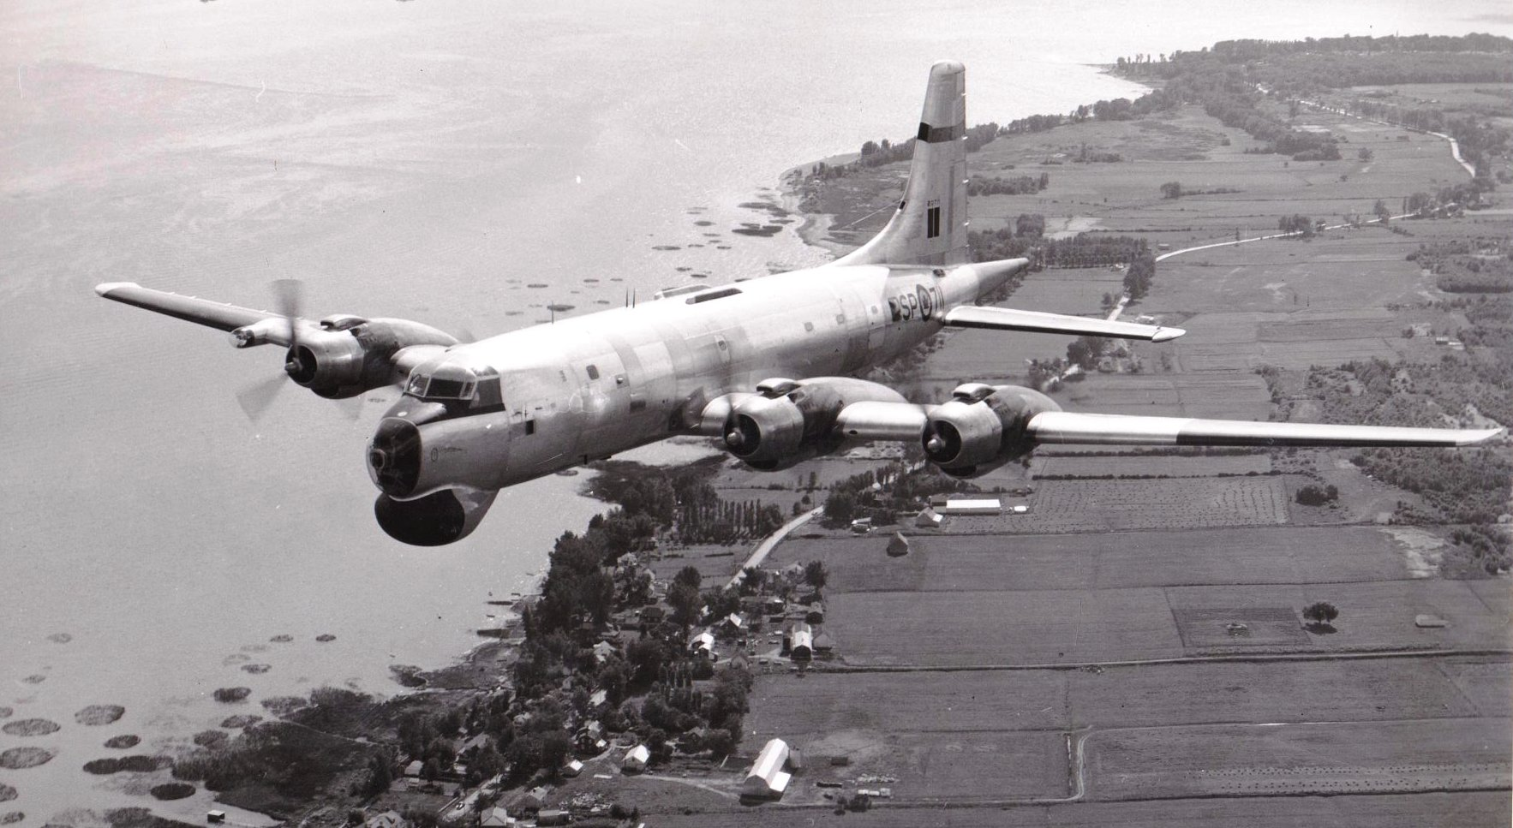
A DAY IN THE LIFE OF A CP107 ARGUS CREW

Slide 2
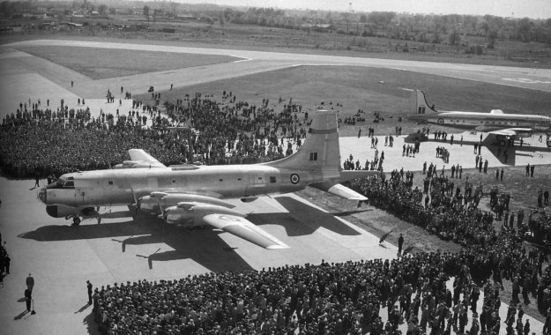
First Argus Rolled Out in 1956

Slide 3
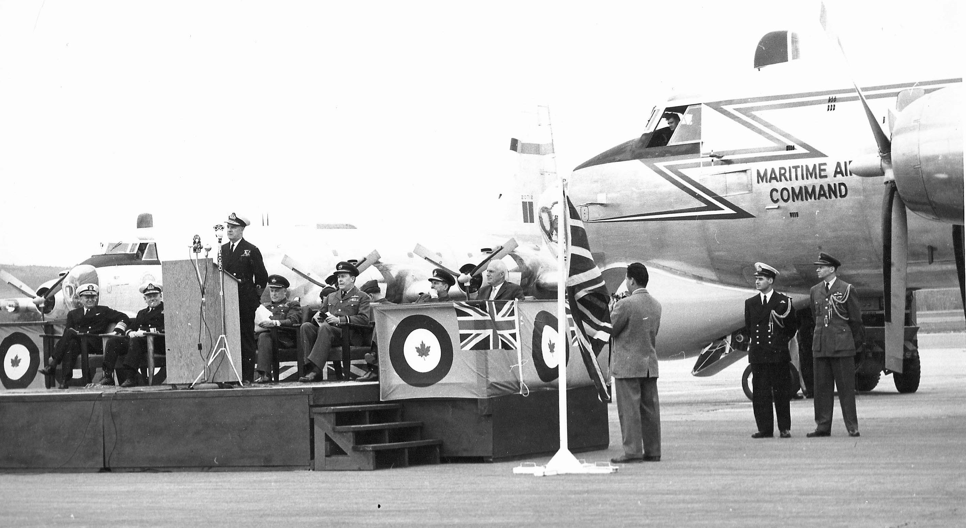
405 Squadron was the first unit to receive the Argus. flew its first Argus test flight
on August 7, 1959 and flew its first operational mission 0n August 11, 1959 on 720.

Slide 4
In 1968 405 Squadron had:
- 8 Crews with on the average of 18 pers per crew,
- 24/7 operations centre,
- Their own aircraft identified by blue prop spinners,
- Owned ½ the upstairs space in 11 Hangar,
- No computers, cellphones or tablets,
- Manual typewriters and rotary phones’
- Everyone had a secondary duty be it Crew, Squadron or Base.

Slide 5
ASW MISSION
Day Before
Key crew members check the Form Green and begin mission planning.
3 hours before takeoff
Crew checks in at Base Operations in 9 Hangar to prepare for briefing while FEs get the plane ready.
2 Hours Before Takeoff
Base Operations gives the crew their briefing including Intel, area air traffic, acoustic predictions, weather, mission
parameters followed by the individual crew lead briefings.
1 Hour Before Takeoff
Crew goes to aircraft for pre-flight preparations.

Slide 6
ASW MISSION
Argus crew was made of:
3 Pilots
2 Flight Engineers
6 Navigators
7 Radio Officers

Slide 7
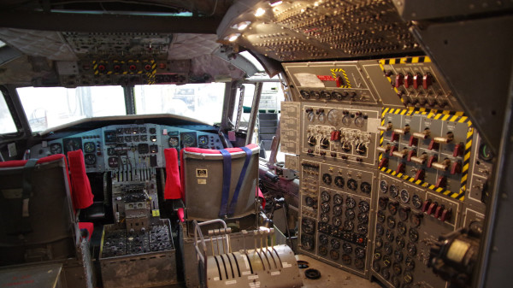

Slide 8
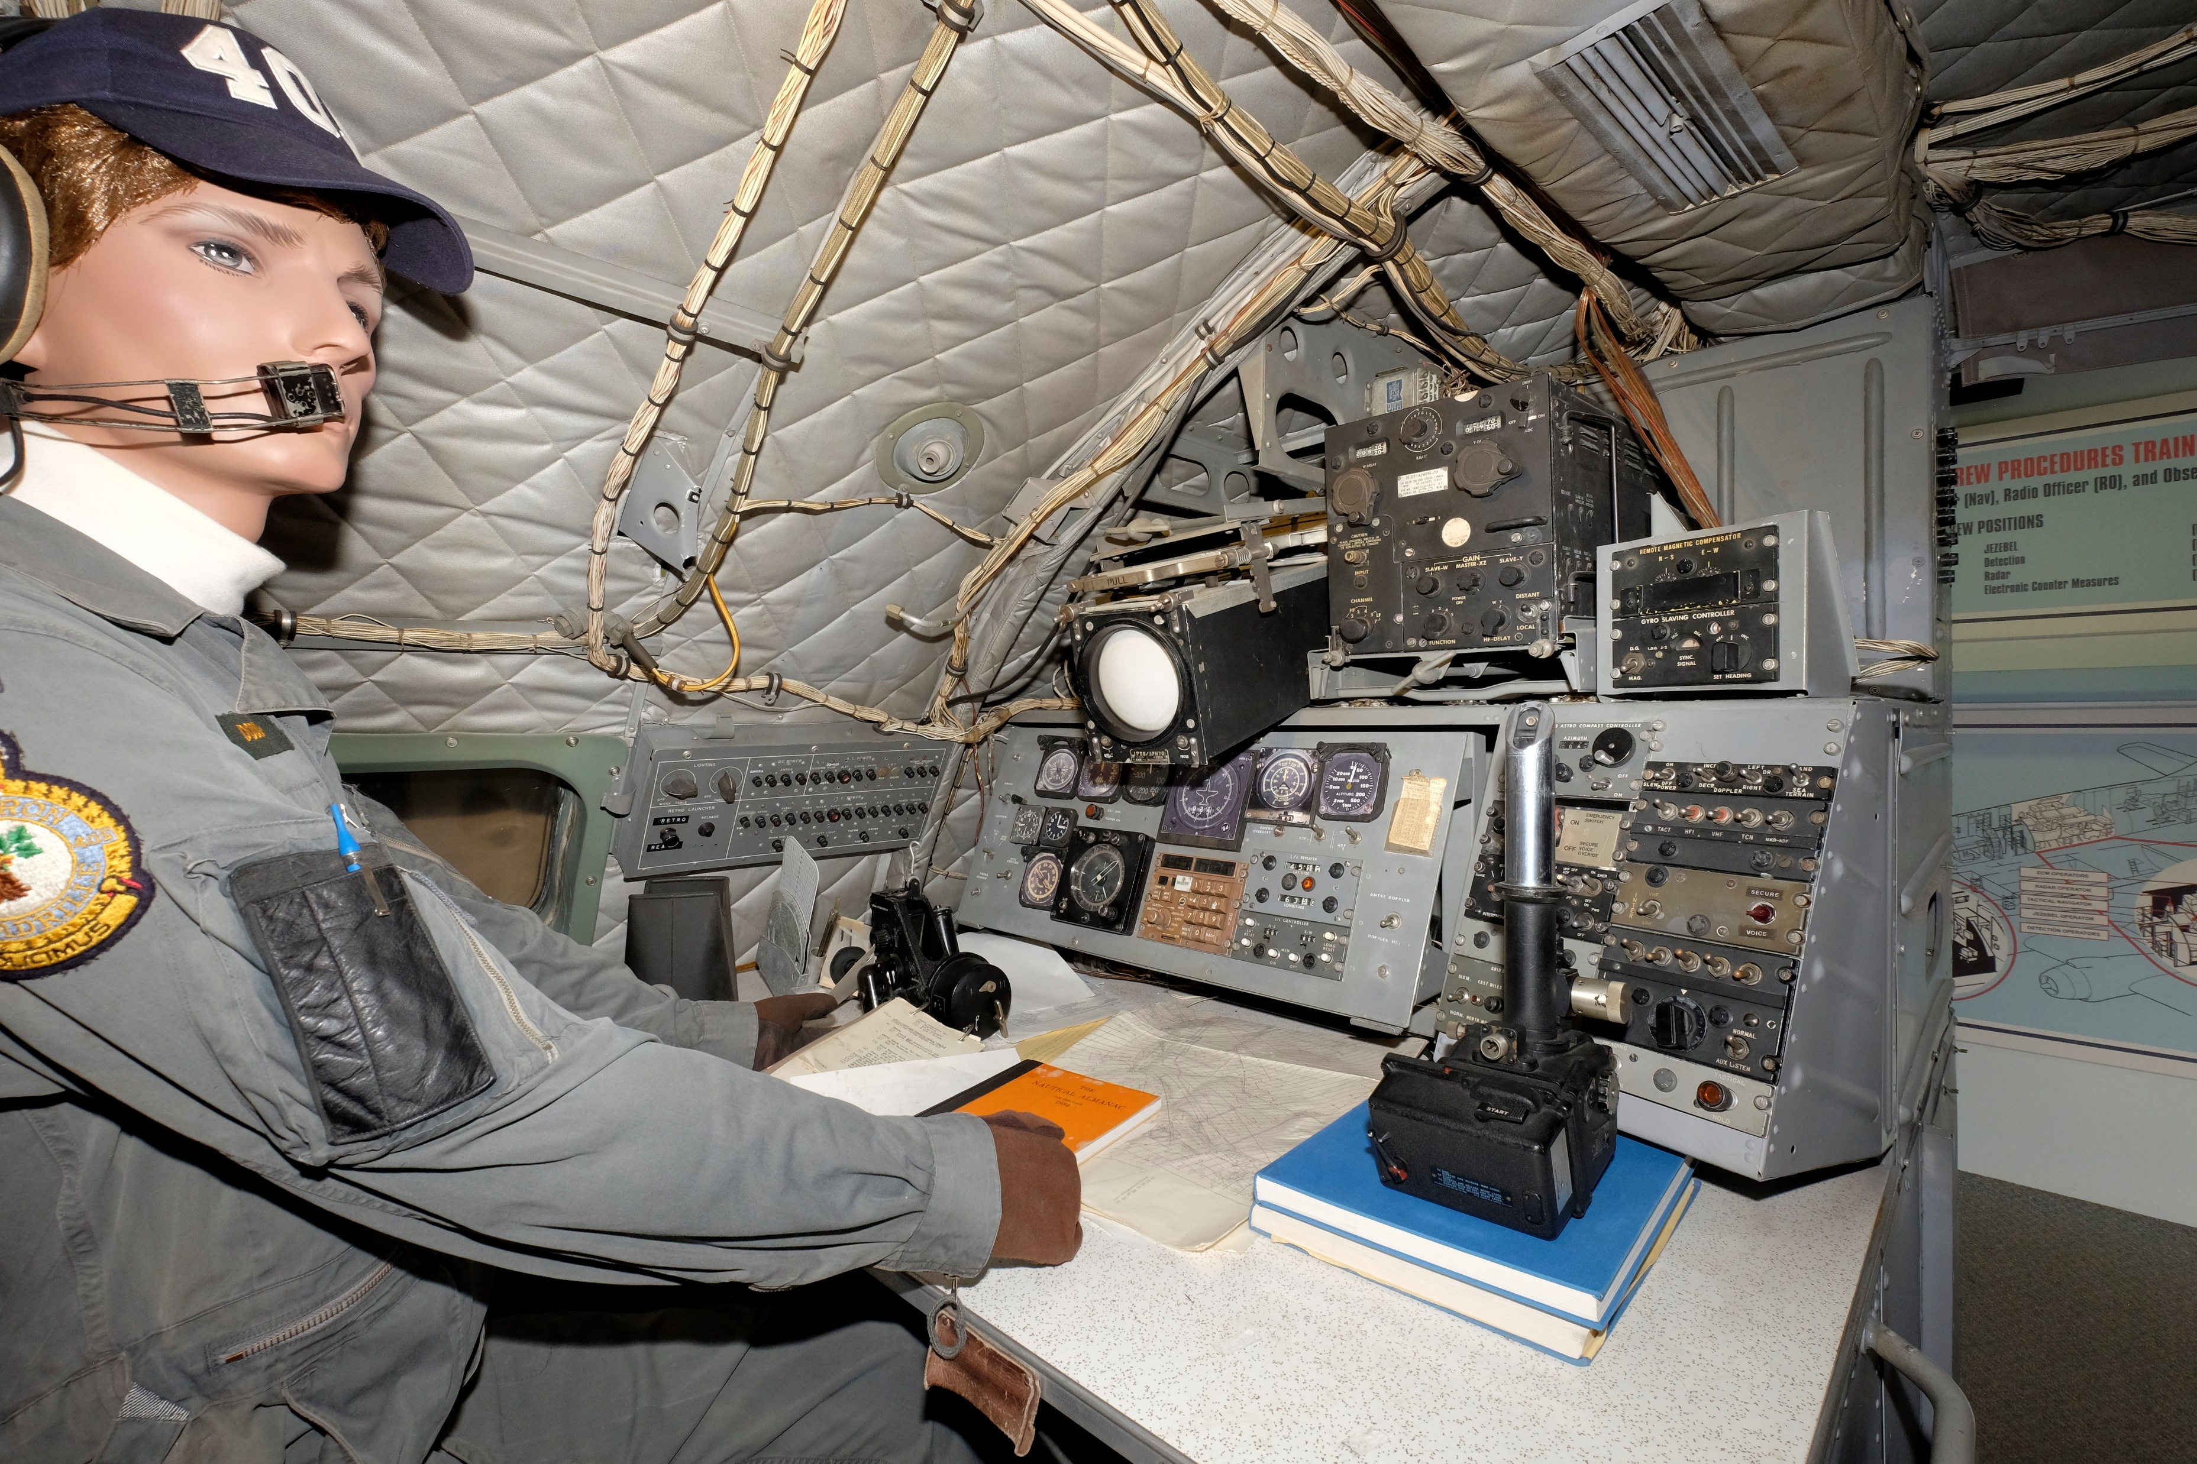
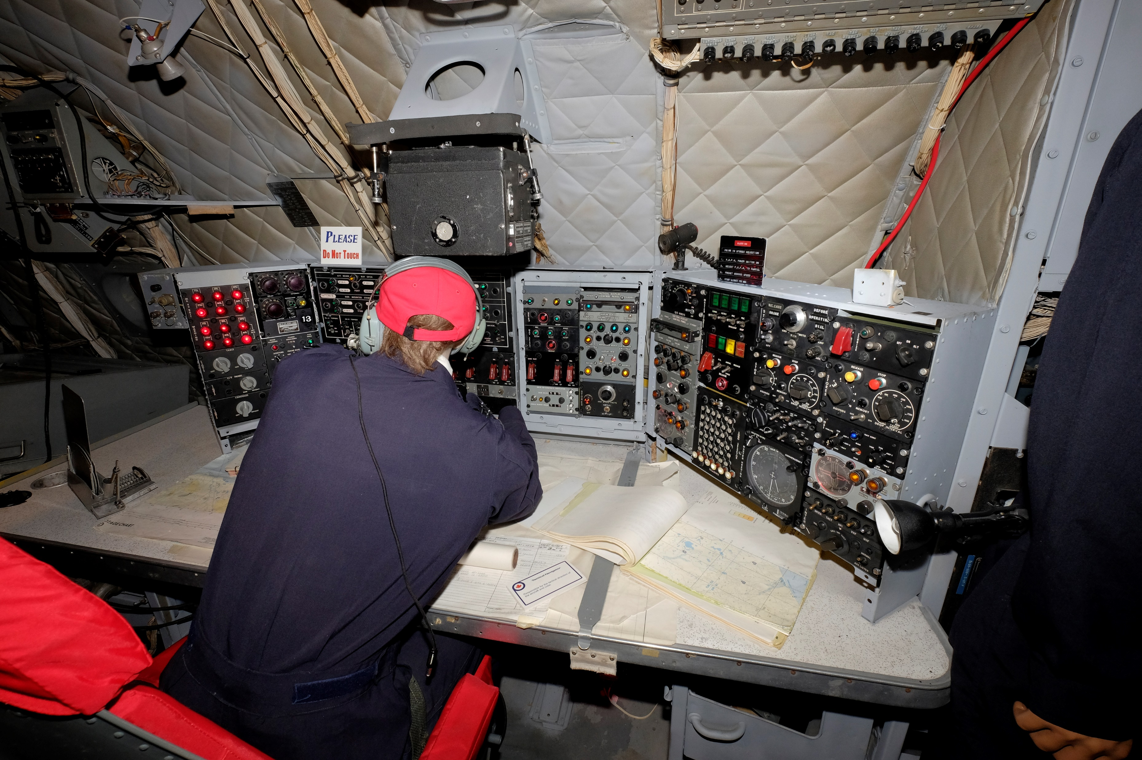

Slide 9
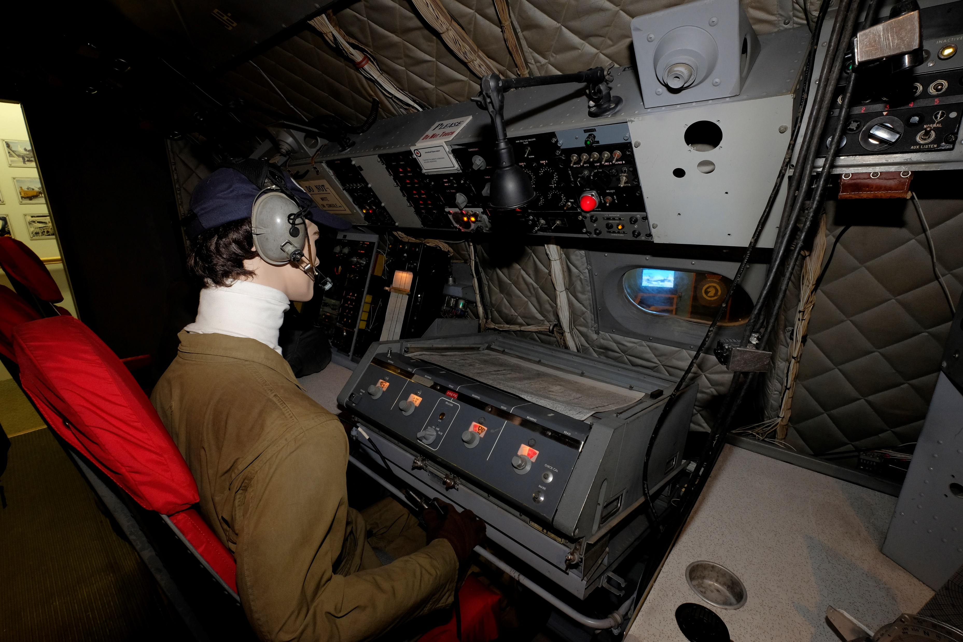
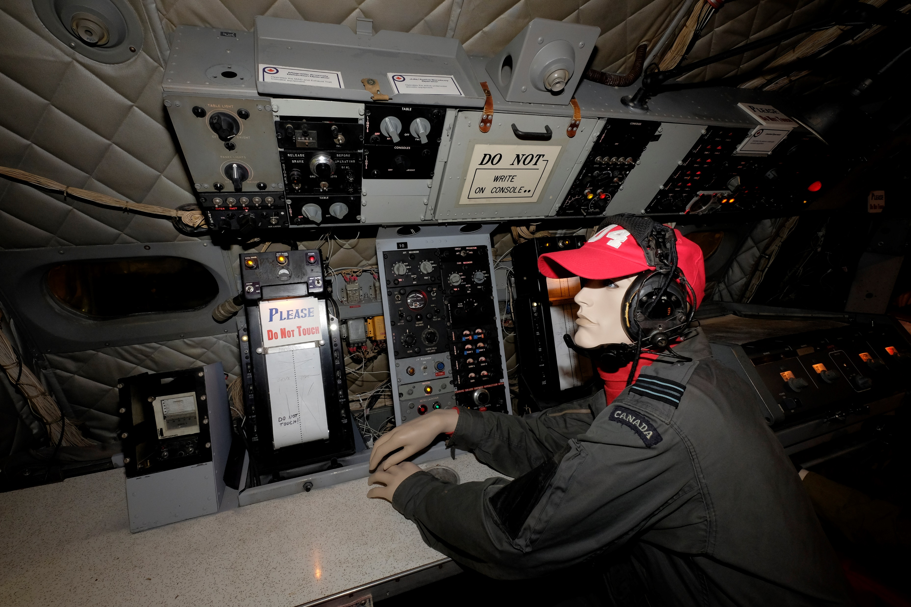
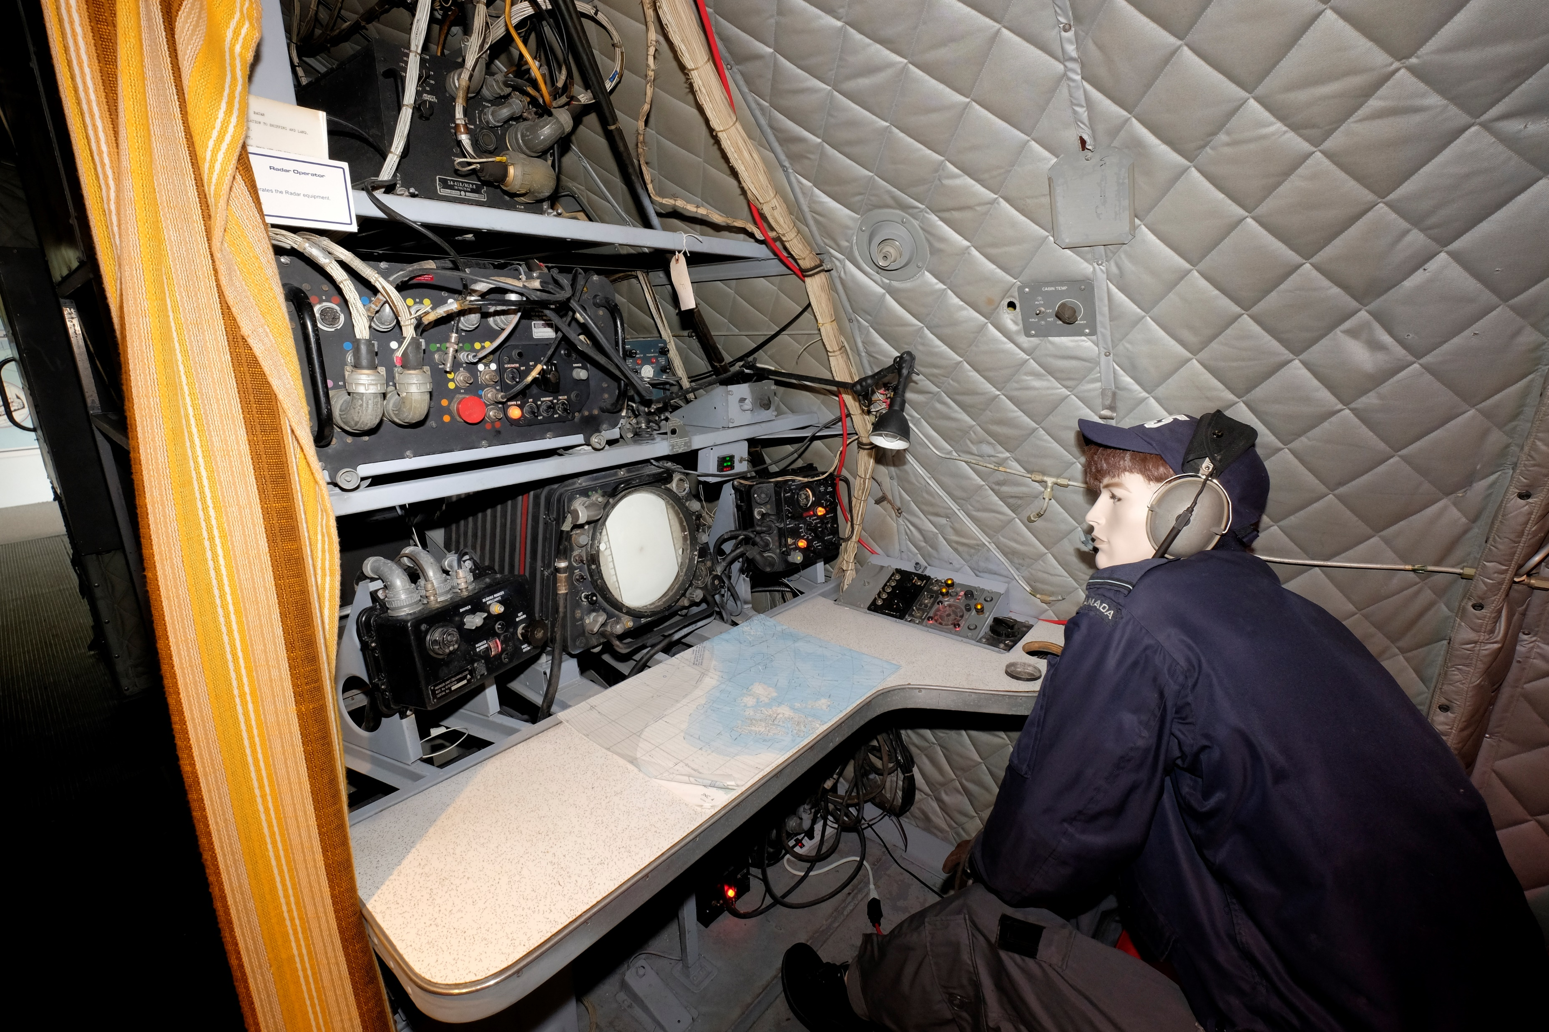
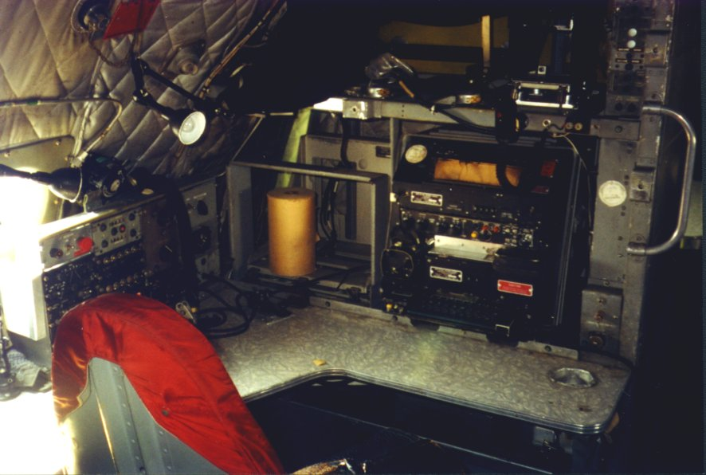

Slide 10
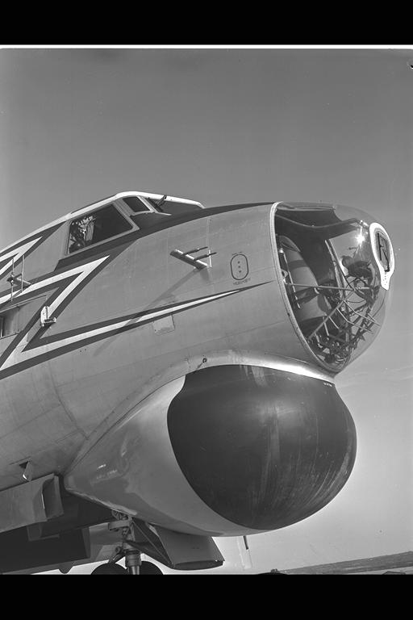

Slide 11
As the Argus transits to the patrol area the crew finalize their search tactics based on the latest intelligence, weather and oceanographic data.

Slide 12
In the patrol area they descend to an appropriate altitude that would allow for sonobuoy reception, reduce their being detected by the submarine, weather and fuel consideration.

Slide 13
For a passive acoustic search a pattern of sonobuoys is placed in the water based on the target they are searching for, oceanography and the estimated position of the target.

Slide 14
Detection of the contact on a sonobuoy now moves into the location phase where additional sonobuoys and different patterns are used to accurately position the contact.

Slide 15
Once the contact has been localized they now move into the tracking phase where accurate position, course and speed are known.

Slide 16
While maintaining contact and attack criteria is met the Argus prepares for the attack phase. It descends to 300 feet, arms the torpedo, opens the bomb bay doors, turns on MAD while heading towards the datum.

Slide 17
A torpedo is launched on the command of the TacNav, based on acoustic information or with a MAD mark indicating the contact was under the aircraft.

Slide 18
Post attack phase sees the Argus in a 1800 yard circle around the datum waiting to hear the sound of an explosion through the sonobuoys while at the same time monitoring MAD in case the contact escapes the attack and tries to get away. Additional sonobuoys and also launched to maintain acoustic contact.

Slide 19
Off Task
Complete Purple
Land
Debriefing
Average mission lasts 18 hours
Designed to fly 1,000, 8 hour on station then return
Longest unrefueled flight – over 30 hours

Slide 20
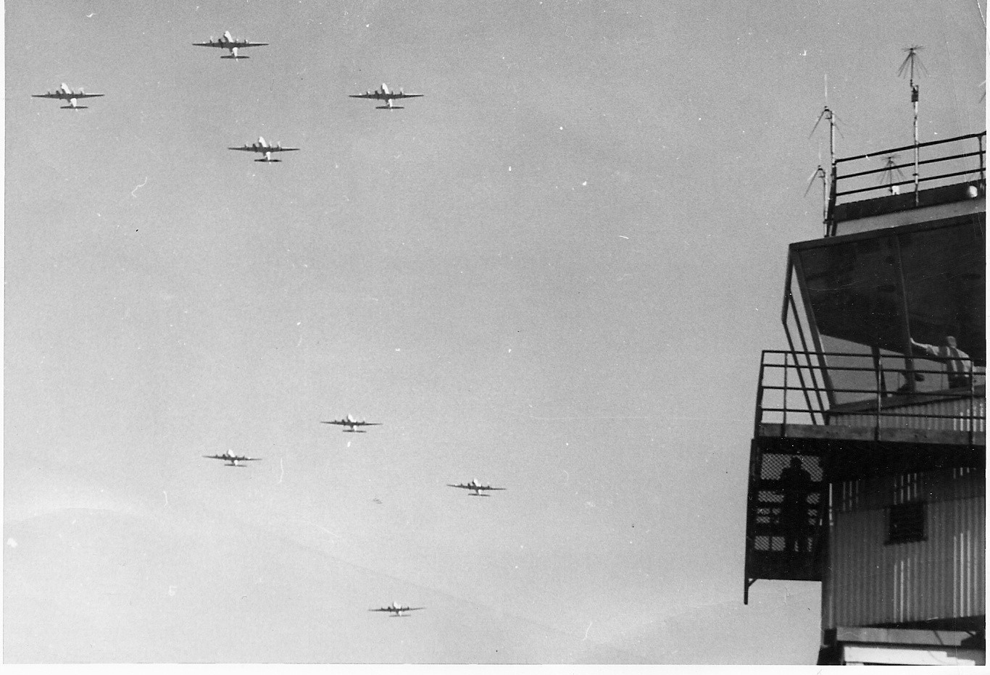

Slide 21
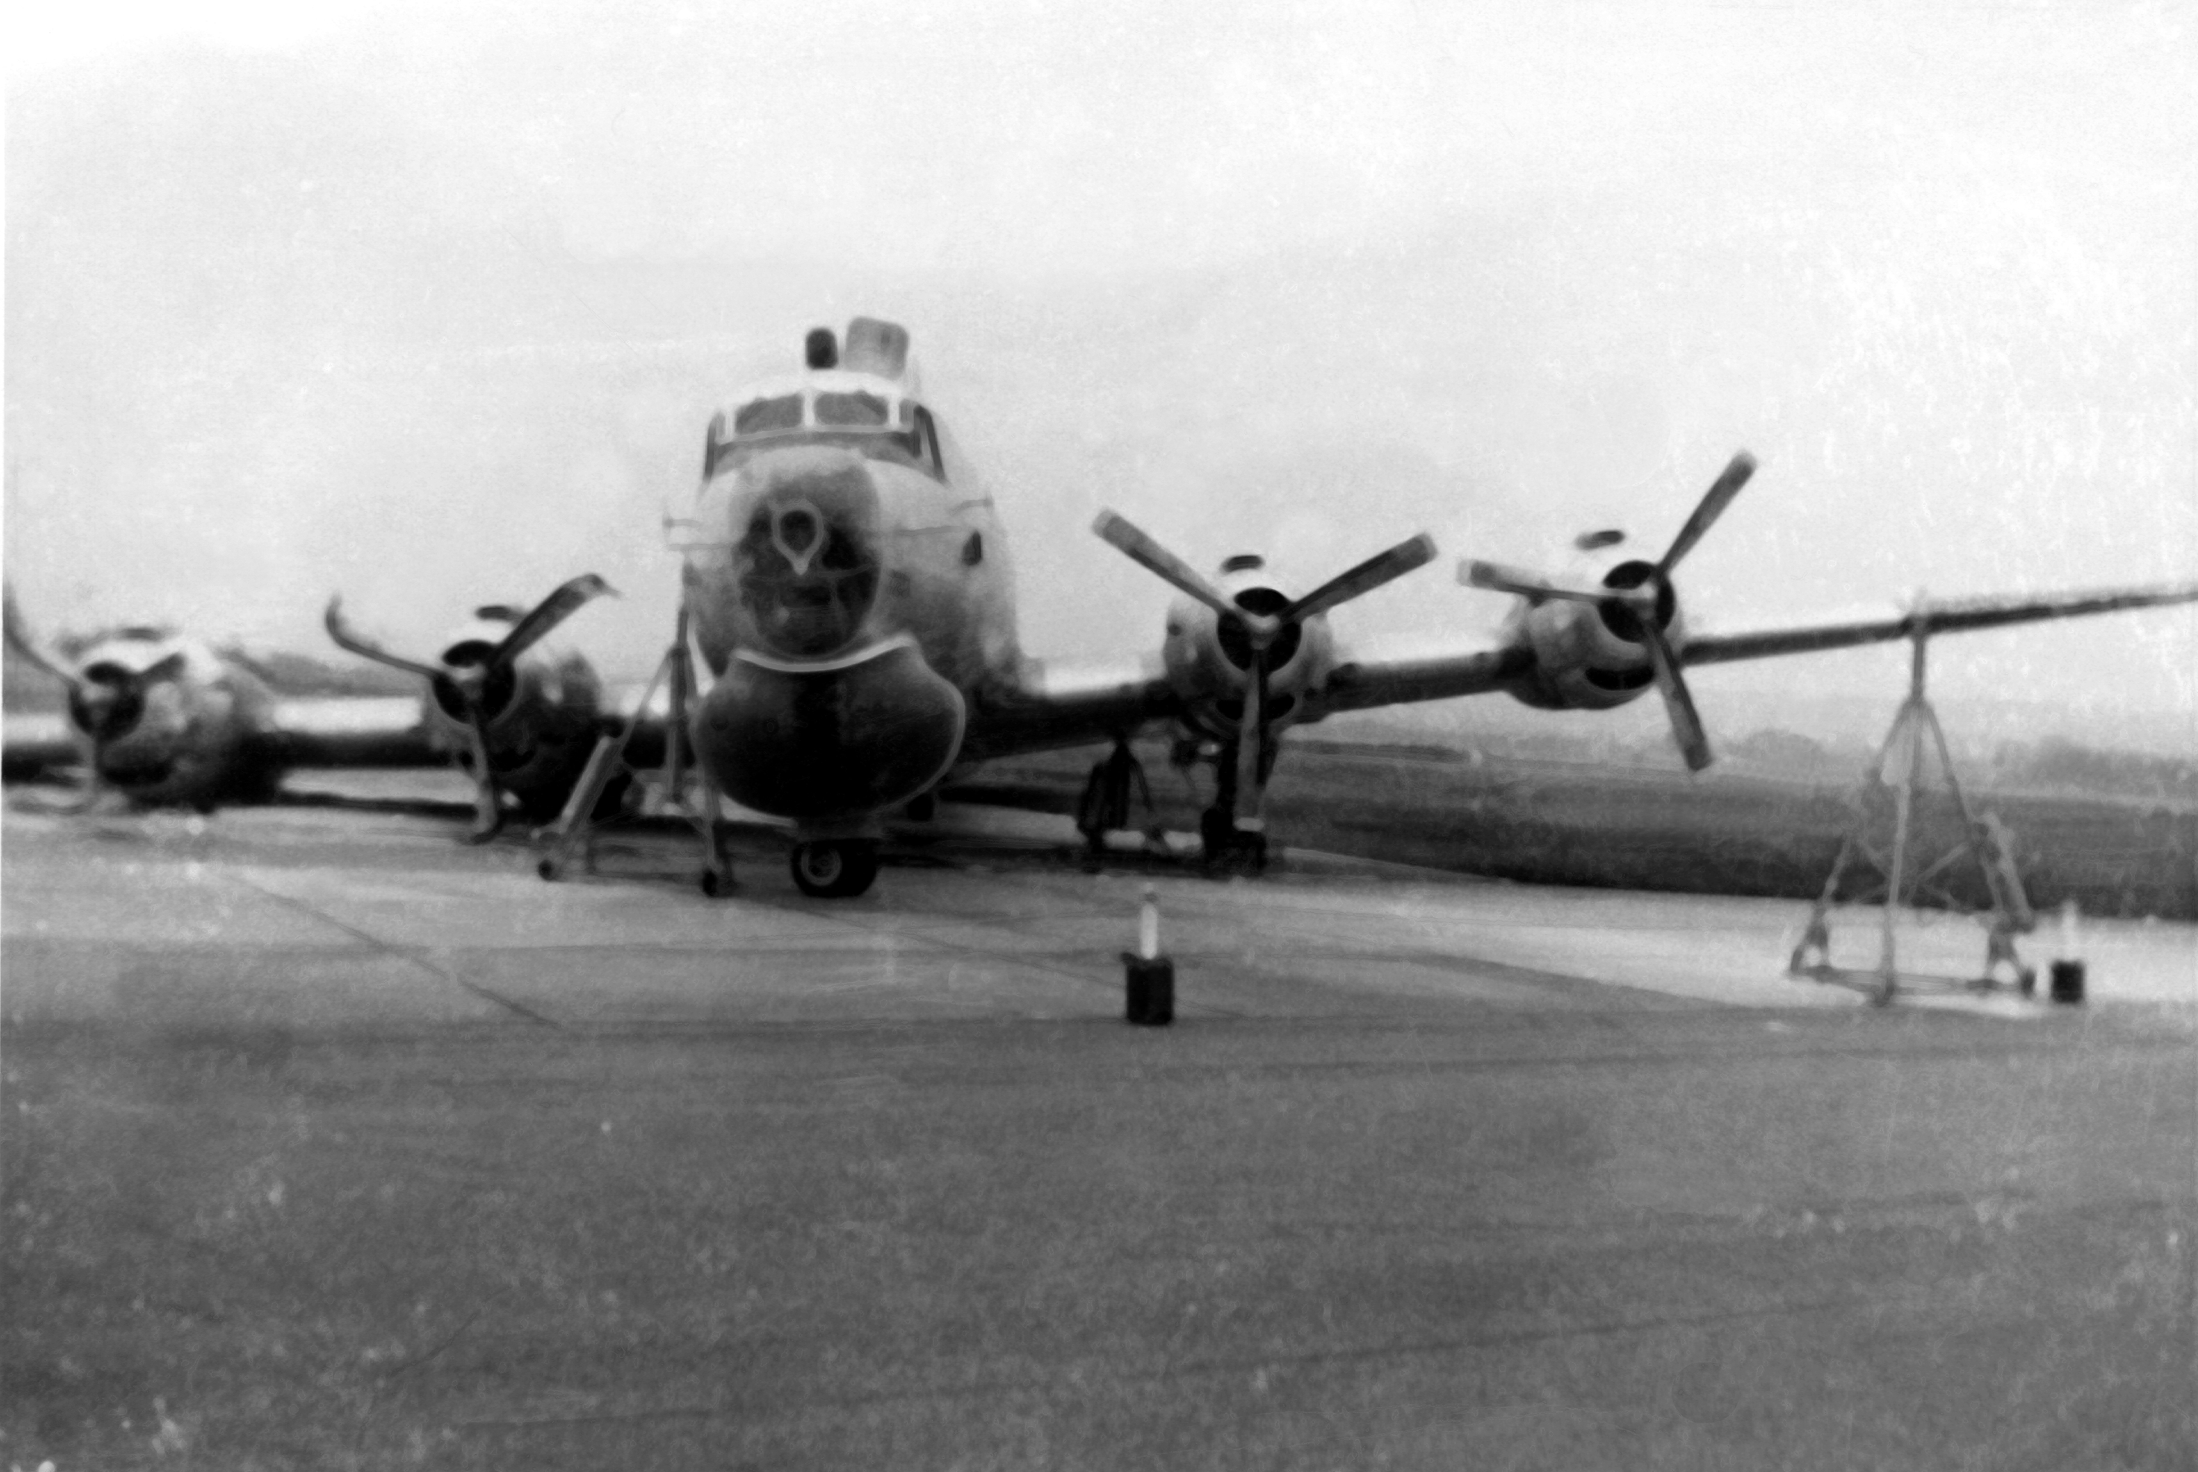

Slide 22
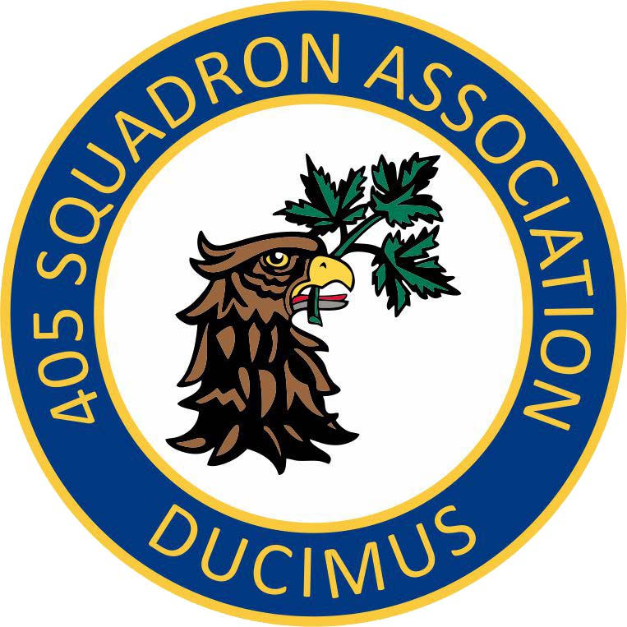
QUESTIONS

