Slide 1

Developing Your Personal Brand
BBV2M LLC

Slide 2
What is a Brand?
It has been defined as
A) A trademark or distinctive name identifying a product, service or organization
B) A product or services so identified
C) An association of positive qualities with widely recognized names as of a product line or celebrity
D) A distinctive category or a particular kind
BBV2M LLC

Slide 3
9 Ideas to Assist You in Personally Branding Yourself
Spell out your vision and aspiration that into your personal brand.
Post video clips of you speaking about who you are and what you like to do (clips should be related to those things that enhance your brand). This allows for people to see and hear you in the flesh (almost).
Assure all pictures and comments show you in a favorable way.
Edit, edit, edit – make sue all spelling and grammar is correct.
Define who you want your audience to be as it relates to your brand.

Slide 4
9 Ideas to Assist You in Personally Branding Yourself
6. Make sure you are a member of those groups that enhance your personal brand.
7. Limit who has access to inputting information on your media channel.
8. Be careful and selective about the information that you share in your social media that is really not related to you. You don’t want to share information that is contradictory to your personal brand.
9. Never post items on your social media when you are upset or emotionally not yourself. As some celebrities have fond out, once it goes on line someone will see it before you can take it down.

Slide 5
Brand Importance
Each day we are involved with someone’s brand. It could be a product, a service or an individual. These brands are powerful and those that are responsible for the brand want to make sure that those things that are associated with the brand are true representation of the brand.
BBV2M LLC

Slide 6
Familiar Celebrity Brands
Martha Stewart, Kathy Lee Gifford,
Donald Trump, Versace, Dior,
Giorgio Armani, Calvin Klein
BBV2M LLC

Slide 7
Personal Branding Tools
Utilization of Social Media can support, enhance, or hurt your personal brand. Use them wisely
Face book, YouTube, Twitter, LinkedIn, Snapchat, Yammer, Instagram, Tumblr, MySpace, Vine, Reddit, Flickr, WhatsApp
Resumes, Interviews, Training Sessions, Public Outings
BBV2M LLC

Slide 8
How Important is Your Brand?
Each time you meet someone or your name is being spoken your brand is put to the test. In a job interview people want you to sell them on your brand and you want to sell them on your brand and why your brand is the better brand for their needs
BBV2M LLC

Slide 9

So What is Your Personal Brand?
It
Is
You!!!
BBV2M LLC

Slide 10
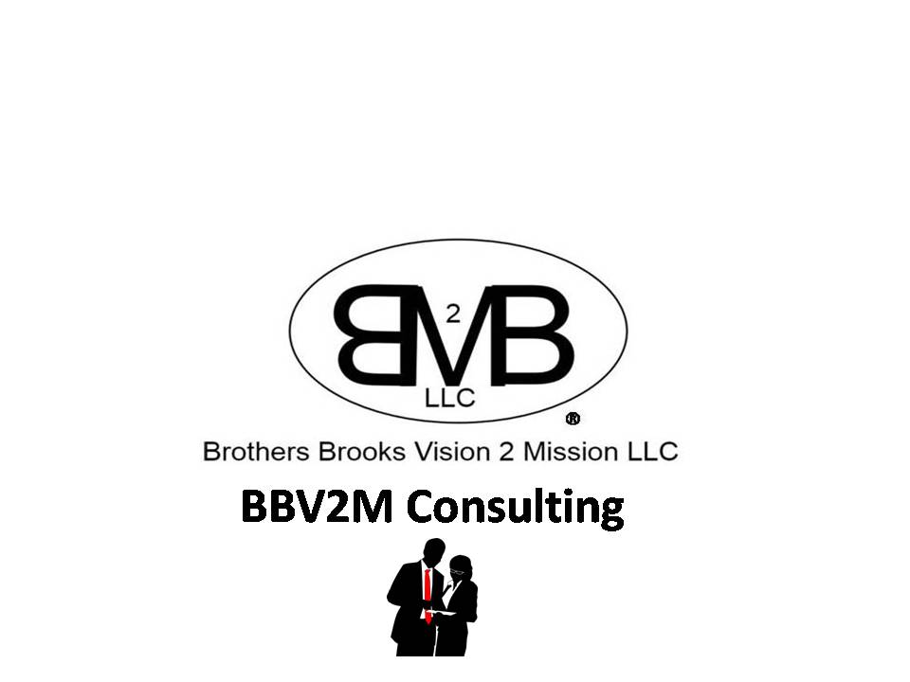
BBV2M-BrothersBrooksVision2MissionLLC.com
BBV2MLLC@gmail.com

