Slide 1
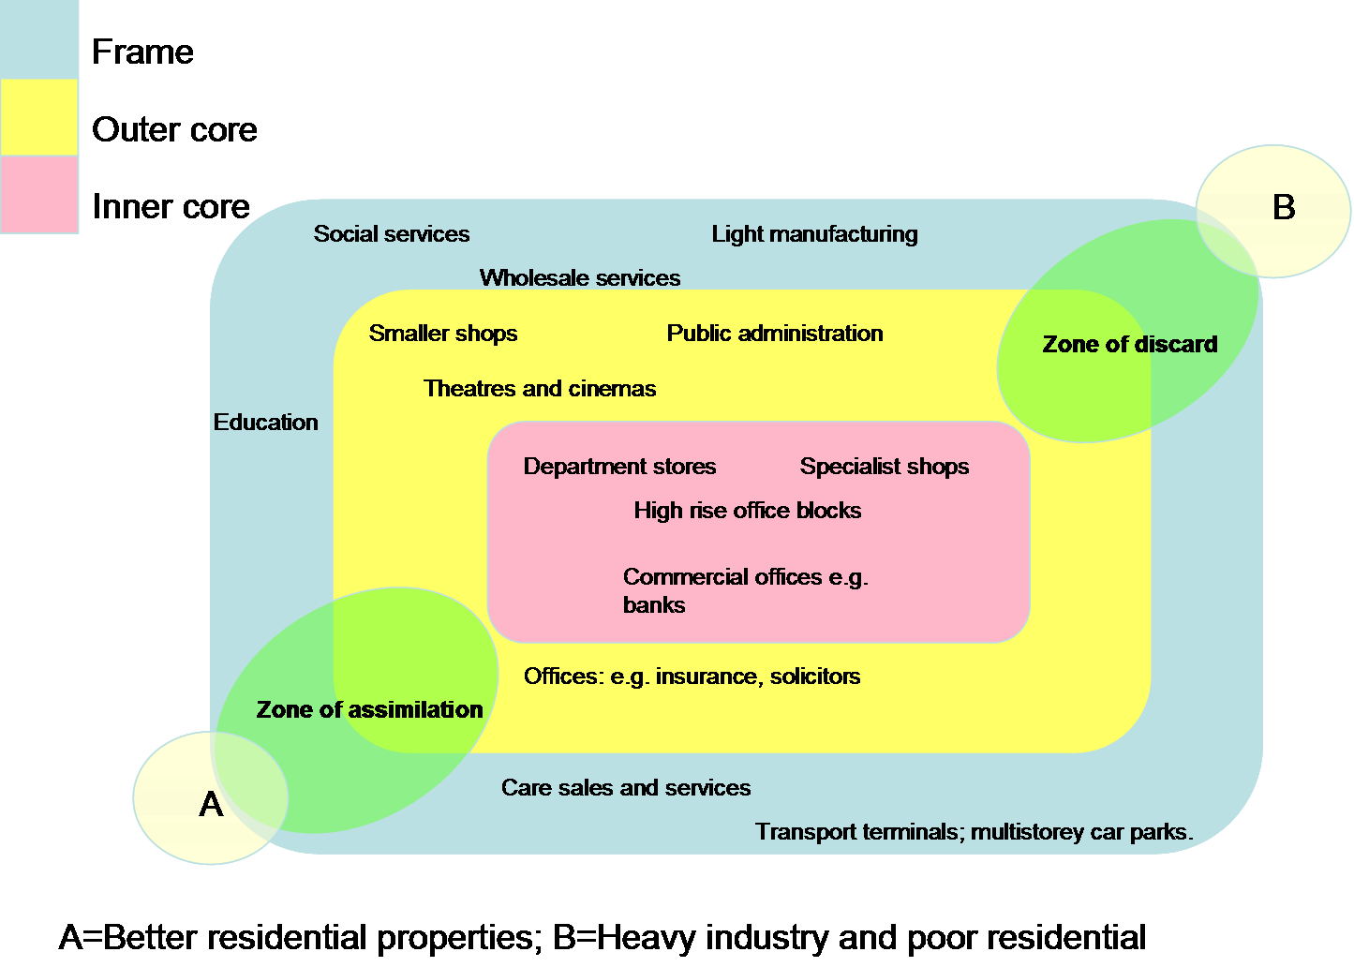
Model of land use in a typical CBD

Slide 2
CBD IDEAS AND THEMES
1.Land use patterns in the CBD
-location of convenience and comparison shops and services
-location of high order, middle order and low order shops and services
-recognition and delimiting the inner core / outer core / frame of the CBD
2.Pedestrian densities in the CBD
-the relationship between pedestrian densities and distance from the PLVI
(peak land value intersection... Centre of the CBD)
3. Land values within the CBD
-the relationship between land value (RATE INDEX £’s per metre of frontage)
and distance from the centre of the CBD (PLVI)
These ideas can be expressed as aims and or hypotheses

Slide 3
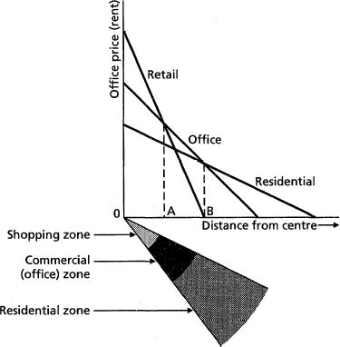
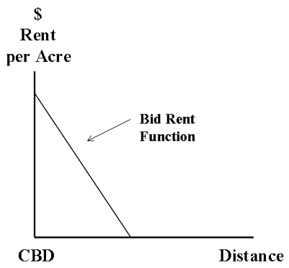
Bid rent
RATE INDEX
£ per metre of frontage
PLVI = PEAK LAND VALUE INTERSECTION
(site of greatest land values)
PLVI

Slide 4
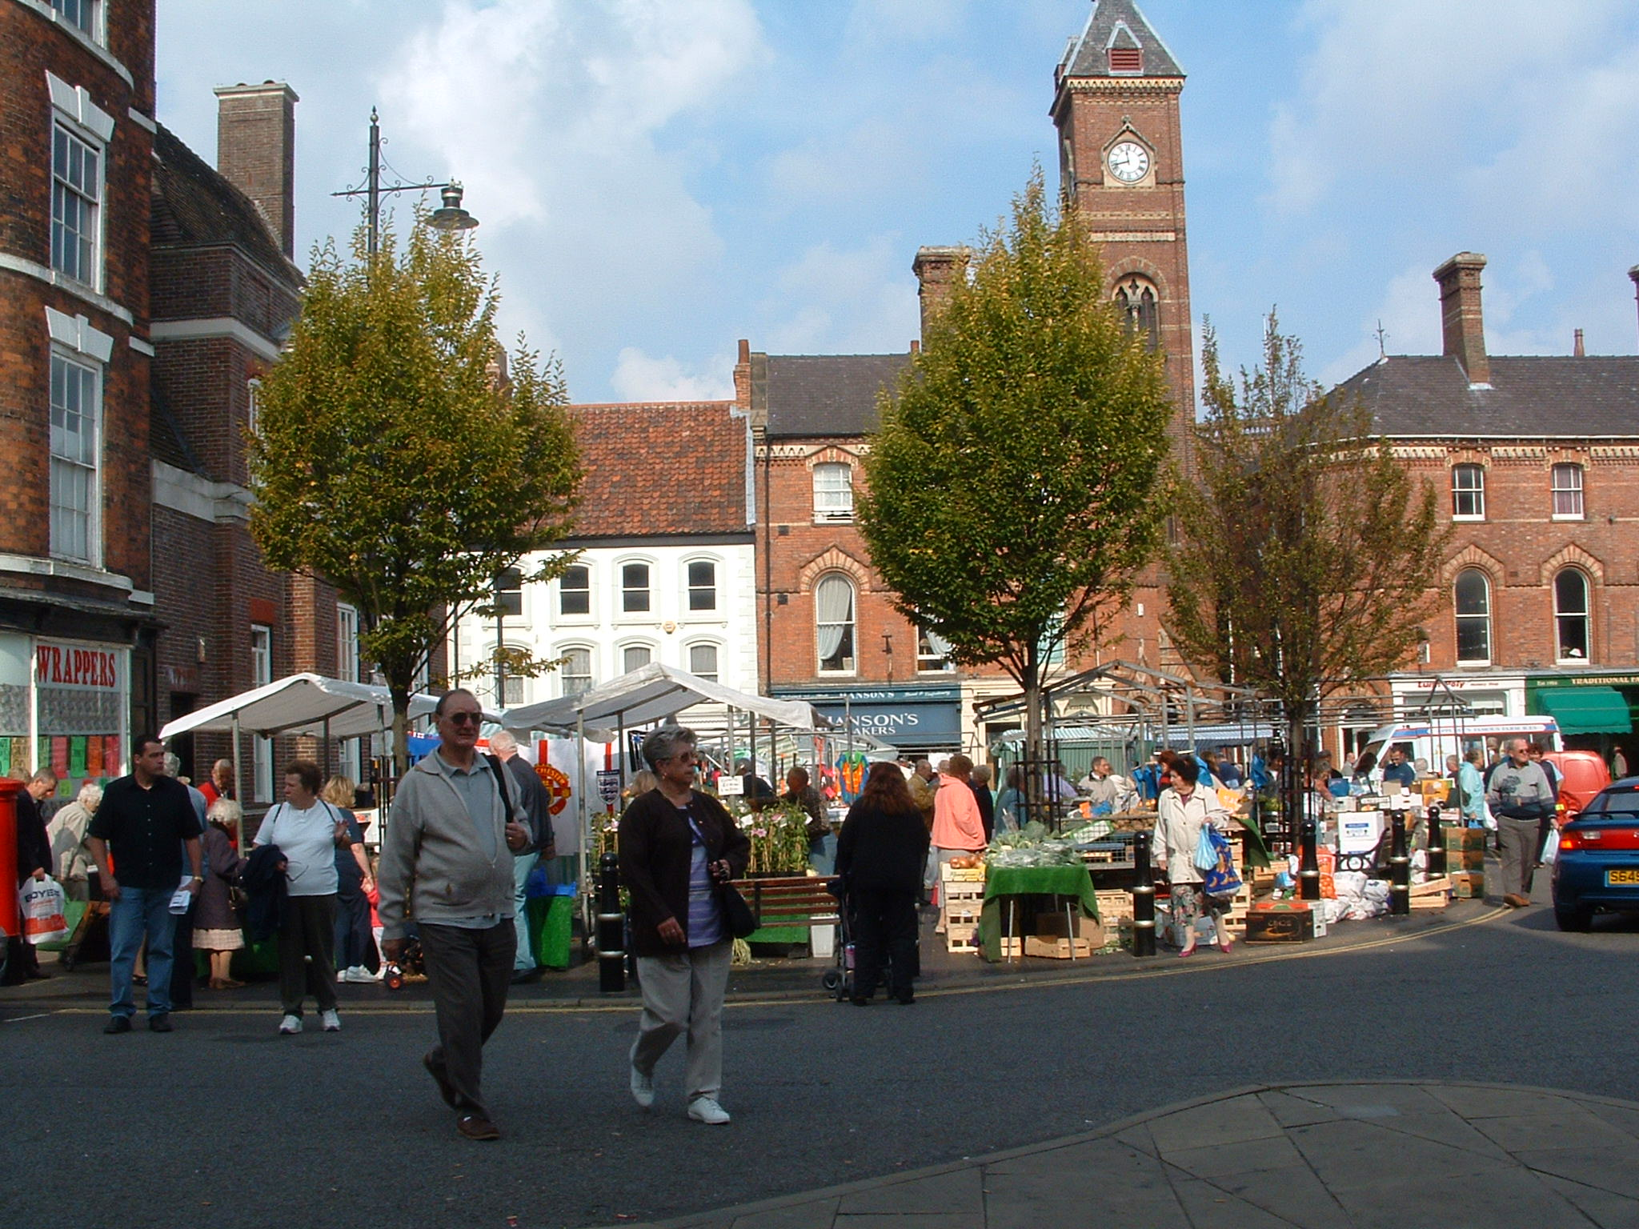

Slide 5
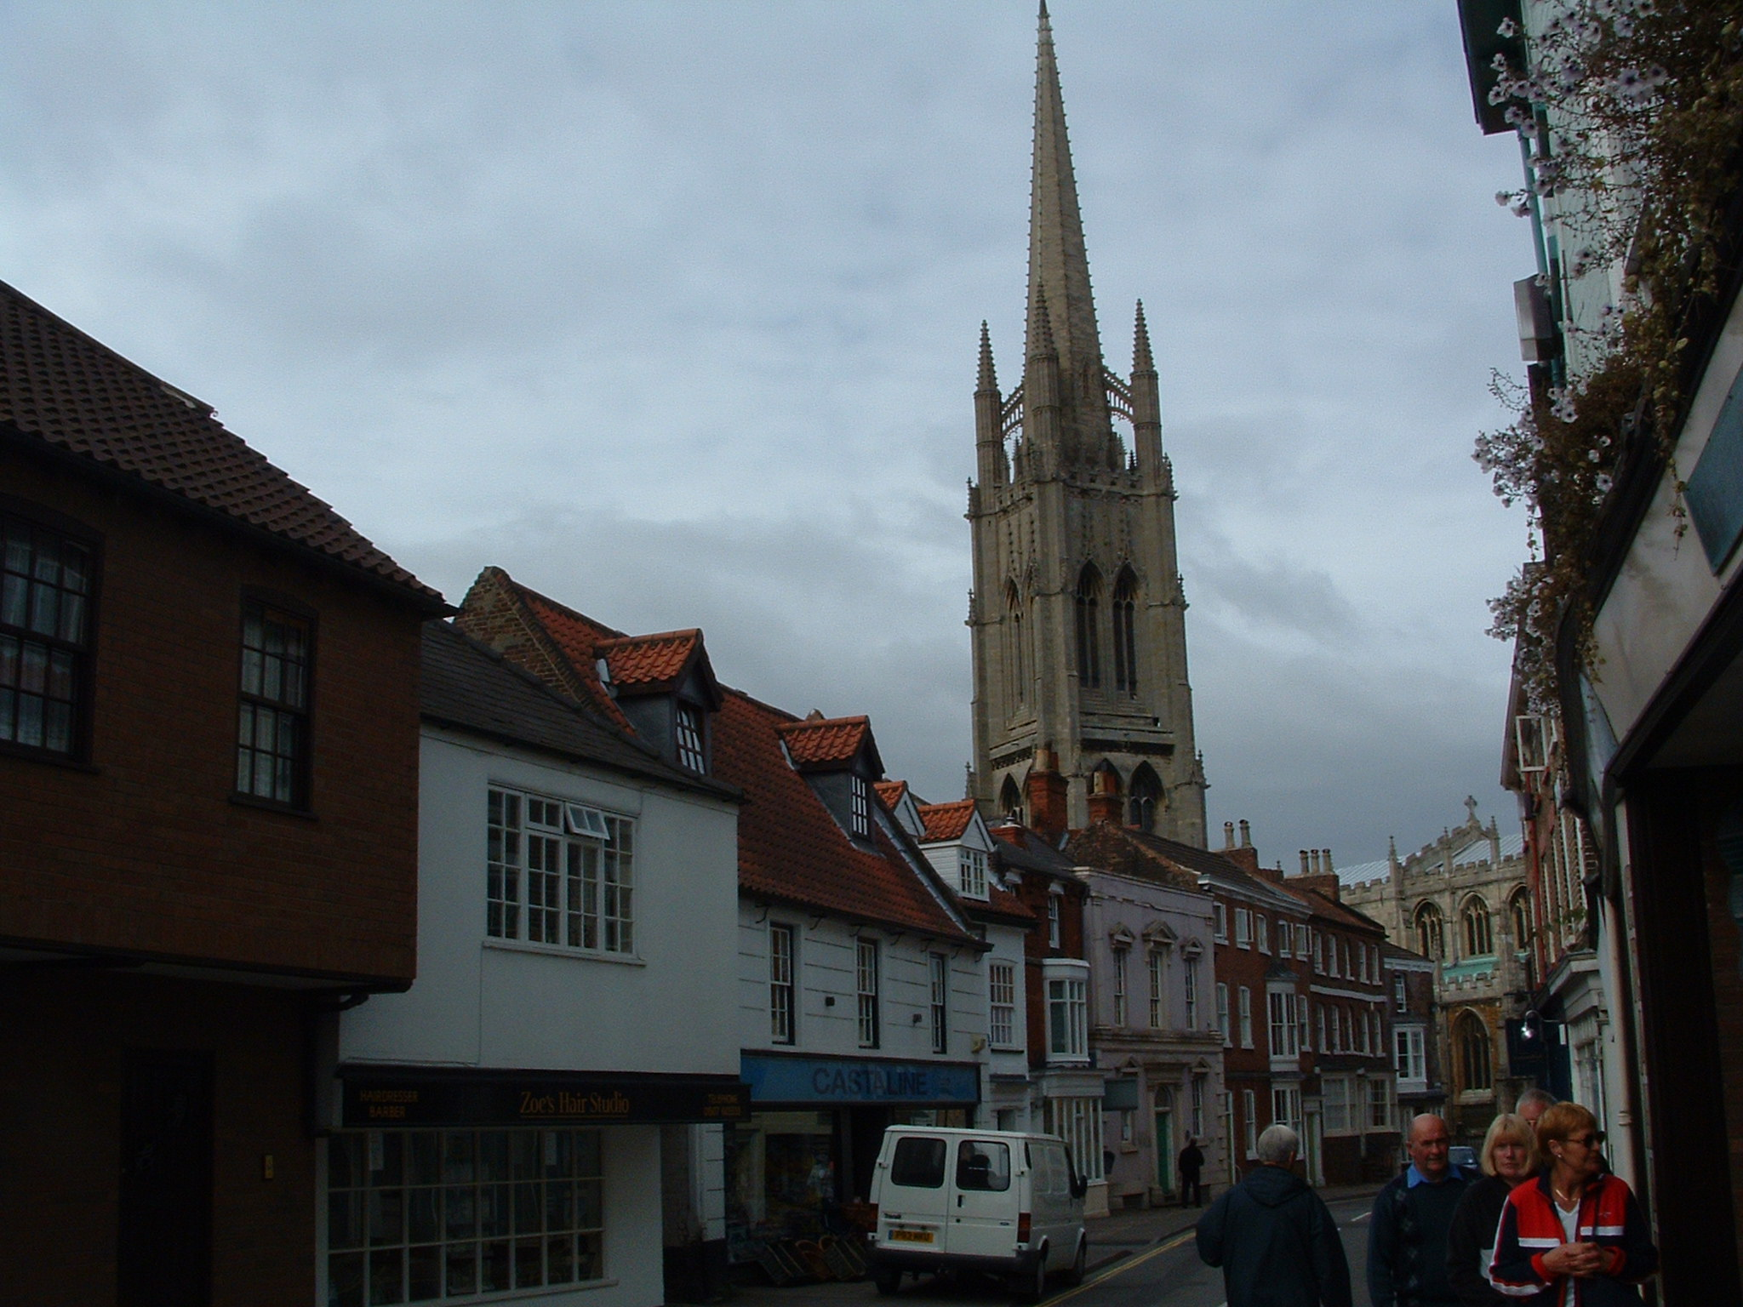

Slide 6
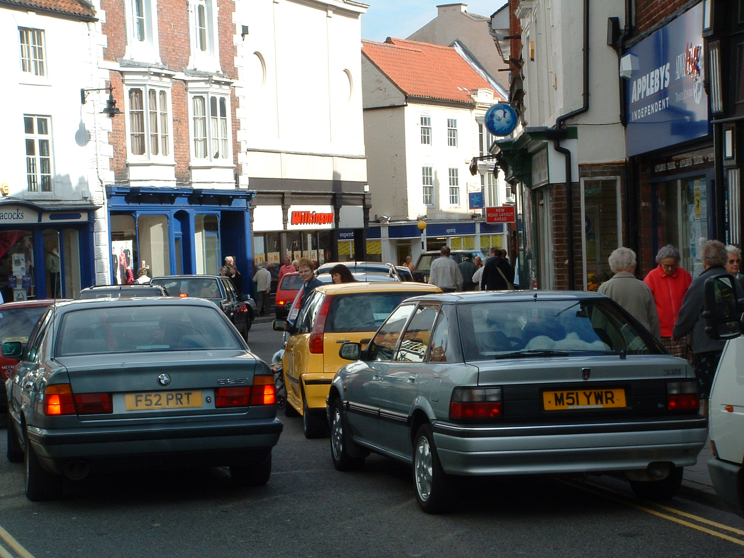

Slide 7
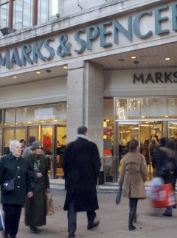
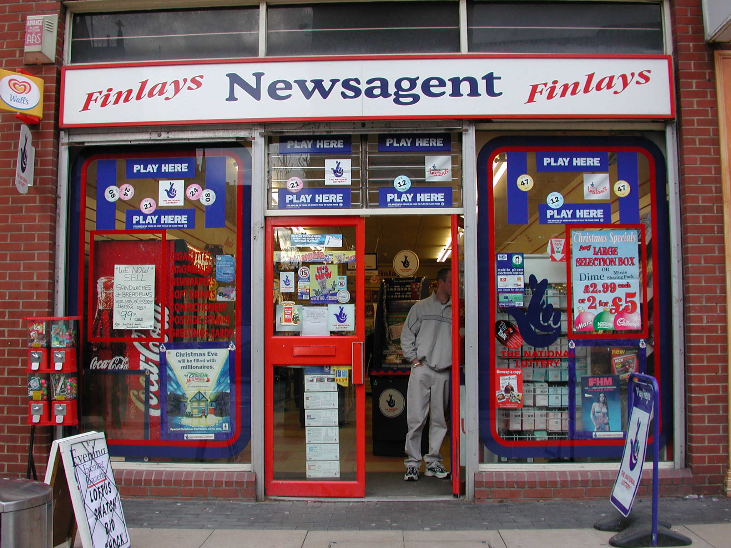

Slide 9
