Slide 2
Regional Burn Networks in England, Wales and Scotland
National Network for Burn Care Scotland*
Northern Burn ODN Midland Burn ODN
London and South East Burn ODN
South West Burn ODN

Slide 3
www.midlandsburnnetwork.nhs.uk

Slide 4
Burn Centre for Children
BCH (Birmingham)
Burn Centre for Adults
QEHB (Birmingham)
Burn Facility for Adults & Children
UHL (Leicester)
Burn Unit for Adults & Children
Nottingham
Take adults with minor, moderate, severe and complex severe burns
Takes children with minor, moderate, severe and complex severe burns
QMC Takes children with minor and moderate burn injuries
NCH Takes adults with minor, moderate and severe burns
Takes adults and Children with minor burn injuries
UHCW(Coventry) RSH (Stoke)
MBODN

Slide 6
689

Slide 7
MBODN Team
Lead Clinician
Lead Nurse
Manager
Lead Therapist
Burn Services

Slide 8
The strategic vision of both the commissioners and providers of burn care in the Midlands is to develop a burns service that is capable of meeting all the physical, psychological and social needs of all the patients in the Midlands. The service needs to be sustainable and both economically and clinically efficient. It is the intention of the network team to deliver a service of the highest quality that has parity of access for all the patients and carers in the Midlands.

Slide 9
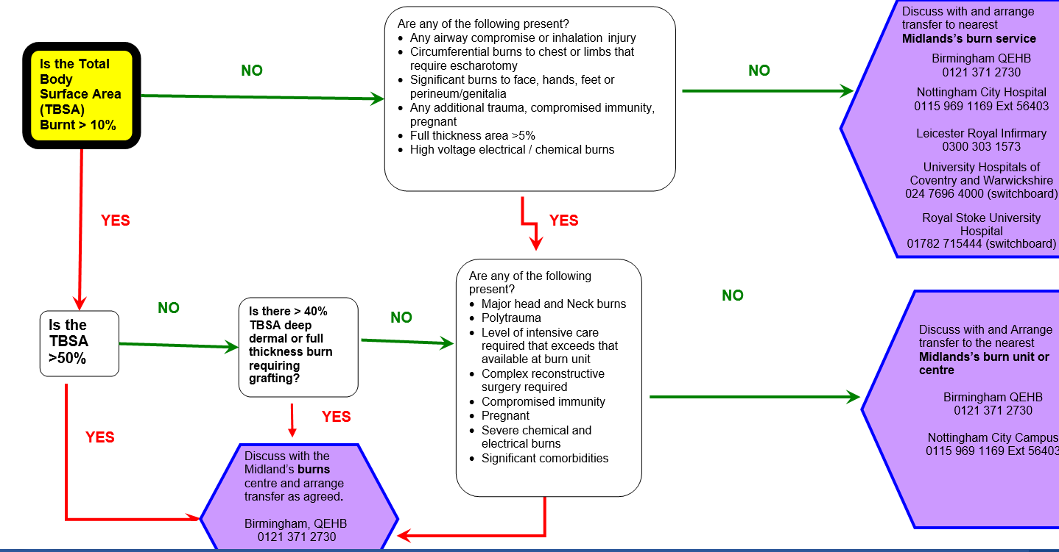
Adult Burns referral flow chart

Slide 10
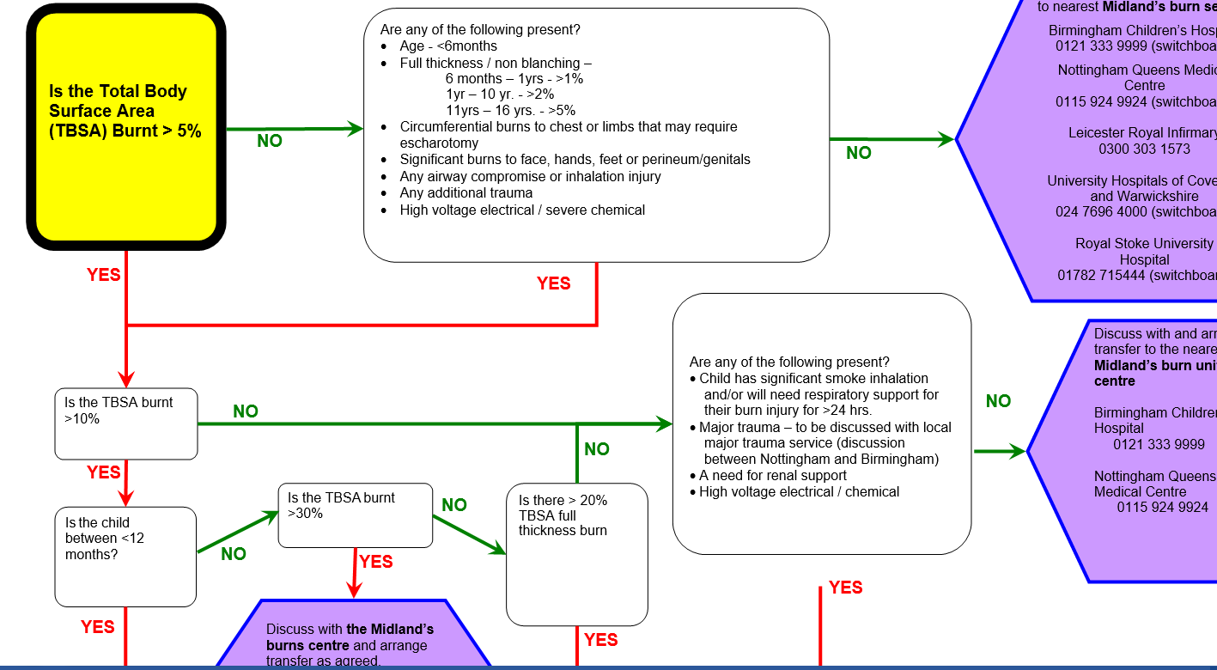
Paediatric Burns referral flow chart

Slide 11
Key Activities
Quarterly Audit/teaching/research meetings (Open to all)
Clinical Advisory Group (key clinical leads in all services)
Quarterly Board Meeting (Network team, Service clinical lead and manager, Chair)
Burn Awareness day (October) and prevention activities
Senior Nurse Meeting
ED and other study days
Guidance/website

Slide 12
National Bed Bureau
Originally hosted by West Midlands ambulance service
Now integrated with the NHS Pathways Directory of Services which was developed for critical care,
iBID
International Burn Injury Database
Dashboard

Slide 13
MBODN Contact Details
B
Tel:
Email:

