Slide 1


LDC UPDATE
Planning & Zoning
Special Master
September 11, 2025

Slide 2
AGENDA
1
Project Scope
2
LDC Reorganization
3
Major Changes
4
Next Steps

Slide 3



PROJECT SCOPE
ANALYZE
PROPOSE
AMEND
1
2
3

Slide 4



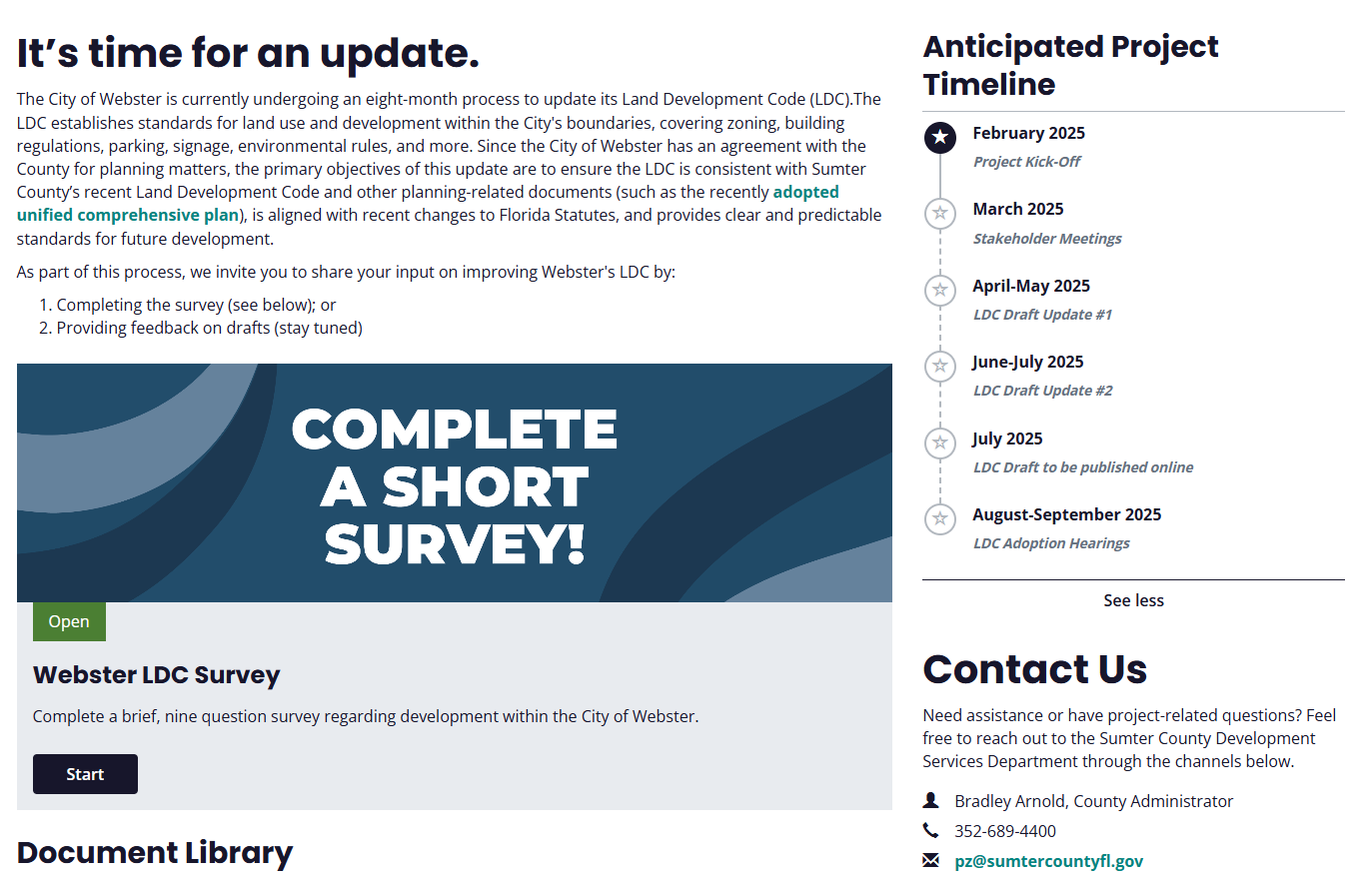


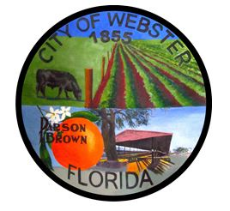
PROJECT WEBSITE
https://www.inspire-engagement.com/webster-ldc

Slide 5
LDC REORGANIZATION
Current
Art. I. General Provisions
Art. II. Definitions
Art. III. Administration
Art. IV. Zoning
Art. V. General Development Standards
Art. VI. Accessory, Temporary and Specific Use Standards
Art. VII. Floodplain Management
Proposed
Art. I. General Provisions
Art. II. Definitions
Art. III. Administration
Art. IV. Zoning
Art. V. Accessory, Temporary and Specific Use Standards
Art. VI. Access, Circulation, and Parking
Art. VII. Development Design and Utilities
Art. VIII. Landscaping Standards
Art. IX. Resource Protection Standards
Art. X. Sign Standards
Art. XI. Floodplain Management

Slide 6
Major Changes
Art. I
Article I. General Provisions
  Division 1. General
  Division 2. Abrogation and Severability
  Division 3. Vesting
  Division 4. Nonconforming Situations
  Division 5. Eminent Domain Lots
Major Changes
Change “Director” references to “City Manager or designee”
Cleaned up the non-conforming section to address lots, uses, and structures
Removed vesting projects if plans are submitted

Slide 7
Major Changes
Art. II
Article II. Definitions
  Section 13-200. Definitions
  Section 13-201. Abbreviations
  Accessory dwelling unit
  Accessory use or structure
  Agricultural classification
  Agricultural pole barn
  Agritourism
  Agritourism operator
  Alcoholic beverage establishment
  Assisted living facility
  Bona fide agricultural purposes
  Bond or irrevocable letter of credit
  Business service
  Campground
  City
  City engineer
  Council
  County
  Dwelling unit – clarified “kitchen”
  Family day care home
  Farm
  Farm operation
  Flag lot
  Hardscape
  Imperiled Species
  Kennel
  Livestock
  Lot front
  Maintenance agreement
  Mobile vendor
  Nonresidential farm building
  Personal services
  Planning and Zoning Special Master
  Poultry
  Protected tree
  Recreational vehicle (RV) park
  Road setback – clarified measurements
  Sign-added temporary displays
  Significant tree
  Special public assembly events
  Townhouse
  Understory tree
  Undesirable trees
  Unreasonably burdened
Major Changes
Deleted terms not used in the LDC
Moved standards out of definitions
Added Abbreviations
Added or updated definitions for:

Slide 8
Major Changes
Art. III
Article III. Administration
  Division 1. Approving Authorities
  Division 2. Development Approval Process
  Division 3. LDC and Zoning Map Amendments
  Division 4. Use Permits
  Division 5. Development Permits
  Division 6. Subdivision Procedures
  Division 7. Appeals and Variances
  Division 8. Concurrency Management
Major Changes
Revised list of developments that are exempt from development review
Added submittal requirements for PUD requests
Revised Table 13-313A Development Reviews and Approvals
Cleaned up review criteria for various applications
Specified the number of extensions allowed for use permits (two 1-year extensions)
Allow de minimis code deviations
Clarified that Preliminary Plat review is optional
Changed Final Plat review process (per statutes)
Added “recreation” to activities subject to concurrency
Address FS requirement to establish a process to review special accommodation requests for certified recovery residences
Notes:
Table 13-313A- changes made include adding PZSM column, removing conceptual plan, update cross references
Plats are now administratively approved. Made changes to final plat review process.

Slide 9
Major Changes
Art. IV
Article IV. Zoning
  Division 1. Generally
  Division 2. Zoning Districts
  Division 3. Planned Unit Development District
  Division 4. Overlay Zones
Major Changes
Revised Future Land Use and Zoning District correlation table
Eliminated AC, R6W & REC districts. REC combined with PIE
Consolidated PUD districts (WMPUD, RPUD, RVPUD, CP, and IP)
Added R2C & R2M, RR2.5, RR2.5C, RR5, and RR5C zoning districts
Renamed suburban residential to urban residential
Clarified lineal descent subdivision standards
Eliminated joint ownership provisions
Added Conservation Subdivision standards
Revised R/W Table and removed measurement from Centerline
Clarified lot front (shortest distance along road)
Consolidated R6M and R6C to have the same lot standard
Added 2 columns to table of uses – cross-reference to standards and NAICS code
Revised setbacks of RR1 & RR1C to align with Sumter
Clarified maximum building height for Neighborhood Commercial District (20’ single use and 35’ vertical mixed use)
Allow Multifamily in commercial districts; restrict to 4 units in R2C, R4C, R6C districts
Added Economic Activity Center Overlay Zone

Slide 10
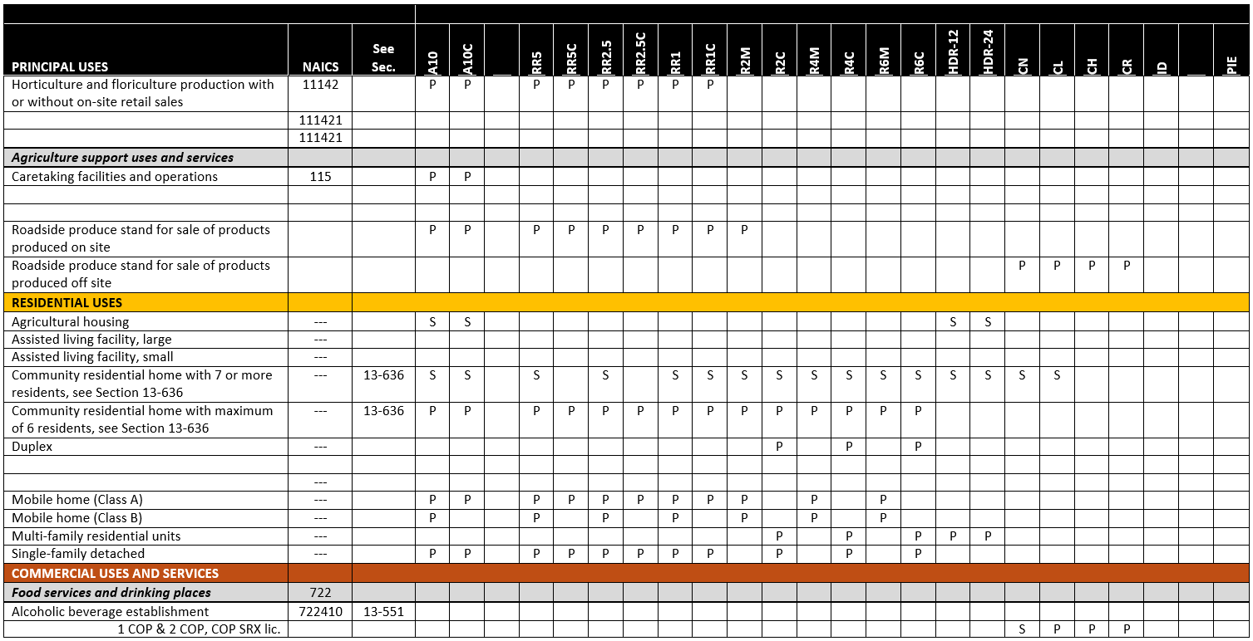
Major Changes
Art. IV
NEW

Slide 11
Major Changes
Art. V
Article V. Accessory, Temporary, and Specific Use Standards
  Division 1. General
  Division 2. Accessory Use & Structures
  Division 3. Temporary Uses & Structures
  Division 4. Specific Use Standards
Major Changes
Revised Accessory Family Cottages section to Accessory Dwelling Units (ADUs)
Revised the following:
  RV parks and accessory structures in RV parks (clarify)
  Home Occupations (consistency with FS)
  Alcoholic beverage (clean up)
  Bed & Breakfast (consistency with Sumter)
  Swimming pool enclosures
Added standards for:
  Accessory racetracks
  Internet cafes
  Existing motion picture arcade booths
  Yard sales (3-day in 30-day period)
Allow the use of an RV as a temporary dwelling
Added animal density equivalencies
Removed animal control provisions

Slide 12
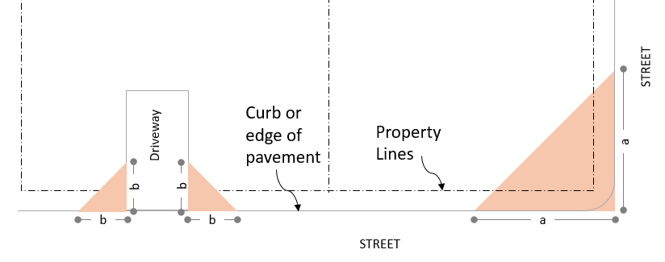
Major Changes
Art. VI
Article VI. Access, Circulation, Parking
  Division 1. Roadway Standards
  Division 2. On-site Traffic Circulation, Parking and Loading
Major Changes
Require traffic impact analysis for minor development
Updated references to the County’s Engineering Standards Manual and eliminated references to FDOT’s Green Book
Clarify that the design requirements apply to public streets only
Removed bike path requirement
Added sight triangle (visibility) standards
Reduced the size of grass parking spaces (12x24 to standard)
Added minimum standard for drive-through lane stacking (5 spaces)
Notes:
Revised minimum intersection offset from 65 to 75 feet where local roads intersect and the design or posted speed is 35 MPH or less

Slide 13
Major Changes
Art. VII
Article VII. Development, Design, and Utilities
  Division 1. Subdivision Standards
  Division 2. Utility Standards
  Division 3. Drainage and Stormwater Management Standards
  Division 4. Safety and Nuisance Standards
Major Changes
Noted that non-platted sites may provide access through private easements
Clarified that PUDs, RV parks, and individual RV sites are required to be served by central water & sewer systems if available
Added RV parks to list of development required to provide a fire protection system
Provides standards for rural fire protection (areas outside service area of pressurized source)
Added subsection prohibiting illicit discharge into stormwater system
Revised minimum lighting intensity for parking areas from 2 to 1 foot-candle

Slide 14

Major Changes
Art. VIII
Article VIII. Landscaping Standards
  Section 13-800. Tree Protection
  Section 13-801. Landscaping Standards
  Section 13-802. Buffer Standards
Major Changes
Moved definitions to Art. II.
New, simplified table of required buffers
Added buffer type D (brought in from another chapter)
Simplify the right-of-way buffer table

Slide 15
Major Changes
Art. IX
Article IX. Resource Protection Standards
  Section 13-900. Wetlands
  Section 13-901. Surface Water Quality
  Section 13-902. Groundwater Quantity/Quality
  Section 13-903. Flora and Fauna
  Section 13-904. Waste disposal
  Section 13-905. Air Quality
  Section 13-906. Historic Preservation
  Section 13-907. Soils
Major Changes
Streamlined list of requirements major development need to identify and protect to focus on the environmental aspects that are regulated (listed specifies and jurisdictional wetlands)
Added language on non-conforming uses regarding sludge and septage
Added new language to clarify the Historic Preservation requirements & require a letter of clearance

Slide 16

Major Changes
Art. X
Article X. Sign Standards
  Section 13-1000. General
  Section 13-1001. Design Standards
  Section 13-1002. Private signs on public property
Major Changes
Added cross-reference to sight triangle
Clarified Billboard regulations are handled by FDOT

Slide 17
Major Changes
Art. XI
Article XI. Floodplain Management
  Division 1. Administration
  Division 2. Flood Resistant Development
No Changes

Slide 18


NEXT STEPS
City Council 1st Hearing – Thursday September 18th
City Council 2nd Hearing – Thursday October 16th
May

