Slide 1
www.itssumnertime.com
Please post any questions in the chat box.

Slide 2
Largo Community Church 1701 Enterprise Rd. Mitchellville, Md 20721
(Camp entrance down by the playground)
Camp Starts: Monday June 16, 2025 Camp Ends: Friday August 22, 2025
Camp Closed: Thursday June 19th and Friday July 4th
Camp Hours: 8:00 am-4:00 pm
BC (7am-8am) AC (4pm-5:30pm)
Rangers: Age 3.5-5
Rock Stars: Age 6+7
Superheros: Age 8-10
Champions: Age 11-14

Slide 3
Camp Rates
Weekly Rate: $260.00 Monday - Friday. Weekly Rate includes 3-4 weekly field trips. Field Trips:​ Every Tues. and Thurs. field trips (plus 5 Fridays) ​*Before Care: 7:00 am-8:00 am ​*After Care: 4:00 pm-5:30 pm ($1.00 per minute late) ​*Each service provided for a $25.00 weekly additional fee.
2 or more Siblings: ​*Before care and after care fee waived.
Daily Drop-Ins Welcome- $60.00 per day

Slide 4
Tuesday Splash Park (1:00pm-3:00pm)
Wear regular bookbag. No drawstring bookbags.
Pack plastic bag for wet clothes with camper’s name written on it.
Pack towel and swimsuit.
If 2 piece, can wear. If 1 piece, please bring.
Please bring cold plastic bottled water.
Crocs are fine to wear. No open toe shoes please.

Slide 5
Rangers
Please put sunscreen on daily before you leave home.
Please label bookbag, lunch bag, and ALL items with camper’s first and last name.
Please keep a change of clothes in a Ziploc bag with camper’s first and last name on it.
No open toe shoes. Crocs are fine.
No nap time in schedule.

Slide 6
Your camper may wear their bathing suit under their clothes if it is a 2 piece. If it is a one piece and your child may need assistance with using the bathroom, please send it with them.
Bathing Suit

Slide 7
Rangers Academics
Daily
writing name
letter sounds
letter and number recognition
seasons, months, days of the weeks
shapes, read alouds
weekly themes
Social skills and interacting

Slide 8
Rockstars Academics
Weekly
Read alouds with critical thinking
Reading fluency
Reading comprehension and vocabulary
Weekly themes
Social skills and interacting
Real life skits
Time, Money, Patterns, 3 Dimensional Shapes

Slide 9
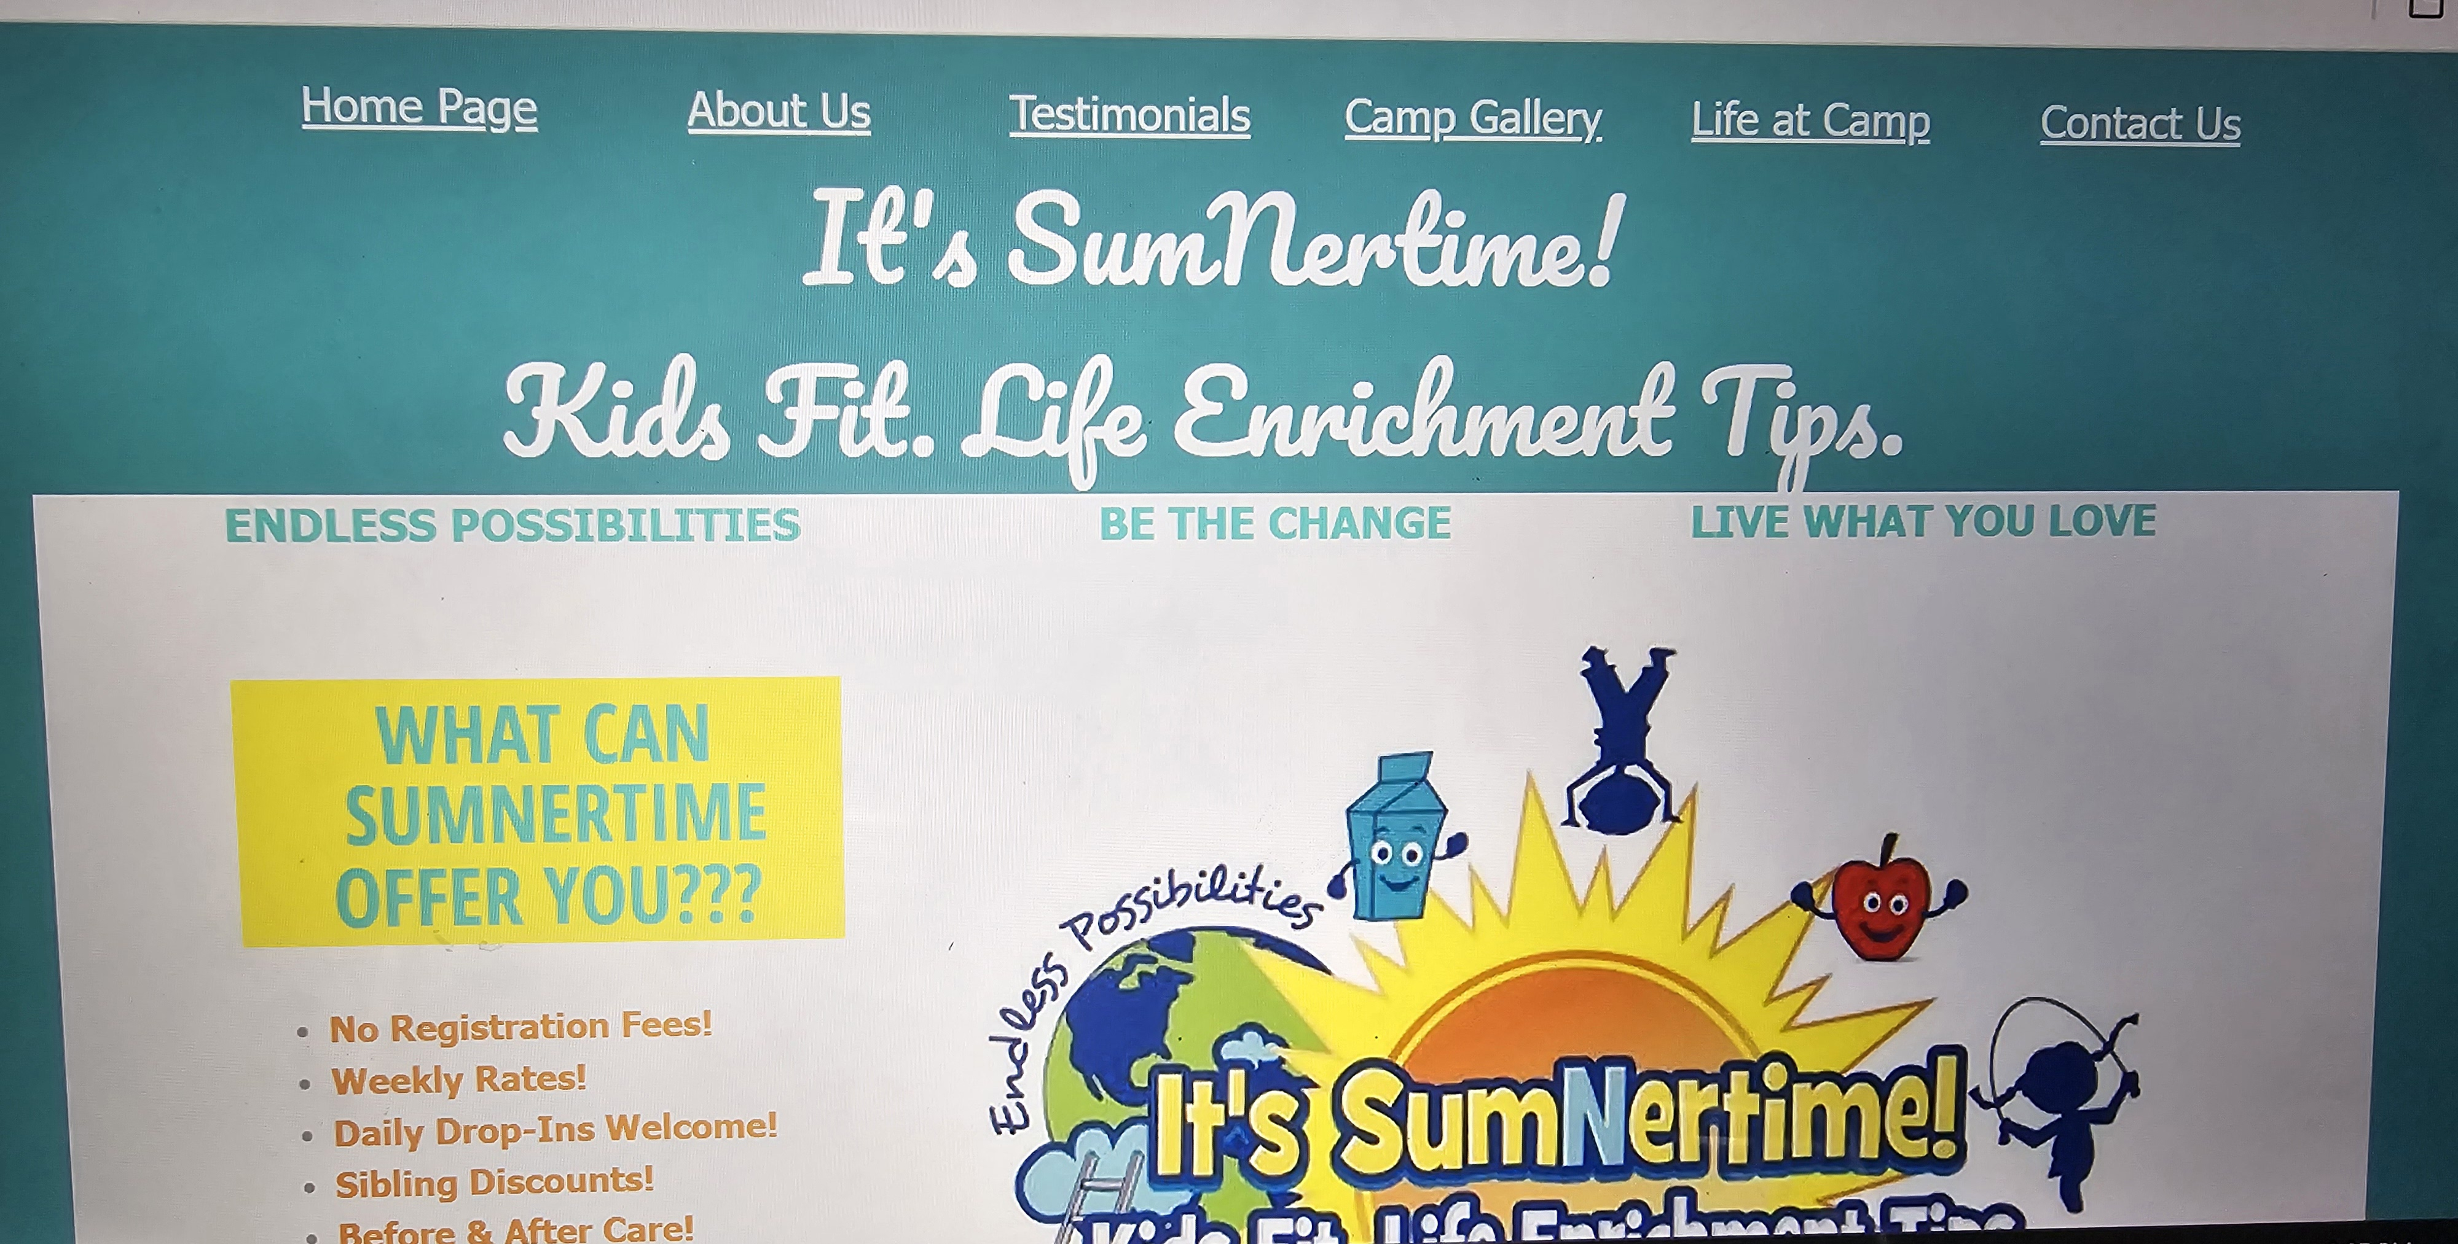
http://www.itssumnertime.com/life-at-camp.html
View “Life at Camp” page on website.

Slide 10
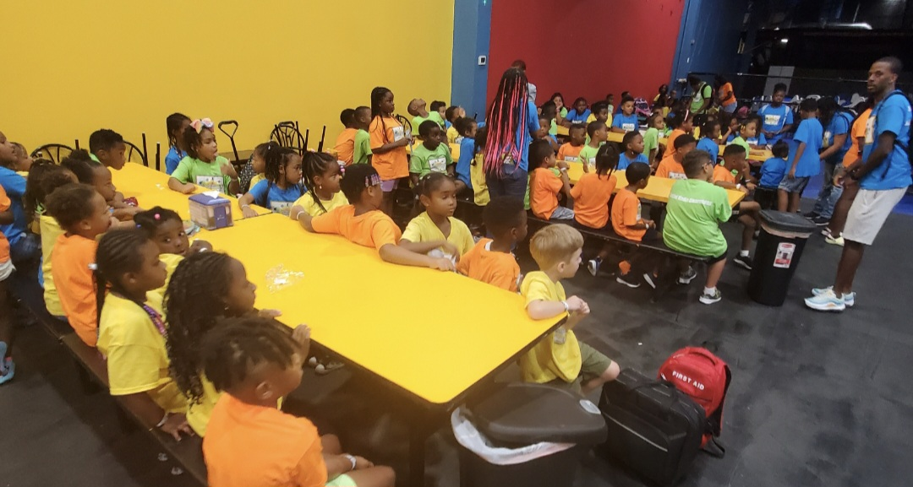
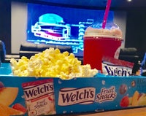
FIELD TRIP DAYS **9:00am Bus Departure**
Field Trip Days
Must wear Camp t-shirt- $15
Every Tuesday Splash Park
Rain or shine except first and last Tuesday of camp.
Kids Combo at movies on Tuesday is $5.50.
Includes icee, popcorn and gummies.
CASH ONLY. Please give ALL CASH to Mrs. Green.
Please complete ALL WAIVERS for field trips.

Slide 11
http://www.itssumnertime.com/contact-us.html
View “Contact Us” page on website.
Click on green button “Print Important Documents!”
Please complete all field trip waivers!

Slide 12
Please Complete Your Field Trip Waiver
1. Kidzden-Bowie “Waiver Form” KIDZDEN
2. Hyper Kidz-Columbia- Green Button “Sign A Waiver”
Indoor Playground in Columbia, Maryland (hyperkidzplay.com)
3. Hyper Kidz- Crofton- Top middle button “Sign A Waiver”
https://waiver.roller.app/hyperkidz/
4. Pump It Up-Lanham Bowie- At the bottom “Waiver”
Lanham Kids Birthday Party | Bounce House | Pump It Up (pumpitupparty.com)
5. Laugh Out Loud Stations- Greenbelt- “Release Waiver”
Laugh Out Loud Stations | Greenbelt, MD | Fun Things to Do (lolstations.com)
6. Get Air Trampoline Park- Alexandria, VA- “Sign Waiver”
Find a Trampoline Park Location Closest to Me in Virginia (getairsports.com)
7. Urban Air- Laurel- Click My Park “Sign Waiver”
https://www.urbanair.com/maryland-laurel/

Slide 13
Largo Church Group Me
Group Me will be the main means of communication.
Please DO NOT POST or write in the group chat.
Please direct message or text me.
Please scan the Group Me that applies.
Rangers are age 3-5, Rockstars are age 6-9, and Champions are 10-14.

Slide 14
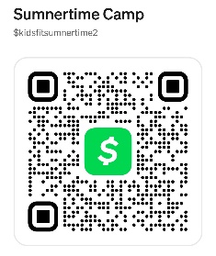
Kathy Sumner 301-704-8495 Cash Preferred
Lunch $8 per day. If paying for lunch for the entire week ($40), can be included in tuition payment. (Ex. Kathy Sumner wk1 +pizza)
(Ex. Kathy Sumner wk1 +ac + pizza)
If paying for lunch DAILY, please put $8 cash in a Ziploc with your camper’s first and last name.

Slide 15
Kathy Sumner 301-704-8495
Examples of how to write in “the description box” of Cash ap or Zelle.
Kathy Sumner wk1 +pizza (Would total $280)
Kathy Sumner wk1 +ac + pizza (Would total $305)
Kathy Sumner wk1, bc, ac (Would total $290)
Kathy Sumner wk1, bc, ac, pizza (Would total $330)
If paying for lunch DAILY, please DO NOT INCLUDE IN YOUR WEEKLY PAYMENT.
Only include pizza for the week in payment.
$8 cash can be given to Ms. Green at the front.

Slide 16
Camp Donations Accepted
Case of waters
Snacks (No nuts or chocolate please)
Magazines
Construction Paper
Any art Supplies
Disinfectant Wipes
Small hand Sanitizers
You can leave items at the front.
Thank you!!!

Slide 17
Thank You! The Sumner Family

