Slide 1
Regional trauma desk triage and its complexities
Ian Lock
Critical Care Paramedic (WMAS)
Notes:
Introduction
Paramedic I’ve been in the ambulance service for 20 years, currently working as a Specialist Trauma Paramedic and Critical Care Paramedic with West Midlands Ambulance Service.
Whistle stop tour.

Slide 2
Aims and Objectives
Reiterate Role of RTD within MTN
Context; 2012 vs 2019
Speciality Trauma Pathways
Difficulties in Remote Pre Hospital Triage

Slide 3
Regional Trauma Desk
Aid appropriate dispatch of specialist resources, Enhanced Care Teams/HEMS
Receive information and support/advise on transport decision/destination
Provide clinical advice to crews
Pass ATMIST alerts from WMAS crews to ED
Conference calls between ECT/ED
Facilitate conference calls between TU & MTC
Organise Hyperacute transfers +/- ECT and act as point of contact for TU-MTC non acute transfers (CCT at UHB)
Notes:
Regional Trauma Desk manned by critical care paramedics.
Various functions:
Aid appropriate dispatch of specialist resources
Contact for both prehospital care providers and hospitals within the network for advice. Conference call to Doctor if required
Typical scenarios are:
• To discuss by pass of TU (LEH) to MTC
• To discuss triage decision in patients who are in high risk category (Step 4 on triage tool)
• To discuss triage to Birmingham Children’s Hospital
• To discuss exceeding 45 minute – 1 hour transport time
• To request or discuss need for an enhanced care team
• For advice on use of new therapies in trauma care (e.g. tourniquet)

Slide 4
West Midlands Trauma Network Map

Slide 5
Context 2012
4 Major Trauma Centres – UHB, UHNS, UHCW, BCH – supported by Trauma Units
MAA/TAAS; Daytime HEMS/Car based.
Regional BASICs. unccordinated ?unaware of MTN
2-3000 calls per day
MERIT only commissioned night time(24hr) ECT service on duty for whole region
1 x MTTT (Triage tool)
No strict Despatch protocol for ECT
Outside of burns, no pathway for specialist trauma
45min radius to divert to MTC

Slide 6
2019
MTC: UHB/UHNS/UHCW and BCH. TU Support (Redditch and City now LEH)
MERIT 24hr commissioned Trauma Service (MAA Day)
MAA: Daytime HEMS, 2 x CC Car (B’Ham and Worcester
TAAS 24hr Service; Daytime HEMs/Night Car 99% Medic led.
Coordinated BASICs
Updated MTTT
Specialist pathways in place regionally
3-4000 calls daily. 4000+ for special occasions!
1hr + divert for TT+ive Patients to MTC.
CC Desk during the day
RTD integrated within RCC

Slide 7
2019
WMAS now has a paramedic on every vehicle. Many are NQP or have less than 3 yrs experience. . . Very little exposure to Major Trauma
EPR automatically states to contact RTD for any Pt who triggers the TT . . .regardless of context
Unprecedented demand and access to real time Ambulance conveyance means ED can ? Patients coming from out of area, will occasionally use MTTT as a triage tool for ED attendance.

Slide 8
Notes:
Aide for Crews; TT1/2 = MTC Direct bypassing if required
TT3/4 = TU or MTC if speciality/crew judgement.
CAN YOU FIND MOST IMPORTANT PHRASE ON TOOL?

Slide 9
Specialist Areas
BURNS
PLASTICS
MAX/FAC
HANDS
VASCULAR
SILVER Trauma
ORTHOPLASTICS
Notes:
Ability to bypass nearest ED for specific conditions. Some MTN agreed protocols exist i.e. Burns (Insert Flowchart)
Others rely on contacting ED direct and pleading the case!
Geographical; UHCW/RSUH, probably already accepting these pts due to catchment area and lack of other hospital options! UHB; has it’s own catchment area – Bham South. Surrounded by 8 TU/LEH from Alex to GHH. E.g none have max/fac, mixed vascular. In current climate of high demand, isolated trauma to specialist areas are very hard to sell direct to ED. Unless significant/catastrophic in nature general process is nearest ED and secondary transfer under specialist pathway. Reasoning is simple; 1 less cubicle taken in ED!
RTD; effectively can attempt to plead/reason the case for bypass . . .no guarantee of success.

Slide 11
Notes:
N.B. Not all Silver Alerts will be diverted to MTC ; Basically no capacity to accept all elderly trauma in MTC, they can’t cope with current levels. So the aim is to have a lower threshold for alerting elderly trauma patients who look well with a low MOI into TU. There is an agreed system that should aim for higher standard level of reception i.e Reg/Cons, reduce time for assessment, higher suspicion for need for early scan.

Slide 12
ORTHOPLASTICS
CONSIDERATION FOR DIVERT TO MTC FOR:
OPEN # INJURIES WITH TISSUE DISRUPTION GREATER THAN A CREDIT CARD SIZED AREA OF SKIN
OPEN # WITH BONE PROTRUDING
ABSENCE OF PULSES OR DELAYED CBR DISTAL TO # POST REDUCTION
SEVERE SOFT TISSUE DAMAGE +/- # (OUTSIDE OF DEGLOVING INJ)
Notes:
N.B. ADDITIONAL NOTES; DO NOT IRRIGATE OPEN # OF LONG BONES/HIND OR MID FOOT AS MAY WASH CONTAMIBATION DEEPER INTO BONE/TISSUE.
REMOVE GROSS CONTAMINATION AND NOTE WHERE/WHAT. COVER IN SALINE SOAKED DRESSING
OPEN # OF HAND/WRIST OR TOES TO TU UNLESS MEETS CRITERIA FOR MTC. . .
** AT THIS TIME UHNS/UHCW AND BCH HAVE SIGNED UP. UHB HAVE AGREED BUT ED NOT ACCEPTING FULLY YET. CASE BY CASE VIA RTD!

Slide 13
Triage complexities . .
Where do I start?!

Slide 14
Geography

Slide 15
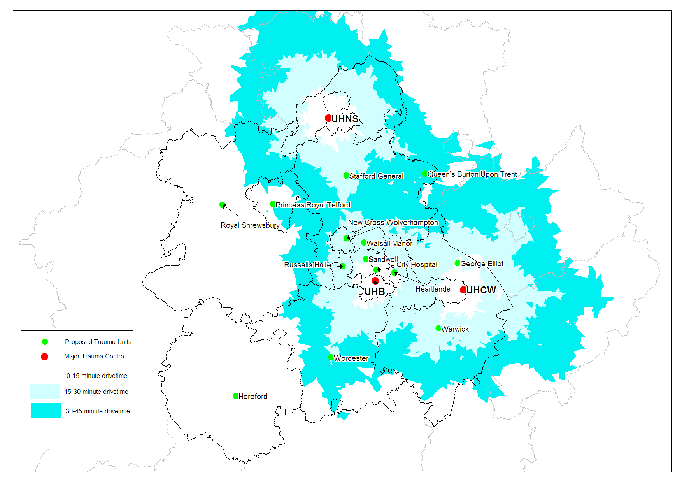
Notes:
As you can see there are still quite large areas to the west of the region where MTC’s can’t be reached within 60 minutes and this is where the Trauma Units in those areas still play an important role in the initial stabilisation of patients. It also highlights the various options we have dependant on day or night MERIT/ECT of either meeting crews en route to hospital and facilitating direct transport or meeting them at the TU in preparation for a secondary hyperacute transfer.

Slide 16
Some TUs are still > 1hr to MTC (RSH/Hereford)
BCH still requires 2ndary transfer for HMED. W/NW of region, HEMS may transfer to Alder Hey
Forward planning for pit stopping in TU/RV with ETC.
UHNS/UHCW have a call and send policy for hyperacute transfers
UHB have same policy but have differing geographical concerns.
Notes:
UHB: Greater population density. Served by TU/LEHs. Shorter run times mean most primary TT1/2 go straight to UHB. Some late presenters who deteriorate in ED can then become ?hyperacute . . Can be subject to individual interpretation

Slide 17
Chinese Whispers
Your GCS 12 is my GCS14 . . .

Slide 18
Notes:
Aide for Crews; TT1/2 = MTC Direct bypassing if required
TT3/4 = TU or MTC if speciality/crew judgement.
CAN YOU FIND MOST IMPORTANT PHRASE ON TOOL?

Slide 19
Patient A
A - PT 40yr male @23:00
M – Fallen in road ?LOC
I – Occipital Head Injury
S – GCS 13 E3V4M6, p96, bp140/90, rr12, spo2 96%
T- Vomited so reluctant to immobilise

Slide 20
A – 40yr male, drinking all day. @23:00
M – Was on bar stool outside of pub, fallen asleep after vomiting, fell off stool onto pavement
I – Small cut to occiput. Pt got himself up and sat back on stool
S – NAD
T – Vomit prior to fall

Slide 21
Patient B
A - 23yr fm @17:00
M – Motorbike vs car
I - ?Pelvic Injury
S – gcs 15, p100, bp105/80, rr20, spo2 98%
T – Immobilised, Pelvic Binder

Slide 22
Patient B
A – 23yr fm, @17:00
M – Motorcyclist vs car: Turning into her residential street, hit parked car, fell to Lt side and bike landed on Pt. PT able to extricate and pick bike up, Pt then walked bike to home address 100m.
S – NAD
T – Mobile, MSC x 4 prior to ambo arrival

Slide 23
Patient C
A - 75yr male, @16:00 hrs
M - RTC, 60mph, skidded left road and through hedge. SB and AB worn. Self Extricated. Walked to ambo.
I – Pale, abdo tenderness ?SB, Chest tenderness, Posterior hip pain.
S – GCS 15, radial pulse 100, BP 135/95, rr24, spo2 94% Air.
T – Declined Immobilisation. IV paracetamol.
35 mins to TU. >80mins to MTC.

Slide 24
A – 75yr male, @16:00 hrs
M – 60mph, skidded, left road, through established hedge, Intrusion >30cm into drivers space, significant front end damage. Self extricated with help from passers by. Was able to walk onto ambo only with help due to pain in lower back/hip.
I – Abdo tenderness with some bruising evident ?SB. Ant chest very tender to touch++
S – As described
T – As described
Subsequent transfer to MTC with significant Sternal/chest Inj/PNx. Blood in abdo and SI Injury.
Crew conveyed direct to TU. No alert.

Slide 25
Conclude
Remote triage is difficult. We will make mistakes
We don’t do it deliberately to make your ED life difficult!
Some Patients present well despite significant MOI
If we triaged every significant MOI to an MTC we would break the system!
The system does work!

Slide 26
Questions

