Slide 1
Germline & Somatic Mutations in Cancer
Heather Hampel, MS, LGC
Associate Director, Division of Human Genetics
Professor, Department of Internal Medicine
Twitter: @HHampel1

Slide 2
Learning Objectives
Discuss the difference in germline and somatic gene mutation
Determine which tumor mutations might also be germline mutations necessitating a referral to Cancer Genetics
Consider how germline and somatic mutations may affect treatment selection

Slide 3
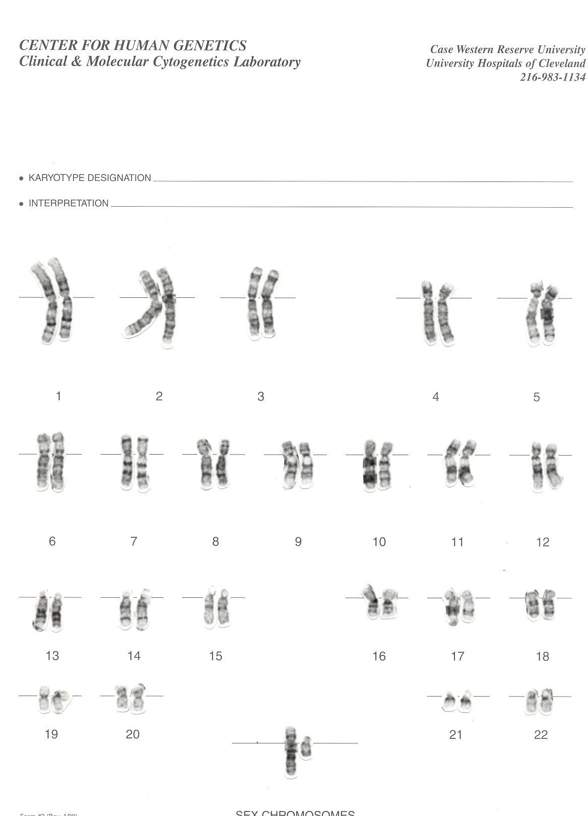
Normal Male Karyotype
Sex chromosomes

Slide 4
Sporadic
Inherited
Normal gene
Germline mutation
Somatic mutation
Somatic mutation
Somatic mutation
Later age at onset (60s or 70s)
Little or no family history of cancer
Single or unilateral tumors
Early age at onset (<50)
Multiple generations with cancer
Clustering of certain cancers (i.e., breast/ovarian)
Notes:
In sporadic cancers, a number of mutations need to accumulate in a specific cell before the function of that gene is lost. As such, we see later ages of onset of single, unilateral cancers, often in the 60’s or 70’s, with little or no family history—shown here. In inherited cancer syndromes, there is a germline mutation in the tumor suppressor gene. That means that every cell in the body has one non-working copy of the gene. So initially, the cell growth is kept in check by the working copy of the gene. But if one cell acquires a mutation in that working copy, no more tumor suppressor activity is present in that cell, and the cell growth can go unchecked, leading to cancer. In a sense, these individuals are one step closer to cancer. As such, we see earlier ages of onset of cancers, multiple affected generations, and clustering of certain types of cancers.

Slide 5
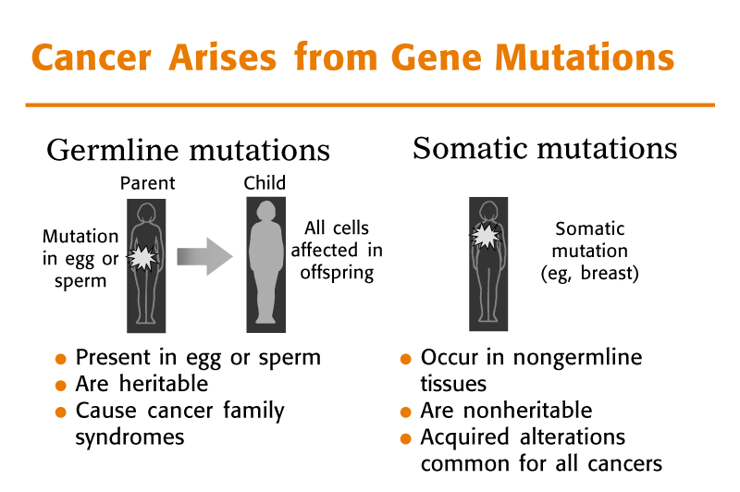
Slide used courtesy of the American Society of Clinical Oncology.

Slide 6


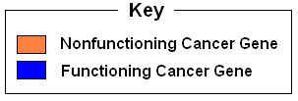
Dominant Inheritance of a Cancer Susceptibility Gene
X
Mother
with
nonfunctioning
cancer gene
Father
Offspring have a 50% chance of inheriting the nonfunctioning cancer gene

Slide 7
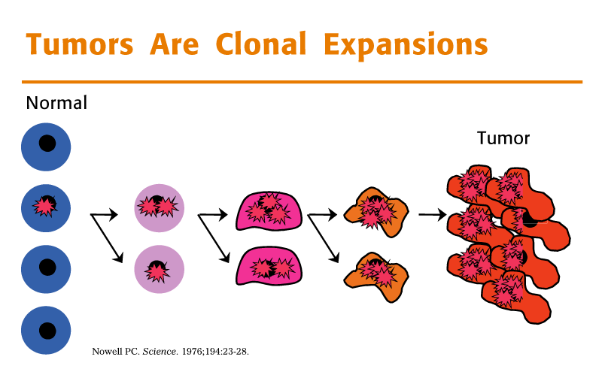
Slide used courtesy of the American Society of Clinical Oncology.

Slide 8
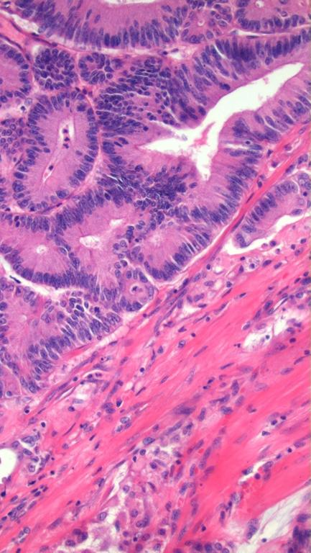
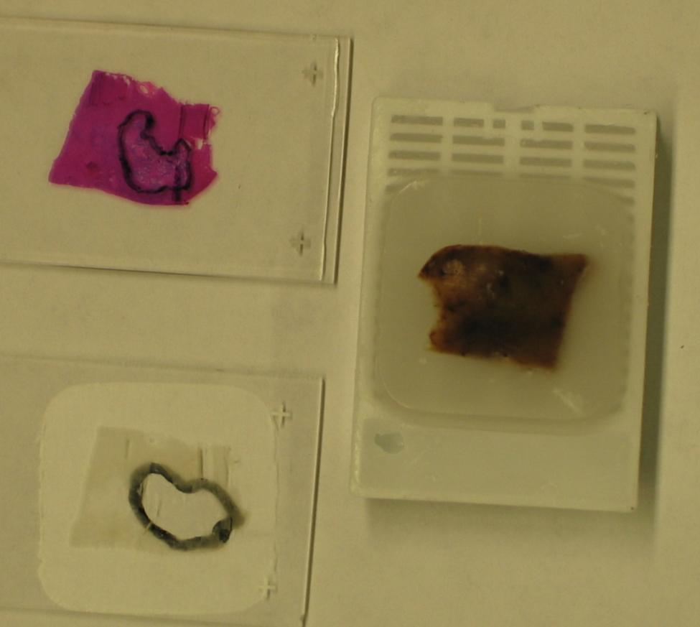
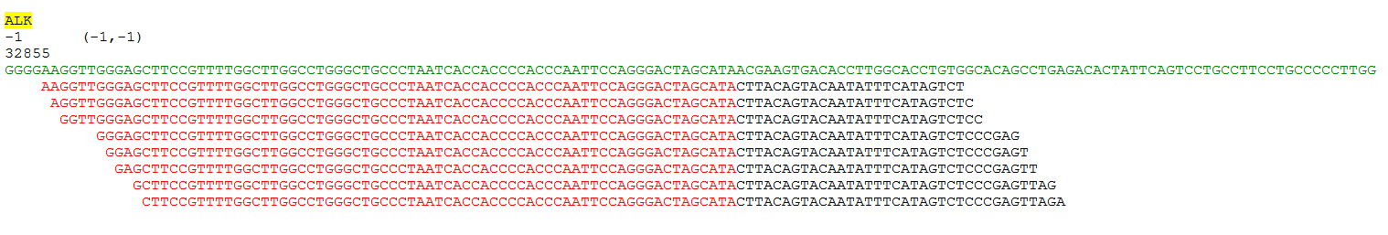
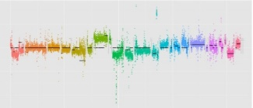

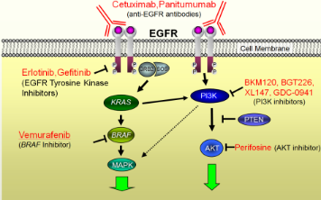
Emerging Model of Cancer Treatment
Tumor tissue routinely acquired for molecular diagnostics
All/or a subset of actionable mutations assessed
Therapy selected based on molecular characteristics

Slide 9
Validated Markers
Cancer | Commonly Used Molecular Tests
Colorectal | KRAS, NRAS, BRAF, MSI
Lung (non-small cell) | EGFR, KRAS, ALK, ROS1
Melanoma | BRAF, KIT, NRAS
Breast | ERBB2, BRCA1, BRCA2

Slide 10


Somatic Mutation Panels
Hotspot Panels
  Examples
    SnapShot®
    Sequenom MassARRAY®
    AmpliSeq™
Comprehensive Sequencing Panels
  Examples
    UW-OncoPlex™
    Foundation ONE™
    GPS@WUSTL

Slide 11
200-gene hotspot panel
≠
200-gene comprehensive panel

Slide 12
Base pairs analyzed
1
10
100
1,000
10⁴
10⁵
10⁶
10⁷
10⁸
10⁹
Single Site
(e.g., BRAF codon 600)
Partial Gene
(e.g., EGFR TKD)
Hotspot panels
Exome
Genome
Comprehensive Panels
Comprehensive panels are more likely to provide clues about germline mutations
TKD = tyrosine kinase domain.

Slide 13
Same Genes, Different Uses
Gene | Somatic Use | Germline Use
MLH1,MSH2, MSH6,PMS2 | Help with MSI status for prognosis and therapy | Lynch syndrome
CDH1 | Aid with diagnosis | Hereditary diffuse gastric cancer
PTEN | Treatment and prognosis | Cowden syndrome
TP53 | Prognosis in some cancers | Li-Fraumeni syndrome
BRCA1/2 | PARP inhibitors, platinum therapy | Hereditary breast/ovarian cancer
MSI = microsatellite instability.

Slide 14
Clues to Suspecting a Germline Mutation*
Clinical and family history, and screening tests
Mutation known to be germline in some cases
Variant allele fraction
*Assuming tumor-only sequencing

Slide 15
Clinical and Family History Are the Most Important
Does the patient’s personal and family history match the gene in which you found a mutation?
  For example, mutations in Lynch syndrome genes: should see colorectal, endometrial, gastric, and ovarian cancers
  Multiple primaries = more likely to be hereditary
  Early-onset cancer = more likely to be hereditary
APC gene is mutated in virtually ALL colorectal cancers
  Do not refer unless I1307K Jewish founder mutation or polyposis
TP53 gene is mutated in virtually ALL cancers
  Do not refer unless personal and family history is suspicious for Li-Fraumeni syndrome

Slide 16
Mutation Is Known to Be Germline in Some Cases
Jewish founder mutations
  c.6174delT in BRCA2 aka c.5946delT or p.S1982fs*22
  c.185delAG in BRCA1 aka c.68_69delAG
  c.5382insC in BRCA1 aka c.5266dupC
  p.I1307K in APC
  p.A636P in MSH2
Common mutations
  c.942+3 a>t in MSH2
  c.3261dupC in MSH6
  c.181T>G in BRCA1 aka p.C61G

Slide 17
Variant Allele Fraction
What percentage of the cells tested have the mutation in them?
Germline mutations often ~50%
  Can be higher if loss of heterozygosity
  Can be lower for indel mutations
Somatic mutations often <35%
Many next-generation sequencing somatic panels produce accurate VAF
VAF can be used in some cases to assess the probability a mutation is germline
Knowledge of tumor purity and ploidy is very helpful
  Less pure tumor = More normal admixed = Lower VAF for somatic mutations
  Triploid tumor with germline mutation = Lower VAF
VAF = variant allele fraction.

Slide 18
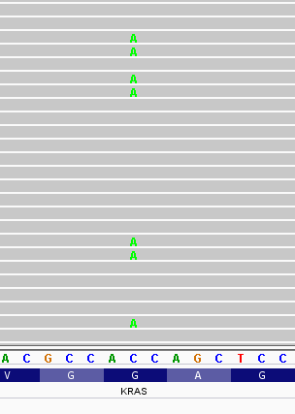
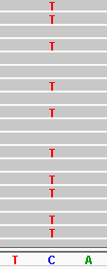
Variant Allele Fraction (cont.)
Example
Two MSH2 loss of function mutations in a colorectal tumor with ~50% tumor cells
  Mutation 1 VAF is 25%
  Mutation 2 VAF is 50%
Mutation 1
Mutation 2
Q. Does this result suggest one mutation is germline?
A. Yes, mutation 2 may be germline based on 50% VAF. Heterozygous somatic mutations in tumor are expected to be at ~25% VAF because only half the sample is tumor cells.

Slide 19
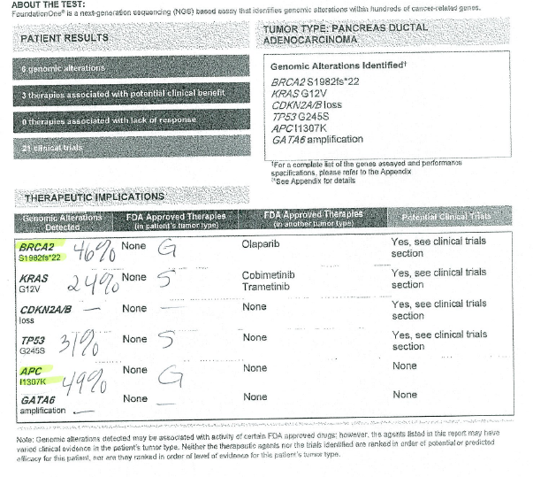
Case Example

Slide 20
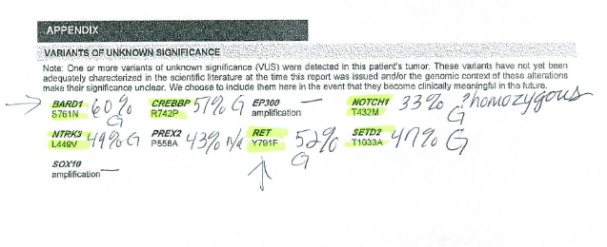
Case Example: Check the Variants Page Too

Slide 21
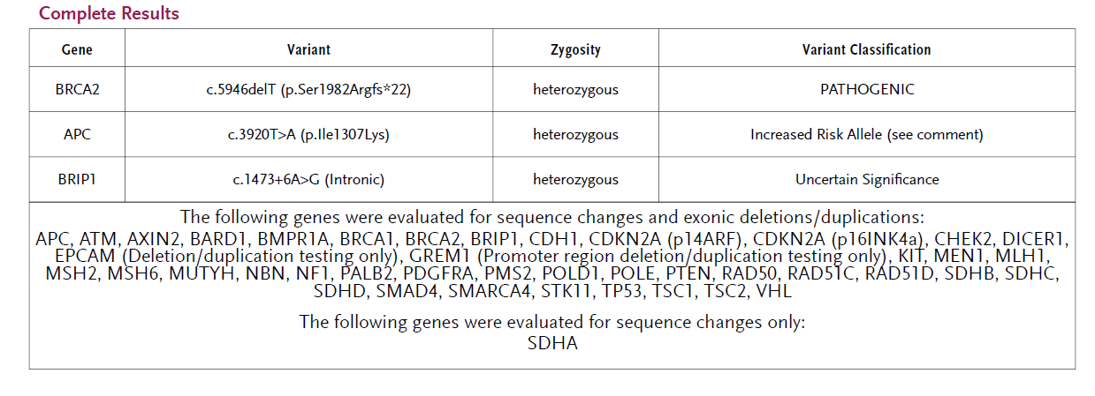
Case Example: Germline Test Results
Note: BRIP1 variant not reported on the report because this gene is not included in their test
BARD1 variant from report was not reported on germline test because it is known to be a benign or likely benign variation
Report courtesy of Heather Hampel, MS, LGC.

Slide 22
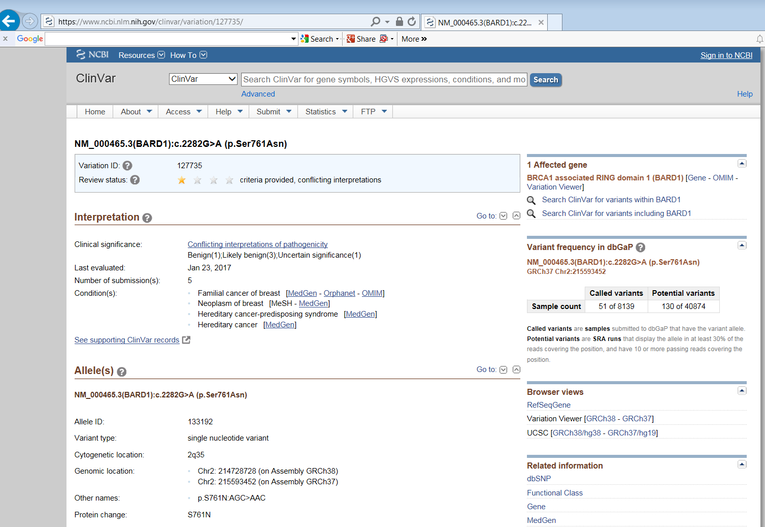
Case Example:
Use of ClinVar

Slide 23
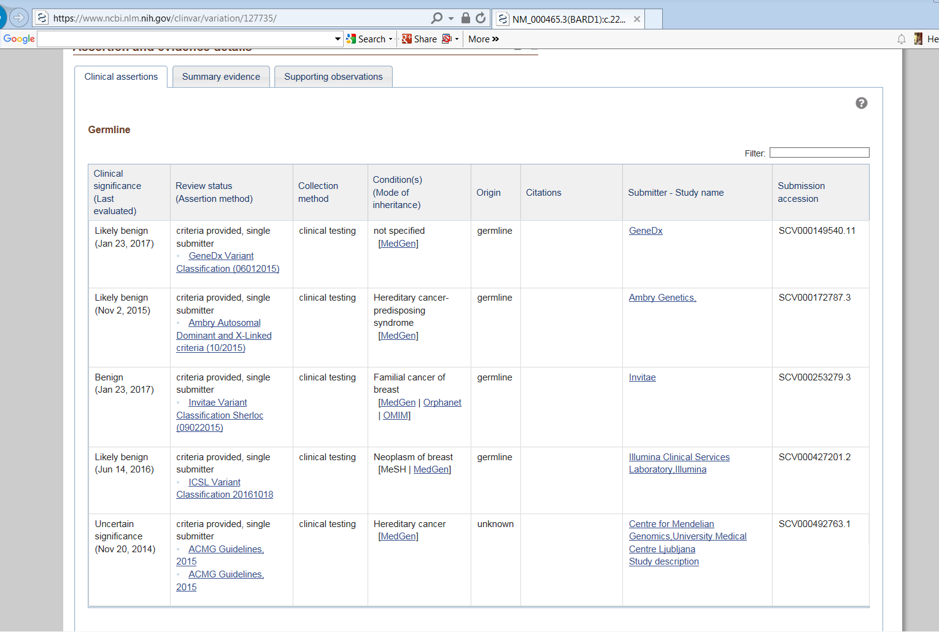
Case Example:
Use of ClinVar

Slide 24
“Lynch-like” Syndrome
Lynch syndrome in 3-4% of colorectal cancer
“Lynch-like” syndrome
  Defined as patients with positive tumor-based screening (including exclusion of MLH1 promoter methylation) and no germline mutation detected
  Increasingly clinically important with universal tumor-based Lynch syndrome screening
Prevalence of “Lynch-like” syndrome
    EPICOLON Study 2.5% (43/1705)
    Rodríguez-Soler, Gastroenterology 2013
    Columbus Lynch syndrome study 3.9%
    Hampel, NEJM 2005; Hampel, Cancer Research 2008
Notes:
MLH1/PMS2 missing =>
80% hypermethylated MLH1
MSH2/MSH6 missing =>
20-25% EPCAM mutations (Ligtenberg MJL, Nat Genet 2009)
5% MSH2 inversion (Rhees J, Familial Cancer 2013)

Slide 25
“Double Somatic” Mutations Explain Many Patients With LLS/Unexplained dMMR
8%-50% of cases remain unexplained and are probable LS cases with an unidentified germline MMR gene mutation
Publication | Somatic Mutations | Somatic Mutation + LOH | Somatic Mosaicism | Other
Sourrouille I, Fam Cancer 2013 | 3/18 (16.7%) | LOH not studied but 5/18 patients had 1 somatic mutation (27.8%) | 1 /18 (5.5%) | 1/18 missed germline mutation
Mesenkamp AR, Vogelaar IP, Gastroenterology 2014 | 5/25 (20%) | 8/25 (32%) | Not assessed (Sanger sequencing)
Geurts-Giele WRR, J Pathol 2014 | 5/40 (13%) | 16/40 (40%) | 0/40 (0%) Not mentioned but probably assessed (Next-gen) | 2 probable germline mutations seen in T&N
Haraldsdottir S, Gastroenterology 2014 | 12/32 (37.5%) | 9/32 (28.1%) | 0/32 (0%) | 6/32 had errors in tumor screening
Total | 45-69% |  | 0-5% | 5-19%
LOH = loss of heterozygosity; LS = Lynch syndrome.

Slide 26
Likelihood of Double Somatic Mutations in dMMR* Endometrial Cancer
Unpublished data
IHC Result | N | Lynch syndrome | Double somatic | Unexplained**
Absent MLH1/PMS2* | 59 | 24 (40.7%) | 35 (59.3%) | 0 (0%)
Absent MSH2/MSH6 | 68 | 54 (79.4%) | 10 (14.7%) | 4 (5.9%)
Absent MSH6 | 18 | 12 (66.6%) | 3 (16.7%) | 3 (16.7%)
Absent PMS2 | 21 | 18 (85.7%) | 3 (14.3%) | 0 (0%)
IHC normal (MSI-H) | 9 | 6 (66.7%) | 2 (22.2%) | 1 (11.1%)
TOTAL | 175 | 114 65.1% of dMMR* | 53 30.3% of dMMR* | 8 4.6% of dMMR*
*No MLH1 promoter methylation
**3 patients with dMMR had insufficient tumor for somatic testing
dMMR = DNA mismatch repair.
Numbers current as of 3/02/17

Slide 27
Likelihood of Double Somatic Mutations in dMMR* Endometrial Cancer
Unpublished data
IHC Result | N | Lynch syndrome | Double somatic | Unexplained**
Absent MLH1/PMS2* | 3 | 0 (0%) | 3 (100%) | 0 (0%)
Absent MSH2/MSH6 | 8 | 2 (25%) | 5 (62.5%) | 1 (12.5%)
Absent MSH6 | 7 | 6 (85.7%) | 1 (14.3%) | 0 (0%)
Absent PMS2 | 1 | 1 (100%) | 0 (0%) | 0 (0%)
IHC normal (MSI-H) | 1 | 1 (100%) | 0 (0%) | 0 (0%)
TOTAL | 20 | 10 50% of dMMR* | 9 45% of dMMR* | 1 5% of dMMR*
*No MLH1 promoter methylation
Numbers current as of 3/02/17

Slide 28

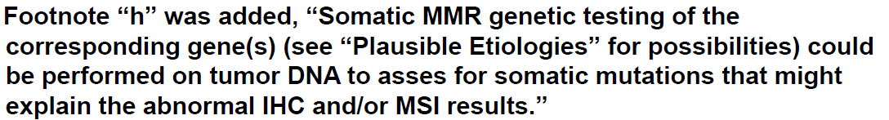
Recommendation to consider somatic MMR testing in some scenarios when germline testing is negative was added to the NCCN guidelines since 2015
NCCN = National Comprehensive Cancer Center.
NCCN Clinical Practice Guidelines in Oncology. Genetic/Familial High-Risk Assessment: Colorectal. V1.2015. Copyright 2017 National Comprehensive Cancer Network.
Copyright 2017 National Comprehensive Cancer Network.

Slide 29
Case 1: Clinical History
52-year-old female died in February from a gastric cancer diagnosed at age 51
Pathology: Poorly differentiated carcinoma with signet ring cell features and a diffuse infiltrative pattern
Prior to her death: Foundation Medicine tumor sequencing was ordered to try to help direct her treatment
2 CDH1 mutations were identified in her gastric tumor
25-year-old daughter and 46-year-old sister referred to Genetics by patient’s oncologist

Slide 30
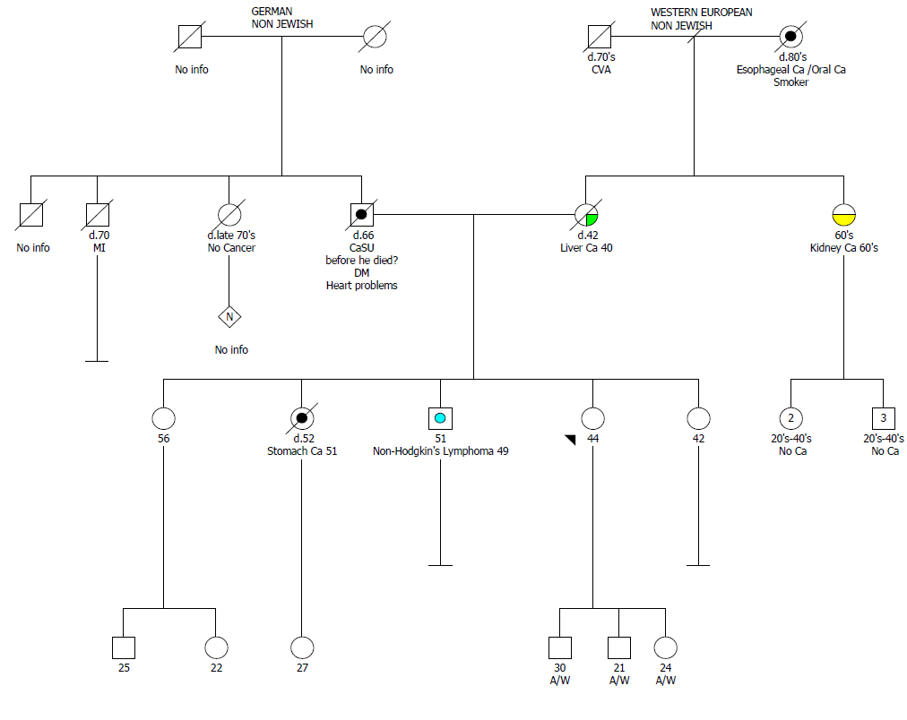
Case 1: Family History

Slide 31
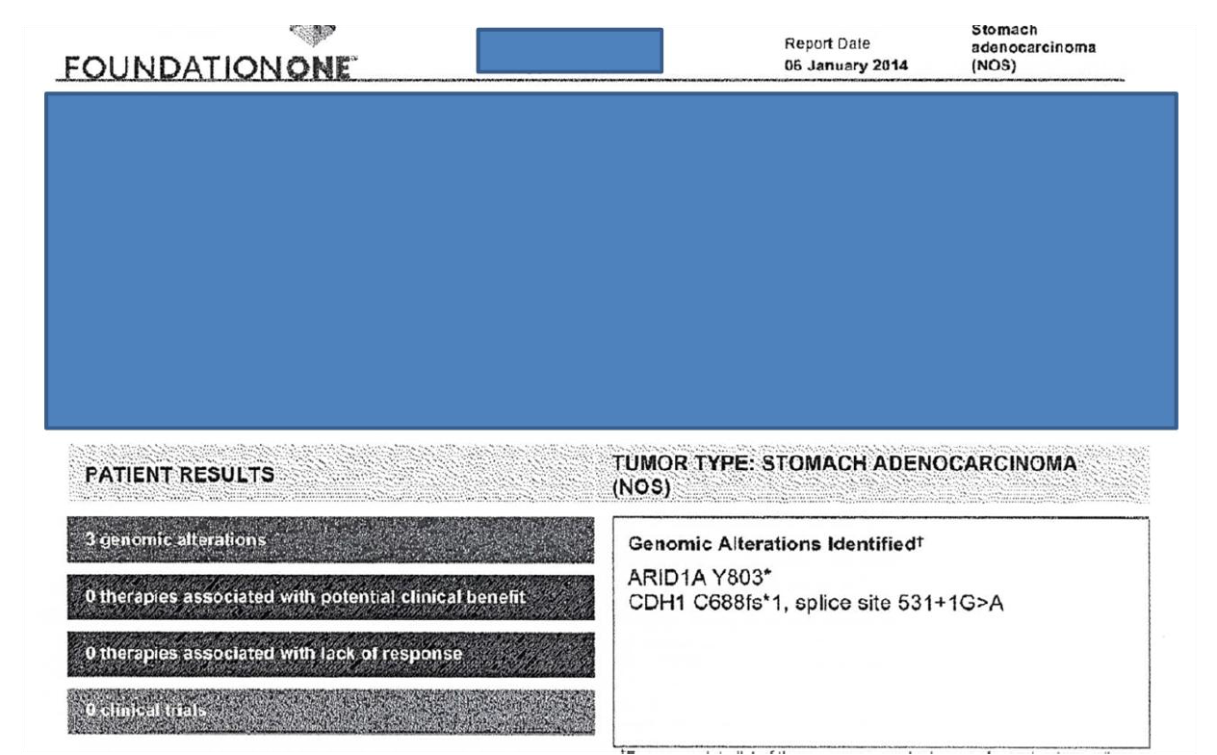
Case 1: Tumor Sequencing Results

Slide 32
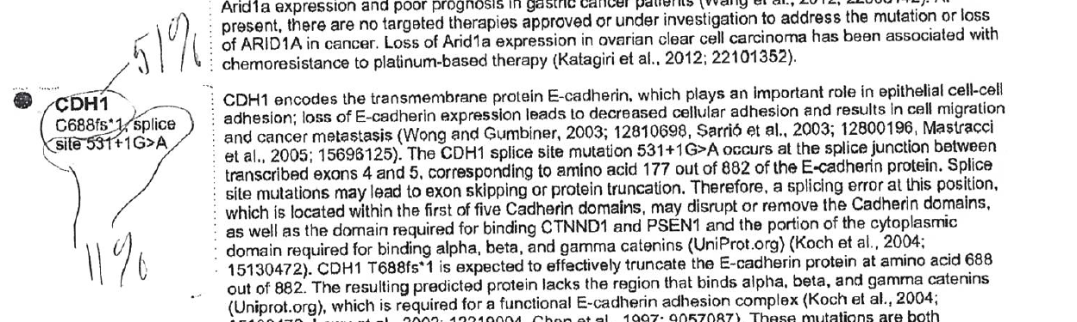
Case 1: CDH1 Variant Allele Fractions

Slide 33
Case 1: Germline Genetic Test Results
Daughter and sister both tested negative for the C688fs*1 CDH1 mutation
Explained that this is not a “true negative” result since we were not 100% sure that the proband had this mutation in her germline
Started exploring the possibility of obtaining banked white cell pellet on proband who was enrolled in a biorepository
In the meantime, proband’s 51-year-old brother presents for genetic counseling
Gave option of waiting for sister’s result or proceeding with single-mutation testing; he pursued test

Slide 34
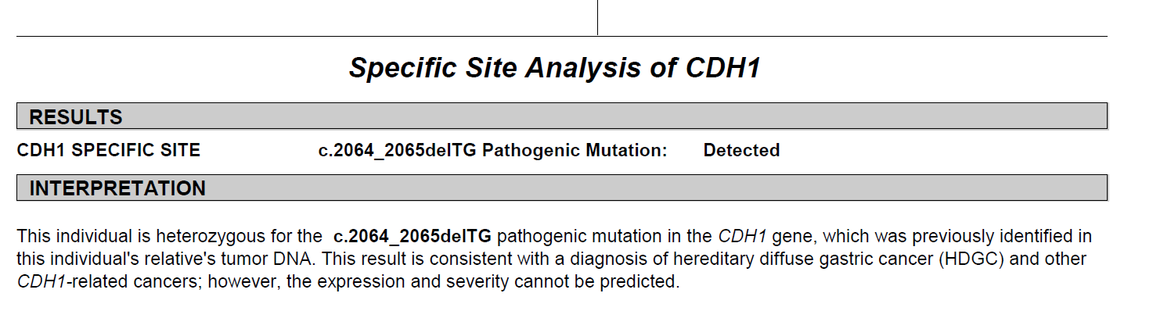
Case 1: Germline Genetic Test Results

Slide 35
Case 1: Outcome
Brother has “prophylactic” gastrectomy
  Stomach, total gastrectomy:
  - Multifocal signet ring cell carcinoma involving gastric mucosa, see synoptic report
  - Resection margins negative for carcinoma
  - Proximal margin with esophageal squamous mucosa and gastric columnar mucosa with intestinal metaplasia (goblet cells), see comments; negative for dysplasia
  - Distal margin with duodenal mucosa
  - Sixteen lymph nodes negative for metastatic carcinoma (0/16)
  - Stomach with chronic active gastritis, Helicobacter-associated
  - Multiple foci of intestinal metaplasia (goblet cells) present
Daughter and sister are “true negatives” and have no increased risks for cancer
We do not need to test the proband’s banked sample
Other at-risk relatives can now be tested

Slide 36
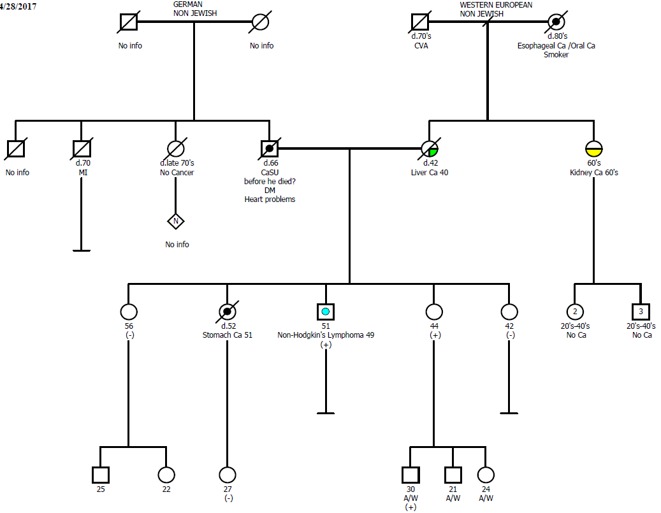
Case 1: Cascade testing

Slide 37
Case 2: Clinical History
59-year-old male died in February 2015 from recurrent metastatic colon cancer diagnosed at age 53. Universal tumor screening for Lynch syndrome done, IHC was reported normal (notes weak MSH6).
Oncologist ordered tumor sequencing to try to direct treatment: 1 MSH6 mutation identified. Oncologist ordered MSI testing, MSI-H.
Patient died before seeing Genetics; 32-year-old daughter referred by patient’s oncologist.
Notes:
There are two scenarios when somatic testing for LS will present itself to you in clinic. We’ve already talked about abnormal IHC from UTS. But what about when a patient is referred to you after somatic testing was already done and you have to work backwards to decipher the meaning for your patient? This case is one of my favorite examples of that.

Slide 38
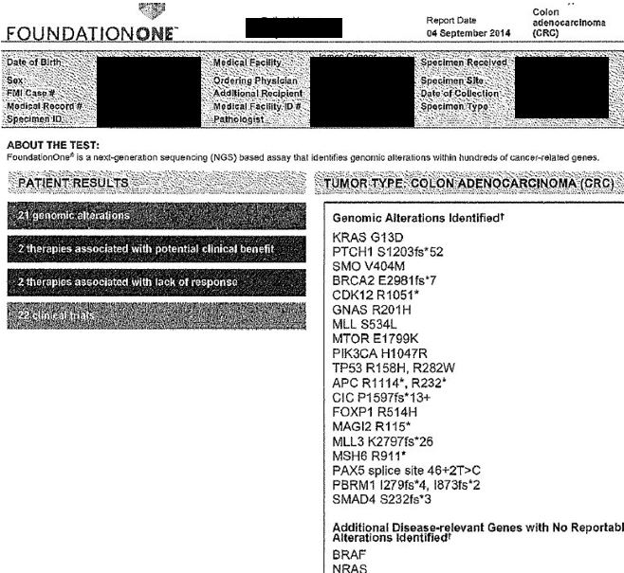
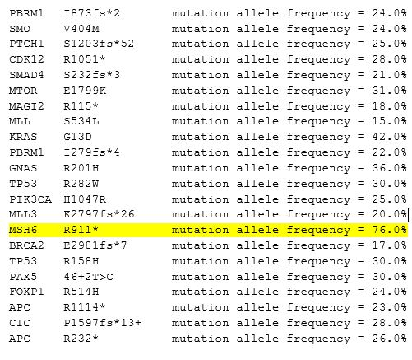
Case 2: Tumor Sequencing Results
Notes:
Variant allele frequency (VAF): The number of mutant sequencing reads divided by total number of sequencing reads at a given position.
-Using VAF alone to draw conclusions about a possible germline change can be unreliable due to tumor heterogeneity, inconsistency in evaluation of tumor percentage and assay limitations. However, we all use it. Internally, we use a 35% VAF as our red flag %. We looked at the tumors of 19 patients with known germline mutations and by using a cut off of 35%, we only missed 1, which was an indel, which we know can INDELS are the exception to the rule, these can be lower than 35% so be careful with those.

Slide 39
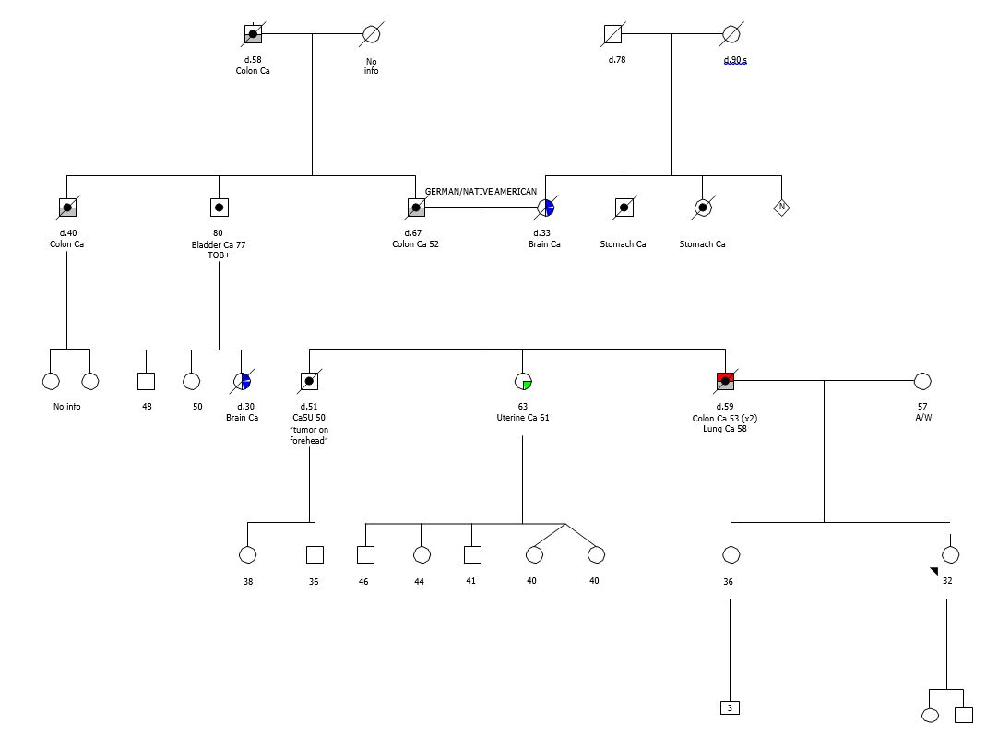
Case 2: Family History

Slide 40
Case 2: Germline Genetic Test Results
Results
  Daughter had single site, tested negative for the p.R911X MSH6 mutation
  Explained that this is not a “true negative” result since we were not 100% sure that her father had this mutation in his germline
  Started exploring the possibility of obtaining banked white cell pellet on deceased proband who was enrolled in a biorepository
  In the meantime, daughter convinced her paternal aunt to undergo testing. 63-year-old aunt presents for genetic counseling, brings pathology records from uterine cancer.

Slide 41
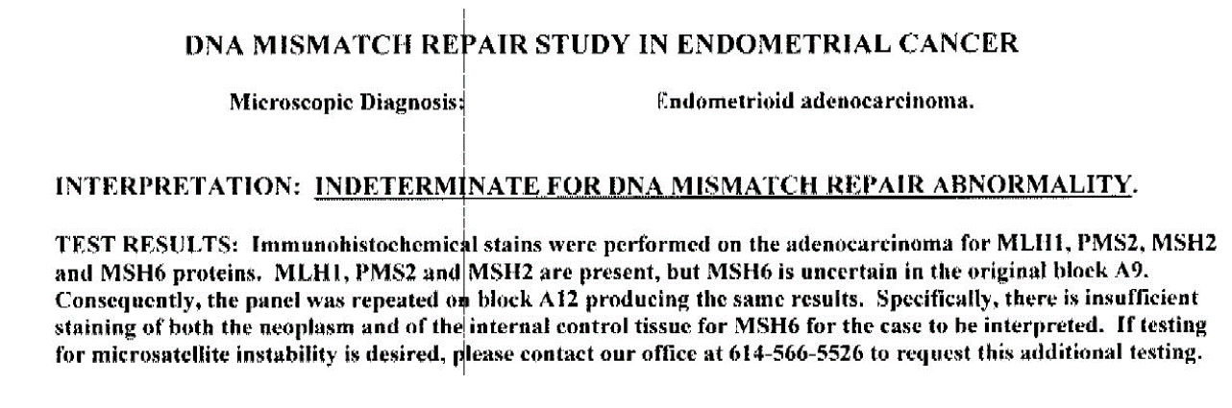
Case 2: IHC Tumor Screening

Slide 42
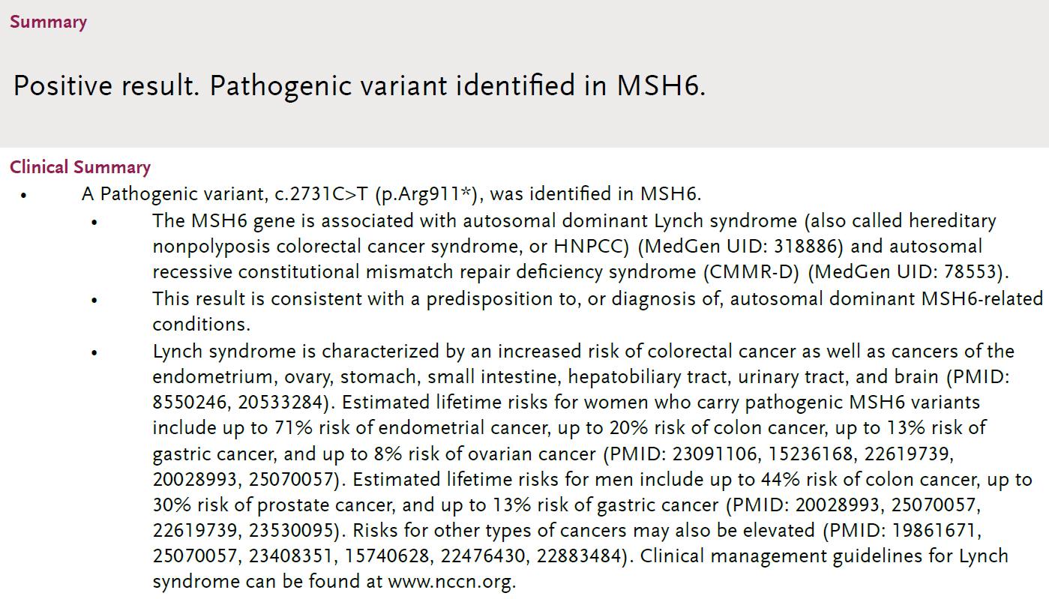
Case 2: Germline Genetic Test Results

Slide 43
Case 2: Outcome
Patient’s affected sister tested positive for p.R911X MSH6 mutation, thus confirming that it was germline in index patient
We do not need to test the patient’s banked sample
Our proband is a true negative
Second daughter tested positive
Cascade testing to other family members

Slide 44
Case 3: Clinical History
Clinical history
  71-year-old female with recent diagnosis of pancreatic cancer
  Personal history of breast cancer diagnosed at age 53
  Oncologist ordered tumor sequencing to try to direct treatment
  Referred to Cancer Genetics based on tumor sequencing results
Notes:
There are two scenarios when somatic testing for LS will present itself to you in clinic. We’ve already talked about abnormal IHC from UTS. But what about when a patient is referred to you after somatic testing was already done and you have to work backwards to decipher the meaning for your patient? This case is one of my favorite examples of that.

Slide 45
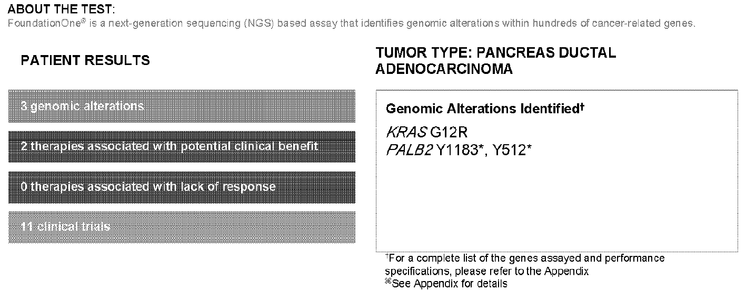
Case 3: Tumor Sequencing Results
In response to your request for further information on TRF100656, please find the raw data below used to generate the final FoundationOne assay result. Spec.: TRF100656.01 DO: Pancreas ductal adenocarcinoma Status: Pass Alterations: KRAS G12R mutation allele frequency = 18.0% PALB2 Y1183* mutation allele frequency = 49.0% PALB2 Y512* mutation allele frequency = 20.0% The raw data included in this report is not intended for clinical use. No clinical evidence exists to support the use of these values for predicting efficacy of treatment.
Notes:
Variant allele frequency (VAF): The number of mutant sequencing reads divided by total number of sequencing reads at a given position.
-Using VAF alone to draw conclusions about a possible germline change can be unreliable due to tumor heterogeneity, inconsistency in evaluation of tumor percentage and assay limitations. However, we all use it. Internally, we use a 35% VAF as our red flag %. We looked at the tumors of 19 patients with known germline mutations and by using a cut off of 35%, we only missed 1, which was an indel, which we know can INDELS are the exception to the rule, these can be lower than 35% so be careful with those.

Slide 46
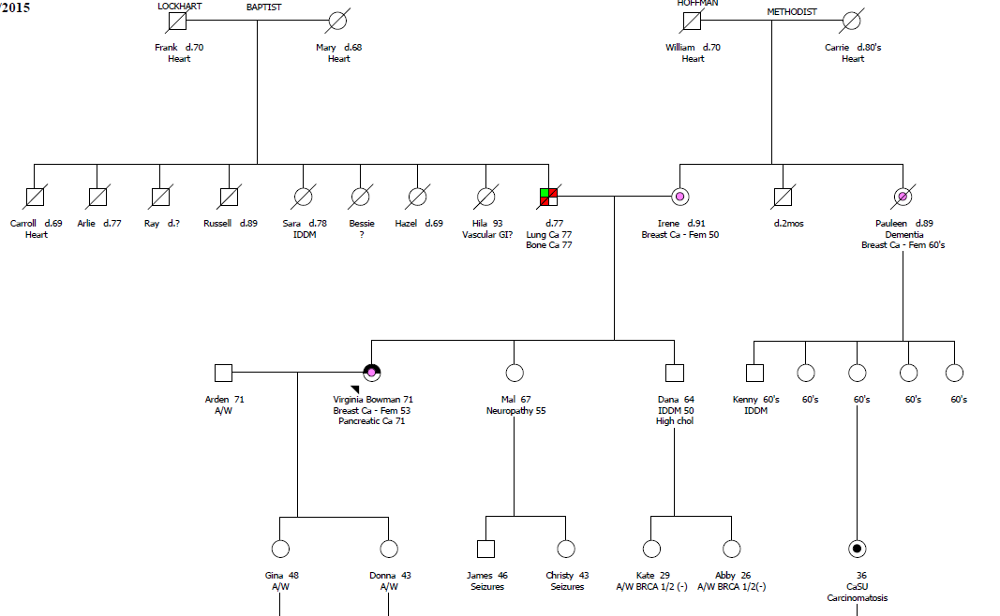
Case 3: Family History

Slide 47
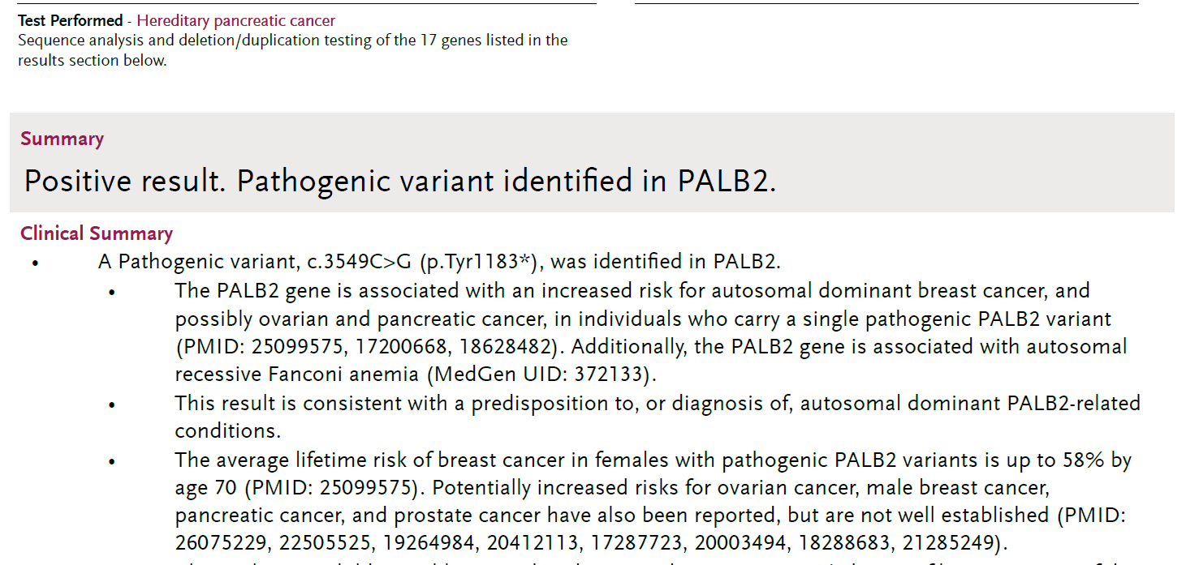
Case 3: Germline Genetic Test Results

Slide 48
Case 3: Outcome
Somatic tumor testing can help both treatment decisions and sometimes can identify germline mutations to help the family
Patient’s oncologist uses platinum-based chemotherapy
Patient’s oncologist considers PARP inhibitor for therapy
Cascade testing offered to other family members

Slide 49
Case 4: Clinical History
74-year-old male with stage 1 ascending colon cancer
MSI-high
IHC results
  MLH1 – Absent
  MSH2 – Present
  MSH6 – Present
  PMS2 – Absent
MLH1 promoter methylation studies negative
Germline genetic testing
  66 gene panel, NEGATIVE
Notes:
So you all remember our patient from case 1, who had MLH1-deficient CRC without methylation and didn’t have any germline mutations. Can you guess what this patient has?

Slide 50
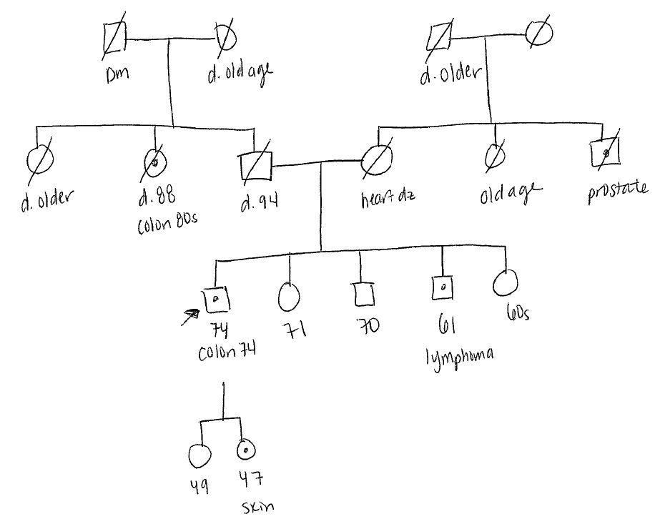
Case 4: Pedigree
Notes:
So you all remember our patient from case 1, who had MLH1-deficient CRC without methylation and didn’t have any germline mutations. Can you guess what this patient has?

Slide 51
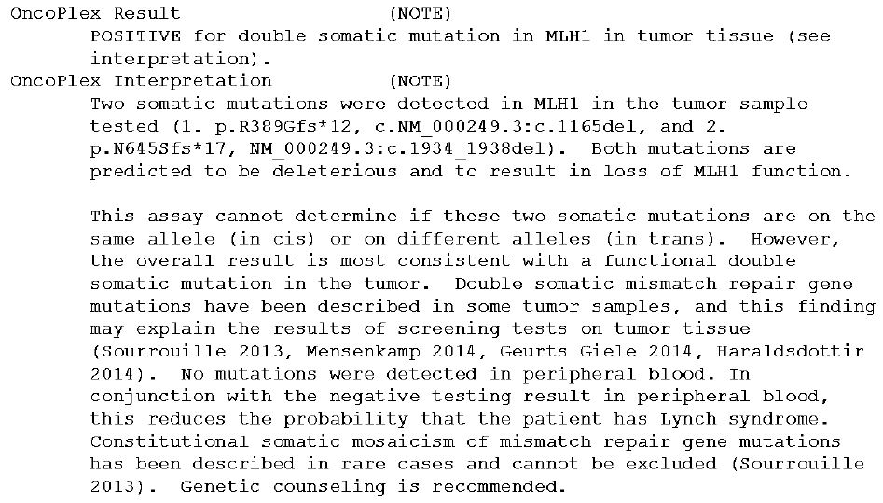
Case 4: Tumor Genetic Test Results
Somatic testing
Management
  Based on family history
Notes:
That’s, right, Double somatic mutations. The report says both are deleterious and predicted to result in loss of fxn of MLH1. It goes on to list all the possible limitations like the test cannot determine if the mutations are in cis or trans (although you would assume trans since she had a dMMR CRC) and also goes on to day that somatic mosaicism cannot be excluded. When we get these results, we feel very comfortable that the patient has a sporadic dMMR CRC and screen based on the fhx. So in this case, it would be general population recs.

Slide 52
Thank You
To learn more about Ohio State’s cancer program, please visit cancer.osu.edu or follow us in social media:

