Slide 1
Trauma Research in the West Midlands
Jonathan Young
Elaine Hardy

Slide 2
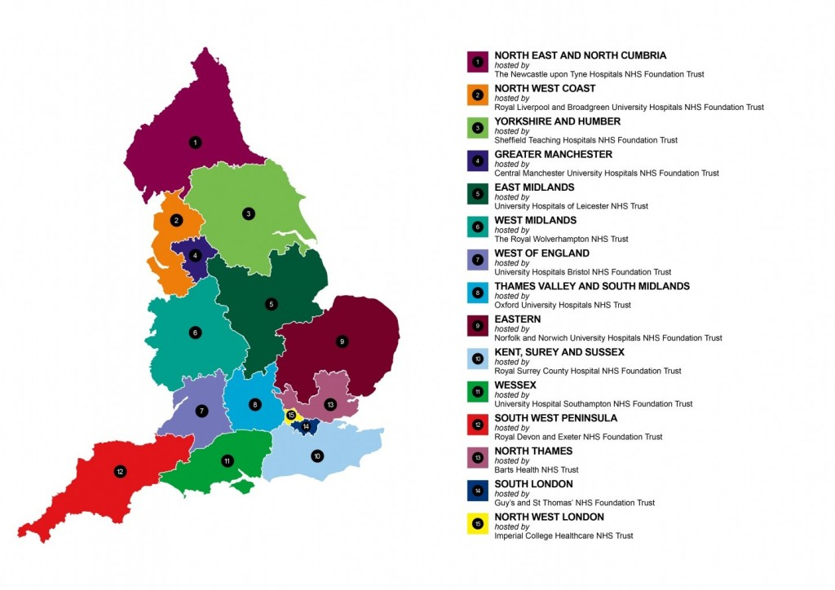
NIHR:15 regional CRNs
Notes:
National Institute for Health Research (NIHR)
Established 2006
Research delivery arm of the NHS
15 regional Clinical Research Networks (CRNs)

Slide 3
CRN West Midlands
CRN has 6 research Divisions.
Injuries & Emergencies is in Division 6.
Division 6 also covers:
Anaesthesia/Perioperative Medicine, Surgery, Critical Care, ENT, ID, Microbiology, Ophthalmology, Respiratory, Gastroenterology & Hepatology.
Division 1: Cancer
Division 5: Primary Care

Slide 4
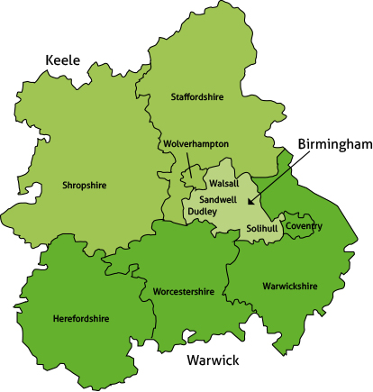
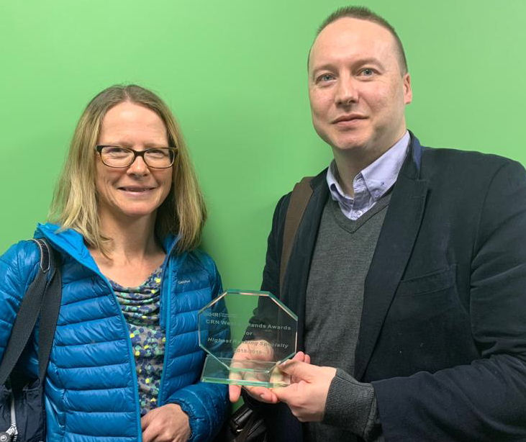
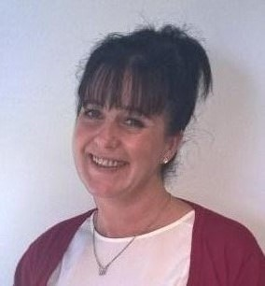
Clinical Research Specialty Lead (CRSL)
& Deputy CRSL for I&E in the
WM CRN
Research Delivery Manager:
Susie Harrison
Research Portfolio Facilitator:
Debbie Peplow

Slide 5
Trauma Research WM CRN 2019
to date this year (April –August 2019):
8 Trusts (10 sites) have recruited to
15 Trauma Research studies
714 patients so far this year

Slide 6
What trauma research is currently being recruited to in our network?
Pre-hospital & ED studies
Trauma studies

Slide 7
Pre-hospital & ED trauma studies
Significant Ankle Ligament Injury (SALI) | 3/10/2016 | 31/12/2019 | 244 | UHCW | 34
 |  |  |  | Warwick | 42
RePHILL Resuscitation with Pre­HospItaL bLood products | 5/12/2016 | 18/1/2020 | 146 | WMAS | 4
 |  |  |  | UHNM | 2
 |  |  |  | UHCW | 12
CRYOSTAT-2 Early cryoprecipitate in major trauma haemorrhage: | 6/7/2017 | 30/6/2020 | 87 | UHNM | 1
 |  |  |  | UHCW | 5
 |  |  |  | UHB | 13
FORCE Forearm fracture Recovery in Children Evaluation | 16/1/2019 | 31/12/2019 | 85 | BCH | 35
 |  |  |  | RWT | 21
 |  |  |  | UHCW | 16
UK REBOA | 1/10/2017 | 30/6/2020 | 5 | UHCW | 2
 |  |  |  | UHB | 0

Slide 8
Does Pre-Hospital Blood Products resuscitation
improve tissue perfusion and
reduce mortality
in trauma patients with haemorrhagic shock compared to current standard practice (crystalloid resuscitation)?
Notes:
*with up to 2 units each of packed red blood cells (PRBC) & lyophilised plasma (LyoPlas N-w)

Slide 9
Early high-dose cryoprecipitate in adult patients with major trauma haemorrhage requiring major haemorrhage protocol (MHP) activation

Slide 10
Clinical & cost-effectiveness of Resuscitative Endovascular Balloon Occlusion of the Aorta (REBOA), in addition to standard MTC treatment, for patients with life-threatening torso haemorrhage.

Slide 11
Orthopaedic Trauma & Burns studies
Short Name | Opened | Closure Date | WM total recruitment | recruiting sites | WM recruitment 2019
World Hip Trauma Evaluation (WHiTE Study) | 11/1/2012 | 31/5/2020 | 3435 | UHNM | 3
 |  |  |  | UHCW | 51
 |  |  |  | SWBH | 26
 |  |  |  | UHB | 58
 |  |  |  | Warwick | 63
WHiTE Five - Main Study | 11/4/2018 | 30/9/2019 | 286 | UHCW | 30
 |  |  |  | UHB | 27
 |  |  |  | Warwick | 43
AIR - Ankle Injury Rehabilitation | 9/10/2017 | 30/9/2019 | 81 | UHCW | 8
ADaPT | 29/3/2019 | 1/4/2020 | 17 | UHB | 17
SIFTI-2 Neutrophil Function & Sepsis in burns | 18/11/2016 | 31/1/2022 | 71 | UHB | 7
ARTISAN Acute rehab after shoulder dislocation | 5/11/2018 | 30/9/2020 | 11 | UHCW | 5
PROFHER-2 | 28/6/2018 | 31/5/2021 | 4 | SWBH | 1
SCIENCE | 21/5/2019 | 31/5/2021 | 1 | UHCW | 1
ACTIVE | 12/3/2018 | 28/2/2021 | 1 | UHNM | 1
The Operative Rib Fixation (ORiF) Study | 21/08/2019 | 31/08/2021 | 0 | QEHB | 0

Slide 12
Some successful trauma studies

Slide 13
Funding Acknowledgement: This project was funded by the National Institute for Health Research [HTA] Department of Health Disclaimer: The views and opinions expressed therein are those of the authors and do not necessarily reflect those of the HTA, NIHR, NHS or the Department of Health.
Notes:
Thank you for listening I will now hand over to Prof Costa to talk about WOLLF

Slide 14
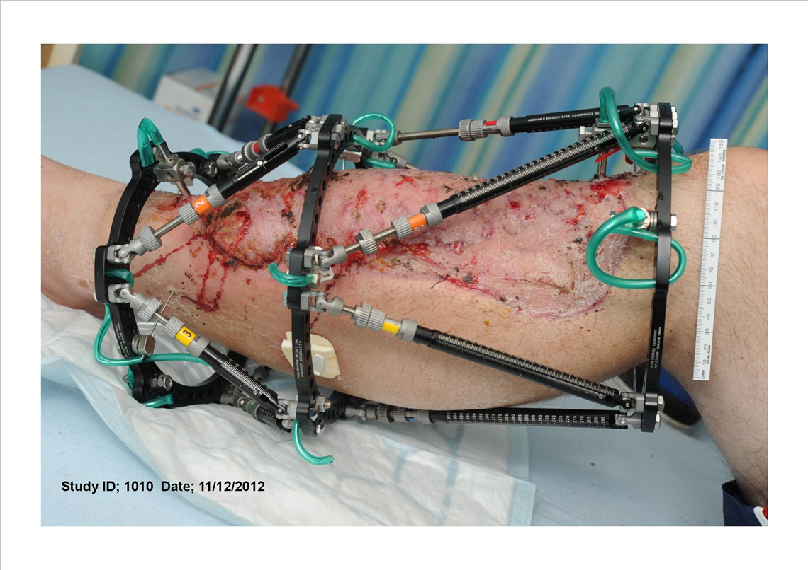
Background – open fracture of the lower limb

Slide 15
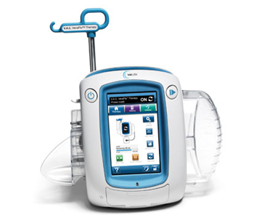
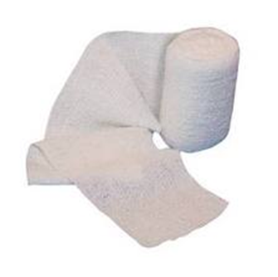
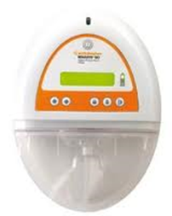
Standard care wound management versus negative pressure wound therapy
NPWT
Standard Dressing
Notes:
NPWT: Median 3 days at pressure 125 mmHg
There was a pressing need to evaluate this relatively expensive technology given the increasing use in clinical practice without a strong supporting evidence base. This multicentre, pragmatic RCT was conducted to compare negative pressure wound therapy with standard dres­sings for patients with wounds associated with open fractures of the lower limb.

Slide 16
Primary Outcome Measure
Disability Rating Index (DRI)
Without difficulty Not at all
Dressing
Out-door walks
Climbing stairs

Slide 17
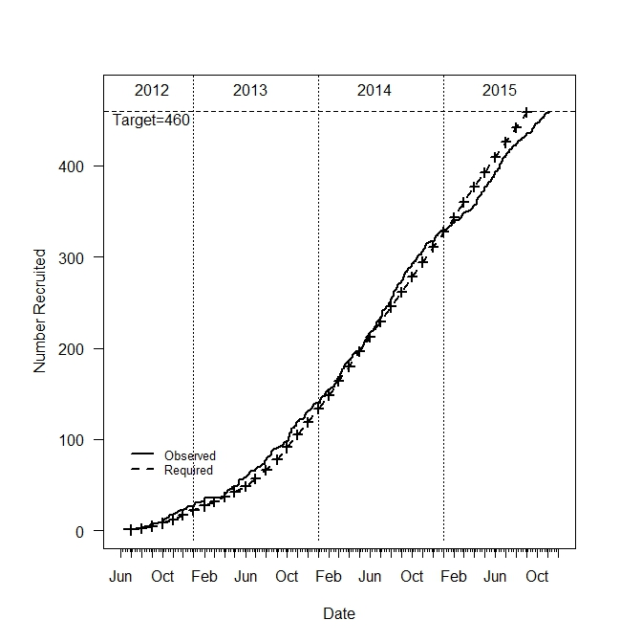
Recruitment (n = 460)
Royal London Hospital (RLH)
Poole Hospital (POH)
Aintree University Hospital (AUH)
Leeds General Infirmary (LGI)
Addenbrookes Hospital, Cambridge (ADH)
University Hospital Southampton (UHS)
Northern General Hospital Sheffield (STH)
Queen Alexandra Hospital (QAH)
Royal Berkshire Hospital (RBH)
Kings College Hospital (KCH)
University Hospital of North Staffordshire (UNS)
Plymouth Hospitals (PLY)
University Hospital Coventry & Warwickshire (UHC)
Norfolk and Norwich University Hospital (NNH)
Queen Elizabeth Hospital, Birmingham (UHB)
Royal Victoria Infirmary (RVI)
Royal Derby Hospital (RDH)
John Radcliffe Hospital (JRH)
Frenchay Hospital (FRH)
Hull Royal Infirmary (HRI)
University Hospital Leicester (UHL)
Nottingham University Hospital (NUH)
Royal Sussex County Hospital, Brighton (RSC)
Morriston Hospital Swansea (MHS)

Slide 18
Consent
Patients consented pre-operatively
Patients who were able to give informed consent preoperatively were approached and recruited by a member of the research team
Patients consented post-operatively
Patients who were unconscious or lacking ability to process information, were recruited under consultee agreement
Notes:
Whole presentation on how we define infections and CDC criteria and photographic assessments.
Julie Bruce is lead this aspect of the work. Will not discuss this in much more detail here.
Resource use led by Ben and Stavros. Again will show main result, but much more to come on this topic.

Slide 19
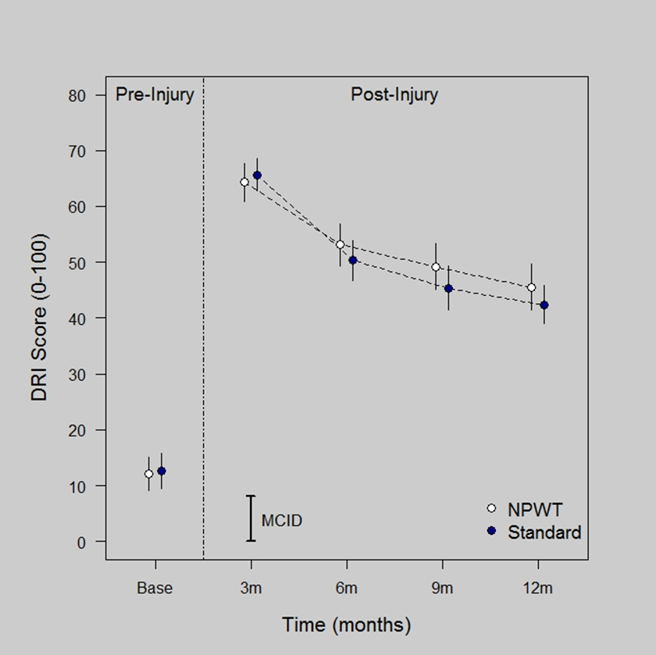
Results

Slide 20
Infection
Deep SSI
In total 35 of the 460 participants (7.6%) deep SSI
16 (7.1%) in NPWT vs 19 (8.1%) in Standard (p = 0.638)
Superficial SSI
In total 68 of the 460 participants (14.8%) had an indication of a superficial SSI
35 (15.5%) in NPWT vs 33 (14.1%) in Standard (p = 0.675)
No evidence of a difference in infection rate

Slide 21
Conclusions
In the context of a national Major Trauma Network, with combined orthoplastic care
Overall infection rate low (7.6%)
Contrary to current UK and international guidelines:
This trial provides no evidence that NPWT provides a clinical or cost benefit for patients with an open fracture of the lower limb

Slide 23
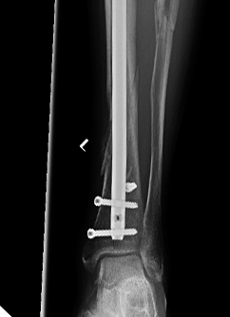
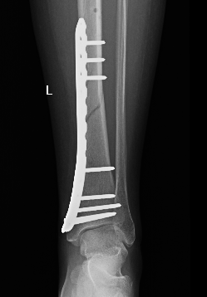
VS

Slide 24
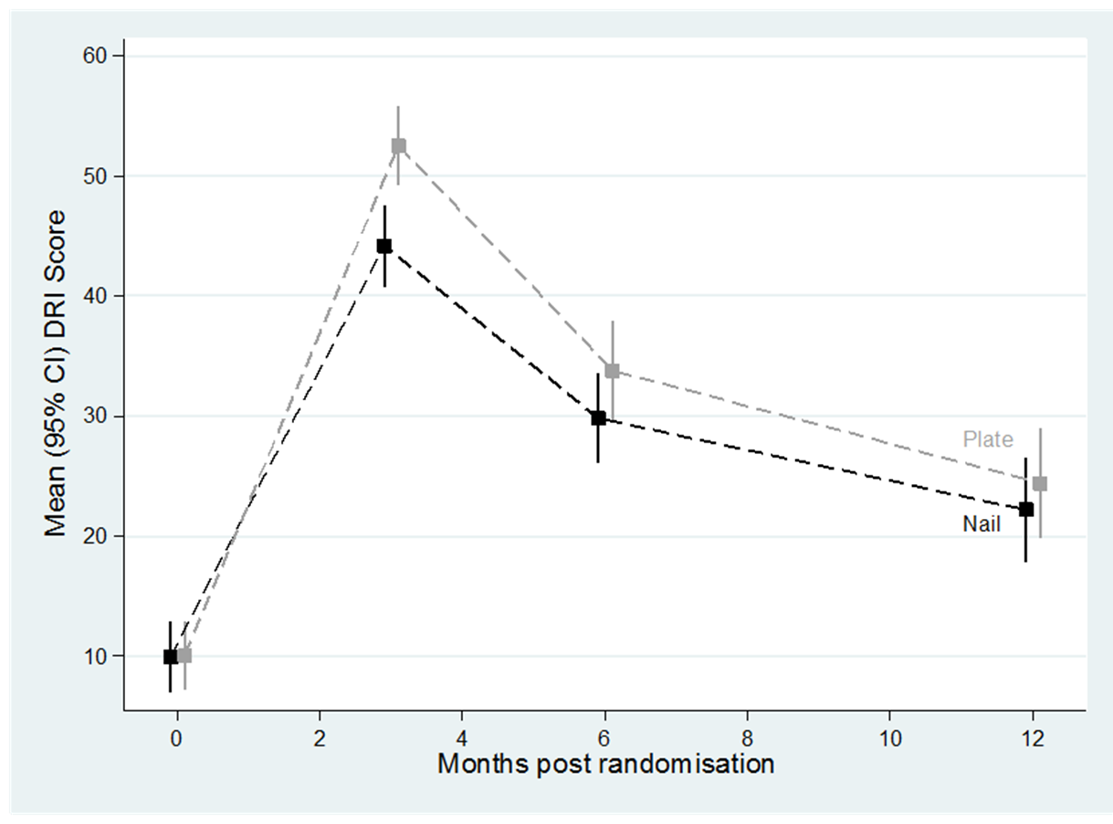
And…

Slide 25
Nail fixation was associated with less disability than locking plate fixation in the 12 months following a fracture of the distal tibia
The difference was statistically significant and clinically important at 3 months (p<0.001), but became less apparent at 6, and there was little difference at 12 months

Slide 26
Results
The same pattern was noted with the secondary outcomes; health-related quality of life and ankle function
The same pattern was noted in patients under 50 years vs those over 50 years

Slide 27
And…
Overall resource use was significantly lower in the nail fixation group
Mostly driven by lower costs during follow-up c.f. initial treatment

Slide 28
So, nail fixation is preferred on both clinical and cost-effectiveness grounds

Slide 29
Interested to find out more...? Need Help...? Got a question...?
CRN West Midlands:
Call 0121 371 8565 or Email studysupport.crnwestmidlands@nihr.ac.uk
Visit our website: https://local.nihr.ac.uk/lcrn/west-midlands/
Follow us on Twitter: @CRN_WMid
CRNWM Injuries & Emergencies Specialty Research Leads:
Jonathan Young Jonathan.Young3@uhcw.nhs.uk
Elaine Hardy Elaine.Hardy2@swft.nhs.uk
CRNWM Injuries & Emergencies Specialty Research Delivery Manager
Susie Harrison susan.harrison@nihr.ac.uk
CRN Injuries & Emergencies National Specialty Lead
Professor Matthew Costa matthew.costa@ndorms.ox.ac.uk
Website:https://www.nihr.ac.uk/explore-nihr/specialties/injuries-and-emergencies.htm
National Institute for Health Research website https://www.nihr.ac.uk/
Discover the latest published research https://discover.dc.nihr.ac.uk/portal/home
Be Part of Research to find Injuries & Emergencies studies in your area http://www.bepartofresearch.co.uk/

Slide 30
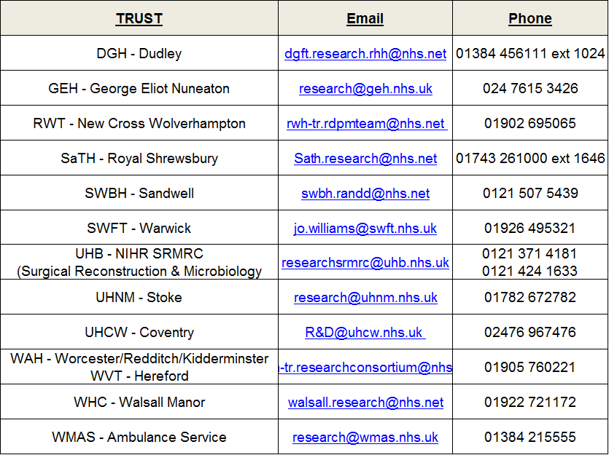
Help from your Trust R&D

