Slide 1
Pharmacology Update 2023
Teresa Knoop, MSN, RN, AOCN®
Nurse Consultant

Slide 2
Disclosures
Speaker Honoraria: ION division AmerisourceBergen, Physicians’ Education Resource, McKesson
Advisory Board Honoraria: Frenesius Kabi

Slide 3
Objectives
Identify new drugs/agents that have been FDA approved for cancer treatment in 2023, as well as notable approvals in 2022.
Recognize how new drugs/agents are given generic (non-proprietary) names.
Identify how to gain information about new drugs based on the generic (non-proprietary) naming system

Slide 4
Progress in Cancer Therapy 2023
  New FDA Approved Cancer Treatment Agents (1/1/2023 to 8/29/23)
    9 drugs : 3 solid tumor indications
    6 hematologic malignancy
      8 Molecularly Targeted/Immunotherapy
      1 Endocrine Receptor Antagonist
      http://www.fda.gov/Drugs/InformationOnDrugs/ApprovedDrugs/ucm279174.htm

Slide 5
Progress in Cancer Therapy 2023
  Additional FDA Approved Cancer Treatment Agent Indications (1/1/2023 to 8/29/2023)
    29 drugs with 15 additional disease indications
      http://www.fda.gov/Drugs/InformationOnDrugs/ApprovedDrugs/ucm279174.htm

Slide 6
Trends

Slide 7
Trends
    Immunotherapy and Molecular Therapies
      Subcutaneous formulations of monoclonal antibodies
      Expanded indications
        Neoadjuvant/adjuvant
        Metastatic and locally advanced treatment
        Maintenance after primary treatment
        New generations of drugs to treat drug resistance
      http://www.fda.gov/Drugs/InformationOnDrugs/ApprovedDrugs/ucm279174.htm

Slide 8
Trends
      Biosimilars
          A biological product that is approved based on a showing that it is highly similar to an already-approved biological product, known as a reference product.
          The biosimilar also must show it has no clinically meaningful differences in terms of safety and effectiveness from the reference product.
          Only minor differences in clinically inactive components are allowable in biosimilar products.
          As of 8/29/23 the number of cancer biosimilars approved by the FDA include:
            10 for cancer supportive care
            12 for cancer treatment
      https://www.fda.gov/drugs/biosimilars/biosimilar-product-information

Slide 9
Trends
    Cellular Gene Therapies
      2017: “The U.S. Food and Drug Administration issued a historic action today making the first gene therapy available in the United States, ushering in a new approach to the treatment of cancer and other serious and life-threatening diseases.”
      6 new therapies FDA approved for cancer treatment since 2017, with expanding indications; more in clinical trials development
      http://www.fda.gov/Drugs/InformationOnDrugs/ApprovedDrugs/ucm279174.htm

Slide 10
Trends
    Adenoviral vector-based gene therapy
      First in class drug approved for high risk Bacillus Calmette-Guerin (BCG) unresponsive non-muscle invasive bladder cancer
      http://www.fda.gov/Drugs/InformationOnDrugs/ApprovedDrugs/ucm279174.htm

Slide 11
Trends
    Tumor Agnostic Drugs
      Drugs designed to treat Biomarkers; not tumor histology specific
      http://www.fda.gov/Drugs/InformationOnDrugs/ApprovedDrugs/ucm279174.htm

Slide 12
Trends
      Bispecific Immunomodulatory Drugs
        Fusion Proteins
        Monoclonal Antibodies
      http://www.fda.gov/Drugs/InformationOnDrugs/ApprovedDrugs/ucm279174.htm

Slide 13
Trends
    Genomic Taxonomy: Use of appropriate terminology to ensure patient safety and quality
      A shift from use of “mutation” to “variant”
        Use of the term “mutation” can cause confusion and medical errors
        DNA sequencing technology has evolved rapidly and can detect multiple types of genomic variations which can be:
          Benign
          Likely benign
          Of uncertain significance
          Likely pathogenic
          Pathogenic (disease causing)
      A shift to “Biomarkers and Biomarker Testing” rather than terms such as molecular, tumor or genomic profiling
      https://www.ons.org/genomics-taxonomy

Slide 14
Progress in Cancer Therapy 2023
    Non-Small Cell Lung Cancer (NSCLC)
      pembrolizumab Keytruda® Merck: adjuvant treatment following resection and platinum-based chemotherapy for stage IB (T2a ≥4 cm), II, or IIIA non-small cell lung cancer (NSCLC) (2023)
      pralsetinib Gavreto® Genentech, Inc: adult patients with metastatic rearranged during transfection (RET) fusion-positive non-small cell lung cancer (NSCLC) (2023)
      http://www.fda.gov/Drugs/InformationOnDrugs/ApprovedDrugs/ucm279174.htm

Slide 15
Of Note 2022: Non-Small Cell Lung Cancer
        Increasing biomarker specific drug approvals for advanced/metastatic NSCLC:
          (MET) exon 14 skipping
          HER2 Mutant
          rearranged during transfection (RET) gene fusion
          KRAS G12C¬-mutated
        First drug approved for HER2-mutant NSCLC
          fam-trastuzumab deruxtecan-nxki Enhertu® Daiichi Sankyo, Inc.: adult patients with unresectable or metastatic non-small cell lung cancer (NSCLC) whose tumors have activating human epidermal growth factor receptor 2 HER2 (ERBB2) mutations, as detected by an FDA-approved test, and who have received a prior systemic therapy. This is the first drug approved for HER2-mutant NSCLC (2022)
      http://www.fda.gov/Drugs/InformationOnDrugs/ApprovedDrugs/ucm279174.htm

Slide 16
Progress in Cancer Therapy 2023
    Breast
      elacestrant Orserdu™ Stemline Therapeutics, Inc.: postmenopausal women or adult men with ER-positive, HER2-negative, ESR1-mutated advanced or metastatic breast cancer with disease progression following at least one line of endocrine therapy (2023)
      abemaciclib Verzenio® Eli Lilly and Company with endocrine therapy (tamoxifen or an aromatase inhibitor): adjuvant treatment of adult patients with hormone receptor (HR)-positive, human epidermal growth factor receptor 2 (HER2)-negative, node-positive, early breast cancer at high risk of recurrence (2023)
      sacituzumab govitecan-hziy Trodelvy® Gilead Sciences, Inc.: unresectable locally advanced or metastatic hormone receptor (HR)-positive, human epidermal growth factor receptor 2 (HER2)-negative (IHC 0, IHC 1+ or IHC 2+/ISH-) breast cancer who have received endocrine-based therapy and at least two additional systemic therapies in the metastatic setting (2023)
      http://www.fda.gov/Drugs/InformationOnDrugs/ApprovedDrugs/ucm279174.htm

Slide 17
Of Note 2022: Breast Cancer
        fam-trastuzumab deruxtecan-nxki Enhertu® received 2 approvals with 1 being:
          adult patients with unresectable or metastatic HER2-low (IHC 1+ or IHC 2+/ISH‑) breast cancer who have received a prior chemotherapy in the metastatic setting or developed disease recurrence during or within six months of completing adjuvant chemotherapy
          Offers a new option for HER2-low metastatic/recurrent breast cancer
      http://www.fda.gov/Drugs/InformationOnDrugs/ApprovedDrugs/ucm279174.htm

Slide 18
Progress in Cancer Therapy 2023
    Urothelial Carcinoma
      enfortumab vedotin-ejfv Padcev® Astellas Pharma with pembrolizumab Keytruda® Merck: patients with locally advanced or metastatic urothelial carcinoma who are ineligible for cisplatin-containing chemotherapy (2023)
      http://www.fda.gov/Drugs/InformationOnDrugs/ApprovedDrugs/ucm279174.htm

Slide 19
Of Note 2022: Bladder Cancer
        Non-Muscle Invasive Bladder Cancer
          nadofaragene firadenovec-vncg Adstiladrin® Ferring Pharmaceuticals: adult patients with high-risk Bacillus Calmette-Guérin (BCG) unresponsive non-muscle invasive bladder cancer (NMIBC) with carcinoma in situ (CIS) with or without papillary tumors (2022)
      http://www.fda.gov/Drugs/InformationOnDrugs/ApprovedDrugs/ucm279174.htm

Slide 20
Progress in Cancer Therapy 2023
    Endometrial
      dostarlimab-gxly Jemperli, GlaxoSmithKline LLC: adult patients with mismatch repair deficient (dMMR) recurrent or advanced endometrial cancer, as determined by an FDA-approved test, that has progressed on or following a prior platinum-containing regimen in any setting and are not candidates for curative surgery or radiation (2023)
      dostarlimab-gxly Jemperli, GlaxoSmithKline: with carboplatin and paclitaxel, followed by single-agent dostarlimab-gxly, for primary advanced or recurrent endometrial cancer (EC) that is mismatch repair deficient (dMMR), or microsatellite instability-high (MSI-H) (2023)
      http://www.fda.gov/Drugs/InformationOnDrugs/ApprovedDrugs/ucm279174.htm

Slide 21
Progress in Cancer Therapy 2023
    Colorectal
        tucatinib Tukysa® Seagen Inc. in combination with trastuzumab: RAS wild-type HER2-positive unresectable or metastatic colorectal cancer that has progressed following fluoropyrimidine-, oxaliplatin-, and irinotecan-based chemotherapy (2023)
        trifluridine and tipiracil LONSURF® Taiho Oncology, Inc.: combined with bevacizumab, for metastatic colorectal cancer (mCRC) previously treated with fluoropyrimidine-, oxaliplatin- and irinotecan-based chemotherapy, an anti-VEGF biological therapy, and if RAS wild-type, an anti-EGFR therapy (2023)
      http://www.fda.gov/Drugs/InformationOnDrugs/ApprovedDrugs/ucm279174.htm

Slide 22
Progress in Cancer Therapy 2023
        Glioblastoma
          dabrafenib Tafinlar® Novartis with trametinib Mekinist® Novartis: pediatric patients 1 year of age and older with low-grade glioma (LGG) with a BRAF V600E mutation who require systemic therapy. The FDA also approved new oral formulations of both drugs suitable for patients who cannot swallow pills (2023)
        Merkel Cell carcinoma
          retifanlimab-dlwr Zynyz® Incyte Corporation: adult patients with metastatic or recurrent locally advanced Merkel cell carcinoma (MCC) (2023)
      http://www.fda.gov/Drugs/InformationOnDrugs/ApprovedDrugs/ucm279174.htm

Slide 23
Progress in Cancer Therapy 2023
        Prostate
          olaparib Lynparza® AstraZeneca Pharmaceuticals LP: combined with abiraterone and prednisone (or prednisolone) for adult patients with deleterious or suspected deleterious BRCA-mutated (BRCAm) metastatic castration-resistant prostate cancer (mCRPC) (2023)
          talazoparib Talzenna® Pfizer, Inc.: combined with enzalutamide for homologous recombination repair (HRR) gene-mutated metastatic castration-resistant prostate cancer (mCRPC) (2023)
          niraparib and abiraterone acetate Akeega™, Janssen Biotech, Inc.: with prednisone: adult patients with deleterious or suspected deleterious BRCA-mutated castration-resistant prostate cancer (mCRPC) (2023)
      http://www.fda.gov/Drugs/InformationOnDrugs/ApprovedDrugs/ucm279174.htm

Slide 24
Progress in Cancer Therapy 2023
    Melanoma
      HEPZATO KIT (melphalan for Injection/Hepatic Delivery System) containing melphalan (HEPZATO, Delcath Systems, Inc.) as a liver-directed treatment for adult patients with uveal melanoma with unresectable hepatic metastases affecting less than 50% of the liver and no extrahepatic disease, or extrahepatic disease limited to the bone, lymph nodes, subcutaneous tissues, or lung that is amenable to resection or radiation (2023)
      http://www.fda.gov/Drugs/InformationOnDrugs/ApprovedDrugs/ucm279174.htm

Slide 25
Of Note: Tumor Agnostic Drugs 2022
        Offer treatment options based on Biomarkers in any type of advanced cancer in which the biomarker is discovered. Potential treatment options when others may have been exhausted.
      alpelisib Vijoice® Novartis Pharmaceuticals: adult and pediatric patients two years of age and older with severe manifestations of PIK3CA-related overgrowth spectrum (PROS) who require systemic therapy (2022)
      dabrafenib Tafinlar® Novartis in combination with trametinib Mekinist® Novartis: for the treatment of adult and pediatric patients ≥ 6 years of age with unresectable or metastatic solid tumors with BRAF V600E mutation who have progressed following prior treatment and have no satisfactory alternative treatment options (2022)
      selpercatinib Retevmo™ Eli Lilly and Company: adult patients with locally advanced or metastatic solid tumors with a rearranged during transfection (RET) gene fusion that have progressed on or following prior systemic treatment or who have no satisfactory alternative treatment options (2022)
      http://www.fda.gov/Drugs/InformationOnDrugs/ApprovedDrugs/ucm279174.htm

Slide 26
Progress in Cancer Therapy 2023
    Mantle Cell Lymphoma
      pirtobrutinib Jaypirca™ Eli Lilly and Company: relapsed or refractory mantle cell lymphoma (MCL) after at least two lines of systemic therapy, including a BTK inhibitor (2023)
    Acute Myeloid Leukemia
      quizartinib Vanflyta® Daiichi Sankyo, Inc.: combined with standard cytarabine and anthracycline induction and cytarabine consolidation, and as maintenance monotherapy following consolidation chemotherapy, for the treatment of adult patients with newly diagnosed acute myeloid leukemia (AML) that is FLT3 internal tandem duplication (ITD)-positive (2023)
    Chronic Lymphocytic Leukemia or Small Lymphocytic Leukemia
      zanubrutinib Brukinsa® BeiGene USA, Inc.: for chronic lymphocytic leukemia (CLL) or small lymphocytic lymphoma (SLL) (2023)
      http://www.fda.gov/Drugs/InformationOnDrugs/ApprovedDrugs/ucm279174.htm

Slide 27
Progress in Cancer Therapy 2023
    Large B-Cell lymphoma (DLBCL)
      polatuzumab vedotin-piiq Polivy® Genentech, Inc. with a rituximab product, cyclophosphamide, doxorubicin, and prednisone (R-CHP): adult patients who have previously untreated diffuse large B-cell lymphoma (DLBCL), not otherwise specified (NOS), or high-grade B-cell lymphoma (HGBL) and who have an International Prognostic Index (IPI) score of 2 or greater (2023)
      epcoritamab-bysp Epkinly™ Genmab US, Inc.: relapsed or refractory diffuse large B-cell lymphoma (DLBCL) not otherwise specified, including DLBCL arising from indolent lymphoma, and high-grade B-cell lymphoma after two or more lines of systemic therapy (2023)
      glofitamab-gxbm Columvi™ Genentech, Inc.: for relapsed or refractory diffuse large B-cell lymphoma, not otherwise specified (DLBCL, NOS) or large B-cell lymphoma (LBCL) arising from follicular lymphoma, after two or more lines of systemic therapy (2023)
      http://www.fda.gov/Drugs/InformationOnDrugs/ApprovedDrugs/ucm279174.htm

Slide 28
Progress in Cancer Therapy 2023
    Multiple Myeloma
      talquetamab-tgvs Talvey™ Janssen Biotech, Inc.: adults with relapsed or refractory multiple myeloma who have received at least four prior lines of therapy, including a proteasome inhibitor, an immunomodulatory agent, and an anti-CD38 monoclonal antibody (2023)
      elranatamab-bcmm Elrexfio™ Pfizer, Inc.: a bispecific B-cell maturation antigen (BCMA)-directed CD3 T-cell engager, for adults with relapsed or refractory multiple myeloma who have received at least four prior lines of therapy, including a proteasome inhibitor, an immunomodulatory agent, and an anti-CD38 monoclonal antibody (2023)
      http://www.fda.gov/Drugs/InformationOnDrugs/ApprovedDrugs/ucm279174.htm

Slide 29
Tips for Learning about
New Cancer Therapies
Know the type of drug/agent
  Small molecule, monoclonal antibody, cellular gene therapy, vaccine, cytotoxic, fusion protein
Know the generic (non-proprietary) name
Know the target and what is does normally in the body/what other FDA approved drugs are similar
Know if the drug is genomically specific to an actionable variant and if biomarker testing is needed before administration

Slide 30
I know the generic name; but how do I pronounce it and how do I learn more??
http://www.cancer.gov/dictionary
http://www.mycancergenome.org/content/molecular- medicine/overview-of-targeted-therapies-for-cancer/

Slide 31
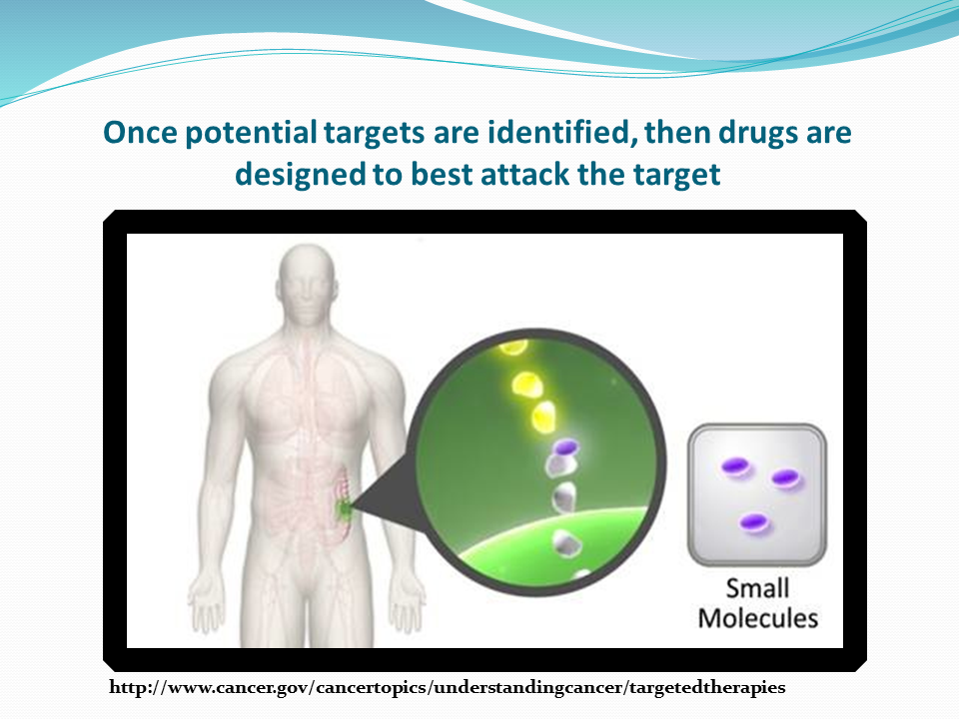

Slide 32
Small Molecules
Majority are oral, although a few are IV or subcutaneous
Implications for orals:
  Adherence
  Possible drug/food , drug/drug interactions
  Patient education regarding taking medication correctly
Targets vary and side effects are related to targets
https://www.ama-assn.org/about/united-states-adopted-names/united-states-adopted-names-naming-guidelines

Slide 33
Of Note: Small Molecules
        Only 3 new small molecules for cancer treatment
        approved by the FDA thus far in 2023 ( 4 in 2022)
      http://www.fda.gov/Drugs/InformationOnDrugs/ApprovedDrugs/ucm279174.htm

Slide 34
Small Molecules Naming Conventions
tinibs:
  kinase inhibitors
    erlotinib, sunitinib, ponatinib, imatinib, dasatinib, ruxolitinib, dacomitinib, lorlatinib, larotrectinib, gilteritinib, neratinib, erdafitinib, pexidartinib, fedratinib, entrectinib, avapritinib, tucatinib, pemigatinib, ripretinib, selpercatinib, pralsetinib, cabozantinib, tepotinib, infigratinib, mobocertinib , pacritinib, futibatinib, quizartinib
paribs
  parp inhibitors
    niraparib with abiraterone
brutinib
  bruton’s kinase inhibitor
    pirtobrutinib
https://www.ama-assn.org/about/united-states-adopted-names/united-states-adopted-names-naming-guidelines

Slide 35
      pirtobrutinib Jaypirca™ Eli Lilly and Company: relapsed or refractory mantle cell lymphoma (MCL) after at least two lines of systemic therapy, including a BTK inhibitor (2023)
www.jaypirca.com

Slide 36
pirtobrutinib Jaypirca™
      pirtobrutinib Jaypirca™ Eli Lilly and Company: relapsed or refractory mantle cell lymphoma (MCL) after at least two lines of systemic therapy, including a BTK inhibitor (2023)
        Oral kinase inhibitor; small molecule
        Drug interactions with strong CYP3A inhibitors; strong or moderate CYP3A inducers; sensitive CYP2C8, CYP2C19, CYP3A, P-gp, or BCRP substrates
        Targets Bruton’s tyrosine kinase (BTK)
        No Biomarker testing needed prior to administration
        Side effects: fatigue, musculoskeletal pain, diarrhea, edema, dyspnea, pneumonia, and bruising, infections, hemorrhage, cytopenias, atrial fibrillation, atrial flutter, second primary malignancies.
www.jaypirca.com

Slide 37
      quizartinib Vanflyta® Daiichi Sankyo, Inc.: combined with standard cytarabine and anthracycline induction and cytarabine consolidation, and as maintenance monotherapy following consolidation chemotherapy, for the treatment of adult patients with newly diagnosed acute myeloid leukemia (AML) that is FLT3 internal tandem duplication (ITD)-positive (2023)
www.vanflyta.com

Slide 38
quizartinib Vanflyta®
      quizartinib Vanflyta® Daiichi Sankyo, Inc.: combined with standard cytarabine and anthracycline induction and cytarabine consolidation, and as maintenance monotherapy following consolidation chemotherapy, for the treatment of adult patients with newly diagnosed acute myeloid leukemia (AML) that is FLT3 internal tandem duplication (ITD)-positive (2023)
        Oral kinase inhibitor; small molecule
        Drug interactions with strong CYP3A inhibitors; strong or moderate CYP3A inducers; Contraindicated with severe hypokalemia, severe hypomagnesemia, long QT syndrome, or pts with a history of ventricular arrhythmias or torsades de pointes
        Targets FLT-3 internal tandem duplication
        Biomarker testing needed prior to administration
        Side effects: QT prolongation, torsades de pointes, cardiac arrest, decreased lymphocytes, potassium, albumin, phosphorus, alkaline phosphatase, magnesium, calcium ; febrile neutropenia, diarrhea, mucositis, nausea, abdominal pain, sepsis, neutropenia, headache, creatine phosphokinase increased, vomiting, and upper respiratory tract infection
www.vanflyta.com

Slide 39
      niraparib and abiraterone acetate Akeega™, Janssen Biotech, Inc.: with prednisone: adult patients with deleterious or suspected deleterious BRCA-mutated castration-resistant prostate cancer (mCRPC) (2023)
www.akeega.com

Slide 40
niraparib and abiraterone acetate Akeega™
      niraparib and abiraterone acetate Akeega™, Janssen Biotech, Inc.: with prednisone: adult patients with deleterious or suspected deleterious BRCA-mutated castration-resistant prostate cancer (mCRPC) (2023)
        Niraparib, oral PARP inhibitor, combined with abiraterone , a CYp17 inhibitor; small molecule
        Drug interactions with strong CYP3A inhibitors; CYP2D6 substrates
        Targets prostate cancer with deleterious or suspected deleterious BRCA-mutations
        Biomarker testing needed prior to administration
        Side effects: hepatotoxicity, adrenocortical insufficiency, hypoglycemia, decreased hemoglobin, lymphocytes, white blood cells, platelets, neutrophils, potassium; constipation, hypertension, nausea, increased creatinine, AST, ALT, alkaline phosphatase; musculoskeletal pain, fatigue edema, dyspnea, decreased appetite, vomiting, dizziness, COVID-19, headache, abdominal pain, hemorrhage, urinary tract infection, cough, insomnia, increased bilirubin, weight decreased, arrhythmia, fall, and pyrexia. PRES, MDS/AML.
www.akeega.com

Slide 41
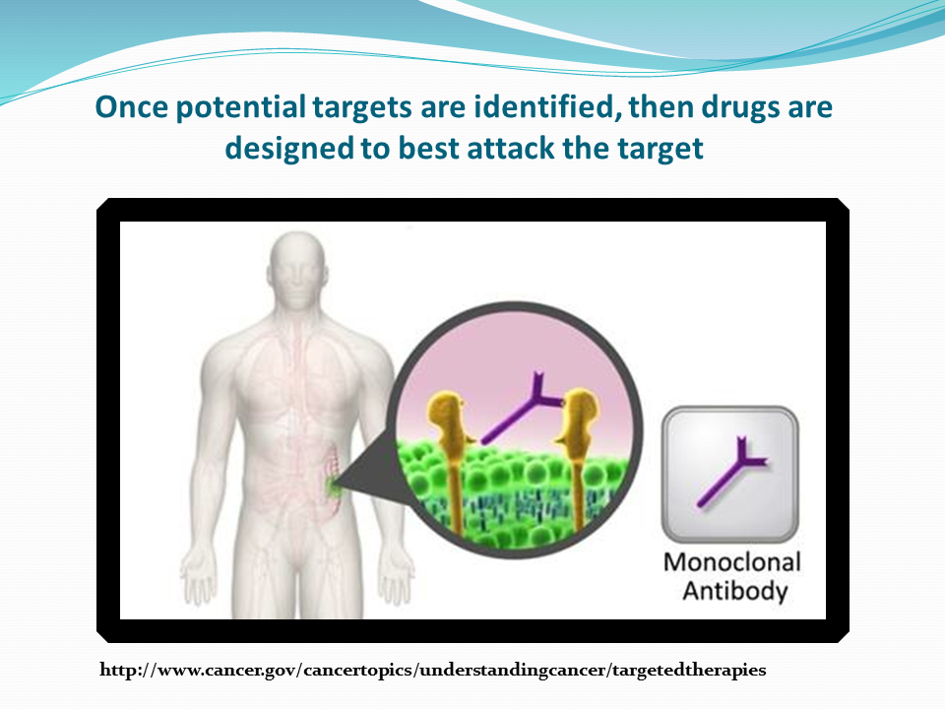

Slide 42
Monoclonal Antibody Naming Conventions
Monoclonal antibody = mab
tositumomab and iodine 131
  mo = mouse
rituximab
  xi = chimeric or cross between mouse and human
trastuzumab, bevacizumab
  zu = humanized
panitumumab
  u = fully human (may also leave out the u)
Decision recently made to eliminate the source inflix
https://www.ama-assn.org/about/united-states-adopted-names/united-states-adopted-names-naming-guidelines

Slide 43
What does the name mean?
t , ta, or tu = tumor
trastuzumab
ci = circulatory
bevacizumab
li or l = immunomodulator
ipilimumab
https://www.ama-assn.org/about/united-states-adopted-names/united-states-adopted-names-naming-guidelines

Slide 44
What does the name mean?
One or two words added to name indicates it is a conjugated monoclonal antibody. May be combined with:
  Radioactive particle: ibritumomab tiuxetan
  Drug (antibody-drug conjugate): ado-trastuzumab emtansine
Two words joined by “plus” or “and” indicates the combination of monoclonal antibody and a second agents
  daratumumab plus hyaluronidase
https://www.ama-assn.org/about/united-states-adopted-names/united-states-adopted-names-naming-guidelines

Slide 45
What does the name mean?
In 2017, the FDA made the decision to name all new biologics (not just biosimilars) with“4 lower case letters devoid of meaning” attached by a hyphen as a suffix:
  There was concern that the suffix on biosimilars would serve as a barrier to their use; creating a misimpression that they were inferior to the reference (originator) products
  Resulted in the FDA deciding to attached the suffix to all new biologics; not just biosimilars
  Change in naming advances patient safety and creates a high quality, competitive market
  FDA does not intend to modify the proper names of biological products that have already been licensed or approved under the Public Health Service Act without an FDA-designated suffix in their proper names.
https://www.ama-assn.org/about/united-states-adopted-names/united-states-adopted-names-naming-guidelines

Slide 46
      retifanlimab-dlwr Zynyz® Incyte Corporation: adult patients with metastatic or recurrent locally advanced Merkel cell carcinoma (MCC) (2023)
www.Zynyz.com

Slide 47
retifanlimab-dlwr Zynyz®
      retifanlimab-dlwr Zynyz® Incyte Corporation: adult patients with metastatic or recurrent locally advanced Merkel cell carcinoma (MCC) (2023)
        Monoclonal antibody targeting the immune system
        Infusion related reactions and serious immune related adverse events
        Targets Programmed death receptor-1 (PD-1)
        Side effects: Immune related adverse events, fatigue, musculoskeletal pain, pruritus, diarrhea, rash, pyrexia, nausea, complications of allogeneic HSCT
www.zynyz.com

Slide 48
Bispecific Immunomodulatory Drugs
      Monoclonal Antibodies
      Fusion Proteins

Slide 49
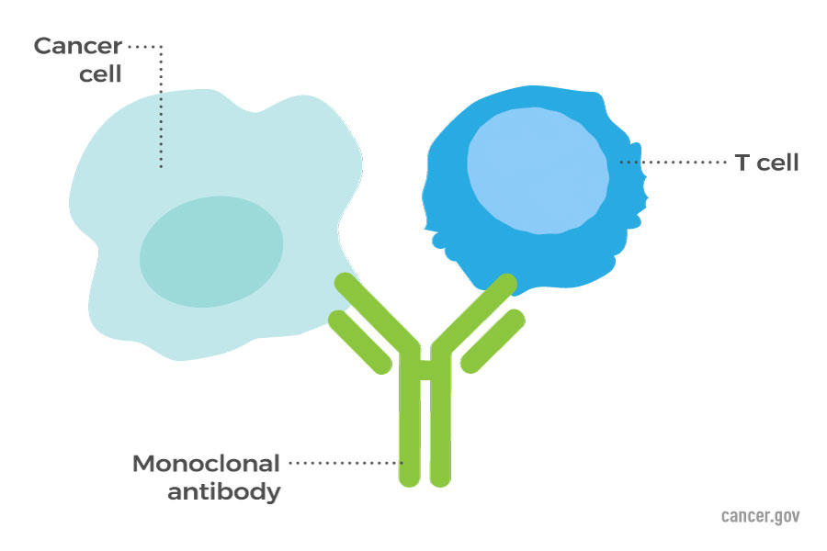
Types of Immune Therapy: Bispecific T Cell Engagers (BiTEs)
Monoclonal antibodies: May bring T-cells close to cancer cells, helping the immune system kill the cells
https://www.cancer.gov/about-cancer/treatment/types/immunotherapy

Slide 50
      epcoritamab-bysp Epkinly™ Genmab US, Inc.: relapsed or refractory diffuse large B-cell lymphoma (DLBCL) not otherwise specified, including DLBCL arising from indolent lymphoma, and high-grade B-cell lymphoma after two or more lines of systemic therapy (2023)
www.epkinly.com

Slide 51
epcoritamab-bysp Epkinly™
      epcoritamab-bysp Epkinly™ Genmab US, Inc.: relapsed or refractory diffuse large B-cell lymphoma (DLBCL) not otherwise specified, including DLBCL arising from indolent lymphoma, and high-grade B-cell lymphoma after two or more lines of systemic therapy (2023)
        Bispecific monoclonal antibody ; subcutaneous
        Premedicate for potential cytokine release syndrome (CRS) and monitor for immune effector associated neurotoxicity syndrome (ICANS)
        Target: CD20 directed CD3 T-cell engager
        Side effects: CRS, ICANS, infections, cytopenias, fatigue, musculoskeletal pain, injection site reactions, pyrexia, abdominal pain, nausea, and diarrhea.
www.epkinly.com

Slide 52
      glofitamab-gxbm Columvi™ Genentech, Inc.: for relapsed or refractory diffuse large B-cell lymphoma, not otherwise specified (DLBCL, NOS) or large B-cell lymphoma (LBCL) arising from follicular lymphoma, after two or more lines of systemic therapy (2023)
www.columvi.com

Slide 53
glofitamab-gxbm Columvi™
      glofitamab-gxbm Columvi™ Genentech, Inc.: for relapsed or refractory diffuse large B-cell lymphoma, not otherwise specified (DLBCL, NOS) or large B-cell lymphoma (LBCL) arising from follicular lymphoma, after two or more lines of systemic therapy (2023)
        Bispecific monoclonal antibody ; intravenous
        Premedicate for potential cytokine release syndrome (CRS) and monitor for immune effector associated neurotoxicity syndrome (ICANS). Pretreat with Obinutuzumab IN 7 days before initiation.
        Target: CD20 directed CD3 T-cell engager
        Side effects: cytokine release syndrome, neurologic toxicity, serious infections, tumor flare, musculoskeletal pain, rash, and fatigue. lymphocyte count decreased, phosphate decreased, neutrophil count decreased, uric acid increased, and fibrinogen decreased.
www.columvi.com

Slide 54
      talquetamab-tgvs Talvey™ Janssen Biotech, Inc.: adults with relapsed or refractory multiple myeloma who have received at least four prior lines of therapy, including a proteasome inhibitor, an immunomodulatory agent, and an anti-CD38 monoclonal antibody (2023)
www.talvey.com

Slide 55
talquetamab-tgvs Talvey™
      talquetamab-tgvs Talvey™ Janssen Biotech, Inc.: adults with relapsed or refractory multiple myeloma who have received at least four prior lines of therapy, including a proteasome inhibitor, an immunomodulatory agent, and an anti-CD38 monoclonal antibody (2023)
        Bispecific monoclonal antibody; targets in immune system and tumor; subcutaneous
        Premedicate for potential cytokine release syndrome (CRS) and monitor for immune effector associated neurotoxicity syndrome (ICANS).
        Targets GPRC5D and CD3 T-cell receptor
        Side effects: cytokine release syndrome, neurotoxicity, oral toxicity and weight loss, infections, cytopenias, skin toxicity, hepatotoxicity, pyrexia, CRS, dysgeusia, nail disorder, musculoskeletal pain, rash, fatigue,, dry mouth, xerosis, dysphagia, upper respiratory tract infection, diarrhea, hypotension, and headache. Available through REMS program.
www.talvey.com

Slide 56
      elranatamab-bcmm Elrexfio™ Pfizer, Inc.: a bispecific B-cell maturation antigen (BCMA)-directed CD3 T-cell engager, for adults with relapsed or refractory multiple myeloma who have received at least four prior lines of therapy, including a proteasome inhibitor, an immunomodulatory agent, and an anti-CD38 monoclonal antibody (2023)
www.elrexfio.com

Slide 57
elranatamab-bcmm Elrexfio™
      elranatamab-bcmm Elrexfio™ Pfizer, Inc.: a bispecific B-cell maturation antigen (BCMA)-directed CD3 T-cell engager, for adults with relapsed or refractory multiple myeloma who have received at least four prior lines of therapy, including a proteasome inhibitor, an immunomodulatory agent, and an anti-CD38 monoclonal antibody (2023)
        Bispecific monoclonal antibody; targets in immune system and tumor; subcutaneous
        Premedicate for potential cytokine release syndrome (CRS) and monitor for immune effector associated neurotoxicity syndrome (ICANS).
        Targets B-cell maturation antigen (BCMA) and CD3 T-cell receptor
        Side effects: CRS, neurotoxicity, hepatotoxicity, infections, fatigue, injection site reaction, diarrhea, upper respiratory tract infection, musculoskeletal pain, pneumonia, decreased appetite, rash, cough, nausea, and pyrexia. Decreased lymphocytes, neutrophils, hemoglobin, white blood cells, and platelets. Available through REMS program.
www.elrexfio.com

Slide 58
      tebentafusp-tebn Kimmtrak® Immunocore Limited: a bispecific gp100 peptide-HLA-directed CD3 T cell engager, for HLA-A*02:01-positive adult patients with unresectable or metastatic uveal melanoma (2022)
www.kimmtrak.com

Slide 59
tebentafusp-tebn Kimmtrak®
      tebentafusp-tebn Kimmtrak® Immunocore Limited: a bispecific gp100 peptide-HLA-directed CD3 T cell engager, for HLA-A*02:01-positive adult patients with unresectable or metastatic uveal melanoma (2022)
        Bispecific T cell engager; fusion protein
        Gp100 peptide HLA directed CD3 T cell engager
        Potential for cytokine release syndrome; monitor for at least 16 hours following first 3 infusions and then as clinically indicated
        Biomarker testing needed prior to administration
        Side effects: cytokine release syndrome, rash, pyrexia, pruritus, fatigue, nausea, chills, abdominal pain, edema, hypotension, dry skin, headache, vomiting. decreased lymphocyte count, increased creatinine, increased glucose, increased aspartate aminotransferase, increased alanine aminotransferase, decreased hemoglobin, and decreased phosphate
www.kimmtrak.com

Slide 60
Living Drugs/ Genetically
Engineered Cells

Slide 61
leucel
Cellular therapies; “living drugs”; immune effector cells
Intravenous; currently must be given at approved centers
Precision: Cells from patient, genetically engineered and given back to pt
Examples
  sipuleucel-T, tisagenlecleucel, axicabtagene ciloleucel, brexucabtagene autoleucel, lisocabtagene maraleucel, idecabtagene vicleucel, ciltacabtagene autoleucel
https://www.ama-assn.org/about/united-states-adopted-names/united-states-adopted-names-naming-guidelines

Slide 62
Adenoviral Vector-Based Gene Therapy

Slide 63
      nadofaragene firadenovec-vncg Adstiladrin® Ferring Pharmaceuticals: adult patients with high-risk Bacillus Calmette-Guérin (BCG) unresponsive non-muscle invasive bladder cancer (NMIBC) with carcinoma in situ (CIS) with or without papillary tumors (2022)
https://www.fda.gov/vaccines-blood-biologics/cellular-gene-therapy-products/adstiladrin

Slide 64
nadofaragene firadenovec-vncg Adstiladrin®
      nadofaragene firadenovec-vncg Adstiladrin® Ferring Pharmaceuticals: adult patients with high-risk Bacillus Calmette-Guérin (BCG) unresponsive non-muscle invasive bladder cancer (NMIBC) with carcinoma in situ (CIS) with or without papillary tumors (2022)
        Intravesical
        Non-replicating adenoviral vector-based gene therapy
        Pre-medication with an anticholinergic advised; contraindicated in pts with hypersensitivity to interferon alfa or any component
        No Biomarker testing needed prior to administration
        Side effects: glucose increased, instillation site discharge, triglycerides increased, fatigue, bladder spasm, micturition, creatinine increased, hematuria , phosphate decreased, chills, pyrexia, and dysuria. Risk of disseminated adenovirus infection in persons immunocompromised or immunodeficient.
https://www.fda.gov/vaccines-blood-biologics/cellular-gene-therapy-products/adstiladrin

Slide 65
Estrogen Receptor Antagonist

Slide 66
    elacestrant Orserdu™ Stemline Therapeutics, Inc.: postmenopausal women or adult men with ER-positive, HER2-negative, ESR1-mutated advanced or metastatic breast cancer with disease progression following at least one line of endocrine therapy (2023)
www.orserdu.com

Slide 67
elacestrant Orserdu™
    elacestrant Orserdu™ Stemline Therapeutics, Inc.: postmenopausal women or adult men with ER-positive, HER2-negative, ESR1-mutated advanced or metastatic breast cancer with disease progression following at least one line of endocrine therapy (2023)
        Oral estrogen receptor antagonist
        Drug interactions with strong and moderate CYP3A4 inducers and inhibitors
        Biomarker testing needed prior to administration: ER, HER2 and ESR-1
        Side effects: dyslipidemia, musculoskeletal pain, nausea, increased cholesterol, increased AST, increased triglycerides, fatigue, decreased hemoglobin, vomiting, increased ALT, decreased sodium, increased creatinine, decreased appetite, diarrhea, headache, constipation, abdominal pain, hot flush, and dyspepsia
www.orserdu.com

Slide 68


Slide 69


Slide 70
References
https://www.ama-assn.org/about/united-states-adopted-names/united-states-adopted-names-naming-guidelines
http://www.cancer.gov/cancertopics/understandingcancer/targetedtherapies
http://www.cancer.gov/dictionary
http://www.fda.gov/Drugs/InformationOnDrugs/ApprovedDrugs/ucm279174. htm
http://www.mycancergenome.org
https://www.ons.org/genomics-taxonomy
https://www.fda.gov/drugs/biosimilars/biosimilar-product-information
Search proprietary or non proprietary name of any drug to reach the web site dedicated to that drug. Prescribing information will be available on each web site.

