Slide 1

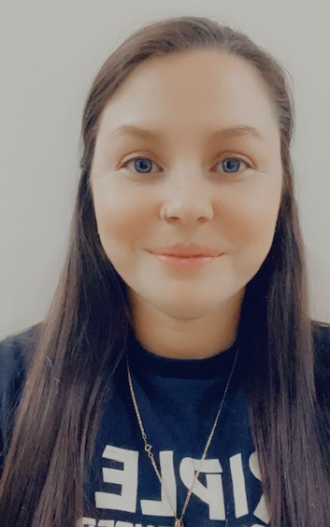

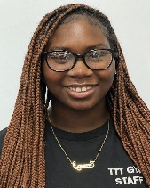
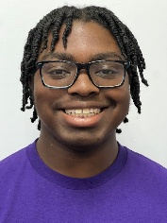
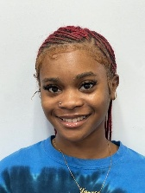

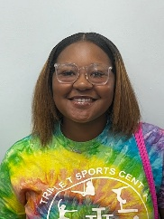


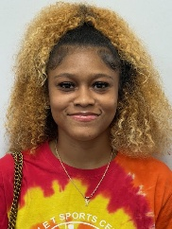
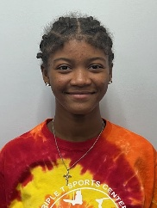

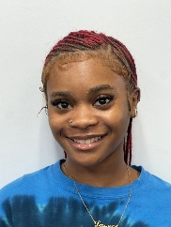
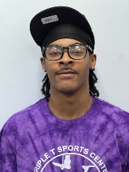

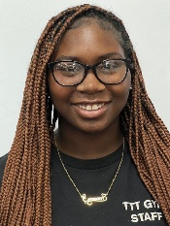
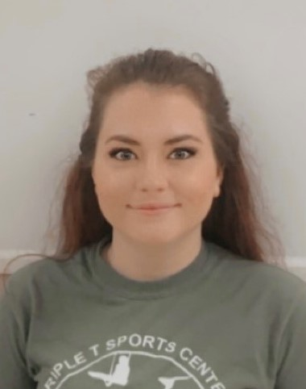
Triple T’s Amazing Staff
Kaitlyn Sabatino
Facility Manager
Breionna Goodman
Rec Director
Cheryl Burks: Business Manager/Owner
Recreational Gymnastics Instructors
Childcare Staff
Grace Sims
Recreational, Adv, Int, Ninja Instructor
Taekwondo / Ninja
Jacy Keith
Lead Teacher
Alicia Brown
Preschool Lead Teacher
Nathaniel Bowen
Assistant Teacher
Kaitlyn Sabatino
Childcare Director
TKD Director
Jenna Plumblee
Ty’Shiyanna Riddick
Recreational, Adv, Int, Ninja Instructor
Samantha Wilson
Preschool Director / Preschool Lead Teacher
Destiny Jackson
Lead Teacher
Ju’Neela Beamon
Preschool Lead Teacher
Ju’Neela Beamon
Preschool Lead Teacher
TKD/ Ninja Instructor
Nathaniel Bowen
Destiny Jackson
Recreational / Ninja Instructor
Destiny Jackson
Lead Teacher
Zakiria Jordan
Lead Teacher
Miracle Stephens
Lead Teacher
TKD
Instructor
Ashley Conney
Ju’Neela Beamon
Recreational Instructor
Ty’Shiyanna Riddick
Lead Teacher
Dariente Riddick
Lead Teacher
Hannah Miller
Recreational Instructor
Dariente Riddick
Ninja Instructor
Office Staff
Kaitlyn Sabatino
Office Customer Service
Sydney Bartkovich
Office Customer Service
Orlexia Gordon
Lead Teacher
Grace Sims
Lead Teacher
Victoria Garrison
Recreational Instructor
Tyson Smith
Ninja Instructor

