Slide 1
CYBERBULLYING, SEXTING, AND BEYOND
Presented by Judge Bryan D. Haggerty
Co-Authored by Scott Crichton, Associate Justice
Louisiana Supreme Court
Notes:
Next Slide = Why am I here?

Slide 2
Why am I here?
Notes:
As a Judge, I am here to educate the younger generation so that you can make better decisions and hopefully avoid the many pitfalls that can derail your future.
Too often, I must deal with the bad choices of juveniles and adults who get involved in criminal behavior that impact the rest of their lives.
It all starts with education!
Next Slide = Why are you here?

Slide 3
Why are you here?
Notes:
I am hopeful you want to:
Learn about the law
Choose to stay out of trouble
And avoid the criminal justice system
Next Slide = What will I learn?

Slide 4
What should you expect to learn?
Notes:
During this presentation, we will address certain crimes, electronic misbehavior, plus the legal and moral consequences of each.
Next Slide = How are laws made

Slide 5
How are laws made, how are they enforced, and by whom?
Notes:
Laws are enacted by our legislature and subject to approval by our governor.
Next Slide = 3 Branches government

Slide 6
3 Equal Branches of Government
Notes:
The Legislative Branch
The Executive Branch
The Judicial Branch
Next Slide = Legislative Branch

Slide 7
The Legislative Branch
Notes:
We elect our legislators to enact statutes or laws that govern us.
There are 105 members of the House and
39 members of the Senate.
Next Slide = St. Tammany Delegates

Slide 8
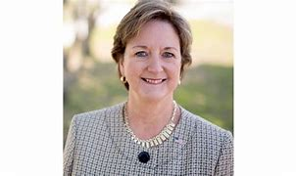
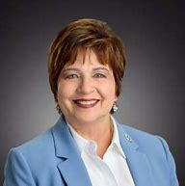
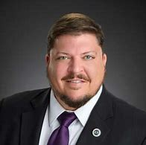
St. Tammany Parish Delegates
Senator
Sharon Hewitt
District 1
Representative
Mary Dubuisson
District 90
Representative
Bob Owen
District 76
Notes:
They have the authority to enact laws on a wide array of subjects:
Which include crimes and their penalties; and
They also enact laws affecting the safety, health and welfare of our citizens.
Next Slide = The Executive Branch

Slide 9
The Executive Branch
Governor
John Bel Edwards
Notes:
We elect the Governor as the top Executive of the State
The Governor can either signs the law into effect or he can veto it.
Next Slide = The Judicial Branch

Slide 10
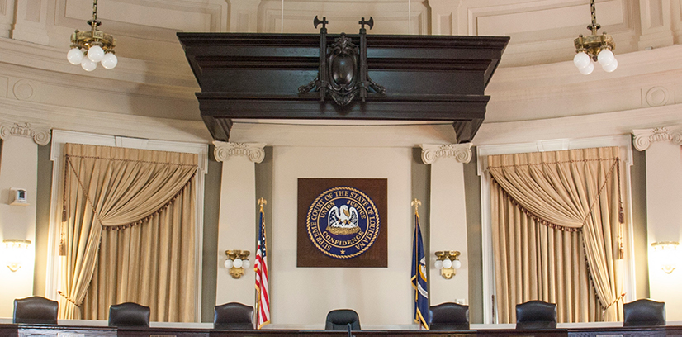
The Judicial Branch
Notes:
The third branch of government is the Judiciary.
Courts apply the law to individual cases.
Next Slide = City Court East St Tammany

Slide 11
City Court of
East St. Tammany
Bryan D. Haggerty
Presiding Judge
Notes:
Local judges are elected.
Hear various juvenile matters like:
Delinquency
CINC
FINS and
Adoptions
Next Slide = Who's involved in Criminal process

Slide 12
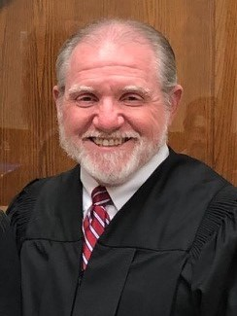
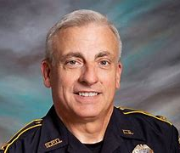
Who’s involved in the criminal process?
Bryan D. Haggerty
Judge
Randy Smith Sheriff
Randy Fandal Chief of Police
Warren Montgomery District Attorney
Reginald Laurent City Prosecutor
Notes:
The District Attorney (AKA the prosecutor) has control over every criminal prosecution in his district.
He determines whom, when, and how he shall prosecute. La. C.Cr.P. art. 61
As Judge, I can only rule on what is presented by the prosecutor for criminal prosecution.
Next Slide = Who can be charged with a crime

Slide 13
WHO CAN BE
CHARGED WITH
A CRIME?
Notes:
ANYONE - Including Juveniles!
The PARTIES to a crime are classified as:
(1) Principals
(2) Accessories
Next Slide = Principals

Slide 14
PRINCIPALS
All persons concerned in the commission of a crime are principals.
La. R.S. 14:24
Notes:
Next Slide = Law of Principals
Juveniles have special laws and timelines; however, can be charged as adults depending on the seriousness of the crime committed.

Slide 15
What does the
Law of Principals mean?
Whether present or absent,
Whether you directly commit the act, or
Aid in its commission, or
Directly or indirectly counsel another to commit the crime.
Notes:
Next Slide = Example # 1

Slide 16
Example No. 1:
My friend, Pee Wee, and I go walk the neighborhood with the intent to steal from unlocked cars.
Pee Wee takes the lead and enters several unlocked cars.
Notes:
Next Slide = Example # 1 continued

Slide 17
Example No. 1: (CONT.)
I agree to be the lookout for Pee Wee and stand on the sidewalk.
Pee Wee comes back with sunglasses, electronics and a gun.
Can I be charged with Burglary?
Notes:
Next Slide = Answer - Yes

Slide 18
Yes.
All persons concerned in the commission of a crime are principals.
Notes:
The lookout is as guilty as the one who goes in the vehicle;
Just as a getaway driver is as guilty as the one who goes in the vehicle or property.
Next Slide = Example # 2

Slide 19
Example No. 2:
I invite Pee Wee to my house and encourage him to steal from unlocked cars.
Pee Wee does it while I’m watching TV at my house.
Can I be charged with Burglary?
Notes:
Next Slide = Answer - Yes

Slide 20
Yes.
All persons concerned in the commission of a crime are principals.
Notes:
Even if you are absent from the scene …
If you directly or indirectly counsel another to commit the crime.
Next Slide = Age Legal Responsibility

Slide 21
THE AGE OF LEGAL RESPONSIBILITY IS 18
Notes:
In most cases, if you are between the ages of 10-17 and commit a crime, you would report to juvenile court and, because of your age, special laws apply.
Next Slide = Age Exception

Slide 22
AGE EXCEPTION
For certain crimes, like:
Murder, Kidnapping, Rape, Armed Robbery and other Violent crimes …
Juveniles 15 or older may be prosecuted in ADULT court; and, if convicted, sent to prison with adults.
Notes:
La. Ch. Code art. 305.
Next Slide = Guns & Drugs

Slide 23
GUNS
AND
DRUGS
Notes:
It is illegal to possess a dangerous weapon while in the possession of a controlled substance.
Next Slide = According to National Heath Institute

Slide 24
According to the National Institute of Mental Health
Gun violence is a national epidemic and the second leading cause of death for adolescents (aged 10-14), and teens and young adults (aged 15-24).
Notes:
#1 = Motor Vehicles
#2 = Homicides
#3 = Suicide
When coupled with the suicide risk among this vulnerable age group, the numbers are staggering and should not be ignored.
Next Slide = Discharge of Weapon

Slide 25
Illegal Discharge of a Weapon
Is a felony crime which carries a penalty of up to 2 years hard labor.
La. R.S. 14:94
Notes:
The intentional or negligent discharge of a firearm, where it is foreseeable that it may result in death or great bodily harm to a human being, is a felony.
Never retaliate to negative behavior with a gun!
Next Slide = 68% Gun related incidents

Slide 26
Notes:
Next Slide = Stolen Guns

Slide 27
Stolen Guns
No person shall intentionally possess a stolen firearm.
Penalty – First time offenders shall be imprisoned from one to five years
La. R.S. 14:69.1
Notes:
Second time offenders shall be imprisoned from two to ten years.
Next Slide = Synthetic Marijuana

Slide 28
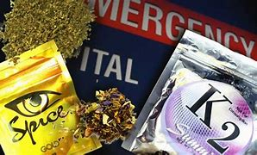
Synthetic Marijuana
Also known as:
K2 * Voodoo * Spice
The health effects from using synthetic cannabinoids can be unpredictable and harmful—even life threatening
Extremely dangerous!
Notes:
Adverse effects include:
rapid heart rate,
hallucinations,
raised blood pressure,
reduced blood supply to the heart, even leading to heart attacks.
Next Slide = Cocaine

Slide 29
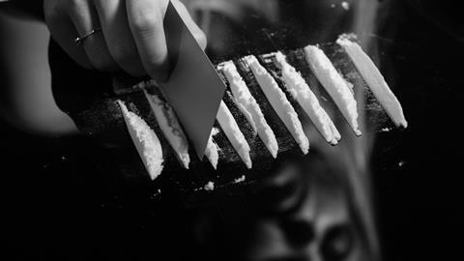
COCAINE
Powder or Crack
Both are physically and psychologically addictive.
Can lead to long term health problems including depression, paranoia, memory lapses – and because of its addictive qualities, spin-off crimes.
Notes:
Trying even one time could lead to death.
These are unknown chemicals mixed together by unknown criminals.
It’s not worth the chance!
Next Slide = Methamphetamines

Slide 30
Methamphetamine
A powerful, highly addictive stimulant
Affects the central nervous system
Comes in form of powder, crystals, and pills
Notes:
Short-Term effects include:
increased breathing, heart rate, blood pressure, and body temperature.
Also irregular heart rate, increased wakefulness and decreased appetite.
How do people use methamphetamine?
by smoking
swallowing (pill)
snorting
injecting the powder that has been dissolved in water/alcohol
Next Slide = Penalty

Slide 31
The penalty for possession of a dangerous weapon while in possession of controlled substance is between 20-30 years imprisonment.
La. R.S. 14:95(E)
Notes:
Next Slide = Spin-off Crimes

Slide 32
Spin-Off Crimes
There are hundreds related to Drugs
Why?
Because use of illegal drugs can lead to addiction, and
Illegal drugs are expensive.
Notes:
Some people therefore turn to crime and steal money to buy drugs.
Others barter with sex / prostitution
Next Slide = 5 Reason for Teen Drug Abuse

Slide 33
Top 5 Reasons for Teen Drug Abuse
5. Media influences
4. Coping with trauma, anxiety, depression
3. Escape or self-medication
2. Academic or performance pressure
1. Peer pressure and social influence
Notes:
Next Slide = Alcohol & Related Crimes

Slide 34
ALCOHOL
AND
RELATED CRIMES
Notes:
Possession by minor
DWI under 21
Vehicular Homicide
Next Slide = Possession by Minor

Slide 35
Possession by a Minor
It is illegal for a person under 21 to purchase or have public possession of any alcoholic beverage.
La. R.S. 93:12
Notes:
Next Slide = DWI Under 21

Slide 36
Driving While Intoxicated Under 21
It is unlawful for any person under the age of twenty-one (21) to operate a vehicle when the operator’s blood alcohol concentration is 0.02 % or more.
La. R.S. 14:98.6
This is one beer!
Notes:
Underage DWI, as defined by Louisiana Revised Statute 14.98.1, is the operation of a motor vehicle by a person who is under the age of 21 and who has a BAC between .02 and under .08.
If the BAC is .08 or above, then the person is charged with an adult DWI, regardless of age.
Next Slide = Graphic Crash pic # 1 of 2

Slide 37
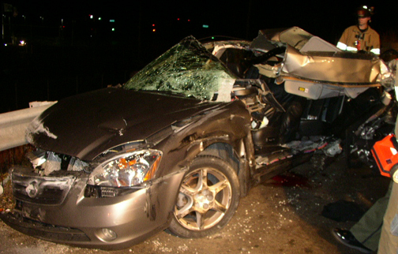
DISCLAIMER: The crime of operating a vehicle while intoxicated can have deadly consequences.
Notes:
The next series of slides are real photos from crash scenes of impaired drivers and are graphic.
Click to show photo
Next Slide = Graphic Crash pic # 2 of 2

Slide 38
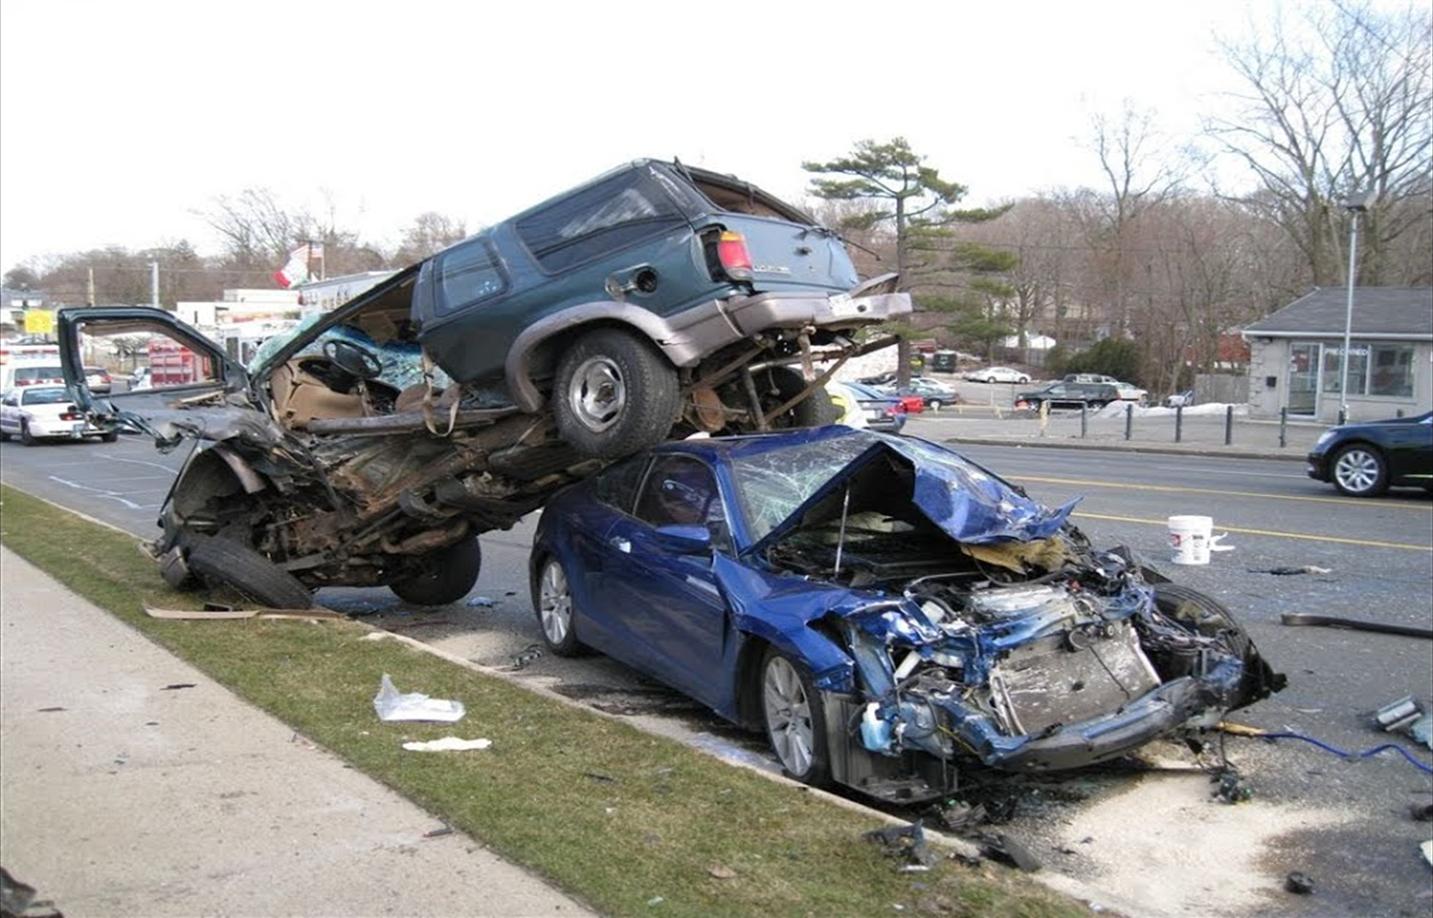
Unfortunately, impaired drivers are not always the only victim
Notes:
Next Slide = Electronic Crimes

Slide 39
ELECTRONIC
CRIMES
Notes:
Next Slide = Don’t Do It

Slide 40
Just Don’t Do IT …
Cyberbullying
Sexting
Texting While Driving
ALL ARE AGAINST THE LAW
Notes:
Next Slide = Cyberbullying

Slide 41
Cyberbullying
Cyberbullying is the electronic transmission of a communication with the intent to abuse, torment, or intimidate a person under the age of 18.
La. R.S. 14:40.7
Notes:
Next Slide = Penalty
Bullying is a form of abuse, comprised of repeated acts over time.
Examples include:
Name calling
Harassment or tormenting
Spreading false rumors
Getting people to “gang up” on others
Sending nasty messages
Studies have shown a direct correlation between cyberbullying and suicide.

Slide 42
Whoever commits this crime can be imprisoned for up to 6 months.
Notes:
Next Slide = Example # 1
Don’t suffer in silence
Report it to school officials and parents

Slide 43
Example No. 1:
I sent a group text with a picture of another student that was edited in an unflattering way.
All the kids in the group text posted laughing emojis or made not-so-nice comments.
Can I be charged with Cyberbullying?
YES
Notes:
Next Slide = Example # 2

Slide 44
Example No. 2:
I RECEIVED a group text with a picture of another student that was edited in an unflattering way.
I forwarded this text to more people.
Can I be charged with Cyberbullying?
YES
Notes:
Next Slide = Effects of Cyberbullying

Slide 45
Effects of Cyber Bullying
On those being bullied (victim):
Depression and anxiety
Increased sadness and loneliness
Changes in sleep and eating patterns
Decreased academic achievement
Loss of interest in activities
Suicidal thoughts and/or death
Notes:
These issues most likely will follow you into adulthood.
Next Slide = Sexting

Slide 46
SEXTING
The act of sending sexually explicit photos electronically by person under 17 (can be of yourself or another person), including between mobile devices.
R.S. 14:81.1.1
Notes:
This is a crime we are seeing more and more
primarily from middle school & high school teenagers.
It may include photos and/or inappropriate sexual language.
Violations include:
taking a photo,
Sending the photo,
receiving and possessing it,
sending to another
Next Slide = Penalty

Slide 47
PENALTY:
First offense is a fine from anywhere between $100-$250, imprisonment of up to 10 days, or both.
La. R.S. 14:81.1.1
Notes:
Staggering Statistics:
1 out of 5 kids has been sexually solicited online
1 out of 4 kids has been sent a picture of a naked person online
About ½ of 1 percent of all internet communication is pornographic
Next Slide = Sexting continued

Slide 48
SEXTING (CONT).
A social danger with sexting is that material can be very easily and widely distributed … over which the originator has no control.
Once it’s out there, there’s no getting it back!
Notes:
Next Slide = VIDEO
Many times the person on the other end is a predator who is luring you into something more nefarious - such as sex trafficking.
These predators are good at pretending to be your peer.
They will try to earn your trust, then they will manipulate until under their control.

Slide 49
Notes:
Next Slide = Cell Phone Use

Slide 50
Cell Phone Use
Notes:
Next Slide = National Safety Council
18.7 Billion text messages are sent worldwide every day!
If you include social media apps like twitter and instragram – the number of text messages transmitted is more than 60 billion per day!

Slide 51
According to the National Safety Council
8% of fatal crashes, 15% of injury crashes, and 14% of all police-reported motor vehicle traffic crashes in 2018 were distraction-affected crashes.
https://crashstats.nhtsa.dot.gov/Api/Public/ViewPublication/812926
Notes:
Next Slide = Don’t Text & Drive

Slide 52
That means if you are 15, 16 or 17
DO NOT USE YOUR CELL PHONE WHILE DRIVING.
Notes:
Next Slide = VIDEO

Slide 53
Notes:
Next Slide = Texting & Driving

Slide 54
Texting While Driving
No person (regardless of age) shall operate a car while texting.
La. R.S. 32:300.5
Notes:
Next Slide = Graphic # 1 of 1

Slide 55
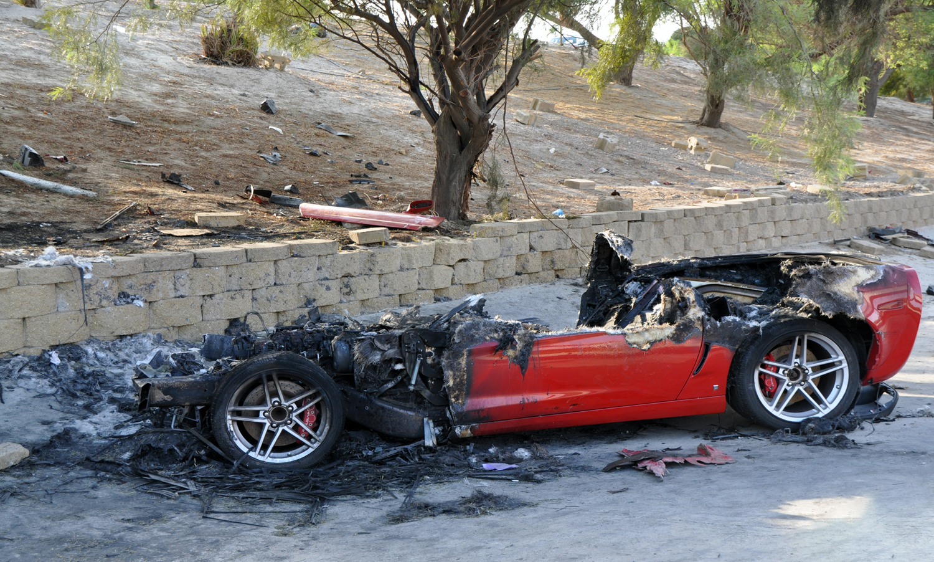
One bad decision is all it takes
Notes:
Next Slide = Civil Liability for Parents

Slide 56
Civil Liability For Parents
PARENTS CAN BE SUED FOR INJURIES OR DAMAGE DONE BY THEIR MINOR CHILD.
La. C.C. art. 2318
Notes:
Next Slide = Why Important

Slide 57
WHY
IS ALL THIS
IMPORTANT?
Notes:
Next Slide = Jail could be Future

Slide 58
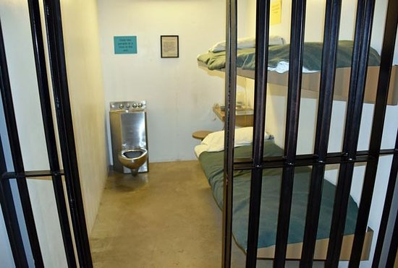
JAIL COULD BE YOUR FUTURE
Notes:
THINK ABOUT YOURSELF;
THINK ABOUT YOUR FAMILY
It’s not all about you
Next Slide = Consequences are Significant

Slide 59
CONSEQUENCES ARE SIGNIFICANT.
Notes:
Next Slide = Having a Criminal Record

Slide 60
Having a criminal record
May prevent your admission into college or prevent getting a scholarship
May prevent you from military service
May prevent you from getting a job
May cause you to go to jail or prison
May cause you injury or death
May cause someone else’s injury or death
Notes:
Next Slide = Disadvantages of Social Media

Slide 61
DISADVANTAGES OF SOCIAL MEDIA
Gives license to people to be hurtful
Decreases face-to-face communication skills
Facilitates laziness
Creates a skewed self-image
Reduces family closeness
Notes:
Social networking is a topic that divides opinion.
Some people think its an amazing tool.
But others are worried about the impact it has on peoples lives.
As Judge, I can speak first hand about the dangers and negatives affects that social media has had on our society.
I encourage each of you to put the phone down and be present. Live your real life and not some version of it. And be vigilant when online, predators are real.
Next Slide = Conclusions

Slide 62
CONCLUSIONS
Notes:
Next Slide = No Rewind

Slide 63
THERE IS NO REWIND.
“Judge, I wish I could take it back - but I can’t.”
Notes:
I often hear these words
Next Slide = Power of Choice

Slide 64
You can choose the direction of your life.
Notes:
Next Slide = Choose Wisely

Slide 65
CHOOSE WISELY
Notes:
The End

Slide 66
CYBERBULLYING, SEXTING, AND BEYOND
Presented by Judge Bryan D. Haggerty
Co-Authored by Scott Crichton, Associate Justice
Louisiana Supreme Court

