Slide 1
OPIOID ADDICTION TREATMENT AND PREVENTION PENSACOLA METRO TREATMENT CENTER
By A J McCovery, MSW
Senior Addiction Counselor 4

Slide 2
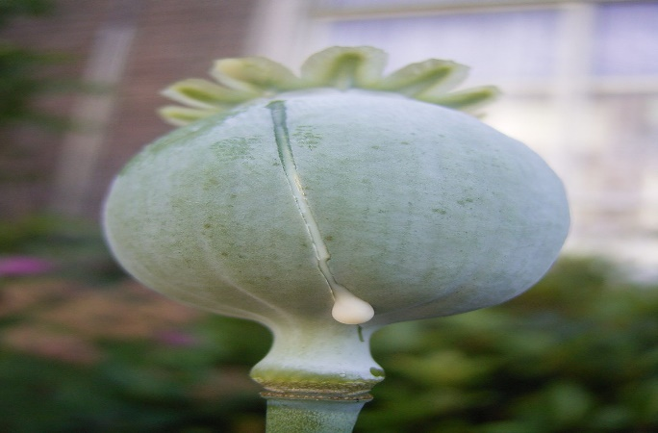
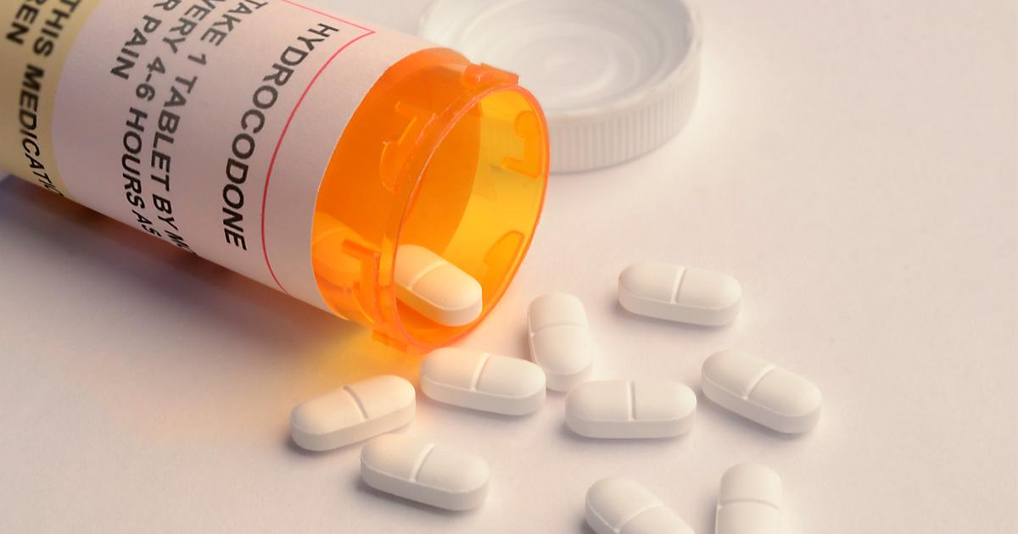
Chemical dependency/ Addiction
Chemical Dependency- addiction to a mood or mind altering drug such as heroin, cocaine, or alcohol.
Addiction- the state of being enslaved to a habit or practice or to something that is psychologically or physically habit-forming, as narcotics, to such an extent that its cessation causes severe trauma.

Slide 3
What is relapse?
A person who's trying to stop using drugs can make mistakes, feel bad, and start using again. This return to drug use is called a relapse. Relapse is common and normal and happens to a lot of people recovering from drug addiction. People will often have one or more relapses along the way because it takes practice to learn how to live without drugs.
https://easyread.drugabuse.gov

Slide 5
What causes relapse?
Missing a couple of meetings, skipping counseling, or forgetting to check in with the aftercare program director from the drug rehab center may seem harmless to a newly recovering addict; however, these types of avoidance behaviors can spiral out of control and lead to a drug or alcohol relapse.
https://www.relapse-prevention.org

Slide 6
The Cause of Triggers:
A trigger is anything that makes a person want to go back to using drugs. It can be a place, person, thing, smell, feeling, or something that happened in the past that reminds the person of taking a drug and getting high. A trigger can be something that you worry about that you want to get away from. It can even be something that makes you feel happy. People fighting addiction need to stay away from the triggers that can make them start using drugs again, just like people with breathing problems need to avoid smoke and dust.
https://easyread.drugabuse.org

Slide 7
Triggers:
Triggers can be
Emotional
Physical
Psychological
Social
Traumatic past or current event
Environmental
https://easyread.drugabuse.gov

Slide 8
Veteran Face A Dangerous Combination of Painkillers and PTSD
Many of the more than 2 million veterans who served in Iraq and Afghanistan suffer from both pain and post traumatic stress disorder(PTSD). Often they are treated with opioid painkillers, which can be a dangerous mix with mental illness because of the risk of addiction(The Wall Street Journal).

Slide 9
Veterans with PTSD are nearly twice as likely to be prescribed opioids as those without mental health problems, according to a study by a Veterans Affairs researcher. They are more likely to get more than one opioid, and to receive the highest dose. The study found veterans with PTSD were more than twice as likely to suffer injuries, overdoses and other bad outcomes if they were given opioids.

Slide 10
According to VA records, about 30 percent of Iraq and Afghanistan veterans under VA care have PTSD. More than half of them suffer chronic pain. More than 50,000 veterans were treated by the VA last year for serious problems associated with opioid use—almost double the number compared with 10 years earlier. During that time, the total number of VA patients grew 30 percent. The newspaper found the number of opioid prescriptions written by the VA increased by 287 percent between 1999 and 2012.

Slide 11
Another study led by a VA doctor found the rate of accidental drug overdoses among veterans receiving VA care is almost double that of the U.S. population as a whole. Dr. Andrew Kowal, who helped develop clinical guidelines for pain management used by the VA, said the number of troops “retiring out of the Army on narcotics chronically is just absolutely unbelievable.” In 2010, the VA revised opioid prescribing guidelines to emphasize the risks. The VA says it will make additional revisions.

Slide 12
Changing Negative Behavior:
Talk to your counselors/clinical therapist about your problems
Understand why you became addicted
See how the drugs have changed your behavior
Stop running from your problems and face them
Learn to avoid negative people, places, and situations
Start seeing yourself as someone whose life matters
Speak positive affirmations ( I can live clean, sober, and happy)
Try to make amends even if they don’t accept it
https://easyread.drugabuse.gove

Slide 13
Make Attainable Goals:
Test negative on drug screens
Start a personal journal
Make realistic goals
Attend groups at clinic
Re-educate yourself
Get vocational training
Find better employment: ESCAROSA
Become independent/self-sufficient

Slide 14
REFERRALS:
Gulf Coast Veteran Health Care System (850)912-2000
Gulf Coast VA Biloxi (228)523-5000
Dept of Veterans Affairs Mental Health (386)366=6700
CDAC Behavioral Health(850)434-2724

Slide 15
EVIDENCED BASED PRACTICE:
PROCESS GROUP
EXPLORE INTERNAL AND EXTERNAL FEELINGS
ROLE PLAY
OPEN DISCUSSION OF HOW DRUGS HAVE AFFECTED YOUR LIFE/FAMILY MEMBERS/JOB/LACK OF EMPLOYMENT
FRESH START RELAPSE PREVENTION: SAFETY PLAN
Activity worksheets
https://twodreams.com/dream-journal/142-substance-abuse-group-therapy-activities
www.nhchildrenstrust.org/sites/default/.../fresh_start_relapseprevention_safety_plan .

Slide 16
Conclusion
Holistic Approach:
Spiritual/God/Jesus Christ
Meetings: A.A., N.A., C.A., Al Anon, Adult Children of Alcoholics
Therapy / Counseling (confront past traumatic experiences)
Anger/Emotional Management
Meditation
Quality Time/Family
Beach
Nature walk
Exercise
Do volunteer work in the community/ help the homeless in your community(give back)

Slide 17
References:
https://easyread.drugabuse.gov
Video courtesy of YouTube (Opioid Crisis), NIDA(National Institute of Drug Abuse)
https://www.relapse-prevention.org
https://twodreams.com/dream-journal/142-substance-abuse-group-therapy-activities
www.nhchildrenstrust.org/sites/default/.../fresh_start_relapseprevention_safety_plan
Partnership to End Addiction
https://drugfree.org/drug-and-alcohol-news/veterans-face-dangerous-combination-of-painkillers-and-ptsd/
Do not modify or redistribute without permission of creator

