Slide 1
Effective Assertiveness

Slide 2
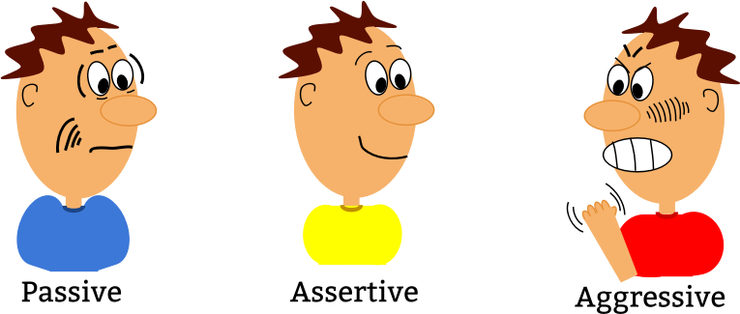

Slide 3
Do You Think You’re Assertive?
You have numerous opportunities to communicate with others every single day. What is your natural tendency in your daily interactions with coworkers, friends and family?
Think about the following questions:
Do you overreact in certain situations?
Do you hesitate to speak up in certain situations?
Do you express yourself clearly and directly?

Slide 4
Definition of Assertiveness
Assertiveness is best described in practical terms:
Stating your views clearly and articulately
Having the ability to express your own feelings--even about difficult issues--in a way that is respectful and honest
Standing up for your own needs without violating the needs of others
Saying what you mean and meaning what you say

Slide 5
Benefits of Assertiveness
Fewer internal and external conflicts
You have fewer regrets
It allows you to express your own needs and get them met
More quality and healthy relationships
It ensures that you communicate with others respectfully and effectively
It allows you to influence others in order to gain acceptance, agreement or a behavior change
More self-confidence

Slide 6
The Assertiveness Continuum

Slide 7
Blocks to Assertiveness
If you know what assertiveness is and why it’s beneficial, why don’t you use it all the time? Often, your ability to be assertive depends on the situation or the person involved.
Common reasons people struggle with assertiveness:
Wanting people to like you
Needing to be responsive to people with different agendas, such as supervisors, peers or customers
Feeling responsible for the harmony of your group or department

Slide 8
A.S.K. Yourself
In what situation(s) are you most likely to act assertively?
In what situation(s) are you least likely to act assertively?
With whom are you most likely to act assertively?
With whom are you least likely to act assertively?

Slide 9
Pillars of Assertiveness
You can overcome any blocks to assertiveness by building on the Pillars of assertiveness.
The Pillars of assertiveness are:
Self-worth: Believing you have value and are as worthy as anyone else
Knowledge: Knowing assertive language and behaviors to use, and non-assertive language and behaviors to avoid
Practice and experience: Starting small and make incremental improvements in your efforts to act assertively

Slide 10
Self-worth
Self-worth: Believing you have value and are as worthy as anyone else

Slide 11
Knowledge
Knowledge: Knowing assertive language and behaviors to use, and non-assertive language and behaviors to avoid

Slide 12
Practice and Experience
Practice and experience: Starting small and make incremental improvements in your efforts to act assertively

Slide 13
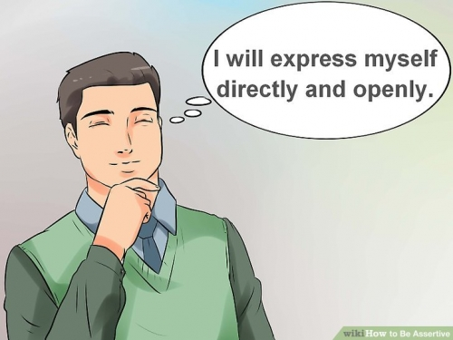
Your Assertive Rights
Statements to say to yourself to reinforce your desire to act assertively.
“My needs are as important as anyone else’s.”
“It’s OK to meet my needs and/or ask to have them met.”
“I accept responsibility for my thoughts, feelings, opinions and behavior. “
“I cannot be responsible for the thoughts, feelings, opinions and behaviors of others.”

Slide 14
Changing to Positive Self-Talk

Slide 15
Change Your Language
Although assertiveness begins in your head, there are concrete, specific communication techniques you can use to convey your assertiveness appropriately.
Use “I” statements
Wrong way: “You always interrupt me.”
Right way: “I would like to complete my explanation without interruption.”
Use factual statements
Wrong way: “You’re lazy and you don’t care about your work.”
Right way: “I noticed you arrived late three times this week.”

Slide 16
Change Your Communication
Make clear, direct requests or directives
Wrong way: “Don’t you think you should review your presentation?”
Right way: “Please review and practice your presentation before the meeting this afternoon.”
Express feelings honestly (don’t dramatize)
Wrong way: “Could that meeting have been run any worse?”
Right way: “I feel we strayed too far from the agenda and digressed on issues we can’t control.”

Slide 17
Effective Assertiveness
BBV2M-BrothersBrooksVision2MissionLLC.com
BBV2MLLC@gmail.com

