Slide 1
Emergency Medical Responder
Chapin Area Rescue Squad

Slide 2
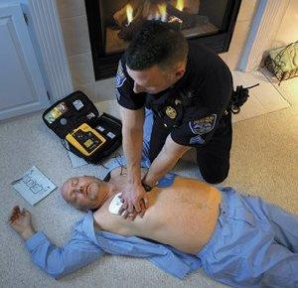
Chapter 8: Patient Assessment

Slide 3
Objectives
Utilize scene findings and simple patient assessment findings to treat life threatening conditions
Ensure the scene is safe
Assist other crews with scene management
  Additional resources
  Incident Command
Identify MOI and NOI to develop patient assessment skills

Slide 4
Introduction
Patient assessment sequence
  Perform a scene size-up.
  Perform a primary assessment.
  Obtain the patient’s medical history.
  Perform a secondary assessment.
  Perform a reassessment.

Slide 5
Scene Size Up
General overview of the incident and its surroundings
Review dispatch information.
  Location of the incident
  Main problem or type of incident
  Number of people involved
  Safety level of the scene
Number of Patients- If need additional rigs, call Control EARLY
MOI/NOI

Slide 6
Primary Assessment
Form a general impression.
  Note the patient’s sex and approximate age.
  Determine whether the patient has experienced trauma or illness.
  Determine the patient’s level of consciousness- AVPU
ABCs
Skin Conditions
Rapid Scan

Slide 7
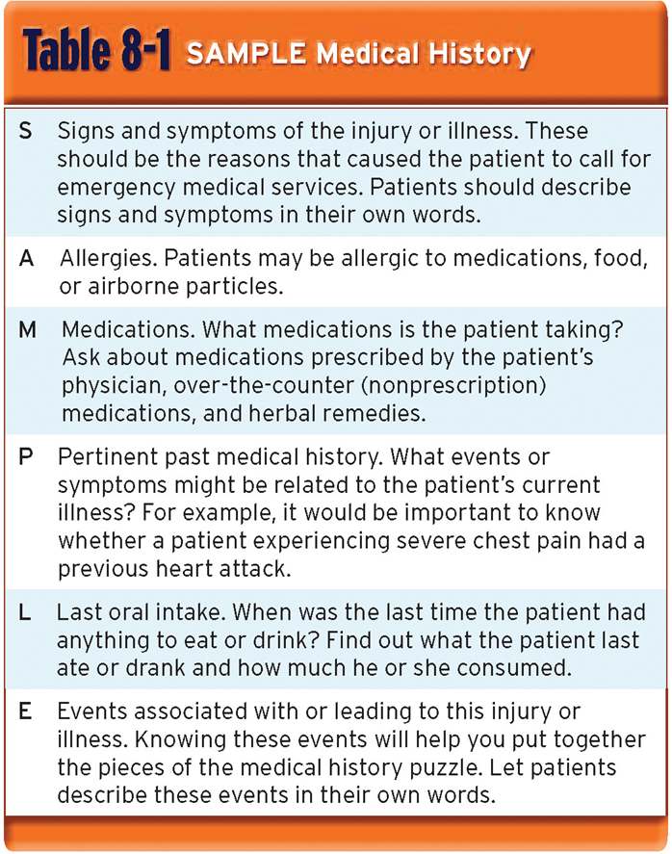
History Taking
Investigate the chief complaint
SAMPLE
EMTs- OPQRST

Slide 8
Secondary Assessment
Critical (sick)/Non-Critical (not sick)
  Rapid Trauma Exam/Rapid Physical Exam also RTA/RPA
If Not Critical or time persist
  Focused Physical Exam
Obtain Vitals
  Pulse
  RR
  BP
  Pupils
  SPO2

Slide 9
Reassessment
Repeat Primary Assessment, History and Secondary Assessment
Recheck Vitals
  5 minutes for unstable patients
  15 minutes for stable patients

Slide 10
Review
The patient assessment sequence can be used to examine patients who have experienced illnesses, trauma, or both
When examining medical patients, follow the basic assessment sequence.
When caring for a trauma patient, perform the secondary assessment before taking the medical history.

