Slide 1
WRITING- Narrative Literacy TOOLS
www.kbumreading.com
Cut out each of the 6 Steps in the Walk.
Glue them onto large index cards or card stock.
After laminating individual cards, join them together to make a sequential line of steps in writing an NARRATIVE paper.

Slide 2
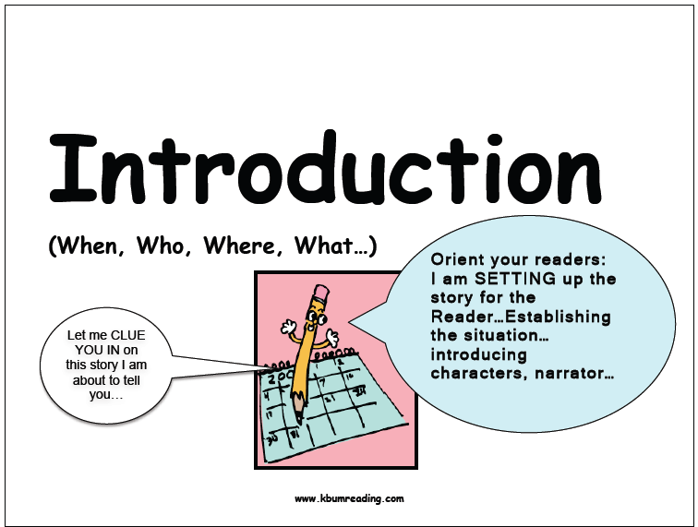
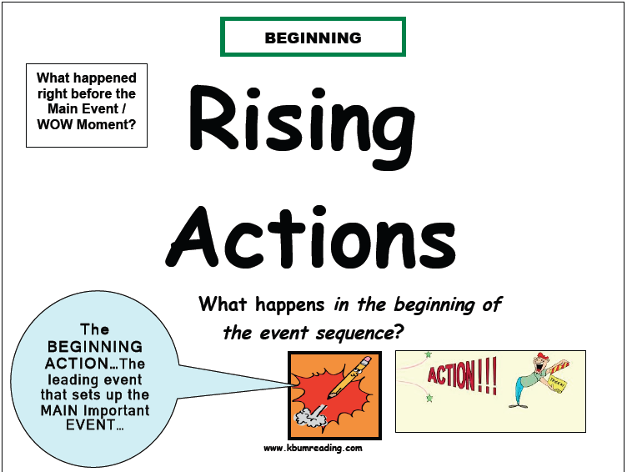
1
2
3

Slide 3
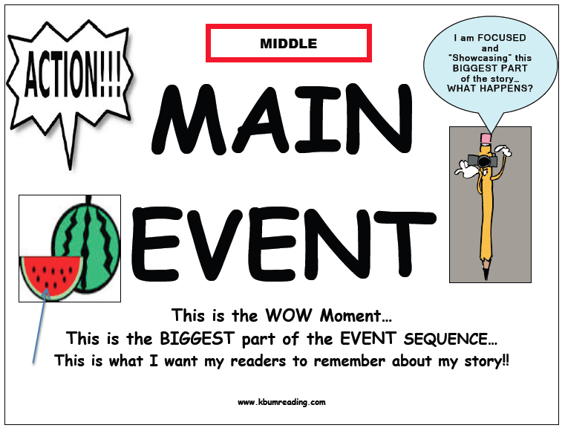
6
5
4

