Slide 1



EL Civics: Diversity
Task 2 Practice
Listen and talk about your country.

Slide 2
Tell me about education in your country.

Slide 3
Tell me about food or cooking in your country.

Slide 4
Tell me about holidays or gift giving in your country.

Slide 5
Tell me about homes in your country.

Slide 6
Tell me about work in your country.

Slide 7
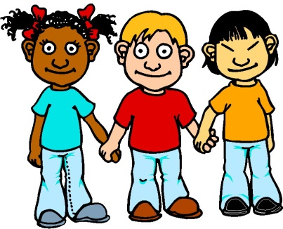
Tell me about children in your country.

Slide 8
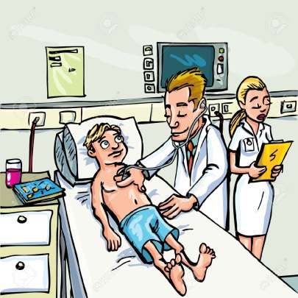
Tell me about hospitals or doctors in your country.

Slide 9

Tell me about weddings or marriage in your country.

