Slide 1


Slide 2
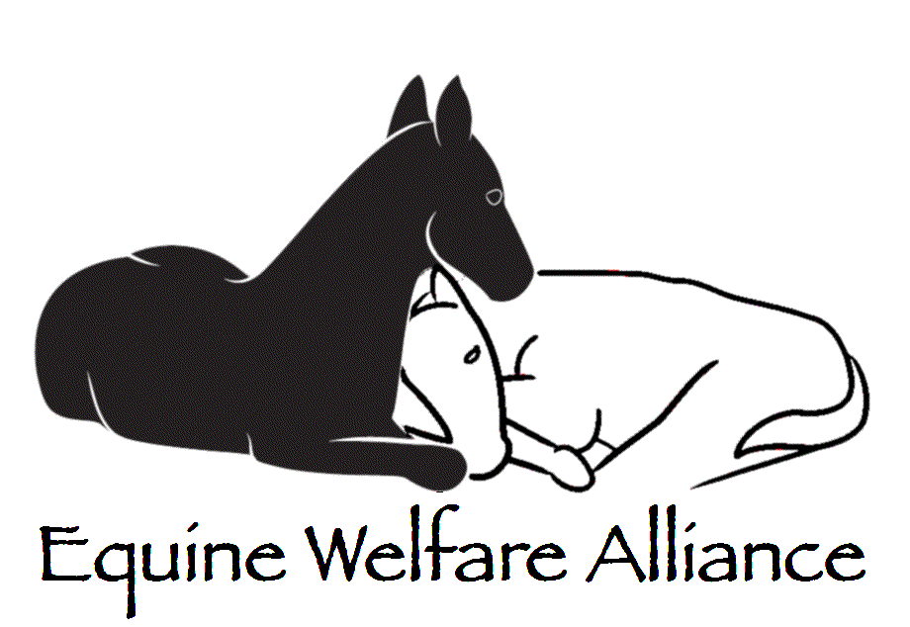
The Historic Relationship between Horse Slaughter and Abuse and Neglect
John Holland, President

Slide 3
A Brief History of Horse Slaughter in the US
During the 1980’s, there were about 16 slaughter houses in the US.
During the 1990’s slaughter declined rapidly and by 2000 there were only three left.
In 2007, state and federal legislation shut down the remaining three.
Exports of slaughter horses to Canada and Mexico quickly made up for the closures.

Slide 4
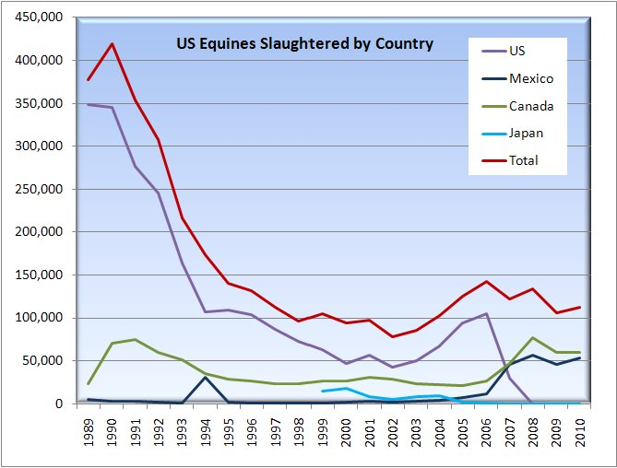
US Plants Close
Cavel Reopens
Cavel Burns

Slide 8


Slide 10
Proponent’s Claim that Slaughter Reduces Abuse and Neglect

Slide 12

Would our horses be better off if we brought slaughter back?
Would their trips to slaughter be shorter?
Would APHIS protect them from abuse?

Slide 13
Would the trip to slaughter be shorter if we brought slaughter back?
We have always exported horses to Mexico and Canada
The trips within the US were already excessively long

Slide 14
Did APHIS Protect the Horses at the US Plants?
The following images were obtained from the United States Department of Agriculture under a FOIA request by Julie Caramante of Animals’ Angels. These are only four of 900 such images.
WARNING! THEY ARE VERY GRAPHIC

Slide 15
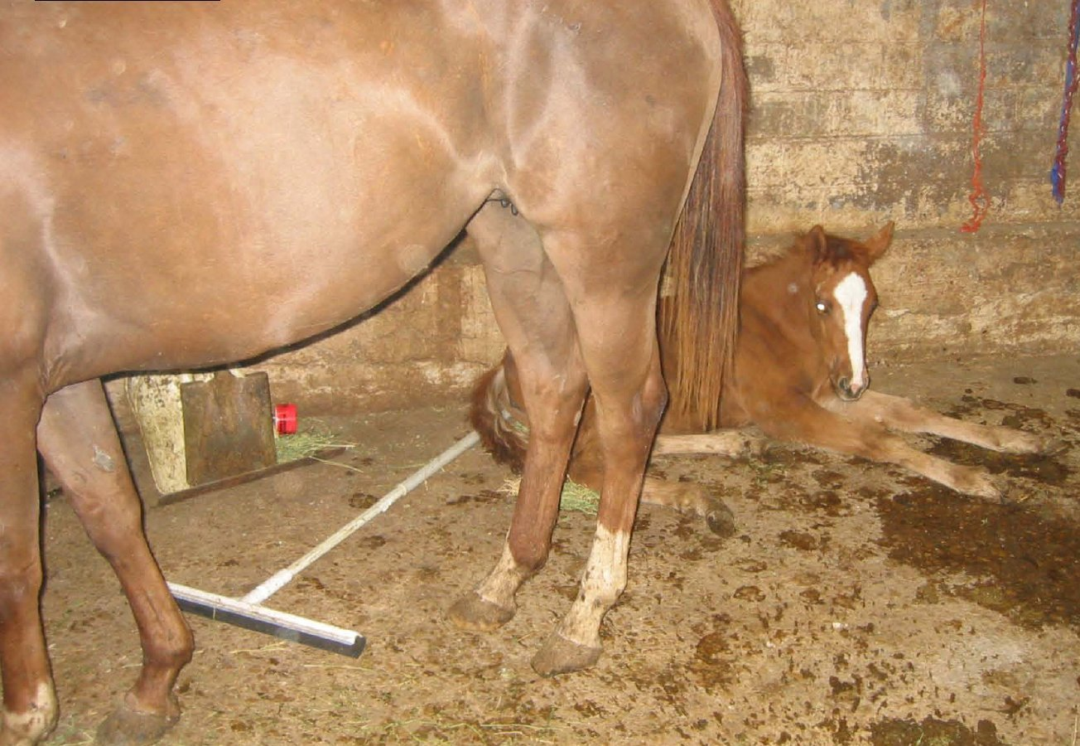
Foals are commonly born in route or on the slaughter floor.

Slide 16
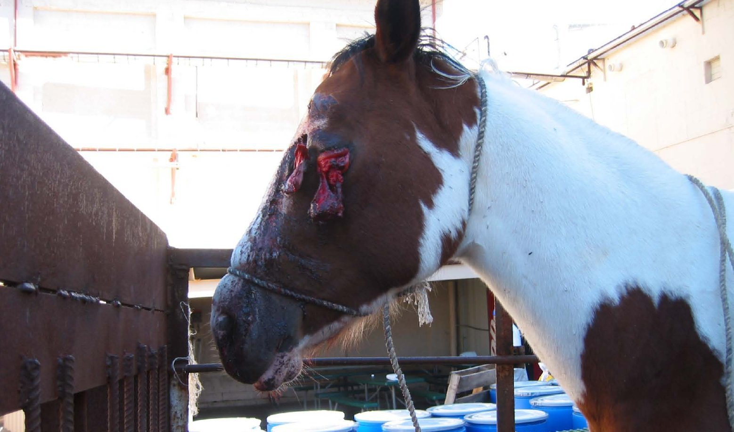
Horses were sometimes intentionally blinded by kill buyers to make them more manageable.

Slide 17
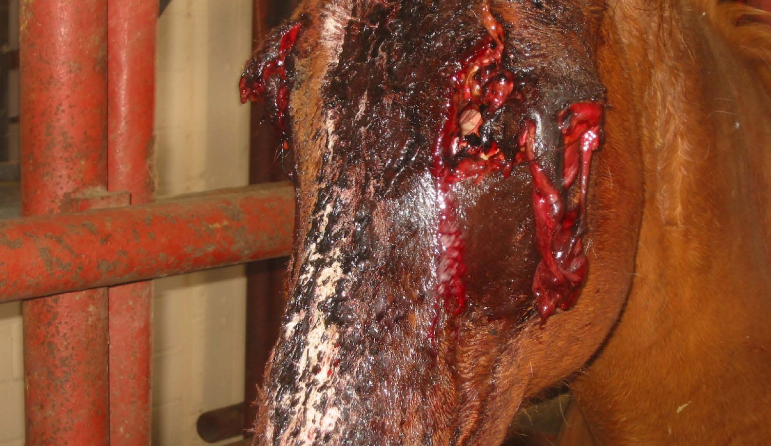

Slide 18
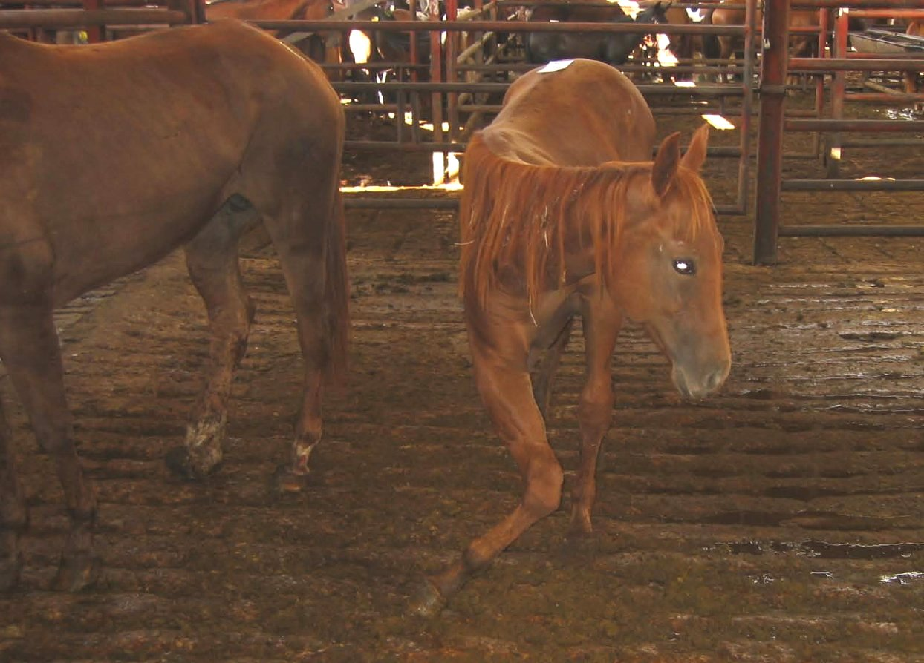

Slide 19
Conclusions:
Historically horse slaughter has never had a beneficial effect on abuse, abandonment or neglect.
Horse slaughter has never been anything but a brutal process.
Equine neglect is influenced almost entirely by economic conditions
Slaughtering 100,000 horses a year has not offset the negative impact of the great recession.

Slide 20
What is the EWA?
The Equine Welfare Alliance is a dues free umbrella organization.
EWA has 200 member organizations
We have members in 16 countries
We provide research, resources, alerts, press releases and other information to help equine advocates protect wild and domestic equines.

