Slide 1
IIPS Fall 2014
Deploying and Updating Windows Software: ‘A-Batchy-Way’
Steven Young
Director of IT
Blue Ridge Community College

Slide 2
Common Software Deployment Issues
Different installation methods, configuration
Different installation programs depending on OS (32-bit, 64-bit, XP/7/8)
Different methods and time lines for updates
Require Administrator privileges and sometimes affirmative user action (i.e. UAC prompt)

Slide 3
3rd Party Tools
3rd Party tools such as Microsoft SMS, Symantec Altiris can ease deployments and also provide a wide variety of other functions such as inventory control
They often also rely on specific package formats (e.g. MSI) or underling customized scripting as well
Can be costly and cumbersome

Slide 4
Benefits of ‘A Batchy Way’
Benefits:
  No additional software is required: All versions of Windows are able to execute (properly written) batch files
  Generalized skill set: Most IT professionals will have at least some familiarity with the Windows command line thereby avoiding the need for additional training on a 3rd party deployment software
  Strengthens core IT Skills: Reinforces core IT skills such as the command line as well as understanding and maintaining short procedural programs
  Highly Customizable: Batch scripts can (often must) be customized to install a particular program
  Zero additional cost: If you already paid for Windows, you already ‘own’ the ability to use batch files to automate software deployment

Slide 5
Drawbacks to ‘A Bachy Way’
Skill Set: Requires knowledge of Windows command line and basic procedural programming
Customization: Each batch script requires some level of customization for the given software to be deployed
Obsolescence: Future versions of Windows or a given program might not support command line / batch. In addition there is an industry perception that such methods of installing software is outdated and should be done with new, state-of-the-art tools
Lack of Automatic Auditing: Many commercial deployment tools build in methods to audit software installation activates. Such audit trails would need to be incorporated into each script and/or augmented with more generalized system configuration / inventory techniques

Slide 6
Common ‘Template’
Variables / editable items
  File names, server addresses, paths, etc.
Flag File Check
  Check for presence of flag file to quickly skip further processing if already installed
Log install starting
Deployment code
  Where all the fun actually happens
Log install finished and error codes if available

Slide 7
Example 1: Silverlight – Basic Installation
@ECHO OFF
setlocal
REM *************************************************************************
REM Purpose: install or upgrade Silverlight client to select systems
REM *************************************************************************
REM
REM Set install location to SYSVOL. This will automatically route users to their
REM local login server.
REM
set DeployServer=\\blueridge.edu\sysvol\blueridge.edu\install\silverlight
REM Set InstallerName to the name of your copy of the Silverlight installer
set InstallerName=Silverlight51.exe
REM Set LogLocation to a central directory to collect log files.
Set LogLocation=\\logserver.blueridge.edu\gp_install_logs$
Set FLAGFILE=C:\silverlight51inst.txt
REM *************************************************************************
REM Deployment code below…
REM *************************************************************************
if not exist %FLAGFILE% (goto DeploySilverlight) else (goto End)
REM If 1 returned, the product was not found. Run setup here.
:DeploySilverlight
echo %0 Starting at %date% %time% >> %LogLocation%\%computername%.txt
start /wait %DeployServer%\%InstallerName% /q
echo %0 %date% > %FLAGFILE%
echo %0 Ended at %date% %time% with error code %errorlevel%. >> %LogLocation%\%computername%.txt
:End
Endlocal

Slide 8
Example 2: Java – Arguments and 64-bit ‘Detection’
@ECHO OFF
setlocal
REM *************************************************************************
REM Purpose: install or upgrade Java JRE v7u67
REM *************************************************************************
set DeployServer=\\blueridge.edu\sysvol\blueridge.edu\install\Java_JRE_7
REM Set InstallerName to the name of your copy of the JRE installer
set InstallerName32=jre-7u67-windows-i586.exe
set InstallerName64=jre-7u67-windows-x64.exe
REM Set LogLocation to a central directory to collect log files.
Set LogLocation=\\logserver.blueridge.edu\gp_install_logs$
Set FLAGFILE=C:\jre7u67inst.txt
if not exist %FLAGFILE% (goto DeployJava) else (goto End)
:DeployJava
echo %0 Starting at %date% %time% >> %LogLocation%\%computername%.txt
echo %date% > %FLAGFILE%
REM
REM Always install the 32-bit version (Default is Patch in Place)
REM
start /wait %DeployServer%\%InstallerName32% /s WEB_JAVA=1 WEB_JAVA_SECURITY_LEVEL=VH
echo %0 %InstallerName32% ended at %date% %time% Setup ended with return %errorlevel%. >> %LogLocation%\%computername%.txt
REM If 64-bit OS, install 64-bit JRE in addition to 32-bit (Default is Patch in Place)
REM
IF DEFINED PROGRAMFILES(x86) (goto DeployJava64) else (goto End)
:DeployJava64
start /wait %DeployServer%\%InstallerName64% /s WEB_JAVA=1 WEB_JAVA_SECURITY_LEVEL=VH /L %LogLocation%\%computername%-Java.log
:End
Endlocal

Slide 9
Example 3: MS Office 2013
@ECHO OFF
setlocal
REM *************************************************************************
REM Purpose: Install Microsoft Office 2013 using MSP file and keeping 2010 if installed
REM *************************************************************************
set RootInstallLocation=\\fileserver.blueridge.edu\zInstall$
set MSPFileName=Office_2013_32_bit.MSP
REM Set LogLocation to a central directory to collect log files.
Set LogLocation=\\logserver.blueridge.edu\gp_install_logs$
Set FLAGFILE=C:\Office_2013_32_bit.txt
REM *************************************************************************
REM Deployment code begins here. Do not modify anything below this line.
REM *************************************************************************
if not exist %FLAGFILE% (goto DeployOffice2013) else (goto End)
REM If 1 returned, the product was not found. Run setup here.
:DeployOffice2013
echo %0 starting at %date% %time% >> %LogLocation%\%computername%_office2013.txt
echo %date% > %FLAGFILE%
REM Fix to ensure 2010 and 2013 don’t ‘compete’ for office registration. This doesn’t block
start %RootInstallLocation%\word2010norereg.reg
REM A cheap timed pause statement to make sure the reg injection completed
ping -n 1 1.1.1.1
%RootInstallLocation%\Office2013_32bit\setup.exe /adminfile %RootInstallLocation%\%MSPFileName%
echo %0 completed at %date% %time% with error code %errorlevel%. >> %LogLocation%\%computername%_office2013.txt
REM If 0 or other was returned, the product was found or another error occurred. Do nothing.
:End
Endlocal

Slide 10
Example 4: Lynx Guide Install
@ECHO OFF
set DeployLocation=\\blueridge.edu\SYSVOL\blueridge.edu\Install\Lynx
Set FLAGFILE=C:\lynxinstallv2_10.0.24.0.txt
Set DONOTINSTALLFLAG=C:\lynx_no_install.txt
set InstallerFileName=LynxClient_v10.0.24.0.msi
set dotNetInstallerScript=\\blueridge.edu\NETLOGON\install_dotnet.bat
REM By default the Lynx client will install the computer into the HCC profile.
REM
set LYNXPROFILE="HCC"
Set LogLocation=\\logserver.blueridge.edu\gp_install_logs$
if exist %DONOTINSTALLFLAG% goto End
if not exist %FLAGFILE% (goto DeployLynx) else (goto End)
:DeployLynx
echo %date% > %FLAGFILE%
echo %0 started at %date% %time% >> %LogLocation%\%computername%-Lynx.txt
call \\blueridge.edu\NETLOGON\lynx_panic_icon_v2_install.cmd
REM Fancy code stolen from technet to detect whether at least .Net 3.0 is already installed
REM Added SDY 11/25/13
REM
reg query "HKLM\Software\Microsoft\NET Framework Setup\NDP" /s /v version | findstr /i version | sort /+26 /r | findstr 3.0.
if ERRORLEVEL 1 start /wait %dotNetInstallerScript%
REM Look for TCC strings in computer name and adjust default Lynx clinet profile if
REM the computername contains the name of TCC buildings.
REM
echo %COMPUTERNAME% | findstr /i "TCS" > nul
if ERRORLEVEL 0 Set LYNXPROFILE="TCC"
echo %COMPUTERNAME% | findstr /i "TCT" > nul
if ERRORLEVEL 0 Set LYNXPROFILE="TCC"
echo %COMPUTERNAME% | findstr /i "TCC" > nul
if ERRORLEVEL 0 Set LYNXPROFILE="TCC"
msiexec /I %DeployLocation%\%InstallerFileName% LYNXSERVERHOSTNAME="lynx.blueridge.edu" PROFILE=%LYNXPROFILE% /quiet /forcerestart
echo %0 using %InstallerFileName% ended at %date% %time% with error code %errorlevel% . >> %LogLocation%\%computername%-Lynx.txt
:End

Slide 11
Deployment Logistics
Script Location
  We use the Active Directory NETLOGON share to store most scripts
    + Automatically readable by all domain users and domain member computer accounts
    + Automatically a trusted location via default domain policies (usually)
    + Replicated among all domain controllers
    -/+ Only domain admins can modify – shouldn’t change permissions but makes delegating maintenance more difficult

Slide 12
Deployment Logistics
Installation File Location
  SYSVOL
    SYSVOl great location for small install files for unlicensed programs
    + Automatically replicated among domain controllers
    + Computers are automatically directed to the ‘nearest’ available domain controller – (controlled by AD Sites + Services)
      Reduce WAN traffic
      Automatic (but random) ‘load balancing’
    - All files stored under SYSVOL share(s) are stored on the C: drive of all domain controllers
  Distributed File System Shared Folder
    A DFS shared folder is an even better location to store installation files. All of the benefits of SYSVOL but with more control and flexibility:
      + DFS allows for additional control over replication of data among member servers as well as directing clients which server to use
      + Control security as with any other shared network folder
  Specific Designated Server(s)
    If a DFS infrastructure isn’t available, you could dynamically determine install server location in installation script:
      e.g. “IF %LOGONSERVER% == WESTCAMPUSDC

Slide 13
Using Group Policy to Automate Deployment
Set the scripts as Computer Start up Scripts via Group Policy
  Scripts run as Computer Local System Account:
    + bypass UAC prompts in Windows 7,8
    Remember to set network share permissions to allow computer account access
Why start up scripts vs directly deploying MSI via GP?
Deployment scripts can also be manually run by a user (with admin rights) or set as a ‘job’ or task in a 3rd party deployment tool such as Altiris

Slide 14
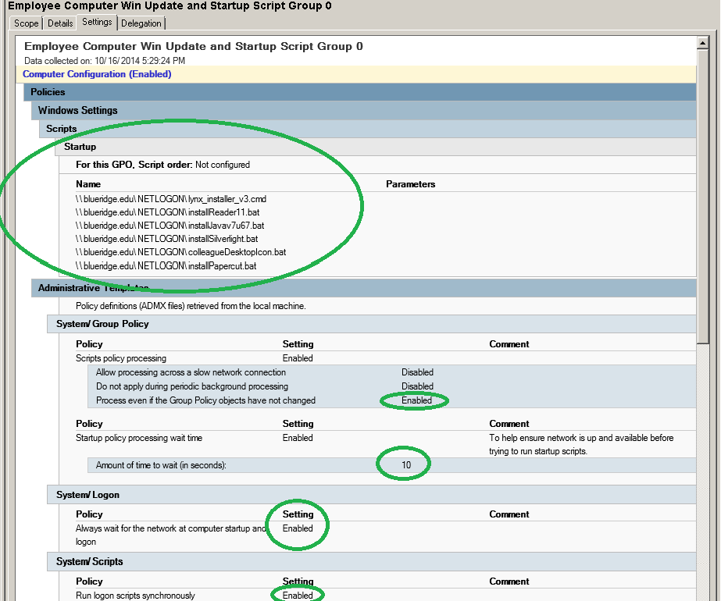
Example of Group Policy Settings

Slide 15
GP Deployment Tips
Use Multiple Groups
  Reduce risk that an error will affect a large number of computers
  Allows for testing and customization
GPO Settings:
  Wait for Network
  Run synchronously (one at a time)

Slide 16
Discussion
Other methods?
Drawbacks?
Is batch just too old fashioned and boring?
…
… ya know, there is a beach nearby… ☺

Slide 17

Thanks and Enjoy Atlantic Beach!

