Slide 1

Founded in 2001 to Fund the Unmet Needs essential to the
Safety, Security, Health & Well-Being
of Talbot County’s Children and
Vulnerable Adults

Slide 2
Talbot Community Connections
Talbot Community Connections (TCC) is a non-profit 501(c)3 volunteer organization
Over $500,000 raised to date to support unfunded needs of Talbot County Department of Social Services (TCDSS) including the Talbot County Children’s Advocacy Center (TCCAC)

Slide 3
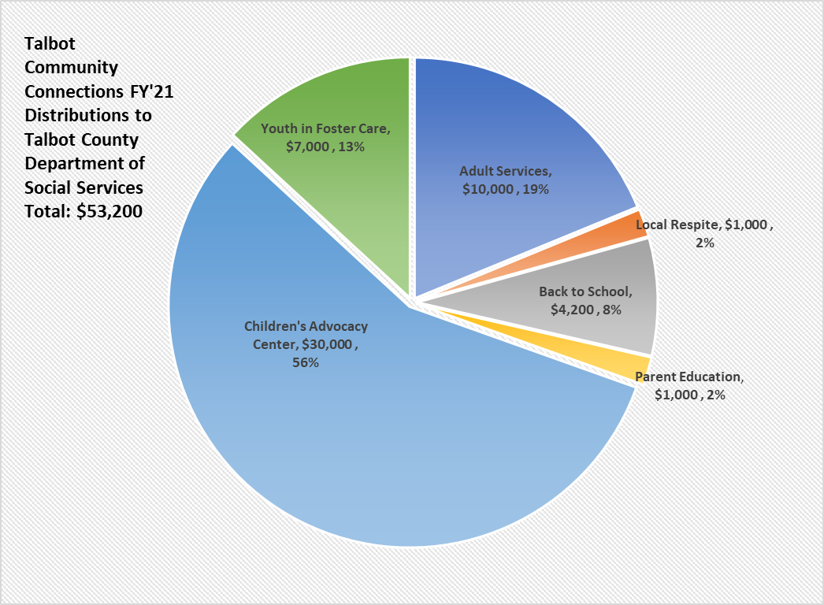

Slide 4

TALBOT COUNTY CHILDREN’S
ADVOCACY CENTER
Talbot Community Connections (TCC) funds services at Talbot County Children’s Advocacy Center (TCCAC) that enhance outcomes for child victims of sexual abuse, serious physical abuse, and extreme neglect.
A Program of Hope and Healing for Everyone

Slide 5
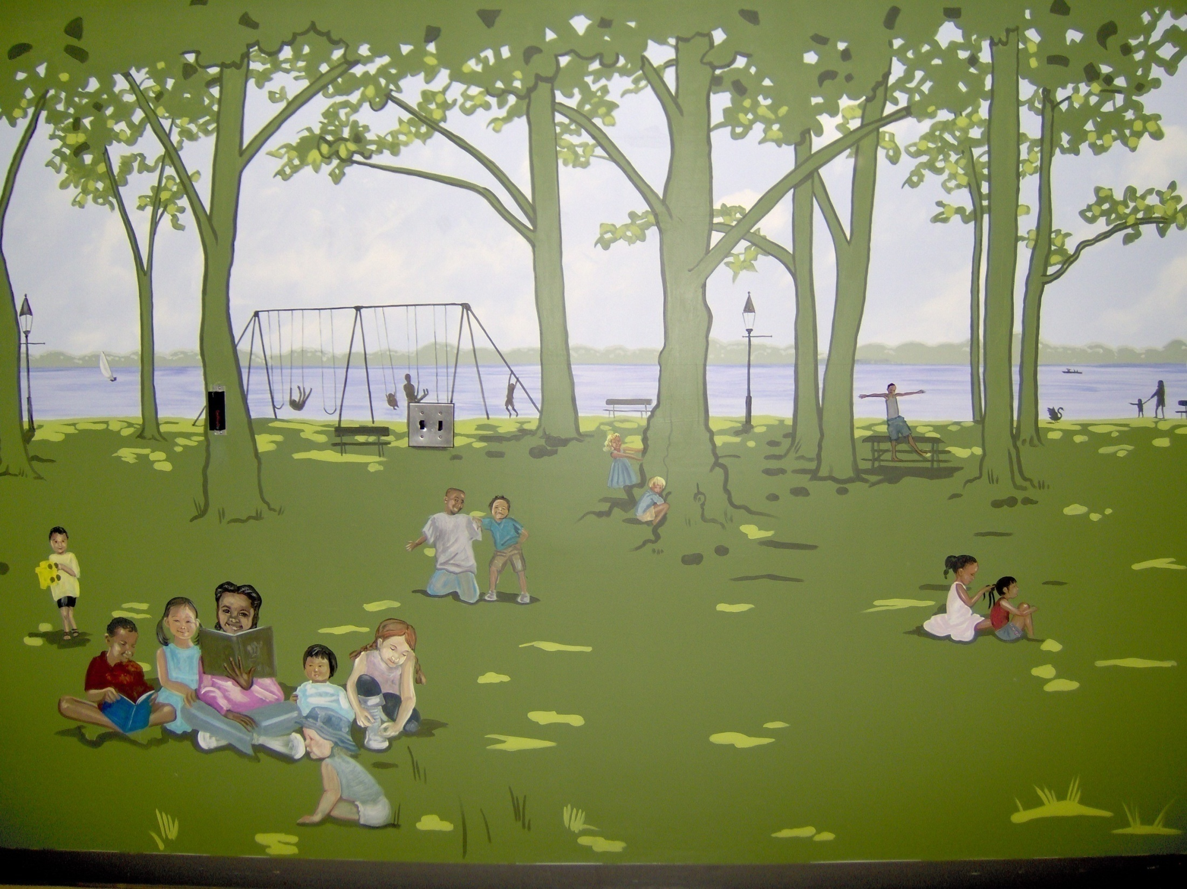
Notes:
History – Multi D Team
Diversity/cultural awareness
Partnership shs and dss created program of hope and healing for victims
Location- where MDT does their work

Slide 6

“Every child deserves a great childhood that's carefree and full of promise.” Lauren Krasko, Coordinator of the Talbot County Children’s Advocacy Center
Notes:
Our job to educate the community

Slide 7
Let’s Talk Statistics
• About 1 in 5 girls and 1 in 20 boys will be sexually abused before they turn 18.
• Child sexual abuse is significantly underreported.
o 73% of child survivors do not tell anyone about the abuse for at least a year.
o 45% of victims do not tell anyone for at least 5 years.
o Some children never disclose.
Numbers may be even higher, because data typically excludes sexual assaults of children by strangers or others who do not have custody or supervision of a child.
About 90% of those that sexually abuse a child are acquaintances of either the child or the family, while roughly 10% of sexual abuse is perpetrated by a stranger.
(MCASA- Maryland Coalition Against Sexual Assault, March 2022)
https://mcasa.org/

Slide 8

Talbot County Department of Social Services
  Specially Trained Forensic Interviewers
  Family Advocate
  CAC Coordinator
  Administrative Structure and Support
This Photo by Unknown Author is licensed under CC BY-SA
Notes:
Although no longer on the hospital premises, we are still in a partnership with them

Slide 9
University of Maryland Shore Regional Health Partnership
  Physical Space
  Sexual Assault Nurse Examiners (SANE Nurses)
  Medical Equipment
  Laboratory Services
This Photo by Unknown Author is licensed under CC BY-SA
Notes:
Although no longer on the hospital premises, we are still in a partnership with them

Slide 10
What is a Children’s Advocacy Center and what does it do?
Comprehensive multidisciplinary response to incidents of child abuse
Talbot County Children’s Advocacy Center provides a comfortable, private, child-friendly setting that is both physically and psychologically safe for diverse populations of children and their families
Designed to provide complete separation of victims and alleged offenders to the maximum extent possible
Provides services and support to
  Child victims of sex abuse, severe physical abuse, extreme neglect
  Non offending caregivers support with a family advocate assigned to the case

Slide 11
Talbot County CHILDREN’S ADVOCACY CENTER
A family waiting room offers a wide variety of toys and snacks for the children and parents
A meeting room for family meetings, therapy sessions for victims, and for the Family Advocate to provide support during interviews
A medical exam room
An observation room for law enforcement, state’s attorney, and the CAC Coordinator to discuss and observe forensic interviews
An interview room where the forensic interviews take place
TCCAC ensures ‘best practice’ standards of service and is accredited by the National Children’s Alliance.
Notes:
These are all components required for accreditation

Slide 12
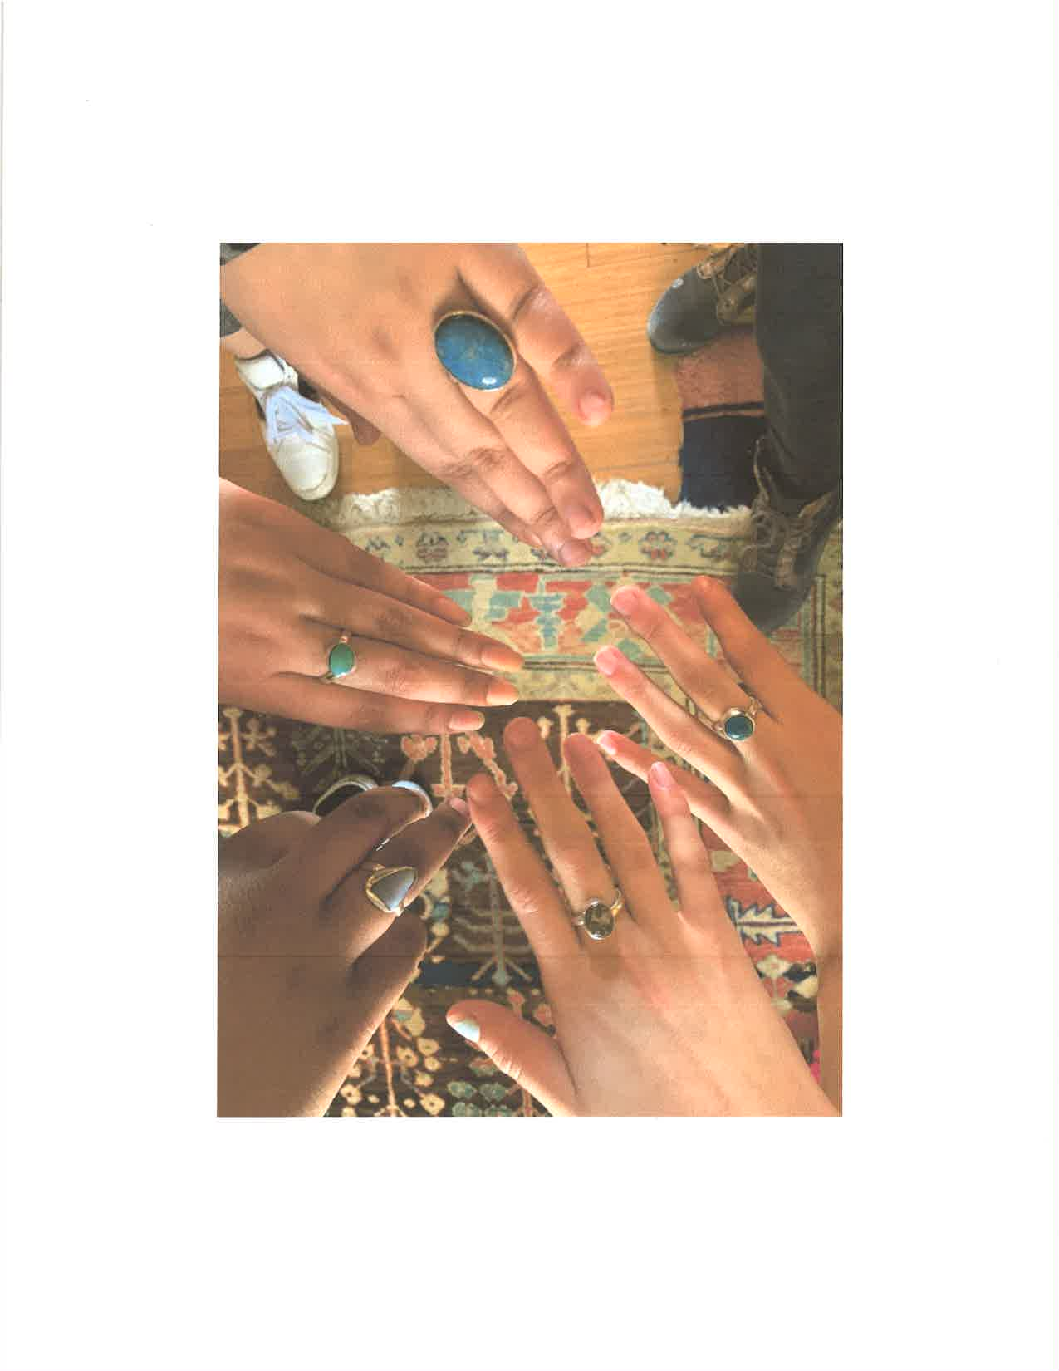
Services
Forensic Interviews
Forensic Medical Examinations for 5 County Mid Shore Region
Mental Health and Other Therapies
  Trauma-Informed Yoga
  Equine Therapy
  Art Therapy
  Music Therapy
  Challenge Course
Independent Living Skills
Team-building Activities
Emergency Financial Assistance
Family Advocacy

Slide 13
THE FAMILY ADVOCATE
    The Family Advocate provides vital case management and support for victims and their families.
    In 2020 – 2021 (fiscal years) the advocate provided over 828 sessions including:
    Crisis counseling
    Referrals for mental health counseling
    Interaction with law enforcement
    Preparation for court assistance
    Victim support
Additionally, provided or assisted with linkages for food, clothing, shelter, educational support and internet access, prescription costs, and transportation.

Slide 14
MULTI-DISCIPLINARY TEAM
Working Together
    Child Protective Services
    Law Enforcement (Talbot County Sheriff’s Office, State Police, Municipal Police Departments)
    Legal – State’s Attorney’s Office
    Mental Health Providers
    Medical
      Medical Director
      Nurses (SANE, lab services, etc.)
    Family Advocate
Child/Family
Mental Health
Child Protective Services
Law Enforcement
Medical
Family Advocate
State’s Attorney’s Office

Slide 15
TCCAC STATS for FY 2021
Medical Exams
  Talbot County 10
  Other Mid Shore Counties 10
Forensic Interviews
  Talbot County 76
  Other Mid Shore Counties 14
Children and Adults served by Family Advocate 160
# of Sessions Provided by Family Advocate 531
Notes:
1 child/interview -

Slide 16
Other Funds TCC Distributes to Talbot County Department of Social Services

Slide 17
FAMILIES & CHILDREN
Supported through TCC
  Families in Crisis
  Respite Care
  Parent Education
  Annual Back-to-School
    Cinch sacks and school supplies for over 450 children from preschool to high school
  Needs of Children in Foster Care & Parents
    Provided funds for a quadriplegic, foster care youth in need of a specialized car seat necessary for his mobility
    Allowed a 17-year-old youth in foster care to complete driver’s education at a cost of $2,000
    Provided tutoring services for a child who was traumatized by entering foster care
    Facilitated visits and activities to brothers in different group homes in distant parts of the State

Slide 18
VULNERABLE ADULTS
Supported through TCC
TCC meets the emergency needs of vulnerable adults by providing funds for :
      Health supplies
      Medications
      Co-pays
      Housing
      Utilities
      Transportation
      Books, reading material
      Other requests

Slide 19
TCC Board Members
Amy Blades Steward, Past President
Cynthia Pease, Co-President
Jennifer Wright, LCSW-C, Co-President
Joseph Carrico, CPA, Treasurer
Valerie Albee
Rev. Elmer Davis
Arlene Guagliano, RDH, D.H.Sc.
Marcie Molloy
Kate Stinton, RN, LCSW
Ruth Sullivan, MS, RN, Vice President
Dodie Theune, PhD
Founding Directors
  Sally Vermilye
  Nancy Wilson
Emeritus Member
  William Banks

Slide 20

TO SUPPORT TCC
Visit: talbotcommunityconnections.org
or mail a donation to:
Talbot Community Connections
P.O. Box 2615
Easton, MD 21601

