Slide 1
RSAI Region Meeting NE Region May 30, 2025

Slide 2
Call to Order & Welcome Barb Schwamman, Riceville and Osage Superintendent

Slide 3
Agenda (call for approval)
Introductions
RSAI Overview and Processes
Election to Leadership Group (if applicable)
Election of Legislative Committee Reps
Review of RSAI Bylaws
Review of the 2025 Legislative Session To Date
Discussion of Region Priorities for 2026 Session
Brainstorming/Networking Discussion

Slide 4
Introductions (Current NE Region Leadership)
Nick Trenkamp, Central CSD & Eastern Allamakee CSD, Leadership Group - NE Regional Representative (Term expires September 2027)
Caleb Bonjour, Gladbrook Reinbeck CSD, Leadership Group - At-Large Representative (term expires September 2027)
Jay Marley, Tripoli CSD, Legislative Committee Representative (term expires June 2025)
Barb Schwamman, Osage CSD & Riceville CSD, Legislative Committee Representative (term expires June 2025)
Will Dible, Alburnett CSD Legislative Committee Representative (term expires June 2025. Will is moving to NW Region so won’t be eligible)

Slide 5
Introductions (RSAI & ISFIS)
James Passick, IT Director
Ken Sturgis, School Finance Director
Larry Sigel, School Finance Guru
Margaret Buckton RSAI Professional Advocate
Jen Albers, RSAI Support & Accountant
Dave Daughton, RSAI Grassroots Advocate

Slide 6
Introductions (all attendees)
Name ____________________________________
District Role ____________________________________
One Sentence: What’s something great happening in your school district today?
________________________________________________
________________________________________________
________________________________________________

Slide 7
RSAI Overview and Process

Slide 8
History of RSAI
The Rural School Advocates of Iowa began with a few rural school leaders getting together in 2013 to discuss many things:
Why were rural school voices not represented in statewide decision-making?
Why did funding formulas not recognize transportation and sparsity factors?
Why did state policy always seem to have a “one-size-fits-all” approach that left little flexibility to rural schools?
What could rural school leaders do to change this situation to benefit students in rural schools?
July 1, 2014 RSAI officially formed with 41 member districts

Slide 9
July 1, 2014

Slide 12
RSAI Relationships
RSAI is recognized as the Iowa affiliate of the National Rural Education Association (NREA) connecting members to rural school leaders nationwide, an annual conference focused on the needs and successes of rural schools
Lends Iowa’s voice to a collective effort in our nation’s Capitol through membership in the Rural Schools Collaborative.
Member of Iowa Rural Development Council to network and collaborative w/rural leaders across all areas of economic development.

Slide 13
Member Benefits
Advocacy presence at the Iowa Capitol focused on RSAI priority issues
Weekly legislative update reports and recap videos to share the latest news from the statehouse and calls to action when needed
A voice to advocate with the executive branch and represent rural schools on various task forces and stakeholder committees convened by DE.
Advocacy resources for local leaders to use, including position papers, advocacy tool kits, talking points, maps, and school finance estimates
Assistance with communications, letters to the editor or sample letters to legislators
Easy to share information, such as RSAI Legislative Priorities Video, to inform school boards, staff, and stakeholders.
RSAI is the state affiliate of the National Rural Education Association, which brings access to NREA research, updates about happenings in Washington, networking
Free Summer regional meetings and RSAI annual conference in October.
Authentic grassroots development of legislative priorities in a one district one vote democratic process.
Free access to NASDTEC teacher licensure checks with your RSAI membership. Learn more about the program here.
Discount on ISFIS Policy-hosting Service
Collective purchasing power as a group, attracting needed supports at discounted prices
Networking, Sharing, Best Practice Connections with other like districts

Slide 14
RSAI Corporate Sponsors
2024-25
www.rsaia.org/corporate-sponsors

Slide 15
RSAI Annual Meeting
https://www.rsaia.org/annual-meeting.html
Meet in October, hear reports, budget, fee schedule, elect officers, approve priorities
Members get one vote per district (affiliate members, guests and nonmembers are welcome but asked to register so we have enough food)
Outside speaker
Network
Share a good meal

Slide 16
Election of RSAI Regional Representative to the Legislative Committee
Office is a 1-year appointment, but no term limits.
By-laws allow additional representatives so each AEA has at least one.
Representative attends August Legislative Committee Meeting in Des Moines, attends the October Annual Meeting, and supports legislative advocacy efforts throughout the Legislative Session.
(Maps show membership & current representation. Thanks to those serving during the 2025 Session! )

Slide 17
Review of RSAI Bylaws
Any changes needed?
Process for Changes:
Comments/recommendations are shared with the RSAI Bylaws Committee.
Bylaws Committee make recommendations to the Legislative Committee.
Legislative Committee makes final recommendation to members at the Annual Meeting (which requires a 2/3 vote for approval).

Slide 18
Summary of 2025 Legislative Session (Some Pending Governor’s Signature) RSAI Priority Action

Slide 19
SSA, Formula Equity, Operational Sharing, Adequate Funding, Teacher Pay, AEAs

Slide 20
SSA Status
SF 167 Signed on May 19
2% increase per pupil (DCPP + $157, Weightings, Categoricals, PK, DoP, ISL, ESAs)
transportation equity increases the state appropriation to $32.7 million, which is a 5% increase ($1.2 million)
DCPP and SCPP inequity by $5 PP (closes the gap to $135 per pupil) (new minimum SCPP will be $157 + $5, or $162, however, district’s with DCPP above $157 will trade property tax authority for state aid for that $5 PP.
increases operational shared weighting cap to 25 students, currently at 21 students (college and career counselor is outside of the cap.)

Slide 21
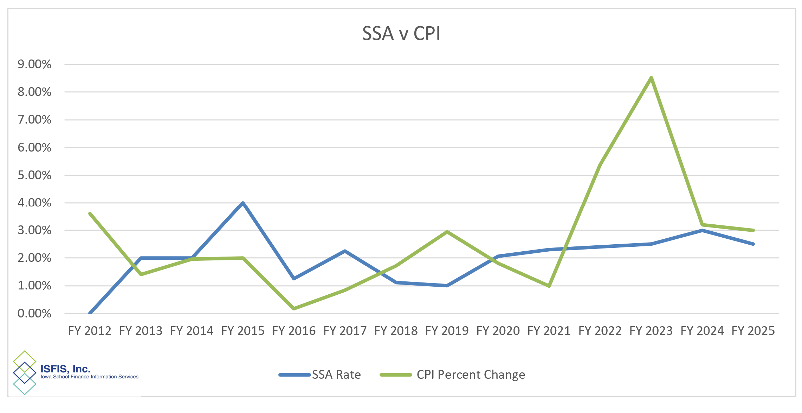

Slide 22
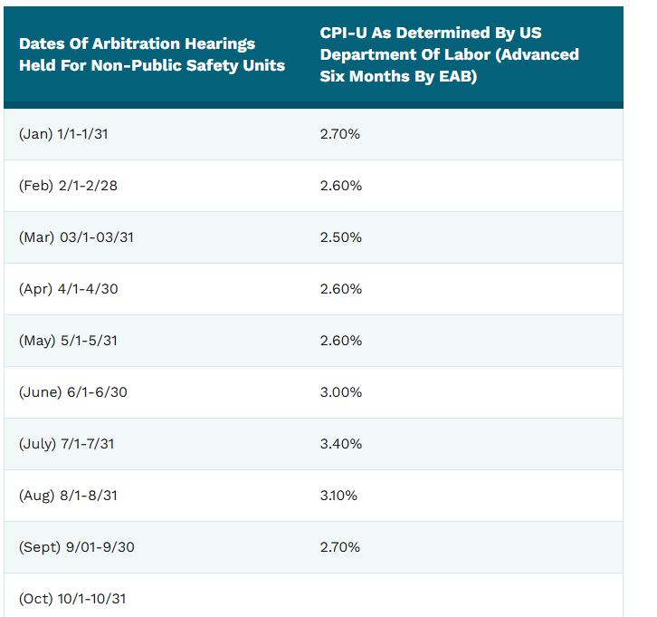
https://eab.iowa.gov/public-collective-bargaining/impasse-mediation#consumer-price-index-cpi-for-midwest-region

Slide 23
Teacher Shortage Priority
HF 787 TSS calculation + SSA Growth + error correction for experience, but also includes:
TeachIowa Job Posting Platform Resurrected
$50K for returning IPERS recipient retirees
Flexibility for student teaching for apprentice or other teachers with classroom experience
Out-of-state placement excess costs shared across the system
Pending Governor’s Signature
SF 206 Management Fund for Recruitment and Retention program is still stuck in Senate W&M

Slide 24
Board Authority/Local Control
HSB 31 [#] School Start Date & SF 250: bills that would have expanded flexibility died, approved by their respective Education Committees but not further.
HF 392 Year-Round School Calendar for grades 9-12 on the Senate Calendar (or entire districts, since K-8 already allowed). Signed by the Governor
HF 395 School Bus Driver Training: requires DE to accept proof of successful completion of entry-level driver training (ELDT) as long as the course included passenger endorsement training and school bus endorsement training curriculum. Requires DE and DOT to collaborate on administrative rules establishing minimum course requirements and standards. Pending Governor’s signature.

Slide 25
Board Authority/Local Control
HF 579 At-Risk/ Dropout Prevention: Allows increase in cap gradually up to 5% if approved by voters, adding ½% annually. Approved by House. Died in the Senate Education Committee.
HF 522 Therapeutic Classroom Incentive Fund: Allows (but does not require) school districts to use grant funds for healthy foods and to improve lighting. (died in the Senate Education Committee)
SF 277 Chronic Absenteeism Clean-up: Fixes certified letter issue, clarifies exceptions, has model policies for county attorneys, allows district discretion on school engagement meetings (focus on students for whom absences are impacting achievement). Signed by the Governor.
SF 444 WGS/Reorganization Extension through 2030: Exempt from the funnel (appropriations impact). Updated in the Property Tax Overhaul bills, so it’s on their radar. (Died without action on the Senate Calendar)

Slide 26
Board Authority/Local Control
HF 856 Banning DEI Efforts: Prohibits anything DEI for state entities including political subdivisions, includes exceptions, creates a court cause of action. Prohibits any effort to promote, as the official position of the state entity, widely contested opinion referencing unconscious or implicit bias, cultural appropriation, allyship, transgender ideology, microaggressions, group marginalization, anti-racism, systemic oppression, social justice, intersectionality, neopronouns, heteronormativity, disparate impact, gender theory, racial privilege, sexual privilege, or any related formulation of these concepts. Signed by the Governor.
Operational Sharing Changes
SF 167 House Amendment raises the cap to 25 (Signed by the Gov. )
SF 168 3 positions outside of the cap (SRO, MH, SW). (Died Senate Calendar)
HF 515 SRO at 4 pupil weighting instead of 2. (Died in Senate Education Committee)

Slide 27
Governor’s Initiatives
SF 22 Cell Phone Restrictions: On House Calendar. Social media impact curriculum for middle school and PD eliminated from the bill. (Senate amended to require sample policies from DE be available by May 1. Signed by the Governor.
HF 784 Math Initiative: Requires DE to develop of family-centered resources to support mathematics learning at home and requires schools to assess students' mathematics proficiency three times a year. Requires schools to create individual math plans for students nonproficient on at least two of those three screeners. Requires progress monitoring every 2 weeks and defines prescriptive interventions for K-6 students until the student is proficient. Requires the DE to provide professional development to improve math instruction for schools with student proficiency needs. Pending Governor’s Signature.

Slide 28
Governor’s Initiatives
SF 445 & H F623 PK/CC Partnership: Creates a process for new providers of four-year-old PK, termed a community-based provider, to directly participate in the SVPP without school district partnership. Enables these providers to receive state preschool foundation aid directly. Provides funding for these community-based provider programs in the initial year of a program based on the number of students served (school district PK budgets are based on the prior year PK count and there is no funding for expansion). The bill transfers responsibilities from the child development coordinating council to the DE, requiring DE oversight and accountability for at-risk early childhood programs. Requires the DE to evaluate PK programs including curriculum and instruction, and to establish an accountability system. Establishes a pilot program for child care continuum partnership grants operated by the DHHS. Senate passed the bill, but the House did not take it up (was approved by House HHS Committee and died on the House Calendar.)

Slide 29
Property Tax Overhaul: SSB 1208 1227 SF 651 and HSB 313 HSB 328
These bills place cities and counties under an expenditure limitation similar to schools.
Eliminates Residential Rollback. SF 651 over 10 years. Residential values will go from being taxed on 47% of the value to 100% and the Homestead tax credit will increase from $4,850 to 25% of home value, not to exceed $125,000. (School district taxable valuations will go up).
Lowers Uniform Levy from $5.40 to $4.48662 by FY 2030 ($2.43 decrease.) Decline in the rate is roughly offset by Increase in the valuation from more residential value being counted. Sets the Foundation Percentage to 100% effective 7.1.2026. (Eliminates controlled foundation portion of the Additional Levy, $1.71/thousand). This is the provision in school property taxes that will deliver approximately $375 million in property tax relief.
Limits the ability to levy additional Management Fund property taxes based on large carry-forward balances.
Any property tax rate limited by law to a specific rate can only be imposed if it was previously imposed in FY 2026. Sets PPEL (both voted and board PPEL), PERL and Debt Levies at 70% of existing PTR’s.
Stops the SAVE fund payment for property tax relief. SF 651 returns it to the State GF to help pay for foundation threshold PTR.

Slide 30
Property Tax Relief First Glance Impact on Schools
SAVE diversion to PTR goes to the state GF instead of to schools. With lower debt/PPEL levies, that means a capacity reduction for schools.
Early analysis by Piper Sandler experts estimates that
3 districts are held harmless,
13 will get between 90-100% of SQ capacity,
185 districts lose between 10-20%,
122 lose between 20-30%, and
2 lose more than 30%.
Most of those that lose the most are rural districts with concentrated agricultural value.
Districts with Management Fund balances in excess of 180% would be prohibited from levying additional Management Fund for FY 2027. The bill would allow a future levy if the district expends funds and falls under the limit. (Does not establish a rate limit or otherwise change the levy purposes.)
Our initial look estimates approximately 160 school districts were over the 180% Management Fund Balance in FY 2024, but data for the base year in the legislation, FY 2026, will not be available for a long time.

Slide 31
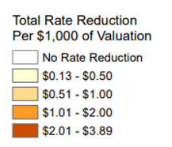
LSA Factbook https://www.legis.iowa.gov/docs/publications/FCTA/1460496.pdf

Slide 32
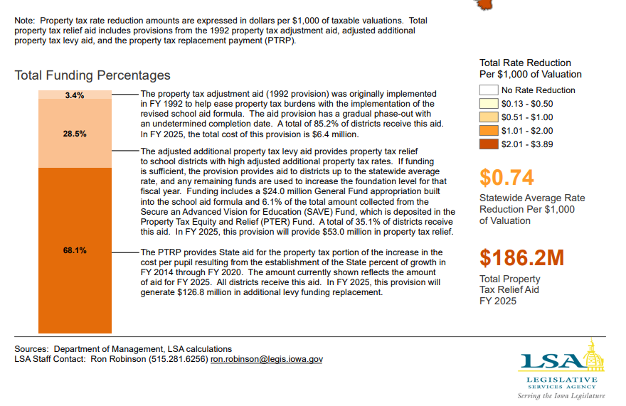

Slide 33
Economic Efficiency of Property Taxation
A 1 percentage point shift from income taxes to sales taxes improves GDP by 0.74%, while shifting to property taxes increases GDP by 1.45% ~ Arnold, Brys, Heady, Johansson, Schwellnus, & Vartia, Economic Journal
Gross state product decreases by 2.8% when the income tax replaces the property tax, while household income declines by 3.47% ~ Faulk, Thairprasert, & Hicks, Ball State working paper
While a 1 percentage point higher rate on personal property reduces annual employment growth by 2.44%, higher real property taxes actually correspond to modestly increased rates of employment growth, likely because the business benefits of higher local spending are greater than the additional tax costs ~ Mark, McGuire, & Papke, National Tax Journal
Abir Mandal, Tax Foundation presentation to TACI, amandal@taxfoundation.org

Slide 34
Legislative Priorities Discussion: (Tracking form in your packet)
Find the 2025 RSAI Priorities list in the packet or on the RSAI website at:
https://www.rsaia.org/2025-legislative-session.html
1. Are there any that need to be removed?
2. Any that need to be added?
3. Any significant (or suggested) policy or direction changes on those already on the list?
Small group or whole group discussion. We can go through them one at a time or consider the whole list with one vote. It’s up to the attendees to decide how to proceed.

Slide 35
RSAI Legislative Priorities 2026
See the RSAI website meeting tab for more information such as RSAI Legislative Digest, Position Papers which will be updated after language is finalized during the process, Legislative Priorities, and this PPT and meeting minutes on the Regional Meeting tab. http://www.rsaia.org/
Suggestions and recommendations from the Regional Meeting Attendees will be compiled and shared with the Legislative Committee. Legislative Committee will recommend final priorities for approval by members at the Annual Meeting in October.

Slide 36
THANK YOU FOR YOUR VOICE on behalf of rural students!
Watch for RSAI Legislative Digest
RSAI Priority Survey later this Summer
Stay connected through the Interim
Let us know what you need to beef up your advocacy efforts.
See you in October at the RSAI Annual Meeting!
Professional Advocate
Margaret Buckton, margaret@iowaschoolfinance.com
1201 63rd Street, Des Moines, IA 50311 (515) 201-3755 cell
Grassroots Advocate
Dave Daughton, dave.daughton@rsaia.org
(641) 344-5205

