Slide 1
Emergency Medical Responder
Chapin Area Rescue Squad

Slide 2
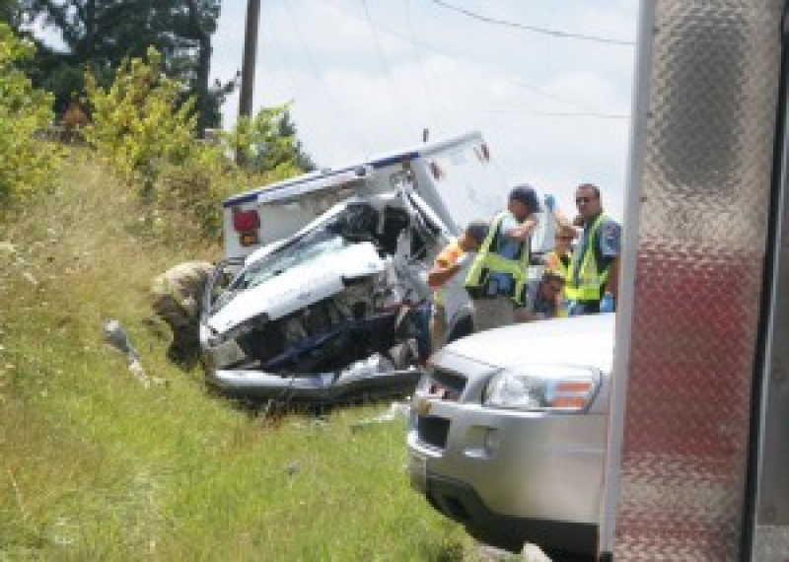
Chapter 2: Safety and Wellness

Slide 3
Objectives
Identify the following and use of:
Standard safety precautions
Personal protective equipment
Stress management
Dealing with death and dying
Prevention of response-related injuries
Demonstrate and Identify BSI procedures and protection for infectious diseases

Slide 4
Introduction
You, your patients, and their families can experience various degrees of stress in a medical emergency.
You must be in decent shape (physically and mentally) to be a quality responder
You must learn how to avoid unnecessary stress and how to prevent your stress level from becoming too high.
The most stressful calls include:
A patient who reminds you of a close family member
Very young or very old patients
Death

Slide 5
Stress
You must make a conscious effort to prevent and reduce stress:
Learn to recognize the signs and symptoms of stress.
Adjust your lifestyle to include stress-reducing activities.
Five stages of reaction to death and dying
Denial: The person experiencing denial cannot believe what is happening.
Anger: Anger is a normal reaction to stress and it will sometimes be directed at you.
Bargaining: The act of trying to make a deal to postpone death and dying.
Depression: The patient is usually silent or seems to retreat into his or her own world.
Acceptance: The patient understands that death and dying cannot be changed.

Slide 6
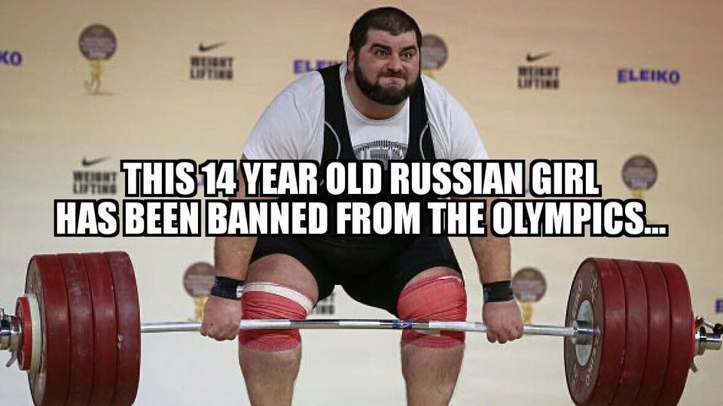
Stress Management
Recognizing Stress
Warning Signs
Preventing Stress
Diet
Exercise
Reducing Stress
CISM

Slide 7
Standard Precautions
Bloodborne pathogens
Disease-causing agents that are spread through contact with infected blood
HIV is transmitted by contact with infected blood, semen, or vaginal secretions.
Wear gloves.
Hepatitis B is also spread by direct contact with infected blood, but it is far more contagious than HIV.

Slide 8
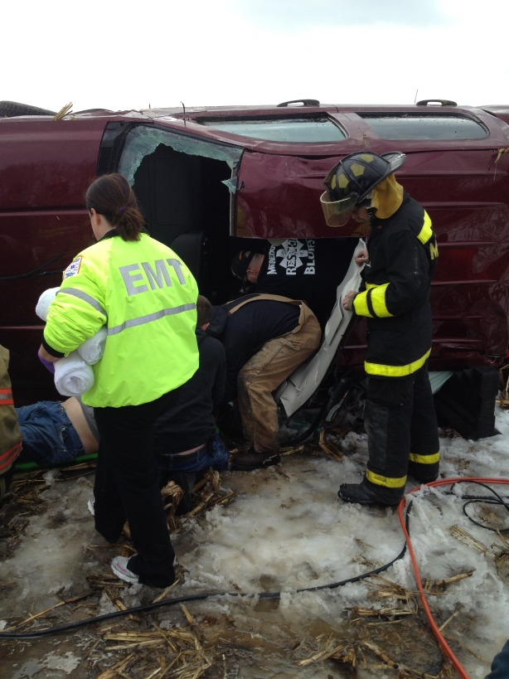
BSI
Standard precautions
Assume that all patients are potentially infected with bloodborne pathogens.
Use protective equipment.
Always wear approved gloves, and change gloves after contact with each patient.
Wash your hands with soap and water.
Always wear a protective mask, eyewear, or a face shield when you anticipate blood.

Slide 9
Responding
Scene safety is a most important consideration to you as an EMR.
Includes your safety and the safety of all other people present at the scene
An injured or dead EMR cannot help those in need.
Drive safely and always fasten your seatbelt when you are in your vehicle.
Parking your vehicle
Park your vehicle so that it protects the area from traffic hazards.
Be sure that the emergency warning lights are operating correctly.
Be careful when getting out of your vehicle.

Slide 10
Review
Stress is a normal part of an EMR’s life.
The five stages of the grief process when dealing with death and dying are denial, anger, bargaining, depression, and acceptance.
Stress management consists of recognizing, preventing, and reducing critical incident stress.
You should understand how airborne and bloodborne diseases are spread and how standard precautions prevent the spread of infection.

