Slide 1

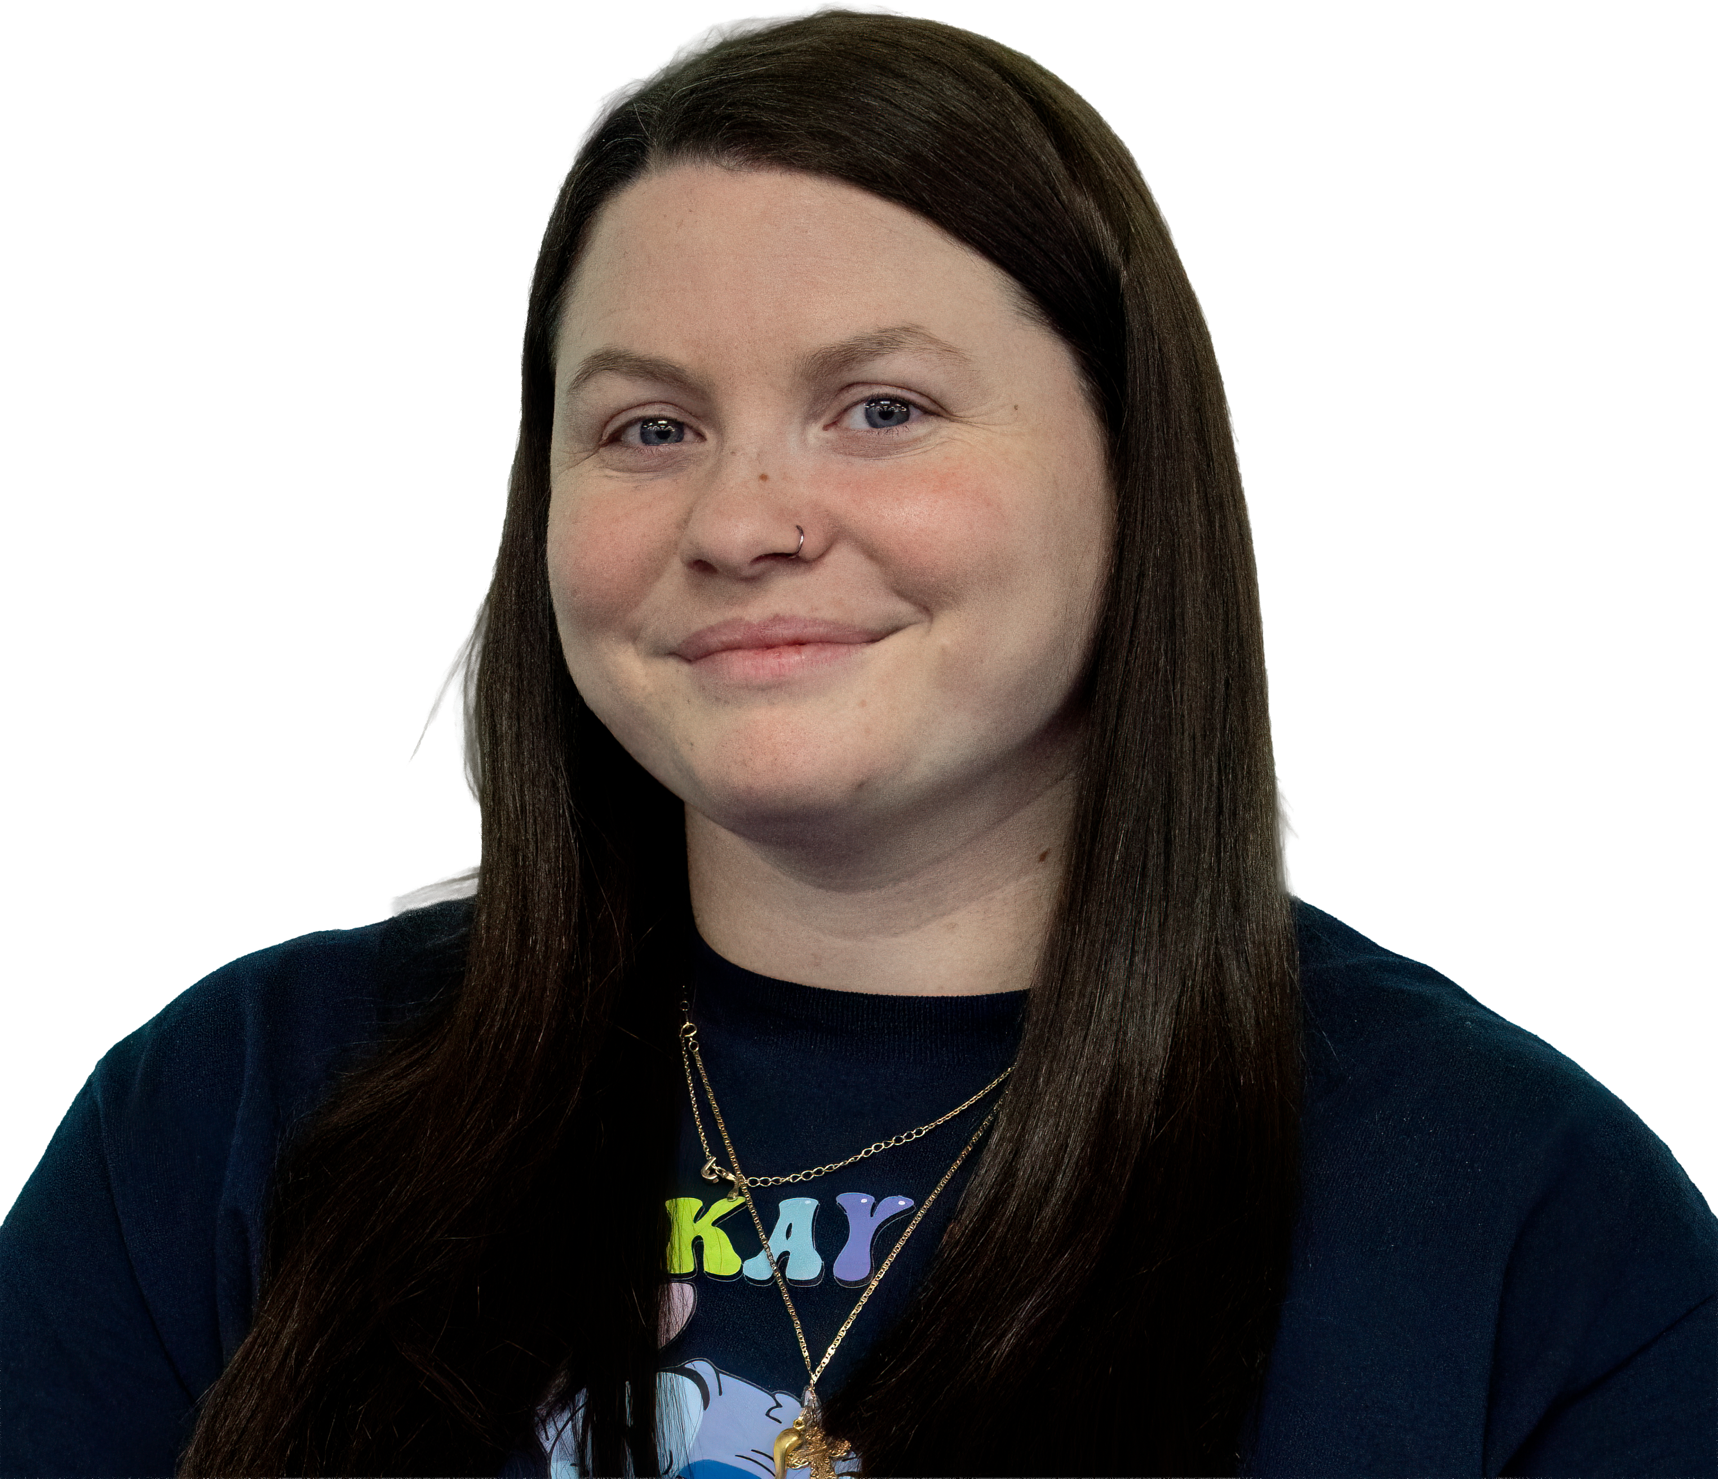

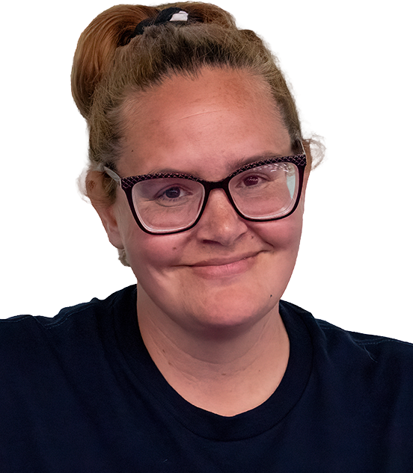
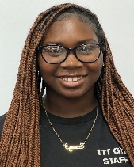
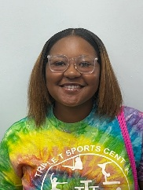
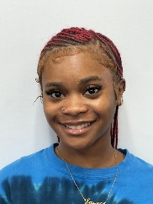
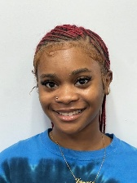

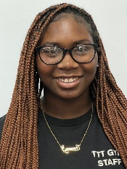
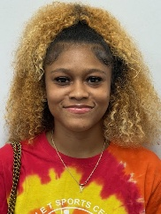

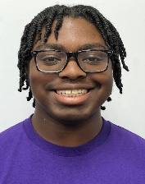
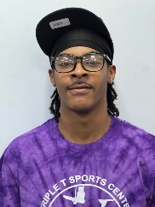

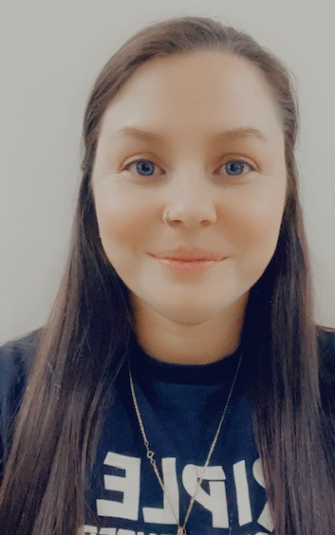

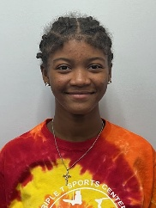
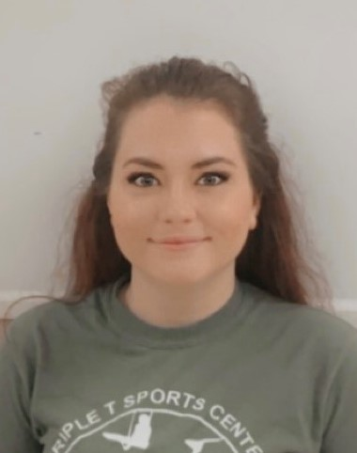
Triple T’s Amazing Staff
Kaitlyn Sabatino
Facility Manager
Childcare Director
Gymnastics Coach
Samantha Wilson
Preschool Director / Preschool Lead Teacher
Breionna Goodman
Recreational Director
Cheryl Burks: Business Manager/Owner
Recreational Gymnastics Instructors
Grace Sims
Recreational, Adv, Int, Ninja Instructor
Childcare Staff
Alicia Brown
Preschool Lead Teacher
Samantha Wilson
Recreational Instructor
Destiny Jackson
Lead Teacher
Ty’Shiyanna Riddick
Lead Teacher
Ty’Shiyanna Riddick
Recreational, Adv, Int, Ninja Instructor
Taekwondo / Ninja
Ju’Neela Beamon
Preschool Lead Teacher
Jenna Plumblee
TKD Director
Grace Sims
Lead Teacher
Zakiria Jordan
Lead Teacher
Destiny Jackson
Recreational / Ninja Instructor
Nathaniel Bowen
TKD/ Ninja Instructor
Dariente Riddick
Lead Teacher
Ju’Neela Beamon
Recreational Instructor
Ashley Conney
TKD
Instructor
Jacy Keith
Lead Teacher
Office Staff
Nathaniel Bowen
Assistant Teacher
Kaitlyn Sabatino
Office Customer Service
Dariente Riddick
Ninja Instructor
Orlexia Gordon
Lead Teacher
Hannah Miller
Recreational Instructor
Miracle Stephens
Lead Teacher
Sydney Bartkovich
Office Customer Service
Victoria Garrison
Recreational Instructor
Tyson Smith
Ninja / Boys Gymnastics Instructor

