Slide 1

Pharmacology Update
2019

Slide 2
Disclosures
      Speaker for ION division AmerisourceBergen 2019

Slide 3
Objectives
Identify new drugs/agents that have been FDA approved for cancer treatment in 2018/2019.
Recognize how new drugs/agents are given generic names.
Identify how to gain information about new drugs based on the generic naming system

Slide 4
Progress in Cancer Therapy 2019
  New FDA Approved Cancer Treatment Agents (since 1/1/18)
    29 total: 17 solid tumor & 12 hematologic
      2 radiopharmaceutical agents
      2 androgen receptor inhibitors
      1 cytotoxin
      1 asparagine specific enzyme
      23 Molecularly Targeted/Immunotherapy
      http://www.fda.gov/Drugs/InformationOnDrugs/ApprovedDrugs/ucm279174.htm

Slide 5
Progress in Cancer Therapy 2019
  New FDA Approved Cancer Treatment Agent Indications (since 1/1/18)
    30 drugs with 53 new indications
      38 solid tumor indications
      15 hematologic indications
      http://www.fda.gov/Drugs/InformationOnDrugs/ApprovedDrugs/ucm279174.htm

Slide 6
Trends

Slide 7
Trends 2019
    Immunotherapy and Molecular Therapies
      Subcutaneous formulations of monoclonal antibodies
      Expanded indications
        Neoadjuvant/adjuvant
        Metastatic and locally advanced treatment
        Maintenance after primary treatment
        New generations of drugs to treat drug resistance
      http://www.fda.gov/Drugs/InformationOnDrugs/ApprovedDrugs/ucm279174.htm

Slide 8
Trends 2019
      Biosimilars
          A biological product that is approved based on a showing that it is highly similar to an already-approved biological product, known as a reference product.
          The biosimilar also must show it has no clinically meaningful differences in terms of safety and effectiveness from the reference product.
          Only minor differences in clinically inactive components are allowable in biosimilar products.
      http://www.fda.gov/Drugs/InformationOnDrugs/ApprovedDrugs/ucm279174.htm

Slide 9
Trends 2019
    Radiolabeled pharmaceutical agents
      http://www.fda.gov/Drugs/InformationOnDrugs/ApprovedDrugs/ucm279174.htm

Slide 10
Trends 2019
    Cellular Gene Therapies
      2017: “The U.S. Food and Drug Administration issued a historic action today making the first gene therapy available in the United States, ushering in a new approach to the treatment of cancer and other serious and life-threatening diseases.”
      http://www.fda.gov/Drugs/InformationOnDrugs/ApprovedDrugs/ucm279174.htm

Slide 11
Trends 2019
    Tumor Agnostic Drugs
      Drugs designed to treat genomic alterations; not tumor histology specific
      http://www.fda.gov/Drugs/InformationOnDrugs/ApprovedDrugs/ucm279174.htm

Slide 12
Progress in Cancer Therapy 2018/19
Solid Tumor
    Non-Small Cell Lung Cancer (NSCLC)
    Small Cell Lung Cancer (SCLC)
    Breast
    Cervical
    Ovarian
    Melanoma
    Paragangliomas/ metastatic pheochromocytomas
    Hepatocellular
    Renal Cell
    Head and Neck Squamous Cell
    Tenosynovial giant cell tumor
      http://www.fda.gov/Drugs/InformationOnDrugs/ApprovedDrugs/ucm279174.htm

Slide 13
Progress in Cancer Therapy 2018/19
Solid Tumor
    Merkel Cell
    Squamous Cell (Skin)
    Colorectal
    Esophageal squamous
    Gastric or gastroesophageal junction (GEJ) adenocarcinoma:
    Gastroenteropancreatic neuroendocrine tumors (GEP-NETs), including foregut, midgut, and hindgut neuroendocrine tumors in adults:
    Thyroid
    Urothelial
    Prostate
    Tumor Agnostic
      http://www.fda.gov/Drugs/InformationOnDrugs/ApprovedDrugs/ucm279174.htm

Slide 14
Progress in Cancer Therapy 2018/19
Hematologic Malignancies
    Acute Myeloid Leukemia (AML)
    Acute Lymphoblastic Leukemia (ALL)
    Chronic Lymphocytic Leukemia (CLL) or Small Lymphocytic Lymphoma (SLL)
    Chronic Myelogenous Leukemia (CML)
    Hairy Cell Leukemia
    Myelofibrosis
    Blastic plasmacytoid dendritic cell neoplasm (BPDCN)
    Follicular Lymphoma (FL) and Marginal Zone Lymphoma (MZL)
    Non –Hodgkin Lymphoma
    Hodgkin lymphoma (HD)
    Mycoses Fungoides or Sezary Syndrome
    Multiple Myeloma
    Steroid-refractory Acute Graft Vs Host Disease
    Systemic Anaplastic Large Cell Lymphoma (pcALCL) or CD30-expressing peripheral T-cell lymphomas
      http://www.fda.gov/Drugs/InformationOnDrugs/ApprovedDrugs/ucm279174.htm

Slide 15
Tips for Learning about
New Cancer Therapies
Know the type of drug/agent
  Small molecule, monoclonal antibody, cellular gene therapy, vaccine, cytotoxic
Know the generic name
Know the target and what is does normally in the body/what other FDA approved drugs are similar
Know if the drug is genomically specific , requiring testing before administration

Slide 16
I know the generic name; but how do I pronounce it and how do I learn more??
http://www.cancer.gov/dictionary
http://www.mycancergenome.org/content/molecular- medicine/overview-of-targeted-therapies-for-cancer/
Reference list at end of slide set

Slide 17
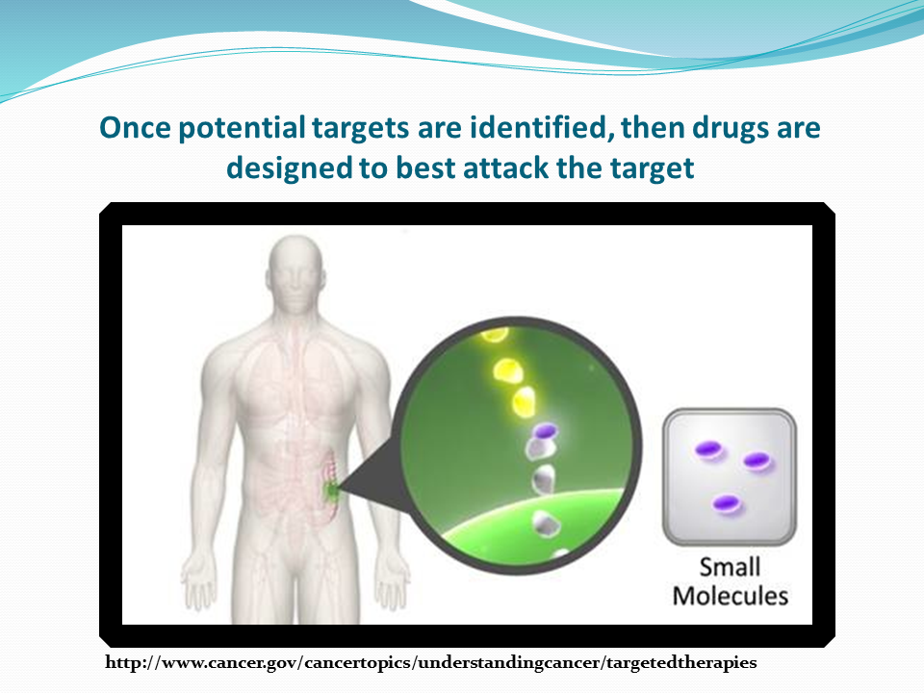

Slide 18
Small Molecules
Majority are oral, although a few are IV or subcutaneous.
Implications for orals:
  Adherence
  Possible drug/food , drug/drug interactions
  Patient education regarding taking medication correctly
Targets vary and side effects related to targets
http://www.ama-assn.org/ama/pub/physician-resources/medical-science/united-states-adopted-names-council/
naming-guidelines/naming-biologics/monoclonal-antibodies.page

Slide 19
Small Molecules
Naming Conventions
tinibs:
  tyrosine kinase inhibitors
    erlotinib, sunitinib, ponatinib, imatinib, dasatinib, ibrutinib, ruxolitinib, dacomitinib, lorlatinib, larotrectinib, gilteritinib, erdafitinib, pexidartinib, fedratinib, entrectinib
rafenibs/metinibs
  RAF/RAS/MEK kinase inhibitors
    sorafenib, dabrafenib, trametinib, vemurafenib, encorafenib, binimetinib
http://www.ama-assn.org/ama/pub/physician-resources/medical-science/united-states-adopted-names-council/
naming-guidelines/naming-biologics/monoclonal-antibodies.page

Slide 20
      dacomitinib (VIZIMPRO®) Pfizer (first line tx metastatic non-small lung cancer with EGFR exon 19 deletion or exon 21 L858R substitution mutations)
www.vizimpro.com

Slide 21
dacomitinib (VIZIMPRO®) Pfizer
    dacomitinib (VIZIMPRO) Pfizer (first line tx metastatic non-small lung cancer with EGFR exon 19 deletion or exon 21 L858R substitution mutations)
        Small molecule; oral kinase inhibitor
        Drug/drug interactions with, strong CYP2D6 substrates, PPIs
        Targets EGFR exon 19 deletions or exon 21 L858R substitution mutations
        Genomic alteration specific; testing required
        Side effects: interstitial lung disease, diarrhea, rash, paronychia, stomatitis, decreased appetite, dry skin, decreased weight, alopecia, cough, and pruritus.
www.vizimpro.com

Slide 22
      lorlatinib (LORBRENA®) Pfizer (ALK positive metastatic NSCLC whose disease has progressed on crizotinib and at least one other ALK inhibitor for metastatic disease or whose disease has progressed on alectinib or ceritinib as the first ALK inhibitor for metastatic disease)
www.lorbrena.com

Slide 23
lorlatinib (LORBRENA®) Pfizer
    lorlatinib (LORBRENA®) Pfizer (ALK positive metastatic NSCLC whose disease has progressed on crizotinib and at least one other ALK inhibitor for metastatic disease or whose disease has progressed on alectinib or ceritinib as the first ALK inhibitor for metastatic disease)
        Small molecule; oral tyrosine kinase inhibitor
        Drug/drug interactions with CYP3A inducers, inhibitors, and substrates
        Targets ALK
        Genomic alteration specific; testing required
        Side effects: edema, peripheral neuropathy, cognitive effects, dyspnea, fatigue, weight gain, arthralgia, mood effects, diarrhea, hepatotoxicity, CNS effects, hyperlipidemia, A-V block, interstitial lung disease,
www.lorbrena.com

Slide 24
    larotrectinib VITRAKVI® Loxo Oncology and Bayer
    Tumor Agnostic: (Adult and pediatric pts with solid tumors that have a neurotrophic receptor tyrosine kinase (NTRK) gene fusion without a known acquired resistance mutation, that are either metastatic or where surgical resection is likely to result in severe morbidity and who have no satisfactory alternative txs or whose cancer has progressed following tx)
www.vitrakvi.com

Slide 25
larotrectinib VITRAKVI®
    larotrectinib VITRAKVI® Loxo Oncology and Bayer
    Tumor Agnostic: (Adult and pediatric pts with solid tumors that have a neurotrophic receptor tyrosine kinase [NTRK] gene fusion without a known acquired resistance mutation, that are either metastatic or where surgical resection is likely to result in severe morbidity and who have no satisfactory alternative txs or whose cancer has progressed following tx)
        Small molecule; oral tyrosine kinase inhibitor
        Drug/drug interactions with strong CYP3A4 inducers/inhibitors, and sensitive CYP3A4 substrates
        Targets NTRK
        Genomic alteration specific; testing required
        Side effects: fatigue, nausea, dizziness, vomiting, increased AST, cough, increased ALT, constipation, diarrhea, neurotoxicity, hepatotoxicity.
www.vitrakvi.com

Slide 26
    entrectinib ROZLYTREK™ Genentech Inc.
    Tumor Agnostic: (Adult and pediatric pts 12 years and older with solid tumors that have a neurotrophic receptor tyrosine kinase (NTRK) gene fusion without a known acquired resistance mutation, that are either metastatic or where surgical resection is likely to result in severe morbidity and who have no satisfactory alternative txs or whose cancer has progressed following tx)
    NSCLC: (Adult patients with metastatic non-small cell lung cancer (NSCLC) whose tumors are ROS1-positive)
www.rozlytrek.com

Slide 27
entrectinib ROZLYTREK™
    entrectinib ROZLYTREK™ Genentech Inc.
    Tumor Agnostic: (Adult and pediatric pts 12 years and older with solid tumors that have a neurotrophic receptor tyrosine kinase (NTRK) gene fusion without a known acquired resistance mutation, that are either metastatic or where surgical resection is likely to result in severe morbidity and who have no satisfactory alternative txs or whose cancer has progressed following tx)
      NSCLC: Adult patients with metastatic non-small cell lung cancer (NSCLC) whose tumors are ROS1-positive.
        Small molecule; oral tyrosine kinase inhibitor
        Drug/drug interactions with moderate and strong CYP3A4 inducers/inhibitors,
        Targets NTRK/ROS1 ; Genomic alteration specific; testing required
        Side effects: fatigue, nausea, dizziness, vomiting, increased AST, cough, edema, dysesthesias, dyspnea, myalgia/arthralgia, cognitive impairment, cough, pyrexia, visions disorders, CHF, CNS issues, constipation, diarrhea, hepatotoxicity, QT prolongation, hyperuricemia, skeletal fractures
www.rozlytrek.com

Slide 28
      gilteritinib XOSPATA® Astellas Pharma(adult pts with relapsed or refractory AML with a FLT3 mutation)
www.xospata.com

Slide 29
gilteritinib XOSPATA®
    gilteritinib XOSPATA® Astellas Pharma(adult pts with relapsed or refractory AML with a FLT3 mutation)
        Small molecule; oral tyrosine kinase inhibitor
        Drug/drug interactions with strong CYP3A inhibitors, combined P-gp and strong CYP3A inducers.
        Targets FLT3
        Genomic alteration specific; testing required
        Side effects: myalgia/arthralgia, transaminase increase, fatigue/malaise, fever, noninfectious diarrhea, dyspnea, edema, rash, pneumonia, nausea, stomatitis, cough, headache, hypotension, dizziness, vomiting, posterior reversible encephalopathy syndrome, pancreatitis, prolonged QT interval.
www.xospata.com

Slide 30
      erdafitinib BALVERSA ™ Janssen Pharmaceutical Companies (locally advanced or metastatic urothelial carcinoma, with susceptible FGFR3 or FGFR2 genetic alterations, that has progressed during or following platinum-containing chemotherapy, including within 12 months of neoadjuvant or adjuvant platinum-containing chemotherapy)
www.BALVERSA.com

Slide 31
erdafitinib BALVERSA ™
      erdafitinib BALVERSA ™ Janssen Pharmaceutical Companies (locally advanced or metastatic urothelial carcinoma, with susceptible FGFR3 or FGFR2 genetic alterations, that has progressed during or following platinum-containing chemotherapy, including within 12 months of neoadjuvant or adjuvant platinum-containing chemotherapy)
        Small molecule, oral kinase inhibitor
        Drug/drug interactions with P-gp substrates, strong CYP2C9 or CYP3A4 inhibitors, strong/moderate CYP2C9 or CYP3A4 inducers, CYP3A4 substrates,OCT2 substrates, serum phosphate level-altering agents
        Targets FGFR gene alterations (point mutations, amplifications, fusions)
        Genomic alteration specific; testing required
        Side effects: ocular disorders, hyperphosphatemia, stomatitis, fatigue, creatinine increased, diarrhea, dry mouth, onycholysis, alanine aminotransferase increased, alkaline phosphatase increased, sodium decreased, decreased appetite, albumin decreased, dysgeusia, hemoglobin decreased, dry skin, aspartate aminotransferase increased, magnesium decreased, dry eye, alopecia, palmarplantar erythrodysesthesia syndrome, constipation, phosphate decreased, abdominal pain, calcium increased, nausea, and musculoskeletal pain.
www.balversa.com

Slide 32
      pexidartinib TURALIO™ Daiichi-Sankyo (adult patients with symptomatic tenosynovial giant cell tumor [TGCT] associated with severe morbidity or functional limitations and not amenable to improvement with surgery)
www. TURALIO.com

Slide 33
pexidartinib TURALIO™
      pexidartinib TURALIO™ Daiichi-Sankyo (adult patients with symptomatic tenosynovial giant cell tumor [TGCT] associated with severe morbidity or functional limitations and not amenable to improvement with surgery)
        Small molecule, oral kinase inhibitor
        Drug/drug interactions with strong CYP3A inhibitors and inducers, UGT inhibitors, proton pump inhibitors, products known to cause hepatotoxicity
        Drug/food interactions with grapefruit juice
        Targets colony stimulating factor 1 receptor (CSF1R), KIT proto-oncogene receptor, and FMS-like tyrosine kinase 3 (FLT3) with an internal tandem duplication mutation
        No genomic alteration testing needed prior to administration
        REMS due to hepatotoxicity
        Side effects: increased lactate dehydrogenase, increased aspartate aminotransferase, hair color changes, fatigue, increased alanine aminotransferase, decreased neutrophils, increased cholesterol, increased alkaline phosphatase, decreased lymphocytes, eye edema, decreased hemoglobin, rash, dysgeusia, and decreased phosphate.
www. TURALIO.com

Slide 34
      fedratinib INREBIC® Impact Biomedicines, Inc. (for adults intermediate-2 or high-risk primary or secondary (post-polycythemia vera or post-essential thrombocythemia) myelofibrosis (MF))
www. INREBIC.com

Slide 35
fedratinib INREBIC®
      fedratinib INREBIC® Impact Biomedicines, Inc. (for adults intermediate-2 or high-risk primary or secondary (post-polycythemia vera or post-essential thrombocythemia) myelofibrosis (MF))
        Small molecule, oral kinase inhibitor
        Drug/drug interactions with strong CYP3A4 inhibitors and strong/moderate CYP3A4 inducers, dual CYP3A4 and CYP2C19 inhibitors
        Targets wild type and mutationally activated JAK2 and FLT3 tyrosine kinases
        No genomic alteration testing needed prior to administration
        Side effects: diarrhea, nausea, vomiting, anemia, thrombocytopenia hepatic toxicity, amylase/lipase elevation, serious and fatal encephalopathy (check baseline levels of thiamine/Vitamin B1)
www. INREBIC.com

Slide 36
Small Molecules
Naming Conventions
paribs
  PARP inhibitors: inhibitors of mammalian polyadenosine 5’-diphosphoribose polymerase (PARP) enzyme.
    olaparib, rucaparib, niraparib, talazoparib
http://www.ama-assn.org/ama/pub/physician-resources/medical-science/united-states-adopted-names-council/
naming-guidelines/naming-biologics/monoclonal-antibodies.page

Slide 37
      talazoparib TALZENNA ™ Pfizer Inc.( a poly [ADP-ribose] polymerase [PARP] inhibitor, for patients with deleterious or suspected deleterious germline BRCA-mutated [gBRCAm], HER2 negative locally advanced or metastatic breast cancer.)
www.talzenna.com

Slide 38
talazoparib (TALZENNA™)
      talazoparib TALZENNA ™ Pfizer Inc. (a poly [ADP-ribose] polymerase [PARP] inhibitor, for adult patients with deleterious or suspected deleterious germline BRCA-mutated [gBRCAm], HER2 negative locally advanced or metastatic breast cancer)
        Small molecule, oral (PARP) inhibitor
        Drug/drug interactions with P-gp inhibitors
        Targets PARP enzymes
        Genomic alteration specific; testing required
        Side effects: Fatigue, nausea, myelosuppression, vomiting, alopecia, diarrhea, decreased appetite. decreases in lymphocytes, leukocytes, and calcium. Rare risk of MDS/AML. Increases in glucose, alanine aminotransferase, aspartate aminotransferase, and alkaline phosphatase.
www.talzenna.com

Slide 39
Small Molecules
Naming Conventions
lisibs:
  PI3 kinase inhibitors
    idelalisib, copanlisib, duvelisib, alpelisib
http://www.ama-assn.org/ama/pub/physician-resources/medical-science/united-states-adopted-names-council/
naming-guidelines/naming-biologics/monoclonal-antibodies.page

Slide 40
      duvelisib (COPIKTRA™) Veristem (relapsed/refractory chronic lymphocytic lymphoma or small lymphocytic lymphoma after at least 2 prior therapies. Also, relapsed/refractory follicular lymphoma after at least 2 prior therapies.)
www.copiktra.com

Slide 41
duvelisib (COPIKTRA™)
      duvelisib (COPIKTRA™) Veristem (relapsed/refractory chronic lymphocytic lymphoma or small lymphocytic lymphoma after at least 2 prior therapies. Also, relapsed/refractory follicular lymphoma after at least 2 prior therapies)
        Small molecule, oral kinase inhibitor
        Drug/drug interactions with CYP3A4 inducers, substrates and inhibitors
        Targets PI3K
        No genomic alteration testing needed prior to administration
        Side effects: pneumonitis, infections, cutaneous rxns, diarrhea or colitis, hepatotoxicity, neutropenia, rash, fatigue, pyrexia, cough, nausea, upper respiratory infection, pneumonia, musculoskeletal pain, and anemia.
www.copiktra.com

Slide 42
      alpelisib PIQRAY® Novartis (in combination with fulvestrant for postmenopausal women, and men, with hormone receptor (HR)-positive, (HER2)-negative, PIK3CA-mutated, advanced or metastatic breast cancer following progression on or after an endocrine-based regimen)
www.PIQRAY.com

Slide 43
alpelisib (PIQRAY®)
      alpelisib PIQRAY® Novartis (in combination with fulvestrant for postmenopausal women, and men, with hormone receptor (HR)-positive, (HER2)-negative, PIK3CA-mutated, advanced or metastatic breast cancer following progression on or after an endocrine-based regimen.
        Small molecule, oral kinase inhibitor
        Drug/drug interactions with strong CYP3A4 inducers, CYP2C9 substrates and BCRP inhibitors
        Targets PI3K
        No genomic alteration testing needed prior to administration
        Side effects: Severe hypersensitivity, severe cutaneous rxns, hyperglycemia, pneumonitis, diarrhea, creatinine increased, rash, lymphocyte count decreased, GGT increased, nausea, ALT increased, fatigue, hemoglobin decreased, lipase increased, decreased appetite, stomatitis, vomiting, weight decreased, calcium decreased, glucose decreased, aPTT prolonged, and alopecia
www.PIQRAY.com

Slide 44
Small Molecules
Naming Conventions
degibs:
  Sonic hedgehog pathway inhibitors
    sonidegib, vismodegib, glasdegib
http://www.ama-assn.org/ama/pub/physician-resources/medical-science/united-states-adopted-names-council/
naming-guidelines/naming-biologics/monoclonal-antibodies.page

Slide 45
      glasdegib DAURISMO ™ Pfizer (in combination with low-dose cytarabine for newly diagnosed AML in pts who are 75 y/o or older or who have co-morbidities that preclude intensive chemotherapy)
www.daurismo.com

Slide 46
glasdegib DAURISMO™
    glasdegib DAURISMO ™ Pfizer (in combination with low-dose cytarabine for newly diagnosed AML in pts who are 75 y/o or older or who have co-morbidities that preclude intensive chemotherapy)
        Small molecule; sonic hedgehog pathway inhibitor
        Drug/drug interactions with strong CYP3A4 inhibitors/inducers; QTc prolonging drugs
        No genomic alteration testing needed prior to administration
        Side effects: myalgia/arthralgia, transaminase increase, fatigue/malaise, fever, noninfectious diarrhea, dyspnea, edema, rash, pneumonia, nausea, stomatitis, cough, headache, hypotension, dizziness, vomiting, QTc interval prolongation. Advised patients not to donate blood or blood products during tx or during 30 days after last dose.
www.daurismo.com

Slide 47
Small Molecules
Naming Conventions
denibs:
  Isocitrate dehydrogenase IDH enzyme inhibitors
    enasidenib (IDH2), ivosidenib (IDH1)
ciclibs:
  Cyclin dependent kinase (CDK) 4 & 6 inhibitors
    palbociclib, ribociclib, abemaciclib
zomibs:
  Proteasome inhibitors
    bortezomib, carfilzomib, ixazomib
http://www.ama-assn.org/ama/pub/physician-resources/medical-science/united-states-adopted-names-council/
naming-guidelines/naming-biologics/monoclonal-antibodies.page

Slide 48
Small Molecules
Naming Conventions
toclax:
  BCL-2 inhibitors
    venetoclax
inostats:
  Histone deacetylase inhibitors (HDAC inhibitors)
    vorinostat, belinostat, panobinostat
http://www.ama-assn.org/ama/pub/physician-resources/medical-science/united-states-adopted-names-council/
naming-guidelines/naming-biologics/monoclonal-antibodies.page

Slide 49
Small Molecules
Naming Conventions
nexor
  small molecule inhibitor of CRM1 (chromosome region maintenance 1 protein, exportin 1 or XPO1), with potential antineoplastic activity. Via the approach of selective inhibition of nuclear export (SINE), restores endogenous tumor suppressing processes to selectively eliminate tumor cells while sparing normal cells.
    selinexor
http://www.ama-assn.org/ama/pub/physician-resources/medical-science/united-states-adopted-names-council/
naming-guidelines/naming-biologics/monoclonal-antibodies.page

Slide 50
      selinexor XPOVIO™ Karyopharm Therapeutics (in combination with dexamethasone for adult patients with relapsed or refractory multiple myeloma (RRMM) who have received at least four prior therapies and whose disease is refractory to at least two proteasome inhibitors, at least two immunomodulatory agents, and an anti-CD38 monoclonal antibody)
www.xpovio.com

Slide 51
selinexor XPOVIO™
      selinexor XPOVIO™ Karyopharm Therapeutics (in combination with dexamethasone for adult patients with relapsed or refractory multiple myeloma (RRMM) who have received at least four prior therapies and whose disease is refractory to at least two proteasome inhibitors, at least two immunomodulatory agents, and an anti-CD38 monoclonal antibody)
        Small molecule, nuclear export inhibitor. First in class.
        No drug/drug interactions
        Targets exportin 1 (XPO1)
        No genomic alteration testing needed prior to administration
        Side effects: thrombocytopenia, neutropenia,, hyponatremia, neuro tox, fatigue, nausea, anemia, decreased appetite, decreased weight, diarrhea, vomiting, leukopenia, constipation, dyspnea, and upper respiratory tract infection
www. xpovio.com

Slide 52
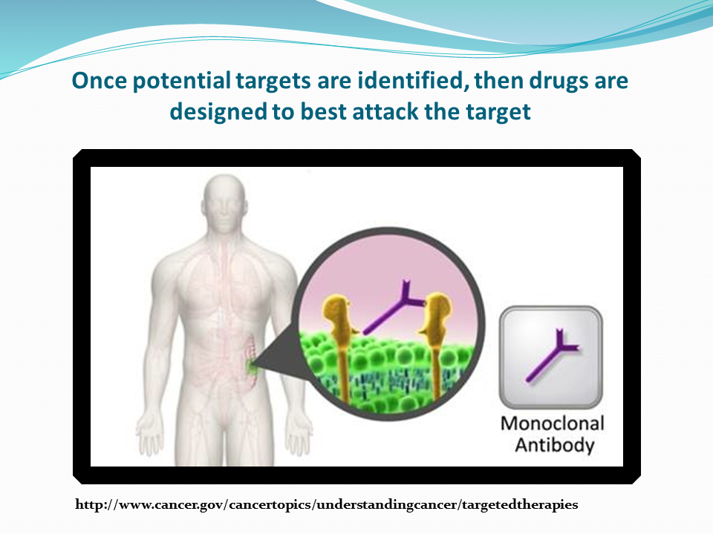

Slide 53
Monoclonal Antibody
Naming Conventions
Monoclonal antibody = mab
tositumomab and iodine 131
  mo = mouse
rituximab
  xi = chimeric or cross between mouse and human
trastuzumab, bevacizumab
  zu = humanized
panitumumab
  u = fully human (may also leave out the u)
http://www.ama-assn.org/ama/pub/physician-resources/medical-science/united-states-adopted-names-council/naming-guidelines/naming-biologics/monoclonal-antibodies.page

Slide 54
What does the name mean?
t or tu = tumor
trastuzumab
ci = circulatory
bevacizumab
li or l = immunomodulator
ipilimumab
http://www.ama-assn.org/ama/pub/physician-resources/medical-science/united-states-adopted-names-council/naming-guidelines/naming-biologics/monoclonal-antibodies.page

Slide 55
What does the name mean?
One or two words added to name indicates it is a conjugated monoclonal antibody. May be combined with:
  Radioactive particle: ibritumomab tiuxetan
  Drug (antibody-drug conjugate): ado-trastuzumab emtansine
http://www.ama-assn.org/ama/pub/physician-resources/medical-science/united-states-adopted-names-council/naming-guidelines/naming-biologics/monoclonal-antibodies.page

Slide 56
What does the name mean?
Biosimilars have the reference product generic name as the “core” with “4 lower case letters devoid of meaning” attached by a hyphen as a suffix:
  bevacizumab-awwb Mvasi™
  trastuzumab-dskt Ogivri™
  trastuzumab-pkrb Herzuma®
  rituximab-abbs Truxima®
http://www.ama-assn.org/ama/pub/physician-resources/medical-science/
united-states-adopted-names-council/naming-guidelines/naming-biologics
/monoclonal-antibodies.page

Slide 57
      trastuzumab-pkrb Herzuma® Celltrion (biosimilar to trastuzumab for HER2-overexpressing breast cancer)
www.Herzuma.com

Slide 58
trastuzumab-pkrb Herzuma®
      trastuzumab-pkrb Herzuma® Celltrion (biosimilar to trastuzumab for HER2-overexpressing breast cancer)
        Humanized monoclonal antibody; biosimilar to trastuzumab
        Potential infusion reactions
        Targets HER2 overexpression
        Genomic alteration specific; testing required
        Side effects: headache, diarrhea, nausea, fever, chills, infection, congestive heart failure, insomnia, cough, rash, cardiomyopathy, infusion reactions, pulmonary toxicity.
www.Herzuma.com

Slide 59
      rituximab-abbs TRUXIMA® Celltrion (CD20-positive B-cell non –Hodgkin Lymphoma as single agent or in combination with chemotherapy)
www.truxima.com

Slide 60
rituximab-abbs TRUXIMA®
      rituximab-abbs TRUXIMA® Celltrion (CD20-positive B-cell non –Hodgkin Lymphoma as single agent in relapsed /refractory low grade or follicular; 1st line with chemotherapy in follicular and as single agent maintenance therapy; and non-progressing low-grade as single agent after 1st line CVP chemotherapy)
        Chimeric monoclonal antibody; biosimilar to rituximab
        Potential infusion reactions; can be fatal within 24 hours
        Targets CD20-positive B cells
        No genomic alteration testing needed prior to administration
        Side effects: tumor lysis syndrome, infusion related reactions (potentially fatal), infections, cardiac events, renal toxicity, bowel obstruction/perforation, fever, lymphopenia, chills, asthenia, mucocutaneous rxns., leukoencephalopathy, HBV reactivation
www.truxima.com

Slide 61
What does the name mean?
In 2017, the FDA made the decision to name all new biologics (not just biosimilars) with“4 lower case letters devoid of meaning” attached by a hyphen as a suffix:
  There was concern that the suffix on biosimilars would serve as a barrier to their use; creating a misimpression that they were inferior to the reference (originator) products
  Resulted in the FDA deciding to attached the suffix to all new biologics; not just biosimilars
  Change in naming advances patient safety and creates a high quality, competitive market
  FDA does not intend to modify the proper names of biological products that have already been licensed or approved under the Public Health Service Act without an FDA-designated suffix in their proper names.
http://www.ama-assn.org/ama/pub/physician-resources/medical-science/
united-states-adopted-names-council/naming-guidelines/naming-biologics
/monoclonal-antibodies.page

Slide 62
      trastuzumab and hyaluronidase-oysk injection™ Herceptin Hylecta Genentech (subcutaneous combination of trastuzumab, a HER2/neu receptor antagonist, and hyaluronidase, an endoglycosidase, for the treatment of HER2 overexpressing breast cancer)
www.Herceptin Hylecta.com

Slide 63
trastuzumab and hyaluronidase-oysk injection™
      trastuzumab and hyaluronidase-oysk injection™ Herceptin Hylecta Genentech (subcutaneous combination of trastuzumab, a HER2/neu receptor antagonist, and hyaluronidase, an endoglycosidase, for the treatment of HER2 overexpressing breast cancer)
        Humanized monoclonal antibody; subcutaneous use only
        Potential infusion reactions
        Targets HER2 overexpression
        Genomic alteration specific; testing required
        Side effects: headache, diarrhea, nausea, fever, chills, infection, neutropenia, congestive heart failure, insomnia, cough, rash, cardiomyopathy, infusion reactions, pulmonary toxicity.
www.Herceptin Hylecta.com

Slide 64
      moxetumomab pasudotox-tdfk (LUMOXITI™) AstraZeneca (CD22-directed cytotoxin indicated for adult patients with relapsed or refractory hairy cell leukemia [HCL] who received at least two prior systemic therapies, including treatment with a purine nucleoside analog [PNA])
www.lumoxiti.com

Slide 65
moxetumomab pasudotox-tdfk (LUMOXITI™)
      moxetumomab pasudotox-tdfk (LUMOXITI™) AstraZeneca (CD22-directed cytotoxin indicated for adult patients with relapsed or refractory hairy cell leukemia [HCL] who received at least two prior systemic therapies, including treatment with a purine nucleoside analog [PNA])
        Monoclonal antibody; antibody drug conjugate
        Potential infusion reactions; needs pre-meds for all infusions
        Targets CD22
        No genomic alteration testing needed prior to administration
        Side effects: infusion related reactions, edema, nausea, fatigue, headache, pyrexia, constipation, anemia, and diarrhea. Most common (≥ 50%) laboratory abnormalities are creatinine increased, ALT increased, hypoalbuminemia, AST increased, hypocalcemia, and hypophosphatemia. Renal toxicity, capillary risk syndrome, hemolytic uremic syndrome
www.lumoxiti.com

Slide 66
      cemiplimab-rwlc LIBTAYO® Regeneron Pharmaceuticals Inc. (for patients with metastatic cutaneous squamous cell carcinoma (CSCC) or locally advanced CSCC who are not candidates for curative surgery or curative radiation)
www.libtayo.com

Slide 67
cemiplimab-rwlc LIBTAYO®
      cemiplimab-rwlc LIBTAYO® Regeneron Pharmaceuticals Inc. (for patients with metastatic cutaneous squamous cell carcinoma (CSCC) or locally advanced CSCC who are not candidates for curative surgery or curative radiation)
        Human monoclonal antibody
        Potential infusion reactions
        Targets PD-1
        No genomic alteration testing needed prior to administration
        Side effects: immune related adverse events, infusion related reactions, fatigue, rash, diarrhea
www.libtayo.com

Slide 68
      polatuzumab vedotin-piiq POLIVY Genentech, Inc.(in combination with bendamustine and a rituximab product for adult patients with relapsed or refractory diffuse large B-cell lymphoma (DLBCL), not otherwise specified, after at least two prior therapies)
www.polivy.com

Slide 69
polatuzumab vedotin-piiq POLIVY ™
      polatuzumab vedotin-piiq POLIVY™ Genentech, Inc.(in combination with bendamustine and a rituximab product for adult patients with relapsed or refractory diffuse large B-cell lymphoma (DLBCL), not otherwise specified, after at least two prior therapies)
        Humanized monoclonal antibody-drug conjugate
        Potential infusion reactions; pre-meds needed
        Targets CD79b
        Drug/drug interactions with strong CPY3A inhibitors and inducers
        No genomic alteration testing needed prior to administration
        Side effects: neutropenia ,thrombocytopenia, anemia, peripheral neuropathy, fatigue, diarrhea, pyrexia, decreased appetite, and pneumonia, infections, progressive multifocal leukoencephalopathy, tumor lysis syndrome, hepatotoxicity
www.polivy.com

Slide 70
Living Drugs/ Genetically
Engineered Cells

Slide 71
leucel
Cellular therapies; “living drugs”
Intravenous; currently must be given at approved centers
Precision: Cells from patient, genetically engineered and given back to pt
Examples
  sipuleucel-T, tisagenlecleucel, axicabtagene ciloleucel
http://www.ama-assn.org/ama/pub/physician-resources/medical-science/united-states-adopted-names-council/naming-guidelines/naming-biologics/monoclonal-antibodies.page

Slide 72
Radiolabeled Pharmaceutical
Agents

Slide 73
radiolabeled
      lutetium Lu 177 dotatate, LUTATHERA® Advanced Accelerator Applications USA, Inc. (a radiolabeled somatostatin analog, for the treatment of somatostatin receptor-positive gastroenteropancreatic neuroendocrine tumors (GEP-NETs), including foregut, midgut, and hindgut neuroendocrine tumors in adults)
      iobenguane I 131 AZEDRA® Progenics (adult and pediatric pts 12 and older with iobenguane scan-positive, unresectable, locally advanced or metastatic paragangliomas or pheochromocytomas that require systemic anticancer therapy)
      http://www.fda.gov/Drugs/InformationOnDrugs/ApprovedDrugs/ucm279174.htm

Slide 74
The Others

Slide 75
      tagraxofusp-erzs ELZONRIS™ Stemline Therapeutics (a CD123-directed cytotoxin for blastic plasmacytoid dendritic cell neoplasm in adult and pediatric pts 2 y/o and older)
www.elzonris.com

Slide 76
tagraxofusp-erzs ELZONRIS™
      tagraxofusp-erzs ELZONRIS™ Stemline Therapeutics (a CD123-directed cytotoxin for blastic plasmacytoid dendritic cell neoplasm in adult and pediatric pts 2 y/o and older)
        CD-123 directed cytotoxin
        Potential infusion reactions; pre-medicate
        Targets CD123
        No genomic alteration testing needed prior to administration
        Side effects: capillary leak syndrome (potentially fatal), hypersensitivity rxns., hepatotoxicity nausea, fatigue, peripheral edema, pyrexia and weight increase, decreases in albumin, platelets, hemoglobin, calcium, and sodium; increases in glucose, ALT and AST.
www.elzonris.com

Slide 77
      calaspargase pegol-mknl ASPARLAS™ Servier (a component of a multi-agent chemotherapeutic regimen for ALL in pediatric and young adult pts age 1 month to 21 years. An asparagine specific enzyme; allows for a longer interval between doses compared to other pegasparagase products)
www.asparlas.com

Slide 78
calaspargase pegol-mknl ASPARLAS™
      calaspargase pegol-mknl ASPARLAS™ Servier (a component of a multi-agent chemotherapeutic regimen for ALL in pediatric and young adult pts age 1 month to 21 years. An asparagine specific enzyme; allows for a longer interval between doses compared to other pegasparagase products)
        Asparagine specific enzyme
        Potential hypersensitivity reactions; observe 1 hour after administration
        Not genomic alteration specific
        Side effects: Thrombosis, hemorrhage, hepatotoxicity, hypersensitivity rxns, elevated transaminase, bilirubin increased, pancreatitis and abnormal clotting studies.
www.asparlas.com

Slide 79
    darolutamide NUBEQA® Bayer (treatment of patients with non-metastatic castration-resistant prostate cancer)
www.nubeqa.com

Slide 80
darolutamide NUBEQA®
    darolutamide NUBEQA ® Bayer (treatment of patients with non-metastatic castration-resistant prostate cancer)
        Oral androgen receptor inhibitor
        Patient needs a gonadotropin-releasing hormone analog concurrently or should have had a bilateral orchiectomy
        Drug interactions: Combined P-gp and strong or moderate CYP3A4 inducers, Combined P-gp and strong CYP3A4 inhibitors, BCRP substrates
        No genomic alteration testing needed prior to administration
        Side effects: fatigue, pain in extremity, rash, neutropenia, abnormal liver function
www.nubeqa.com

Slide 81


Slide 82


Slide 83
References
http://www.ama-assn.org/ama/pub/physician-resources/medical-science/united-states-adopted-names-council/naming-guidelines/naming-biologics/monoclonal-antibodies.page
http://www.cancer.gov/cancertopics/understandingcancer/targetedtherapies
http://www.cancer.gov/dictionary
http://www.fda.gov/Drugs/InformationOnDrugs/ApprovedDrugs/ucm279174. htm
http://www.mycancergenome.org

Slide 84
References
http://www.adcetris.com
http://www.aliqopa.com
http://www.alunbrig.com
http://www.asparlas.com
http://www.avastin.com
http://www.azedra.com
http://www.blaversa.com
http://www.bavencio.com
http://www.besponsa.com
http://www.blincyto.com
http://www.braftovi.com
http://www.cabometyx.com
http://www.calquence.com
http://www.copiktra.com
http://www.daurismo.com
http://www.elzonris.com
http://www.herceptin hylecta.com

Slide 85
References
http://www.herzuma.com
http://www.ibrance.com
http://www.idhifa.com
http://www.imbruvica.com
http://www.imfinzi.com
http://www. Inrebic.com
http://www.jevtana.com
http://www.kadcyla.com
http://www.keytruda.com
http://www.kisqali.com
http://www.kymrhia.com
http://www.lenvima.com
http://www.libtayo.com
http://www.lorbrena.com

Slide 86
References
http://www.lumoxiti.com
http://www.lynparza.com
http://www. mekinist.com
http://www.mvasi.com
http://www.mektovi.com
http://www.mylotarg.com
http://www.nerlynx.com
http:/www.nubeqa.com
http://www.ogivri.com
http://www.opdivo.com
http://www.piqray.com
http://www.poteligeo.com
http://www.revlimid.com
http://www.rituxanhycela.com
http://www.rozlytrek.com
http://www.rubraca.com
http://www.rydapt.com

Slide 87
References
http://www.stivarga.com
http://www.tafinlar.com
http://www.tasigna.com
http://www.tagrisso.com
http://www.talzenna.com
http://www.tecentriq.com
http://www.tibsovo.com
http://www.truxima.com
http://turlario.com
http://www.venclexta.com
http://www.verzenio.com
http://www.vizimpro.com
http://www.vyxeos.com
http://www.vitrakvi.com

Slide 88
References
http://www.vitrakvi.com
http://www.xospata.com
http://www.xpovio.com
http://www.xtandi.com
http://www.yescarta.com
http://www.yervoy.com
http://www.zejula.com
http://www.zykadia.com

