Slide 1
The service structure of Alcoholics Anonymous
“Service that helps us stay sober”

Slide 2
Primary Purpose of this workshop
Provide a general introduction about AA service, including sharing resources where more information can be obtained.
It is hoped that this workshop will help inform our local fellowship about AA service and motivate us to get more active in carrying out the third legacy.

Slide 3
Schedule for the day
12:30-1:00 - Enjoy a fresh lunch
1:00-1:45 - “What is AA service?”
1:45-2:00 - 15 minute break
2:00-2:45 – “How do we do AA service?”
2:45-3:00 – 15 minute break
3:00-4:00 – “The 12 Concepts of World Service”

Slide 4
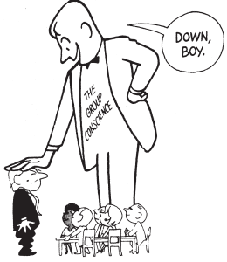
What is AA service?
What to expect for the first session:
Audio track of Bill W introducing AA service
Language of the traditions
AA service structure
Circles of Love and Service
Inside AA – service boards, committees
Service Positions at the group level
Area Committee Meeting (to be held in Yellowknife this May)

Slide 5
Bill W’s message on service:
Summary:
AA had become an incorporated board, and was concerned about the general welfare of the message and traditions of the program
Authorities were developed and assumed for important decisions such as: to print literature, solve group troubles, speak to the public, print the grapevine
The founders and board could not be in charge of things forever, they were too fallible – the day might come where there would be conflict. How could it be guaranteed to continue? How could it be secure?
Each group had its habits intact – and were ready to take matters of affairs into their own hands

Slide 6
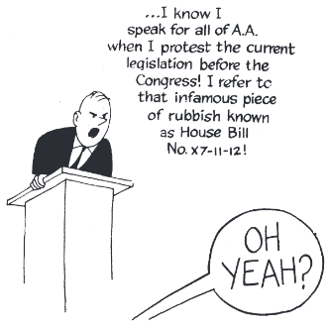
The Twelve Traditions – a look at some of the language
“common welfare” (1)
“group conscience” (2)
“autonomous” (4)
“primary purpose” (5)
“self supporting” (7)
“nonprofessional” (8)
“directly responsible” (9)
“attraction rather than promotion” (11)
“principles before personalities” (12)

Slide 7
Keystone of sobriety and service

Slide 9
Circles of Love and Service

Slide 10
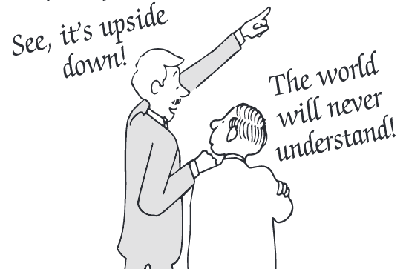
Inverted Triangle Concept

Slide 11
Inside AA
Please follow along using a pamphlet as we look at some of the different service boards and committees involved in Alcoholics Anonymous
Inside AA

Slide 12
Service at our home group – a general description
Set up – prepare the meeting area. Duties often include making coffee and tea, setting up the chairs, and putting out literature.
Greeter – make people feel welcome at the meeting. Basically means someone stands at the door and shakes hands as members enter.
Chairperson – direct the readings and sharing as a trusted servant. Because each group is autonomous, the chair usually follows a “format” agreed upon by the group during a group conscience meeting
Secretary – elected member who keeps track of membership, birthdays, group announcements
Treasurer – elected member who keeps track of 7th tradition collection, paying group bills, signing cheques

Slide 13
Service at our home group – a general description
GSR – General Service Representative brings information from the group to the District, and back to the group
Literature Rep – Keep pamphlets stocked with information to help newcomers, order books and chips or other materials
Grapevine Rep – Order copies of the grapevine to make available to members, report on updates with the magazine and encourage people to read
Temporary Sponsor – Offer to work with newcomers on the first 3 steps (and beyond)
For a great deal more information, see the pamphlet titled “The AA Group”

Slide 14
Area Committee Meeting
Similar to the District table, the Area table has chairpersons for each of their committees. For example: we have a Literature chair for District 35, there is also a literature chair for Area 78. Often the Area chair acts as an important resource for the districts and groups, as they have a lot of experience and wisdom. Chairpersons come from several different parts of the “Area” – which in Area 78 is a vast geographical area.
They discuss issues pertinent to the Area, share reports from GSO and suggestions to be brought back to districts and groups
For the first time ever, the Area Committee Meeting will be held in Yellowknife this May. All members can be involved – planning committee is looking for assistance, plus members can attend some meetings and events. The only real restriction is in voting power and the attendance at some of the reporting meetings where just the committee chairs are present.

Slide 15
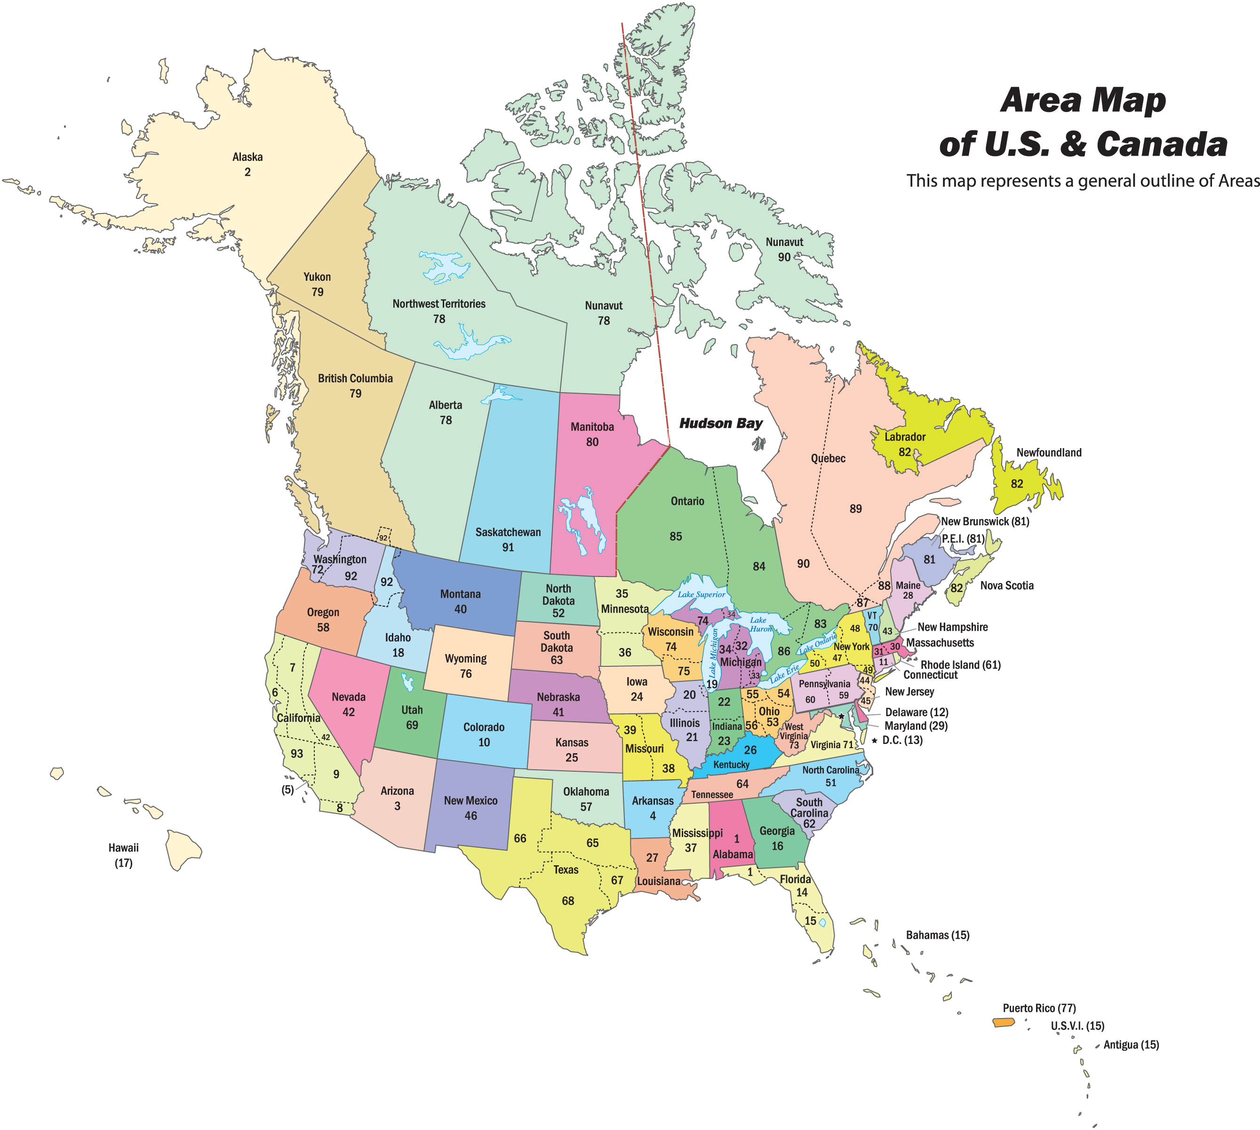

Slide 16
Principal of Rotation
Some questions to think about...
Why is the Principle of Rotation important to the individual member?
Why is the Principle of Rotation important to the growth of the Group? District? Area?
How can we prevent a District from going “dark” if no one steps in to fill a position?

Slide 17
Questions or comments?
Please enjoy a 15 minute break

Slide 18
How do we do AA service?
What to expect from the 2nd session:
Group Conscience or “Business” Meetings
District Committee Meetings
A story of AA service from the Grapevine (Jan 2014)
Resources to learn more
Service Sponsorship stories

Slide 19
Group Conscience Meetings
Usually called once per month, or on a quarterly basis – recommended formats are available in the AA Group pamphlet and aa.org
Group members share reports, discuss money, bring up issues and vote on changes that may need to be made at the group level
Members are elected into service positions (it is recommended that service positions alternate in the principal of rotation)
GSR provides a report from the District
Anyone can call a meeting, but the membership should be notified so that as many members attend as possible

Slide 20
District Committee Meeting
Meet once per month to discuss AA events, share updates, and discuss concepts related to carrying the message to those who are still suffering in our District
There are elected executive positions: District Committee Member (Scott P), Alternate DCM (Anson C), Secretary (Brad C), Treasurer (Teresa H)
There are Committees (see the next slide)

Slide 21
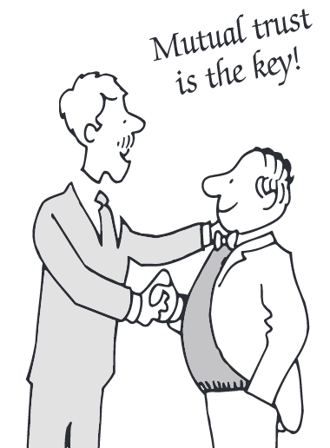
Committees at the District 35 table
Telephone
Meeting Lists
Special Events Committee
Corrections
Remote Communities
Literature
Archives
Grapevine
ACM Planning Committee
Workshops and Education Committee
CPC/PIC
Note: Each committee has a chairperson, and could use the help of AA members. You do not need to be a GSR or have any other formal or informal group position to get involved in our district committees. Even just coming to events like this one and offering to help set up, clean up or bring food is service!

Slide 22
District Committee Member
Elected to chair the district committee as a trusted servant, usually serving for 2 years
Reports to the GSRs about Area and GSO
Can be contacted locally by emailing district35@hotmail.ca
What is it like to be involved in service, including serving as the DCM of District 35?
Experience, strength and hope shared by Kathy B

Slide 23
AA Grapevine story
We’ll pass around a story where involvement in service is the cornerstone of a member’s sobriety.

Slide 24
A brief look at www.aa.org

Slide 25
A brief look at www.aa.org

Slide 26
A brief look at www.aa.org

Slide 27
www.aagrapevine.org

Slide 28
Service Sponsorship

Slide 29
Other resources
The AA service manual (in print or at aa.org)
Printed Pamphlets
District Newsletter
Twelve Steps and Twelve Traditions
The traditions essays are particularly helpful in understanding service and how AA has learned from the “mistakes” of the past

Slide 30
Questions or comments?
Please enjoy a 15 minute break

Slide 31
Concepts Checklist
Intro 12 concepts of world service
Checklist – answer yes/no/I don’t know
Where can we go to find out more?
Discussion in groups
Wrap up:
Area Committee Meeting Reminder
Did you know? The Thursday Night meeting in Behchoko is also part of our District, and could use the support of Yellowknife members?

