Slide 1

Little Actors’ Studio
presents
Murdock Elementary School Drama Club
Sewell Mill Library and Cultural Center
Thursday, March 19 7PM
Saturday, March 21 2PM

Slide 2
Director’s message
Winnie the Pooh takes us back to our childhood! The stories of A.A. Milne , then translated to film and television by Disney, are now brought forward in music. This year, we have explored teamwork, friendship, and joy in the Hundred Acre Wood. We are grateful that Little Actors’ Studio can enjoy its 12th season at Murdock Elementary School.
We are happy to see our actors returning to our program as well as discovering new talent, watching our alumni go off to college, and witnessing some of our alumni continuing in the arts. We give a bittersweet goodbye to our dear 5th graders as they grow up and move on to Middle School, but hope they will return to play with us during the summers.
It is an awesome responsibility to be molding the minds of these precious little actors and not one that we take lightly. We ask them to stretch themselves by singing like no one is listening, dancing like no one is watching, and acting like your character is real! I believe that drama club helps little humans gain self-confidence, out-of-the-box thinking, and the ability to work cooperatively with others. These skills will help them throughout their lives.
We love to see the children, staff, and parents who have helped make us what we are today. From now on, wherever you go, whatever you do, you will always be a part of something special. We hope you take what you’ve learned here and use it to do great things while never letting go of your creativity. We are thankful every day that we can be your teachers. It is truly a gift.
Our favorite thing about drama club is watching the bravery displayed by our little actors as they go out on stage and sing, dance, and act. Their favorite part might be dressing up, learning the exciting music, or kicking up their heels, but surely your favorite part will be watching the joy of our little actors as they bring you Winnie the Pooh!
-- Ms. Amber and Mr. Alex

Slide 3
Production Credits
Artistic Director/Choreographer Alex Lopez
Assistant Director/Choreographer Nadia Opperman
Business and Technical Director Amber Lopez
Costume Designer Amber Lopez
Costume Mistress Pat Sanchez
Set and Prop Design
Amber Lopez, Alex Lopez, Nadia Opperman,
LAS Drama Parents and Friends
Sound Engineer Alex Lopez
Photography Ludmillo Pierre
Thank you to the many parent volunteers who have helped cut, paint,
screw, move sets, costumes, tickets, fan-o-grams and kid wrangle!
Thank you to the Middle and High School Little Actors’ Alumni
who have helped backstage!
Thank you to Murdock Elementary School, especially Mr. Hydo who is always
gracious with his space!
Thank you to the staff at the Sewell Mill Library and Cultural Center!

Slide 4
Musical Numbers
Winnie the Pooh
Ensemble
The Tummy Song
The Rainbow
Honey #1
The Bees
The Tummy Song (Reprise)
Pooh 1
The Wonderful Thing About Tiggers (Part 1)
Tigger 1
The Wonderful Thing About Tiggers (Part 2)
Word Chorus, Tigger 1
Pooh and Piglet
Pooh 1 and Piglet
Honey #2
The Bees
Honey #3
The Bees
The Backson Song
Owl, Eeyore, Kanga, Tigger 2 and Ensemble
Honey #4
The Bees
The Backson Song (Reprise)
Rabbit 2, Kanga, Eeyore, Ensemble
Halfway Down the Stairs
The Word Chorus
Honey #5
The Bees
Hip Hip Pooh Ray/Winnie the Pooh
Rabbit 2, Kanga, Christopher Robin, and Ensemble

Slide 5
cast
Pooh 1/Turtle Alexandria Sibley
Bee Avi Shah
Frog Bennett Hughes
Porcupine/Christopher Robin Brooklyn McMillian
Owl Caroline Smith
Cringy Catherine Rowe
Kanga Cecily Mason
Kessie the Bluebird Clara Da Silva
Creative David Gilbert
Calm Dorothy Slowik
Lottie the Otter Eden Vensel
Red Eliza Vensel
Cool Emerson Preble
Blue Emilia Holloway
Eeyore Everett Cullen
Bee Eyram Ayim
Bee Guhan Vig
Rabbit 1/Gopher Josie Moffitt
Bee Kairaluchi Oragwu
Lovely Lydia Hughes
Skunk/Tigger 2 Madeline Florim
Bee Mae Dale Bosserman
Violet Maggie Lee
Roo Mehar Kaur
Indigo Mira Amirdzhanov
Pooh’s Tummy Noah Silva
Yellow Nora Chaplin
Preppy Ophelia Donahue
Bee Paisley Aeby
Lumpy the Hephalump/Rabbit 2 Parker Aeby
Bee Peyton Gibson
Peaceful Rain Clausing
Skippy the Sheepdog/Pooh 2 Remi Sims
Orange Ruth Musau
Piglet Sophia Shah
Tigger 1/Squirrel Stela Silva
Green Tamsin Glazebrook
Weird Wyatt Leyenaar

Slide 6
Credits
Music and Lyrics by
Richard M. and Robert B. Sherman
Robert Lopez and Kristen Lopez-Anderson
Music Adapted and Arranged and Additional Music and Lyrics by
Will Van Dyke
Book and Additional Lyrics by
Cheryl Davis
Based on the stories of A.A. Milne and the 2011 Disney Animated feature film.
Winnie the Pooh KIDS is presented through and licensed by special arrangement with Music Theatre International (MTI). All authorized performance materials are also supplied by MTI.
www.mtishows.com

Slide 7
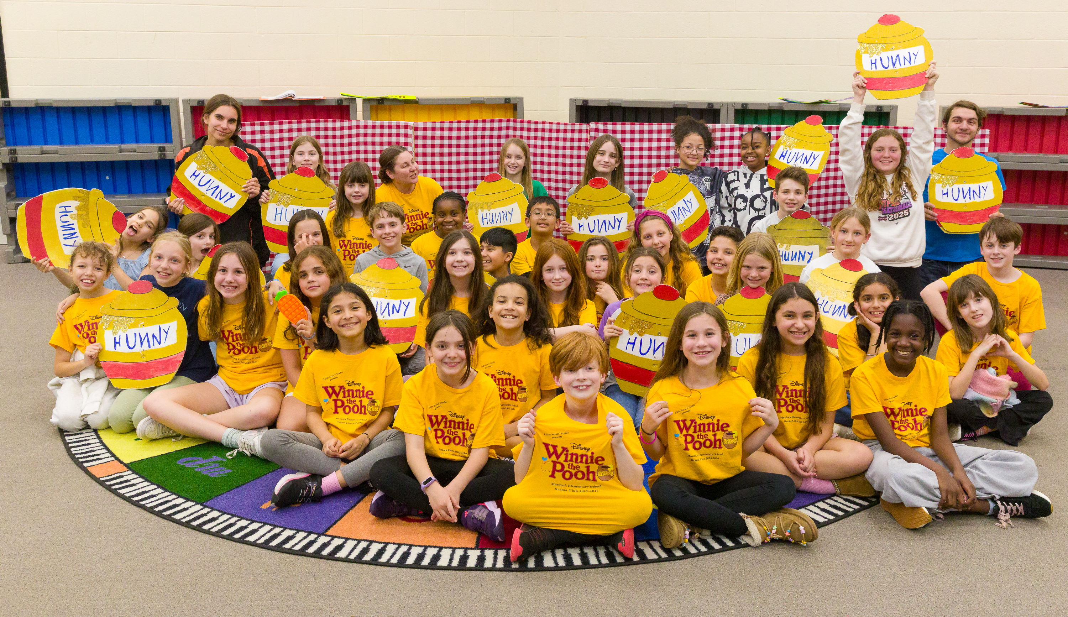
Little Actors’ Studio
www.littleactorsstudio.org
Summer Camps
June 8-19 Shrek Jr. the Musical
July 13-24 Write Your Own Musical
TLC Dance Studio
Join Us
FOR ALL THE
FUN!

