Slide 1

Understanding
Alzheimer’s & Dementia

Slide 2
Three Facts
Three Goals
Any age is a good age to talk about Alzheimer’s and dementia
When speaking to someone progressing through Alzheimer’s, give them at least 20 seconds to process and respond
Alzheimer’s is not meant to be taken on alone
To create a comfortable environment for questions and sharing
To provide education that will have you leave here feeling more empowered than when you entered
Speak up, offer help, and listen if someone you know is affected by a form of dementia

Slide 3

Our Mission
The Alzheimer’s Association is a worldwide voluntary health organization dedicated to Alzheimer’s care, support and research
Our mission is to lead the way to end Alzheimer's and all other dementia — by accelerating global research, driving risk reduction and early detection, and maximizing quality care and support

Slide 4

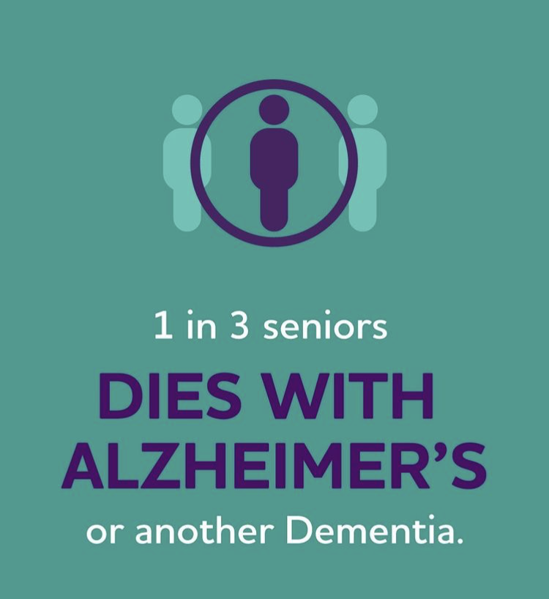

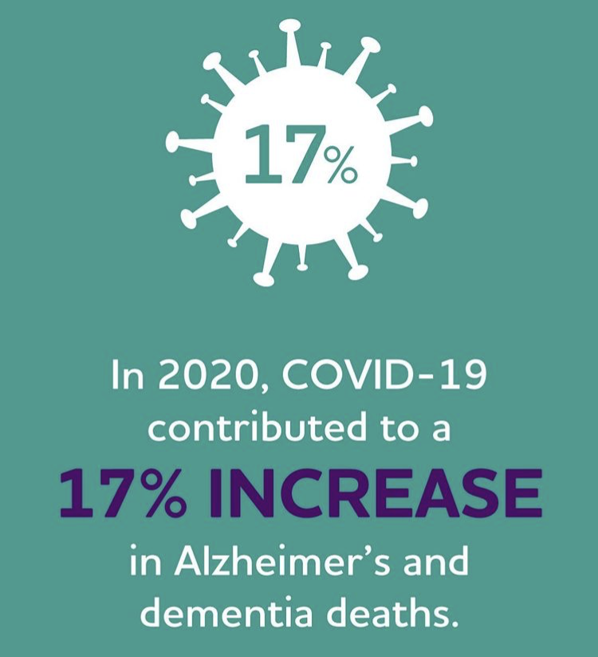
Alzheimer’s Disease Facts & Figures
Alz.org/Facts

Slide 5

Alzheimer’s Disease vs. Dementia
Dementia
Alzheimer’s
Vascular
dementia
Dementia with Lewy bodies
Frontotemporal
dementia

Slide 6
Alzheimer’s Disease vs. Dementia
60-80%
10-40%
10-25%
~10%
Alzheimer’s
Vascular
dementia
Dementia with Lewy bodies
Frontotemporal
dementia

Slide 7
Alzheimer’s is not
Normal Aging

Slide 8
What May Impact Risk
Non-Modifiable Risk Factors
Age*
Genetics
Race / Ethnicity
Modifiable Risk Factors
Environmental / Lifestyle Factors
Cardiovascular Health
Physical Activity
Diet
Sleep
Social / Cognitive Engagement
Education
Traumatic Brain Injury

Slide 9
10 Warning Signs of Alzheimer’s
Memory loss that disrupts daily life*
Challenges in planning or solving problems
Difficulty completing familiar tasks
Confusion with time or place
Trouble understanding visual images or spatial relationships

Slide 10
10 Warning Signs of Alzheimer’s
New problems with works in speaking or writing
Misplacing things and losing the ability to retrace steps
Decreased or poor judgement
Withdrawal from work or social activities
Changes in mood and personality

Slide 11
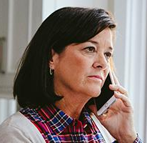



Programs & Services
24/7 Helpline
800.272.3900
Support
Groups
Care Consultations
Educational
Programs & More

Slide 12
Questions?

Slide 13


Slide 14
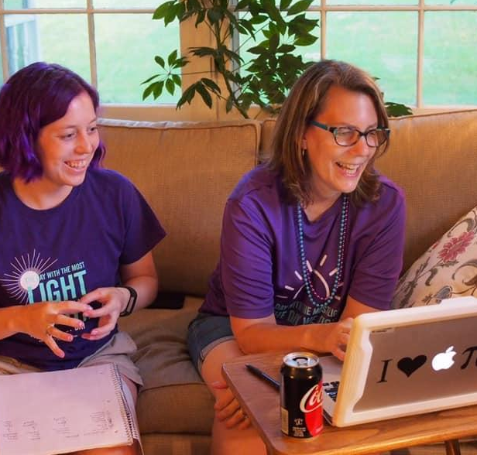
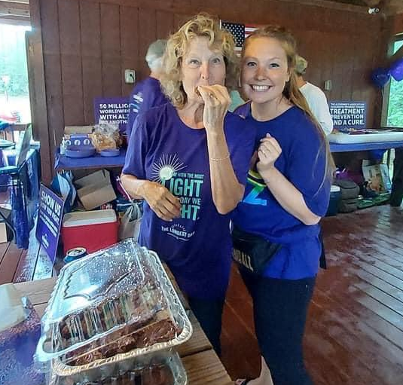
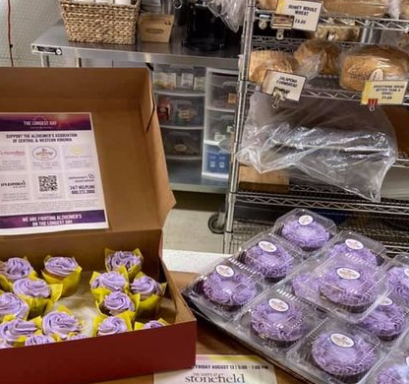
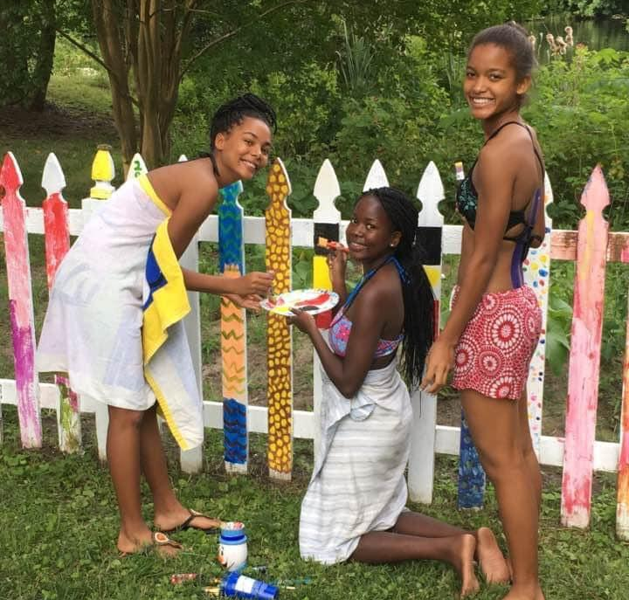
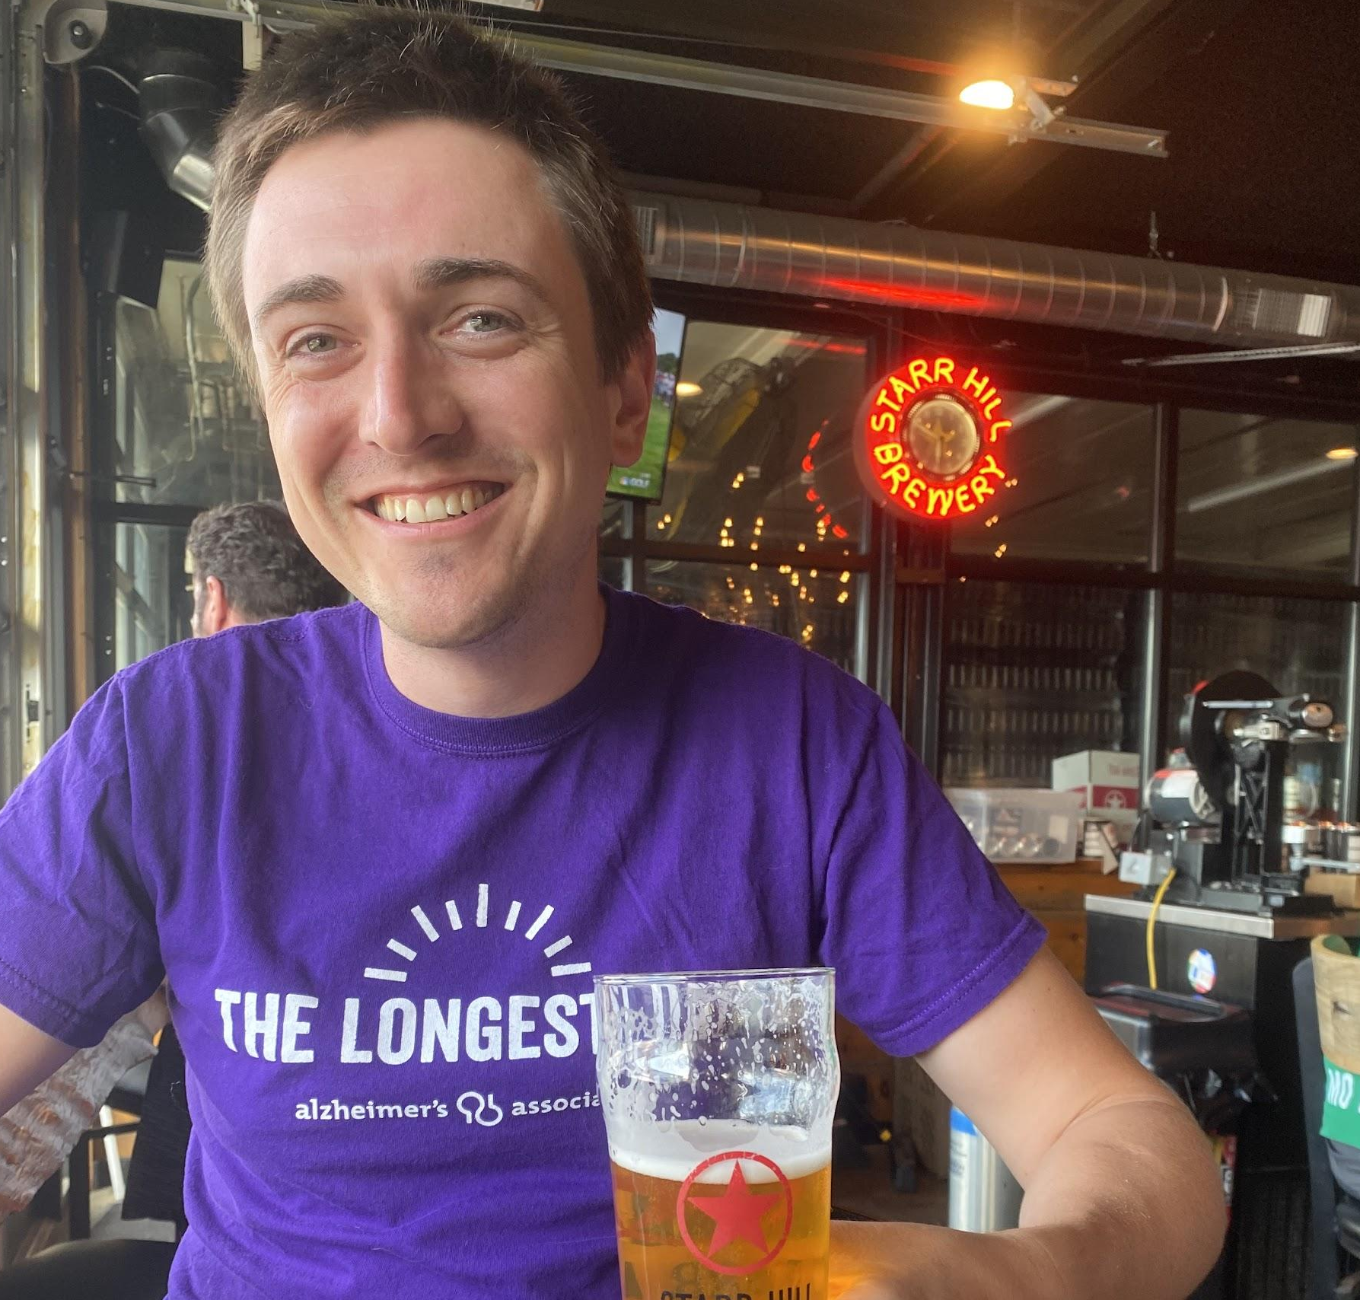
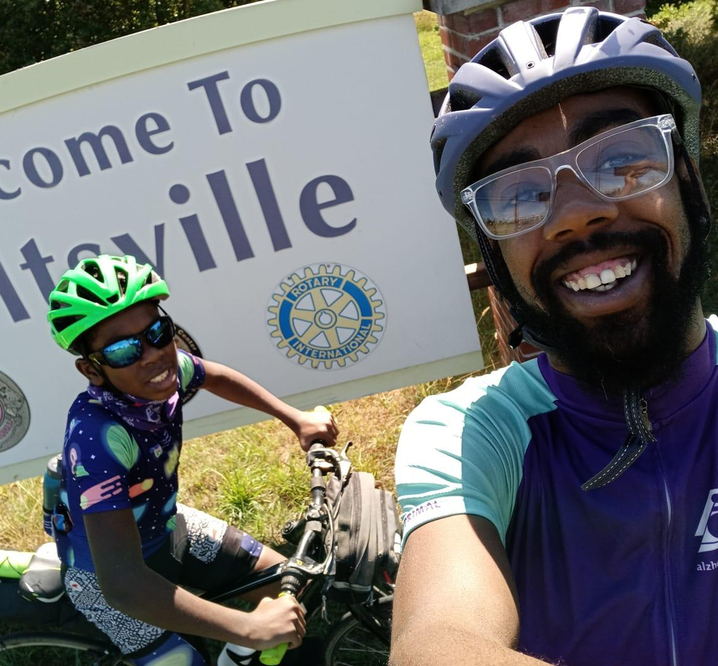
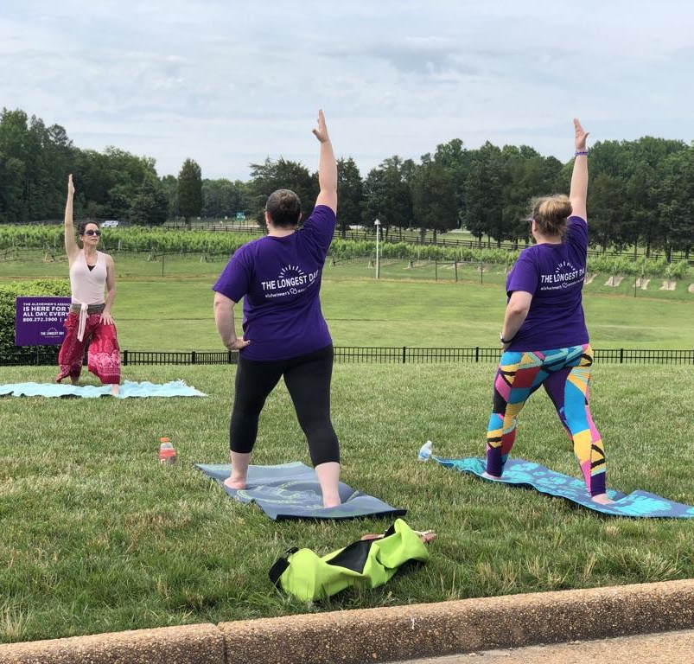
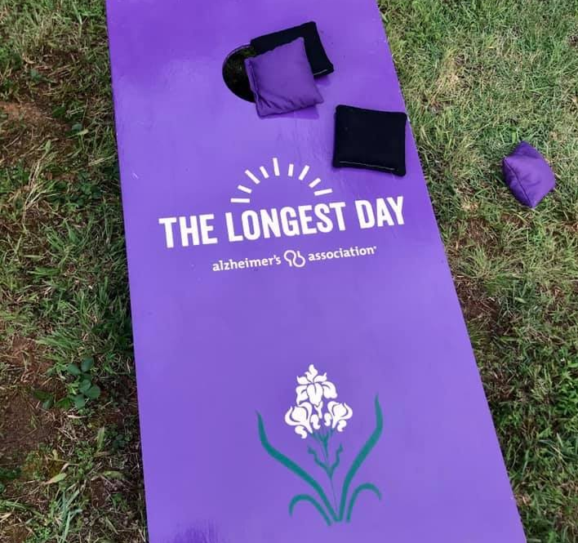
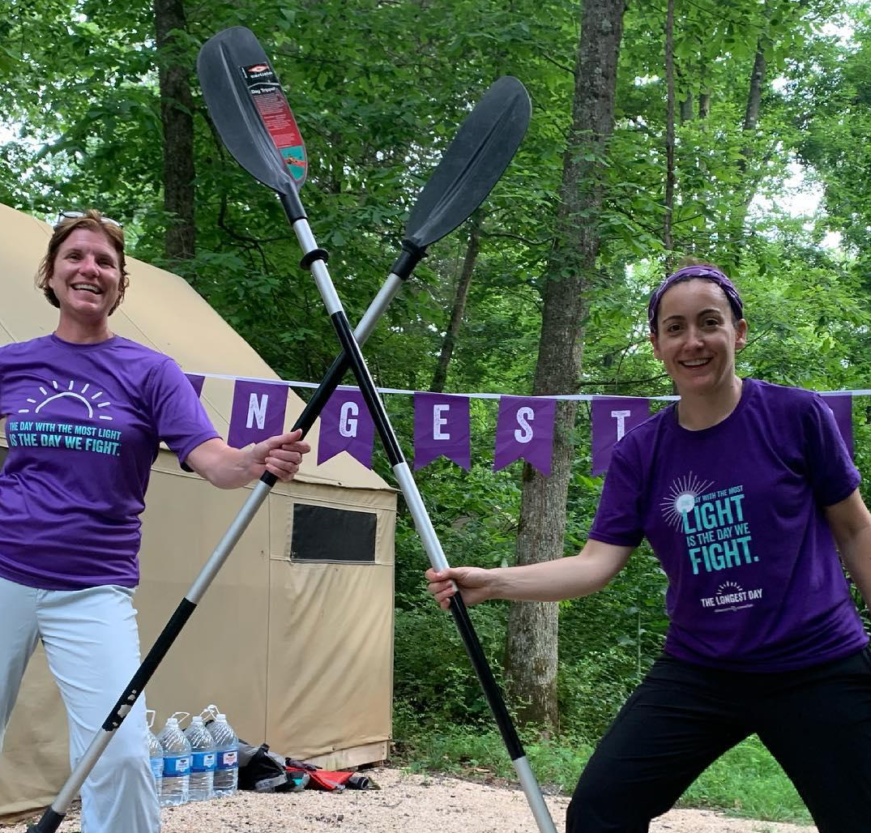
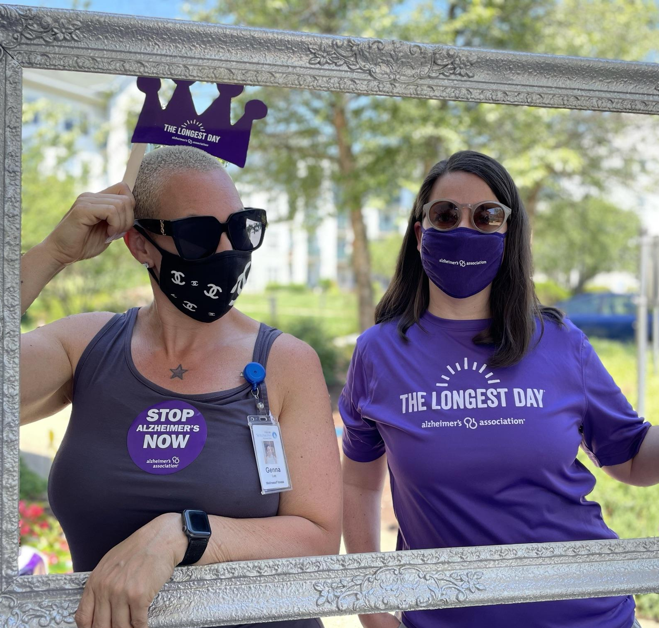
The Longest Day
Gardening
Virtual Trivia
Baking, Cooking
Music
Painting
Cookout
Restaurant Give Back
Lemonade Stand
Cornhole Tournament
Golf Tournament
Adventure with Friends
Biking
Exercise, Running
Yoga Class
Purple Party
Cards, Board Games

Slide 16

Thank You
Madison Wilkins
mwilkins@alz.org
804.965.9977
24/7 Helpline 800.272.3900

