Slide 1

CRIME, CONSEQUENCES
AND
THE POWER OF CHOICE
Prepared for Louisiana Judicial
College/Louisiana State Bar Association
Joint Summer School
June 8, 2022
Associate Justice Scott Crichton
Louisiana Supreme Court
Co-authored by Judge Marilyn Castle
15th Judicial District Court

Slide 2
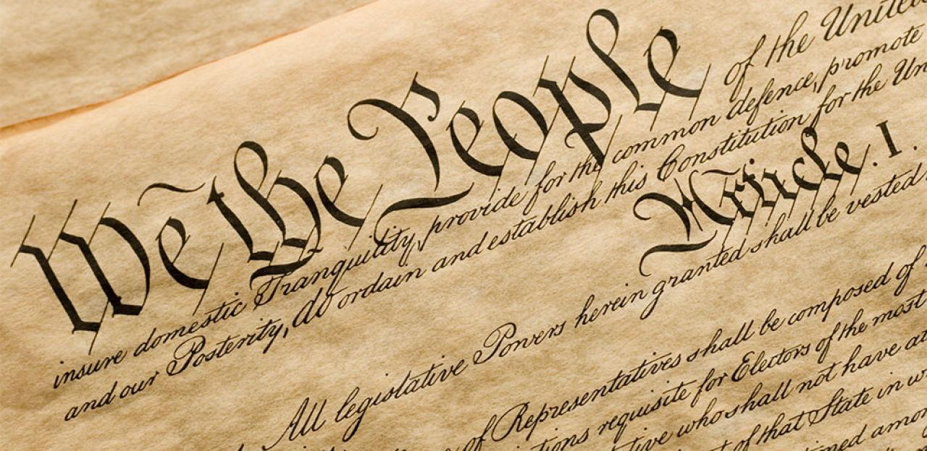
But First….
Some History for Constitution Day

Slide 3
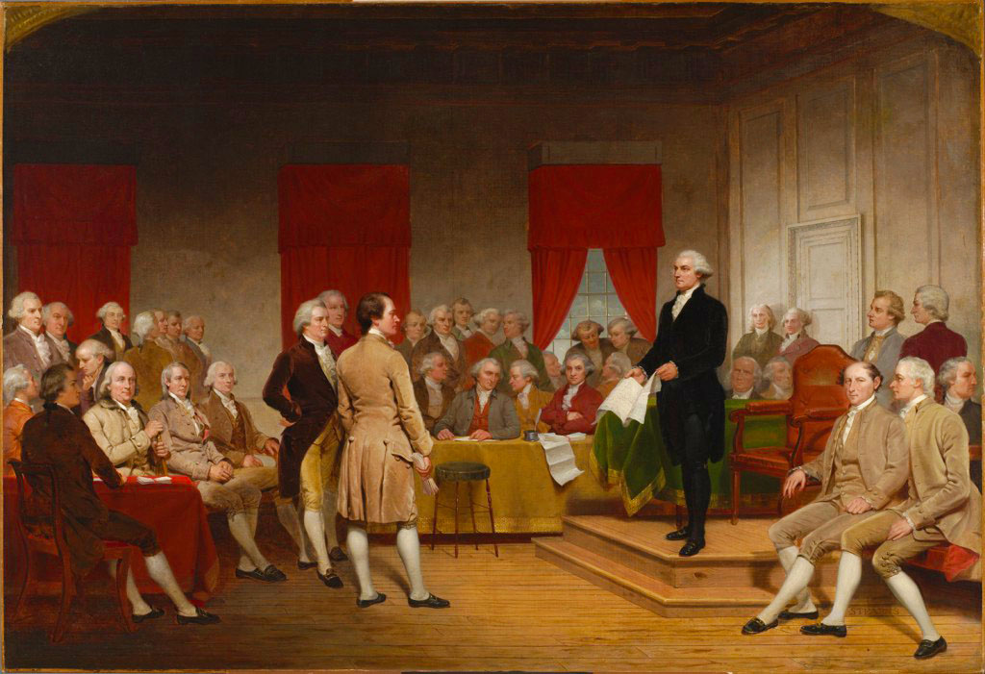
Writing the Constitution
55 men gathered in Philadelphia in the spring of 1787
Representatives from every state attended except Rhode Island.

Slide 4
Did you know?
The men gathered in secret
Why?
They knew they were engaging in a historic act – to design a living government on paper!
U.S. Constitution
Articles of Confederation

Slide 5
What made the Constitution Unique?
The ability to amend!
Delegates created a specific process for amending the Constitution.
Requires a ¾ majority of the states – not unanimity as in the Articles of Confederation.

Slide 6

Victory!
May 1790 → All 13 states ratified the New U.S. Constitution with Rhode Island being the last
Literature promoting ratification amongst the states.

Slide 7
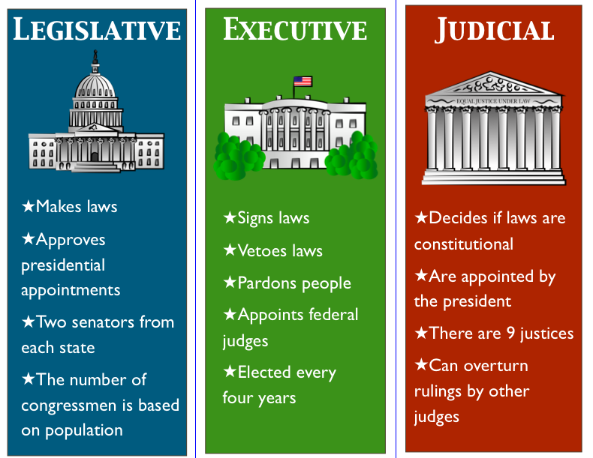
What did it create?
Three Branches of Government
Separation of Powers

Slide 8

Second – Why are you here?
I am hopeful you want to learn about the law, how to stay out of trouble, and never have a brush with the criminal justice system.

Slide 9
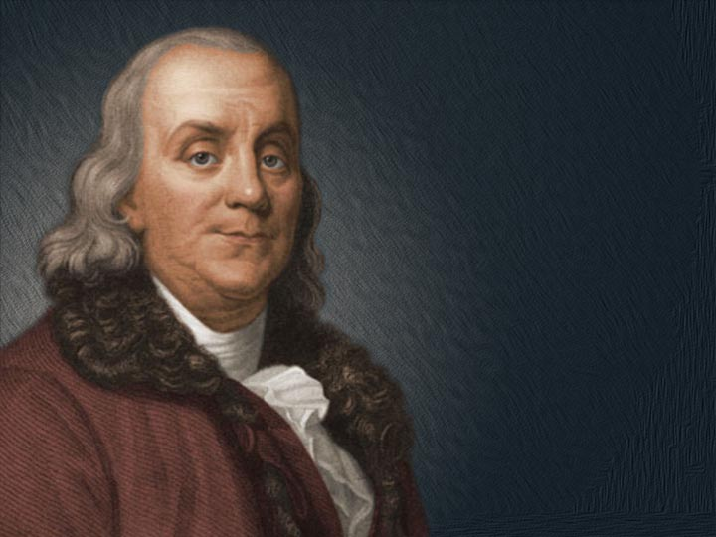
“An ounce of prevention is worth a pound of cure”
Benjamin Franklin (1735)

Slide 10
Q: If you do not know a law and violate it, will you be excused from the violation or can you still be punished for it?

Slide 11
The Law: Ignorance of any criminal statute is not a defense to any criminal prosecution.¹
What does this mean?
Not knowing the rules and the law is not an excuse for a violation.
¹ La. R.S. 14:17

Slide 12
I. How are laws made, how are they enforced and by whom?

Slide 13
Laws are enacted by our legislature and subject to approval by our governor.

Slide 14


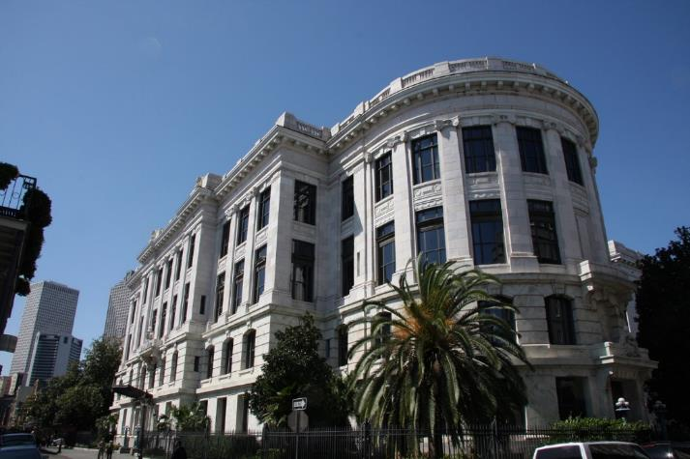
3 branches of government:

Slide 15
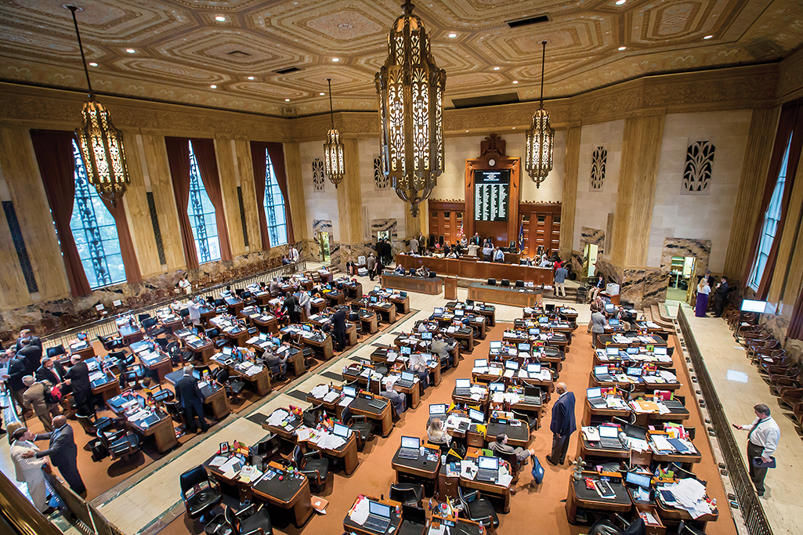
The Legislative Branch

Slide 16
We elect our legislators to enact statutes or laws that govern us.
There are 105 members of the House and 39 members of the Senate.

Slide 17
They have the authority to enact laws on a wide array of subjects, including crimes and their penalties; they also enact laws affecting the safety, health and welfare of our citizens.

Slide 18
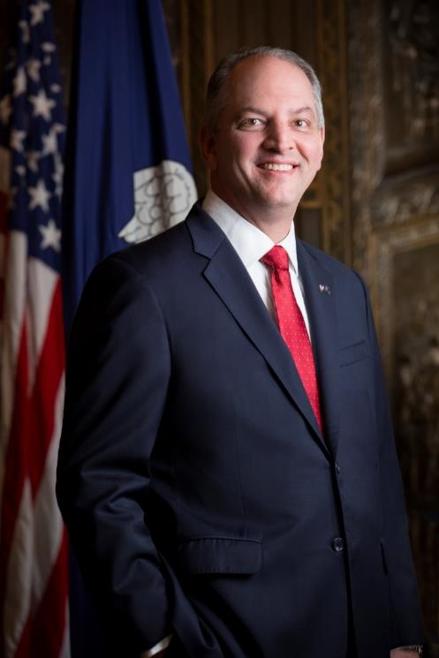
The Executive Branch
We elect the Governor as the top Executive of the State, and he can either sign the law into effect or veto it.
Governor
John Bel Edwards

Slide 19
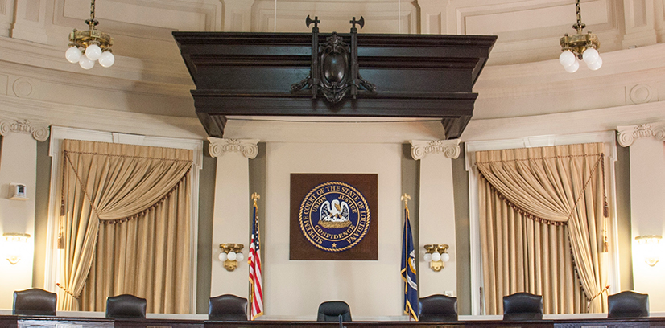
The Judicial Branch
The third branch of government is the Judiciary. Courts apply the law to individual cases.

Slide 20
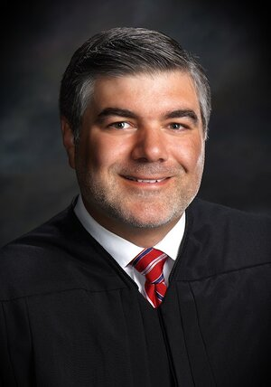

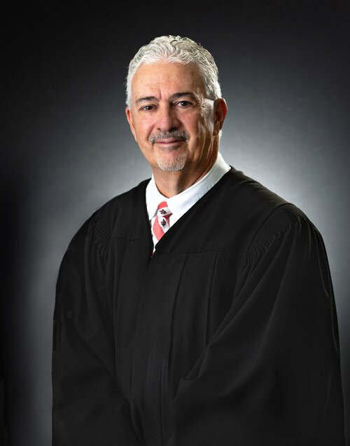
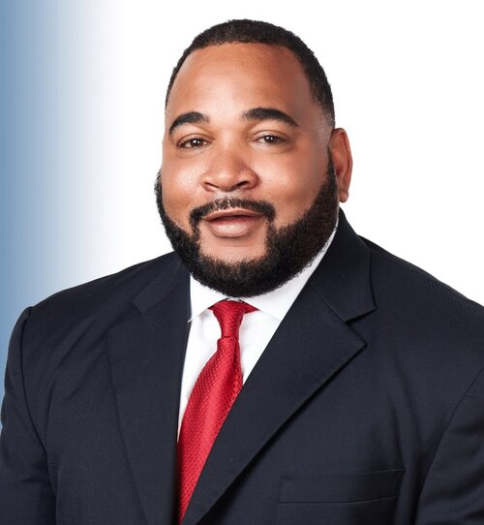
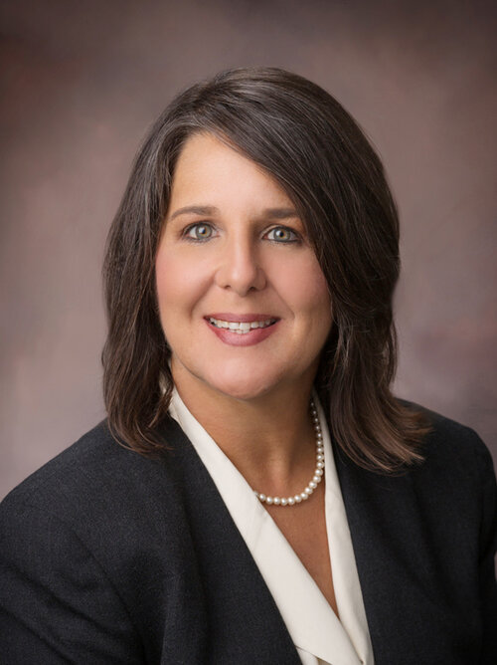
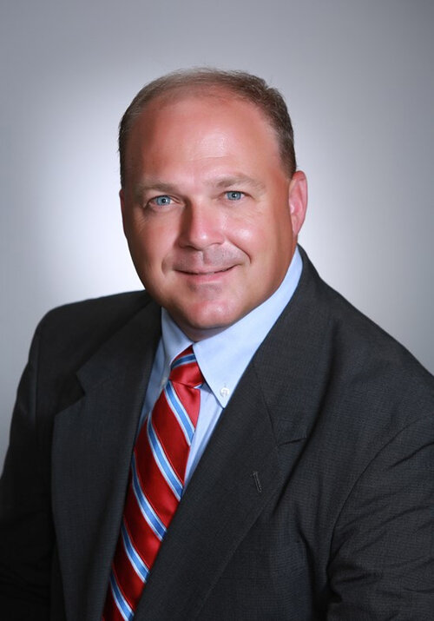

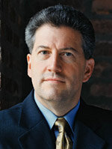
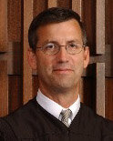
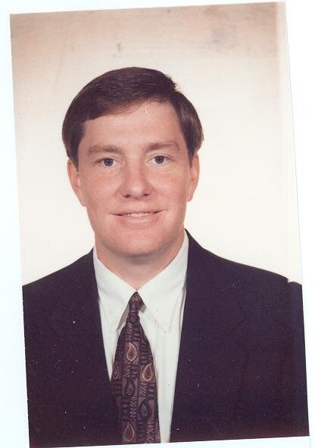


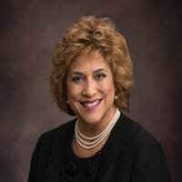
Local judges are elected.
15th Judicial District
13 Judicial District Court Judges

Slide 21
Some people engaged in criminal behavior may never get to the courthouse…
CAUTION: the following slide is graphic

Slide 22
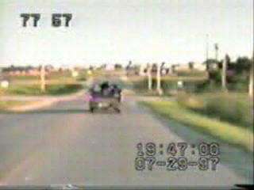

Slide 23
THE TWO
TYPES OF CRIMES
AND
WHO CAN BE
CHARGED WITH A CRIME

Slide 24
A crime is either a misdemeanor or a felony.
Felony: any crime for which an offender may be sentenced to death or imprisonment at hard labor (usually hard labor sentence of a year or more).
Misdemeanor: any crime other than a felony (usually punishable by a maximum of 6 months in parish jail).
R.S. 14:2 (4) and (6)

Slide 25
The parties to a crime are classified as:
(1) Principals
(2) Accessories

Slide 26
PRINCIPALS
All persons concerned in the commission of a crime are principals.
whether present or absent,
whether they directly commit the act, or
aid in its commission, or
directly or indirectly counsel another to commit the crime.⁴
⁴ La. R.S. 14:24

Slide 27
What does the law of Principals mean?
Example No. 1:
My friend, Pee Wee, and I go to Circle K with intent to rob the clerk. Pee Wee goes into Circle K and robs the clerk at gunpoint.

Slide 28
Example No. 1:
I agree to be the lookout and getaway driver for Pee Wee.
Can I be charged with Armed Robbery?

Slide 29
Yes. All persons concerned in the commission of a crime are principals.
The lookout is as guilty as the one who goes in the store; the getaway driver is as guilty as the one who goes in the store.

Slide 30
Example No. 2:
I invite Pee Wee to my house to encourage and help him plan to rob the clerk at the Circle K at gunpoint. Pee Wee does it alone while I’m watching TV at my house. Can I be charged with Armed Robbery?

Slide 31
Yes. All persons concerned in the commission of a crime are principals even if they are absent from the scene if they directly or indirectly counsel another to commit the crime.

Slide 32
By the way…
Armed Robbery carries a minimum penalty of 10 years and a maximum of 99;⁵ if a gun is used, the minimum is 15 years.⁶
Q: Who established that law and the penalty?
A: The legislature.
⁵ La. R.S. 14:64, ⁶ La. R.S. 14:64.3

Slide 33
THE AGE OF RESPONSIBILITY

Slide 34
The law defines “child” as a person who has not reached the age of 18 at the time of the crime.
The age of legal responsibility is 18.
So, if you are age 17 or younger and commit a crime, you would report to juvenile court and, because of your age, special laws apply.
La. Ch. C. art. 804 and La. Act 501 (2016)

Slide 35
But: Juveniles 15 or older at the time of commission of certain felonies can be prosecuted in district court (adult court) and, if convicted, sent to Department of Corrections (with adults).⁸
⁸ La. Ch. Code art. 305.

Slide 36
ALCOHOL AND RELATED CRIMES
Possession
DWI
Vehicular Homicide

Slide 37
Possession
It is illegal for a person under 21 to purchase or have public possession of any alcoholic beverage.
La. R.S. 14:93.12

Slide 38

Driving While Intoxicated Under 21:
It is unlawful for any person under the age of twenty-one (21) to operate a vehicle when the operator’s blood alcohol concentration is 0.02 percent or more.¹⁶
This is one beer!
¹⁶ La. R.S. 14:98.6

Slide 39
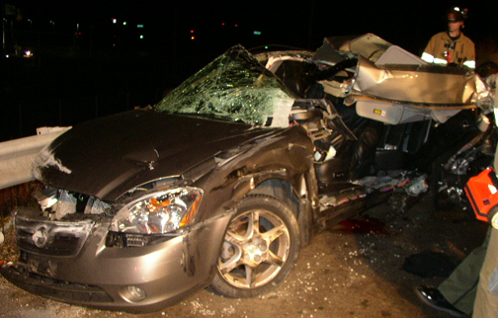
Driving While Intoxicated (DWI):
The crime of operating a vehicle while intoxicated is the operating of any motor vehicle while the operator’s blood alcohol concentration is 0.08 percent or more.
La. R.S. 14:98

Slide 40
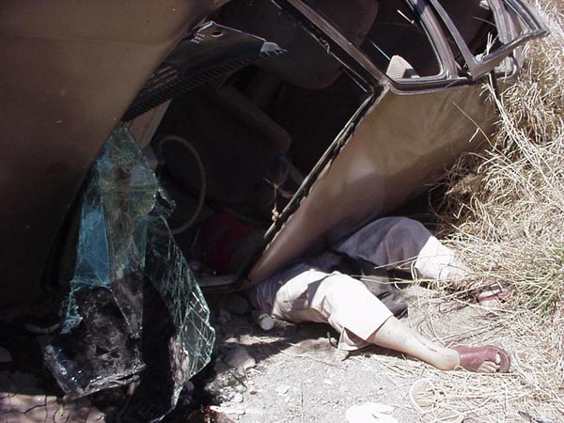
Don’t drive a vehicle while under the influence of alcohol or any controlled dangerous substance.

Slide 41
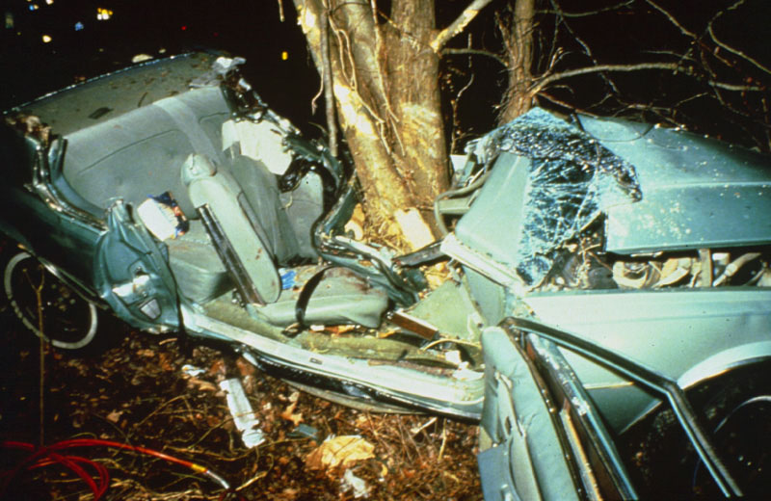

Slide 42
ELECTRONIC CRIMES

Slide 43
Cell phone use while driving
(17 or younger)
Texting while driving
Cyberbullying
Sexting
ALL AGAINST THE LAW

Slide 44
Cell Phone Use
According to the National Safety Council
8% of fatal crashes, 15% of injury crashes, and 14% of all police-reported motor vehicle traffic crashes in 2018 were distraction-affected crashes.
https://crashstats.nhtsa.dot.gov/Api/Public/ViewPublication/812926

Slide 45
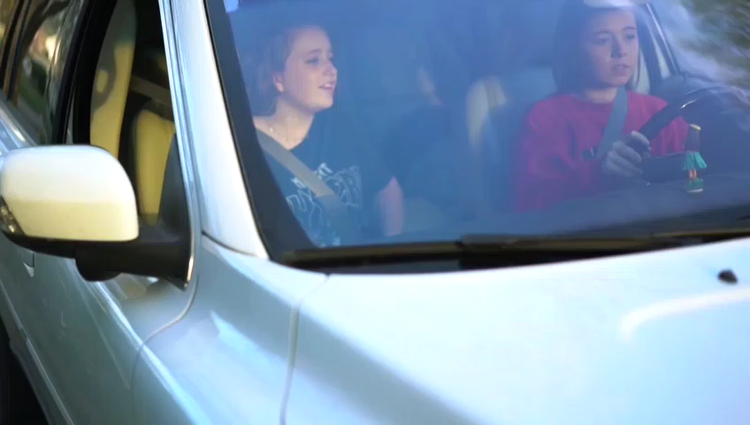

Slide 46
The Law: No person 17 years of age or younger shall operate a motor vehicle while using any wireless telecommunications device.
The Penalty: First offense is up to a $250 fine, every subsequent offense is up to $500 and results in suspension of driver’s license for 60 days.²⁴
²⁴ La. R.S. 32:300.7

Slide 47
So, if you are 16 or 17
DO NOT USE
YOUR CELL PHONE
WHILE DRIVING.

Slide 48


Slide 49
Texting while driving
No person (regardless of age) shall operate a car while texting.²⁶
²⁶ La. R.S. 32:300.5

Slide 50

School Zones
The Law: No person shall operate any wireless telecommunications device while operating a vehicle during the posted hours within a school zone.
This includes: Calls, texts, and social media
The Penalty: $500 - $1000; May even have license suspended!
La. R.S. 32:300.8

Slide 51
Civil Liability For Parents
PARENTS CAN BE SUED FOR INJURIES OR DAMAGE DONE BY THEIR MINOR CHILD.
La. C.C. art. 2318

Slide 52
Sexting
The act of sending sexually explicit photos electronically by person under 17 (can be of yourself or another person), including between mobile devices.
It is a crime practiced primarily by high school teenagers and young adults, though it is known to occur among children as young as middle-school age.
R.S. 14:81.1.1

Slide 53
Penalty:
First offense is a fine from anywhere between $100-$250, imprisonment of up to 10 days, or both. Second offense is a fine anywhere between $250-$500, imprisonment from anywhere between 10-30 days, or both.²⁷
²⁷ La. R.S. 14:81.1.1

Slide 54
Sexting
A social danger with sexting is that material can be very easily widely promulgated/ distributed over which the originator has no control.
Once it’s out there, there’s no getting it back!

Slide 55


Slide 56
The crime of Sexting can in some cases also constitute the felony crime of Pornography Involving Juveniles, which involves the inappropriate photograph or videotape of a child under the age of 17.
La. R.S. 14:81.1

Slide 57
Penalty: Imprisonment not less than 5 years or not more than 20 years (14:81.1).

Slide 58
Cyberbullying
Cyberbullying is the electronic transmission of a communication with the intent to abuse, torment, or intimidate a person under the age of 18.²⁸
²⁸ La. R.S. 14:40.7

Slide 59
Penalty: Whoever commits this crime can be imprisoned for up to 6 months.
R.S. 14:40.7

Slide 60
WHY IS ALL THIS IMPORTANT?

Slide 61
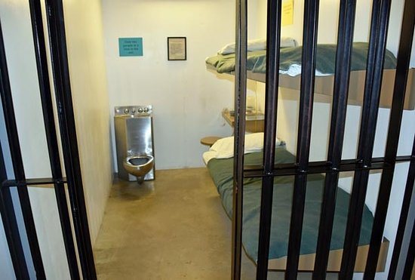
JAIL COULD BE YOUR FUTURE
– THINK ABOUT YOURSELF; THINK ABOUT YOUR FAMILY
(It’s not all about you)

Slide 62
CONSEQUENCES
ARE
SIGNIFICANT.

Slide 63
You could have a criminal record which:
May prevent your admission into college or prevent getting a scholarship
May prevent you from getting a job
May cause you to go to jail or prison
May cause you injury or death
May cause someone else’s injury or death

Slide 64
Why does it matter?
A felony conviction can mean:
Disclosure of conviction required on school (degree or certificate) and job applications.
  In 2018, formerly incarcerated people unemployment 27% higher than total U.S. unemployment rate
Unable to obtain certain occupational licenses (or disclosure required and can be considered on application).
Disclosure can be required and can be justification for termination of current occupation or occupational license.

Slide 65
Why does it matter?
A felony conviction can mean:
Illegal to possess firearm (if sentenced for >1 year)
  possession includes “constructive possession” so illegal if in your house.
Limitations on some government assistance (from housing to educational).
Ineligible to vote until sentence completed (including parole and/or probation).

Slide 66
Examples of Occupations
A Felony Can Affect
Nursing – must obtain permission form Louisiana State Nursing Board to attend nursing classes.
Commercial Driver’s License (certain crimes)
Any industry requiring TWIC Card (oil and gas, shipping, chemical)

Slide 67
Your Circumstances Which May Be Affected if Convicted of: | Felony | Misdemeanor | Sex Offense
Living in public or Section 8 housing | √ | √ | √
Holding or maintaining an employment license | √ | √ | √
Working with children | √ | √ | √
Working in the oil and gas, shipping, chemical or related industries | √ |  | √
Voting or serving on a jury | √ |  | √
Owning a gun (you or a household member) | √ |  | √
Receiving Medicaid | √ |  | √
Receiving Social Security | √ |  | √
Receiving veteran’s benefits | √ |  | √
Receiving food stamps | √ |  | √
Losing your job if convicted, even if not incarcerated | √ | √ | √
Being a prospective adoptive parent or foster parent | √ |  | √
Marriage | √ |  | √
Children | √ |  | √
Currently or planning on pursuing higher education | √ |  | √
Receiving federal or state student financial aid | √ | √ | √
Non-citizen status | √ | √ | √
Running for Public Office | √ | √ | √
Current conviction increases penalty of future conviction | √ | √ | √
Juvenile status | √ * | √ * | √ *
* See explanation within pamphlet:
https://www.opdla.org/attachments/article/104/CollateralConsequencesClientGuide_English.10.pdf

Slide 68

Public Records Doctrine
Any person of the age of majority may inspect, copy or reproduce any public record.²⁹
²⁹ La. R.S. 44:31

Slide 69
Effect of Public Records Doctrine:
If you have been arrested and if the District Attorney has filed charges, anyone is entitled to know.
Why? Because it’s public record!

Slide 70
CONCLUSIONS (AND THE REASON FOR THE TITLE)

Slide 71
Ignorance of the law ≠ excuse
Laws are made and enforced by the people we elect to the 3 branches of government.
When you engage in criminal activity you lose your power of choice.

Slide 72
If you’re a principal to a crime you can be arrested and convicted.
If you have constructive possession of an illegal drug, you can be arrested and convicted.
Illegal drugs are unhealthy, illegal and can lead to additional criminal conduct.

Slide 73
There is no rewind.
What we hear often are these words,
“Judge, I wish I could take it back but I can’t.”

Slide 74
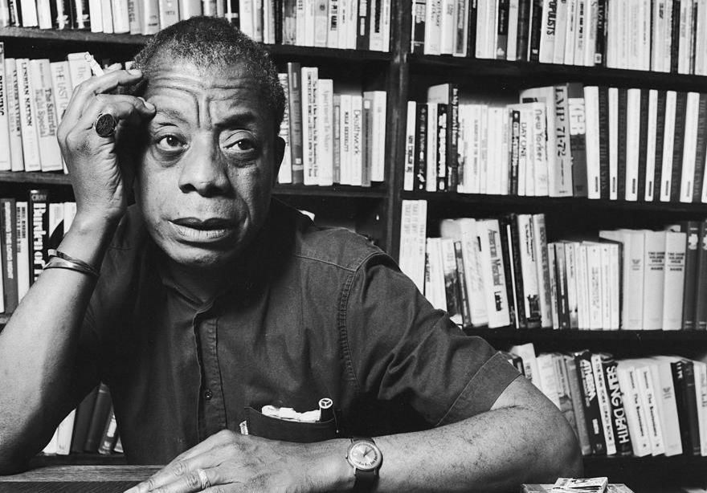
James Baldwin
1924-1987 novelist, playwright and poet.
These are all our children. We will profit by, or pay for, whatever they become. Exactly…we must educate them. Hope for the future. It begins with our children.

Slide 75

UNITED STATES PRESIDENT
JOHN F. KENNEDY,
OUR 35TH PRESIDENT
WHO SERVED
BETWEEN 1961 AND 1963,
SAID THESE WORDS:
“A CHILD MISEDUCATED
IS A CHILD LOST”

Slide 76
Our words today:
Be educated; don’t be lost.
“A lost child” grows up to be a lost adult
without a good education
without a job
in prison

Slide 77
It’s the power of choice.
You can choose the direction of your life.

Slide 78
Choose wisely.

Slide 79
CRIME, CONSEQUENCES
AND
THE POWER OF CHOICE
Developed by Justice Scott Crichton

