Slide 1
Project Management Overview

Slide 2
Objectives
Understand PMI organization and function
High level understanding of main concepts of project management
Recognize project management techniques and situations in our office environment
Understand key terminology used in the Epic IT department
Begin to apply some of these concepts to your work
Notes:
Ethics- how project managers should behave

Slide 3
PMI
PMI is the Project Management Institute, a professional non profit organization for members of the project, program, and portfolio management profession
Establish standards for Project Management
  How it should be done
  Framework for success
  Ethics
“PMP” Project Management Professional certification
Notes:
Ethics- how project managers should behave

Slide 4
What is a Project?
A temporary endeavor undertaken to create a unique product, service, or result
Different from ongoing operations because they have a limited duration (temporary), a definite beginning and a definite end
  But that doesn’t mean you can’t apply the same principles of project management to some types of ongoing operations
Projects can be repeated
Notes:
Temporary and unique. Definite beginning and definite end, but can be repeated. Example: newsletter is a project. Each week. A tip sheet is a project. Building MST. The entire Epic project.

Slide 5
Project Management
Application of knowledge, skills, tools, and techniques to project activities to meet the project requirements
Framework for completing a project
  Organizes the process
  Ensures success
  Provides structure
Notes:
You can break down almost anything you need to do into this framework. As IDs, this appeals because we often have to break tasks down into individual steps.

Slide 6
Project Management Phases
(Process Groups)
Initiating
Planning
Executing
Monitoring and Controlling
Closing
Notes:
Also called “Process Groups”

Slide 7
Initiating
Idea phase
Explore and elaborate idea
Determine feasibility
Defines and authorizes project
Develop project charter
Identify stakeholders

Slide 8
Planning
Defines and refines objectives
Plan course of action to complete objectives and scope
Progressive elaboration begins – improving and detailing a plan as more specific information becomes available

Slide 9
Executing
Make it happen!
Carry out the tasks planned
Create your deliverables
Present to customers
Perform QA

Slide 10
Monitoring and Controlling
Measure and monitor progress in order to take corrective action when needed
Review, track, orchestrate progress and performance
Control quality, schedule, cost, scope, communications, risks, procurements, stakeholder engagement, project work

Slide 11
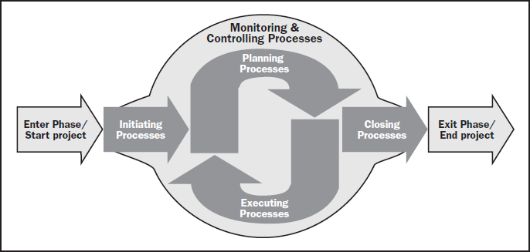
Monitoring and Controlling

Slide 12
Closing
Formally complete project (documented)
Transfer goods
Analyze your work
Finalize and organize documentation
  Including “lessons learned” for the next project

Slide 13
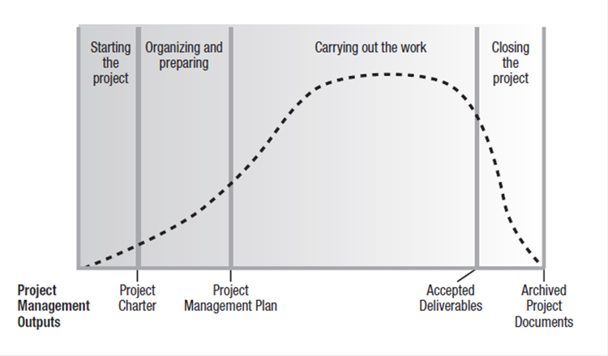
Project Phases
Notes:
Where is the Epic Project in this timeline?

Slide 14
Knowledge Areas
Integration
Cost
Human Resources
Stakeholder Management
Scope
Time
Procurement
Risk Management
Communications
Quality
How are these part of the phases of the project?
Notes:
Components of project management– part of the phases of the project lifecycle– Initiating, Planning, Executing, Monitor and Controlling, Closing

Slide 15
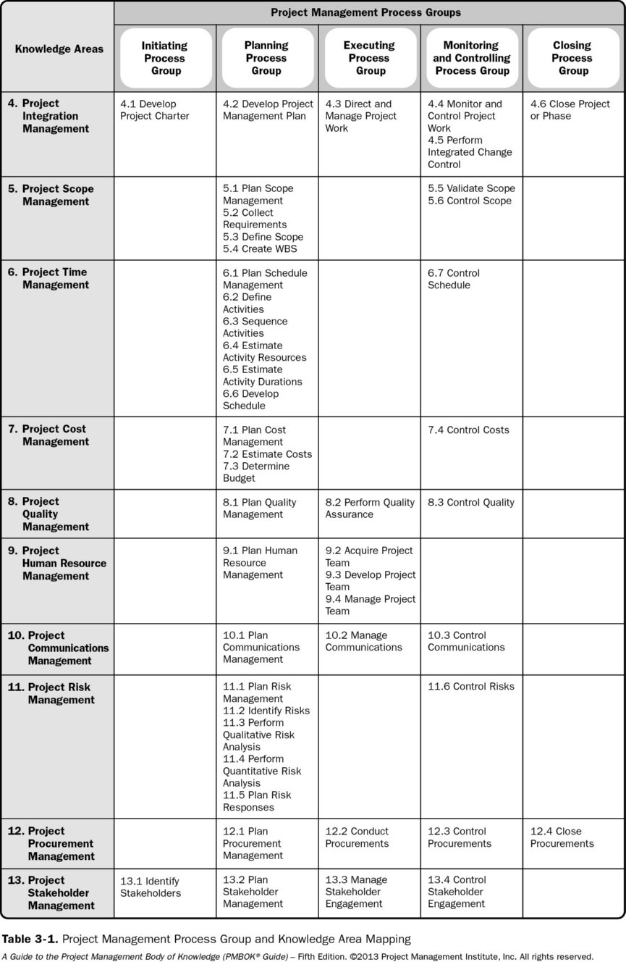
Process Groups and Knowledge Areas

Slide 16
Process Groups and Knowledge Areas

Slide 17
Process Groups and Knowledge Areas

Slide 18
Triple Constraints (Iron Triangle)
Project success is dependent upon all three sides of the triangle remaining in balance
Triangle can skew, but quality will be altered
Triangle cannot break or project will not be successful

Slide 19
The Iron Triangle
Quality
Scope
Resources
Time

Slide 20
The Iron Triangle
Scope
Resources
Time
Notes:
Increased scope

Slide 21
The Iron Triangle
Scope
Resources
Time
Notes:
Little time

Slide 22
Some Project Management Terms
Project Scope – The work performed to deliver a product, service, or result with the specified features and functions.
Scope Creep– The uncontrolled expansion to project scope without adjustments to time, cost, and resources.
Risk – An uncertain event or condition that, if it occurs, has a positive or negative effect on one or more project objectives
Notes:
Terms you have heard of, but may not have understood. Terms you may want to use when escalating issues. Components of a project you may have seen but not recognized.

Slide 23
Some Project Management Terms
Critical Path – The sequence of activities that represents the longest path through a project, which determines the shortest possible duration.
Fast Tracking – A schedule compression technique in which activities normally done in sequence are performed in parallel for at least a portion of their duration.
Crashing– A schedule compression technique used to shorten the schedule duration for the least incremental cost by adding resources.

Slide 24
Some Project Management Terms
Rolling Wave Planning – an iterative planning technique in which the work to be accomplished in the near term is planned in detail, while the work in the future is planned at a higher level
Work Breakdown Structure (WBS) – A hierarchical decomposition of the total scope of the work to be carried out by the project team to accomplish the project objectives and create the required deliverables.

Slide 25
Questions
Can you recognize places where you are already employing project management techniques in your everyday tasks (either work or home)?
How can you use project management in your work today?

Slide 26
Closing
Using the project management framework can help:
  Maintain order
  Manage time
  Plan logically
  Think critically about the way you work

