Slide 1
Working the Pit Crew: Racing Industry Efficiency for Cardiac Arrest Victims
Simple changes- big impact

Slide 2
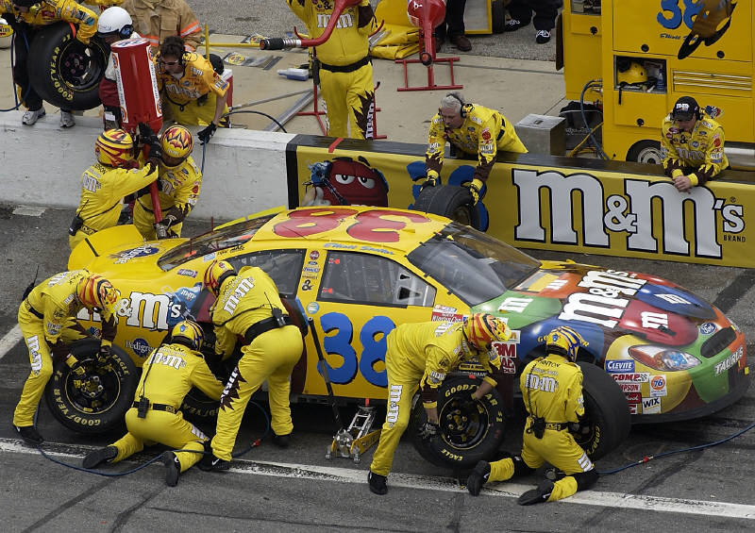
What can we learn from NASCAR?

Slide 3
Objectives
Learn which interventions must be priority
Understand what has the greatest impact on nuero intact discharge
Identify how to reduce PeriShock Pause, improve delivery of care
Adjust priorities based on up to date research/ recommendations
*Current focus- adult, medical cardiac arrest

Slide 4
Which interventions should be the priority?
Airway
DEFIB
Intubation
IV
IO
Immobilization
Transport
EKG
CPR

Slide 5
Which interventions should be the priority?
Airway
DEFIB
Intubation
IV
IO
Immobilization
Transport
EKG
CPR

Slide 6
Which interventions should be the priority?
Airway
DEFIB
Intubation
IV
IO
Immobilization
Transport
EKG
CPR

Slide 7
Why do we do compressions?
Notes:
- Lets talk about high quality CPR, which is a large component of resuscitation.

Slide 8
Coronary Perfusion Pressure (CPP)
Notes:
- What is out measure of myocardial blood flow?
- Coronary Perfusion Pressure: Pressure that drives blood into the heart (CPP≈ Diastolic BP – Central Venous Pressure)
- Turns out by performing chest compressions, we are able to increase this CPP
- A lot of cardiac arrest literature in the last several years has been focused on the CPP and how different interventions affect it.
- The first logical question for us is “does CPP matter?”

Slide 9
Notes:
- The answer is a resounding yes., and logically this makes sense “increased blood flow to the heart should increase your chances of return of spontaneous circulation”
- Turns out CPP is a great predictor of ROSC or failure of ROSC. Infact, CPP less than 15 has been shown to be a very poor prognostic indicator.

Slide 10
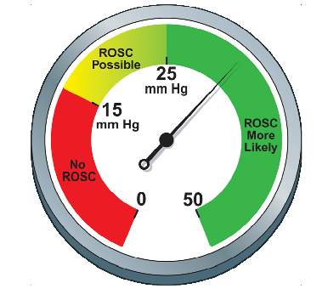
Notes:
- So this is a new way of looking at resuscitation, we finally have a metric that we can try to optimize to improve our outcomes, which is huge!
- Old way was a kitchen sink algorithm and hope for the best, now we have and objective goal to aim for, and can tailor the components of the resuscitation to try to maximize that goal

Slide 11
So what can we do to improve CPP
Notes:
- So we know that a better CPP leads to increased rates of ROSC, so what can we do to improve CPP?
- Today I am going to talk about 3 different topics that have been shown to improve cpp
- Improve Compression Fraction
- Minimize Perishock Pause
- Avoid Hyperventilation

Slide 12
Compression Fraction
Notes:
- So the first topic we are going to discuss is compression fraction.
- By show of hands who has heard of Compression Fraction?
- Compression Fraction is the percent of time during a cardiac arrest that a patient has active chest compression: (EG if a patients total down time is 10 minutes, and 8 of those minutes the patient is getting chest compressions, the compression fraction is 80%)
- So we know that compressions are important, but how important? Several different groups set out to find out how important they are

Slide 13
Notes:
- It has to do with how chest compressions affect CPP:
- So here we have patient A, who during a specific period of time is getting compressions, with 2 short breaks in compressions.
- On initiation of compressions, CPP does not increase instantaneously, (A)
- Any interruption in compressions dramatically and quickly decreases the CPP (B)
- Interestingly, although a drop in CPP occur within a few seconds of pausing compressions, it takes more than one minute of good-quality chest compressions to restore them to pre-pause levels.(C)

Slide 14
Notes:
So when we focus on the CPP, we notice a few important things. First we know that high CPP are associated with high rates of ROSC, and low CPP are associated with low rates of ROSC
In patient A, each interruption in compressions results in a significant drop in CPP, meaning more time spent in an unfavorable CPP

Slide 15
Notes:
So lets compare this to Patient B. Patient B during the same time course has only 1 pause in compressions,

Slide 16
Notes:
IF we again focus on the CPP, we can see that patient B spends a considerably larger proportion of time with a favorable CPP.

Slide 17
Notes:
IF we directly compare the 2 patients, during the same time period, Patient A only has 1 more compression pause than Patient B but there is a significant difference in time spent with an optimal CPP.
This is the fundamental concept behind optimizing compression fraction.

Slide 18
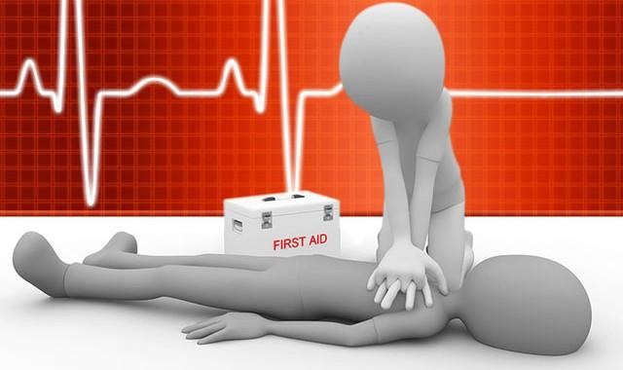
CPR
Rate 120
Full recoil
Minimal interruptions
Notes:
Keeping in mind that all current protocols are still in place and should be followed.

Slide 19
So how can we increase our compression fraction?
Notes:
So now we know that higher CPP improves survival, and that improving the compression fraction time, so what are some things we can do to increase compression fraction?
That brings us to our next topic: the perishock pause

Slide 20
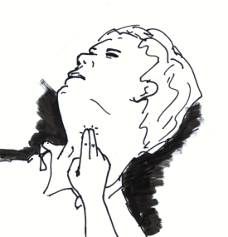
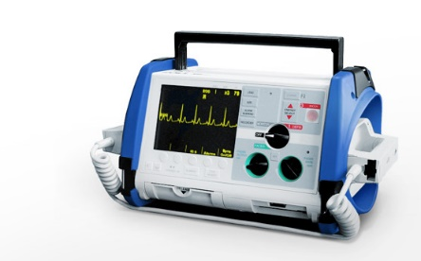
Traditional perishock pause
Notes:
How many people have seen this scenario:
Patient is getting compressions, during the pulse check the monitor shows a shockable rhythm, the team decides to deliver a shock, the machine charges, the shock is delivered and compressions resume?
It takes me almost 13 seconds to just SAY that, much less actually go through all the motions safely. The average perishock pause reported in the literature varies from 20 – 30 seconds, and often it can be considerably longer.
Some of you might be thinking “So what? That not that long”, unfortunately, its long enough to affect survival
.

Slide 21
Peri-Shock Pause
Notes:
The literature shows not only does decreasing the perishock pause improve the success of the defibrillation, survival significantly increases as you decrease the perishock pause
In the above graph you can see that the rate of success in defibrillation is low when the perishock pause is greater than 30 seconds. With every 10 second decrease in perishock pause, you get a significant increase in response to defibrillation

Slide 22
Ways to decrease perishock pause
Notes:
The second option is to charge the zoll prior to the pulse and rhythm check, If a shockable rhythm is identified, you can just deliver the shock and resume compressions, reducing the need to start and stop compressions .

Slide 23
Notes:
So some of you are probably wondering: “how do we incorporate all of this? There are so many different components!”
The perceptive members of the audience are wondering “wasn’t pit crew in the title of your presentation? I have not heard anything about pitcrews yet!”
I will address both of those things now!

Slide 24
PitCrew
Notes:
So anyone familiar with professional racing know that an carry out a large number of individual complex tasks quickly and in sync with the rest of the team,
There are a lot of parallels that can be drawn between a resuscitation and a pitstop.
The future of Pre-Hospital Resuscitation is going towards a “PitCrew” approach towards the cardiac arrest patient,

Slide 25
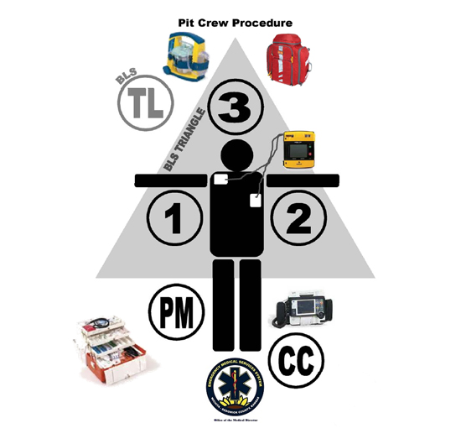
Pit Crew CPR
Specific roles
Specific sequence
Specific locations
2 minute intervals
Notes:
Keeping in mind that all current protocols are still in place and should be followed.

Slide 26
Pit Crew CPR
Role 1
Pt’s right side
Assess
Start chest compressions (CC)
Rate of 120/min
Full recoil
Notes:
Keeping in mind that all current protocols are still in place and should be followed.

Slide 27
Pit Crew CPR
Role 2
Pt’s left side
AED at left shoulder
Defibs
Assist with ventilations
Every 20th compression
Pulse check prior to defib
Notes:
Keeping in mind that all current protocols are still in place and should be followed.

Slide 28
Pit Crew CPR
Role 3
OA/NA
2 hand seal on BVM
Count compressions
Announce every 20th
Keeps count
Notes:
Keeping in mind that all current protocols are still in place and should be followed.

Slide 29
2 minute interval
Provider 1 and 2 change tasks
NOT locations
CC resume as soon as defib/ no shock advised is completed
Notes:
Keeping in mind that all current protocols are still in place and should be followed.

Slide 30
2 minute intervals
Can continue as long as needed
Advanced airway need not be rushed
IV/IO not urgent
What about meds?
Notes:
Keeping in mind that all current protocols are still in place and should be followed.

Slide 31
2nd 2 minute interval
Provider 2 performs CC
Provider 1 assists with ventilations
(help set up airway during off cycle of CC)
Notes:
Keeping in mind that all current protocols are still in place and should be followed.

Slide 32
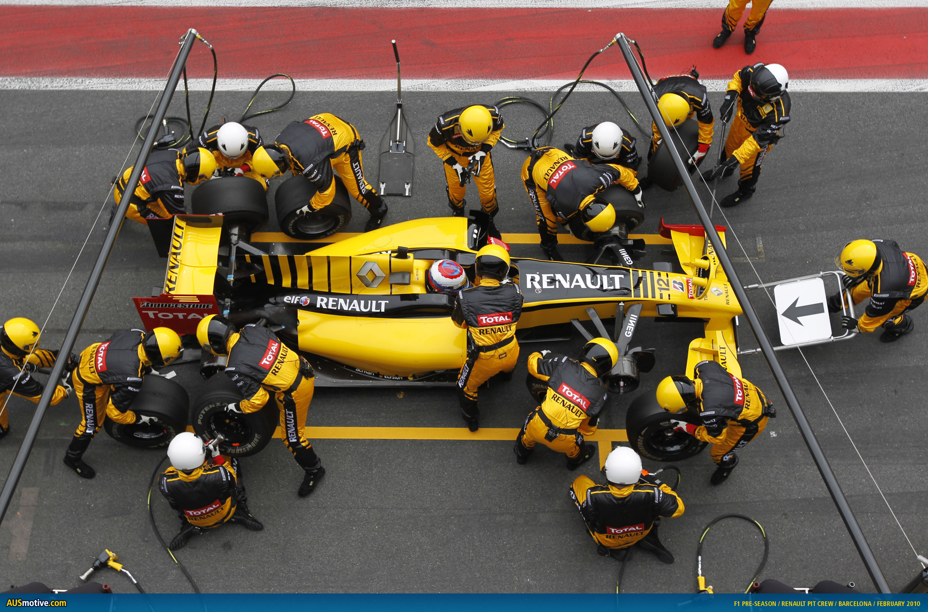

Slide 33
Summary
Notes:
We talked about a lot of good cardiac arrest literature
Compression Fraction
PeriShock Pause
Ventilations
Pit Crew Efficiency the future of pre-hospital cardiac arrest care

Slide 34
Notes:
Thank you!

