Slide 1
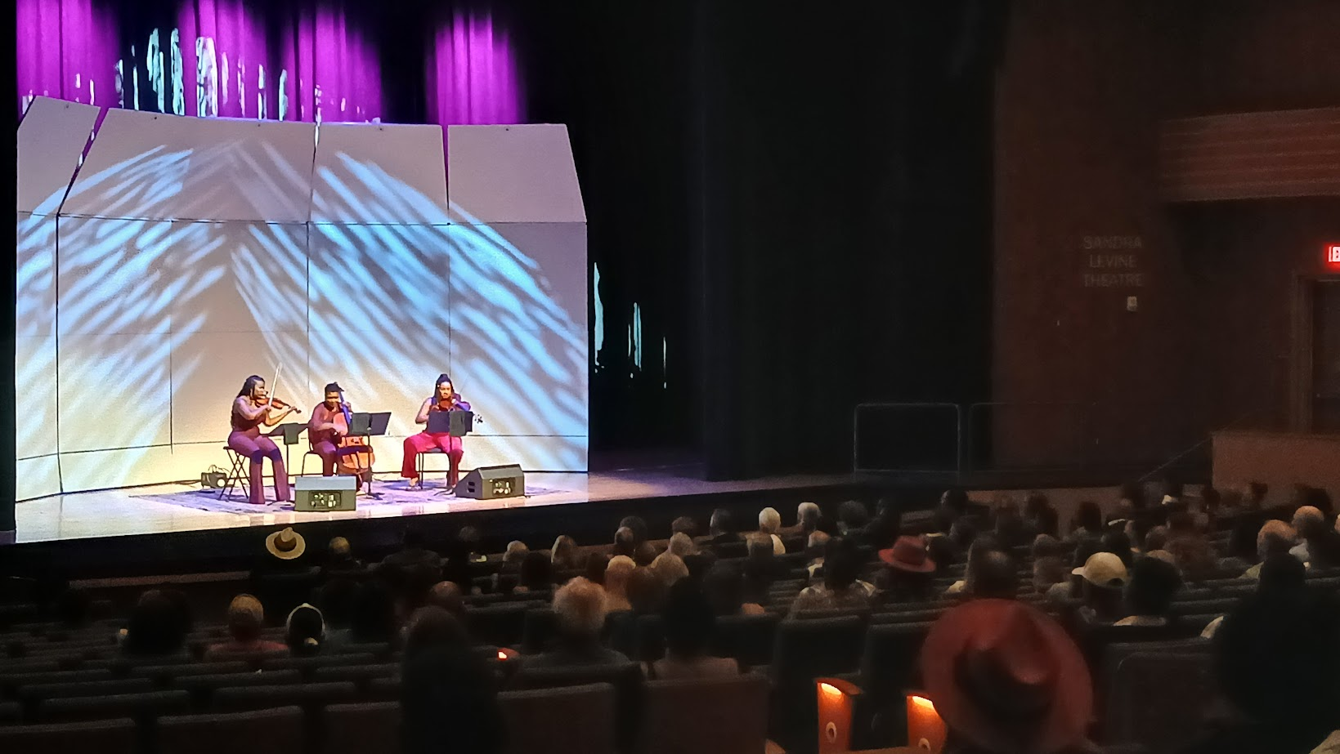
16 Concerts & a WRAL Segment in the last 8 weeks
$9952 Clayton Fee, Bonus & Merch
$8000 Greensboro
$8000 Charlotte
$15,317 Raleigh Sales
$41,269 Total Revenue
$33,952 Artist Fee & Clayton Merch
$ 2847 Delta Hotel
$ 469 Car Rental
$ 90 Fuel
$ 540 Facebook Marketing
$37,898 Total Expenses
$ 3,371 NET
+ 8,200 Grant Support (20% REV)
$11,571

Slide 2
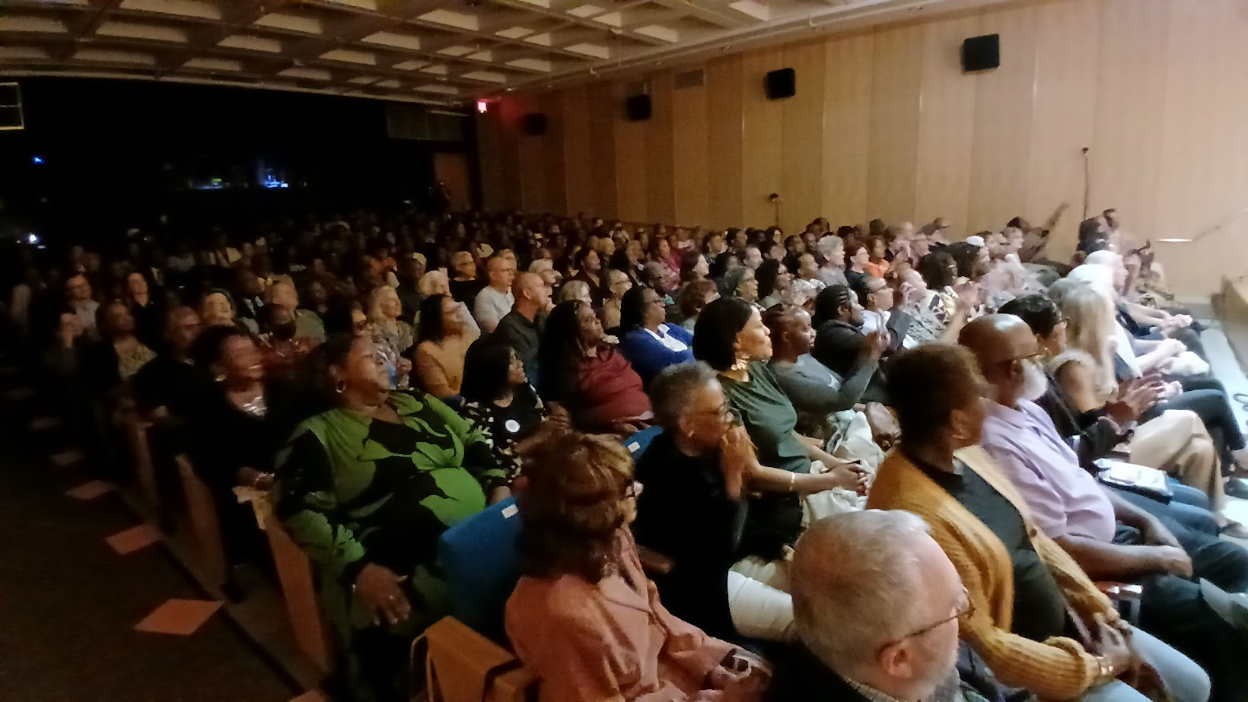
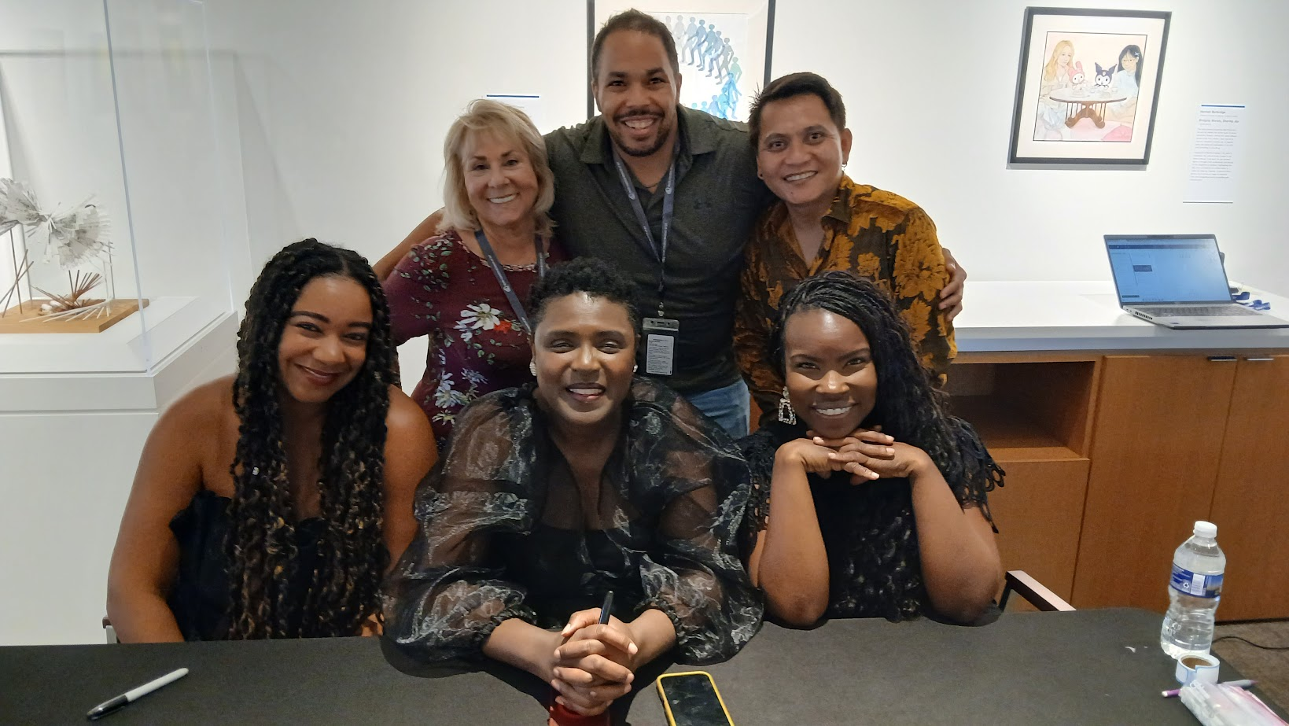
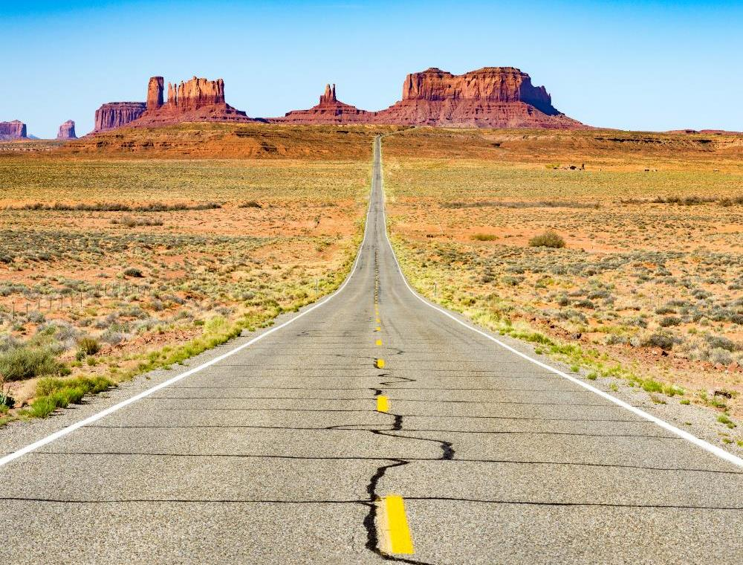
Agenda
Topic one
Topic two
Topic three
Topic four
Topic five

Slide 3
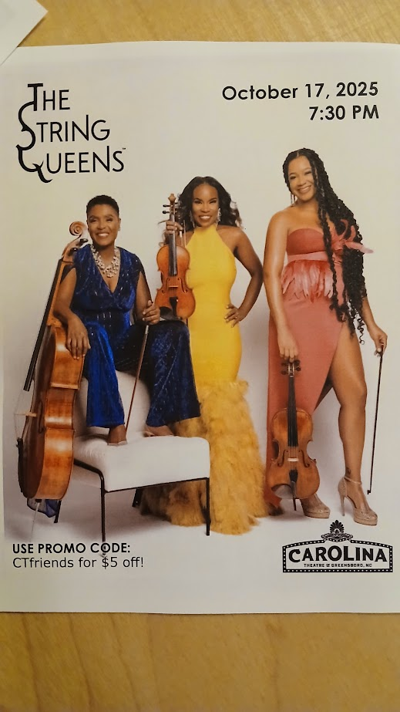
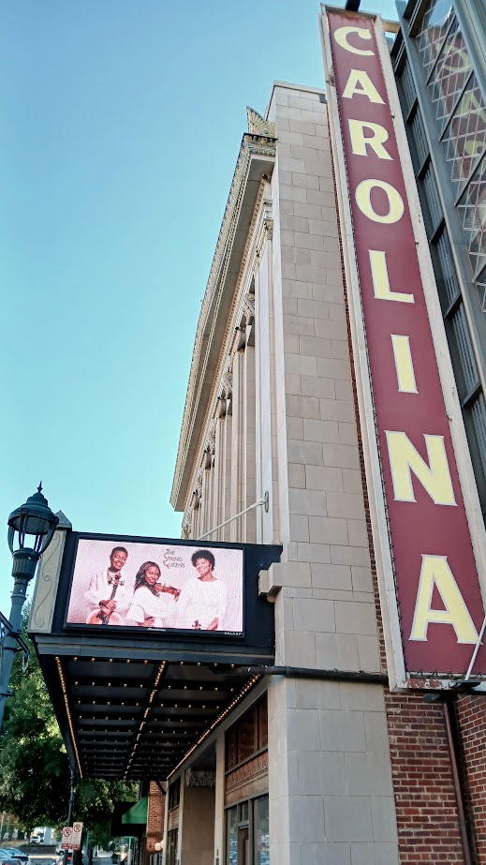
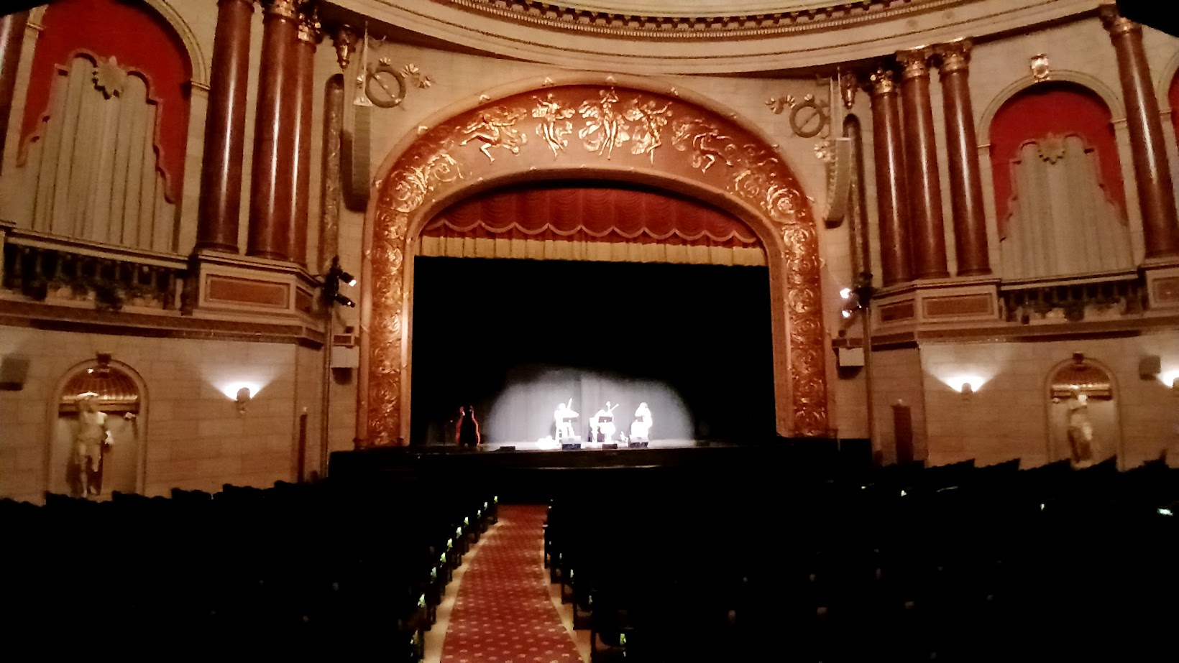
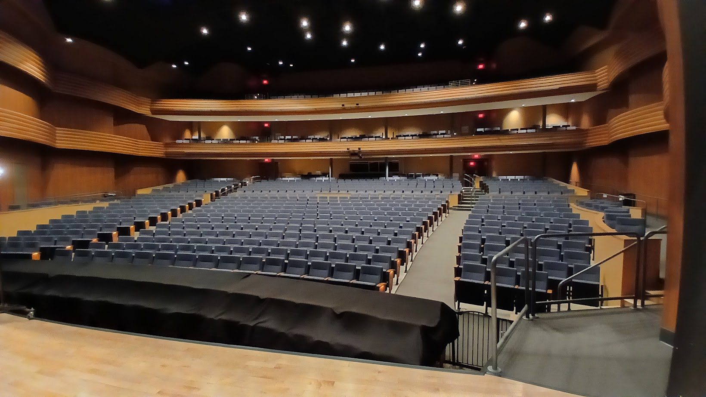
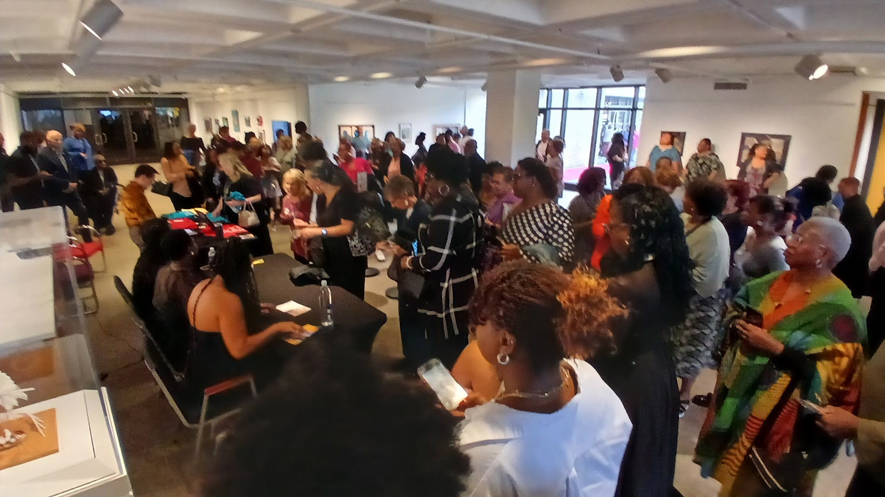
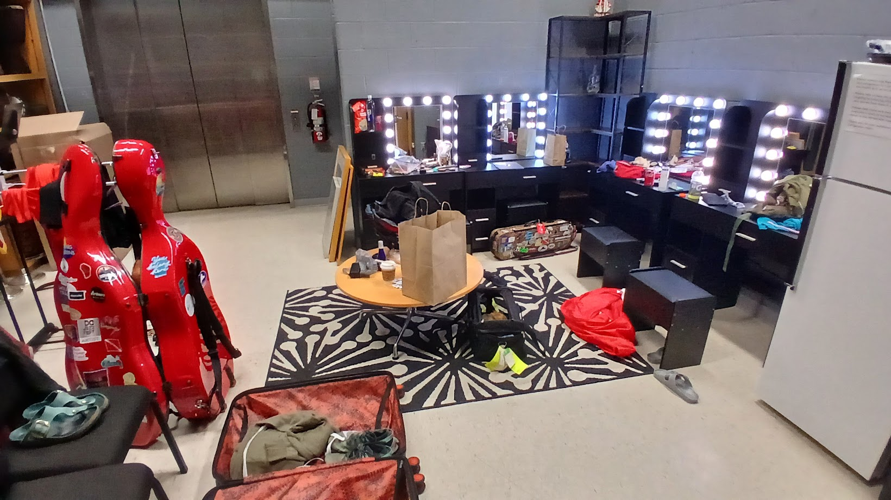
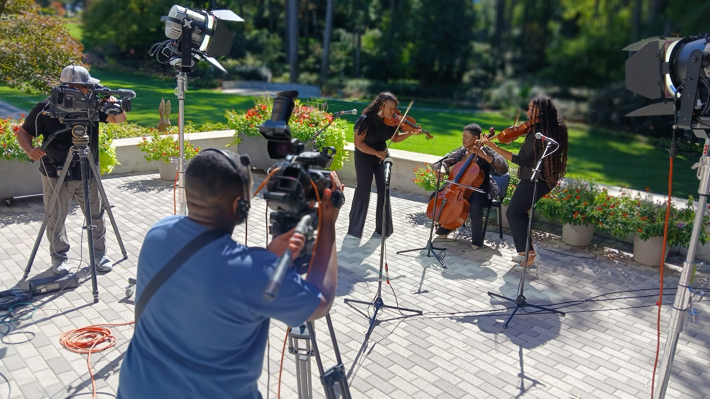
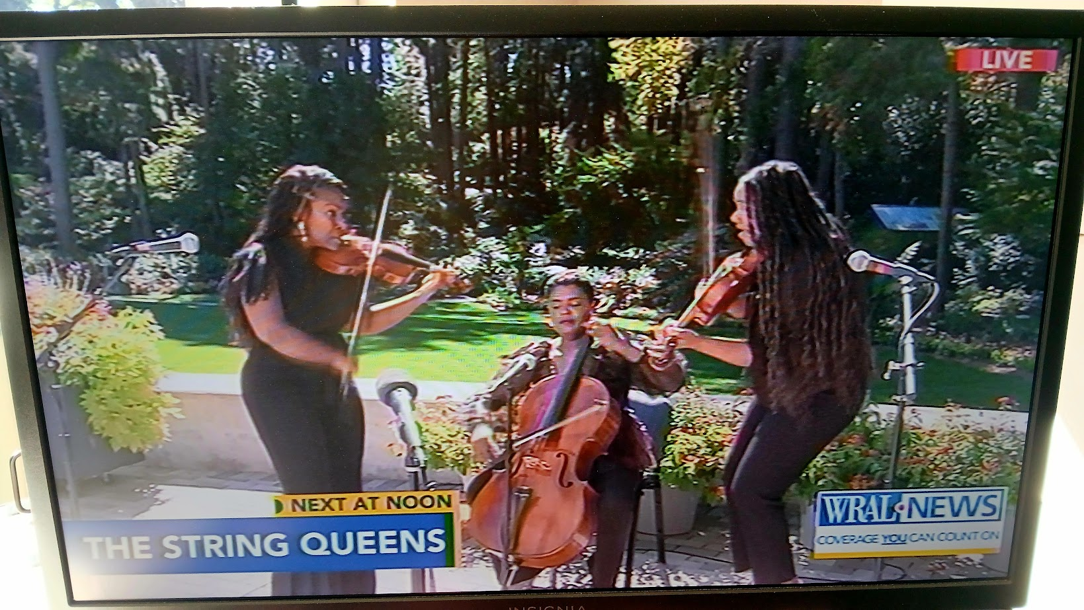
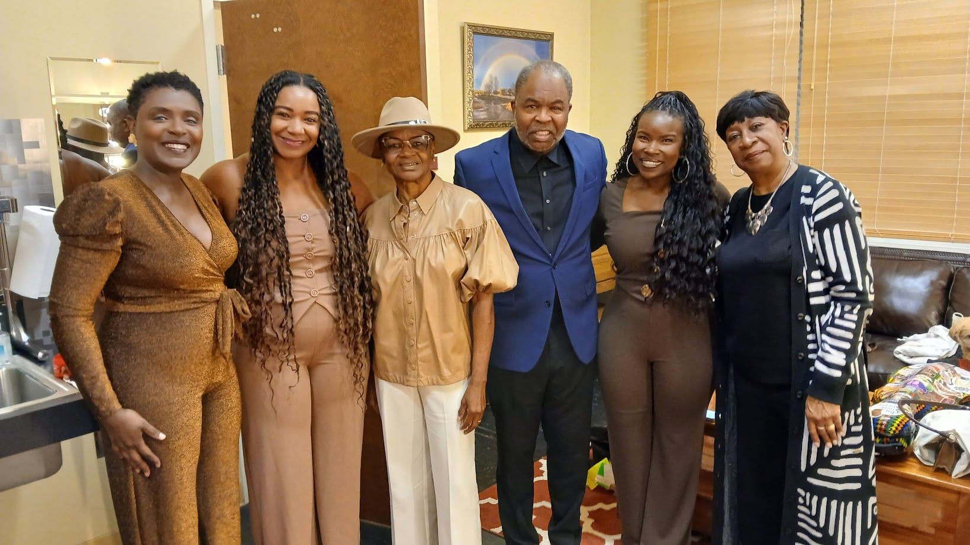
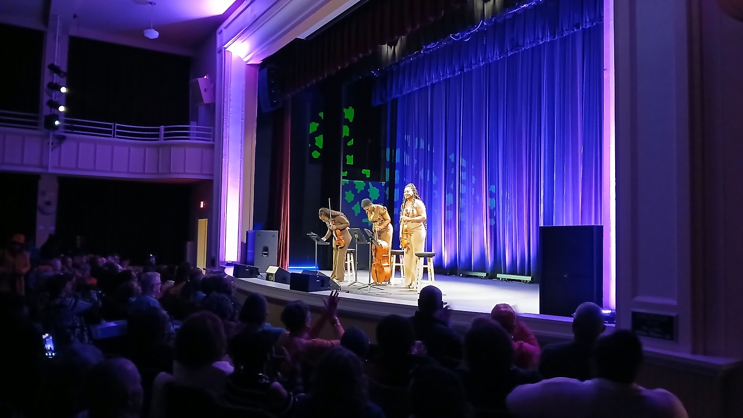
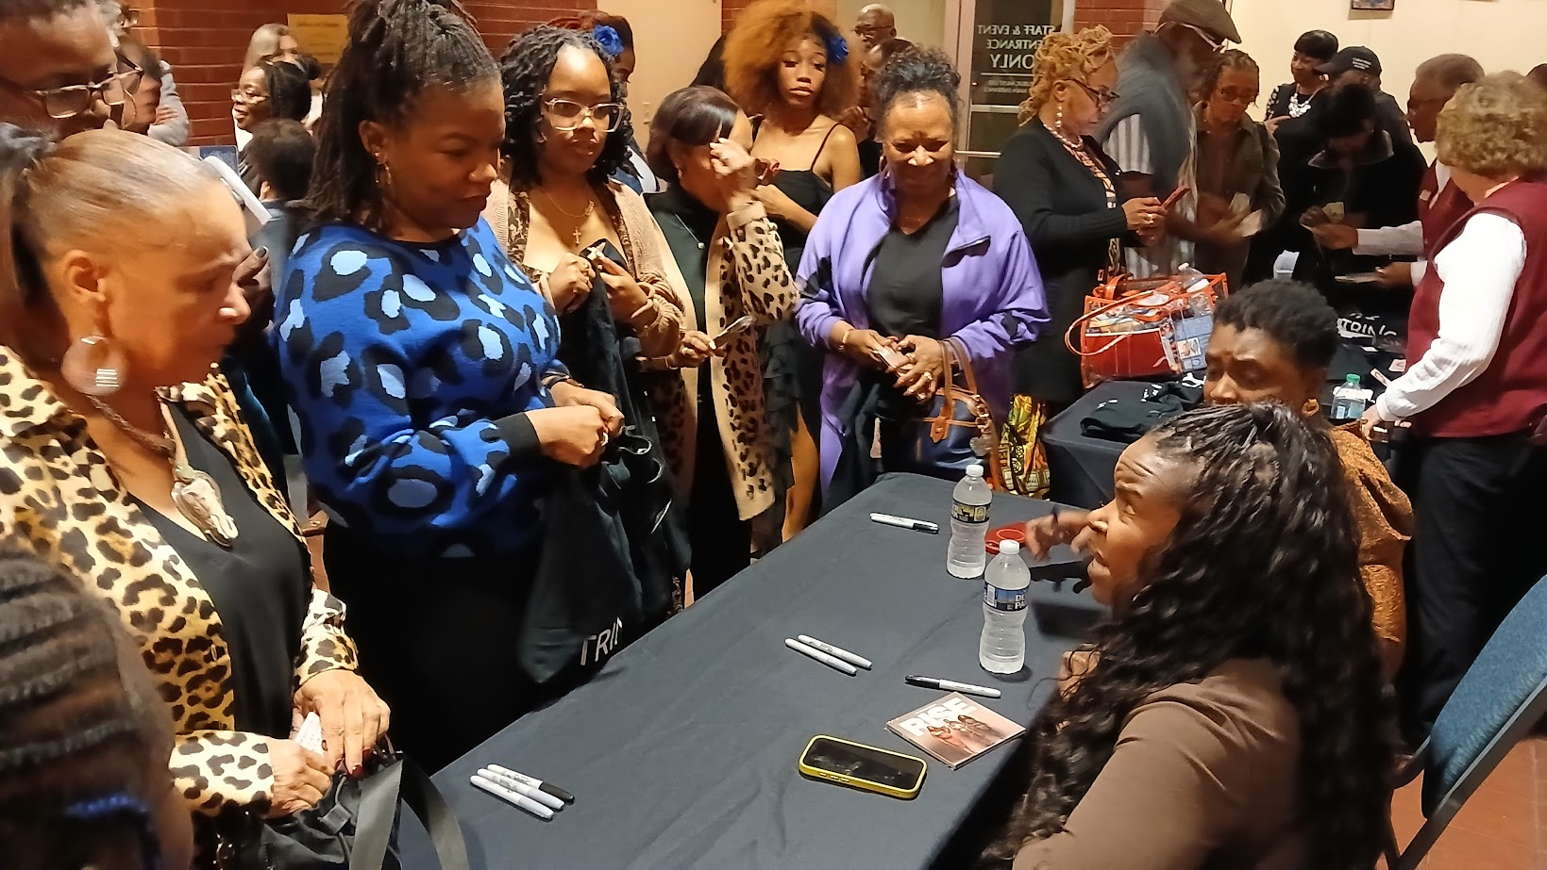
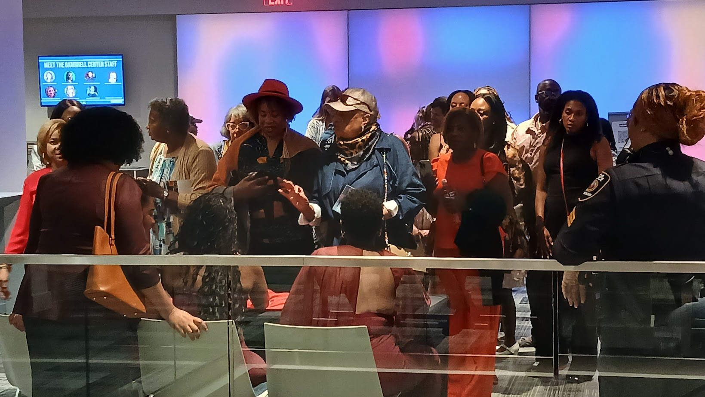
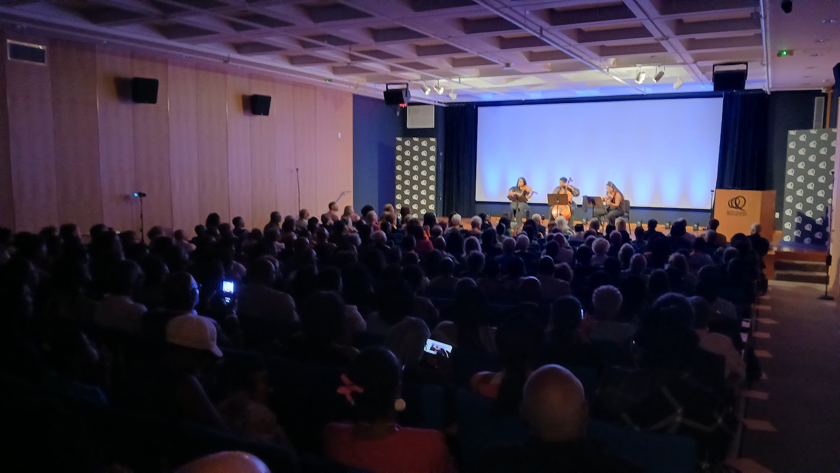
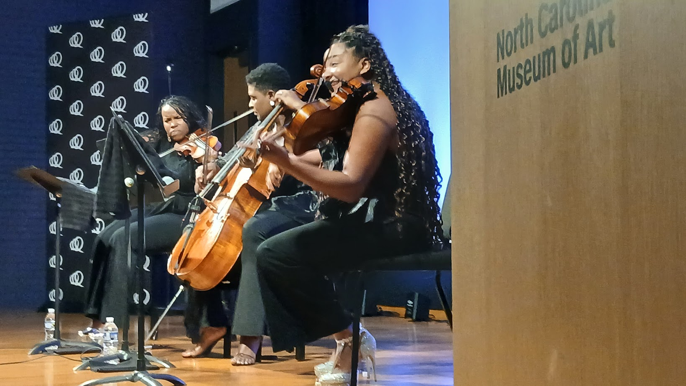
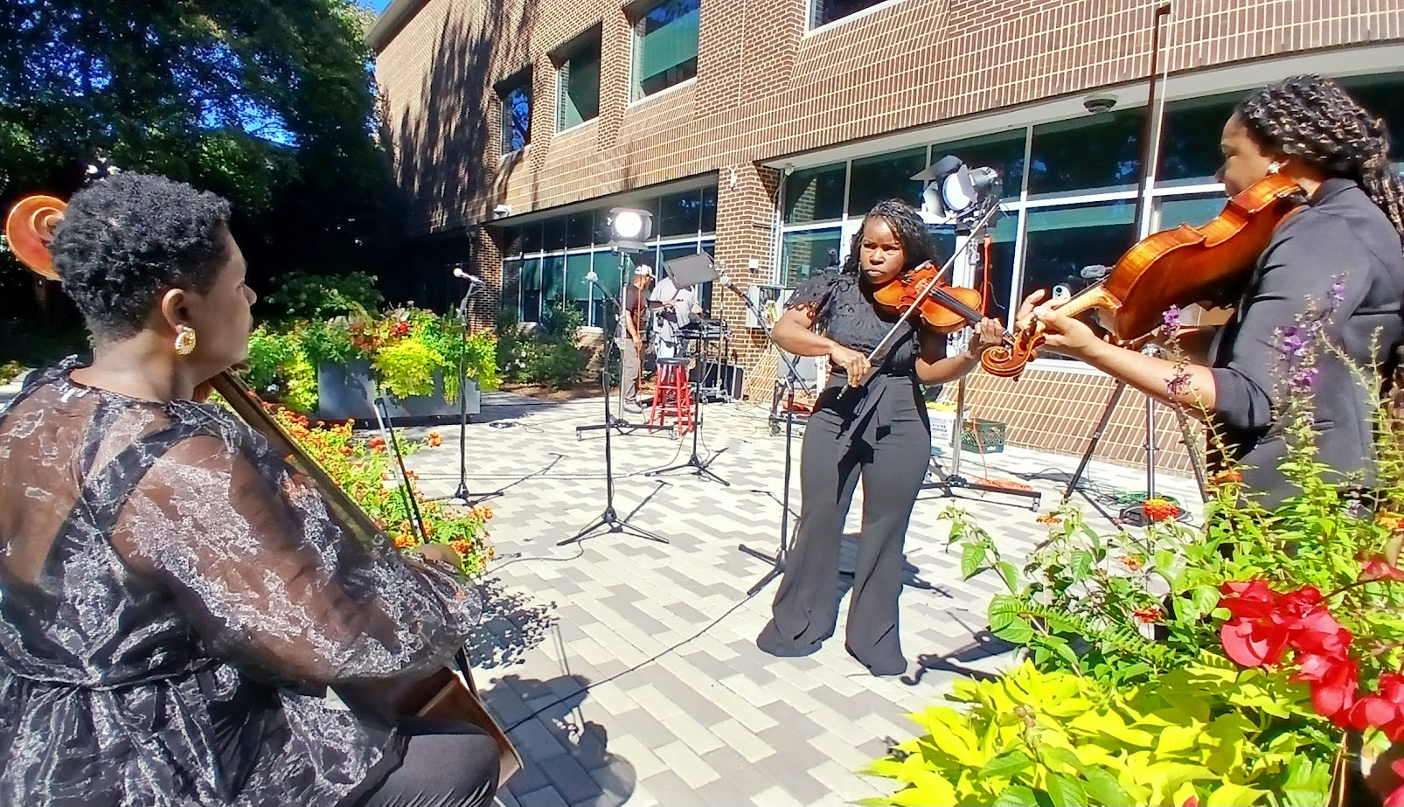
Agenda
Topic one
Topic two
Topic three
Topic four
Topic five

Slide 4
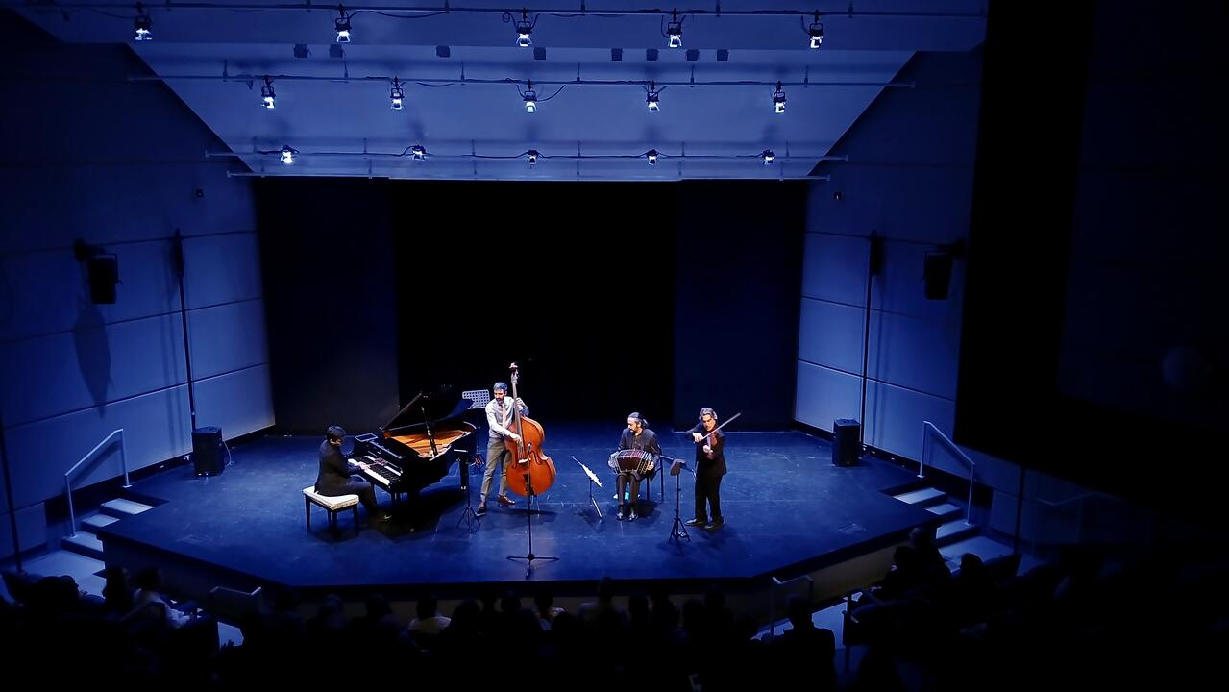
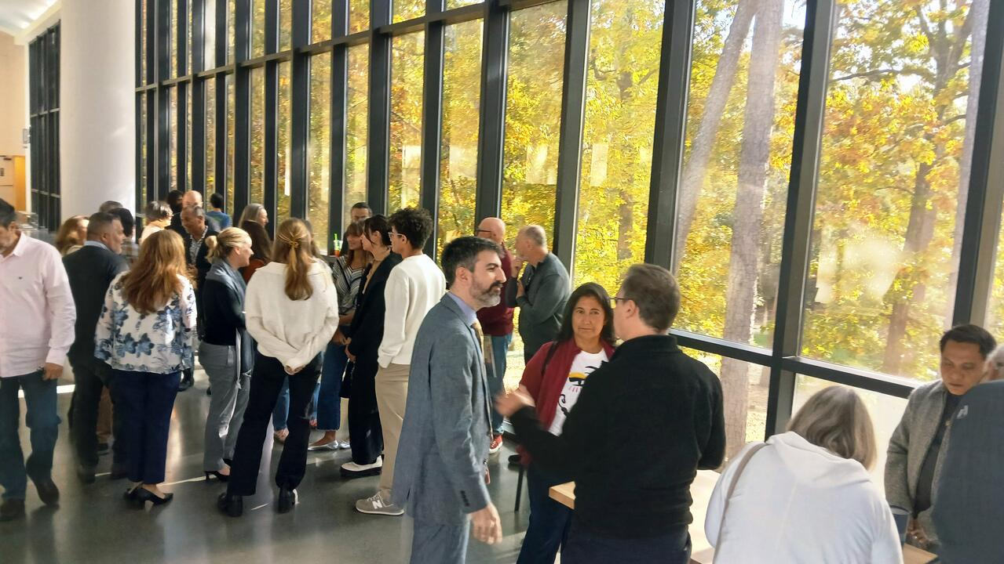
$4,000 Lynchburg
$4,000 Greensboro
$2,322 Winston-Salem Sales
$5,564 Raleigh 2PM Sales
$2,617 Raleigh 7PM Sales
$18,503 Revenue
$16,000 Artist Fee
$1,829 Lodging
$ 285 ½ Rental Car
$ 320 Artist Hospitality
$18,434 Expenses
$ 69 NET REVENUE
+ 3,700 Grant Support
+ 5,000 Collegiate Capital
$8769
PIANO RENTAL & POSTCARD MARKETING NOT INCLUDED (approx. $3000)

Slide 5
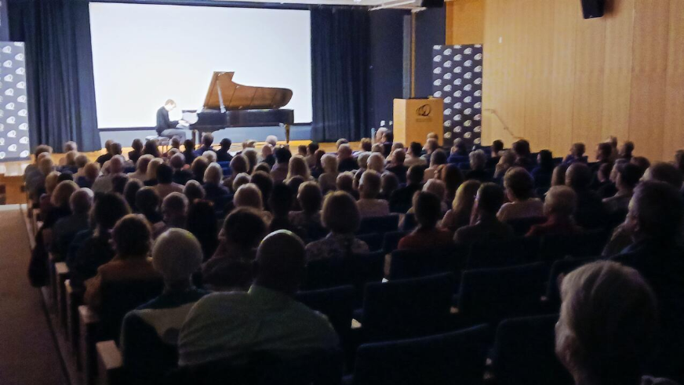
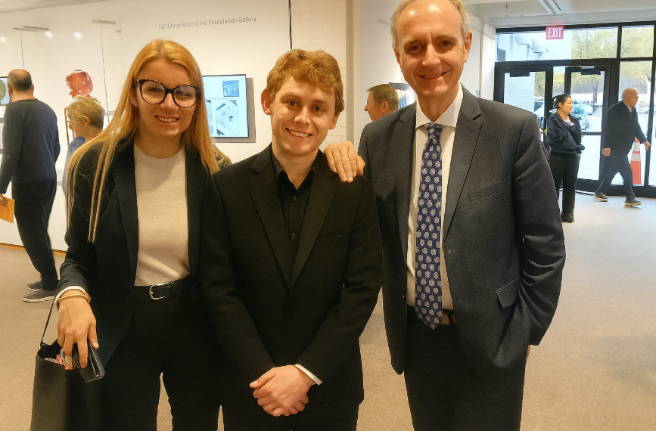

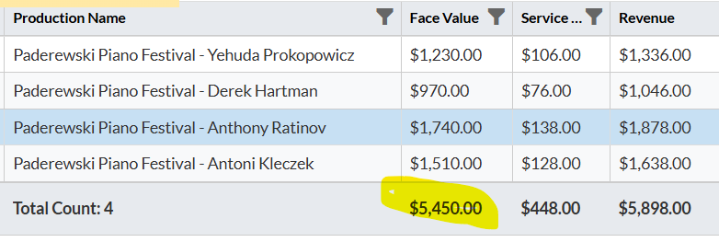
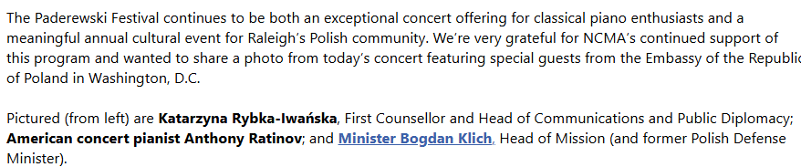

Slide 6

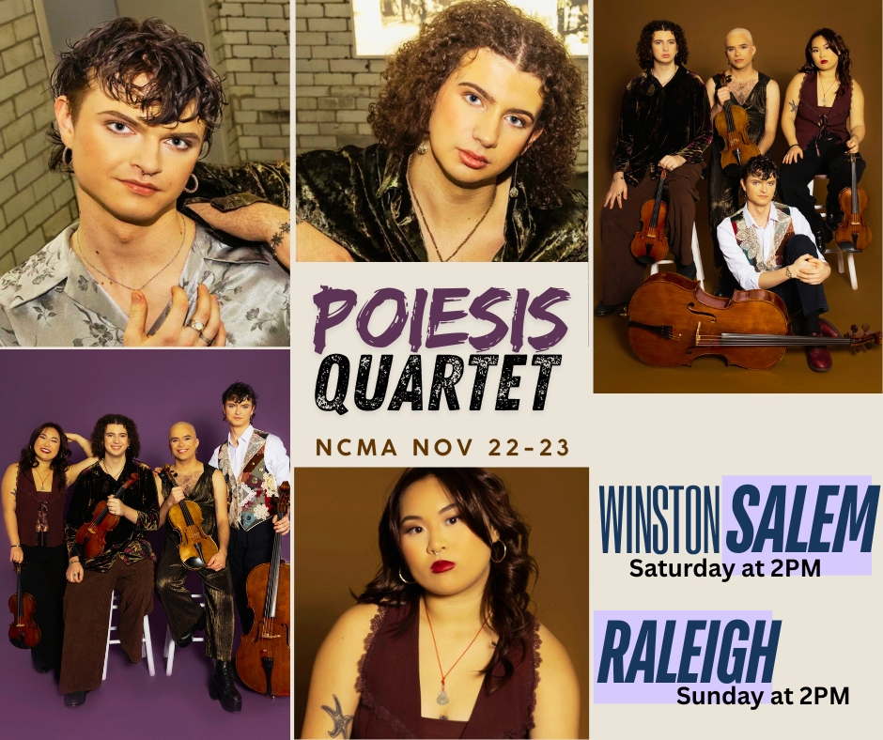
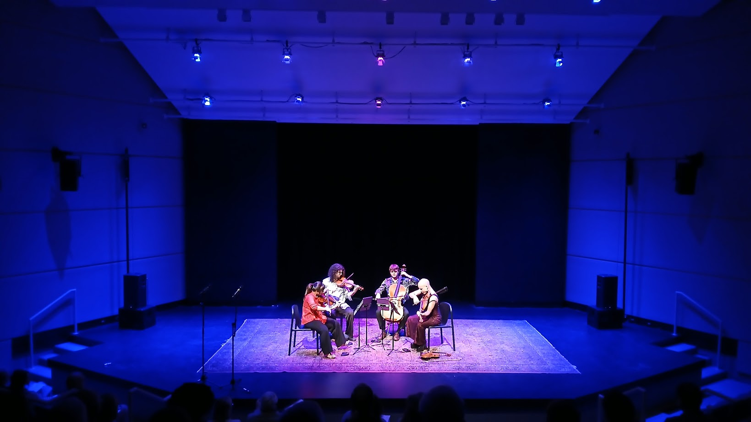
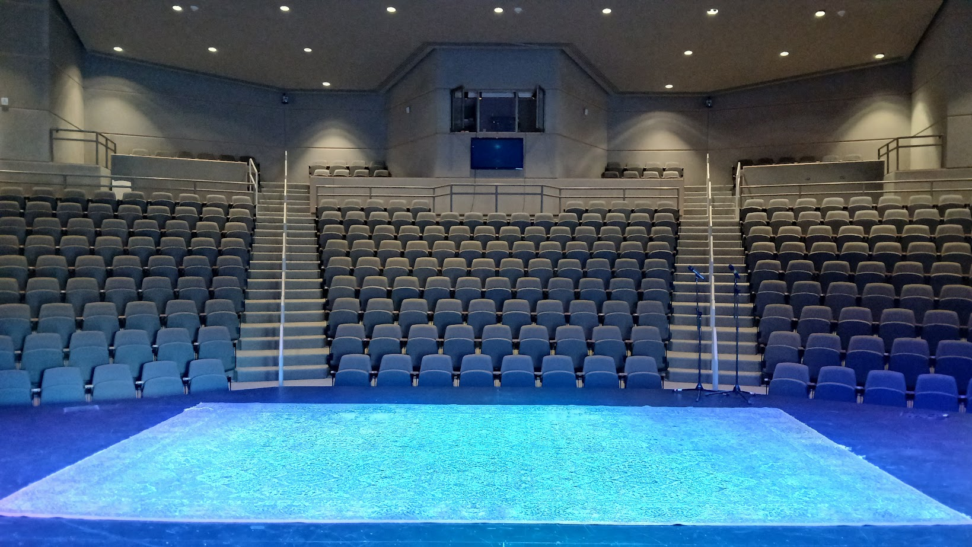
$4,782 Subscription Share
$ 698 Winston Sales
$ 664 Resold Seats for 2PM
$6,144 Total Box Office
$5,000 Ellen Black Winston
11,144 pending endowment
draw
$7,500 Artist Fee
$2,500 Marketing
$ 967 Lodging
$ 270 Car Rental & Gas
$ 310 Artist Hospitality
$11,547 Total Expenses

Slide 7
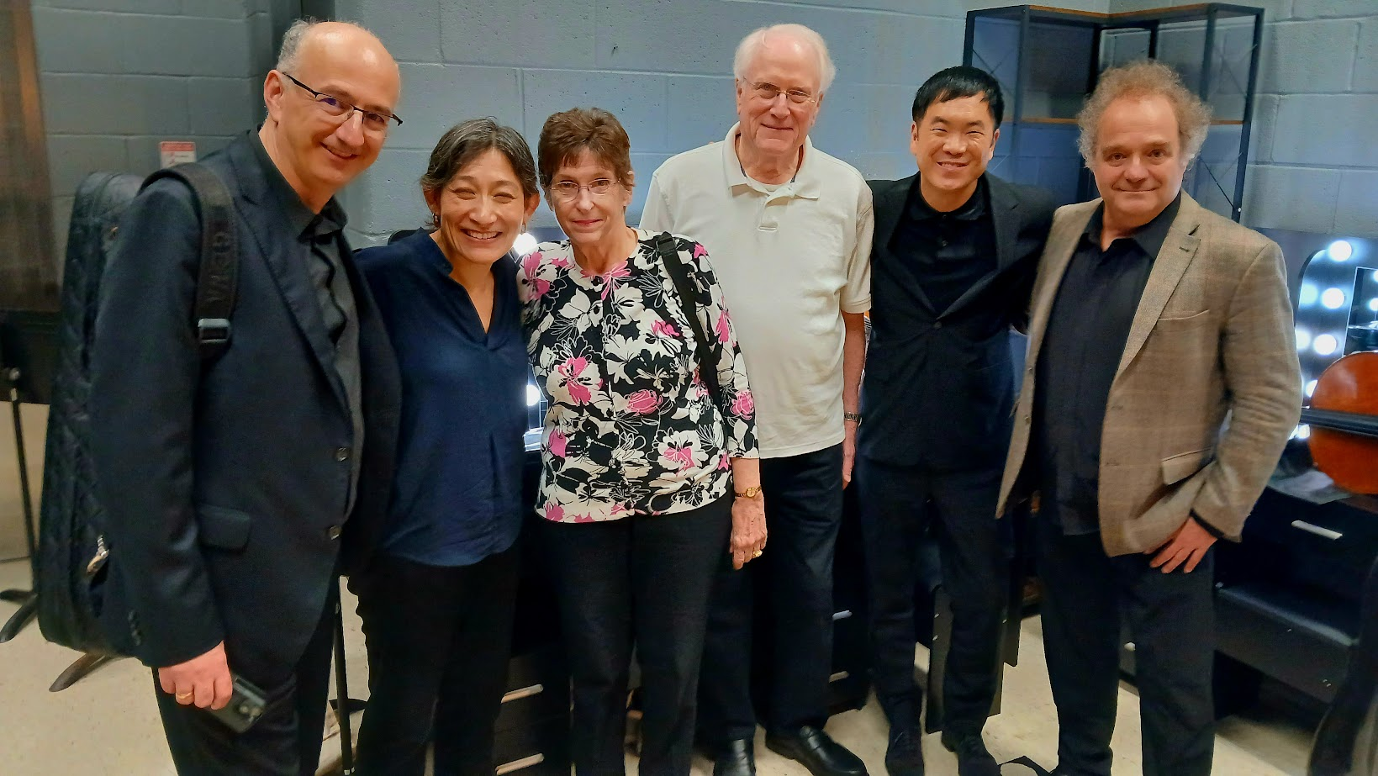
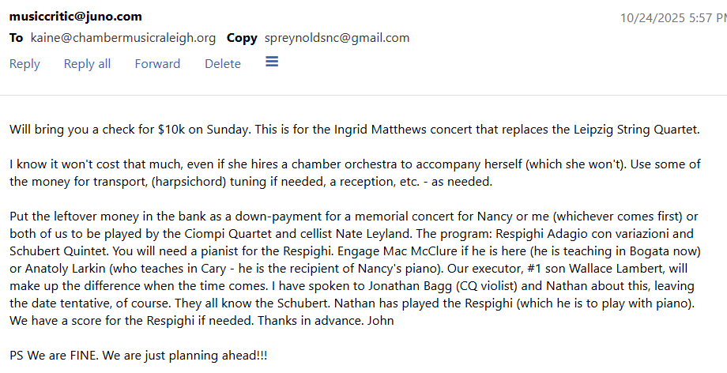

Topic one
Mother’s Day Concert Still Working
Subtitle

Slide 8
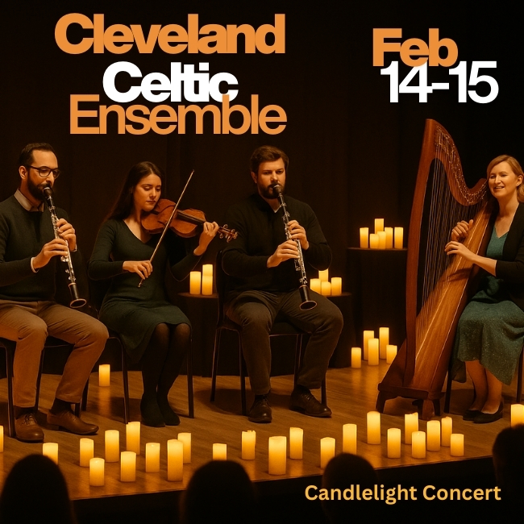
Team
UPCOMING PRODUCTION EXPENSES
Small Ensemble for Catering Works
Valentine’s Dinner
Battery-powered Candles for February
Junylle to Install Seat Numbers @ NCMA

Slide 9

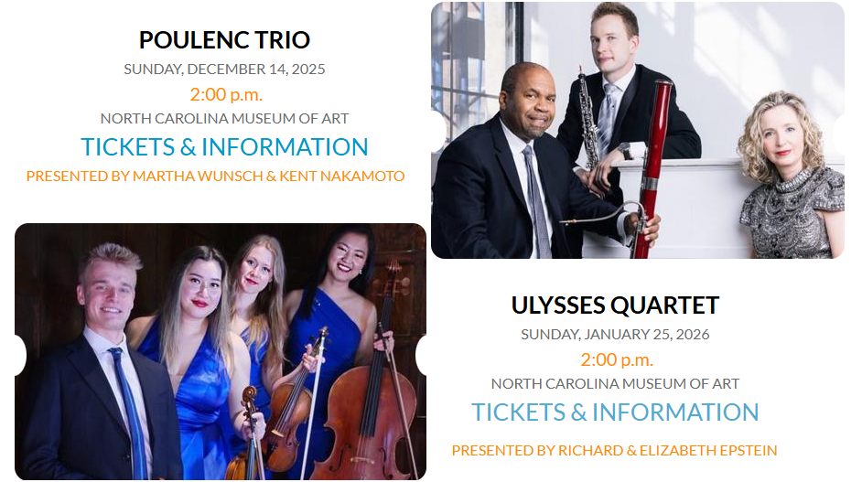
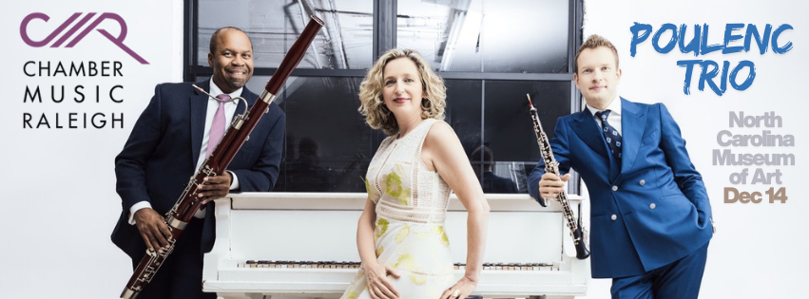
NEXT BOARD MEETING
FEB 2

Slide 10
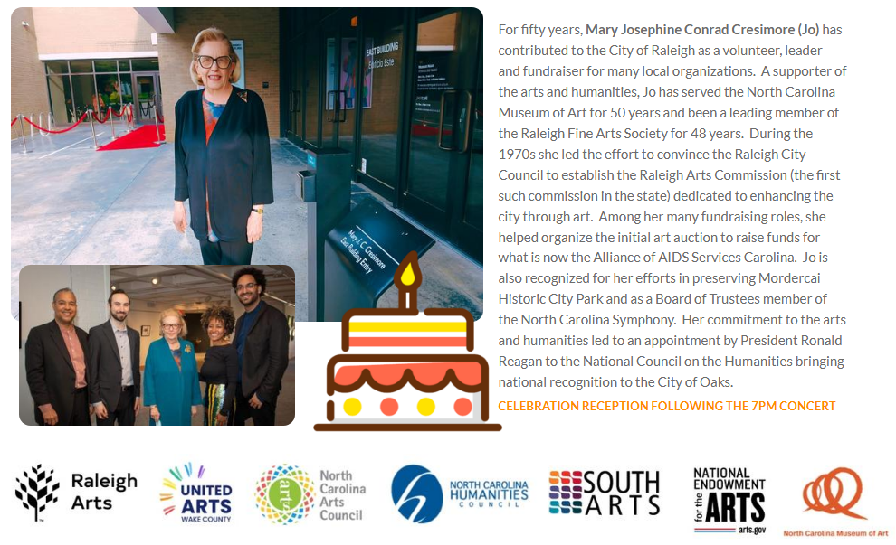
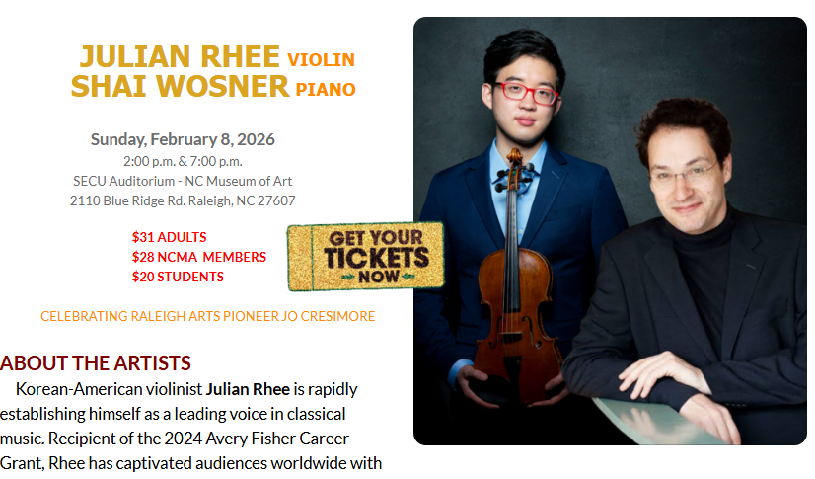
Programming
New Developments
6PM CONCERT

Slide 11
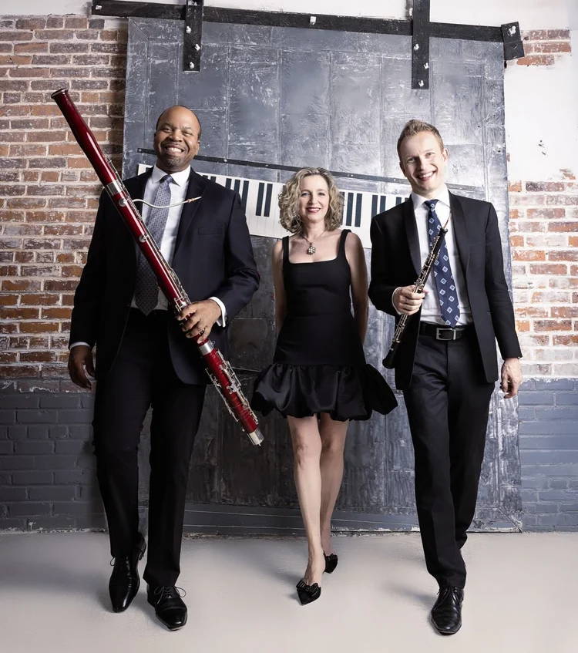

Thank you
PROGRAM INCLUDES:
POULENC, HANDEL & ROSSINI
and
Duke Ellington & André Previn

