Slide 1
Inhale Love…
Exhale Gratitude!

Slide 3
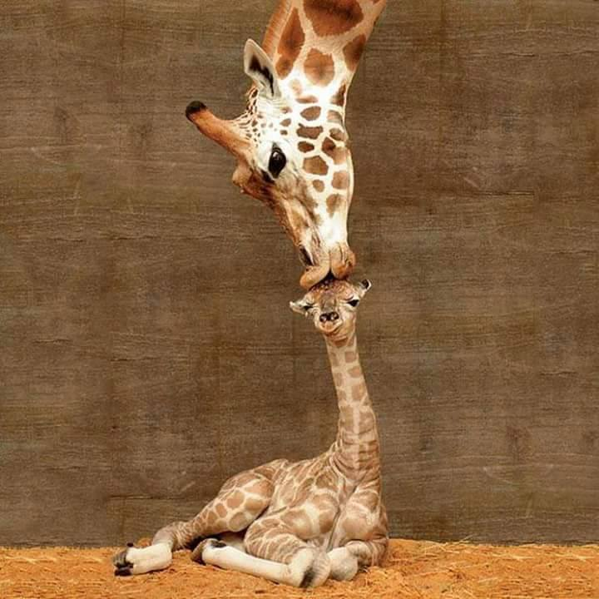
Whatever YOU are, be
a good one.
~Abraham Lincoln~

Slide 4
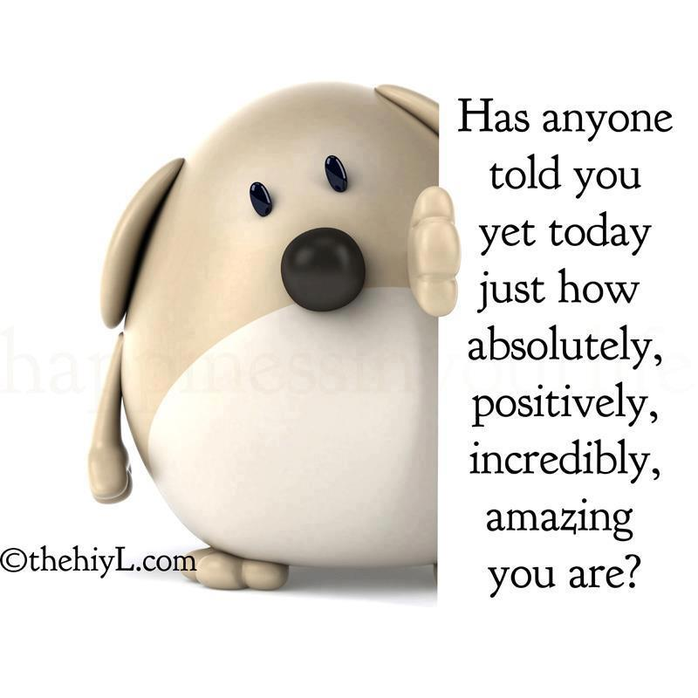

Slide 5
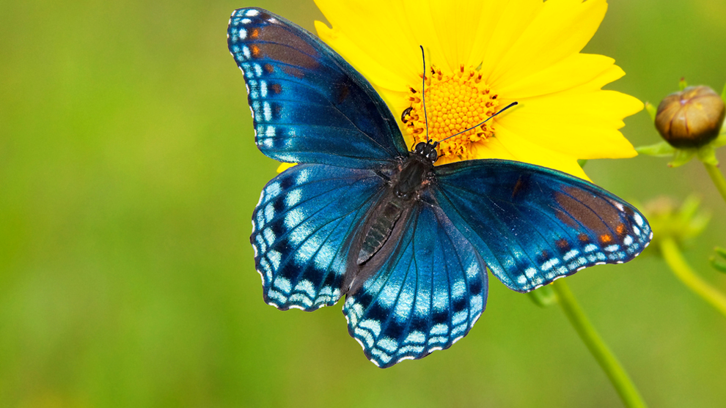
You cannot get through a single day without having an impact on the world around you. What you do makes a difference, and you have to decide what kind of difference you want to make.
Jane Goodall

Slide 6
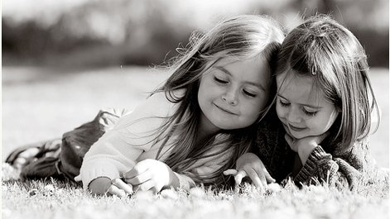
To make a difference in someone's life you don’t have to be brilliant, rich, beautiful, or perfect. You just have to CARE.

Slide 7
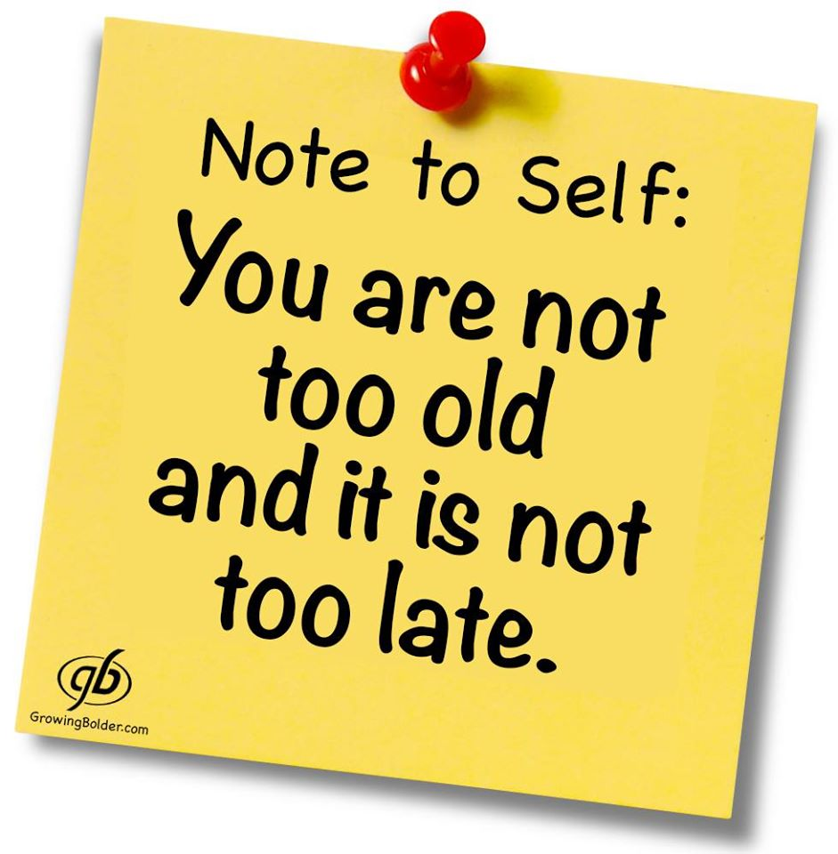

Slide 10
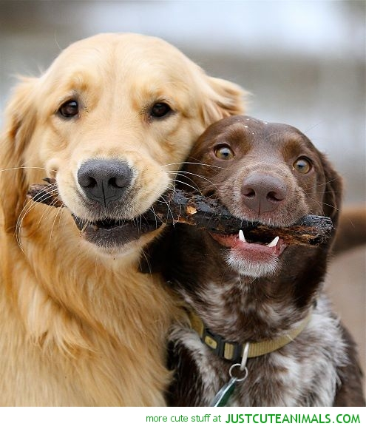
If you are really thankful, what do you do?
You share.
W. Clement Stone

Slide 13
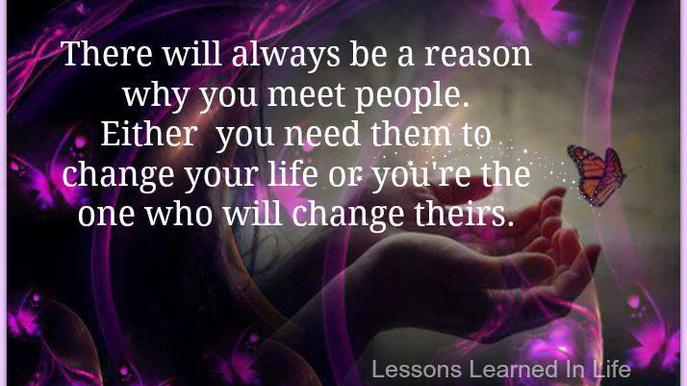

Slide 14
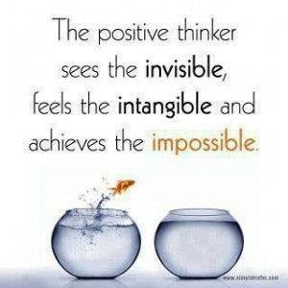

Slide 15
Leap, and the net will appear.

Slide 16
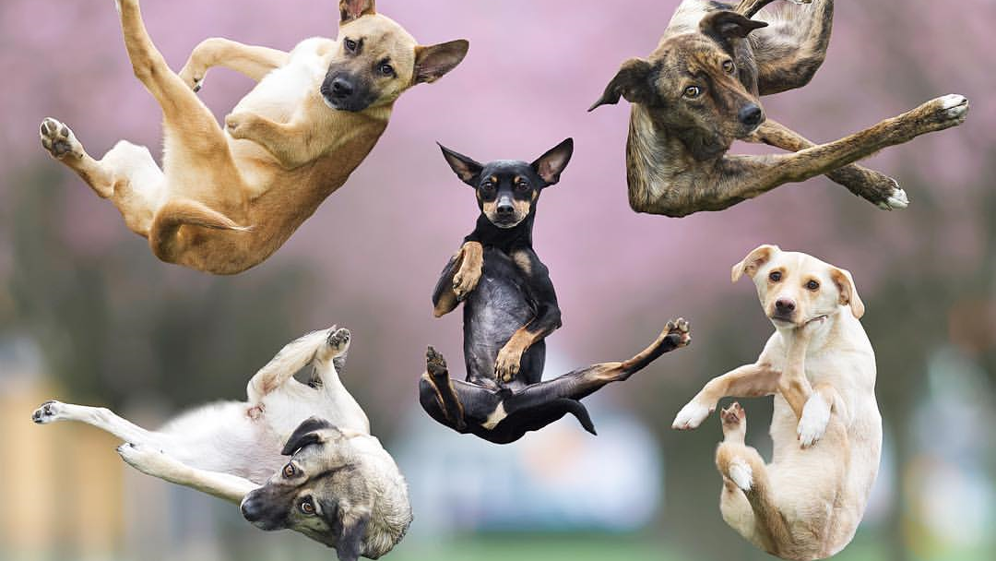
MAY YOUR DREAMS DEFY THE LAWS OF GRAVITY

Slide 18
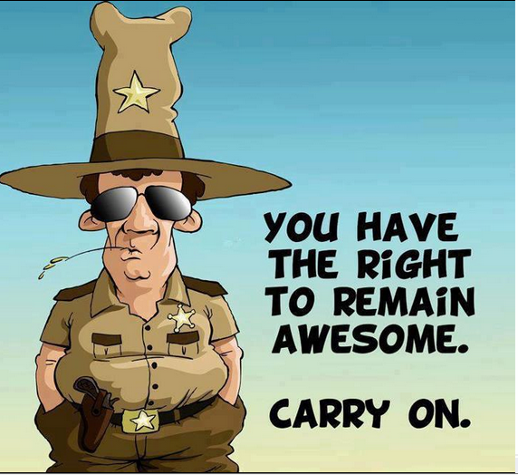

Slide 20
May your troubles be less,
May your blessings be more,
May nothing but happiness
come through your door.
~Irish Proverb

