Slide 1
MINE FLOOR MATERIAL RECOVERY MUST BECOME PART OF LIFE OF MINE PLAN (Au & Ni Prices Updated on 13 04 2024)
By Krzysztof (Kris) Biegaj
Ausvac Mining Pty Ltd
MAusIMM
Australia
Co-Author Dr Simon C Dominy
Camborne School of Mines University of Exeter, Penryn Cornwall TR10 9FE, UK
FAusIMM (CP), Member of PERC (Pan European Reserves and Resources Reporting Committee)

Slide 2
INTRODUCTION
Billions of Dollars have been, and continue to be wasted by Companies and Governments across the World due to the lack of legislation for the recovery of already broken ore left behind/wasted on mine floors never to be recovered
Recovery of broken ore left behind on mine floors will provide:
Significant additional revenue for mining companies – refer to slides No 12, 14 & 15 showing graphs with monthly and yearly revenue losses on typical smaller/medium size Australian nickel/gold mines with the Ausvac Mining PL vacuuming technology hands-on developed in 2003 - 2011
Detailed calculations of Revenue Loss Recovery in Aus$ by Vacuuming of Mine Floors (LHS) and Vacuuming Costs Calculations (RHS) - Excel Spreadsheets on Page No 15
Additional Royalties for Governments – including Compensation Funds for Indigenous Australians
Additional funds for rehabilitation of mined waste disposed of on surface
Including that portion of waste generated whilst accessing in waste/defining the ore left behind on mine floors

Slide 3
House vacuuming invented and implemented globally >120 years ago
Mine floor material vacuuming machines and technology were first invented
and used decades ago in South Africa and only few other countries
The Ausvac Mining PL vacuuming machine is based on the late 1960-ties machines designed to mine opals in Coober Pedy Region in South Australia
Highly-efficient truly mobile and modern mine floor material vacuuming machine and technology was invented and developed in the Kalgoorlie Goldfields + (Western Australia – seven projects and one project in Bendigo – Victoria), has been available since 2003 (now diesel-powered/easily to be converted to be electrically-powered & can be equipped to remotely-controlled operation in open stopes)

Slide 4
Mining Project Stages
Exploration, Pre-feasibility study, Feasibility study, Mineral Resources/Ore Reserves/Life of Mine Plans
Approvals and finance secured/obtained
Development in waste to access ore and disposal of mined waste, including diamond drill/sludge ore definition drilling cuddies (excavated in waste)
Mining
Rehabilitation of mined waste disposed of on surface and mine closure

Slide 5
Mining – What is being missed
Cleaning - vacuuming/vamping of mine floors is globally not yet part of the mining cycle
To hide/cover up the high-grade broken ore left behind on mine floors, “mine call/reconciliation factors” continue to be used by mining companies
Floors of the excavations to be cleaned/vamped/vacuumed
Ore drives
Stopes (remotely controlled vacuuming only in open stopes)
Footwall of low-angle dipping stopes
Top of last lift in cut & fill/under-hand cut & fill mining
Top of mine pillars left behind for geotechnical reasons
Underground sumps
Selective mining of high-grade ore in open pits
Highly efficient cleaning of mills & sumps on surface

Slide 6
Mine floor cleaning/vacuuming must become part of Mining Cycle
After appropriate testwork, metals/precious stones loss to mine floors should be modelled and included in project studies to determine its impact
Mine floors material recovery must be included in Pre-feasibility/Feasibility Studies and Ore Resources/Reserves Estimation/Life of Mine Plans
left behind on mine f
Timing - Mine floors material recovery must be conducted whilst mine ventilation/fresh air and mine water/compressed air supply/dewatering and all infrastructures are fully operational - not after mine is flooded/put on care and maintenance

Slide 7
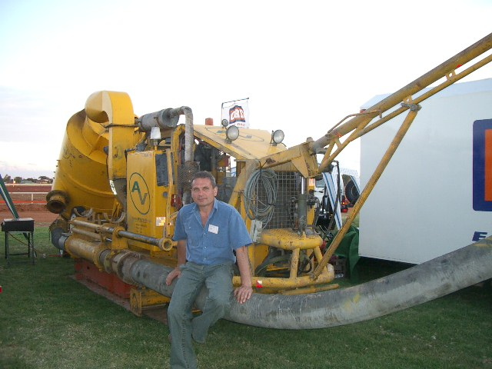

Slide 8
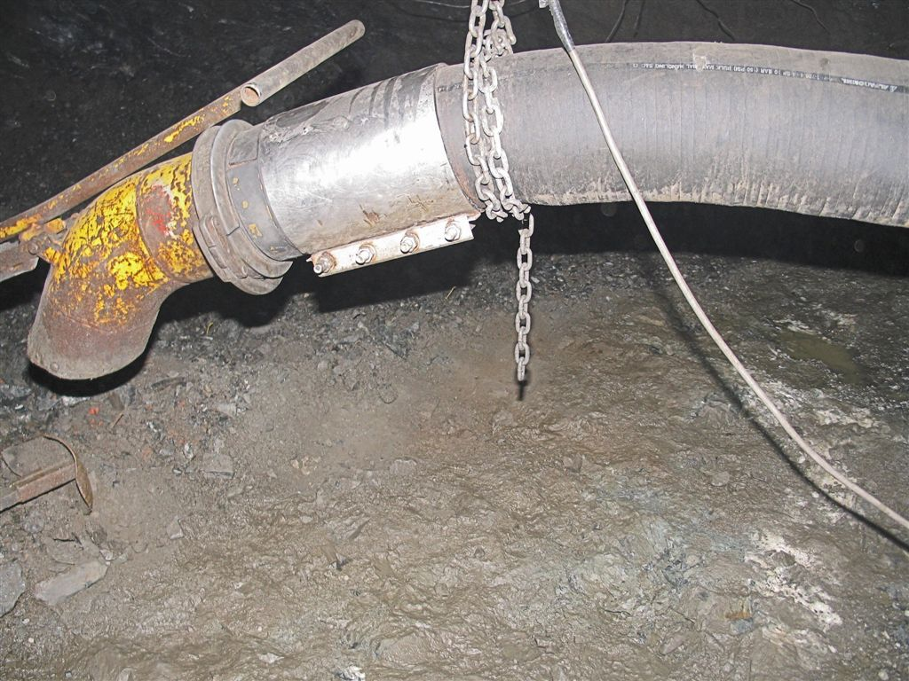
UG Nickel Mine in Western Australia - 2007
Suction hose Dia. 200mm/8 inch
Up to 0.5m thick high-grade mine floor material left behind had been vacuumed on gold and nickel mines in Australia by Ausvac Mining PL in 2003-2011 (Eight Projects)

Slide 9
Vacuuming Technology/Productivity Development by Ausvac Mining PL
When started mine floor material recovery in 2003 no more than five (5) tonnes/shift from ore drives could be achieved with two operators
August/October 2003 Otter-Juan WA – Project # 2 & Bendigo, Victoria State - Project #3
Up to 0.5 m thick broken ore normally left behind on mine floors when using conventional LHD equipment
After eight (8) hands-on projects & development of the mine floors material recovery system - now 40 t/shift are easily achievable with two (2) operators
With additional vacuuming capabilities available
Continuous roster on one or two shifts per day
Detailed vacuuming costs calculations are on Page No 15
RHS Excel Spreadsheet

Slide 10
Summary of Gold & Nickel ore grade vacuumed during 8 (eight) vacuuming projects
in Australia 2003 - 2011
Projects – Ref. to Page 17 App. 12B Vacuuming Projects Map
Mt Pleasant WA, May 2003 – Gold #1 Project – vehicles clean-up sump on surface
Otter-Juan Mine WA, August 2003 – Nickel #2 Project
Bendigo Victoria, October 2003 – Gold #3 Project
Cosmos WA, December 2003 – Nickel #4 Project
Agnew Mine WA, February 2004 – Gold #5 Project
Long-Victor Complex WA, October 2005 - Nickel #6 Project
Redross UG Widgiemooltha WA, February 2007 – Nickel #7 Project
Harlequin Mine CNGC WA, November 2010 Plus - Gold #8 Project
Grades Vacuumed
Gold: one (1) oz to two (2) oz +++; Four (4) Projects
Nickel: Average 8 % +; Four (4) Projects
left behind on mine f

Slide 11
Mine Floor Sample in New In-Stope Decline
Sample of Au grade of mine floor material on in-stope decline – CNGC Harlequin Gold Mine in Norseman WA
Grade: 40.02 g/t
Total weight of sample: 131.9 kg
Last five (5) bottom layers samples across the decline’s floor conducted with small vacuum cleaner to the solid floor
“Low” grade due to low milling factor by LHD equipment & low grade enhancement by water and gravity force in newly excavated in-stope decline
Details are on Page 17 – Sample conducted by Kris Biegaj (then Mining Manager) at the CNGC Harlequin Gold Mine in 2001

Slide 15
Extra Revenue from Mine Floors & Vacuuming Costs Calculation – in Excel Worksheets below
All Costs included i.e. Mine Floor Vacuuming, Ore Transportation, Milling & Roasting where applicable
Additional Extra Revenue from other metals (Copper +++) recovered by vacuuming not included in the Calculations
Typical length & width of mining excavations on Au & Ni mines during the (8) eight Ausvac Mining PL mine floor material vacuuming technology development Projects in Australia 2003 – 2011 used for calculations
15

Slide 16
evaluation of broken floor stocks – operating Mines
Sampling and testwork should be undertaken in support of mine designs, Feasibility studies and LOM plans
The Australasian Joint Ore Reserves Committee Code (JORC, 2012) must be applied in the context of Sections 37-41 and Table 1
Modifications to the JORC Code are needed to address the challenge of potential revenue loss
Where appropriate, vacuuming must be introduced to new and operating mines
ECONOMIC VALUE OF BROKEN ORE RECOVERY FROM MINE FLOORS - ore resources/reserves estimation/LOM Plans

Slide 17
Appendices

