Slide 1
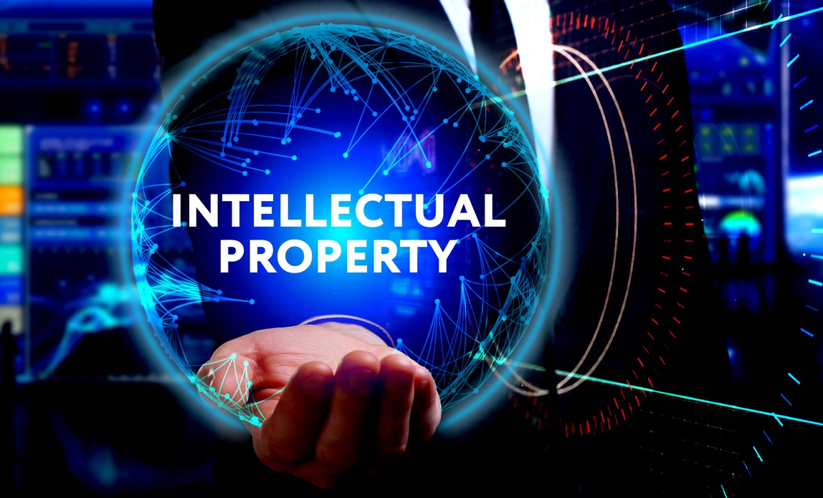


Slide 2
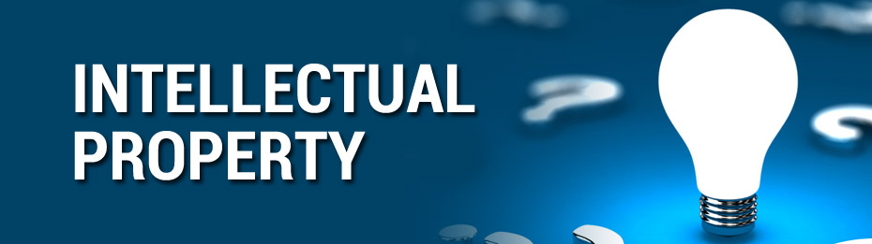

What is Intellectual Property?
Intellectual property (IP) refers to creations of the mind, such as inventions; literary and artistic works; designs; and symbols, names and images used in commerce.

Slide 3
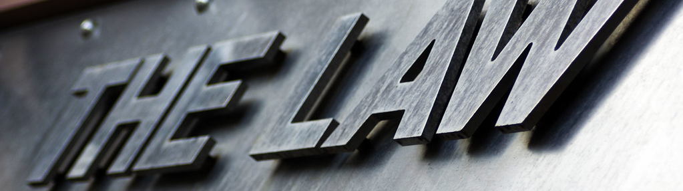
Is IP protected in law?
IP is protected in law by, for example, patents, copyright and trademarks, which enable people to earn recognition or financial benefit from what they invent or create. By striking the right balance between the interests of innovators and the wider public interest, the IP system aims to foster an environment in which creativity and innovation can flourish.

Slide 4

Copyright
Copyright is a legal term used to describe the rights that creators have over their literary and artistic works. Works covered by copyright range from books, music, paintings, sculpture and films, to computer programs, databases, advertisements, maps and technical drawings.

Slide 5
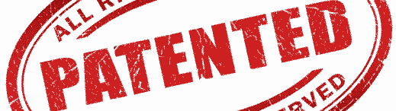
Patents
A patent is an exclusive right granted for an invention. Generally speaking, a patent provides the patent owner with the right to decide how - or whether - the invention can be used by others. In exchange for this right, the patent owner makes technical information about the invention publicly available in the published patent document.

Slide 6

Trademarks
A trademark is a sign capable of distinguishing the goods or services of one enterprise from those of other enterprises. Trademarks date back to ancient times when artisans used to put their signature or "mark" on their products.

Slide 7
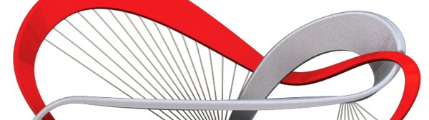
Industrial designs
An industrial design constitutes the ornamental or aesthetic aspect of an article. A design may consist of three-dimensional features, such as the shape or surface of an article, or of two-dimensional features, such as patterns, lines or color.

Slide 8
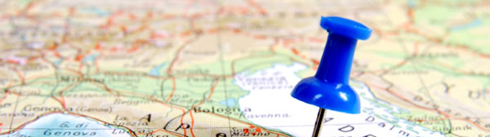
Geographical indications
Geographical indications and appellations of origin are signs used on goods that have a specific geographical origin and possess qualities, a reputation or characteristics that are essentially attributable to that place of origin. Most commonly, a geographical indication includes the name of the place of origin of the goods.

Slide 9

Trade secrets
Trade secrets are IP rights on confidential information which may be sold or licensed. The unauthorized acquisition, use or disclosure of such secret information in a manner contrary to honest commercial practices by others is regarded as an unfair practice and a violation of the trade secret protection.

Slide 10
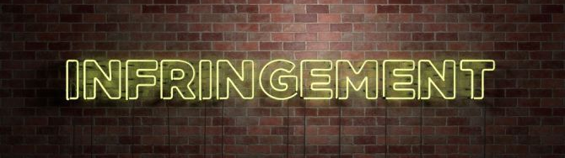
Infringement
Violation of intellectual property rights, called "infringement" with respect to patents, copyright, and trademarks, and "misappropriation" with respect to trade secrets, may be a breach of civil law or criminal law, depending on the type of intellectual property involved, jurisdiction, and the nature of the action.
Trade in counterfeit copyrighted and trademarked works is excise of $600 billion industry worldwide and accounts for 5–7% of global trade.

