Slide 1
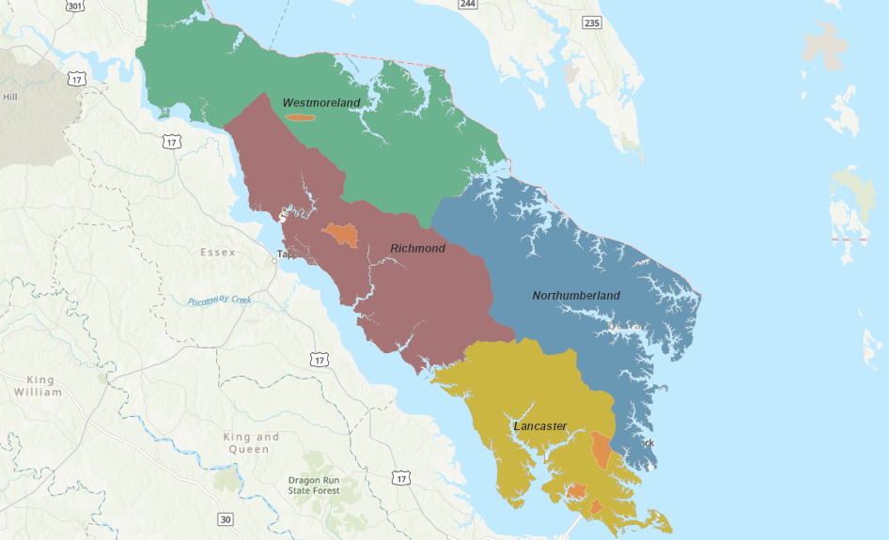
Regional Environmental Programs on Virginia’s Northern Neck
Notes:
For those of you who don’t know, the Northern Neck is the Northern most peninsula in Virginia, bordered by the Potomac, Rappahannock, and Chesapeake Bay
“on” the Northern Neck, in the local parlance…so you know precisely where you are

Slide 2
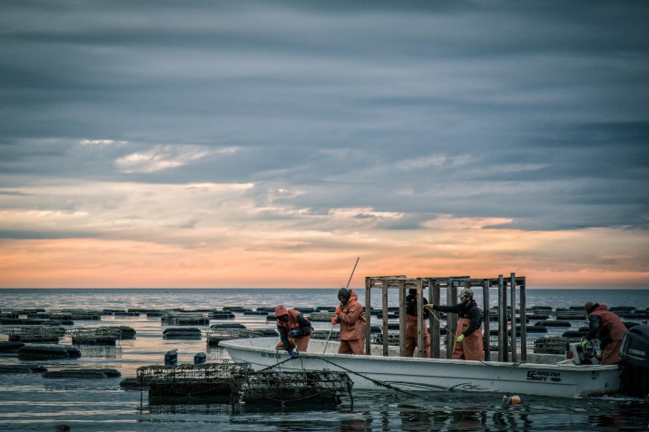
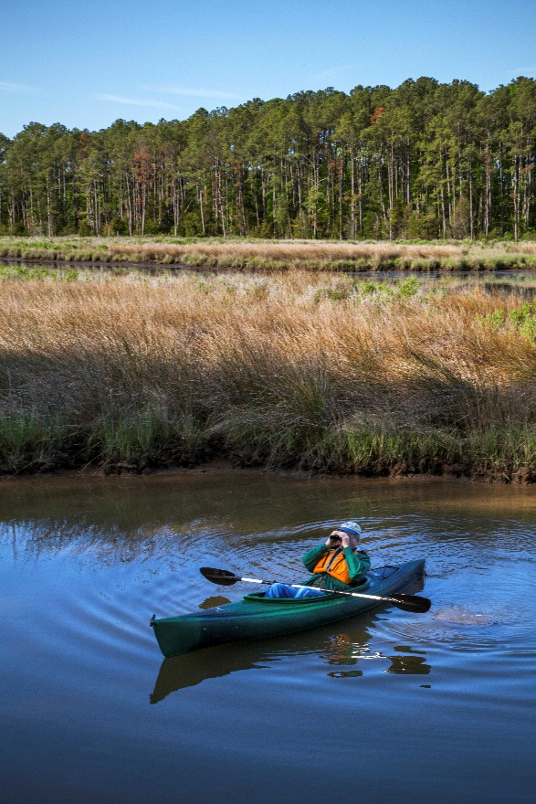
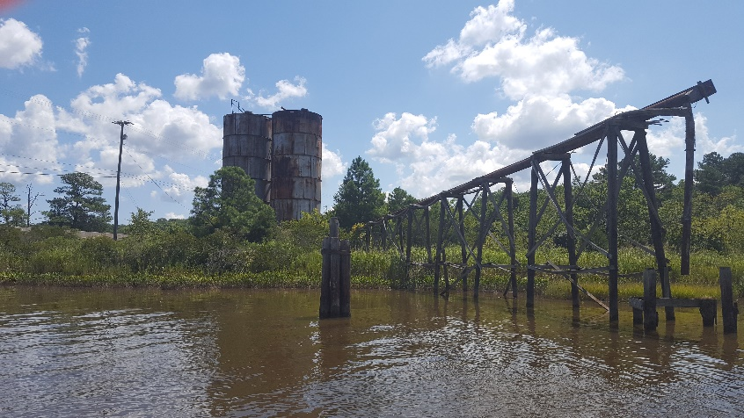
The Importance of Environmental Stewardship on the Neck
Notes:
I chose these photos specifically, because they speak to our greatest assets…”the commercial and recreational use of our natural resources and waterways”
For the uninitiated, an aquaculture operation (WSOC)
Grain elevator on Totuskey Creek (a nod to our critically important agricultural sector)
Paddling is just half the adventure, the region hosts some of the best Sport Fishing and Bird Watching in Virginia
Some visiitors might scoff at the “eyesore” of an abandoned grain elevator, ice house, or the noise of boats in the wee hours of dawn…here that’s life

Slide 3
A Quick Note on the Value of Regionalism and Local Coordination…
The Northern Neck Planning District Commission supports four counties and six towns:
Westmoreland County
Richmond County
Colonial Beach
Warsaw
Montross
Northumberland County
Lancaster County
Kilmarnock
White Stone
Irvington
Notes:
The Northern Neck Planning District Commission serves a large area and administers myriad initiatives in support of its local governments
We are all interconnected by our land and waterways
We have a shared interest in the management our natural and coastal resources
…and becoming more resilient to the environmental challenges we face
Collaboration is the key to our success

Slide 4
Engaging Local Stakeholders – The Critical Role of Environmental Organizations
Environmental Stewardship Organizations of the Northern Neck:
Northern Neck Soil & Water Conservation District
Virginia Cooperative Extension
Northern Neck Land Conservancy
Friends of the Rappahannock
Northern Neck Master Gardeners/Master Naturalists
Notes:
Lets not forget about our partners across the region…
They serve critical and independent roles in preserving the environmental and economic wellbeing of the Northern Neck
NNSWD: a partner who engages closely with the agricultural community
VCE: another partner who engages with the agricultural and natural resources dependent industries
NNLC: a valuable partner charged with conserving land and maintaining the health of our natural environment
FOR: an invaluable partner that promotes river stewardship and contributes greatly to habitat restoration, shoreline erosion, and environmental education
Many of our local school programs feature meaningful watershed education and engage with local organizations promoting the same
Our next generation is our most valuable advocate
NNMG/NNMN: our community members are engaged and passionate about preserving the essence of the Northern Neck way of life

Slide 5
Regional Environmental Programs
Five primary areas of planning, implementation and support:
Coastal Resources Management
Water Quality
Hazard Mitigation and Resilience
Water Quantity
Solid/Hazardous Waste Management and Recycling
Notes:
We work to break down the silos of these interrelated issues
Though these program areas are supported through various State and Federal programs, they represent the intersection of issues critical to our shared prosperity
We like to talk about co-benefits
For instance, water quality and coastal resources management are inextricably linked

Slide 6
Coastal Resources Management
Coastal Resources Management is primarily supported through participation in Virginia’s Coastal Zone Management Program:
Support for local initiatives to promote and advance the sustainable use of our natural resources.
Support for commercial, private, and public access to and navigation of waterways
Support for public and private investment in conservation and restoration
Support for public and private investment in outdoor recreation
Notes:
The VCZMP, funded by NOAA, is the foundation of all efforts to conserve, enhance, and promote our coastal resources
…whether conservation, restoration, access, commercial viability, or tourism

Slide 7
Water Quality
Water Quality programs are supported through various State and Federal programs and initiatives:
Chesapeake Bay Preservation Act/Water Quality Improvement Act
Watershed Implementation Planning – 2025 and beyond
  Living Shoreline Initiative
  Wastewater Infrastructure Improvements
  Stormwater Infrastructure Improvements
No Discharge Zones and TMDL work
Notes:
Our native son, Tayloe Murphy, championed the Chesapeake Bay Preservation Act and the Water Quality Improvement Act
A lasting legacy to minimize negative impacts to our water quality and water-dependent industries.
Decades of watershed implementation planning has culminated in realistic, achievable goals and sound implementation in the region
While all of our jurisdictions are unregulated communities, their voluntary contributions to water quality must not go unnoticed
Our localities lead the way with sound developmental practices like the preservation of open space and collaboration between public and private interests
WIP III resulted in three primary goals:
Erosion and sediment control: NNBFs and Living Shorlines
Wastewater: municipal sewer and residential on-site septic
Stormwater: comprehensive stormwater management planning and urban stormwater retrofit
…lets not forget about the preservation of open space…and credit for keeping it open!
NDZ: DEQ recently finalized a decade-long effort to designate NNK waterways as NDZ’s with the submission of an application to EPA
TMDL: DEQ and VDH work together to identify impaired waters and engage the community to mitigate bacteriological contamination.

Slide 8
Water Quality – Implementing Wastewater Solutions
Collaboration with local partners to implement improvements to wastewater:
Town of White Stone municipal sewer system
Northern Neck Septic Pump-out Program
  Assisting LMI households with the full-cost and administration of pump-outs and BMP reporting
  Funded through DEQ Chesapeake Bay Implementation Grants
Northern Neck Septic & Well Assistance Program
  Assisting LMI households with the full-cost and administration of septic repair, replacement, connection to alternative system or public sewer, and well replacement
Notes:
The intersection of water quality, public health and resiliency
White Stone is one of a few municipalities on the Northern Neck to lack wastewater infrastructure
The project will see over 300 septic systems abandoned
Will contribute significantly to eliminate the impairments to local waterways
…important because White Stone is a blue-collar town historically home to watermen
Increasing compliance with CBPA requirements while contributing to public health and increasing the lifespan of residential on-site septic systems
Finally! All of our planning and advocacy work has paid off and wastewater issues are receiving State and Federal attention
ARPA funds allocated to VDH
MEB funds allocated to DEQ
ARPA funds allocated to DEQ SLPP

Slide 9
Water Quality – Implementing Stormwater Solutions
Collaboration with local partners to implement improvements to stormwater infrastructure:
Town of Warsaw stormwater retrofit
Town of Beach comprehensive stormwater management plan
Town of White Stone comprehensive stormwater management plan
Improving “urban” floodplain management capability and addressing High Hazard Potential Dams
Notes:
Warsaw: a wholistic planning and implementation approach to downtown revitalization
CB: a wholistic planning approach to resilience planning
Comprehensive Stormwater Management
Comprehensive Shoreline Management (Town owns all shoreline)
WS: a wholistic planning approach to stormwater management
Providing technical support to develop policies that minimize impacts of flooding in the floodplain
Increased prevalence of Pluvial Flooding and impacts to water quality has forced us alter priorities

Slide 10
Hazard Mitigation and Resilience
Regional Hazard Mitigation and Resilience planning and implementation support:
Northern Neck Resilience Adaptation Feasibility Tool (RAFT)
Northern Neck Hazard Mitigation Plan and resilience incorporation
Alignment of local plans and incorporation of resilience, particularly flooding resilience
Support for local resilience groups and annual review of hazard mitigation and resilience implementation progress
Notes:
We all share vulnerabilities to natural hazards, but priorities and approaches differ
RAFT: year long planning effort to engage all 10 localities
Scoring (not important)
Development of local priority actions to improve resilience
HMP: utilized the outcomes of the RAFT to improve local mitigation goals and actions
RAFT revealed the need to reprioritize flooding and address all forms of flooding (including pluvial-IDF)
“The goal is to utilize existing planning processes to translate State policy into local implementation”
Regional Planning→Local Planning→Local Buy-in→Local implementation

Slide 11
Hazard Mitigation and Resilience – Implementing Solutions to Protect Property
Regional support and administration of strategies to protect property from hazards and improve community resilience:
Northern Neck Hazard Mitigation Home Elevation Program
  Assisting property owners with the elevation of repetitively flooded homes.
Mitigating shoreline erosion with NNBF’s
  Providing resources to local governments and residents on best practices for mitigating shoreline erosion
  NFWF living shoreline demonstration project
Notes:
Some of our region’s highest value properties face devaluation due to repetitive flooding
Lewisetta, Windmill Point, Little Florida, Narrows, Essex
Living shoreline initiative: NNBFs
Homeowner education
Designer/contractor education
Streamlined processes and seed funding

Slide 12
Water Quantity
Identifying funding and opportunities to further study impacts to groundwater in the region and water supply planning:
Northern Neck Water Supply Plan (2018 update)
  Impacts to water supply brought on by pandemic population increases
  Impacts to water supply brought on by sea level rise and saltwater intrusion
Northern Neck SWAP
  Assisting LMI households improve water availability and quality through well upgrades and connection to public water
Notes:
Groundwater Management Area:
Pressures from external sources (industry use of groundwater)
Pressures from population surges (pandemic)
Pressures from sea level rise (unique geology of the CB Basin)
Many shallow aquifers are no longer viable
Finally funding to address failing wells and provide adequate safe water to rural residents (the most in need and historically underserved/underrepresented?

Slide 13
Solid/Hazardous Waste Management and Recycling
Regional planning support and programs to increase recycling, reduce hazardous waste, and control litter:
Regional Solid Waste Management Plan
Regional Hazardous Materials Response Plan
Regional Waste Stream/Recycling Report
Regional “Assign-A-Highway” Litter Control/Prevention Program
Notes:
Biggest issues:
Landfill capacity
Recycling capacity
Non-point pollution from improper disposal of hazardous waste (NNSWC Events, Richmond Tire Recycling Program)
Litter…and the culprit is not who you’d suspect

Slide 14
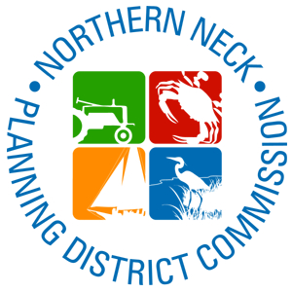
Questions?
John Bateman
Senior Regional Planner
Northern Neck Planning District Commission
jbateman@nnpdc17.state.va.us
(804) 313-8478

