Slide 1
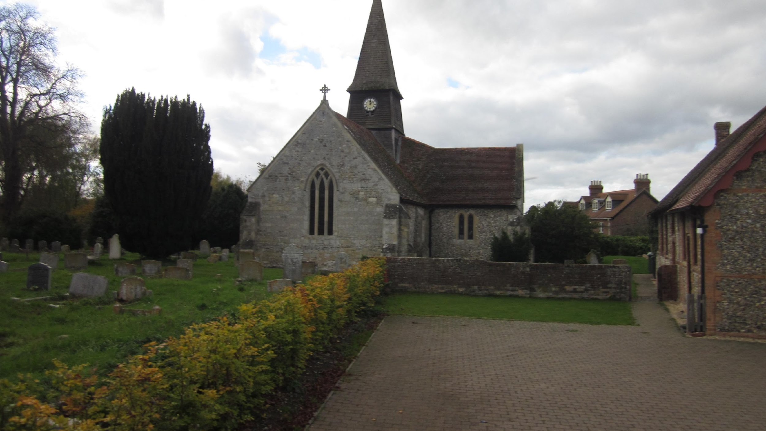
Sydenham Neighbourhood Plan
Village Meetings
January 2025

Slide 2
2. Sydenham Neighbourhood Plan Group
Mark Kermack
Tara Glen
Michael May
Mark Oliver
Toby Roe

Slide 3
3. What we will cover
What is a Neighbourhood Plan (NP)?
Applying the Sydenham NP – recent successes
Why does the Sydenham NP need updating?
What can be updated in the Sydenham NP?
How long will process take?
How can I comment and have my say?
Your questions?

Slide 4
4. What is a Neighbourhood Plan (NP)?
A community-led framework that guides the building development of a local area.
Provides real legal weight on:
- where new homes are built
- what new buildings should look like
Sydenham NP part of wider South Oxfordshire District Council (SODC) Local Plan.
Approximately 2,800 neighbourhood plans in UK, half of which are already formally 'designated' as planning policy.

Slide 5
5. Vision of Sydenham NP
“To preserve Sydenham Parish’s rural village environment, by ensuring that appropriate development occurs within the area, recognising the need for a balanced community.”

Slide 6
6. Applying the Sydenham NP – recent successes
Development in Chinnor
- Application for 150 houses rejected
- Importance of NP Views policy
Development on Park View
- Application for house, initial design rejected as out of keeping with the village
- Importance of NP Design policy

Slide 7
7. National Planning Hierarchy
National Planning Policy Framework (NPPF)
Updated December 2024
SODC Local Plan
Sydenham
Neighbourhood Plan

Slide 8
8. What is status of Sydenham NP?
Adopted as part of the SODC local plan on 20 May 2021
Structured around seven development policies
Used by Parish Council with SODC Local Plan to inform and determine planning application decisions
Now requires updating…….

Slide 9
9. Why does the Sydenham NP need updating?
1) Existing NP will no longer be current post May 2026.
2) Lack of SODC five-year housing supply (currently <4 years).
3) NPPF requires NPs to have an allocated development site.

Slide 10
10. Opportunity to enhance Sydenham NP
To make it current and to include allocated site(s) to be in line with the NPPF.
Enhance existing NP policies.
Add new policies.
Update references to SODC Emerging Joint Local Plan.

Slide 11
11. Process for the allocation of sites
1) Site Identification involving
a) Call for sites
b) Identification by landowners and Sydenham NP Group
2) Site Assessment
- Assessed against criteria and policies that align with Sydenham NP
3) Site Selection
- Selected sites incorporated into draft Sydenham NP

Slide 12
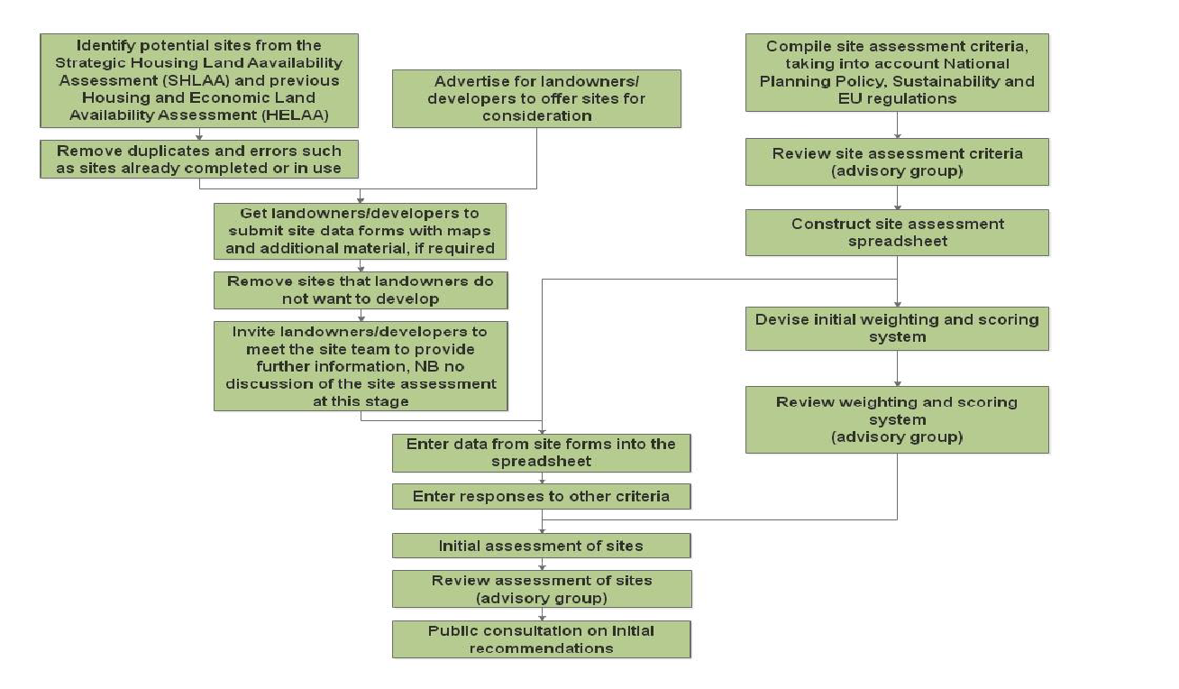
12. Site Allocation Process Chart

Slide 13
13. Existing policies
SYD1: Village Boundary and Infill Development
SYD2: Housing Mix
SYD3: Design
SYD4: Local Heritage Assets
SYD5: Local Green Space
SYD6: Local Gap
SYD7: Important Views - ENHANCE
SYD8: Community Facilities

Slide 14
14. Potential new policies
Local Landscape Character and Setting - e.g. maintaining the visual relationship between the settlement and its rural surroundings, including views of the Chilterns.
Protection of Natural Features and Environmental Assets - e.g. consideration of hedgerows & trees.
Rural Roads & Traffic Management - e.g. maintenance of rural road character, off-road parking.
Dark Skies - e.g. minimise external lighting levels, maintain rural character & tranquillity.
Rooflines - e.g. preserve Sydenham's distinctive character and protect views of St Mary's Church spire.
Development Size and Form - e.g. maintain Sydenham's rural character and prevent suburban-style overdevelopment.

Slide 15
15. How long will this take?
 | Dec 24 | Jan 25 | Feb 25 | Mar 25 | Apr 25 | May 25 | Jun 25
Village Meetings |  |  |  |  |  | Questionnaire
Review new content
Develop new content
Site allocation process
Draft Plan
Consult community

Slide 16
15. How long will this take?
 | Jul 25 | Aug 25 | Sep 25 | Oct 25 | Nov 25 | Dec 25 | Jan 26 | Feb 26
Amend plan
Pre-submission
Further review
Independent exam
Referendum

Slide 17
16. How can I comment and have my say?
Raise points today.
Email - parishcouncil@sydenhamvillage.co.uk.
Identify potential sites for development - call for sites.
Suggestions for new policies/updating of existing ones – questionnaire.
Reg 14 Consultation period before review by SODC.
Referendum prior to adopting the plan.

Slide 18
17. Questions?

