Slide 1

Managing the Risks of Direct Oral Anticoagulants
Graeme E. McFarland, MD
Assistant Professor
UAB Division of Vascular Surgery and Endovascular Therapy

Slide 2
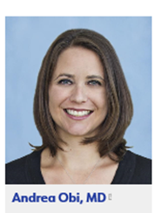

Disclosures
I have no disclosures.

Slide 3
DOACs
Directly inhibit proteins within the coagulation cascade
As opposed to inhibiting the synthesis of Vit K-dependent clotting factors
Am J Cardiovasc Drugs 19, 525–539 (2019).
Notes:
-Thrombin – Thrombin (factor IIa) is the final enzyme of the clotting cascade that produces fibrin; it is formed by the proteolytic cleavage of prothrombin by factor Xa. (bival, argatroban, dabigatran)
-Factor Xa – Factor Xa acts immediately upstream of thrombin in the clotting cascade, at the convergence point of the intrinsic and extrinsic coagulation pathways (rivaroxaban, apixaban, edoxaban, betrixaban)

Slide 4
DOAC Benefits
Fixed dosing
Fewer drug and dietary interactions
Rapid onset
Short half-lives

Slide 5
DOAC Cons
Expense
Short half-lives require strict adherence
Lack of reversal agents (historically)
Renal impairment

Slide 6

Median cost 30 day supply:
DOACs $317
VKA $8
30 day supply of DOAC 40xs >> VKAs

Slide 7

ANTICOAGULATION HISTORY
2009
2010
DOAC Era
Warfarin (VKA) Era
Warfarin used as “full dose” anticoagulation for the treatment of Afib, VTE, valvular disease, etc.
(INR of 2-3 or 2.5-3.5)
No low dose option
“Prophylaxis” dosing via LMWH, UFH (requires injection)

Slide 8

2009
2010
DOAC Era
Warfarin (VKA) Era
FDA approved DOAC indications 2010-present
FDA approved reversal agents
Idarucizumab (dabigatran)
Andexanet Alfa (Xa)
Off label: PCC
Non valvular Atrial fibrillation
VTE treatment
“full dose”
reduced “lower” dose
VTE prophylaxis; MACE risk reduction
(post surgery; after VTE treatment)

Slide 9
DOACs v. VKAs prescriptions in the US
All AC
VKAs
DOACs
DATA FROM 2015

Slide 10
FDA approvals
Currently 5 DOACs approved in the U.S.:
Rivaroxaban (Xarelto^{R})
Apixaban (Eliquis^{R})
Edoxaban (Savaysa^{R})
Dabigatran (Pradaxa^{R})
Betrixaban (Bevyxxa^{R})
Approved indications:
VTE prevention/tx
Non-valvular atrial fibrillation
Risk reduction of MACE (PAD/CAD patients)

Slide 11
U.S. FDA APPROVALS
FDA approved indication | Dabigatran | Rivaroxaban | Apixaban | Edoxaban | Betrixaban
NVAF | X | X | X | X
Acute VTE | X | X | X | X
Secondary prevention of VTE | X | X | X
VTE prevention in major orthopedic surgery | X | X | X
MACE/MALE risk reduction |  | X
VTE prevention in acute ill medical patients |  | X |  |  | X

Slide 12
Off label use, new data and ongoing trials
Peripheral disease
Superficial venous thrombosis (SVT)
Post thrombotic syndrome (PTS) prevention
MALE following peripheral revascularization
HIT/HITT
Post operative MI
Central disease
Cardiac valvular disease – prevention of arterial thromboembolism
Embolic stroke of unknown origin (ESUS)
Low risk AF + cognitive decline
CHF
Peri/post procedure AF cardioversion, pulmonary v. ablation, catheter ablation
Paradoxical emboli
AF + ACS

Slide 13
SVT – SURPRISE trial
Prospective, randomized open label trial.
High risk patient cohort.*
45 days of treatment
Primary endpoint: recurrent SVT, DVT, PE, death.
Rivaroxaban non-inferior to fondaparinux.
Rivaroxaban
Fondaparinux
Lancet Hematol 2017;4:e105-e113
*5cm supragenual thrombus + one additional risk factor (older than 65 years, male sex, previous VTE, cancer, autoimmune disease, thrombosis of non-varicose veins)
Notes:
Fondaparinux Calisto

Slide 14
DOACs and MALE – COMPASS PAD
PAD patients only (~7500, 27% of original cohort – prespecified subgroup analysis):
asymptomatic limb PAD (18%)
symptomatic limb PAD (56%)
asymptomatic & symptomatic carotid disease (25%)
2.5 mg BID Rivar + ASA
vs.
5 mg BID Rivar + ASA
vs.
ASA only

Slide 15
COMPASS PAD - MALE
ALI, chronic limb ischemia, amputation reduced in
rivaroxaban (2.5mg) + ASA v. ASA alone
(1% v. 2%, HR 0.54, 0.4-0.8, p=0.005)
ASA alone
Combo therapy

Slide 16
COMPASS PAD – key findings
No overall mortality benefit for PAD patients.
ARR ~3% for combined MALE/MACE endpoints (9% v. 6%) in favor of rivaroxaban 2.5mg + ASA
Major MALE benefit from avoidance of ALI and amputation:

Slide 17
COMPASS PAD
MACE MALE

Slide 18
COMPASS PAD
MACE/MALE BLEEDING

Slide 19
COMPASS PAD – NET clinical benefit
MI, stroke, CV death, MALE (including amputation);
fatal bleeding, bleeding into a critical organ
ASA alone: 9%
Riva + ASA: 6%
HR 0.72 (0.59-0.87; p<0.0008)

Slide 20
VOYAGER PAD design
Successful revascularization
within 10 days
Infrainguinal PAD
ABN ABIs
>50yo
Estimated primary completion date: 11/22/19
Notes:
Moderate claudication to CLI
Technically successful revascularization procedure within 10 days
Infrainguinal PAD, > 50yo, abn ABIs
Aug 2015 – Jan 2018 enrollment (n=6564)

Slide 21
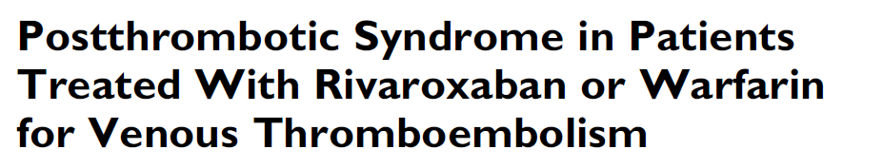
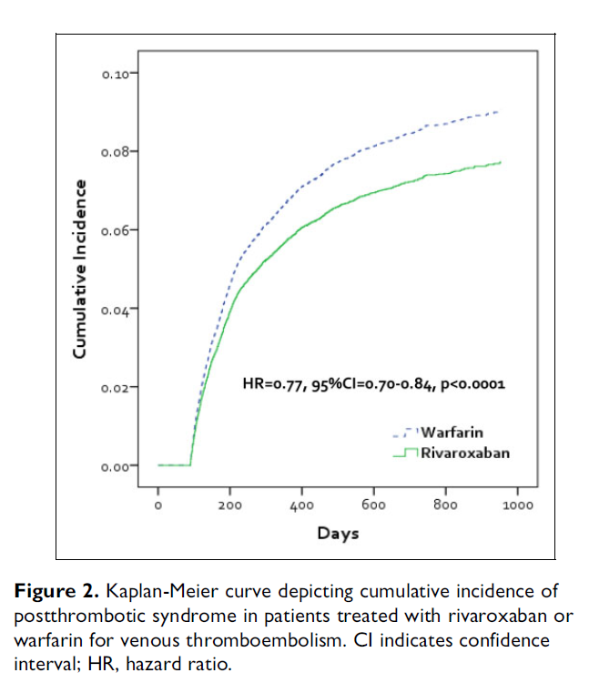
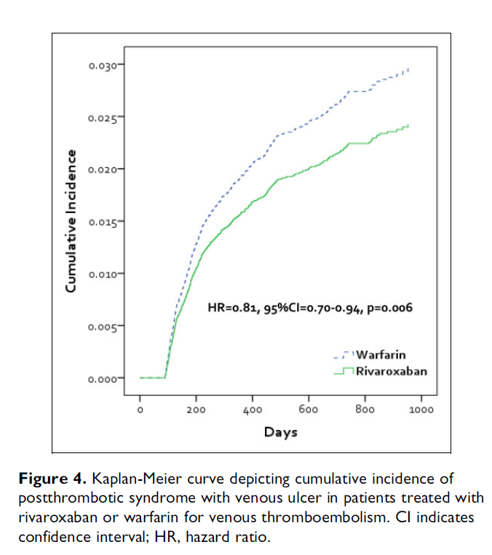
Marketscan data, 2012-2015.
n~37,000 patients with DVT and prescribed rivaroxaban or VKA.
Reduced hazard of any PTS and PTS with venous ulcer.

Slide 22
HITT/HIT
Difficult to study in RCT due to low prevalence: about 6% of those suspected of having HIT/HITT will be confirmed.
Rationale:
DOACs do not react with PF4 nor are they recognized by pre-existing HITT antibodies.
Current management strategy is imperfect: risk of warfarin induced skin necrosis/gangrene with premature transition to VKA; PTT confounding with argatroban leading to inaccurate dosing; prolonged LOS.
Tran CATH 2018 pg 201-209.

Slide 23
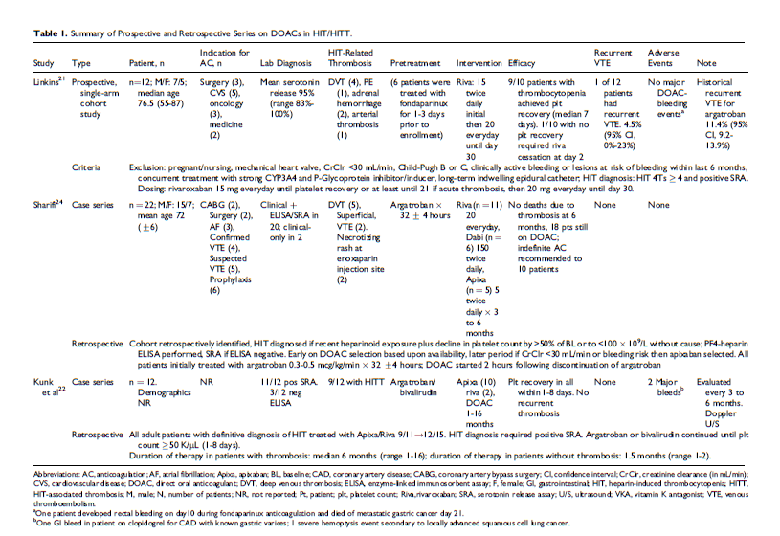
HITT/HIT
1 prospective study
2 case series
Multiple case reports
Total: 56 patients
57% + HITT
75% treated initially with parenteral AC.
54% rivaroxaban
29% apixaban
19% dabigatran
2 recurrent TE events
3 major bleeding events (none while on DOAC therapy)
Tran CATH 2018 pg 201-209.

Slide 24
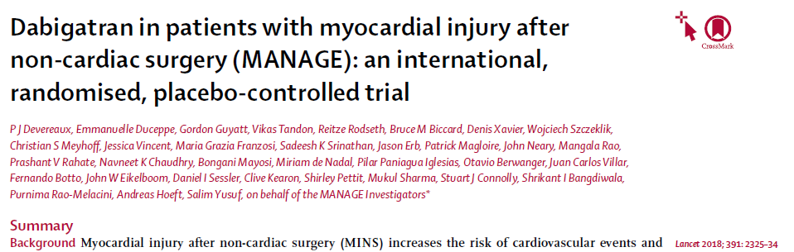
Role of DOACs in post operative myocardial injury
Double blind international RCT, n =1754
Patients all > 45 yo, undergone non-cardiac surgery, treated within 35 days of MINs (myocardial injury after non-cardiac surgery)
Randomized to dabigatran or placebo for up to 2 years.

Slide 25
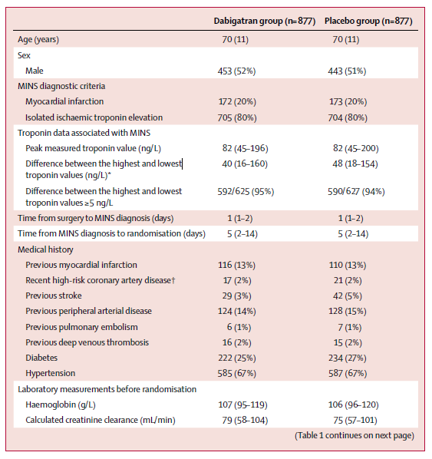
Role of DOACs in post operative myocardial injury
Troponins obtained on patients aged 45-64 with a history of CAD, PAD or stroke.
~80% of patients asymptomatic isolated troponin elevation within 48 hours of surgery.
~80% had undergone orthopedic, general or vascular operation.

Slide 26
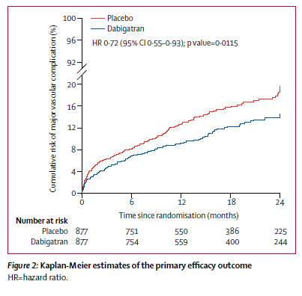
Role of DOACs in post operative myocardial injury
Primary efficacy outcome:
Vascular mortality, non-fatal MI, non-hemorrhage stroke, peripheral arterial thrombosis, symptomatic VTE
11% dabigatran v. 15% placebo HR 0.72 (95% CI 0.55-0.93), p=0.0115.
Primary safety outcome:
Life threatening, major and critical organ bleeding:
3% dabigatran v. 4% placebo, 0.92 (95% CI 0.55-1.53) p=0.78.

Slide 27
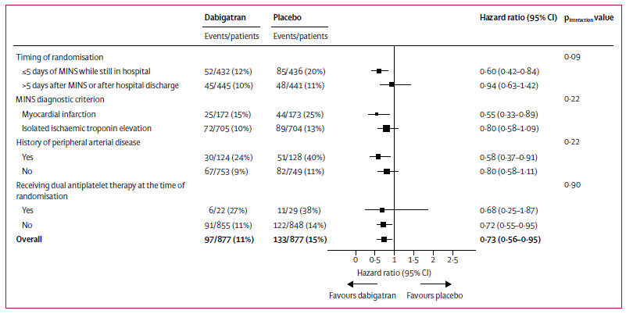
Role of DOACs in post operative myocardial injury
Trial terminated early.
~40% discontinued study drug early.
~70% statin use and ~60% antiplt use.
9% died before randomization.
Most convincing benefit: diagnosis of MI within 5 days, hx of PAD and not on DAPT

Slide 28
Conclusions
Rivaroxaban safe and has evolving role in treatment of SVT; unknown role in EHIT.
Low dose rivaroxaban likely beneficial for prevention of MALE in subset of PAD patients, awaiting results following revascularization.
Therapeutic AC following high risk peripheral arterial procedures or use of DOACs following diagnosis of HIT/HITT unlikely to be studied in RCT: will have to rely on registry/retrospective study.
Use of dabigatran for MIs intriguing, potentially beneficial. Needs further investigation.

Slide 29
2016 ACCP Guidelines
In patients with DVT of the leg or PE and no cancer, as long-term (first 3 months) anticoagulant therapy, we suggest dabigatran, rivaroxaban, apixaban, or edoxaban over vitamin K antagonist (VKA) therapy (all Grade 2B).
Chest 2016;149:315-352

Slide 30
DOAC: Common Class Effects
Recurrent VTE
or
VTE-related Death
Blood 2014;124:1968-1975

Slide 31
DOAC dosing basics
OAC Selection often not an exact science
Some key don’ts
  Don’t use DOAC if mechanical valve
  Don’t use DOAC if patient can’t afford
  Don’t use DOAC if high-risk anti-phospholipid antibody syndrome
  Don’t use DOAC for initial therapy in cancer patients
General points
  DOACs more convenient than warfarin
  Apixaban ≈ rivaroxaban for most patients

Slide 32
Drug Dosing
 | Dabigatran | Rivaroxaban | Apixaban | Edoxaban
AF Dosing | 150mg BID | 20mg Daily | 5mg BID | 60mg Daily
AF Dosing (renally adjusted) | 75mg BID CrCl 15-30 | 15mg Daily CrCl 15-50 | 2.5mg BID 2+ of: Age≥80, Weight≤60kg, Cr≥1.5 | Do NOT use CrCl>95 30mg Daily CrCl 15-30
VTE Dosing | LMWH for 5-10d 150mg BID (CrCl>30) | 15mg BID x3 wk Then 20mg daily (CrCl≥30) | 10mg BID x7 days Then 5mg BID (2.5mg BID for long-term therapy) | LMWH for 5-10 days 60mg Daily 30mg Daily ≤60kg or CrCl 15-50
Renal Clearance | 80% | 33% | 25% | 35%
Half-life | 8-15hr | 12 hrs | 7-11hrs | 10-14 hrs
Drug-drug Interactions | P-Gp | Cyp3A4 P-Gp | Cyp3A4 P-Gp | P-Gp

Slide 33
Renal Excretion of DOACs
Apixaban has lowest renal
excretion and shortest half life of the DOACs.

Slide 34
(On Label Dosing) Dose adjustments for renal dysfunction
Adjust for Renal Dysfunction (VTE treatment)
Dabigatran
  Not recommended if CrCl<30
Rivaroxaban
  Not recommended if CrCl<30
Edoxaban
  Not recommended if CrCl<15
  Dose adjustment to 30mg if CrCl 15-50.
Apixaban
  No dose adjustment for VTE (clinical data limited if CrCl<15)

Slide 35
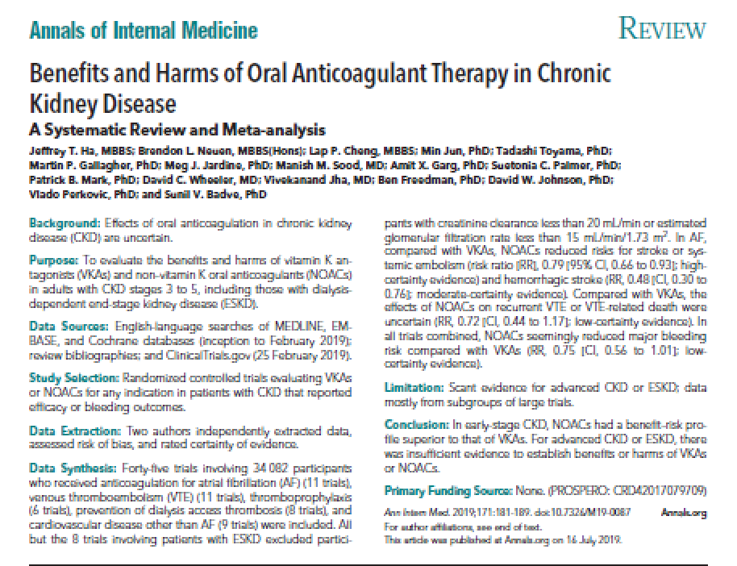
Benefits of DOACs in CKD stages 3-5
45 trials with 34,082 patients
Mostly excluded patients with Cr clearance <20 mL/min or eGFR < 15 mL/min.
In AF, DOACs reduced embolic or stroke events (RR, 0.79; 95% CI 0.66-0.93), and hemorrhagic stroke (RR, 0.48; 95% CI 0.30-0.76).
DOACs seemed to reduce major bleeding risk over VKAs (RR, 0.75; 95% CI 0.56-1.01).
Notes:
A 2019 meta-analysis that included 45 trials (34,000 patients, most with atrial fibrillation) reported a statistically significant benefit over warfarin in reducing the risk of stroke in those with atrial fibrillation who had mild-to-moderate renal impairment (risk ratio [RR], 0.79; 95% CI 0.66-0.93), without an obvious increase in bleeding (RR for major bleeding, 0.80; 95% CI 0.61-1.04; RR for intracranial hemorrhage [ICH], 0.49; 95% CI 0.30-0.80) and a trend toward improved survival (RR, 0.88; 95% CI 0.78-0.99) [21]. These findings are similar to the general population without renal insufficiency. The benefits and harms of DOACs over warfarin in individuals with VTE were uncertain, and individuals with end-stage kidney disease (estimated glomerular filtration rate <15 mL/minute/1.73 m² or creatinine clearance <20 mL/minute) were mostly excluded.
-Warfarin generally preferred if Cr clearance is < 30 and DOACs are contraindicated for CrCL < 15.

Slide 36
Drug Choice
Characteristic | Drug Choice | Rationale
CrCl 30-50 ml/min | Rivaroxaban, apixaban or edoxaban | Less affected by renal impairment than dabigatran
All-oral therapy | Rivaroxaban or apixaban | Dabigatran and edoxaban require heparin bridging
Dyspepsia or upper GI complaints | Rivaroxaban, apixaban or edoxaban | Dyspepsia with dabigatran in up to 10% of patients
Recent GI bleed | Apixaban | More GI bleeding with dabigatran, rivaroxaban and edoxaban than with warfarin
Significant CAD | Rivaroxaban, apixaban or edoxaban | Small MI signal with dabigatran
Poor compliance with twice-daily dosing | Rivaroxaban or edoxaban | Only agent given once-daily
Yeh C, Gross P, Weitz JI. Blood. 2014;124:1020

Slide 37
When to Monitor DOACs
Bleeding
Before surgery/procedure with recent DOAC use (<24hrs, or 48-72hrs if CrCl<30)
Extremes of body weight
Declining renal function
Potential need for DOAC reversal
Suspected overdose
Assessing compliance (limited by short t_{1/2})
Baglin JTH 2013

Slide 38
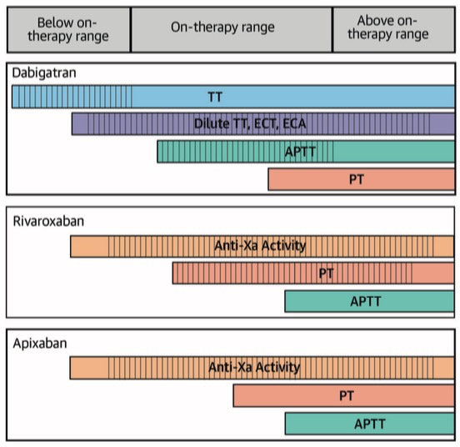
DOAC Lab Monitoring
Must ensure calibration for DOACs
Normal APTT usually indicates drug levels are insignificant; Prolonged APTT suggests that patient has clinically significant drug levels
Negative Anti-Xa assay usually indicates drug levels are insignificant; Prolonged PT/APTT suggests that patient has clinically significant drug levels
Anderson and Cifu JAMA 319:2032-2033, 2018
Notes:
ECT – Ecarin Clotting Time, ECA – Ecarin Chromogenic Assay, TT – Thrombin time

Slide 39
RISKS
BLEEDING

Slide 40
DOAC: Common Class Effects
Major Bleeding
Blood 2014;124:1968-1975

Slide 41
DOAC: Common Class Effects
Blood 2014;124:1968-1975

Slide 42
Yeh, Gross and Weitz, Blood 124:1020-1028, 2014 | Safety outcomes
 | Major Bleeding |  | Major and Clinically Non-major Bleeding
 | NOAC, n/N (%) | Warfarin, n/N (%) | NOAC n/N (%) | Warfarin, n/N (%)
Dabigatran | 37/2553 (1.4) | 51/2554 (2.0) | 136/2553 (5.3) | 217/2554 (8.5)
Rivaroxaban | 40/4130 (1.0) | 72/4116 (1.7) | 388/4130 (9.4) | 412/4116 (10.0)
Apixaban | 15/2676 (0.6) | 49/2689 (1.8) | 115/2676 (4.3) | 261/2689 (9.7)
Edoxaban | 56/4118 (1.4) | 66/4122 (1.6) | 349/4118 (8.5) | 423/4112 (10.3)

Slide 43
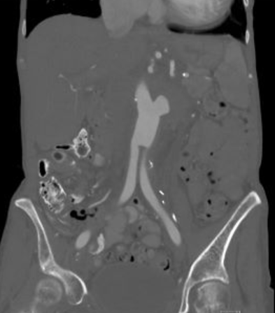
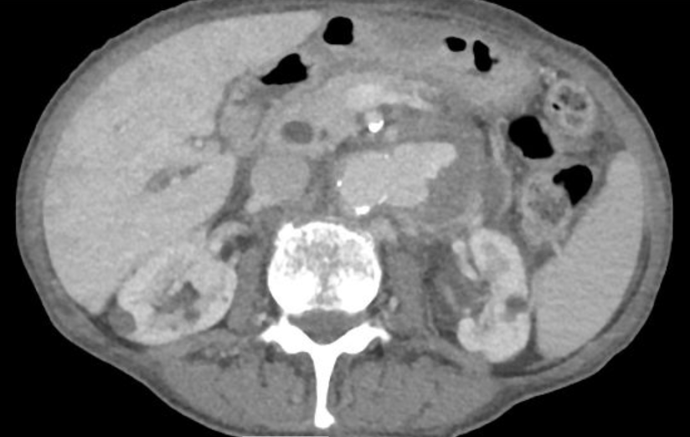
Case #1
83 yo female with atrial fibrillation and severe cardiac disease (EF 10%) on Coumadin presents with back pain and drop in hct. Hx of AFB.
Notes:
With our hypothesis in mind, we had two main objectives. ***CLICK*** First, we wanted to investigate all patients undergoing surgery with appropriate VTE chemoprophylaxis compared to those patients who did not and look at ***CLICK*** overall postoperative VTE rates ***CLICK***, mortality and **CLICK*** complications. ***CLICK***

Slide 44
Case #1
EVAR cuff urgently booked.
INR 9.2.
What is the optimal reversal strategy?
Fresh frozen plasma (FFP)
Prothrombin complex concentrate (PCC)
FFP + IV Vitamin K
PCC + IV Vitamin K
Notes:
With our hypothesis in mind, we had two main objectives. ***CLICK*** First, we wanted to investigate all patients undergoing surgery with appropriate VTE chemoprophylaxis compared to those patients who did not and look at ***CLICK*** overall postoperative VTE rates ***CLICK***, mortality and **CLICK*** complications. ***CLICK***

Slide 45
PATIENT ASSESSMENT
SEVERITY OF BLEEDING
  Major
  Minor
ANTICOAGULATION STATUS
  Drug
  Dose
  Compliance
ANTICOAGULATION INDICATION

Slide 46
PATIENT ASSESSMENT
BLEEDING
  Active?/Rate of hemorrhage
  Location
    Intracranial or compartment
    Retroperitoneal
    GI
  Drug
    Dosing and last dose
  Renal or Liver Impairment
    Effecting anticoagulant effect
  Other Medications
    ASA, Plavix

Slide 47
ANTICOAGULATION ASSESSMENT
Specific agent
Dose
Time since last dose
Renal and hepatic function

Slide 48
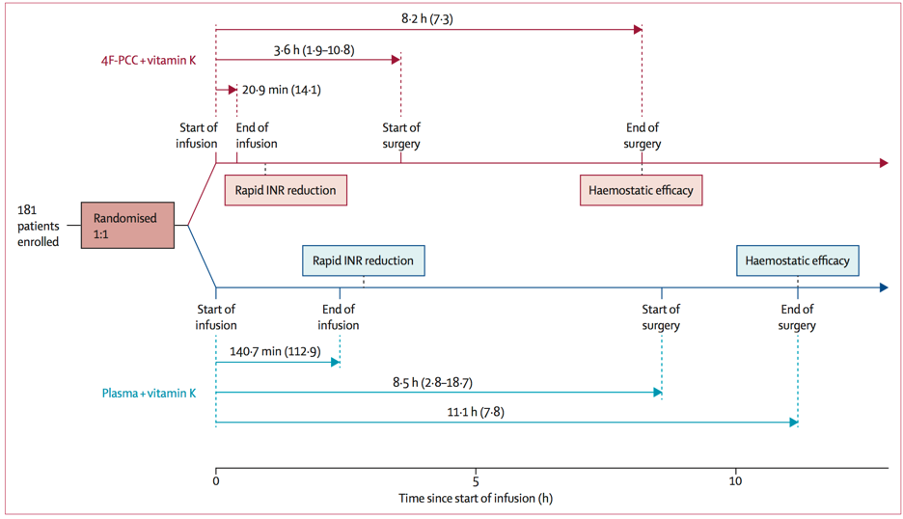
Urgent reversal of warfarin: current standard of care
PCC + Vit K
FFP + Vit K
Lancet 2015;385:2077-87

Slide 49
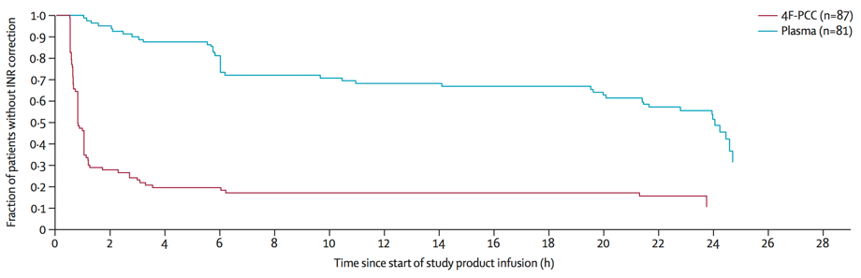
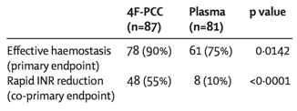
Urgent reversal of warfarin: current standard of care
PCC superior to FFP for hemostasis and INR reversal
Lancet 2015;385:2077-87

Slide 50
Using PCC: basic practical points
Know your dosing and key allergy to check for:
50U/kg + 10mg Vitamin K IV
Heparin – Most PCCs have heparin to keep from coagulating.
Notes:
With our hypothesis in mind, we had two main objectives. ***CLICK*** First, we wanted to investigate all patients undergoing surgery with appropriate VTE chemoprophylaxis compared to those patients who did not and look at ***CLICK*** overall postoperative VTE rates ***CLICK***, mortality and **CLICK*** complications. ***CLICK***

Slide 51
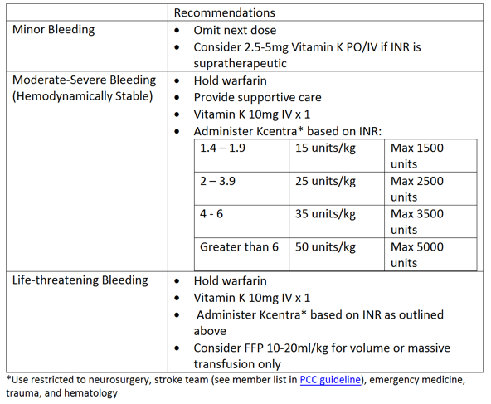
Michigan protocol for urgent reversal of VKAs
Notes:
With our hypothesis in mind, we had two main objectives. ***CLICK*** First, we wanted to investigate all patients undergoing surgery with appropriate VTE chemoprophylaxis compared to those patients who did not and look at ***CLICK*** overall postoperative VTE rates ***CLICK***, mortality and **CLICK*** complications. ***CLICK***

Slide 52
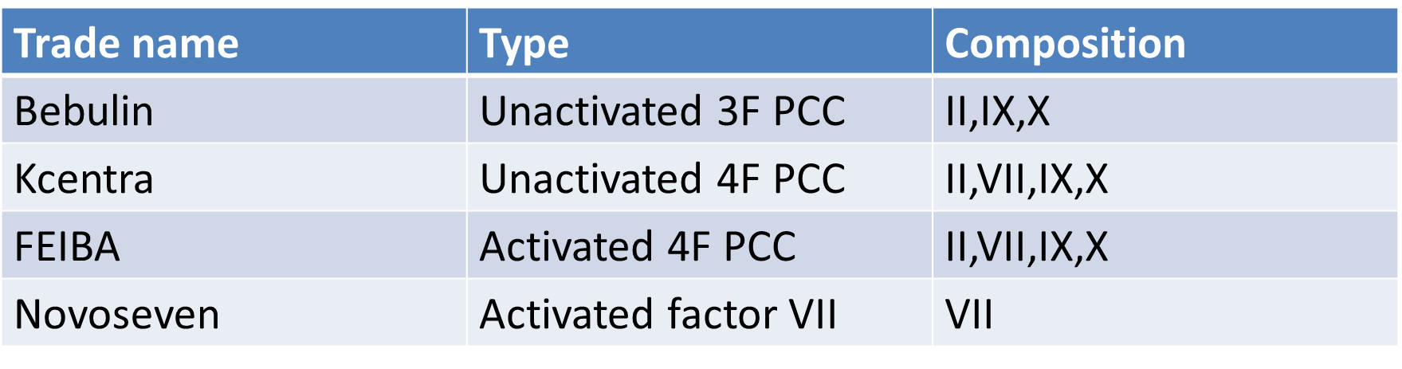
Using PCC: basic practical points
Most contain heparin, protein C & S to prevent activation of factors (remember to check for heparin allergy)
Concentration 25x plasma; doesn’t need to be thawed; administration 15-30min
In general 4F > 3F – “poor man’s 4F” by adding small amt of FFP to 3F
Notes:
With our hypothesis in mind, we had two main objectives. ***CLICK*** First, we wanted to investigate all patients undergoing surgery with appropriate VTE chemoprophylaxis compared to those patients who did not and look at ***CLICK*** overall postoperative VTE rates ***CLICK***, mortality and **CLICK*** complications. ***CLICK***

Slide 53
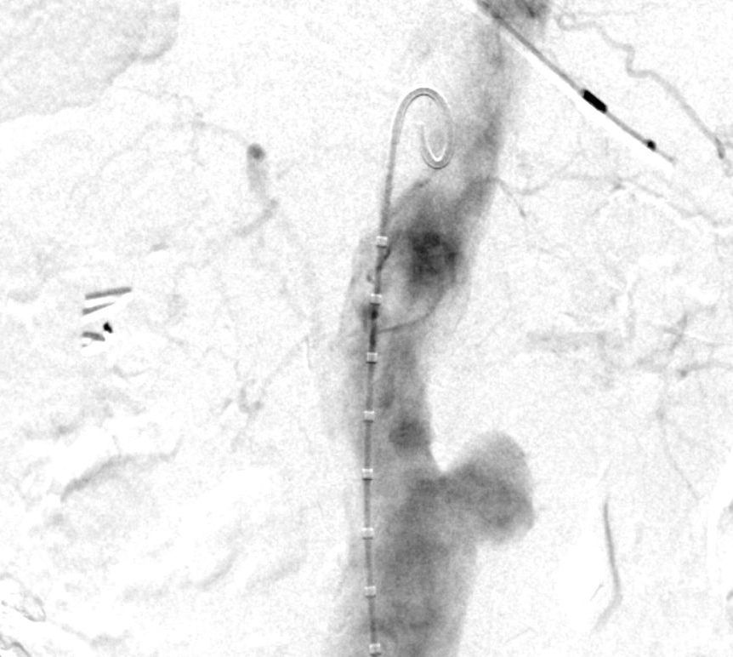
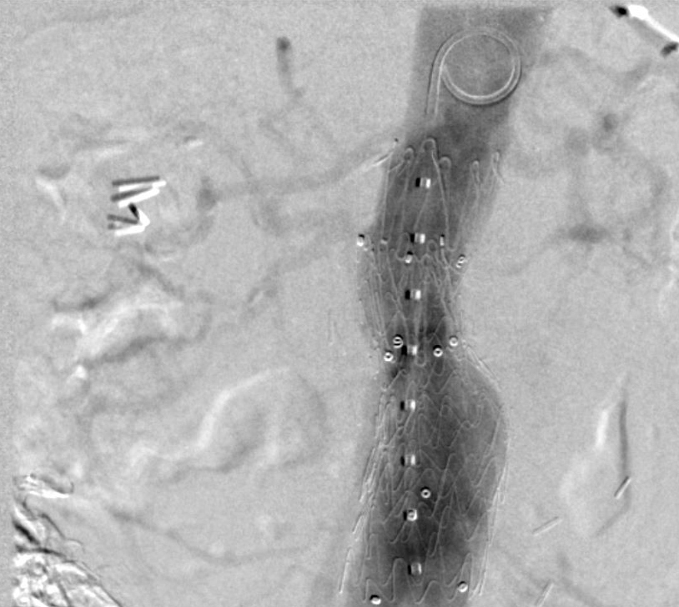
Case #1
What is the optimal reversal strategy?
Fresh frozen plasma (FFP)
Prothrombin complex concentrate (PCC)
FFP + IV Vitamin K
PCC + IV Vitamin K
Notes:
With our hypothesis in mind, we had two main objectives. ***CLICK*** First, we wanted to investigate all patients undergoing surgery with appropriate VTE chemoprophylaxis compared to those patients who did not and look at ***CLICK*** overall postoperative VTE rates ***CLICK***, mortality and **CLICK*** complications. ***CLICK***

Slide 54
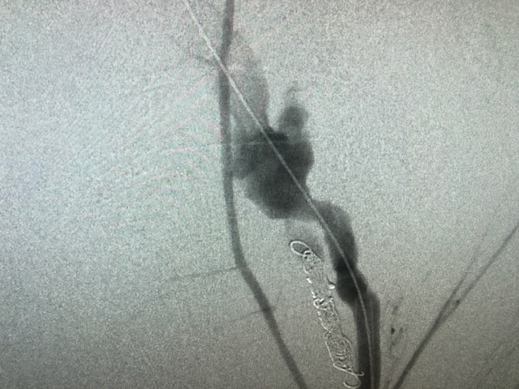
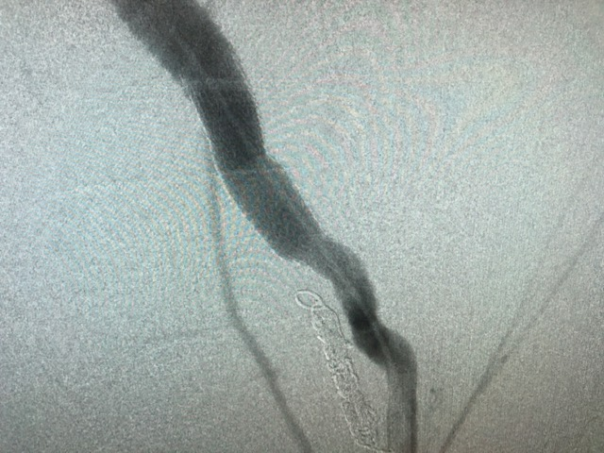
Case #1
You administer PCC, take patient to OR urgently for repair. Not an easy case, you rupture an iliac and have to stent and it takes much longer than elective case, but ultimately technically successful.
Total EBL 500cc and 2u prbcs given.
High fives all around.
Notes:
With our hypothesis in mind, we had two main objectives. ***CLICK*** First, we wanted to investigate all patients undergoing surgery with appropriate VTE chemoprophylaxis compared to those patients who did not and look at ***CLICK*** overall postoperative VTE rates ***CLICK***, mortality and **CLICK*** complications. ***CLICK***

Slide 55
Case #1
You go to pull sheaths and there is excessive bleeding from around sheath and in soft tissue. What is happening?
Patient is in DIC
Low platelets from heparin induced thrombocytopenia
PCC inadequately dosed
Transfusion coagulopathy
Notes:
With our hypothesis in mind, we had two main objectives. ***CLICK*** First, we wanted to investigate all patients undergoing surgery with appropriate VTE chemoprophylaxis compared to those patients who did not and look at ***CLICK*** overall postoperative VTE rates ***CLICK***, mortality and **CLICK*** complications. ***CLICK***

Slide 56
Using PCC: practical points
PCC has “worn off”…
Only good as your shortest ½ life – FVII ~6 hours.
If still operating at this time point, consider rechecking coagulation parameters and redosing.
But beware…
Repeat dosing can lead to accumulation of FII (thrombin) t1/2 ~60-72h – this can cause vessel/graft thrombosis.
Notes:
With our hypothesis in mind, we had two main objectives. ***CLICK*** First, we wanted to investigate all patients undergoing surgery with appropriate VTE chemoprophylaxis compared to those patients who did not and look at ***CLICK*** overall postoperative VTE rates ***CLICK***, mortality and **CLICK*** complications. ***CLICK***

Slide 57
Case #1
You go to pull sheaths and there is excessive bleeding from around sheath and in soft tissue. What is happening?
Patient is in DIC
Low platelets from heparin induced thrombocytopenia
PCC inadequately dosed – re-dose or give FFP
Transfusion coagulopathy
Notes:
With our hypothesis in mind, we had two main objectives. ***CLICK*** First, we wanted to investigate all patients undergoing surgery with appropriate VTE chemoprophylaxis compared to those patients who did not and look at ***CLICK*** overall postoperative VTE rates ***CLICK***, mortality and **CLICK*** complications. ***CLICK***

Slide 58
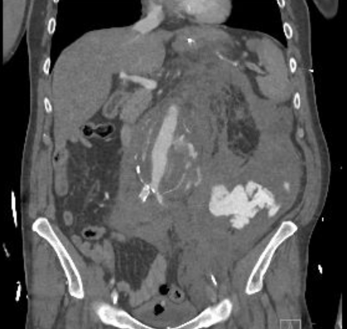
Case #2
62 yo male with atrial fibrillation on dabigatran (Pradaxa) took 2 hours ago presents following MVC; hypotensive BP 50-70s in the CT scanner.
Notes:
With our hypothesis in mind, we had two main objectives. ***CLICK*** First, we wanted to investigate all patients undergoing surgery with appropriate VTE chemoprophylaxis compared to those patients who did not and look at ***CLICK*** overall postoperative VTE rates ***CLICK***, mortality and **CLICK*** complications. ***CLICK***

Slide 59
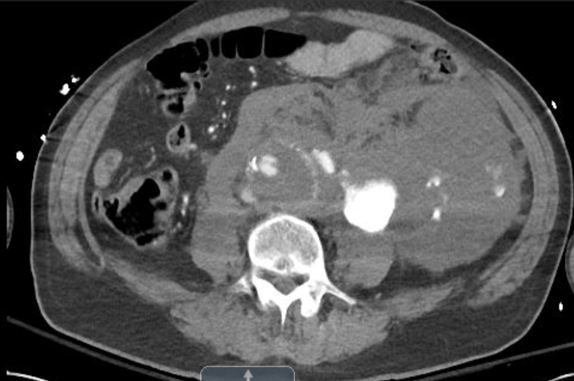
Case #2
Diagnosis: ruptured AAA + MVC
What is your reversal strategy?
PCC + Vit K
Idarucizumab
Dialysis
4. Andexanet Alfa
Notes:
With our hypothesis in mind, we had two main objectives. ***CLICK*** First, we wanted to investigate all patients undergoing surgery with appropriate VTE chemoprophylaxis compared to those patients who did not and look at ***CLICK*** overall postoperative VTE rates ***CLICK***, mortality and **CLICK*** complications. ***CLICK***

Slide 60
ANTICOAGULATION ASSESSMENT
Dabigatran
  Half life: 12 to 17 hours
  Fully Resolved: 2.5 - 3.5 days
Rivaroxaban
  Half life: 5 to 9 hours
  Fully Resolved: 1 – 2 days
Apixaban
  Half life: 8 to 15 hours
  Fully Resolved: 1.5- 3 days
Edoxaban
  Half life: 6 to 11 hours
  Fully Resolved: 1.3 to 2 days
Betrixaban
  Half life: 19 to 27 hours
  Fully resolved: 4 to 5.5 days

Slide 61
Renal and Hepatic Function Assessment
Dabigatran – 80 to 85% renal.
Rivaroxaban – 35% renal
  Severe hepatic impairment could result in bio-accumulation.
Apixaban – 25% renal
  Severe hepatic impairment could result in bio-accumulation.
Edoxaban – 35% renal
  Severe hepatic impairment could result in bio-accumulation.
Betrixaban – 11% renal
  Not recommended in hepatic impairment.

Slide 62
ANTICOAGULATION ASSESSMENT
DOAC anticoagulant testing will be institutional specific
Anti-factor Xa testing
  Ideally calibrated to the specific anti-factor Xa agent used
  Absence of anti-factor Xa testing indicates no active anti-factor Xa drug activity
Thrombin time (Dabigatran)
  Calibrated dilute TT preferable
Currently no data to support the use of TEG in assessing DOAC effect

Slide 63
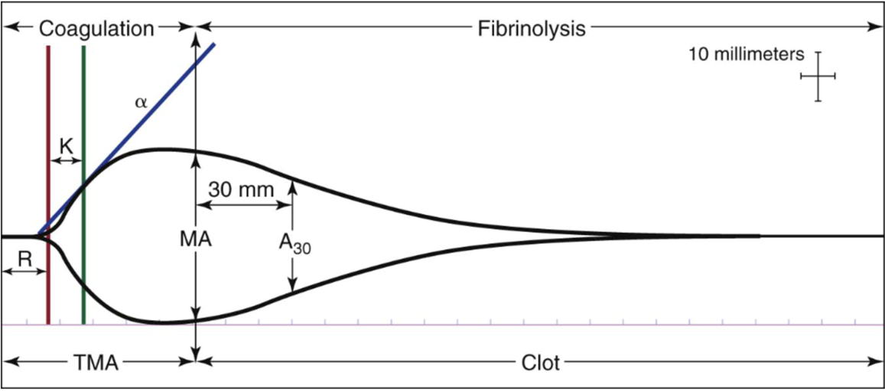
Rotational thromboelastography (ROTEM, TEG)
Viscometers that measure the increasing viscosity of blood during the coagulation process and produce a time-based record of the process
R= Clot initiation
K time and ⍺ angle= Circulating fibrinogen levels
R→MA= Clot Strength
MA→ = Clot Stability
Notes:
One way to monitor bleeding intraoperaively and adjust the resuscitation accordingly is thromboelastography (TEG). TEG is designed to assist the clinician in identifying whether a patient has normal hemostasis or is bleeding due to a coagulopathy or anticoagulant therapy. If a coagulopathy is identified, the TEG results will point to the specific therapy to treat it, whether using fresh frozen plasma, cryoprecipitate, or an anti-fibrinolytic or thrombolytic drug. Conventional TEG is activated with kaolin for the intrisic pathway and/or tissue factor for the extrinsic pathway. coagulation factors begin to accumulate producing the R-time or TEG-ACT. These values will be prolonged in the presence of coagulopathy and shortened in hypercoagulability. At this point, fibrin cross-linking begins the initial phases of clot formation. This is measured as both a time index known as the “K-time” (defined as time to 20 mm of clot) and as a rate. This rate can be determined by the slope of the TEG tracing and is expressed as the α-angle. The K-time and α-angle thus reflect the levels of circulating fibrinogen. Platelet aggregation then occurs until maximum clot strength occurs at the “maximum amplitude” (MA). Lysis of the clot may then begin especially in the presence of severe coagulopathy or of fibrinolytic agents. The percentage of clot that has dissipated at 30 minutes time is expressed as the LY-30.

Slide 64
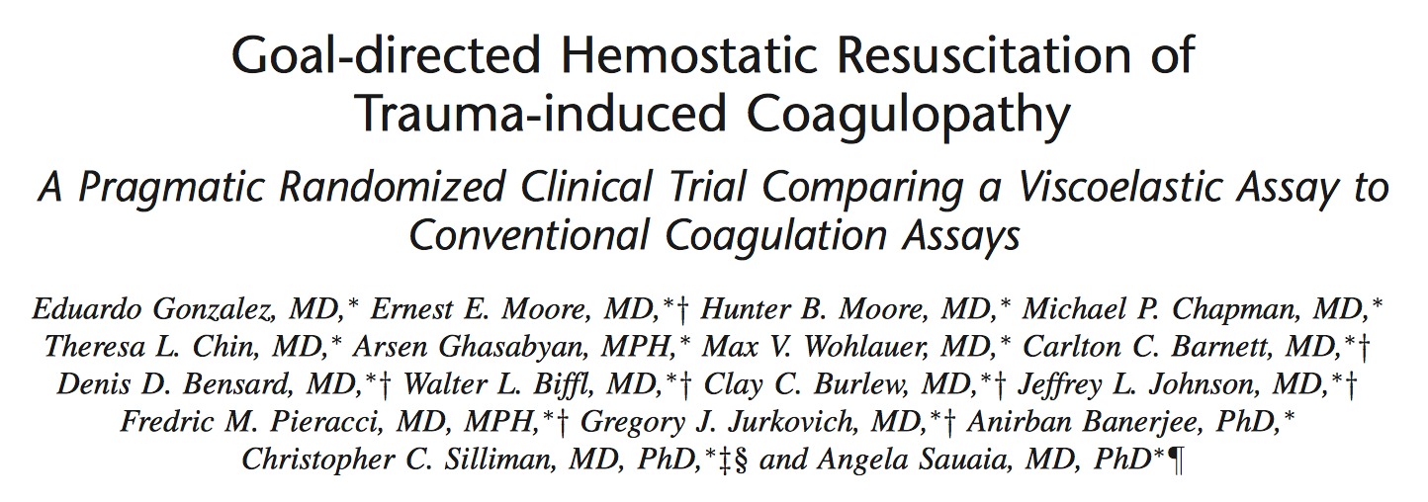
  111 patients massive transfusion protocol guided by RoTEM vs. conventional monitoring
  Survival in the TEG group was significantly higher than the CCA group; 20 deaths in the CCA group (36.4%) compared with 11 in the TEG group (19.6%).
  CCA patients required similar number of red blood cell units as the TEG patients, but more plasma units and more platelets units
sources
Rotational thromboelastography (ROTEM, TEG)

Slide 65
Urgent reversal of DOACs
 | Idarucizumab | Andexanet Alpha | Ciraparantag
Drug Reversed | Dabigatran | Rivaroxaban, Apixaban, Edoxaban (non-FDA), LMWH (non-FDA) | Dabigatran, Xa Inhibitors LMWH, UFH
Mechanism | Monoclonal Ab Binds Dabigatran Frees Thrombin | Recombinent Factor Xa High affinity for Xa Inhibitors | Covalent bonds to drugs
Published Clinical Studies | Bleeding Patients & Emergent Reversal | Healthy Volunteers & Bleeding Patients | Healthy Volunteers
FDA Approval | Approved! | Approved! | TBA
Notes:
With our hypothesis in mind, we had two main objectives. ***CLICK*** First, we wanted to investigate all patients undergoing surgery with appropriate VTE chemoprophylaxis compared to those patients who did not and look at ***CLICK*** overall postoperative VTE rates ***CLICK***, mortality and **CLICK*** complications. ***CLICK***

Slide 66
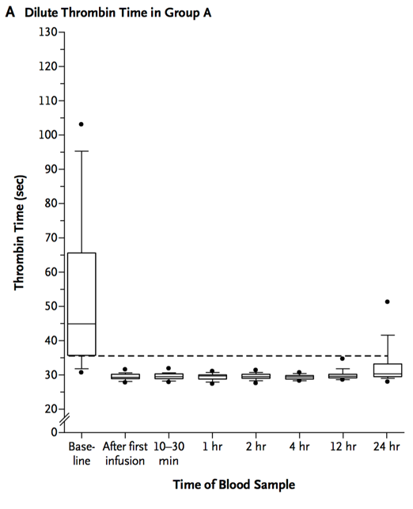
Dabigatran reversal
Idarucizumab (Praxbind®)
Two cohorts (single arm):
Serious Bleeding
Urgent/Emergent Procedure
Two boluses (2.5g each) within 15 minutes
N Engl J Med
Volume 377(5):431-441
August 3, 2017
Notes:
With our hypothesis in mind, we had two main objectives. ***CLICK*** First, we wanted to investigate all patients undergoing surgery with appropriate VTE chemoprophylaxis compared to those patients who did not and look at ***CLICK*** overall postoperative VTE rates ***CLICK***, mortality and **CLICK*** complications. ***CLICK***

Slide 67
Dabigatran reversal
Idarucizumab was 100% effective in reversing the anticoagulant effect of dabigatran among
1. 300 patients with uncontrolled bleeding
(median time to bleeding cessation, 2.5 hours)
and
2. Among 200 patients who required an urgent procedure (median time to procedure initiation, 1.6 hours)
N Engl J Med
Volume 377(5):431-441
August 3, 2017
Notes:
With our hypothesis in mind, we had two main objectives. ***CLICK*** First, we wanted to investigate all patients undergoing surgery with appropriate VTE chemoprophylaxis compared to those patients who did not and look at ***CLICK*** overall postoperative VTE rates ***CLICK***, mortality and **CLICK*** complications. ***CLICK***

Slide 68
DOACs: Route of clearance
Best for patients with impaired renal clearance, even dialysis
Other strategies:
PCC
TXA
Topical Adjuncts
When in doubt: ROTEM
Can clear with dialysis
Notes:
With our hypothesis in mind, we had two main objectives. ***CLICK*** First, we wanted to investigate all patients undergoing surgery with appropriate VTE chemoprophylaxis compared to those patients who did not and look at ***CLICK*** overall postoperative VTE rates ***CLICK***, mortality and **CLICK*** complications. ***CLICK***

Slide 69
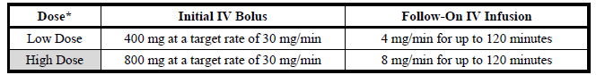
Urgent reversal of Xa inhibitors
Andexanet Alfa (Annexa) FDA approved May 4, 2018
Thrombin generation restored in 96% Annexa v. 7% placebo patients
Siegal 2015 NEJM
Notes:
With our hypothesis in mind, we had two main objectives. ***CLICK*** First, we wanted to investigate all patients undergoing surgery with appropriate VTE chemoprophylaxis compared to those patients who did not and look at ***CLICK*** overall postoperative VTE rates ***CLICK***, mortality and **CLICK*** complications. ***CLICK***

Slide 70
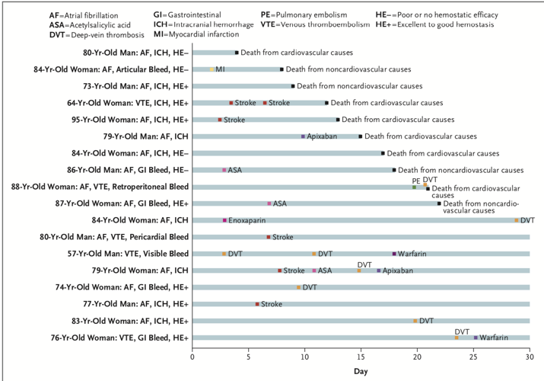
Andexanet Alfa thromboembolic complications
TE Events: 12/67 (18%)
1 MI
7 DVT
1 PE
4 w/in 3 days
8 at 4-30 days
10 deaths (15%)
Notes:
With our hypothesis in mind, we had two main objectives. ***CLICK*** First, we wanted to investigate all patients undergoing surgery with appropriate VTE chemoprophylaxis compared to those patients who did not and look at ***CLICK*** overall postoperative VTE rates ***CLICK***, mortality and **CLICK*** complications. ***CLICK***

Slide 71
PCC for urgent reversal of DOACs
Single-center, retrospective analysis of 4F-PCC for DOAC reversal
Apixaban 17 (55%)
Rivaroxaban 14 (45%)
Antiplatelets 10 (32%)
Patient Outcomes | PCC N=31 | ANNEXA N=67
Effective Hemostasis | 25 (81%) | 79%
Ineffective Hemostasis | 6 (19%)
Thrombotic events | 0 | 18%
In-hospital mortality | 5 (16%) | 15% (30-day)
Type of Bleed | N=31
ICH | 18 (58%)
Pericardial | 5 (16%)
Musculoskeletal | 4 (13%)
Intra-spinal | 1 (3%)
Intrathoracic | 1 (3%)
Gastrointestinal | 1 (3%)
Epistaxis | 1 (3%)
PCC Treatment | N=31
Dose 4F-PCC (units) | 3070 ± 1225
- 25 u/kg | 12 (39%)
- 50 u/kg | 16 (52%)
- other | 3 (10%)
Smith MN, JTT 2019 ePub April 2
NEJM 2016;375:1131-1141
Notes:
With our hypothesis in mind, we had two main objectives. ***CLICK*** First, we wanted to investigate all patients undergoing surgery with appropriate VTE chemoprophylaxis compared to those patients who did not and look at ***CLICK*** overall postoperative VTE rates ***CLICK***, mortality and **CLICK*** complications. ***CLICK***

Slide 72
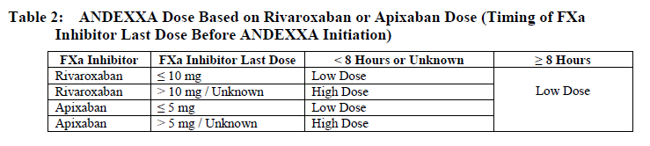
Urgent reversal of anticoagulants: perspective
Most *DOACs t1/2 ~12 hrs
Safe to intervene ~24 hr
*dabigatran up to 18hr
Enoxaparin t1/2 = 4.5hr
Safe to intervene ~12 hr
Protamine
(not as effective as with heparin)
Emergency strategy
Notes:
With our hypothesis in mind, we had two main objectives. ***CLICK*** First, we wanted to investigate all patients undergoing surgery with appropriate VTE chemoprophylaxis compared to those patients who did not and look at ***CLICK*** overall postoperative VTE rates ***CLICK***, mortality and **CLICK*** complications. ***CLICK***

Slide 73
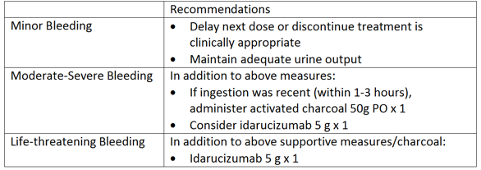
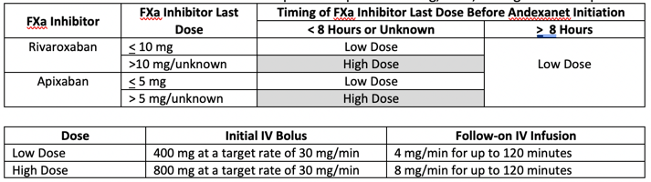
Michigan protocol for urgent DOAC reversal
Dabigatran-related Bleeding
Apixaban/Rivaroxaban-related Bleeding:
Andexanet alpha restricted to ICH bleed
Notes:
With our hypothesis in mind, we had two main objectives. ***CLICK*** First, we wanted to investigate all patients undergoing surgery with appropriate VTE chemoprophylaxis compared to those patients who did not and look at ***CLICK*** overall postoperative VTE rates ***CLICK***, mortality and **CLICK*** complications. ***CLICK***

Slide 74
Case #2
Diagnosis: ruptured AAA + MVC
What is your reversal strategy?
PCC + Vit K
Idarucizumab
Dialysis
Andexanet Alfa
Notes:
With our hypothesis in mind, we had two main objectives. ***CLICK*** First, we wanted to investigate all patients undergoing surgery with appropriate VTE chemoprophylaxis compared to those patients who did not and look at ***CLICK*** overall postoperative VTE rates ***CLICK***, mortality and **CLICK*** complications. ***CLICK***

Slide 75
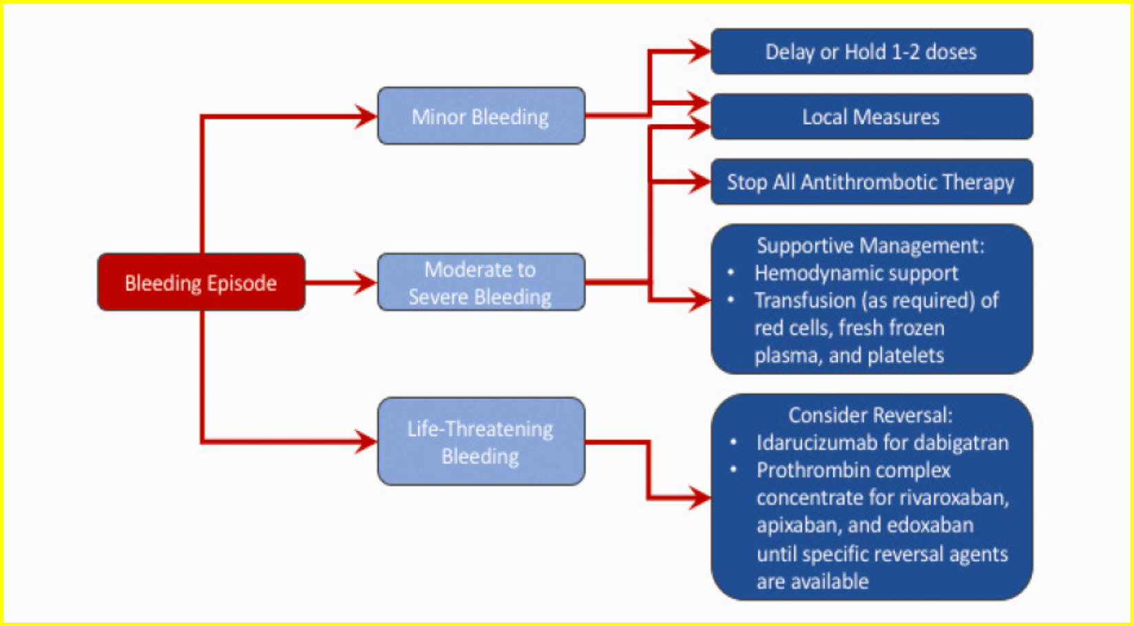
Conclusions
DOACs are becoming much more commonplace for multiple reasons.
Understanding monitoring and reversal are essential for major bleeding episodes.

Slide 76
Thank You

