Slide 1
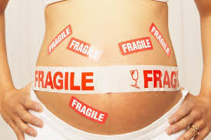
Pregnancy in Trauma Simulation Video
Dr M Fisher, Dr L May
Dr S Tanner, Dr A S Jessel, Dr T Keown, Dr P Wyatt, Dr C Leech, Dr N Sabri

Slide 2
Introduction
The rationale
The clinical case
The simulation video development
Simulation video clip
Simulation video feedback
Future aims

Slide 3
The Rationale
Recent serious incident at the Trust – trauma in a pregnant patient

Slide 4
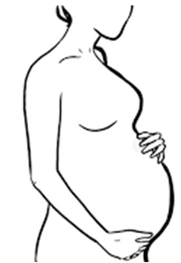
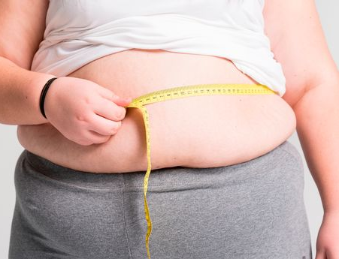
The Clinical Case

Slide 5
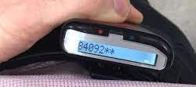
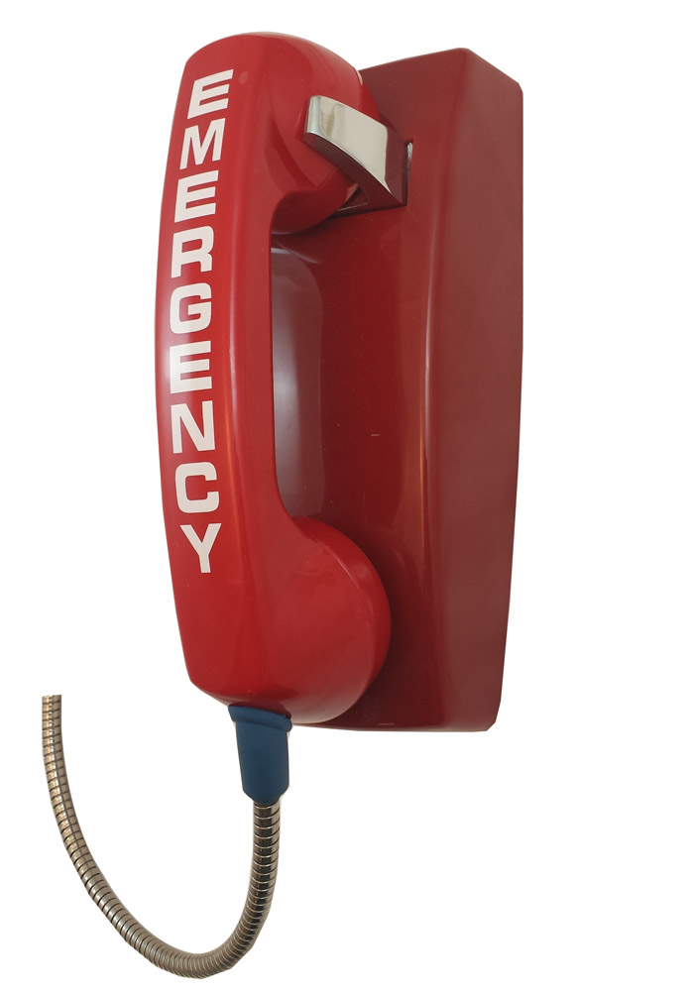
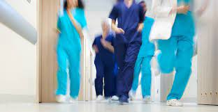
The Clinical Case
Notes:
Trauma alert – ED consultant, ITU reg, Ortho SHO +/- ED junior, Trauma ODP – at UHCW

Slide 6
The Challenges
Clinical Factors:
Pregnancy
High energy trauma
Multiple injuries
Obesity
Unstable patient
Non-technical Factors
Noise, stress, fatigue
Unfamiliar…
Clinical presentation
Environment
Team

Slide 7
The challenges
Trauma in the obstetric patient is challenging
Clinical and Non-technical/Human factors
Different physiology
Two patients!

Slide 8
The Rationale (2)
Learning from the event highlighted the need for:
Greater Trust-wide awareness
Greater understanding of the management of the injured pregnant patient
Likely to see other cases in the future – UHCW is a busy adult trauma centres
Something needed implementing…

Slide 9
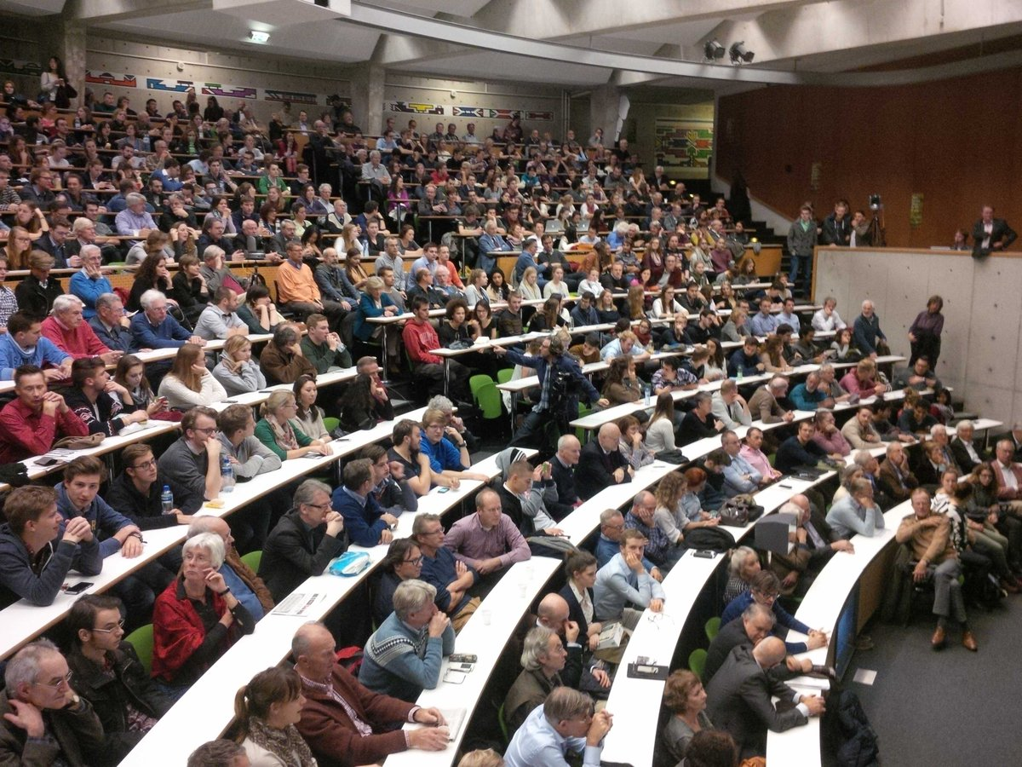
The Rationale - Simulation Video
Ad-hoc teaching
Distribution to high numbers
Socially distanced learning
Online learning
Avoids logistical issues of simulation sessions
Notes:
Can be used in a variety of learning environments
Lecture based teaching
Induction training sessions
Small group sessions
Simulation practice
Ad-hoc teaching
Self-directed learning

Slide 10
The Simulation Video
MDT representation from Emergency Medicine, Anaesthetics and Obstetrics
Drafted a simulation scenario:
Highlighted specific learning points: clinical and non-clinical
Pregnant trauma patient
Depicted:
Trauma call + Emergency alerts
Paramedic handover
Primary survey
Cardiac arrest
Resuscitative hysterotomy
Onward planning
Multiple injuries
Multiple specialties
Filmed in a high-fidelity suite

Slide 11
The Video…
https://drive.google.com/file/d/13xKgMZiTysnIwEuOiupWM4V3rbwwPSBE/view?usp=sharing

Slide 12
The Video – What was missed?

Slide 13
What we did
Video was presented at the joint departmental Anaesthetic and Obstetric induction
Multiple small group sessions
15-20 minute video was presented
Important learning points highlighted, and group discussion facilitated by obstetric and anaesthetic senior trainees/consultants

Slide 14
The Feedback
Feedback was collected via questionnaire immediately pre and post induction session
CT2 – ST7

Slide 15
The Feedback
Before the video teaching session | After the video teaching session
Only 36% had prior involvement in managing obstetric trauma or cardiac arrest | 86% agreed the session improved their management/confidence
43% did not feel confident to manage obstetric trauma | 7.1% did not feel confident in the management of obstetric trauma
 | Session improved understanding of: The MDT roles Appropriate emergency alerts Cardiovascular implication of pregnancy on the management of cardiac arrest

Slide 16
The Future
Increase teaching sessions to the following staff:
Obstetric, Anaesthetic and Emergency Medicine doctors (all grades)
Midwives
Departmental inductions for rotating doctors in: Obstetrics, Anaesthetics, Emergency Medicine, Intensive Care
Departmental teaching
Online learning package
Current project to incorporate the video into an e-learning package for midwifery staff

Slide 17
Thank you…

