Slide 1



Scan now to
complete the pretest
Toxicity Management and Symptom Control in Advanced RCC: Playbook Update
Scan the QR code to complete the pretest OR use the paper assessment included in your conference bag
To scan the QR code:
FOR IPHONE:
Open the camera & focus it to QR code
Your internet browser should pop up with a link
Click the link and complete
FOR ANDROID:
Open the camera & focus it to QR code
Hold ‘Home’ button
The pretest comes visible to complete

Slide 2
Toxicity Management and Symptom Control in Advanced RCC: Playbook Update
Nazy Zomorodian, NP, RNC, MSN, CUNP, CCRC
Director, GU Clinical Trials Program
David Geffen School of Medicine at UCLA
Institute of Urologic Oncology at UCLA

Slide 3
Provided by i3 Health
ACCREDITATION
In support of improving patient care, i3 Health is jointly accredited by the Accreditation Council for Continuing Medical Education (ACCME), the Accreditation Council for Pharmacy Education (ACPE), and the American Nurses Credentialing Center (ANCC), to provide continuing education for the healthcare team.
i3 Health designates this live activity for a maximum of 1.0 ANCC contact hour for learners who successfully complete this nursing continuing professional development activity.
INSTRUCTIONS TO RECEIVE CREDIT
An activity evaluation will be available after the presentation. To claim credit, you must complete and submit an evaluation form at the conclusion of the program. Your certificate of attendance will be emailed to you in approximately 2 weeks.
UNAPPROVED USE DISCLOSURE
This educational activity may contain discussion of published and/or investigational uses of agents that are not indicated by the FDA. The planners of this activity do not recommend the use of any agent outside of the labeled indications.
The opinions expressed in the educational activity are those of the faculty and do not necessarily represent the views of the planners. Please refer to the official prescribing information for each product for discussion of approved indications, contraindications, and warnings.
DISCLAIMER
The information provided at this NCPD activity is for continuing education purposes only and is not meant to substitute for the independent medical/clinical judgment of a healthcare provider relative to diagnostic and treatment options of a specific patient’s medical condition.
COMMERCIAL SUPPORT
This activity is supported by an independent educational grant from Merck Sharpe & Dohme LLC..

Slide 4
Disclosures
Nazy Zomorodian, NP, RNC, MSN, CUNP, CCRC, has no relevant financial relationships to disclose
i3 Health has mitigated all relevant financial relationships
Notes:
4
Slide ID: 26484
Metastatic renal cell carcinoma (RCC) represents a very small proportion of a physician’s overall workload
RCC remains a low-incidence cancer
Patients with metastatic RCC do not survive long (compared with patients with metastatic disease from common cancers such as breast and prostate)
Physicians have limited opportunity to treat RCC; therefore, few have the opportunity to refine their clinical experience
For many physicians, anecdotal experience with a handful of patients defines their knowledge of and approach to managing this disease
US estimates for 2008: cancer of the kidney and renal pelvis¹
Incidence >54,000 (males 33,130, females 21,260)
Mortality >13,000 (males 8,100, females 4,910)
Globally, kidney cancer was the 15th most common cancer and accounted for more than 180,000 cases in 2000²
RCC accounts for about 90% of all kidney cancer³
References
American Cancer Society. Cancer facts & figures 2008. http://www.cancer.org/docroot/STT/content/STT_1x_Cancer_Facts_and_Figures_2008.asp?from=fast.
Stewart BW, Kleihues P, eds. World Cancer Report. Lyon, France: IARC Press; 2003.
American Cancer Society. Detailed guide: kidney cancer. http://www.cancer.org/docroot/CRI/CRI_2_3x.asp?dt=22.

Slide 5
Learning Objectives
Differentiate the mechanisms of action (MOAs) of novel therapeutic strategies for advanced renal cell carcinoma (RCC)
Appraise the efficacy and safety profiles of novel immunotherapies and targeted therapies for advanced RCC
Assess strategies to optimize treatment safety and tolerability and ensure the provision of patient-centered RCC care
Notes:
5
Slide ID: 26484
Metastatic renal cell carcinoma (RCC) represents a very small proportion of a physician’s overall workload
RCC remains a low-incidence cancer
Patients with metastatic RCC do not survive long (compared with patients with metastatic disease from common cancers such as breast and prostate)
Physicians have limited opportunity to treat RCC; therefore, few have the opportunity to refine their clinical experience
For many physicians, anecdotal experience with a handful of patients defines their knowledge of and approach to managing this disease
US estimates for 2008: cancer of the kidney and renal pelvis¹
Incidence >54,000 (males 33,130, females 21,260)
Mortality >13,000 (males 8,100, females 4,910)
Globally, kidney cancer was the 15th most common cancer and accounted for more than 180,000 cases in 2000²
RCC accounts for about 90% of all kidney cancer³
References
American Cancer Society. Cancer facts & figures 2008. http://www.cancer.org/docroot/STT/content/STT_1x_Cancer_Facts_and_Figures_2008.asp?from=fast.
Stewart BW, Kleihues P, eds. World Cancer Report. Lyon, France: IARC Press; 2003.
American Cancer Society. Detailed guide: kidney cancer. http://www.cancer.org/docroot/CRI/CRI_2_3x.asp?dt=22.

Slide 6
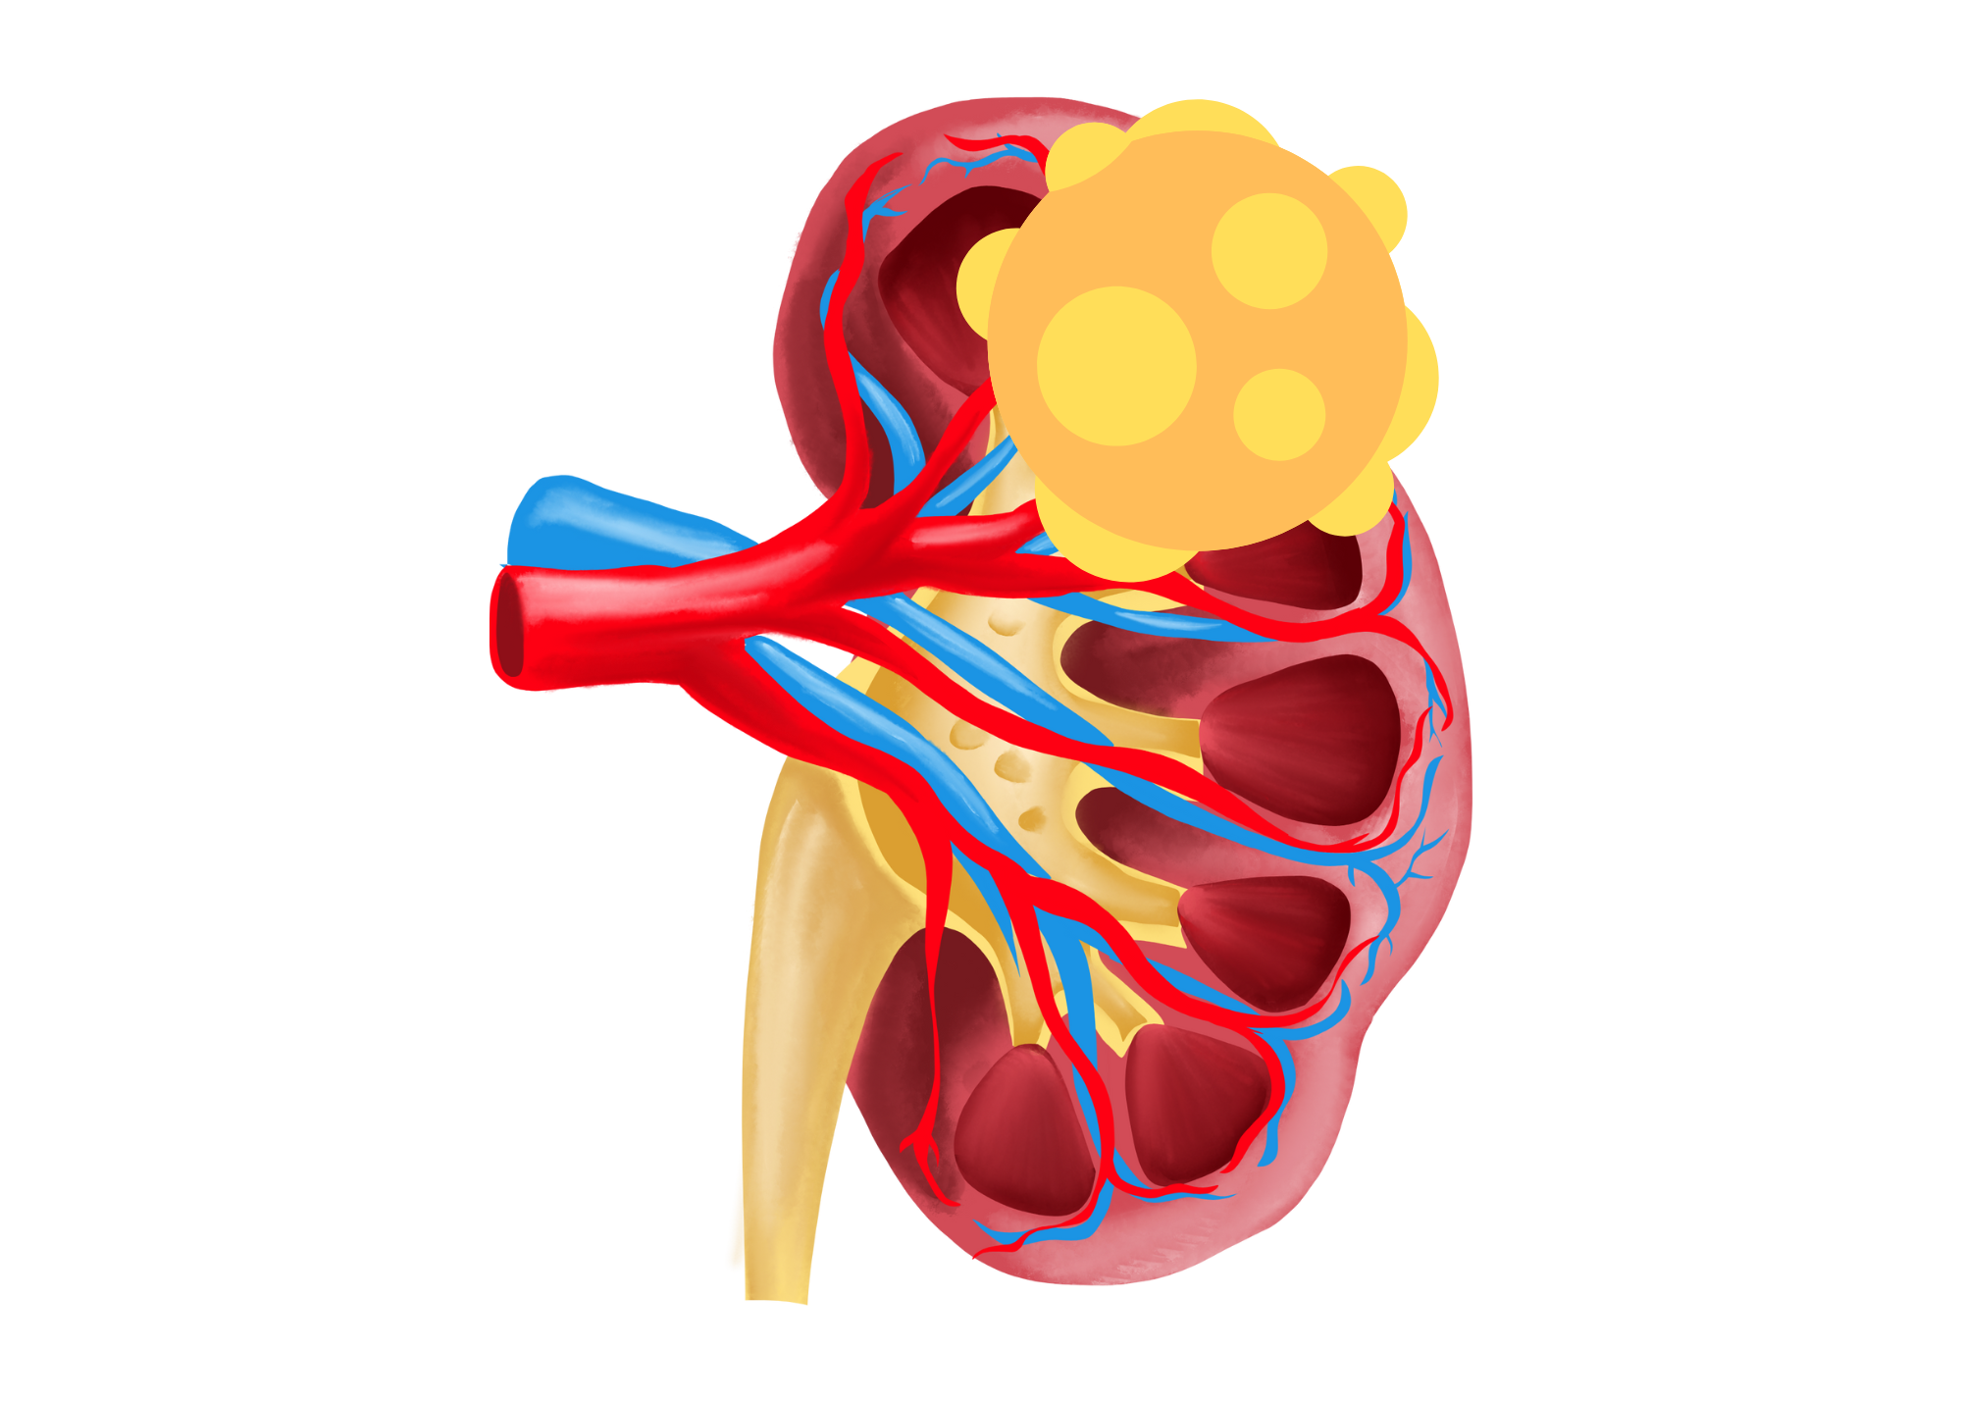
Kidney Cancer Landscape
Tumor
Accounts for ~4% of all types of cancer
Patients with metastatic disease do not survive long (18.2% 5-year survival)
US 2024 estimates
  81,610 diagnosed cases of cancer of kidney and renal pelvis
  14,390 deaths
Median age at diagnosis is 65 years
Heterogenous disease
85% of kidney tumors are RCC, and 70% of these have clear cell histology
Renal vein
Renal artery
Kidney
Ureter
SEER, 2024; Moch et al, 2022; NCCN, 2024; Saint John’s Cancer Institute, 2024.
Notes:
Slide ID: 26484
Metastatic renal cell carcinoma (RCC) represents a very small proportion of a physician’s overall workload
RCC remains a low-incidence cancer
Patients with metastatic RCC do not survive long (compared with patients with metastatic disease from common cancers such as breast and prostate)
Physicians have limited opportunity to treat RCC; therefore, few have the opportunity to refine their clinical experience
For many physicians, anecdotal experience with a handful of patients defines their knowledge of and approach to managing this disease
US estimates for 2024: cancer of the kidney and renal pelvis (from Siegel et al, 2024)
Incidence >81,000 (males 52,380, females 29,230)
Mortality >14,000 (males 9,450, females 4,940)
Globally, kidney cancer was the 15th most common cancer and accounted for more than 180,000 cases in 2000²
RCC accounts for about 85% of all kidney cancer and 70% of these have clear cell histology (NCCN, 2024)
References
American Cancer Society. Cancer facts & figures 2008. http://www.cancer.org/docroot/STT/content/STT_1x_Cancer_Facts_and_Figures_2008.asp?from=fast.
Stewart BW, Kleihues P, eds. World Cancer Report. Lyon, France: IARC Press; 2003.
American Cancer Society. Detailed guide: kidney cancer. http://www.cancer.org/docroot/CRI/CRI_2_3x.asp?dt=22.

Slide 7
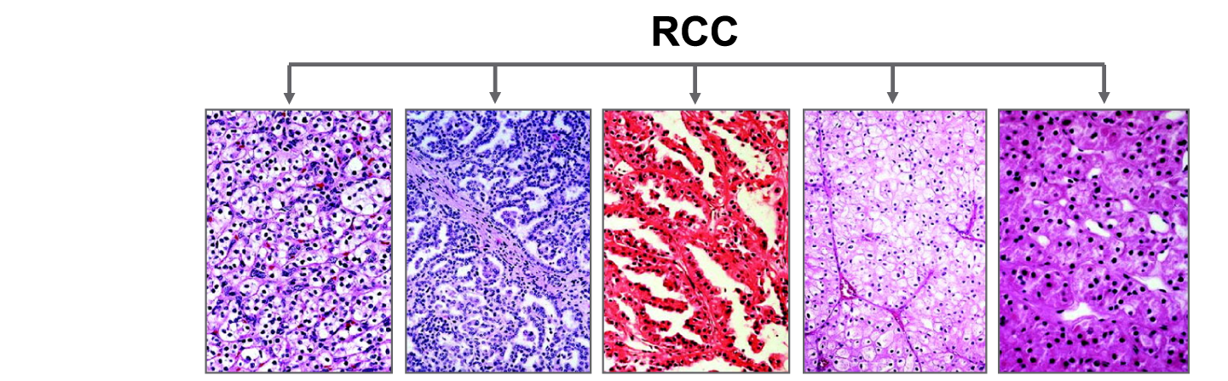





RCC Facts and Figures
Histologic diagnosis of RCC is established by biopsy or after surgical removal
There are 20+ types of RCC disease, but clear cell accounts for 75% of cases and 90% of deaths
Type | Clear cell | Papillary type 1 | Papillary type 2 | Chromophobe | Oncocytoma
Incidence | 75% | 5% | 10% | 5% | <5%
Associated mutations | VHL | c-Met | FH | FLCN | FLCN
VHL = von Hippel-Lindau disease; c-Met = mesenchymal-epithelial transition factor; FH = fumarate hydratase; FLCN = folliculin gene.
Linehan et al, 2003; Linehan et al, 2009; Linehan, 2012; Siegel et al, 2024; SEER, 2024; NCCN, 2024.
Notes:
7
Slide ID: 26487
The majority of patients with RCC have clear cell histology
Reference
Linehan et al. J Urol. 2003;170:2163-2172.

Slide 8
RCC Facts and Figures (cont.)
Incidence is increasing at 0.8% per year from 2007-2021
Risk factors include smoking, obesity, hypertension, and genetic disposition (VHL disease is the most common)
Prognosis varies greatly depending on stage
  5-year survival, from 99% for local to 10% for metastatic
Treatment may range from watching, to heroic operations involving adjacent organs, to systemic therapy
Siegel et al, 2024; SEER, 2024; NCCN, 2024.
Notes:
8
Slide ID: 26484
Metastatic renal cell carcinoma (RCC) represents a very small proportion of a physician’s overall workload
RCC remains a low-incidence cancer
Patients with metastatic RCC do not survive long (compared with patients with metastatic disease from common cancers such as breast and prostate)
Physicians have limited opportunity to treat RCC; therefore, few have the opportunity to refine their clinical experience
For many physicians, anecdotal experience with a handful of patients defines their knowledge of and approach to managing this disease
US estimates for 2024: cancer of the kidney and renal pelvis (from Siegel et al, 2024)
Incidence >81,000 (males 52,380, females 29,230)
Mortality >14,000 (males 9,450, females 4,940)
Globally, kidney cancer was the 15th most common cancer and accounted for more than 180,000 cases in 2000²
RCC accounts for about 85% of all kidney cancer and 70% of these have clear cell histology (NCCN, 2024)
References
American Cancer Society. Cancer facts & figures 2008. http://www.cancer.org/docroot/STT/content/STT_1x_Cancer_Facts_and_Figures_2008.asp?from=fast.
Stewart BW, Kleihues P, eds. World Cancer Report. Lyon, France: IARC Press; 2003.
American Cancer Society. Detailed guide: kidney cancer. http://www.cancer.org/docroot/CRI/CRI_2_3x.asp?dt=22.

Slide 9
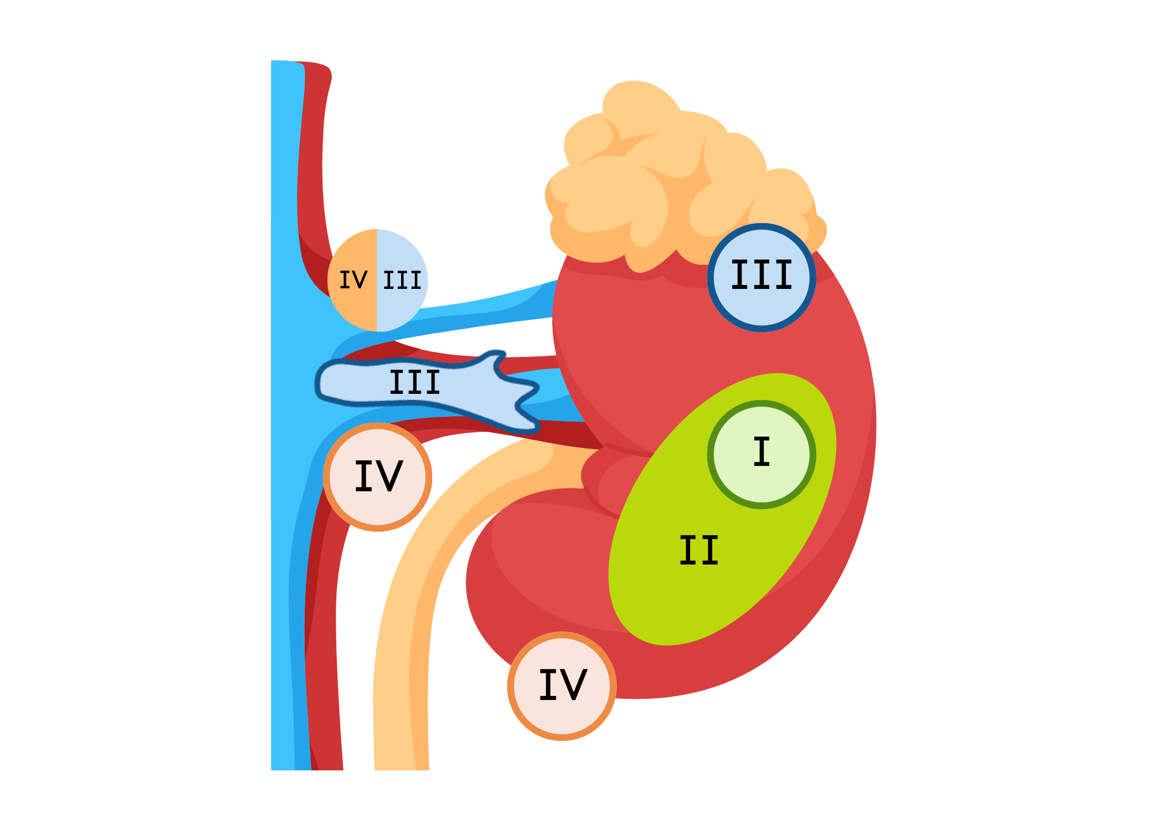
Cancer (AJCC) Clinical Staging System
Gerota’s fascia
Stage I
  Tumor <7 cm in greatest dimension and limited to kidney
Stage II
  Tumor >7 cm in greatest dimension and limited to kidney
Stage III
  Tumor major veins or adrenal gland, tumor within Gerota’s fascia, or 1 regional lymph node involved
Stage IV
  Tumor beyond Gerota’s fascia, >1 regional lymph node involved, or distant metastases
Adrenal gland
Lymph nodes
AJCC = American Joint Committee on Cancer.
Amin et al, 2017.
Notes:
9
Slide ID: 26485

Slide 10
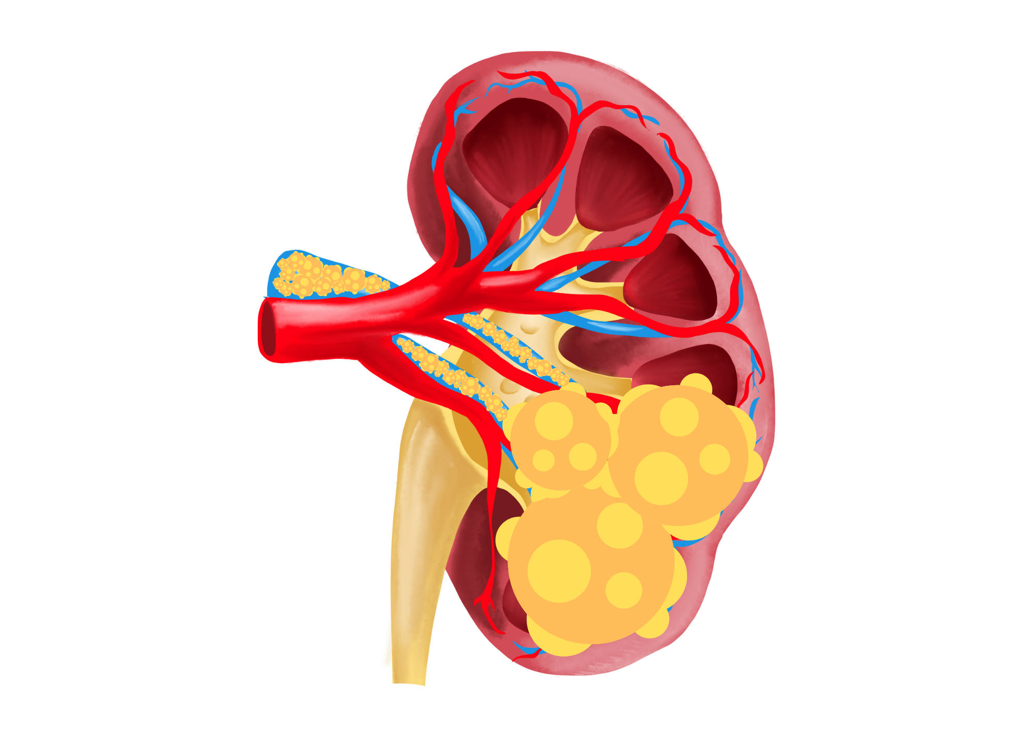
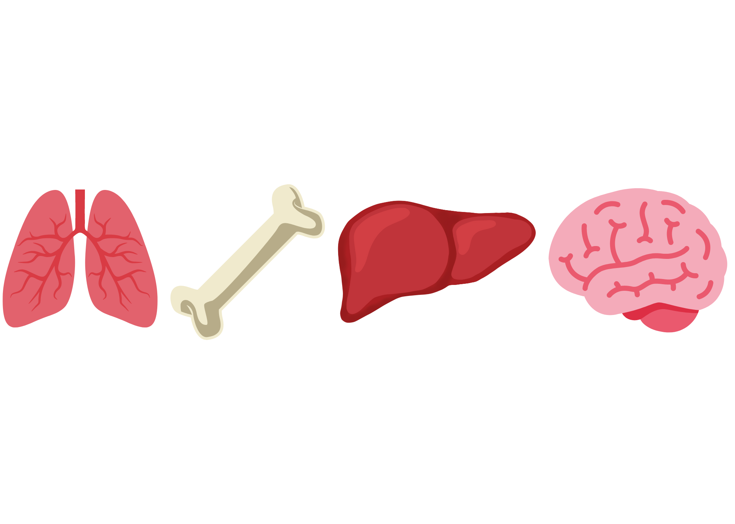
Stage IV Metastatic RCC
The most common sites of metastasis:
Lung (50%-60%)
Bone (30%-40%)
Liver (30%-40%)
Brain (5%)
Motzer et al, 1996.
Notes:
10
Slide ID: 26486

Slide 11
Risk Factors Associated With Worse Prognosis
Patients With Metastatic RCC
MSKCC Prognostic Model
IMDC Prognostic Model
Karnofsky performance status <80%
Interval from diagnosis to treatment of <1 year
Anemia: low serum hemoglobin (13 g/dL/11.5 g/dL: M/F)
Hypercalcemia: high corrected calcium (10 mg/dL)
Risk
Factors
High lactate dehydrogenase
(300 U/L)
Thrombocytosis
Leukocytosis
0 factors = low risk or good prognosis
1-2 = intermediate risk
≥3 = poor risk
Prognosis
MSKCC = Memorial Sloan Kettering Cancer Center;
IMDC = International Metastatic RCC Database Consortium.
Motzer et al, 2002; Motzer et al, 2004; Heng et al, 2009.

Slide 12
Approaches to Management of Advanced RCC
Surgery
  Cytoreductive nephrectomy
  Solitary or limited metastasectomy
Radiotherapy
  Palliative to sites of metastasis
Systemic approaches
  Cytotoxic therapy
  Targeted therapies
  Immune checkpoint inhibitors
NCCN, 2024.
Notes:
A brief listing of various approaches to the management of advanced RCC is shown here.
Because no cytotoxic therapy has provided a reasonable level of activity against advanced RCC, the discussion will primarily focus on targeted therapies.¹
1/Linehan/1151/A,1152/A
2/NCCN/KID-2/A,B,C
1/Linehan/1152/B,1157/A
3/Sutent PI/2/A;6/A
4/Nexavar PI/1/A;6/A
TORISEL PI/3/D;15/A
1/Linehan/1152/B
Reference:
1. Linehan WM, Bates SE, Yang JC. Cancers of the genitourinary system. In: DeVita VT Jr, Hellman S, Rosenberg SA, eds. Cancer: Principles and Practice of Oncology. 7th ed. Philadelphia, Pa: Lippincott Williams & Wilkins. 2005:1139-1168.
Note to reviewer: This slide is a copy from the oncologist deck (job# 203611) and will be made to conform to final CCC comments on that deck.

Slide 13

Understanding of RCC Has Evolved
1880-1920
1920-1960
1960-1980
1980-1995
1995-2012
2013
2022
Hypernephroma
Grawitz tumor
Renal cell carcinoma
Clear cell
Granular
Clear cell
Papillary
Chromophobe
Clear cell
Papillary I & II
Chromophobe
Collecting duct
Medullary
Unclassified
Clear cell
Multilocular clear cell RCC
Papillary I
Papillary II
Chromophobe
Hybrid oncocytic
Collecting duct
Renal medullary carcinoma
Neuroblastoma associated
Mucinous tubular & spindle cell
Tubulocystic RCC
Acquired cystic disease RCC
Clear cell papillary RCC
Unclassified RCC
MiTF translocation RCC
HLRCC
Morphologic
Clear cell
Multilocular clear cell RCC
Papillary RCC
Chromophobe
Other oncocytic tumors
Collecting duct
Clear cell papillary
Mucinous tubular & spindle cell
Tubulocystic RCC
Acquired cystic disease-RCC
Eosiniphilic solid and cystic
RCC unclassified
Molecularly defined
TFE3 RCC
TFEB RCC
ELOC-mutated RCC
FH-deficient/HLRCC
SDH-deficient
ALK-rearranged RCC
Medullary RCC
SMARCB1-deficient subtypes
HLRCC = hereditary leiomyomatosis and RCC; TFE3 = transcription factor E3; TFEB = transcription factor EB; ELOC = elongin C-mutated; SDH = succinate dehydrogenase;
ALK = anaplastic lymphoma kinase; SMARCB1 = SWI/SNF-related matrix-associated actin-dependent regulator of chromatin subfamily B member 1.
Shuch et al, 2023.

Slide 14
RCC Systemic Therapy Has Evolved
1950-1980
1990-2000
2006
2015
2019+
Chemotherapy
Immunotherapy
Targeted therapy
Immunotherapy
Targeted therapy
Checkpoint immunotherapy
Combination immunotherapy
Yang et al, 2024.

Slide 15
Systemic Therapy in 2024
For metastatic ccRCC, survival has nearly tripled
Median survival was 1 year in 1990 and is now ~4 years in trial populations with combination therapy
First-line treatment is either IO/IO or IO/TKI
Therapy has significant toxicity and high cost, and some patients have very deep response→ Cures?
ccRCC = clear cell RCC; IO = immuno-oncology; TKI = tyrosine kinase inhibitor.
Minasian et al, 1993; Motzer et al, 2024; NCCN, 2024; Yoo et al, 2023.

Slide 16
Progress in the Treatment of RCC
Increased understanding of the molecular changes
Identification of cellular pathways relevant in RCC: HIF2-alpha, VEGF, PDGF, mTOR
Targeted therapy: VEGFR inhibitors and TKIs
Sunitinib (multi-targeted TKI)
Axitinib (VEGFR TKI)
Cabozantinib (multi-targeted TKI)
Pazopanib (multi-targeted TKI)
Tivozanib (multi-targeted TKI)
Bevacizumab (VEGFR inhibitor)
mTOR inhibitors and combinations
Everolimus (mTOR inhibitor)
Everolimus/lenvatinib (mTOR inhibitor + VEGFR inhibitor)
Immunotherapy
Nivolumab (ICI)
Ipilimumab/nivolumab (ICI/ICI)
Targeted therapy/immunotherapy
Axitinib/pembrolizumab (VEGFR TKI/ICI)
Cabozantinib/nivolumab (multi-targeted TKI/ICI)
Lenvatinib/pembrolizumab (multi-targeted TKI/ICI)
Axitinib/avelumab (VEGFR TKI/ICI)
HIF2-alpha inhibitor
Belzutifan (HIF2-alpha inhibitor)
PDGF = platelet-derived growth factor; mTOR = mammalian target of rapamycin; VEGFR = vascular endothelial growth factor receptor;
HIF2 = hypoxia-inducible factor 2; ICI = immune checkpoint inhibitor.
NCCN, 2024.
Notes:
As in many other types of cancer, an increased understanding of the molecular and genetic bases of cancer has improved the understanding of RCC. In recent years, scientists have identified cellular pathways relevant to RCC, and they have discovered the roles of vascular endothelial growth factor (VDGF) and its receptor, platelet-derived growth factor (PDGF) and its receptor, the Ras signaling pathway, and the mammalian target of rapamycin (mTOR).^{1,2}
These new understandings have led, in turn, to the development of targeted agents applicable to RCC. Three new agents now have FDA approval: the tyrosine kinase inhibitors sorafenib (Nexavar®, Bayer Pharmaceuticals)³ and sunitinib (Sutent®, Pfizer)⁴ and the mTOR inhibitor temsirolimus (TORISEL™, Wyeth Pharmaceuticals).⁵ Another agent, bevacizumab (Avastin®, Genentech), which is a monoclonal antibody that targets VEGF, is in clinical trials in RCC but not approved for use.⁶
References:
Kaelin WG Jr. The molecular basis of the VHL hereditary cancer syndrome. N Rev Cancer, 2002;2(9):673-682.
2. Cohen HT, McGovern FJ. Renal-cell carcinoma. N Engl J Med. 2005;353:2477-2490.
3. Nexavar (sorafenib tosylate) [package insert]. West Haven, CT: Bayer HealthCare/Onyx Pharmaceuticals;2007.
4. Sutent (sunitinib malate) [package insert]. New York: Pfizer Labs;2007.
5. TORISEL (temsirolimus) [package insert]. Madison, NJ: Wyeth Pharmaceuticals;2007.
6. Avastin (bevacizumab) [package insert]. South San Francisco, CA: Genentech;2006.
1/Kaelin/673/A
2/ Cohen, McGovern/2482-2483, Fig. 4; 2487/B; 2486/Table 2
1/Kaelin/673/A
2/ Cohen, McGovern/2482-2483, Fig. 4; 2487/B; 2486/Table 2
3/Nexavar PI/6/A
4/Sutent PI/1/A
5/ TORISEL PI/1/A-1
6/Avastin PI/11/A

Slide 17
NCCN Guidelines: Kidney Cancer
Systemic Therapy for Stage IV Disease or Relapse
First-Line Therapy for Clear Cell Histology
Risk | Preferred regimens | Other recommended regimens | Useful in certain circumstances
Favorable | Axitinib + pembrolizumab (category 1) Cabozantinib + nivolumab (category 1) Lenvatinib + pembrolizumab (category 1) Ipilimumab + nivolumab | Axitinib + avelumab Cabozantinib (category 2B) Pazopanib Sunitinib | Active surveillance Axitinib (category 2B)
Poor/ intermediate | Axitinib + pembrolizumab (category 1) Cabozantinib + nivolumab (category 1) Ipilimumab + nivolumab (category 1) Lenvatinib + pembrolizumab (category 1) Cabozantinib | Axitinib + avelumab Pazopanib Sunitinib | Axitinib (category 2B)
NCCN = National Comprehensive Cancer Network.
NCCN, 2024.

Slide 18
NCCN Guidelines: Kidney Cancer (cont.)
Systemic Therapy for Stage IV Disease or Relapse
Subsequent Therapy for Clear Cell Histology
IO therapy history status | Preferred regimens | Other recommended regimens | Useful in certain circumstances
IO therapy–naive | None | Axitinib + pembrolizumab Cabozantinib Cabozantinib + nivolumab Everolimus + lenvatinib Ipilimumab + nivolumab Lenvatinib + pembrolizumab Nivolumab | Axitinib Everolimus Pazopanib Sunitinib Tivozanib Belzutifan (category 2B) Bevacizumab (category 2B) Axitinib + avelumab (category 3)
Prior IO therapy | None | Axitinib Belzutifan Cabozantinib Everolimus + lenvatinib Tivozanib | Axitinib + pembrolizumab Cabozantinib + nivolumab Everolimus Ipilimumab + nivolumab Lenvatinib + pembrolizumab Pazopanib Sunitinib Bevacizumab (category 2B) Axitinib + avelumab (category 3)
NCCN, 2024.

Slide 19
Front-Line Trials in Metastatic RCC
 | TKI | IO/IO | IO/TKI
 | CABOSUN Cabozantinib n=79 vs sunitinib | CheckMate 214 Ipilimumab/nivolumab n=550 vs sunitinib | KEYNOTE-426 Axitinib/pembrolizumab n=432 vs sunitinib | CheckMate 9ER Cabozantinib/nivolumab n=323 vs sunitinib | CLEAR Lenvatinib/pembrolizumab n=355 vs lenvatinib/everolimus vs sunitinib
Risk level | Intermediate/ poor risk | Favorable/ intermediate/poor risk | Favorable/intermediate/ poor risk | Favorable/intermediate/ poor risk | Favorable/intermediate/ poor risk
PFS HR | 0.48 | 0.73 | 0.69 | 0.51 | 0.39 vs sunitinib
Median PFS, months | 8.6 | 11.6 | 15.1 | 16.6 | 23.9
ORR, % | 20% | 42% | 59% | 56% | 71%
CR, % | 0 | 9% | 6% | 8% | 16%
Combination therapies are preferred first-line for most patients
PFS = progression-free survival; HR = hazard ratio; ORR = overall response rate; CR = complete response.
NCCN, 2024; Choueiri et al, 2018; Motzer et al, 2018; Rini et al, 2019; Choueiri et al, 2021; Motzer et al, 2021.

Slide 20
Subsequent-Line Trials in Metastatic RCC Without Prior IO
 | IO/TKI |  |  | IO/IO or IO |  | mTOR Inhibitor/TKI
 | Axitinib/ pembrolizumab n=38 | NCT02496208 Cabozantinib/ nivolumab or cabozantinib/ nivolumab/ ipilimumab n=16 | KEYNOTE-146 Lenvatinib/ pembrolizumab n=121 | FRACTION-RCC Ipilimumab/ nivolumab n=46 | CheckMate 025 Nivolumab n=406 vs everolimus | NCT01136733 Everolimus/lenvatinib n=51 vs lenvatinib vs everolimus
Prior therapies in trial | 1 prior therapy | 1 or more prior therapies | Prior IO or no prior IO | 1 or more prior therapies | 1 or 2 prior anti-angiogenics excluding mTORi | Prior anti-angiogenic
NCCN-recommended use | No prior IO | No prior IO | No prior IO | No prior IO | No prior IO | After any
PFS HR | - | - | - | - | 0.84 | 0.40 vs everolimus 0.66 vs lenvatinib
Median PFS, months | 9.7 | NR | No prior IO: 11.8 Prior IO: 11.6 | 3.7 | 4.2 | 14.6
ORR, % | 25% | 62.5% | No prior IO: 52.9% Prior IO: 62.5% | 17.4% | 22.9% | 43%
CR, % | 0 | 0 | 0 | 0 | 1.0% | -
If you haven’t tried a combination, try a combination second-line
NR = not reported; mTORi = mTOR inhibitor.
NCCN, 2024; Dizman et al, 2023; Apolo et al, 2021; Lee et al, 2021; Choueiri et al, 2022; Motzer et al, 2020; Motzer et al, 2015.

Slide 21
Subsequent-Line Trials in Metastatic RCC After Prior IO
 | TKI |  |  | HIF2-Alpha Inhibitor | mTOR Inhibitor/TKI
 | AXIS Axitinib n=361 vs sorafenib | METEOR Cabozantinib n=187 vs everolimus | TIVO-3 Tivozanib n=175 vs sorafenib | LITESPARK-005 Belzutifan n=374 vs everolimus | NCT01136733 Everolimus/lenvatinib n=51 vs lenvatinib vs everolimus
Prior therapies in trial | Any | After prior VEGFR-targeted therapy | 2 or 3 prior therapies | Prior VEGF-TKI and prior IO | Prior anti-angiogenic
NCCN-recommended use | After IO | After any | After IO | After IO | After any
PFS HR | 0.66 | 0.58 | 0.73 | 0.74 | 0.40 vs everolimus 0.66 vs lenvatinib
Median PFS, months | 8.3 | 7.4 | 5.6 | 5.6 | 14.6
ORR, % | 23% | 21% | 18% | 22.7% | 43%
CR, % | - | 0 | 0 | 4% | -
If combination fails, try something else
NCCN, 2024; Motzer et al, 2013; Choueiri et al, 2015; Rini et al, 2020; Albiges et al, 2023; Motzer et al, 2015.

Slide 22

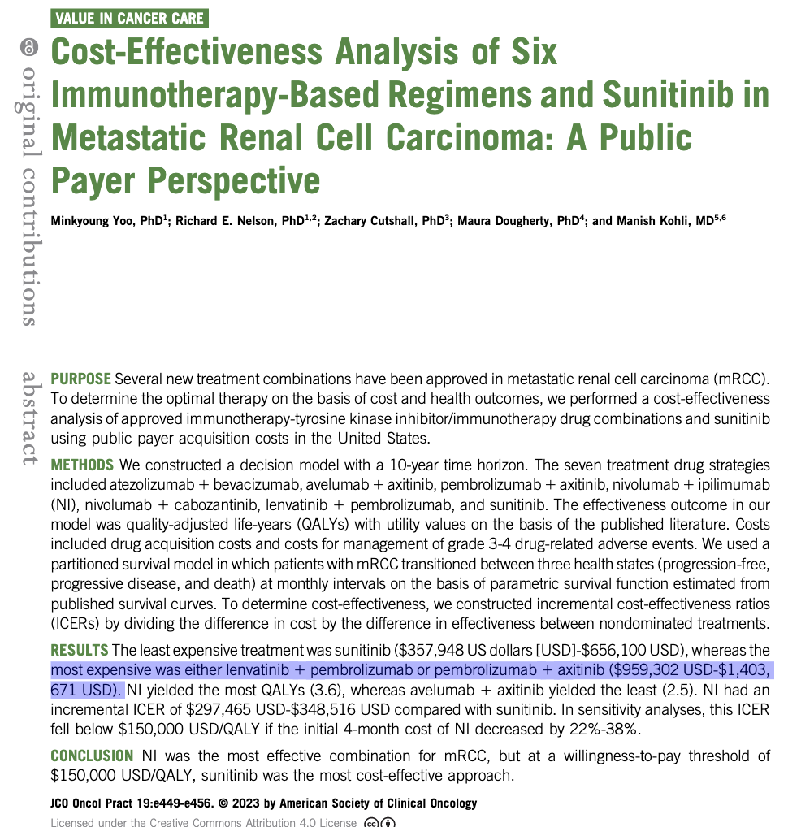
Toxicity and Cost
Event | Any Grade | Grade ≥3
Any event | 351 (99.7%) | 290 (82.4%)
Diarrhea | 216 (61.4%) | 34 (9.7%)
Hypertension | 195 (55.4%) | 97 (27.6%)
Hypothyroidism | 166 (47.2%) | 5 (1.4%)
Decreased appetite | 142 (40.3%) | 14 (4.0%)
Fatigue | 141 (40.1%) | 15 (4.3%)
Nausea | 126 (35.8%) | 9 (2.6%)
Stomatitis | 122 (34.7%) | 6 (1.7%)
Dysphonia | 105 (29.8%) | 0
Weight decrease | 105 (29.8%) | 28 (8.0%)
Proteinuria | 104 (29.5%) | 27 (7.7%)
Palmar-plantar erythrodysesthesia syndrome | 101 (28.7%) | 14 (4.0%)
Arthralgia | 99 (28.1%) | 5 (1.4%)
Rash | 96 (27.3%) | 13 (3.7%)
Vomiting | 92 (26.1%) | 12 (3.4%)
Constipation | 89 (25.3%) | 3 (0.9%)
Dysgeusia | 43 (12.2%) | 1 (0.3%)
Yoo et al, 2023; Motzer et al, 2021.

Slide 23
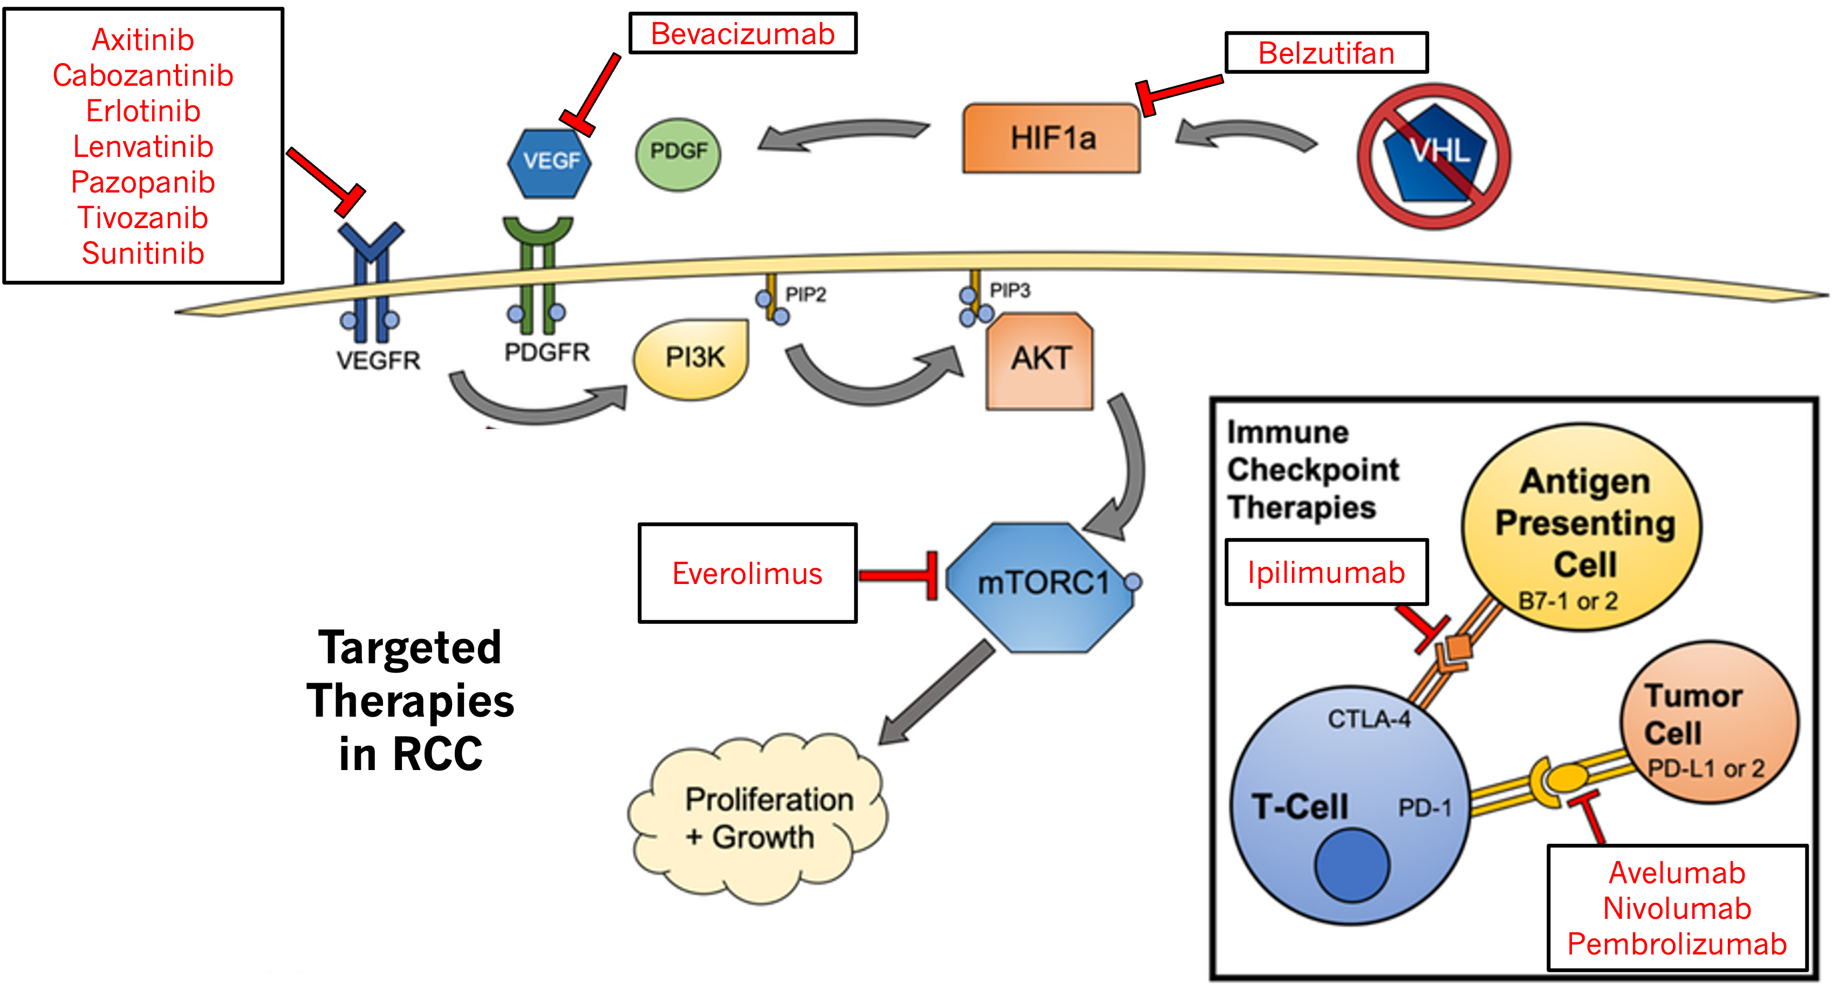
Therapies for RCC
PDGFR = platelet-derived growth factor receptor; HIF1a = hypoxia-inducible factor 1-alpha; PI3K = phosphoinositide 3-kinase;
AKT = protein kinase B; PIP2 = phosphatidylinositol biphosphate; PIP3 = phosphatidylinositol triphosphate; mTORC1 = mammalian target of rapamycin complex 1;
CTLA-4 = cytotoxic T-lymphocyte–associated antigen 4; PD-1 = programmed cell death 1; PD-L1 = programmed death ligand 1.
Figure adapted from Jones et al, 2020.
Notes:
References
Rieger PT, Green M, Murray JL. Monoclonal antibodies: applications in solid tumors and other diseases. In: Rieger PT, ed. Biotherapy: A Comprehensive Overview. 2nd ed. Sudbury, MA: Jones and Bartlett Publishers; 2001:13, 317-357.
Ross JS et al. Am J Clin Pathol. 2003;119(4):472-485.

Slide 24
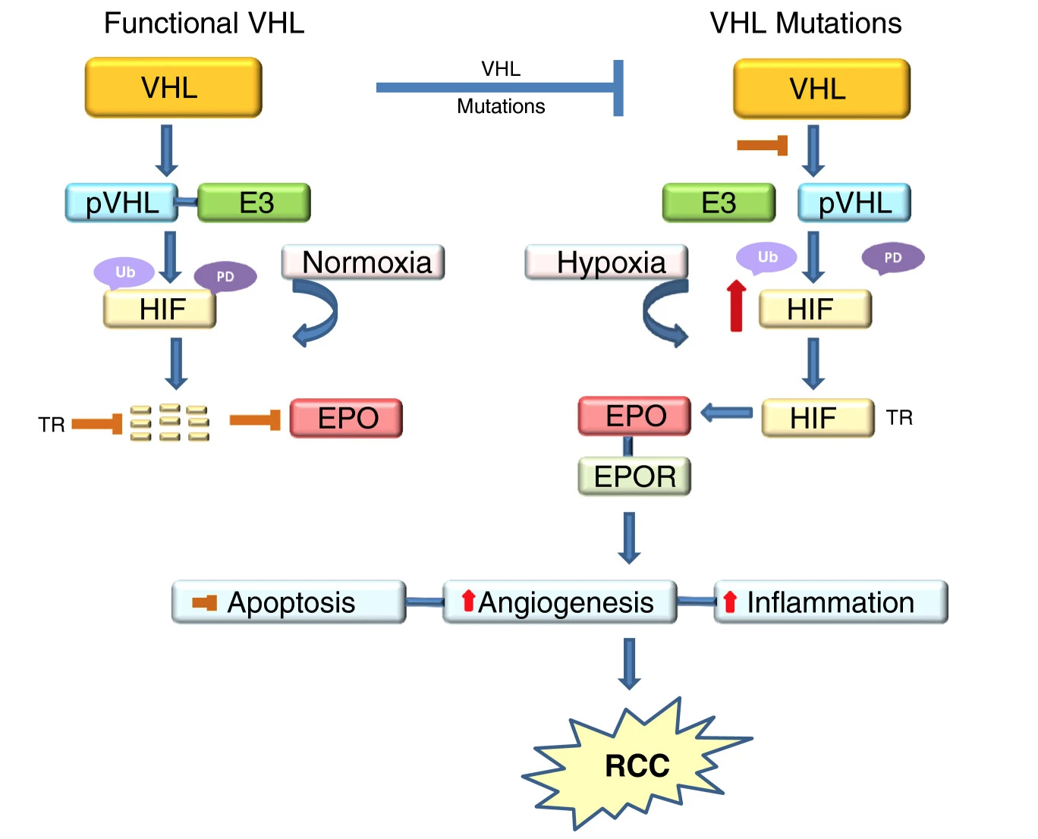
VHL Deficiency Leads to Upregulation of VEGF
Mutations in VHL cause HIF to not be degraded
More HIF causes upregulation of angiogenesis
Functional VHL helps target HIF for degradation
pVHL = protein VHL; E3 = E3 ubiquitin ligase; Ub = poly ubiquitination; PD = proteosome degradation; EPO = erythropoietin; EPOR = EPO receptor;
TR = translocation to nucleus.
Figure from Morais et al, licensed under CC BY 2.0.
Morais et al, 2013.

Slide 25
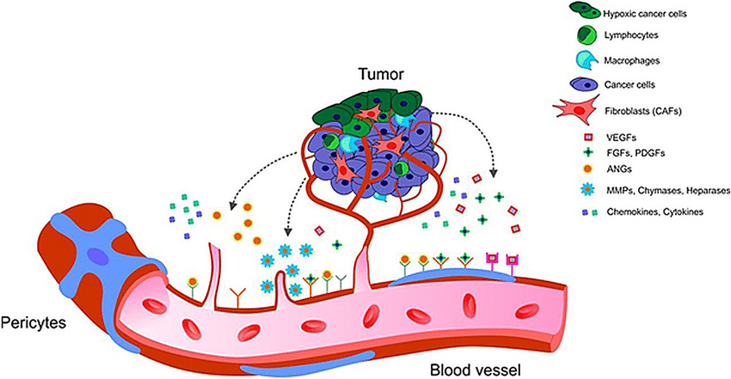
The Importance of VEGF in Angiogenesis
Binds to receptors and activates endothelial cells, inducing:
  Survival
  Proliferation
  Migration
Required for tumor growth
  Stimulates new blood vessel formation
  Promotes survival of immature vessels
  Increases vascular permeability
Tumor
VEGF
VEGF
Normal
Stroma
Angiogenesis
May also bind to VEGF receptors on tumor cells, directly stimulating their growth and survival
CAF = cancer-associated fibroblast; FGF = fibroblast growth factor; ANG = angiopoietin; MMP = matrix metalloproteinase.
Liskova et al, 2020; Yang & Cao, 2022.
Notes:
Talking Points
There are several members of the mammalian VEGF family: VEGF-A (VEGF), VEGF-B, VEGF-C, VEGF-D, and placental growth factor. Alternative splicing of a single VEGF mRNA transcript results in several isoforms, with sizes of 121, 145, 165, 189, and 206 amino acids.¹
In the adult, VEGF mediates physiologic angiogenesis during the female reproductive cycle in the uterus, ovary, and breast; in wound healing; in bone repair, and in skeletal muscle in response to exercise.¹ Thus, VEGF has effects on quiescent vasculature, which is important in regards to the adverse events that occur with anti-VEGF therapy.
Members of the VEGF ligand family bind with high-affinity and in a specific manner to three different receptor tyrosine kinases: VEGFR1, VEGFR2, and VEGFR3. All VEGF-A isoforms bind to both VEGFR1 and VEGFR2, which are co-expressed in the vascular endothelium.^{2,3}
VEGFR2, expressed by endothelial cells, is the predominant mediator of angiogenesis. VEGFR2 binding by VEGF-A causes the activation, migration, proliferation, and survival of endothelial cells that form new blood vessels within the tumor.^{2,3}
VEGF receptors have also been shown to be expressed by tumor cells; VEGF released from tumor cells may have autocrine functions, acting as a survival factor in protecting tumor cells from hypoxia, chemotherapy, and radiotherapy.⁴
While tumor cells are the primary source of VEGF, tumor-associated stromal cells (such as fibroblasts) are also important sources of VEGF.³
References
1. Maharaj AS, et al. Microvasc Res. 2007;74(2-3):100-113.
2. Cross MJ, et al. Trends Biochem Sci. 2003;28(9):488-494.
3. Ferrara N, et al. Nat Med. 2003;9(6):669-676.
4. Byrne AM, et al. J Cell Mol Med. 2005;9(4):777-794.

Slide 26
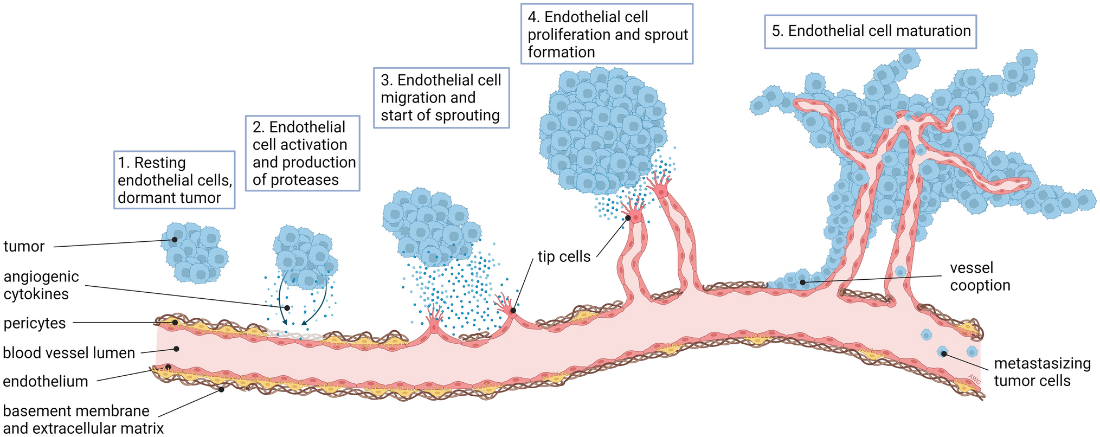

Angiogenesis Is Required for Tumor Growth
Tumors need a blood supply to grow and to metastasize
Dudley & Griffioen, 2023.
= Proangiogenic Factors = Angiogenic Inhibitors
Notes:
26
Talking Points
Angiogenesis is necessary for tumors to receive nutrients and oxygen for further growth and maintenance. Tumors smaller than 1-2 mm³ are generally avascular, and receive nutrients through diffusion or by growing near a blood vessel. As they get larger, diffusion is no longer effective in getting nutrients to the center of the tumor.
When the balance of angiogenesis shifts toward an excess of pro-angiogenic factors and a deficit of anti-angiogenic factors, angiogenesis occurs. This process is known as ‘the angiogenic switch’. With the increase in vascularization, rapid tumor growth occurs.
Vascularization of the tumor also creates a route for metastasis. Invasive tumor cells are able to detach from the primary tumor. Tumor vessels are more leaky and permeable than normal vasculature.
The observation that angiogenesis is a key determinant in malignant progression has led researchers to explore anti-angiogenic approaches in cancer treatments. We will discuss further the applicability of these approaches to cancer therapy.
References
Bergers G et al. Nat Rev Cancer. 2003;3(6):401-410.
Cross MJ, et al. Trends Biochem Sci. 2003;28(9):488-494.
Fidler IJ. Nat Rev Cancer. 2003;3(6):453-458.
Griffioen AW et al. Pharmacol Rev. 2000;52(2):237-268.
Mendelsohn J, Howley P, Liotta L, Israel M, eds. The Molecular Basis of Cancer. 2nd ed.
Philadelphia, PA: WB Saunders Co; 2001:164.

Slide 27
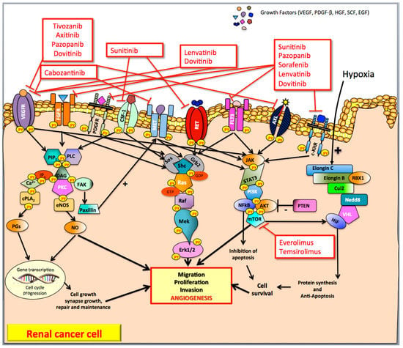
Multi-Targeted TKIs
Diverse class
Affect multiple parts of cell signaling involved in cell growth, proliferation, and angiogenesis
Often in more than 1 way through more than 1 target
If 1 isn’t working, it’s worth trying another
Ranieri et al, 2017; NCCN, 2024.

Slide 28
mTOR and mTOR Inhibition: Everolimus
Nutrients
(Glucose)
Growth Factors
mTOR is an intracellular protein
mTOR inhibition reduces:
  Cell proliferation
  Angiogenesis
  Glucose uptake
PI3K
AKT
Everolimus
mTOR
mTOR
Inhibitor
Protein Synthesis
Cell Proliferation
Glucose Uptake
Angiogenesis
Cauley, 2009.
Notes:
28
Slide ID: 27180
mTOR is an intracellular protein¹
The mTOR pathway is dysregulated in several human cancers²
mTOR inhibition reduces cell proliferation, angiogenesis, and glucose uptake²
References
1. Bjornsti MA, Houghton PJ. The TOR pathway: a target for cancer therapy. Nat Rev Cancer. 2004;4:335-348.
2. Afinitor [package insert]. East Hanover, NJ; Novartis Pharmaceuticals Corporation; 2009.

Slide 29
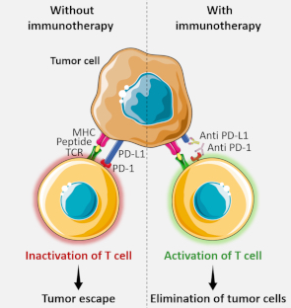
Immunotherapy Mechanism
Tumor Microenvironment
Lymph Node
MHC = major histocompatibility complex; TCR = T-cell receptor; CD = cluster of differentiation; ipi = ipilimumab.
Armezzani, 2019; Cooper et al, 2015.
.

Slide 30
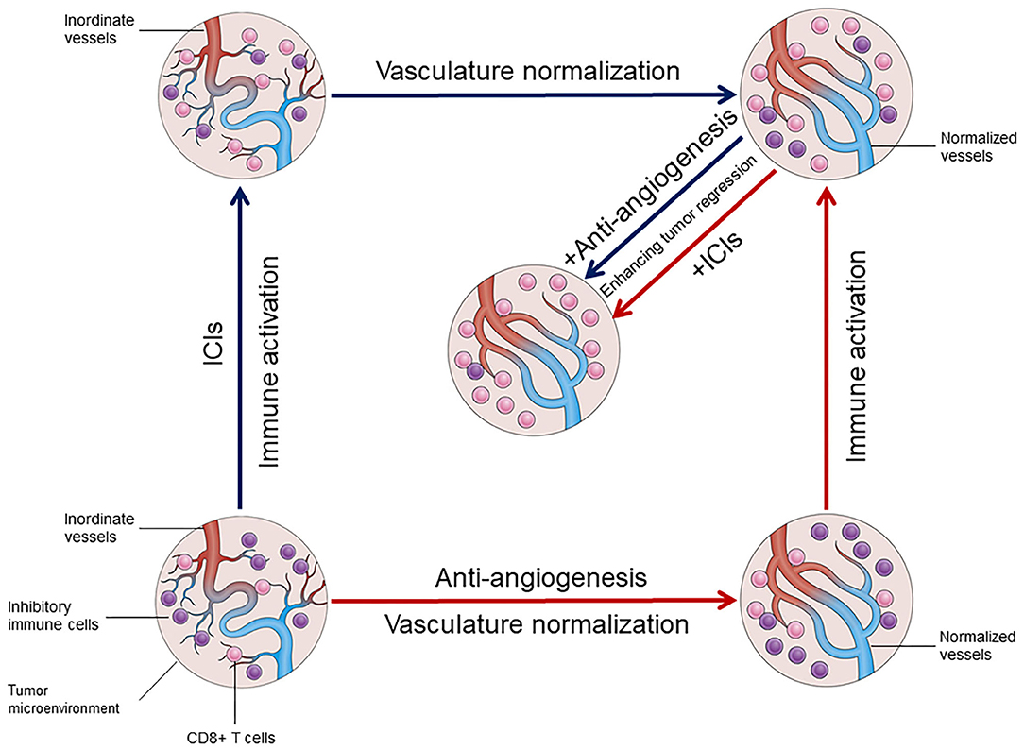
Immunotherapy + VEGF Inhibition
ICIs and VEGF inhibitors synergistically normalize the tumor microenvironment
Song et al, 2020.
Notes:
In tumor microenvironment immune cells are given a boost by the ICI therapy to help them recognize tumor cells and eliminate them> helps decrease tumor cells and make vasculature more normal

Slide 31

Case Study: Mr. DW
73-year-old male
Retired firefighter
Nonsmoker
Diagnosed 5 years ago
  Hematuria at initial presentation
  CT scan: 17-cm left kidney tumor, IVC invaded
  Radical nephrectomy
  Followed for 5 years
Current imaging: 3 spots suspicious for metastasis (liver)
  Bone scan ordered
Requires systemic therapy
CT = computed tomography; IVC = inferior vena cava.

Slide 32
Case Study: Mr. DW (cont.)
Considerations in Choosing Therapy
Metastatic renal cell carcinoma
  Intermediate risk
PMH
  Crohn’s disease (2013)
    Treatment history: budesonide, adalimumab, infliximab
    Controlled on vedolizumab Q8W x2 years (current)
  Hypertension
    Controlled on amlodipine 10 mg daily
PMH = past medical history; Q8W = every 8 weeks.

Slide 33
Case Study: Mr. DW (cont.)
Choosing First-Line Treatment
Treatment planning
First-line therapy
  TKI + ICI combination
Clinical decision making
  Comorbidity considerations
  Multidisciplinary approach
  Role of the pharmacist

Slide 34
Case Study: Mr. DW (cont.)
How Will His Comorbidities Affect His Care?
Impact of comorbidities
  Concerns
    Autoimmune flare
    Appropriate candidate or not
    HTN 143/70
  HCP monitoring
    Group effort!
    Multidisciplinary approach
Treatment plan: axitinib plus pembrolizumab
    Axitinib 5 mg PO BID plus pembrolizumab 200 mg IV Q21 days
HTN = hypertension; HCP = healthcare provider; PO = orally; BID = twice a day; IV = intravenously; Q21 = every 21 days.

Slide 35
Case Study: Mr. DW (cont.)
What Would You Do?
Mr. DW is a 73-year-old man receiving pembrolizumab/axitinib for the last 3 months. Which of these drugs is well-known for a class side effect of diarrhea?
  Axitinib
  Pembrolizumab
  Axitinib and pembrolizumab
  Neither, this is disease-related

Slide 36
Case Study: Mr. DW (cont.)
What Would You Do?
Mr. DW is a 73-year-old man receiving pembrolizumab/axitinib for the last 3 months. Which of these drugs is well known for a class side effect of diarrhea?
  Axitinib
  Pembrolizumab
  Axitinib and pembrolizumab
  Neither, this is disease-related

Slide 37
Case Study: Mr. DW (cont.)
How to Prevent AEs and IRAEs
Pre-existing Crohn's disease
  Continued multidisciplinary management with gastroenterologist
  Frequency of visits per gastroenterologist
Following 12 weeks of therapy, no change in bowel function
  Change frequency of pembrolizumab administration to Q6W
  Continued controlled HTN
AEs = adverse events; IRAEs = immune-related adverse events; Q6W = every 6 weeks.

Slide 38
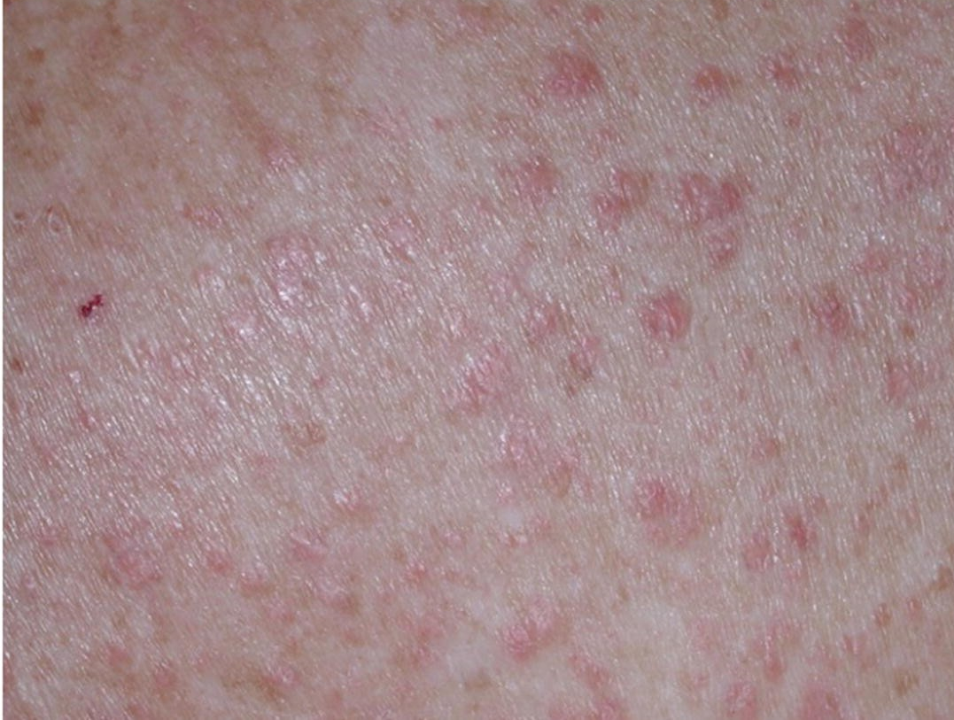
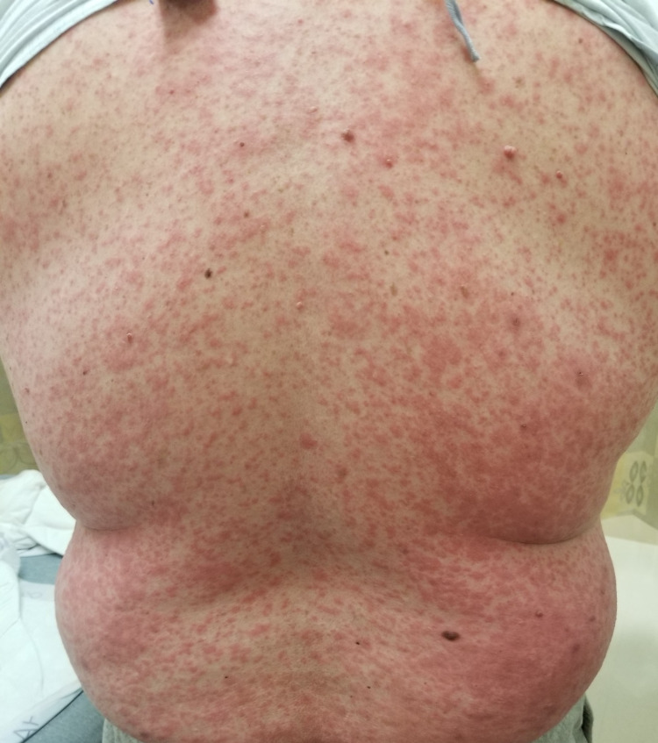
Case Study: Mr. DW (cont.)
Mr. DW Develops Rash
Rash
  Patient has been on Q6W pembro for 18 weeks
  Patient calls with new onset of rash
  Patient seen in clinic
Assessment
  Symptoms
  Patient interventions
Management
  Consider both axitinib and pembrolizumab
  Hold axitinib and pembrolizumab
  Consider topical, systemic steroids if no improvement
  with topical steroid cream, and/or oral antipruritic
  Dermatology consult (biopsy)
  Anticancer regimen management
VEGF inhibitor (sunitinib)–associated rash
ICI (pembrolizumab)–associated rash
Grávelos et al, 2018; Thomas et al, 2022.

Slide 39
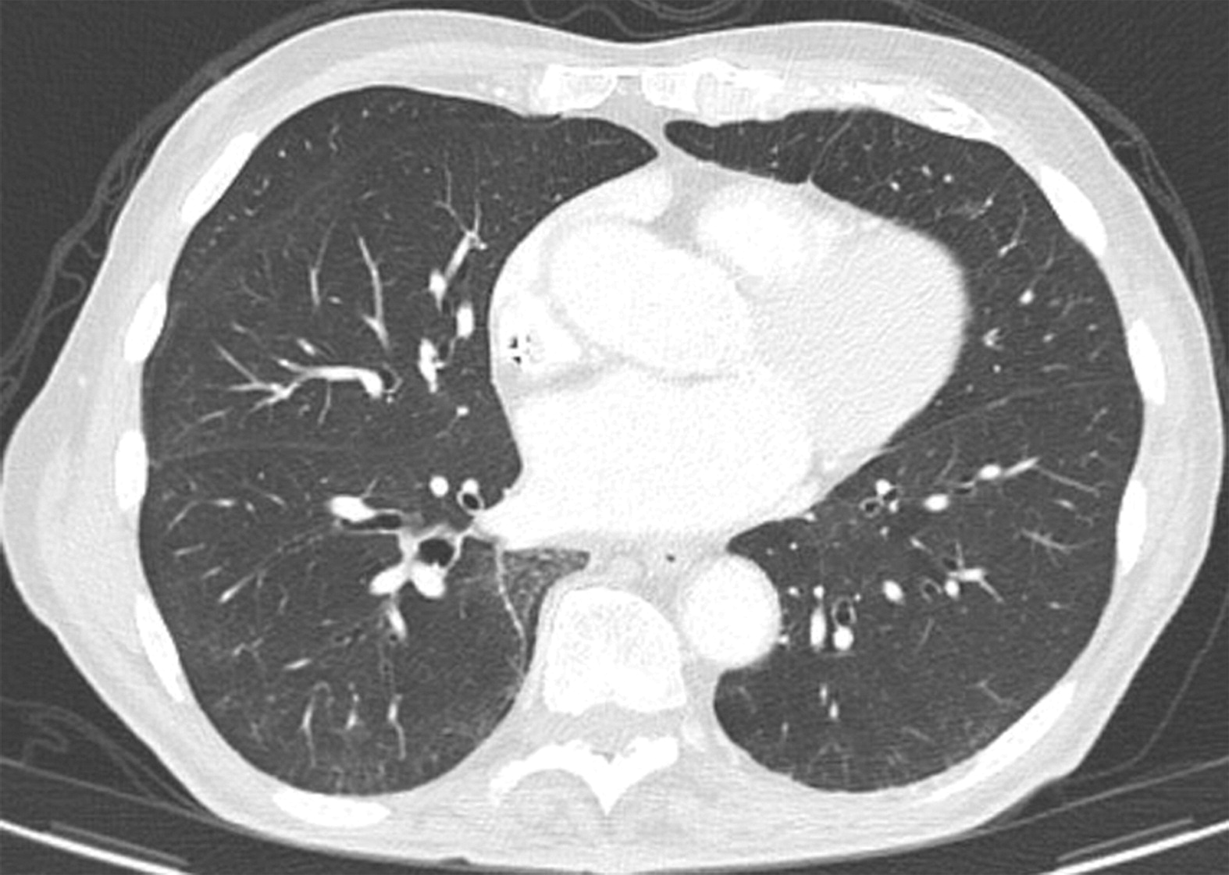
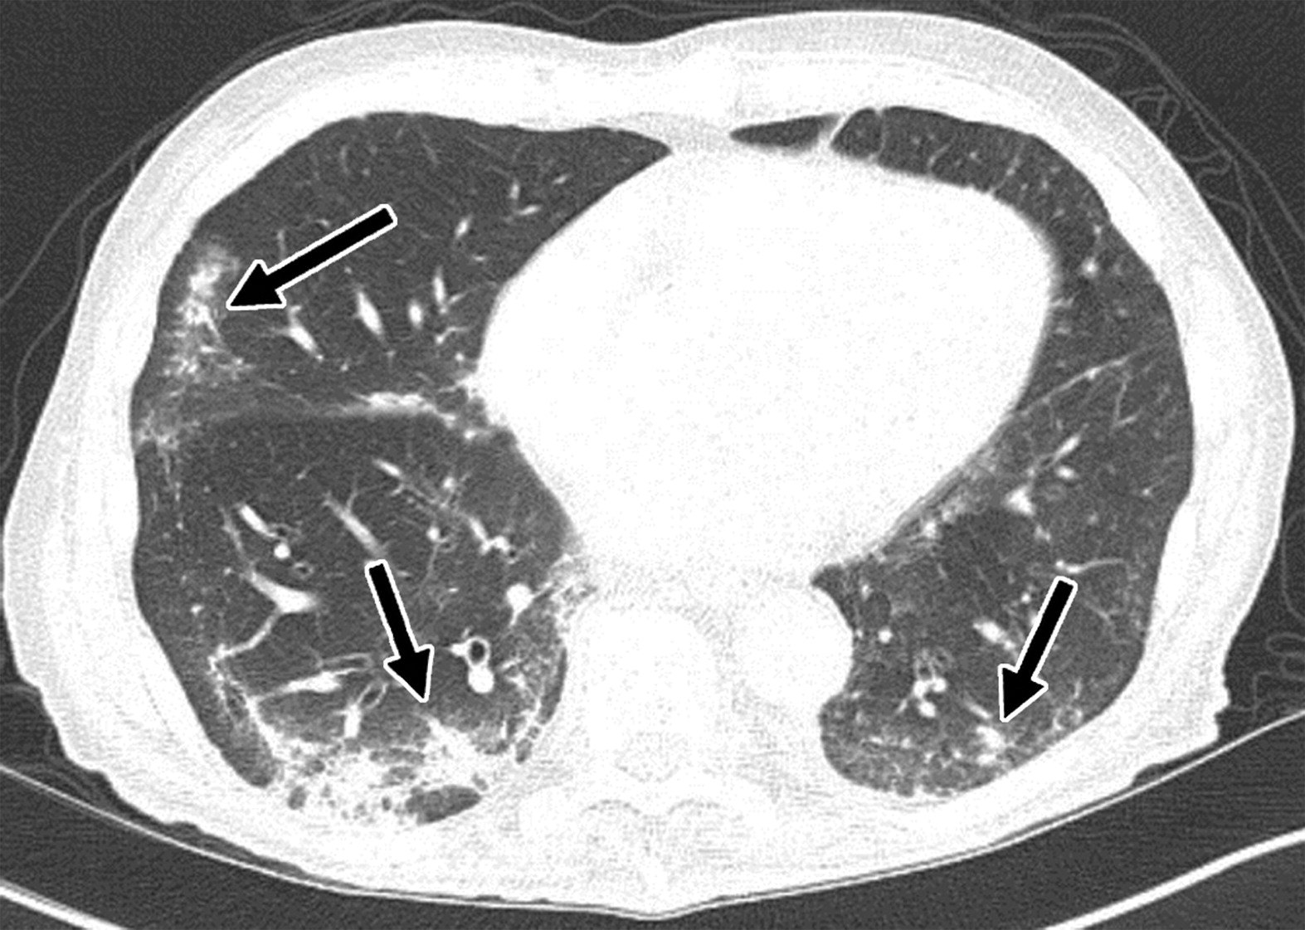
Case Study: Mr. DW (cont.)
Mr. DW Develops Interstitial Lung Disease (ILD)
After 9 months, he develops shortness of breath on exertion
New ground-glass opacities on imaging
Kalisz et al, 2019.

Slide 40
Case: Mr. DW (cont.)
What Would You Do?
Mr. DW is a 73-year-old man with pneumonitis. He has shortness of breath and mild cough. He’s been on pembrolizumab + axitinib for the last 9 months. What is the course of action for this AE?
  Hold axitinib and continue pembrolizumab
  Hold pembrolizumab and continue axitinib
  Hold pembrolizumab and axitinib
  Hold pembrolizumab and axitinib and start corticosteroids until resolution of pneumonitis
  Continue both drugs. It will resolve by itself

Slide 41
Case: Mr. DW (cont.)
What Would You Do?
Mr. DW is a 73-year-old man with pneumonitis. He has shortness of breath and mild cough. He’s been on pembrolizumab + axitinib for the last 9 months. What is the course of action for this AE?
  Hold axitinib and continue pembrolizumab
  Hold pembrolizumab and continue axitinib
  Hold pembrolizumab and axitinib
  Hold pembrolizumab and axitinib and start corticosteroids until resolution of pneumonitis
  Continue both drugs. It will resolve by itself

Slide 42
Interstitial Lung Disease
Pembrolizumab/Axitinib for Metastatic RCC
Phase 3 trial results:
  12 cases (2.8%) of interstitial lung disease, including a fatality
  Some patients may be asymptomatic, with infiltrates detected on CT or X-ray
  Others present with dyspnea, cough, hypoxia
  Some required discontinuation of treatment and/or treatment with corticosteroids and/or antibiotics
  Some patients may continue treatment without additional intervention
Recommendations:
  Patient should be advised to report promptly any new or worsening
  respiratory systems
  Monitor for symptoms or radiographic changes of interstitial lung disease
  If interstitial lung disease is suspected, discontinue TKI/IO and consider use of corticosteroids and/or antibiotics
Rini et al, 2019; Leucht et al, 2022.
Notes:
TORISEL PI/12/B
TORISEL PI/6/C
TORISEL PI/7/A
TORISEL PI/1/A

Slide 43
Managing Overlapping AEs of IO and TKI
If you are unsure if a reaction is related to the ICI or the TKI, discontinue the TKI and ICI
Quick improvement: AE may be due to TKI, dependent on TKI half-life
  Axitinib (2.5-6.1 hours); cabozantinib (110 hours); lenvatinib (28 hours)
Type and severity of AE and patient’s condition should be considered when deciding for or against corticosteroid therapy for a potential IRAE
  Quick improvement on corticosteroids: AE may be due to immunotherapy
  Consider other possible diagnoses as erroneous diagnosis of IRAE could lead to nonessential discontinuation of ICI
Leucht et al, 2022.

Slide 44
IRAE Monitoring and Management
ICI Therapy for Metastatic RCC
IRAEs and management
  Organ toxicity
    Liver, endocrine system, gastrointestinal tract, skin (LEGS)
    Occurrence is LEGS in reverse
  Monitoring
    Laboratory and physical assessments
    Scheduled toxicity checks
  Management
    Hold/interrupt
    Immunosuppressants
    Multidisciplinary management
Leucht et al, 2022.

Slide 45
TKI Adverse Event Monitoring and Management
TKI therapy (VEGF inhibitors) important considerations
  AEs:
    Cardiovascular: hypertension, hemorrhage, impaired healing
    Dermatological: rash, PPE
    Gastrointestinal: nausea, vomiting, diarrhea, stomatitis
    Other: proteinuria, hepatotoxicity
  Monitoring
    Laboratory and physical assessments
    Scheduled toxicity checks
  Management
    Hold/interrupt
    Dose reduction
    Multidisciplinary management: cardio, gastrointestinal, endocrinology
PPE = palmar-plantar erythrodysesthesia.
Inlyta® prescribing information, 2024; Cabometyx® prescribing information, 2024; Lenvima® prescribing information, 2024.
Notes:
Axitinib (Inlyta) [package insert]. New York, NY: Pfizer, Inc.; June, 2020, Cabozantinib (Cabometyx) [package insert]. Alameda, CA: Exelixis, Inc; July, 2022, Lenvatinib (Lenvima) [package insert]. Woodcliff Lake, NJ: Eisai Inc.; December, 2021

Slide 46
Key Nursing Actions for Patients Taking TKIs
Provide patient education
  Assess level of understanding of treatment plan
Analyze concomitant medications
Review treatment plan
Assess potential side effects
  Assess side effects from current and/or prior therapy
  Assess for hypertension, thrombotic events, cardiac dysfunction, others depending on agent used
  Review laboratory values, especially LFTs, TSH, urine protein, others depending on agent
LFT = liver function test; TSH = thyroid-stimulating hormone.
Inlyta® prescribing information, 2022; Cabometyx® prescribing information, 2023; Lenvima® prescribing information, 2024.
Notes:
Oncology nurses must be prepared to manage patients receiving TORISEL.
They should be prepared to assess a patient’s level of understanding of the treatment plan and to provide appropriate patient education.
They should be prepared to analyze a patient’s concomitant medications in order to avoid or minimize interactions with TORISEL.
They should understand the importance of premedication for patients in order to avoid or minimize hypersensitivity reactions.
They should be prepared to assess a patient’s potential side effects
From current and/or prior therapy
Affecting the pulmonary system
As reflected in laboratory values
References:
1. Camp-Sorrell D, Hawkins RA. Introduction. The role of the advanced practice nurse in cancer care. In: Camp-Sorrell D., Hawkins RA, eds. Clinical Manual for the Oncology Advanced Practice Nurse. 2nd ed. Pittsburgh, PA: Oncology Nursing Society;2006:3-10.
2. TORISEL (temsirolimus) [package insert]. Madison, NJ: Wyeth Pharmaceuticals;2007.
1/Camp-Sorrell/9/A
2/TORISEL PI/3/D,5/B
1/Camp-Sorrell/9/A; 2/TORISEL PI/
10-11/Table 1; 12/Table 2
2/TORISEL PI/20/A; 3/F
Camp-Sorrell/9/A
TORISEL PI/20/A;3/F
TORISEL PI/3/D,5/B
Camp-Sorrell/9/A; TORISEL PI/
10-11/Table 1; 12/Table 2

Slide 47
Axitinib/Pembrolizumab in Specific Populations
Pregnancy category D
  Women of childbearing age should be advised of the potential hazard to the fetus and to avoid becoming pregnant
  Women and men of childbearing age or potential should use contraception during and up to 1 week after last dose of axitinib; women of childbearing potential should use contraception during and up to 4 months after last dose of pembrolizumab
Hepatic elimination: predominant pathway
  Dose reduction is required for moderate hepatic impairment; severe hepatic impairment has not been studied (axitinib)
Renal impairment
  No dose adjustment recommended for patients with impaired renal function (axitinib)
Keytruda® prescribing information, 2024; Inlyta® prescribing information, 2022.
Notes:
See package insert for full details about precautions.
Reference:
1. TORISEL (temsirolimus) [package insert]. Madison, NJ: Wyeth Pharmaceuticals;2007.
1/TORISEL PI/13-14/A
TORISEL PI/8/C
TORISEL PI/14/B
TORISEL PI/13/C
TORISEL PI/1/C
TORISEL PI/8/C

Slide 48
Case Study: Mr. DW (cont.)
Relapse
After 2 years, imaging found progression of disease with 2 liver masses and bone metastases

Slide 49
Case Study: Mr. DW (cont.)
What Would You Do?
What is an appropriate next line of therapy after progression of disease?
  Chemotherapy
  Nivolumab/ipilimumab
  Belzutifan
  Temsirolimus

Slide 50
Case Study: Mr. DW (cont.)
What Would You Do?
What is an appropriate next line of therapy after progression of disease?
  Chemotherapy
  Nivolumab/ipilimumab
  Belzutifan
  Temsirolimus

Slide 51
Case Study: Mr. DW (cont.)
Next line of therapy: belzutifan 120 mg PO daily
What education does Mr. DW need about side effects?

Slide 52
Belzutifan AE Monitoring and Management
Anemia
  Monitoring
    Before initiating and periodically throughout therapy
  Management
    Transfusion as clinically indicated
    For patients with hemoglobin <8 g/dL, withhold dose until ≥8 g/dL, then resume at same or reduced dose or discontinue
    For patients with life-threatening anemia or requiring urgent intervention, withhold until resolved and resume at reduced dose or discontinue
WeliregTM prescribing information, 2023.

Slide 53
Belzutifan AE Monitoring and Management (cont.)
Hypoxia
  Monitoring
    Before initiation and periodically throughout therapy
    Advise patients to report signs and symptoms of hypoxia
  Management
    For patients with pulse oximeter <88% with exercise, consider withholding until resolved and resume at same or reduced dose
    For patients with pulse oximeter <88% at rest or urgent intervention indicated, withhold until resolved and resume at reduced dose or discontinue
    For patients with life-threatening or recurrent symptomatic hypoxia, discontinue
WeliregTM prescribing information, 2023.

Slide 54
Best Practices
Counseling: patient and caregiver education
  Patient/caregiver
    Self-monitoring, important numbers
  Treatment team
    Assessment tools
    Pharmacy in-service
  Wallet card
Patient concerns and financial support (pharmacist)
  Reimbursement and prior authorization
  Guideline recommendations
  Oral chemotherapy aspect
    Coordination with specialty pharmacy
      Internal or external
Slide courtesy of Nazy Zomorodian, NP, RNC, MSN, CUNP, CCRC.

Slide 55
Key Takeaways
Personalized medicine to fit patient profile
Efficient management of AEs is key to continuing treatment
Educate the providers, patients, and caregivers
Explore all the options recommended by the NCCN, AUA, and ASCO
It’s never too late to learn, teach, and welcome technology and new treatments into our practice
AUA = American Urological Association; ASCO = American Society of Clinical Oncology.

Slide 56

Scan now to complete the posttest and evaluation
Thank you joining us!
Scan the QR code to complete the posttest and evaluation OR fill out the paper assessment and evaluation included in your conference bag.
To scan the QR code:
FOR IPHONE:
Open the camera & focus it to QR code
Your internet browser should pop up with a link
Click the link and complete
FOR ANDROID:
Open the camera & focus it to QR code
Hold ‘Home’ button
The pretest comes visible to complete

Slide 57

Let’s Change Treatment

Slide 58
References
Albiges L, Rini BI, Peltola K, et al (2023). Belzutifan versus everolimus in participants (pts) with previously treated advanced clear cell renal cell carcinoma (ccRCC): randomized open-label phase III LITESPARK-005 study. Ann Oncol, 34(suppl_2):S1329-S1330. DOI:10.1016/j.annonc.2023.10.090
Amin MB, Edge S, Green F, et al (2017). AJCC Cancer Staging Manual. 8th ed. New York, NY: Springer International Publishing
Apolo AB, Powles T, Burotto M, et al (2021). Nivolumab plus cabozantinib (N+C) versus sunitinib (S) for advanced renal cell carcinoma (aRCC): outcomes by baseline disease characteristics in the phase 3 CheckMate 9ER trial. J Clin Oncol, 39(suppl_15). Abstract 4553. DOI:10.1200/JCO.2021.39.15_suppl.455
Armezzani A (2019). Immune checkpoint inhibitors: as strategy to tackle cancer? Available at: https://www.genoway.com/commentaries/comment-icp.htm
Cabometyx® (cabozantinib) prescribing information (2024). Exelixis, Inc. Available at: labels.fda.gov
Cauley DH (2019) Newly approved mTOR inhibitors for the treatment of metastatic renal cell carcinoma. US Pharm, 34(11):HS-20-HS-26.
Choueiri TK, Escudier B, Powles T, et al (2015). Cabozantinib versus everolimus in advanced renal-cell carcinoma. New Engl J Med, 373:1814-1823. DOI:10.1056/NEJMoa1510016
Choueiri TK, Hessel C, Halabi S, et al (2018). Cabozantinib versus sunitinib as initial therapy for metastatic renal cell carcinoma of intermediate or poor risk (Alliance A031203 CABOSUN randomised trial): progression-free survival by independent review and overall survival update. Eur J Cancer, 94:115-125. DOI:10.1016/j.ejca.2018.02.012
Choueiri TK, Kluger H, George S, et al (2022). FRACTION-RCC: nivolumab plus ipilimumab for advanced renal cell carcinoma after progression on immuno-oncology therapy. Journal for ImmunoTherapy of Cancer, 10:e005780. DOI:10.1136/jitc-2022-005780
Choueiri TK, Powles T, Burotto M, et al (2021). Nivolumab plus cabozantinib versus sunitinib for advanced renal cell carcinoma. N Engl J Med, 384:829-841. DOI:10.1056/NEJMoa2026982
Cooper AJ, Carlino MS & Kefford RF (2015). Immune checkpoint inhibitors in melanoma. Future Medicine, 2(3):267-284.
Dizman N, Austin M, Considine B, et al (2023). Outcomes with combination pembrolizumab and axitinib in second and further line treatment of metastatic renal cell carcinoma. Clin Genitourin Cancer, 21(2):221-229. DOI:10.1016/j.clgc.2023.01.002
Dudley AC & Griffioen AW (2023). Pathological angiogenesis: mechanisms and therapeutic strategies. Angiogenesis, 26:313-347. DOI:10.1007/s10456-023-09876-7

Slide 59
References (cont.)
Grávelos C, Sanmartín O, Gúrpide A, et al (2019). Clinical management of cutaneous adverse events in patients on targeted anticancer therapies and immunotherapies: a national consensus statement by the Spanish Academy of Dermatology and Venereology and the Spanish Society of Medical Oncology. Clin Translational Oncology, 21:556-571. DOI:10.1007/s12094-018-1953-x
Heng DYC, Xie W, Regan MM, et al (2009). Prognostic factors for overall survival in patients with metastatic renal cell carcinoma treated with vascular endothelial growth factor-target agents: results from a large, multicenter study. J Clin Oncol, 27(34):5794-5799. DOI:10.1200/JCO.2008.21.4809
Inlyta® (axitinib) prescribing information (2024). Pfizer laboratories Div Pfizer Inc. Available at: labels.fda.gov
Jones TM, Carew JS & Nawrocki ST (2020). Therapeutic targeting of autophagy for renal cell carcinoma therapy. Cancers (Basel), 12(5):1185. DOI:10.3390/cancers12051185
Kalisz KR, Ramaiya NH, Lakamp KR & Gupta A (2019). Immune checkpoint inhibitor therapy-related pneumonitis: patterns and management. RadioGraphics, 39:1923-1937. DOI:10.1148/rg.2019190036
Keytruda® (pembrolizumab) prescribing information (2024) Merck Sharp & Dohme LLC. Available at: labels.fda.gov
Lee CH, Shah AY, Rasco D, et al (2021). Lenvatinib plus pembrolizumab in patients with either treatment-naïve or previously treated metastatic renal cell carcinoma (Study 111/KEYNOTE-146): a phase 1b/2 study. Lancet Oncol, 22(7):946-958. DOI:10.1016/S1470-2045(21)00241-2
Lenvima® (lenvatinib) prescribing information (2024). Eisai Inc. Available at: labels.fda.gov
Leucht K, Ali N, Foller S & Grimm MO (2022). Management of immune-related adverse events from immune-checkpoint inhibitors in advanced or metastatic renal cell carcinoma. Cancers (Basel), 14(18):4369. DOI:10.3390/cancers14184369
Linehan WM, Walther MM & Zbar B (2003). The genetic basis of cancer of the kidney. J Urol, 170(6 pt 1):2163-2172. DOI:10.1097/01.ju.0000096060.92397.ed
Linehan WM, Pinto PA, Bratslavsky G, et al (2009). Hereditary kidney cancer. Cancer, 115(S10):2252-2261. DOI:10.1002/cncr.24230
Linehan WM (2012). Genetic basis of kidney cancer: role of genomics for the development of disease-based therapeutics. Genome Res, 22(11):2089-2100. DOI:10.1101/gr.131110.111
Liskova A, Koklesova L, Samec M, et al (2020). Implications of flavonoids as potential modulators of cancer neovascularity. J Cancer Res and Clin Oncol, 146:3079-3096. DOI:10.1007/s00432-020-03383-8

Slide 60
References (cont.)
Minasian LM, Motzer RJ, Gluck L, et al (1993). Interferon alfa-2a in advanced renal cell carcinoma: treatment results and survival in 159 patients with long-term follow-up. J Clin Oncol, 11(7):1368-1375. DOI:10.1200/JCO.1993.11.7.1368
Moch H, Amin MB, Berney DM, et al (2022). The 2022 World Health Organization Classification of tumors of the urinary system and male genital organs —Part A: renal, penile and testicular tumors. Eur Urol, 82(5):458-468. DOI:10.1016/j.eururo.2022.06.016
Morais C, Johnson DW, Vesey DA & Gobe GC (2013). Functional significance of erythropoietin in renal cell carcinoma. BMC Cancer, 13:14. DOI:10.1186/1471-2407-13-14
Motzer R, Alekseev B, Rha SY, et al (2021). Lenvatinib plus pembrolizumab or everolimus for advanced renal cell carcinoma. N Engl J Med, 384:1289-1300. DOI:10.1056/NEJMoa2035716
Motzer RJ, Bacik J, Mariani, et al, (2002). Treatment outcome and survival associated with metastatic renal cell carcinoma of non-clear-cell histology. J Clin Oncol, 20(9):2376-2381. DOI:10.1200/JCO.2002.11.123.
Motzer RJ, Bacik J, Schwartz LH, et al (2004). Prognostic factors for survival in previously treated patients with metastatic renal cell carcinoma. J Clin Oncol, 22(3):454-463. DOI:10.1200/JCO.2004.06.132
Motzer RJ, Bander NH & Nanus DM (1996). Renal-cell carcinoma. N Engl J Med, 335(12):865-875. DOI:10.1056/NEJM199609193351207
Motzer RJ, Escudier B, George S, et al (2020). Nivolumab versus everolimus in patients with advanced renal cell carcinoma: updated results with long-term follow-up of the randomized, opel-label, phase 3 CheckMate 025 trial. Cancer, 126(18):4156-4167. DOI:10.1002/cncr.33033
Motzer JR, Escudier B, Tomczak P, et al (2013). Axitinib versus sorafenib as second-line treatment for advanced renal cell carcinoma: overall survival analysis and updated results from a randomized phase 3 trial. Lancet Oncol, 14(6):552-562. DOI:10.1016/S1470-2045(13)70093-7
Motzer RJ, Hutson TE, Glen H, et al (2015). Lenvatinib, everolimus, and the combination in patients with metastatic renal cell carcinoma: a randomised, phase 2, open-label, multicentre trial. Lancet Oncol, 16(15):1473-1482. DOI:10.1016/S1470-2045(15)00290-9
Motzer RJ, Porta C, Eto M, et al (2024). Lenvatinib plus pembrolizumab versus sunitinib in first-line treatment of advanced renal cell carcinoma: final prespecified overall survival analysis of CLEAR, a phase III study. J Clin Oncol, 42(11):1222-1228. DOI:10.1200/JCO.23.01569

Slide 61
References (cont.)
Motzer RJ, Tannir NM, McDermott DF, et al (2018). Nivolumab plus ipilimumab versus sunitinib in advanced renal-cell carcinoma. N Engl J Med, 378:1277-1290. DOI:10.1056/NEJMoa1712126
National Comprehensive Cancer Network (2024). Clinical Practice Guidelines in Oncology: kidney cancer. Version 1.2025. available at: https://www.nccn.org/guidelines/guidelines-detail?category=1&id=1440
Ranieri G, Marech I, Asabella AN, et al (2017). Tyrosine-kinase inhibitors therapies with mainly anti-angiogenic activity in advanced renal cell carcinoma: value of PET/CT in response evaluation. Int J Mol Sci, 18(9):1937. DOI:10.3390/ijms18091937
Rini BI, Pal SK, Escudier BJ, et al (2020). Tivozanib versus sorafenib in patients with advanced renal cell carcinoma (TIVO-3): a phase 3, multicentre, randomised, controlled, open-label study. Lancet Oncol, 21(1):95-104. DOI:10.1016/S1470-2045(19)30735-1
Rini BI, Plimack ER, Stus V, et al (2019). Pembrolizumab plus axitinib versus sunitinib for advanced renal-cell carcinoma. N Engl J Med, 380:1116-1127. DOI:10.1056/NEJMoa1816714
Saint John’s Cancer Institute (2024). Kidney cancer: symptoms, risk factors, diagnosis, stages, and treatment. Available at: https://www.saintjohnscancer.org/urology/conditions/kidney-cancer/
Schuch et al (2023). State-of-the-art lecture: histologic subtypes in renal cell carcinoma: comparing and contrasting different treatment pathways/options. Presented at the 2023 American Urological Association (AUA) Annual Meeting.
Siegel RL, Giaquinto AN & Jemal A (2024). Cancer Statistics, 2024, CA Cancer J, 74(1):12-49. DOI:10.3322/caac.21820
Song Y, Fu Y, Xie Q, et al (2020). Anti-angiogenic agents in combination with immune checkpoint inhibitors: a promising strategy for cancer treatment. Front Immunol, 11:1956. DOI:10.3389/fimmu.2020.01956
Surveillance, Epidemiology, and End Results (2024). Cancer stat facts: kidney and renal pelvis cancer. Available at: https://www.seer.cancer.gov/statfacts
Thomas M, Wazir A & Poudel A (2022). Pembrolizumab-induced acute skin reaction: a case report and review of literature. Cureus, 14(6):e26143. DOI:10.7759/cureus.26143
WeliregTM (belzutifan) prescribing information (2023). Merck & Co., Inc. Available at: labels.fda.gov

Slide 62
References (cont.)
Yang S, Yang X, Hou Z, et al (2024). Rationale for immune checkpoint inhibitors plus targeted therapy for advanced renal cell carcinoma. Heliyon, 10(4):e29215. DOI:10.1016/j.heliyon.2024.e29215
Yang Y & Cao Y (2022). The impact of VEGF on cancer metastasis and systemic disease. Sem Cancer Biol, 86(3):251-261. DOI:10.1016/j.semcancer.2022.03.011
Yoo M, Nelson RE, Cutshall Z, et al (2023). Cost-effectiveness analysis of six immunotherapy-based regimens and sunitinib in metastatic renal cell carcinoma: a public payer perspective. JCO Oncol Pract, 19(3):e449-e456. DOI:10.1200/OP.22.00447

