Slide 1

Bob Wilkinson
Mission Support Alliance
September 12, 2019

Slide 2


Hanford Essential Services
Integrated
Services
COST AVOIDANCE / SAVINGS
Payroll, Pensions, Small Business Utilization
Portfolio Management
Supply Chain & Warehouse
Business Management System
Integration and Interface
$1.5B Savings to date
2023: 576K
Original
Baseline
FREIGHT ITEMS
PER YEAR
2023: 8 Apps
2018: 192K
BMS EFFICIENCY
ALIGNMENT
2019: 50 Apps
Notes:
MSA contract exists to enable Hanford cleanup contractors through right-sized and prioritized essential services using a integrated service delivery model
Delivering right-sized and prioritized services using a service delivery model
Enables cleanup contractors to focus on cleanup
Integrates contractors needs
Rapid, efficient and flexible delivery of services
Identifies solutions to maximize effective mission outcomes
Reduces costs, improves service delivery, and shows transparent costs
Consolidates overall services footprint
Achieved 100s of upgrades while right-sizing processes which achieved $1.5B in savings and avoidance

Slide 3
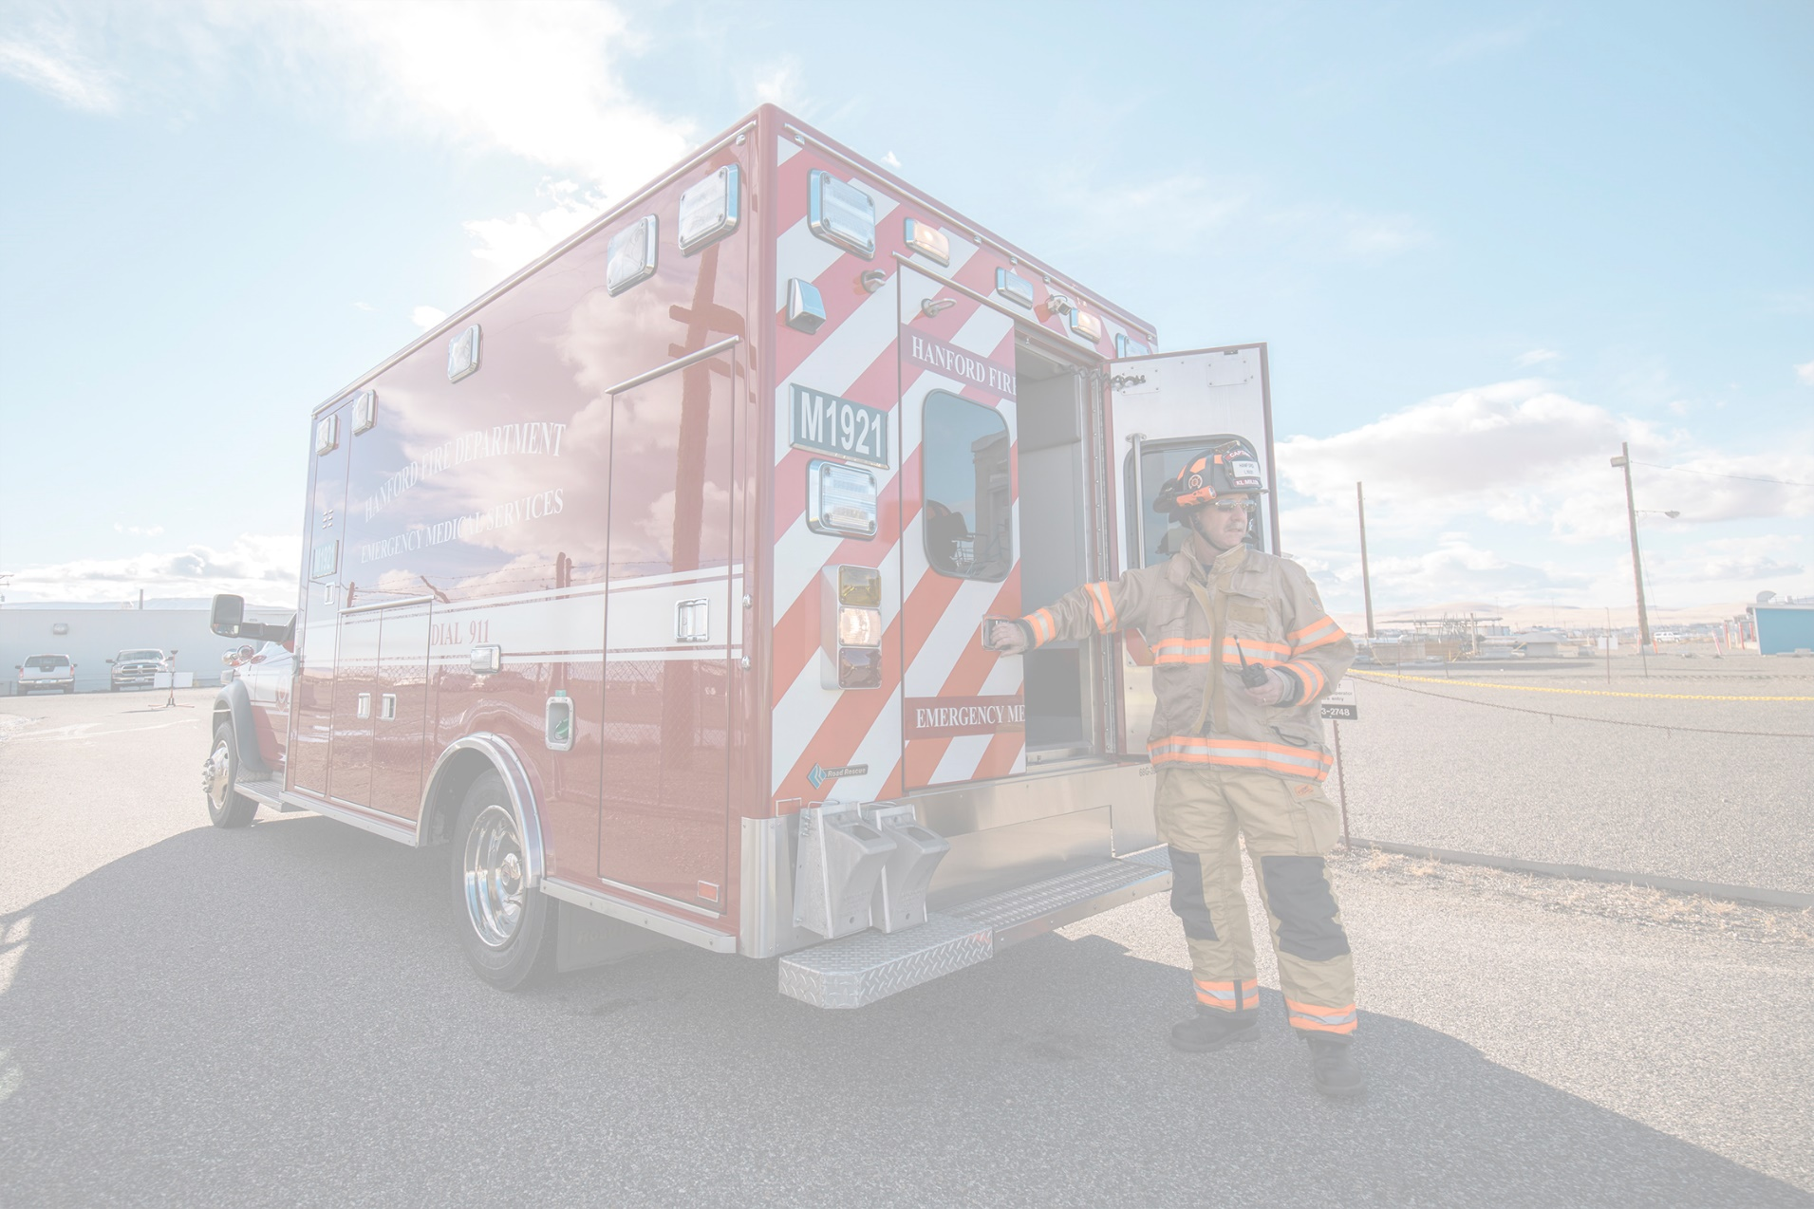

Hanford Essential Services
Support
Services
SCBA BOTTLES
FILLED
Emergency Response
Site Security
Sitewide Craft Services
Environmental Services
Sitewide Training
Fleet
Crane and Rigging
Meteorology
Fire System Maintenance
Project/Construction Services
2018: 110K
2020: 110K
2015: 51K
FUEL IN
GALLONS
2020: 2.1M
2024: 34K
2018: 1M
ACRES OF
WEED CONTROL
2019: 10K
2022: 150K
STUDENT
TRAINING DAYS
2018: 50K
Notes:
MSA contract exists to enable Hanford cleanup contractors through right-sized and prioritized essential services using a integrated service delivery model
Delivering right-sized and prioritized services using a service delivery model
Enables cleanup contractors to focus on cleanup
Integrates contractors needs
Rapid, efficient and flexible delivery of services
Identifies solutions to maximize effective mission outcomes
Reduces costs, improves service delivery, and shows transparent costs
Consolidates overall services footprint
Achieved 100s of upgrades while right-sizing processes which achieved $1.5B in savings and avoidance

Slide 4
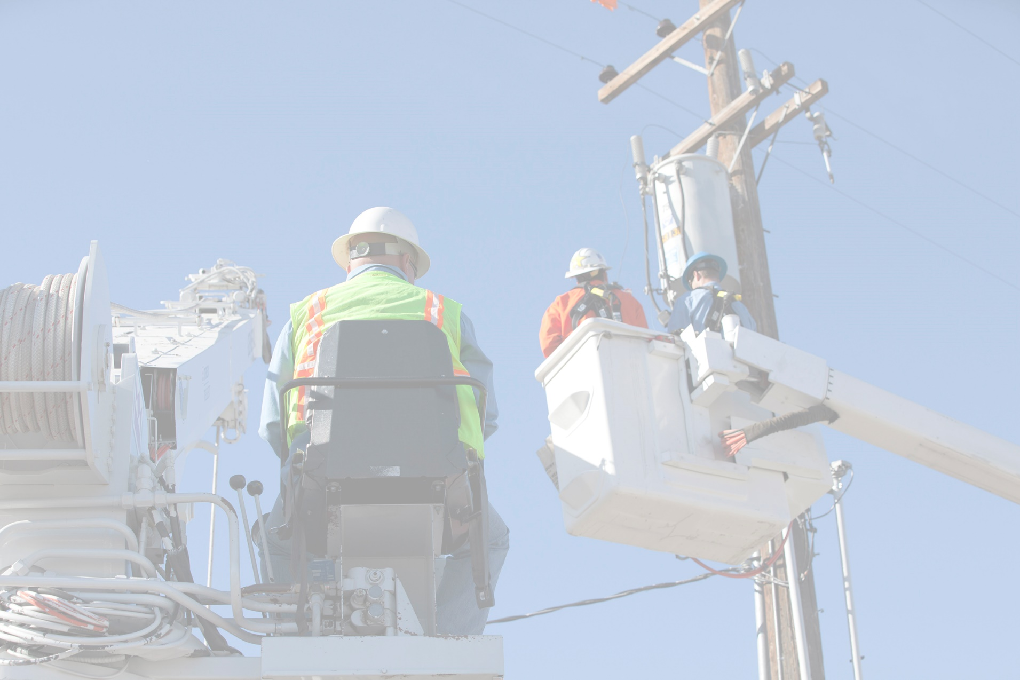

Hanford Essential Services
Physical
Services
2022: 1.4B
Water
Sewer
Electrical
Transportation
Roads
Information Technology
2022: >350K
USAGE IN GALLONS
2019: 922M
2022: 12,130
MEGAWATT
HOURS
2018: 133K
2022: 420
COMMUTERS
2018: 9,870
Exabytes
SERVICE TRUCKS
2018: 200
DATA STORAGE
& DEVICES
Petabytes
Terabytes
Megabytes
Gigabytes
Mainframe
PC
Internet
Mobile
Notes:
MSA contract exists to enable Hanford cleanup contractors through right-sized and prioritized essential services using a integrated service delivery model
Delivering right-sized and prioritized services using a service delivery model
Enables cleanup contractors to focus on cleanup
Integrates contractors needs
Rapid, efficient and flexible delivery of services
Identifies solutions to maximize effective mission outcomes
Reduces costs, improves service delivery, and shows transparent costs
Consolidates overall services footprint
Achieved 100s of upgrades while right-sizing processes which achieved $1.5B in savings and avoidance

Slide 5
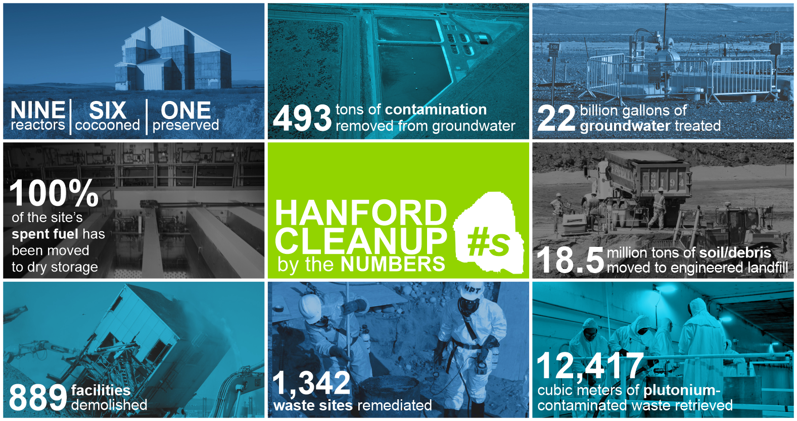
Hanford Cleanup Progress

Slide 6
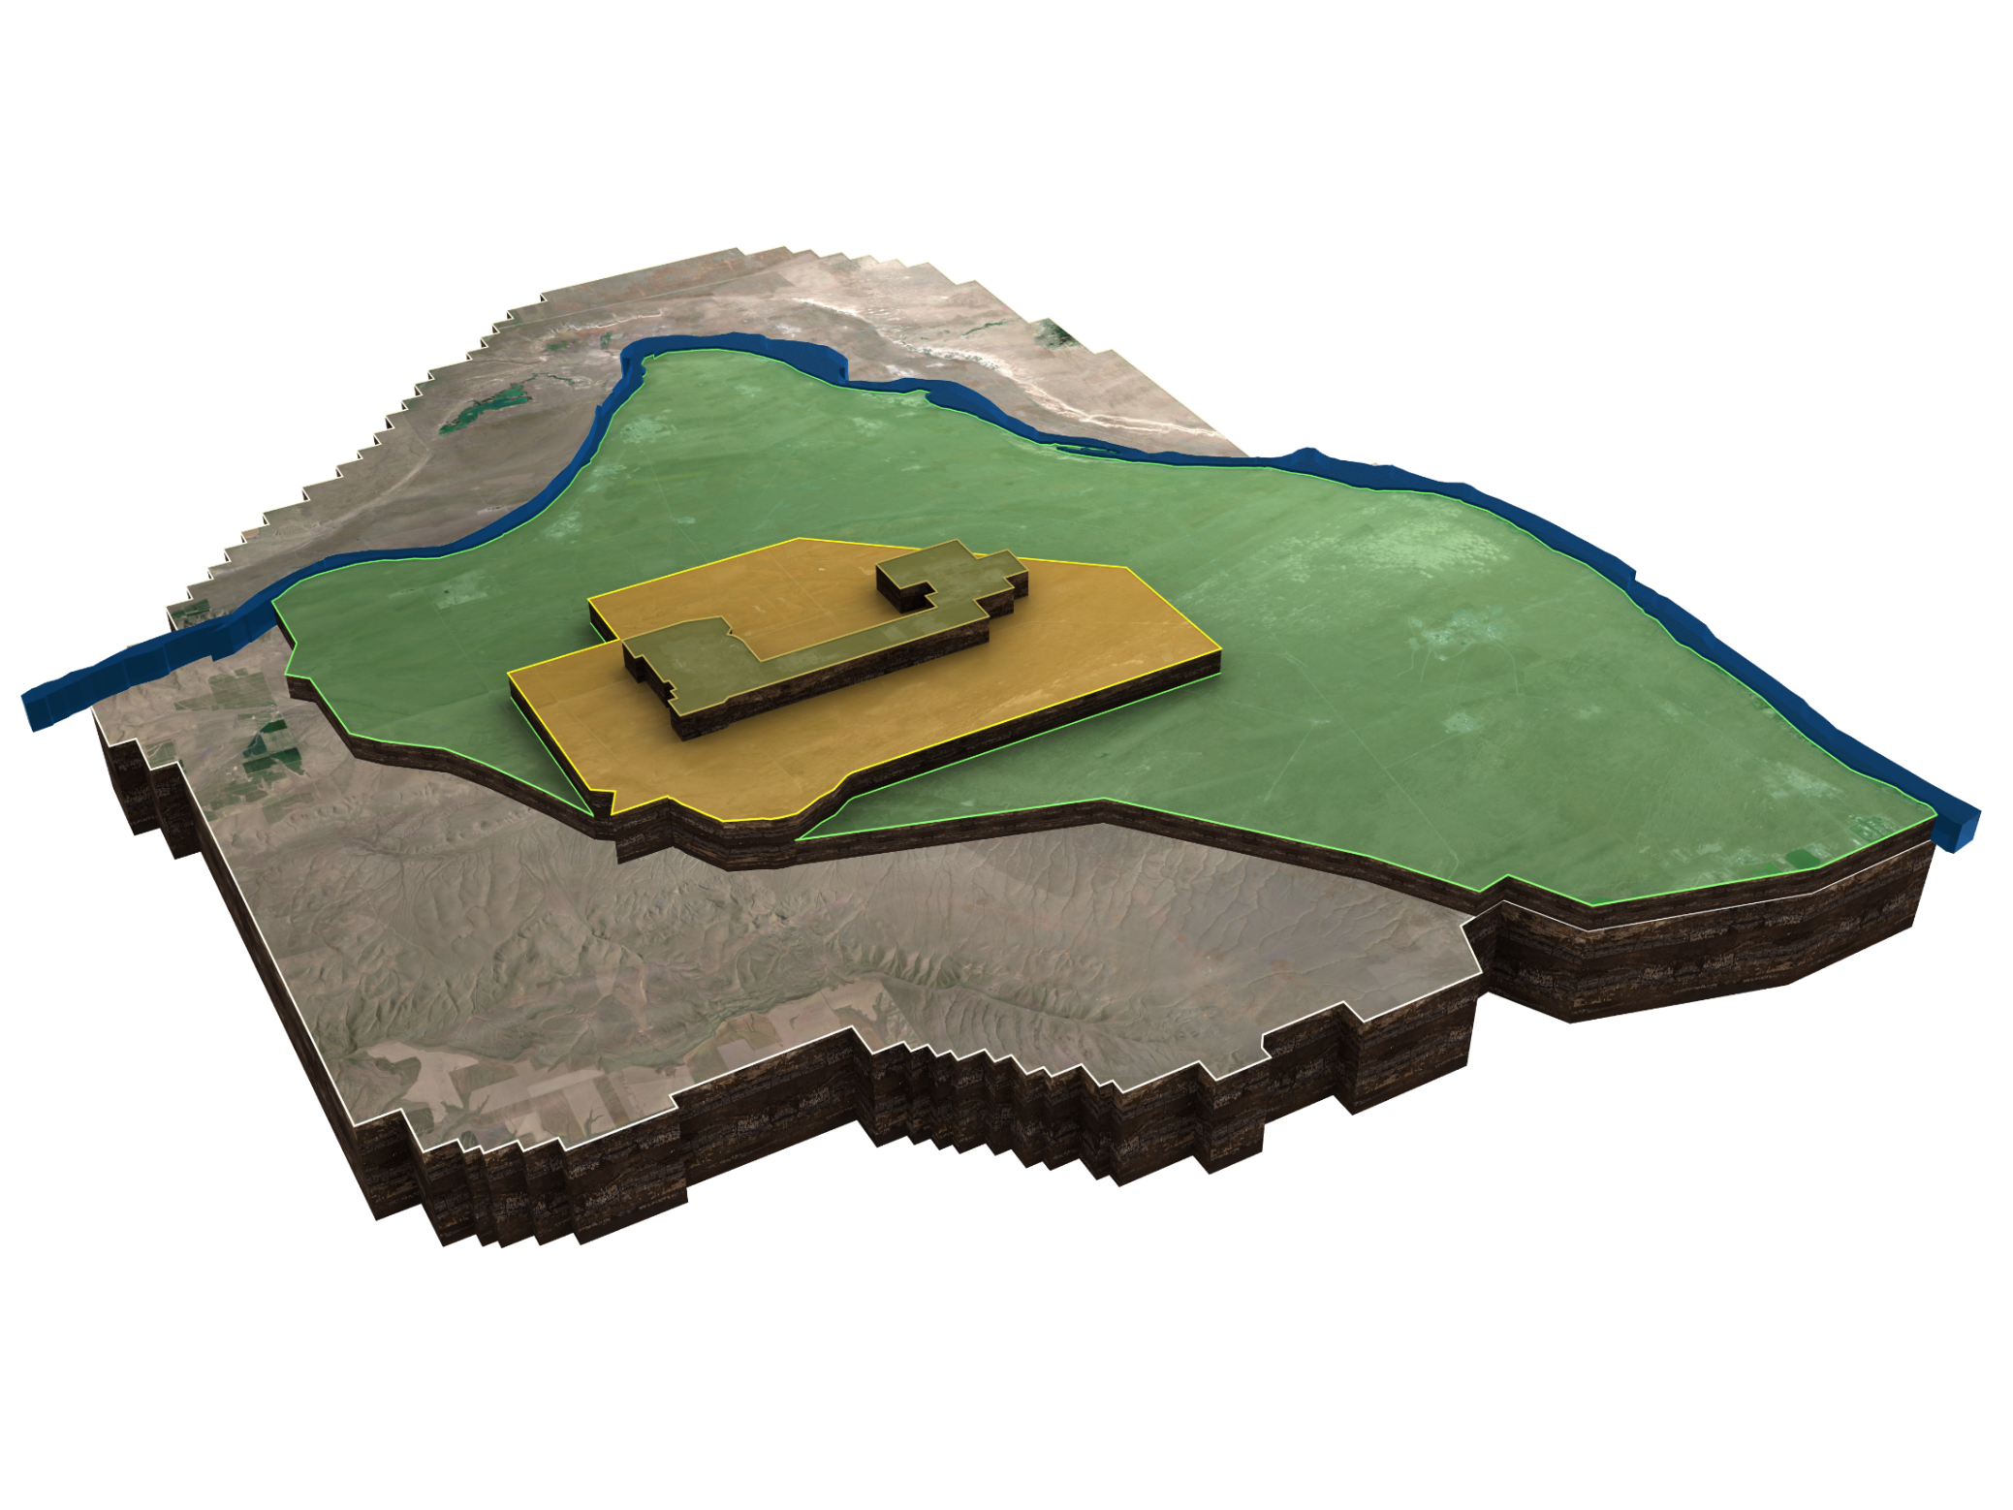
Next 5 Years
Cs/Sr Capsules
Tank Retrievals
K Basin
DFLAW Operations
Groundwater Treatment
324 Bldg.
Infrastructure / Reliability
Tank Integrity
Risk Reduction
Acceleration Opportunities
PFP, REDOX
Notes:
DOE and its contractors have made significant progress in cleaning up the Hanford Site:
River corridor nearly complete
Bulk of the active work now shifting to the Central Plateau
As we transition into the next phase of cleanup, its critical that we continue to foster our workforce of the future through investments in STEM, active recruiting, and knowledge transfer.
Simplify the final slide just to show the site picture, no animation, with some key / larger projects being progressed.
I'll just close with the theme that the many successes at the Hanford site over the last 75 years provides a solid foundation for optimism as we move forward into the next phase, tank waste treatment.

Slide 7
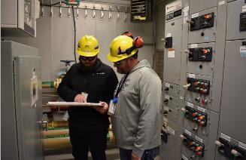
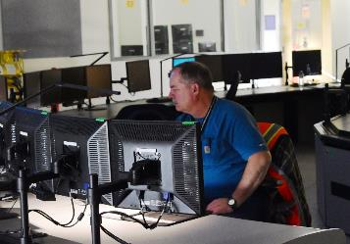
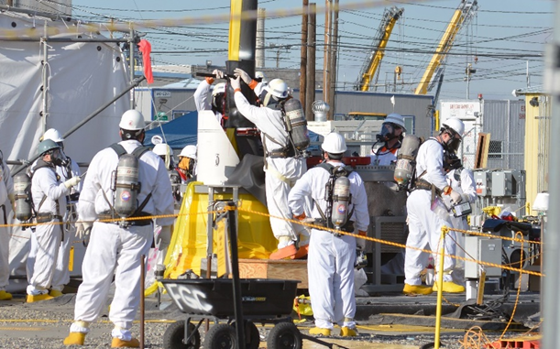
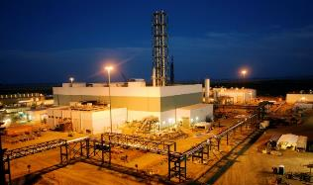
Transition to 24/7 Operations
Notes:
Entering a period of change with contactor transitions and DFLAW operations while continuing to reduce risks across the site.
We will continue to focus on key enabling activities:
1. Culture shift that supports site wide operations

Slide 8

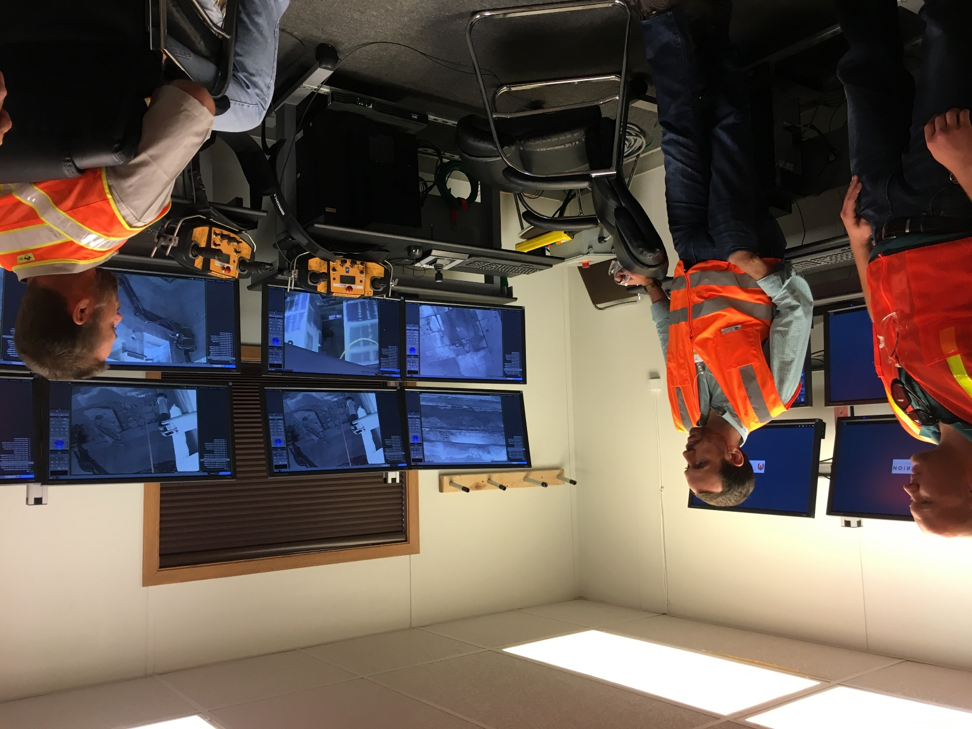
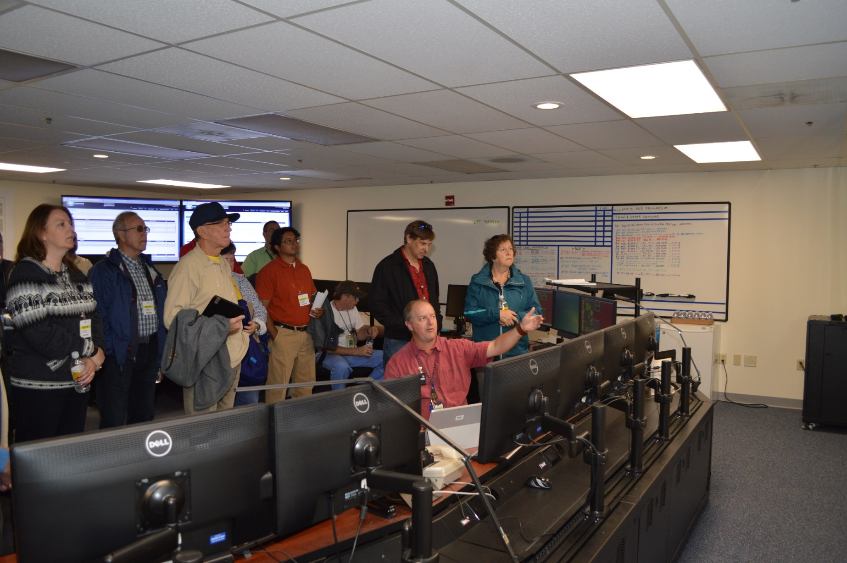
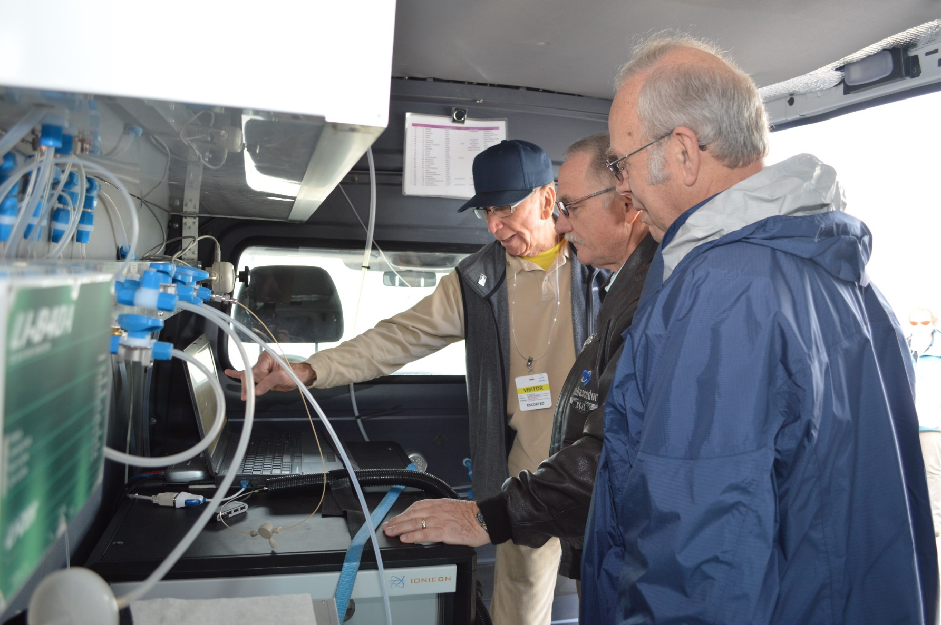
Stakeholder Engagement
Notes:
3. Active stakeholder engagement to ensure a constructive dialog focused on enabling mission progress.

Slide 9
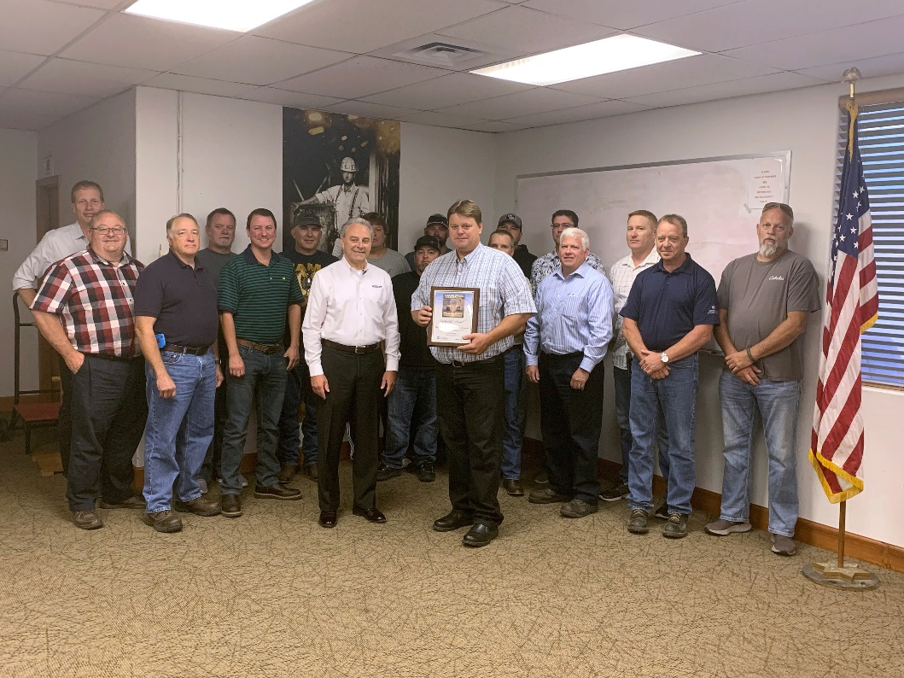
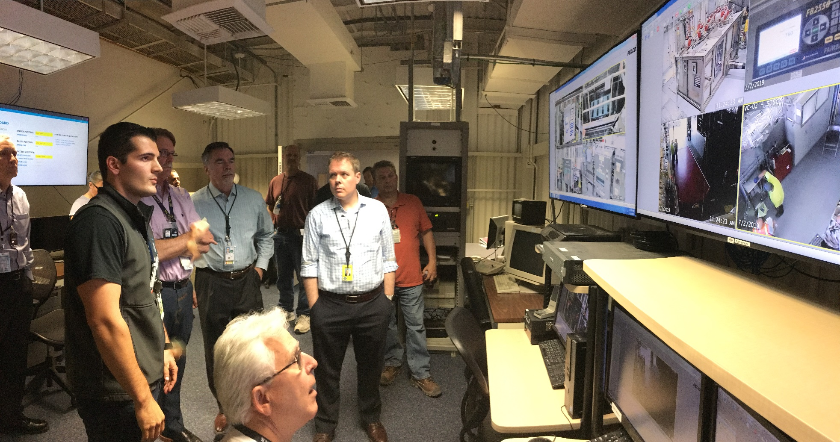
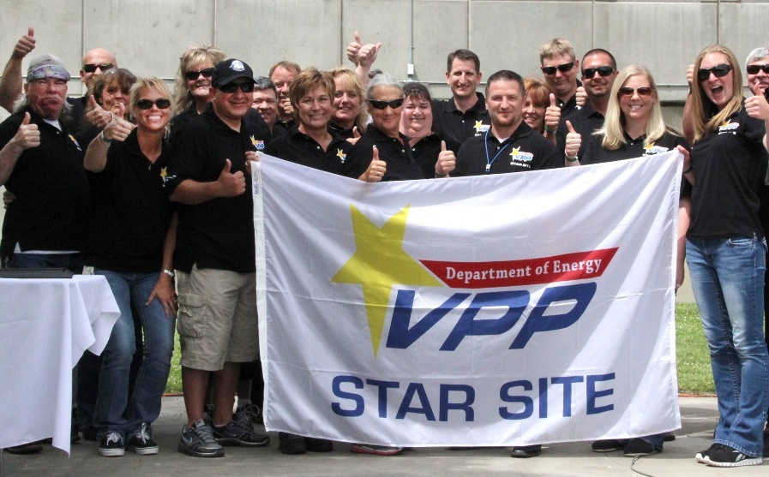
High Performing Team
Notes:
4. DOE as a high performing team, working towards a singular culture while remaining as two separate offices.

