Slide 1
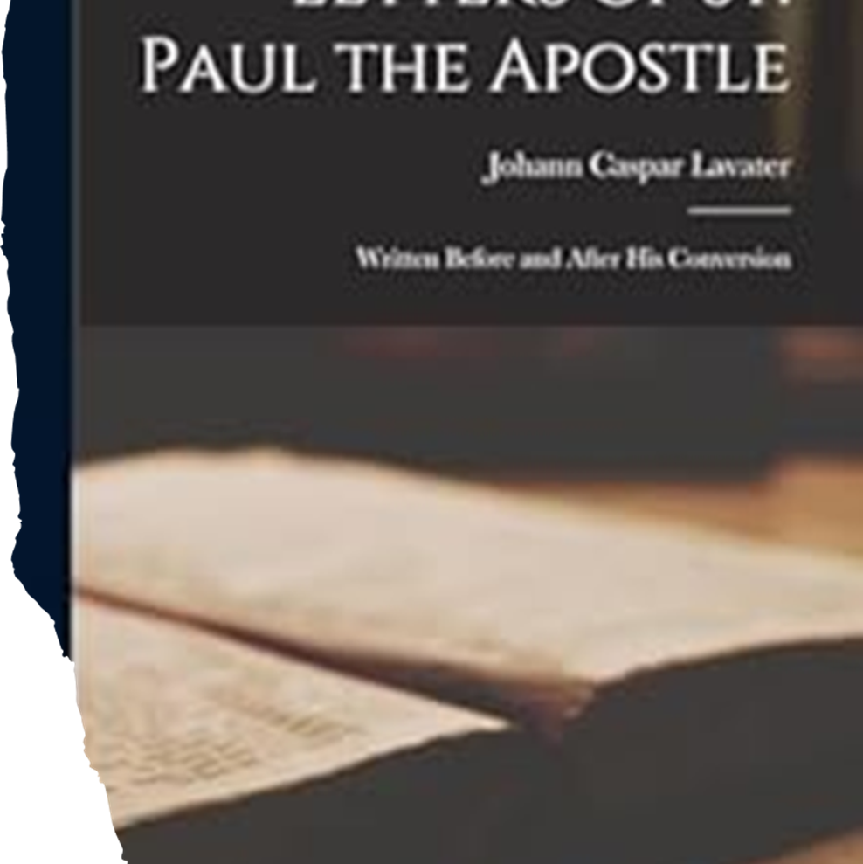
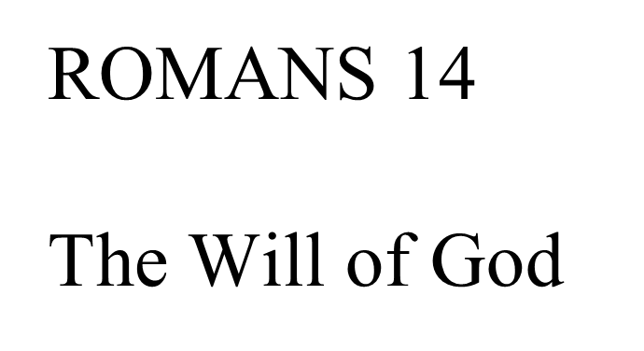

Slide 2
Chapter 14 theme: Keeping Peace.
Chapter highlights:
Disputable matters.
Live for God.
Strong and weak.
You are what you eat.
Our first loyalty.

Slide 3
Nik'isóó t'áadoo baa nánít’íní
1 Diné bi'oodlą' doo bidziilígíí éí k'é dabidohní, nidi bintsékees t'áá sahdii át'éhígíí biniinaa t'áadoo bił ałghada'doht'áhí.
The Law of Liberty
Receive one who is weak in the faith, but not to disputes over doubtful things.
Catch the little foxes.

Slide 4
2 Diné ła'da bi'oodlą' binahjį' ch'iyáán t'áá silį́'ígíí yiyą́ą dooleełgo éí yidooyį́į́ł, nidi diné bi'oodlą' doo bidziilígíí éí nanise' bił da'adáanii t'éiyá yiyą́.
3 Diné t'áá azlį́'ígíí jiyáanii éí náánáła' diné doo yiyáanii t'áadoo bilááh ánísht'é jiníziní doo, áádóó nanise' t'éiyá jiyáanii éí t'áá azlį́'ígíí yiyáanii t'áadoo baa níjít'íní doo, háálá Diyin God bił nilį́įgo nábidiiłtį́.
For one believes he may eat all things, but he who is weak eats only vegetables.
Let not him who eats despise him who does not eat, and let not him who does not eat judge him who eats; for God has received him.
In God’s Kingdom, we are all the same height.

Slide 5
Wrap-up by verses:
Acting as the judge of another in disputable matters is contrary to the Word of God. We are not to judge others when it comes to disputable matters. That is God’s job, vs. 1-3.
Study question:
What does the term “doubtful things” mean throughout Romans 14?

Slide 6
4 Náánáła' naat'áanii yá naal'a'í baa nánít'į́įgo ha'át'íísh biniyé baa nánít'į́? Jó, yá'át'éehgo nijilnishgo, doodaii' doo yá'át'ééhgóó nijilnishgo, éí hananit'a'í t'éiyá bee bóhólníihgo haa nídóot'įįł. Hanaanish yá'át'éehgo ájoolíił doo, háálá hó Diyin God hadziil áhósingo yíneel'ą́.
Who are you to judge another’s servant? To his own master he stands or falls. Indeed, he will be made to stand, for God is able to make him stand.
Judge – condemn.
Mind your Master.

Slide 7
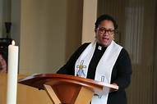
“Actually, all of us differ from others in significant ways. We Christians have different opinions about what a believer should and shouldn’t do. Some think women should be ordained; others violently disagree…. These differences tended then and now to divide believers into subgroups of “them” and “us.” And all such antagonistic divisions are harmful to community! All distort the unity and ministry of Jesus’ church.” – Larry Richards, author of The Book of Romans, the Smart Guide to the Bible Series.

Slide 8
5 Diné ła'da yoołkáałii ła' t'ah atisígo át'éego yidísin łeh, nidi diné ła' náánásdzį́, éí yoołkáałii t'áá ałtso aheełt'éego yidísin łeh. Bíni'dii diné t'ááłá'í nítínígo t'áá bí doo bił naaki danilį́į́ góne' yaa nitsídaakees.
6 T'áá háiida ła'a jį́ hodílzinígíí jidísinii éí Bóhólníihii hoł nilį́įgo jidísingo ájít'į́. Áádóó t'áá háiida ła'a jį́ hodílzinígíí doo jidísin da nidi Bóhólníihii hoł nilį́. Diné ła'da t'áá azlį́'ígíí jiyáanii éí ałdó' Bóhólníihii hoł nilį́įgo t'áá azlį́'ígíí jiyą́, háálá Diyin God bich'į' ahééh jinízingo ájít'į́. T'áá azlį́'ígíí doo yiyáanii éí ałdó' Bóhólníihii bił nilį́įgo doo t'áá azlį́'ígíí yiyą́ą da, áádóó Diyin God yich'į' ahééh nízingo át'į́.
One person esteems one day above another; another esteems every day alike. Let each be fully convinced in his own mind.
He who observes the day, observes it to the Lord; and he who does not observe the day, to the Lord he does not observe it. He who eats, eats to the Lord, for he gives God thanks; and he who does not eat, to the Lord he does not eat, and gives God thanks.
Follow the Leader.

Slide 9
7 Diné doo ła' t'áá ádííghahígo hináa da, índa diné doo ła' t'áá ádííghahígo daatsaah da.
8 Dahinii'náago Bóhólníihii bá dahinii'ná, índa danii'néego Bóhólníihii bá danii'né. Éí bąą dahinii'náago, éí doodaléi' danii'néego Bóhólníihii bíí' daniidlį́.
For none of us lives to himself, and no one dies to himself.
For if we live, we live to the Lord; and if we die, we die to the Lord. Therefore, whether we live or die, we are the Lord’s.

Slide 10
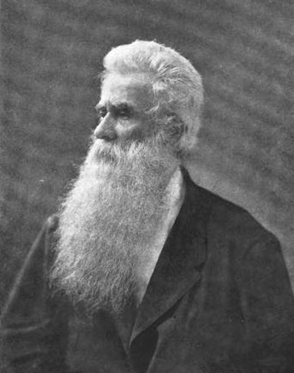
We belong to God , our life and our death are ordered by Him; We accountable to Him for the use we make of our liberty, in things uncommanded; and if we make a right use of that liberty, we do glorify God living or dying, and are the property of the Lord, not of one another.”
William S. Plumer
1802-1880
American Clergy

Slide 11
Wrap-up by verses:
God accepts both the weak and the strong and commands the strong not to look down on the brother who differs from him. Divergent behaviors exist in the Body of Christ. Whether it is food or drink, sacred days, or the eating of meat, we should all do as unto the Lord and not criticize those who disagree with us, vs. 4-9.
Study question:
What does Paul mean when he talks about the strong and the weak believer?
According to Paul, Judging a fellow believer is wrong. Why?

Slide 12
9 Háálá daneeznánígíí índa dahinánígíí éí Bóhólníihii hwee bóhólníih dooleeł biniyé Christ daaztsą́ áádóó hinááh násdlį́į́’.
10 Ha'át'íishą' biniyé nik'is baa nánít'į́? Éí doodaléi' nishą' ha'át'íí biniyé nik'is jiiníłá? Háálá t'áá áníiltso Christ bibikáá'dóó ánihwiit'aah bidááhdóó deidiidzįįłgo nihaa nídahódóot'įįł.
For to this end Christ died and rose and lived again, that He might be Lord of both the dead and the living.
But why do you judge your brother? Or why do you show contempt for your brother? For we shall all stand before the judgment seat of Christ.
Who you to judge?

Slide 13
11 Jó, Diyin God bizaad bee ak'e'ashchíinii ání:
Ts'ídá t'áá aaníí hinishná, ní Bóhólníihii,
t'áádóo nídí ałdó' diné t'áá ałtso shich'į' nitsidazhdidoogoh.
T'áá ádzíłtso Diyin God jílį́, dashijiníi doo.
12 Ákohgo t'ááłá'í niitínígo Diyin God bich'į' ádaa nidahodiilnih.
For it is written:
“As I live, says the Lord,
Every knee shall bow to Me,
And every tongue shall confess to God.”
So then each of us shall give account of himself to God.

Slide 14
Tips to keep you accountable:
Place yourself under the leadership of godly leaders who will disciple you.
Develop a relationship with two or three people who will hold you
accountable. These are friends that walk with the Lord and keep close accounts.
3. Get into the habit of Bible reading, listen to the voice of the Holy Spirit.
4. Pray for ways to share your faith in Christ; stay humble and real.
5. Develop a regular habit of worship and praise where the Word is taught.
As you get your footing, reach out o others and build relationships.
Close accounts – deal with sinful attitudes and actions quickly.

Slide 15
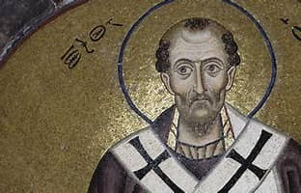
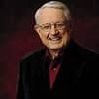
“It is not the law which will demand an account from us but Christ. You see how Paul has released us from the fear of the law.”
“What a wonderful future [and present] God has for people who accepts grace It is almost too good to be true. When George MacDonald, the great Scottish preacher, was talking with his son about the glories of the future, his little boy interrupted and said, “It seems too good to be true, Daddy.” … “Nay, laddy, it is so good it must be true!”
Chuck
Swindoll
John Chrysostom
347 AD - 407 AD
Archbishop of Constantinople
American Evangelical
Pastor

Slide 16
Nik'is t'áadoo naníłtł’aí
13 Éí bąą haa'íshą' doo ahaa nínáádeiit'į́į da doo, nidi nihik'isóó ła' yik'ee bąąhági ádooníiłii, doodaii' bidínóołtł'ahii t'áadoo bidáahjį' adahoh'níłí dooleełjí bee hasht'e'nitsídadoohkos.
14 Bóhólníihii Jesus binahjį' doo shił naaki nilį́į́góó díí shił bééhoozin, t'áá ałtso yá'ádaat'éeh nidi doo yá'ádaat'éeh da jinízinígíí éí t'áá ádííghahígo doo hoł yá'át'éeh da.
Therefore let us not judge one another anymore, but rather resolve this, not to put a stumbling block or a cause to fall in our brother’s way.
The Law of Love
I know and am convinced by the Lord Jesus that there is nothing unclean of itself; but to him who considers anything to be unclean, to him it is unclean.
You are what you eat.

Slide 17
Paul Roots for Reconciliation
Paul is determined to bring this clash between believers to a godly conclusion. There are two issues to confront:
They disagreed about what to eat.
They were passing judgment on one another.
Paul reasons with his readers. He exhorts them to think of each other,
Paul was able to see the Roman’s situation from at least three different angles.
He saw the difficulty the Jews were going through because he was a Jew himself and had for most of his life lived by the laws of the Old Covenant.
2. He saw the Gentiles’ temptation to look down on the Jews because he shared their belief that no food was unclean.
He saw the situation from a Christ-like perspective because Paul’s first loyalty was to God and God’s kingdom.

Slide 18
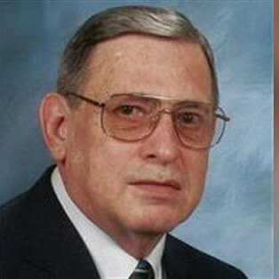
“The weak hold false beliefs about things like food and special days that they would use as criteria for not accepting others in the community who act more in line with the boldness and freedom of Jesus’ faithfulness.
The strong are inclined to accept the weak only in order to attack their superstitious beliefs with rational arguments, acting like philosophers subjecting the foolish to therapy of the passions of reasons.”
– Stanley K. Stowers,
Professor Emeritus of Religious Studies

Slide 19
15 Yíníyą́'ígíí nik'isóó ła' bee bąąh nahwííníłkaadgo t'áadoo bahat'aadí doo ayóó'ííní'níi da sínílį́į́'. Yíníyą́'ígíí bee Christ bá daaztsáanii ła' bee wóółchǫǫh lágo.
Yet if your brother is grieved because of your food, you are no longer walking in love. Do not destroy with your food the one for whom Christ died.
Food isn’t worth it.

Slide 20
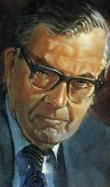
“Love takes precedence over knowledge. If the “strong” do not care about the sensitivities of the “weak” but openly fly in the face of them, what will the results be? Will the “weak” be distressed, ruined, for example by their being led to act against their consciences” Will they be put off and made to backslide as a result of the example of the “strong” which to them is sin? If so, the overall loss is surely far, far greater than the net gain.”
F.F. Bruce
1910 – 1990
Scottish Evangelical Scholar

Slide 21
16 Ha'át'íida nihił yá'át'éehgo t'áadoo nihits'ą́ą́' nichǫ́'ógo ádaahłíiłii baa yáti'í.
Therefore do not let your good be spoken of as evil;
From good to bad.

Slide 22
17 T'áá ha'át'íhígíida yidáanii, doodaii' t'áá ha'át'íhígíida yidláanii éí Diyin God bee bóhólníihgo bił haz'áanii doo bídéét'i' da, nidi ts'ídá t'áá ákogi é'ét'é áádóó k'é hwiindzin índa ił hózhǫ́ Níłch'i Diyinii eidii'aahii bídéét'i’.
18 Háálá ákót'éego Christ bá nijil'a'ii Diyin God bił yá'ájít'ééh, áádóó diné ałdó' bił t'áá ákǫ́ǫ́ ájít'é.
for the kingdom of God is not eating and drinking, but righteousness and peace and joy in the Holy Spirit.
For he who serves Christ in [e]these things is acceptable to God and approved by men.
Keep first things first.

Slide 23
Wrap-up by verses:
The strong ought not be a stumbling block to the weak. They should not practice their freedom at the expense of another’s spiritual development,
vs. 10-18.
Study question:
How might some believers be stumbling blocks to other believers?
What does Paul mean when he says, “Do not let your good be spoken of as evil?”

Slide 24
19 Éí bąą haa'íshą' bee k'é náhoodleełii áádóó t'áá áníiltso ahidiníłnáago danihidziil ánihidoolíiłii hádeiit'į́į doo.
20 Daahsánígíí biniinaa Diyin God yinaalnishii t'áadoo danółtł'aí. Daadáanii t'áá ałtso yá'ádaat'ééh, nidi t'áá háiida ha'át'íhída jiyánígíí biniinaa ła' bąąhági át'į́ ádajile'go t'áá éí bee doo ákǫ́ǫ́ ájít'į́į da.
21 Atsį' jiyą́ągoda áádóó wáin jidlą́ągoda, doodaii' ha'át'íhída bee hak'is bąąhági át'į́įgo áníjiil'įįhii, doodaii' bidínóołtł'ahii, doodaii' bi'oodlą' doo bidziilgóó ábidoolíiłii doo baa nijigháájí yá'át'ééh.
Therefore let us pursue the things which make for peace and the things by which one may edify another.
Do not destroy the work of God for the sake of food. All things indeed are pure, but it is evil for the man who eats with offense.
It is good neither to eat meat nor drink wine nor do anything by which your brother stumbles or is offended or is made weak.
Fostering fellowship.

Slide 25
Wrap-up by verses:
Christians should remember that they are to be loyal to God, not their freedoms. God calls for whatever action will bring peace and mutual edification, vs. 19-21.

Slide 26
22 Kódaat'éhígíí baa nitsíníkeesgo yisínídląądígíí éí Diyin God t'éiyá bił bééhózingo íínísin. Jó, t'áadoo át'éhé da jinízingo ájooníłígíí doo bee ák'íhojit'ááhgóó bąą hoł hózhǫ́ǫ doo.
Do you have faith? Have it to yourself before God. Happy is he who does not condemn himself in what he approves.
Paul’s beatitude.

Slide 27
23 Nidi t'áá háiida hoł naaki nilį́įgo ajiyánígíí éí há nihoot'ą́, háálá doo hwe'oodlą' bik'ehgo ajiyą́ą da. Jó, doo hwe'oodlą' binahjį' ájooníiłii éí ádił ni'iidzííh át'é.
But he who doubts is condemned if he eats, because he does not eat from faith; for whatever is not from faith is sin.
From faith.

Slide 28
“It is not wise equally to press upon young converts and newly formed churches all the truths of Scripture. There is an order of divine instruction; milk for babes, strong meat for men. Let that order be observed. At all events, let us keep the Spirit in the bond of peace.”
William S. Plummer

Slide 29
Wrap-up by verses:
The strong are to be blessed by exercising their freedoms in private. The weak are to act as their consciences direct them, vs. 22-23.

