Slide 1

Sorting Out the Courts
The Structure, Function, and Powers of the Judicial Branch
These materials have been adapted, with permission from The Florida Bar Benchmarks Adult Civic Education Program, for use in Louisiana. Principal authors of the Florida Benchmarks Program are Annette Boyd Pitts and Richard Levenstein. For assistance with adaptation in other states, contact staff@flrea.org

Slide 2
PUZZLED!
Using the clues on the pieces, assemble the puzzles!
You should have two triangles when you are finished.

Slide 3
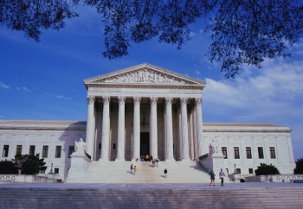
Court Structure
U.S. Supreme
Court
Appeal
Appeal
Louisiana Supreme
Court
U.S. Court of
Appeals
12 U.S. Circuit Courts
Appeal
District Courts of Appeal
5 Circuits
Appeal
Appeal
District Courts (Trial Courts)
94 District Courts
District Courts
43 Judicial Districts
Family Court Juvenile Courts
City & Parish Courts
Municipal Court Mayor’s Courts
Small Claims Court Justice of the Peace
Trial Courts
Louisiana Courts
Federal Courts

Slide 4
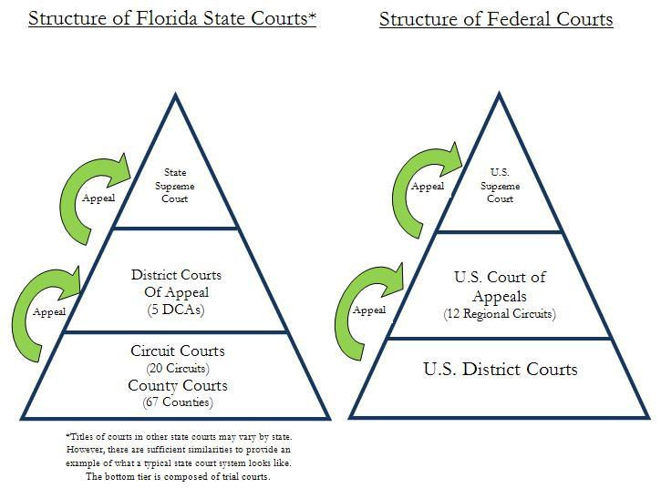
Puzzled
Structure of Louisiana State Courts
Structure of Federal Courts
LA
Supreme
Court
U.S.
Supreme
Court
Death Penalty Cases
District Courts of Appeal
(5 Circuits)
U.S. Court of
Appeals
(12 Regional Circuits)
District Courts (43)
Family Court Juvenile Court
(1) (4)
U.S. District Courts
Parish
Courts
(3)
City
Courts
(49)
Municipal Court (1)
Mayor’s Courts (250)
Small Claims Courts
Justice of the Peace (382)

Slide 5
The Role of the Judicial Branch

Slide 6
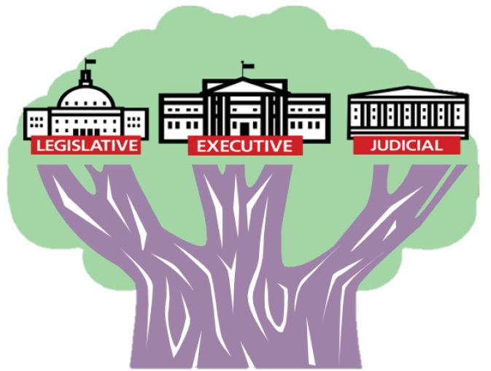
Three Branches of Government
Legislative Branch – Makes the law
Executive Branch – Enforces the law
Judicial Branch – Interprets and applies the law

Slide 7
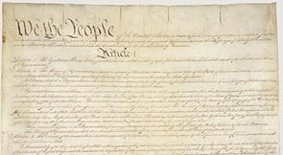

The Role of the Judicial Branch (courts)
The Constitution outlines our rights…
…and the courts protect our rights.
The courts also:
Review laws
Explain laws
Resolve disputes
Decide if a law challenged in the courts conflicts with the Constitution

Slide 8

The Role of Judges and Justices
Judges and Justices interpret and apply the law
Decisions have to be based on facts & law.
  Constitution
  Statutes
  Legal reasoning
  Precedent: prior cases
  (persuasive authority)
  Higher court decisions
  And more
Notes:
Judges are found in trial courts and in the lower appellate courts. Justices are found in the Florida Supreme Court and U.S. Supreme Court.

Slide 9
Two Court Systems
State and Federal Courts

Slide 10


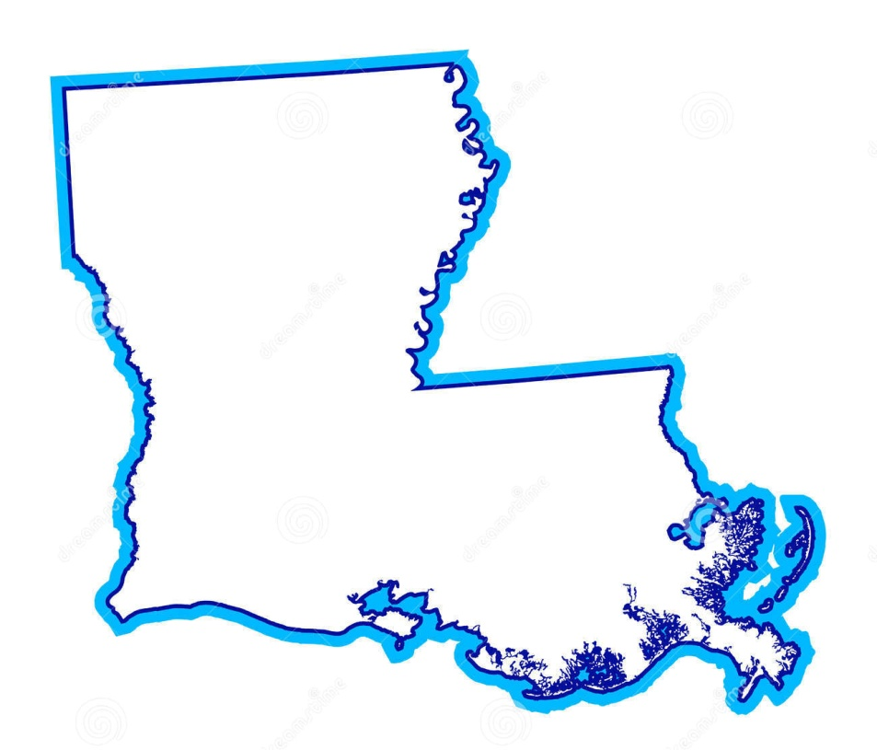
Two Court Systems: Federal and State
The judicial branch is divided into two parallel court systems:
federal courts
and state courts.

Slide 11

Where do courts get their power and jurisdiction*?
The Constitution of the State of Louisiana
What does “jurisdiction” mean?
Legal authority a court has to hear a case.
United States
Constitution
Federal courts deal with issues granted to them by the U.S. Constitution and federal law.
State courts deal with issues granted to them by their constitutions and state statutes. They also handle legal issues not granted to the federal courts or denied to the states.
Notes:
Definition from http://www.law.cornell.edu/wex/jurisdiction

Slide 12
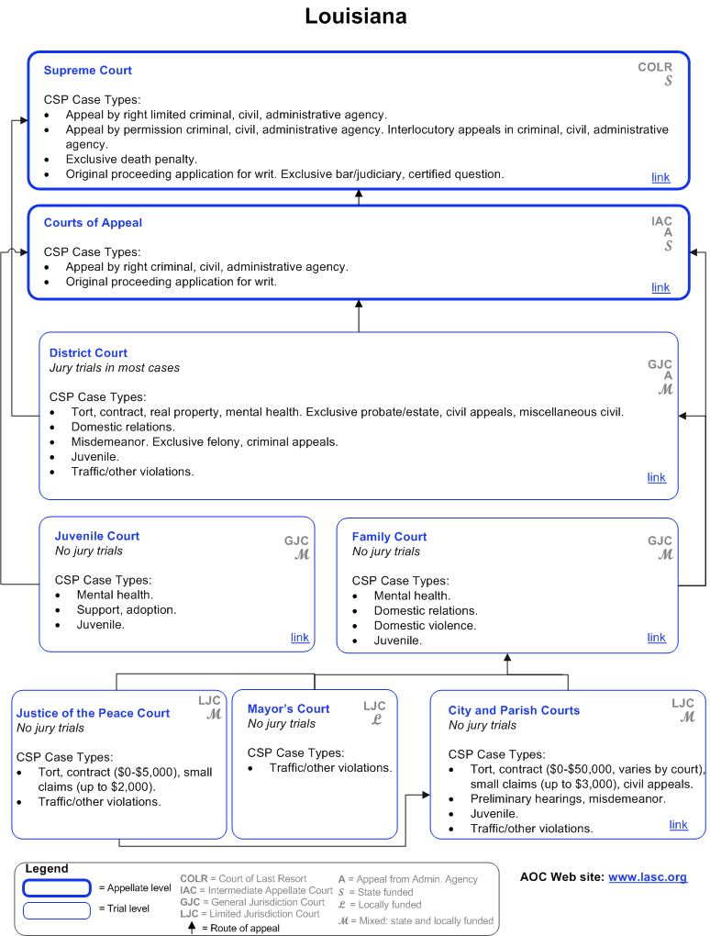
Louisiana Court
Jurisdiction Chart

Slide 13
Trial and Appellate Courts
What is the difference?

Slide 14
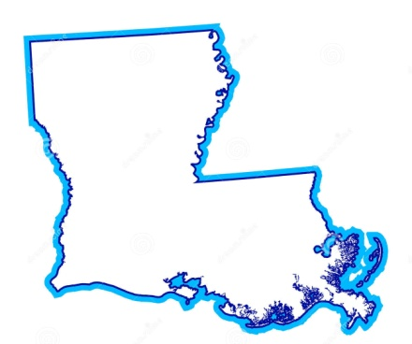
Trial and Appellate
In addition to being divided into federal and state courts…
…courts are then broken down into trial and appellate courts.
Trial | Appellate
Trial | Appellate

Slide 15
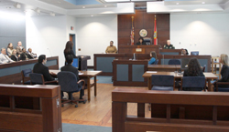
Trial Courts
1 Judge
Jury
Witnesses
Attorneys
Plaintiff/Prosecution – Defense/Defendant
Introduction of evidence

Slide 16
The Role of the Jury
The jury listens to the evidence during a trial, decides what facts the evidence has established.
The jury decides whether a defendant is "guilty" or "not guilty" in criminal cases, and "liable" or "not liable" in civil cases.
Notes:
http://www.americanbar.org/groups/public_education/resources/law_related_education_network/how_courts_work/trialjury_role.html
Emphasize that the jury exists to stand between the government and the accused in order to insure a fair trial.

Slide 17

Steps of a trial
    What are the steps of a trial?
    Review warm-up activity.

Slide 18
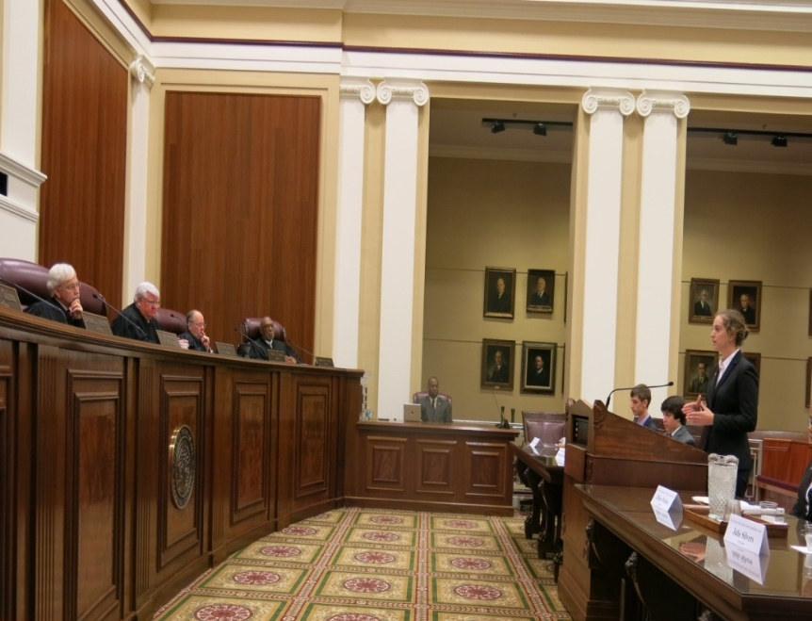
Appellate Courtroom
Panel of judges
No juries
Petitioner/Respondent or Appellant/Appellee
Attorneys submit briefs and present oral arguments on legal or policy issues; no witnesses or presentation of evidence.
Determines if the law was applied correctly and/or if the trial was fair.

Slide 19
What is an appeal?
A Challenge to a Previous Legal Decision
Structure of Louisiana State Courts
Structure of Federal Courts
LA
Supreme Court
U.S. Supreme Court
Death Penalty Cases
District Courts
of Appeal
(5 Circuits)
U.S. Court of Appeals
(12 Regional Circuits)
District Courts
Family Court Juvenile Court
U.S. District Courts
Other Courts of
Limited/Special Jurisdiction
City & Parish Courts
Notes:
http://www.law.cornell.edu/wex/appeal

Slide 20
Court Structure
U.S. Supreme
Court
Appeal
Appeal
Louisiana Supreme
Court
U.S. Court of
Appeals
13 U.S. Circuit Courts
Appeal
Death Penalty
District Courts of Appeal
5 Circuit Courts
Appeal
District Courts (Trial Courts)
94 District Courts
Appeal
District Courts
43 Judicial Districts
Family Court Juvenile Courts
City & Parish Courts
Municipal Court Mayor’s Courts
Small Claims Court Justice of the Peace
Trial Courts
Louisiana Courts
Federal Courts

Slide 21
Sort it out!
Work in a small group
Read the two case scenarios provided.
Diagram how the case moved through the courts

Slide 22

Peggy Cotogno, Executive Director
Louisiana Center for Law and Civic Education
Peggy.Cotogno@LSBA.org
ACE is a partnership of the Louisiana State Bar Association, Louisiana District Judges Association and the Louisiana Center for Law and Civic Education
These materials have been adapted, with permission from The Florida Bar Benchmarks Adult Civic Education Program, for use in Louisiana. Principal authors of the Florida Benchmarks Program are Annette Boyd Pitts and Richard Levenstein. For assistance with adaptation in other states, contact staff@flrea.org

Slide 23
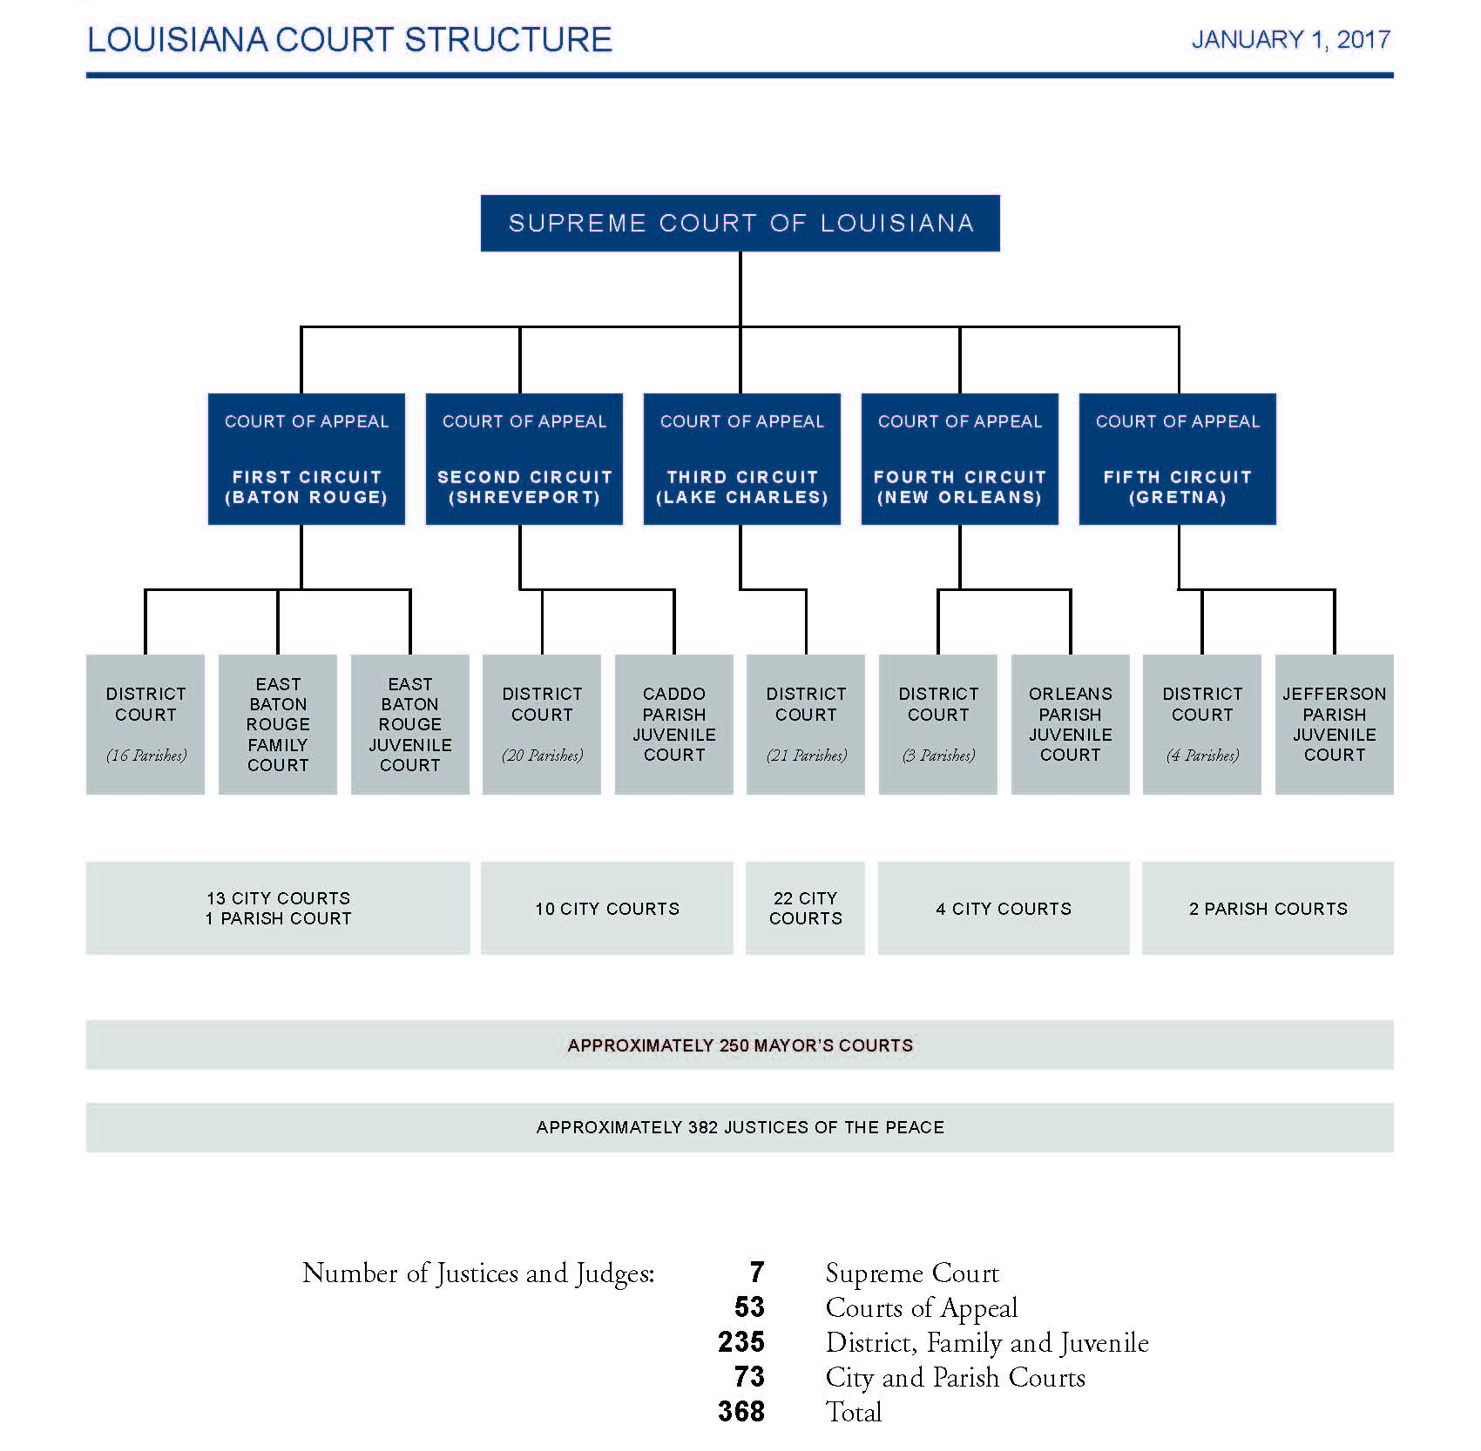

Slide 24
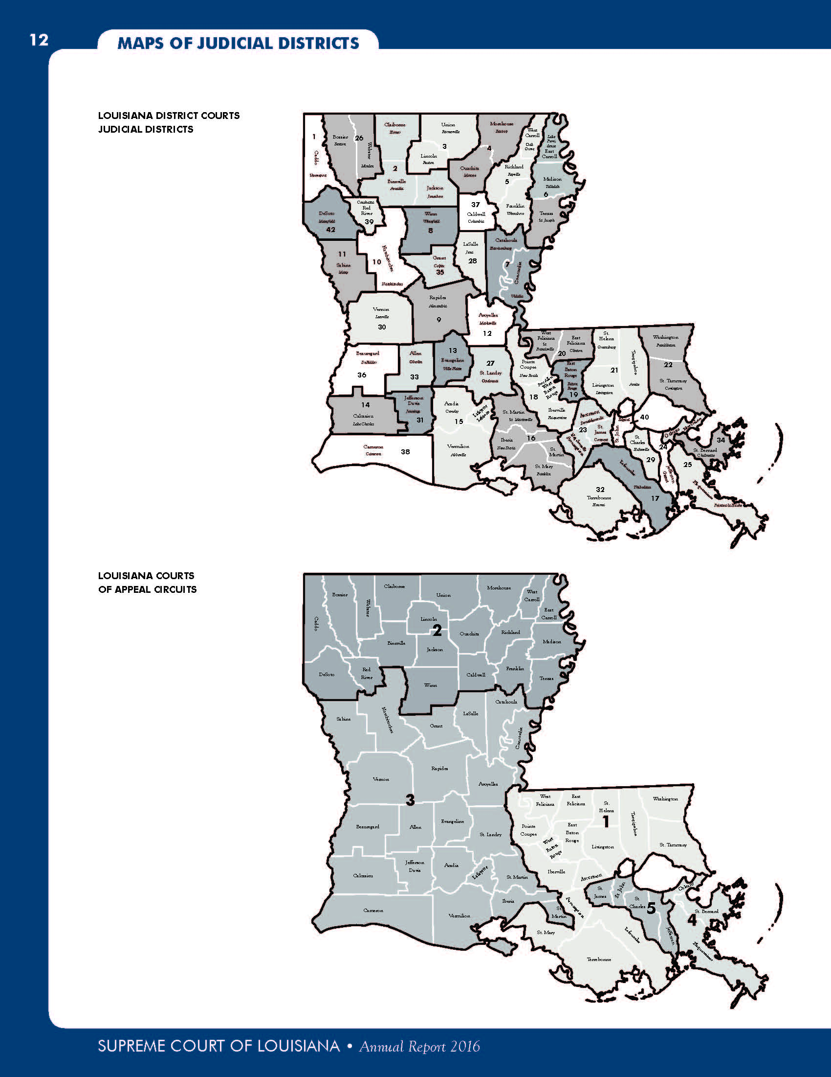
Louisiana District Courts Judicial Districts

Slide 25
Louisiana Appellate Courts
Appellate Circuits

Slide 26
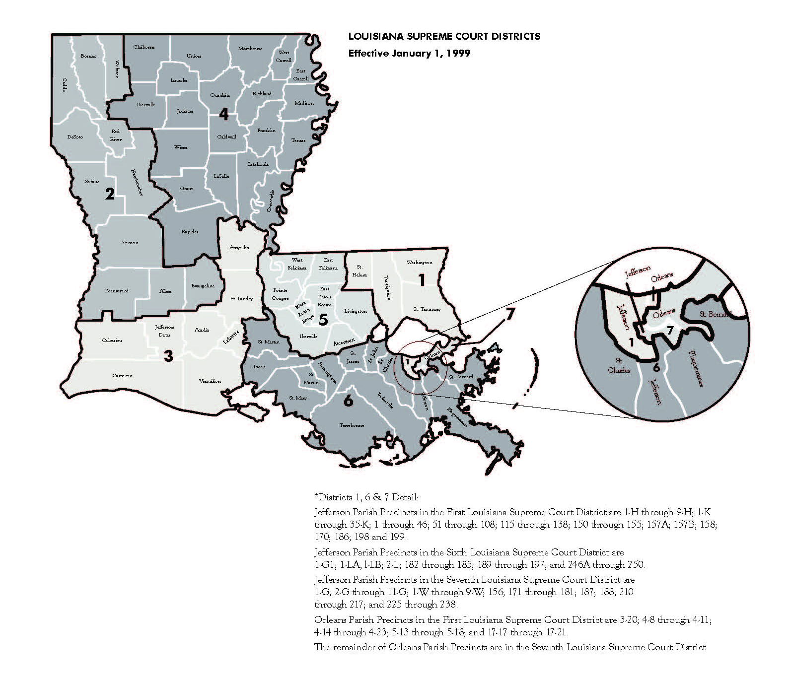
Louisiana Supreme Court Districts

