Slide 1
Eat This, Not That – Animals in the Food Chain
International Equine Conference
Marlene E. Haffner, MD, MPH
Mhaffner3@verizon.net
September 26, 2011

Slide 2
So who is responsible for food in the US?
In the beginning – The Department of Agriculture held all food responsibility
FDA originated in the Department of Agriculture
So—
Jurisdiction is not always clear
Federal Meat Inspection Act (FMIA), Poultry Products Inspection Act (PPIA).Egg Products Inspection Act (EPIA), and the Federal Food Drug and Cosmetics Acts (FFDCA or FDA)

Slide 3
Food Responsibilities
Fair Packaging and Labeling Act (FPLA) of the Fair Trade Commission (FTC)
Food Advertising regulated by FTC

Slide 4
Department of Agriculture – Food Safety and Applied Nutrition (FSIS)
--determines Meat and Poultry in interstate or foreign commerce, or that substantially affect that commerce are wholesome, not adulterated, and properly marked, labeled and packaged
--FSIS determines misbranding or adulteration

Slide 5
FDA Responsibilities
Primary statutory responsibility for the labeling for foods and food ingredients including fish but not meat
But – Department of Agriculture Food Safety Inspection Service (FSIS) has responsibility for meats and poultry
How is responsibility determined FDA vs FSIS–
Process is called “amenability”
Based on how the product is formulated, not on the compositions of finished product
But FDA determines the drugs that animals are permitted to be administered – through the Center for Veterinary Medicine
Center for Food Safety and Applied Nutrician (CFSAN) also involved

Slide 6
Drug Development for use in Animals
Must be produced with Good Manufacturing Practices
Must be shown to be safe and effective for intended use in the species
Use in animals for slaughter to be used for food is tightly regulated
Extensive list issued by Canada in 2009 of Veterinary drugs not permitted for use in Equines slaughtered for food.

Slide 7
Avoiding Unsafe Drug Residues in Human Food
Drugs not approved for food-producing animal use, and very high-level drug residues are high priorities for FDA investigation
Rapid growth in food imports provides additional challenges
FDA works together with FSIS and with individual states
Organs of animals are periodically biopsied from slaughtered animals
Unsafe drug residues also checked in imported and domestic aquaculture foods

Slide 8
Use of Phenylbutazone
No residue permitted; no safe level! No approved use in any animal in the food chain
(http://www.fda.gov/cvm/CVM_Updates/buteup.htm
Phenylbutazone has been shown to cause blood dyscrasias in humans which can lead to death.
Is permitted for use in horses as there is no horse slaughter for human consumption in the US
While horses not eaten in the US, are eaten in many foreign nations

Slide 9
Buying drugs for animals on-line
Most often purchased for pets
Caution is the watch word
The following cannot be legally imported to the US:
Prescription drugs available from a foreign pharmacy that are not approved in the US;
Products with similar, but not identical formulations as FDA-approved products;
Products not made under the US quality standards or not labeled according to US requirements
Products not stored under quality conditions as required

Slide 10
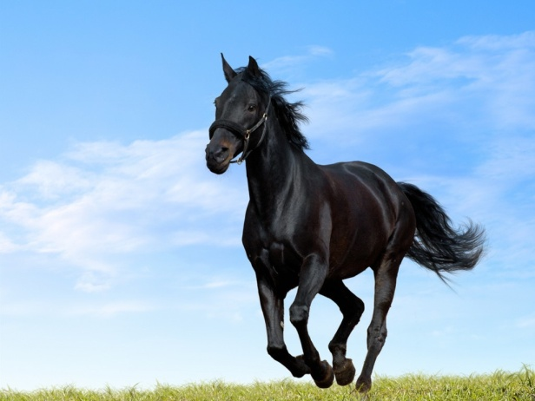
?
Marlene E. Haffner, MD, MPH
mhaffner3@verizon.net
301 983-5729

