Slide 1
Understanding how EDX works
William Sanders, Wake Tech
Ben Jenkins, Wake Tech (moderator)

Slide 2
What is EDX?
Envision Data eXchange provides synchronization of data between Colleague and other interfacing products.
Publisher -> Subscriber
Common Subscribers used in NC Community Colleges
LDAP
EPNC
PRTL
Notes:
EDX transmittals go from a publisher to a subscriber. For outbound transmittals, Colleague is the publisher and the partner software is the subscriber.

Slide 3
50,000ft overview
PERSON*1112233
LAST.NAME- Lebowski
FIRST.NAME – Jeffrey
PERSON*1114455
LAST.NAME – Sobchak (changed)
PERSON*1117722
LAST.NAME - Quintana
FIRST.NAME - Jesus
FIRST.NAME - Walter
PERSON*1112233
LAST.NAME- Lebowski
FIRST.NAME – Jeffrey
PERSON*1114455
LAST.NAME – Cronkite
PERSON*1117722
LAST.NAME - Quintana
FIRST.NAME - Jesus
FIRST.NAME - Walter
Subscriber
EDX

Slide 4
How does it work?
Field update causes a trigger to fire and send a transaction to EDX
EDX background process transforms and sends an XML file to a Subscriber

Slide 5
How does it really work?
Field update causes a trigger to fire and send a transaction to EDX
EDX background process transforms and sends an XML file to a Subscriber
Notes:
MIO creates a MIO transaction and places it in the EDX.TX file. The EDX background process periodically checks the EDX.TX file to see if a new transaction is ready for processing. The EDX background process retrieves the MIO transaction and creates from it one or more DMI transactions. The EDX background process then moves the DMI transaction to the EDX.STATUS file.
When a transaction is placed in the EDX.STATUS file, the background process does one of the following with each DMI transaction: 􀂄
If you have designated the associated XML document for manual processing only, the background process keeps the DMI transaction in the EDX.STATUS file, with a status of Manual, to be processed later.􀂄
If the DMI transaction is missing data required for the XML document, the background process stores the DMI transaction in the EDX.ERR file. Later, you can enter the missing data in Colleague to create the desired transaction.􀂄
If the document is not flagged for manual processing, and all required data is present, the background process sends the DMI transaction to the DMI application server.

Slide 6
How does it really work?
RFSPECS record defines triggers for fields within files
MIO generates a transaction when data changes for a defined field trigger and places it in the EDX.TX file
EDX background process periodically scans EDX.TX for new records and moves them to EDX.STATUS
EDX attempts to build XML document (if configured) and send to Subscriber

Slide 7
Subscriber Setup
EDX Subscriber definition (EDSD) specifies the endpoint of the subscriber (eg – https, dmi, file)
Loaded subscriber interfaces (CORE-EDIL) will generate MIO transactions that will be sent to EDX.
Documents created by EDX for the Subscriber are specified on EDXS
Notes:
Disabled subscribers will still generate EDX transactions. Disable the interface to stop transactions from being created by triggers.

Slide 8
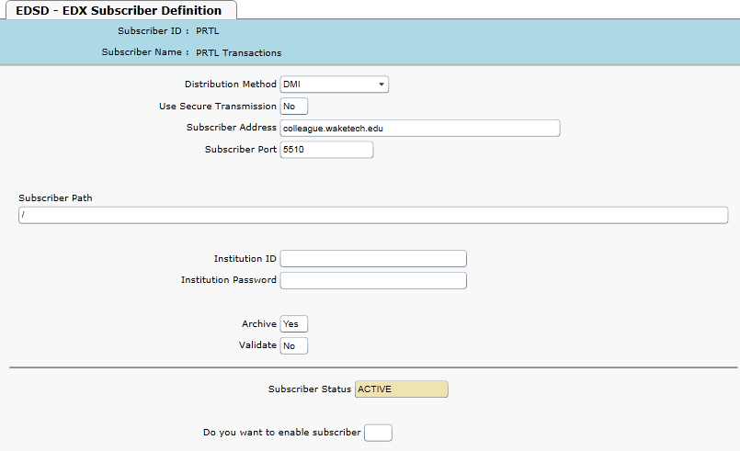
Subscriber Setup

Slide 9
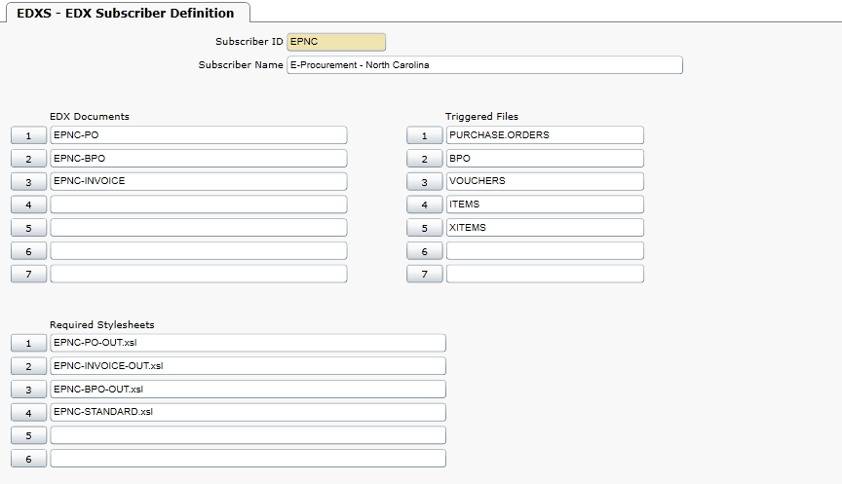
Subscriber Setup

Slide 10
Triggers
CORE-EDIL can be used to disable and install triggers for a particular Subscriber
EDIL updates the RFSPECS record for the files defined for the subscriber (EDXS)
(see Article #82.361 for more details on RFSPECS)
EDIL Loads triggers based on definitions in EDX.DELIVERY and files specified in EDXS.

Slide 11
How do Triggers Work?
Updating a field in Unidata will cause MIO to look for any triggers defined for the field in RFSPECS
Triggers define which Subscriber documents are created (EDXS).
Any trigger conditions specified in RFSPECS can be defined on EDTC.
Trigger conditions limit which MIO transactions actually create a Subscriber document.

Slide 12
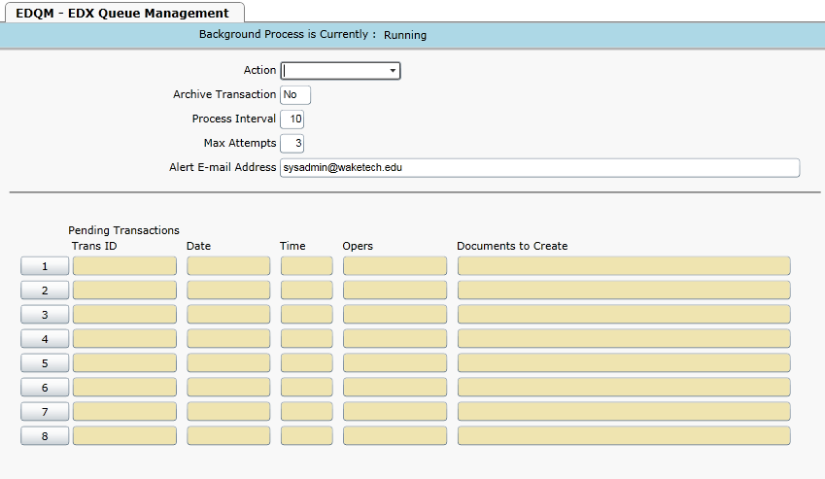
EDX Background Process

Slide 13
EDX Background Process
Background process scans any new MIO transactions added to EDX.TX and moves them to EDX.STATUS
Records in EDX.STATUS are displayed in the Queue Status Form (EDQS)
App Listener processes each DMI transaction and attempts to create an XML document which will be sent to the subscriber
If sent successfully (and archiving is enabled), an entry is written to EDX.LOG

Slide 14
It’s not working, now what?
Is the EDX background process running?
Notes:
EDQM. If running, it should show no pending transactions.
ps –ef | grep ‘PHANTOM EDQM’

Slide 15
It’s not working, now what?
Check the status of the EDX queue

Slide 16
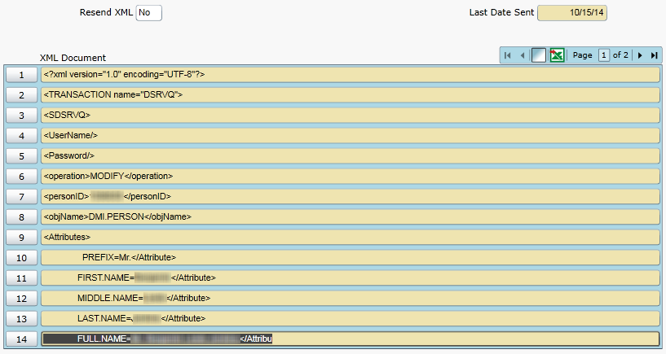
It’s not working, now what?
Check the status of the EDX queue

Slide 17
Additional EDQS Options

Slide 18
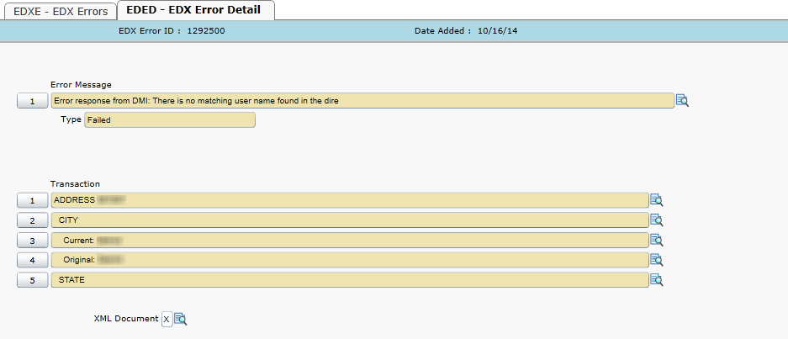
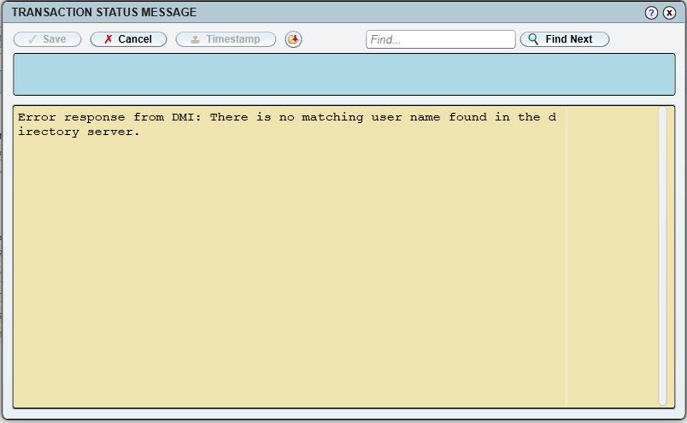
Viewing Errors
Check to see if any errors exist (EDXE)

Slide 19
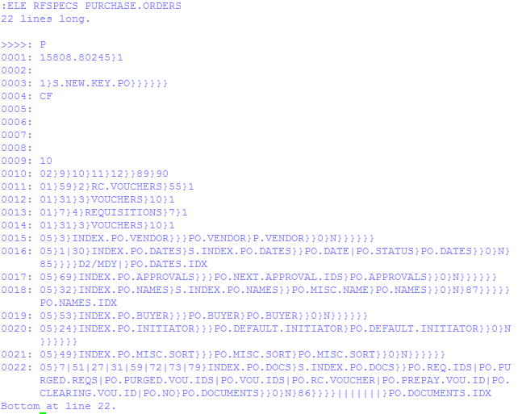
It’s not working, now what?
What do you check if EDX events are not being created for a subscriber?

Slide 20
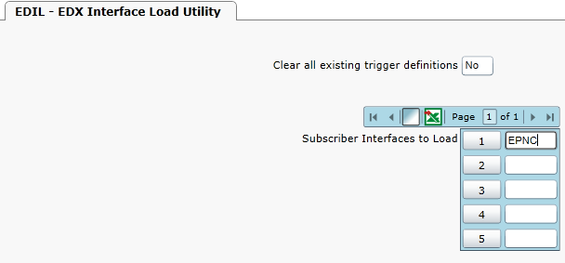
It’s not working, now what?
How do you correct the scenario?

Slide 21
Fixing the problem
How do you correct the scenario?

Slide 22
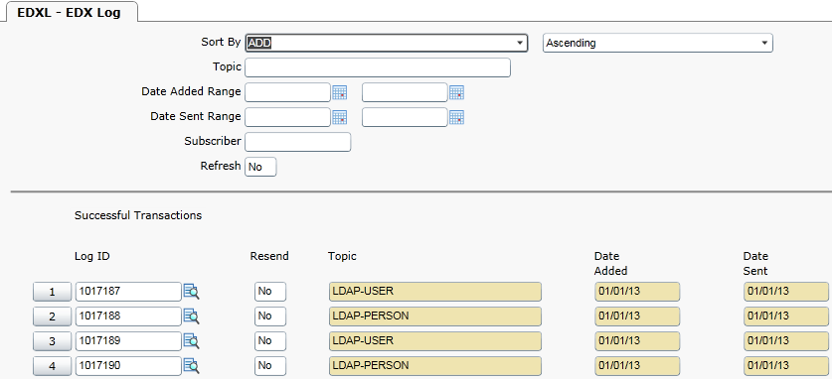
Viewing Sent Transactions
Archiving must be enabled for the subscriber
EDX.LOG and EDX.SUBSCRIBER.XML (Informer Reporting/Dashboards)
EDX Log (EDXL)

Slide 23
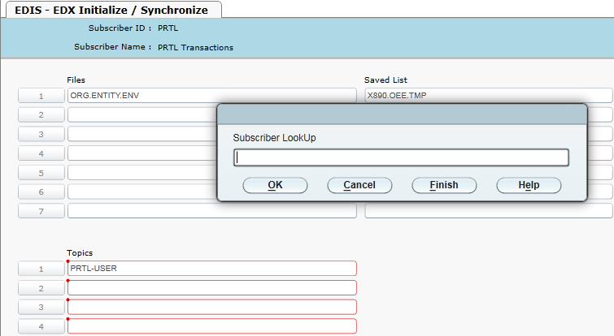
Re-Sending multiple EDX transactions

Slide 24
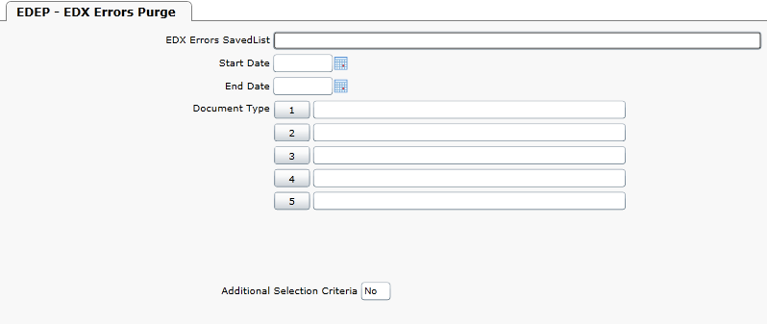
EDX Cleanup
Purge Errors

Slide 25
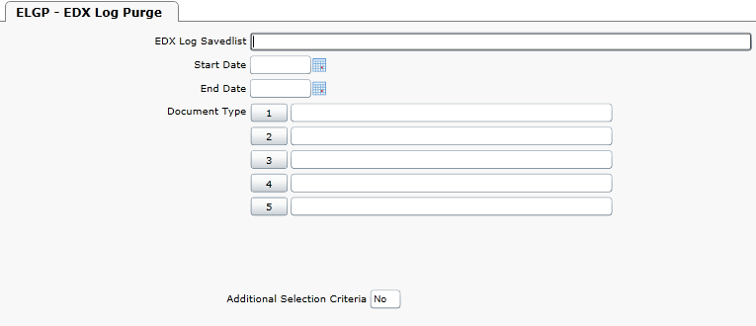
EDX Cleanup
Purge Log

Slide 26
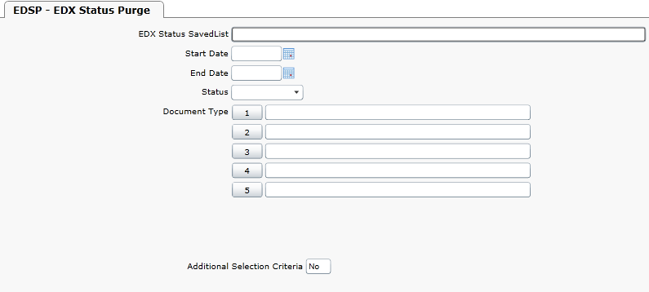
EDX Cleanup
Purge Status (manual transactions and/or undelivered)

Slide 27
Questions?

