Slide 1
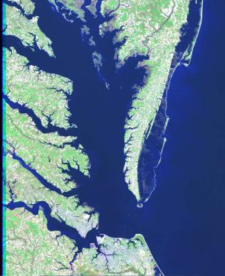
The Chesapeake Bay Preservation Act & Allowed Development
Daniel Moore
Principal Environmental Planner
Office of Watersheds and Local Government Assistance Programs
Potomac Watershed Roundtable
October 6, 2023

Slide 2
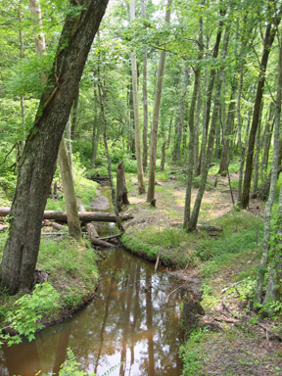
Topics
Background on the Bay Act
Regulatory Requirements
Local Program Requirements
Waivers and Exceptions
New Amendments

Slide 3
How the Bay Act started
Result of Virginia’s Commitment to the Original Chesapeake Bay Agreement
1986-87: Chesapeake Bay Land Use Roundtable formed
Composed of legislators, farmers, developers, local government officials, the conservation community and citizens
Charge: to evaluate and recommend actions needed to reduce the impact of nonpoint source pollution on the water quality of the Bay and its tributaries
Findings: need to address non-point source loadings from land use
Consensus Recommendation: new legislation to address land use and non-point source pollution and an independent agency (Chesapeake Bay Local Assistance Department) to implement that legislation

Slide 4
The Bay Act: Authorities & Intent
Statutory Authority:
1988 - Chesapeake Bay Preservation Act adopted
Code of Virginia Sec. 62.1-44.15:67 through
62.1-44.15:79
Regulatory Authority:
1989 Chesapeake Bay Preservation Area Designation and Management Regulations; amended in 1991, 2001 and 2014
Focus:
Prevent and reduce NPS pollution with a comprehensive approach to protecting water quality
Revise land development ordinances
Protect sensitive lands
Performance standards for development and redevelopment
Water quality policies in comprehensive plans

Slide 5
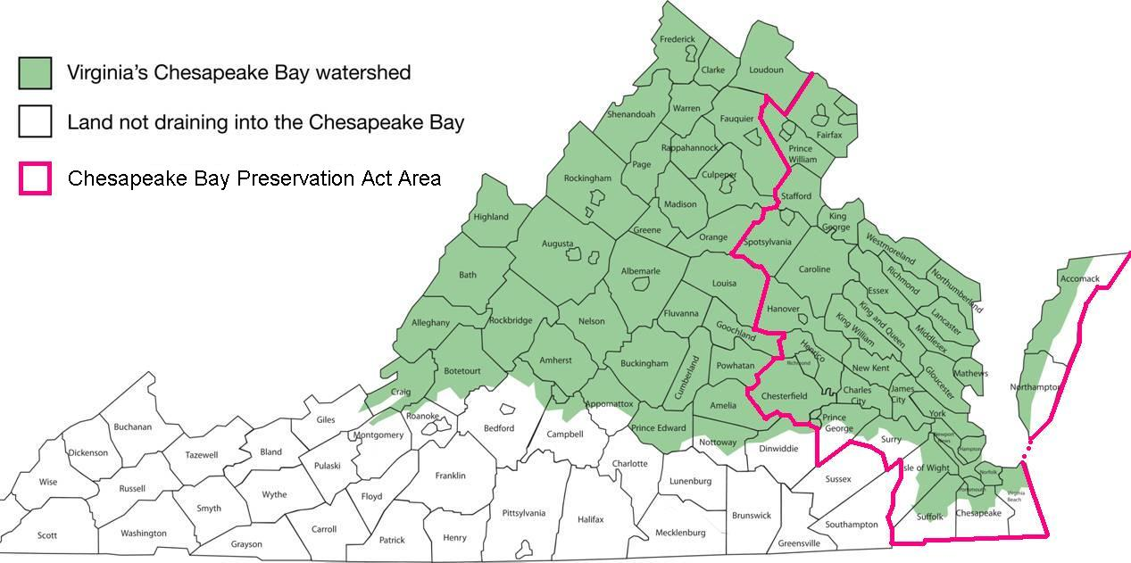
Chesapeake Bay Watershed and Bay Act Region

Slide 6
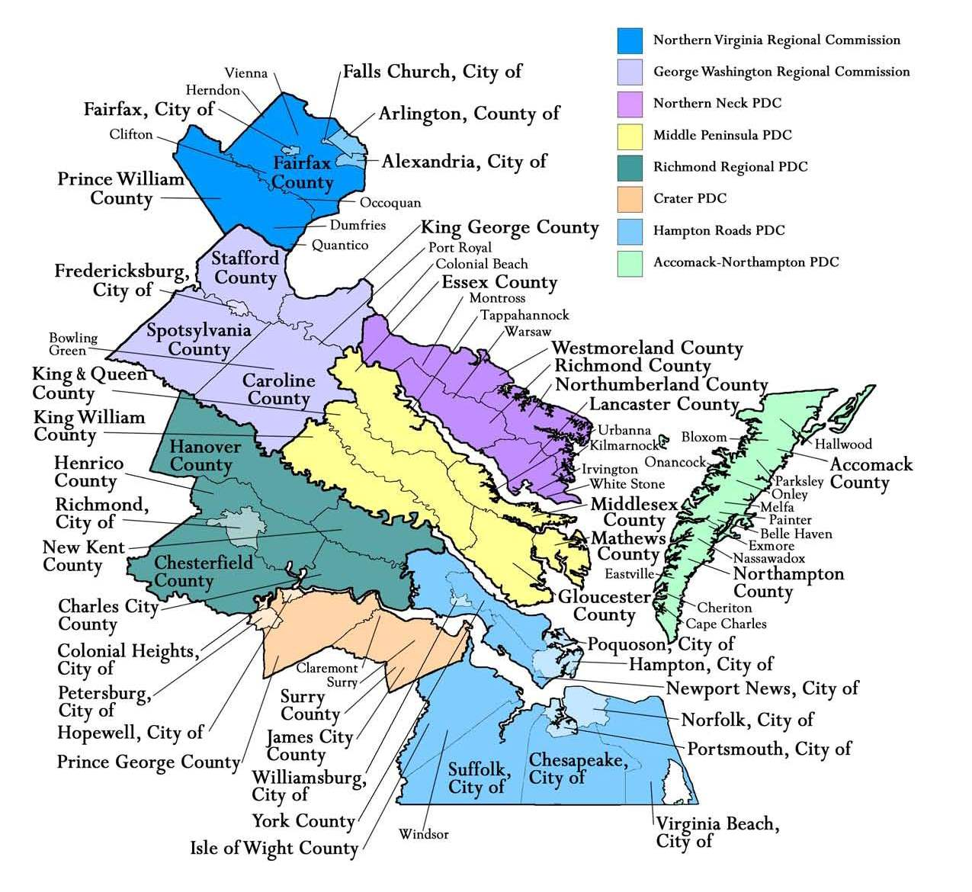
17 Cities
29 Counties
38 Towns

Slide 7
Integrated DEQ Programs
Water quality protection begins with project planning, design, and approval
Continues with the control of erosion and sediment during construction, and
Is ongoing throughout the life of the development as stormwater runoff is managed.
Together, the three programs protect water quality
Bay Act –
Pre - Construction
E & S – During Construction
VSMP – Post Construction
Notes:
The BA is a planning program, aimed at preventing pollution from reaching the Bay’s tributaries through pre-construction land development practices (risk avoidance), not mitigating for damage once it has occurred.
The BA is complementary, not duplicative of other DEQ initiatives, such as E&S and Stormwater, requires compliance with them and provides opportunities to meet stormwater requirements through the protection of the buffer and use of Better Site Design principals within CBPAs.
BA also complements other water quality program initiatives, such as the multi-jurisdictional Bay Program \providing opportunities to meet the requirements of the Phase III WIP, to establish living shorelines, and to address coastal resiliency needs.

Slide 8
Required Elements of Local Bay Act Programs
Chesapeake Bay Preservation Area map
Local ordinance provisions containing 10 performance criteria for the use, development and redevelopment of land
Comprehensive Plan elements incorporating water quality protection
Zoning ordinance containing water quality protection
Subdivision ordinance containing water quality protection
Adequate Plan of Development Review process

Slide 9
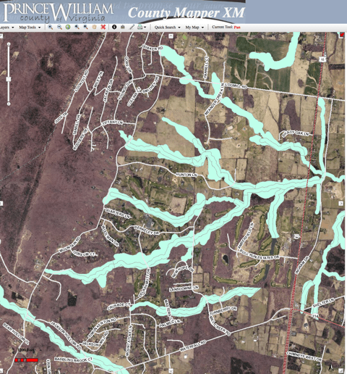
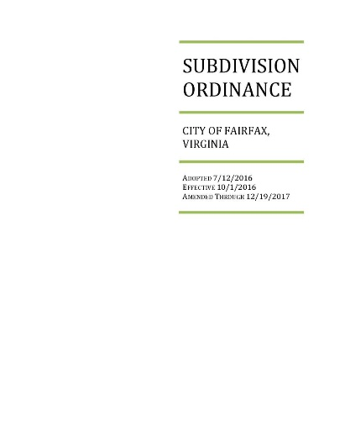
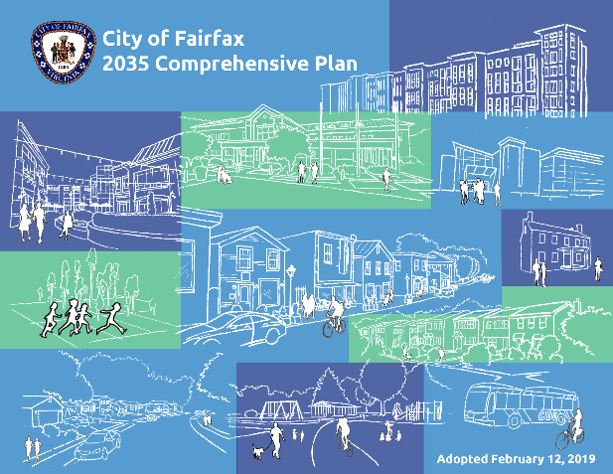
Phases of a Local Bay Act Program
Phase I: Mapping of Chesapeake Bay Preservation Areas, adoption of management program & local ordinance provisions including 10 performance criteria
Phase II: Adoption of Comprehensive Plan criteria
Phase III: Review and revision of local codes for inclusion of specific standards that implement water quality performance criteria. Add climate change resilience and adaptation criteria

Slide 10
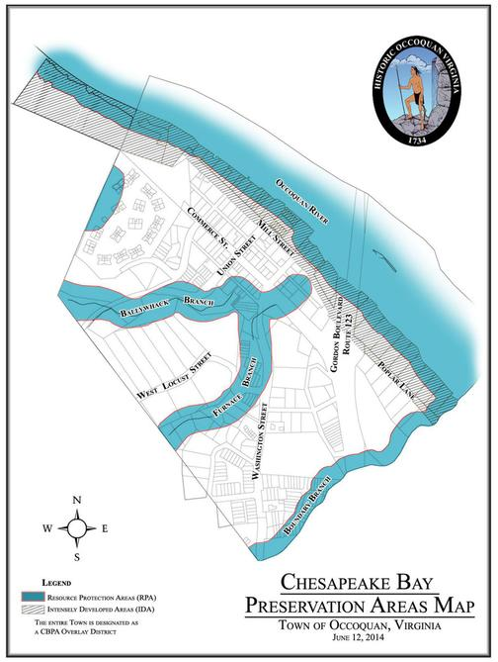
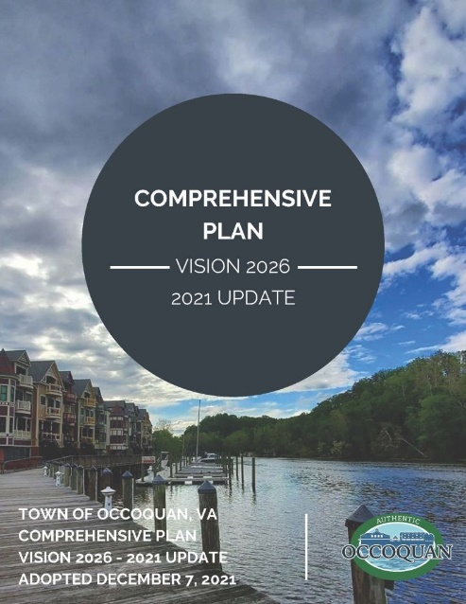
Phase I – Mapping and Ordinance Adoption
Designate and map Chesapeake Bay Preservation Areas (CBPAs)
Implement land use, development and redevelopment performance criteria within CBPAs

Slide 11
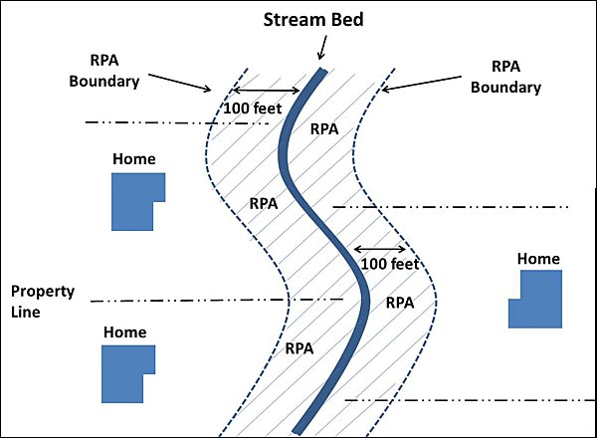
Phase II - Comprehensive Plan Criteria
Summary of data (partial list)
Chesapeake Bay Preservation Areas
Existing & proposed land uses
Existing & potential sources of pollution
Shoreline and stream bank erosion problems
Analysis and policy discussions
Land use plan map
Implementing measures/ time frame for accomplishment

Slide 12
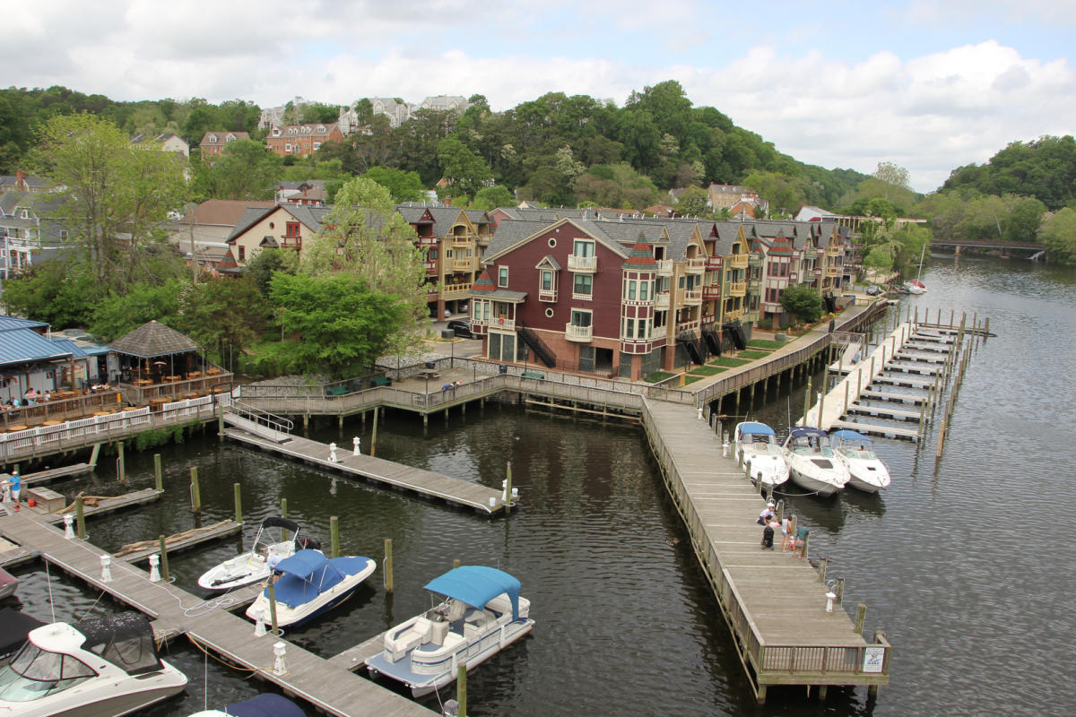
Phase III – Land Use Code Review & Revision
Local ordinances must:
Include specific development standards to address the three general performance criteria
Include six provisions applicable to approved plats and plans
Identify and resolve obstacles and conflicts to achieving the “water quality goals of the Act” within local programs and ordinances

Slide 13
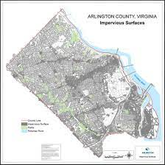
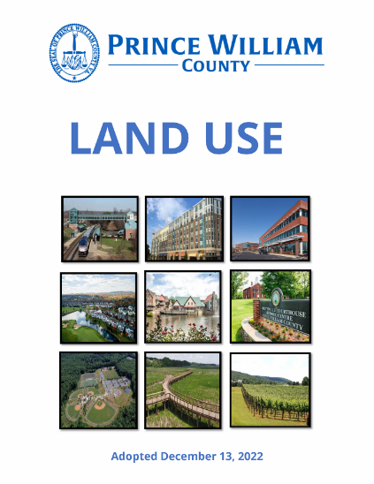
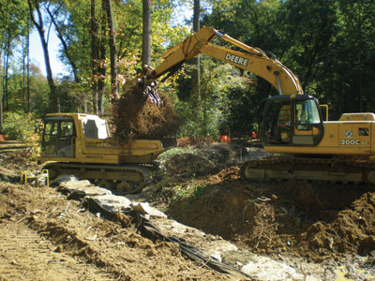
Specific Development Ordinances
Local land development ordinances must contain “specific development standards” that implement the three general performance criteria. (9VAC 25-830-130 1, 2 & 4)
Minimize Land Disturbance
Preserve Indigenous Vegetation
Minimize Impervious Cover

Slide 14
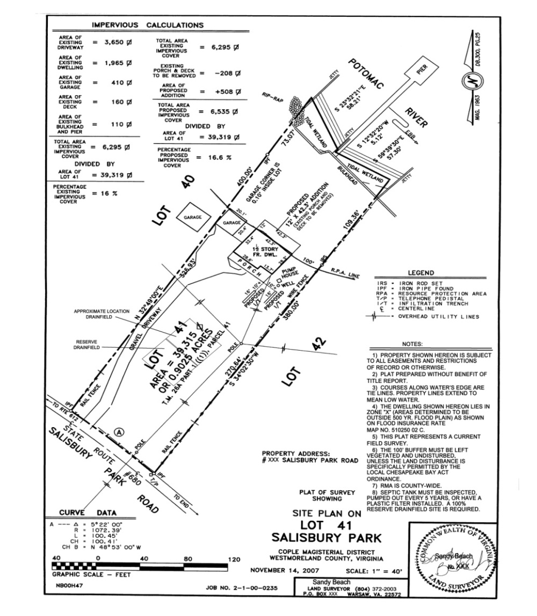
Required Provisions for Site Plans and Plats
Local ordinances must require approved plats and plans to include:
depiction of RPA & RMA boundaries
notation for the requirement to retain an undisturbed and vegetated 100’ buffer
notation regarding the requirement for on-on-site septic system 5 year pump-out
notation regarding the requirement for a a a a 100% reserve drain field
notation that development in the RPA is is limited to water dependent facilities or or redevelopment
delineation of the buildable areas on on each lot

Slide 15
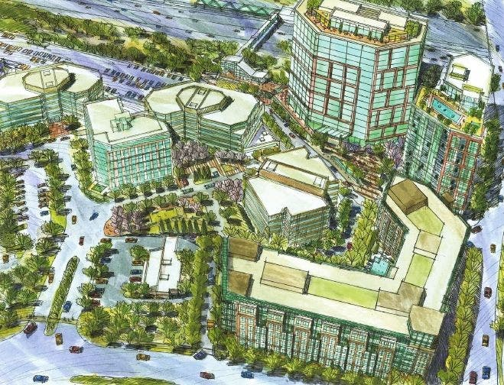
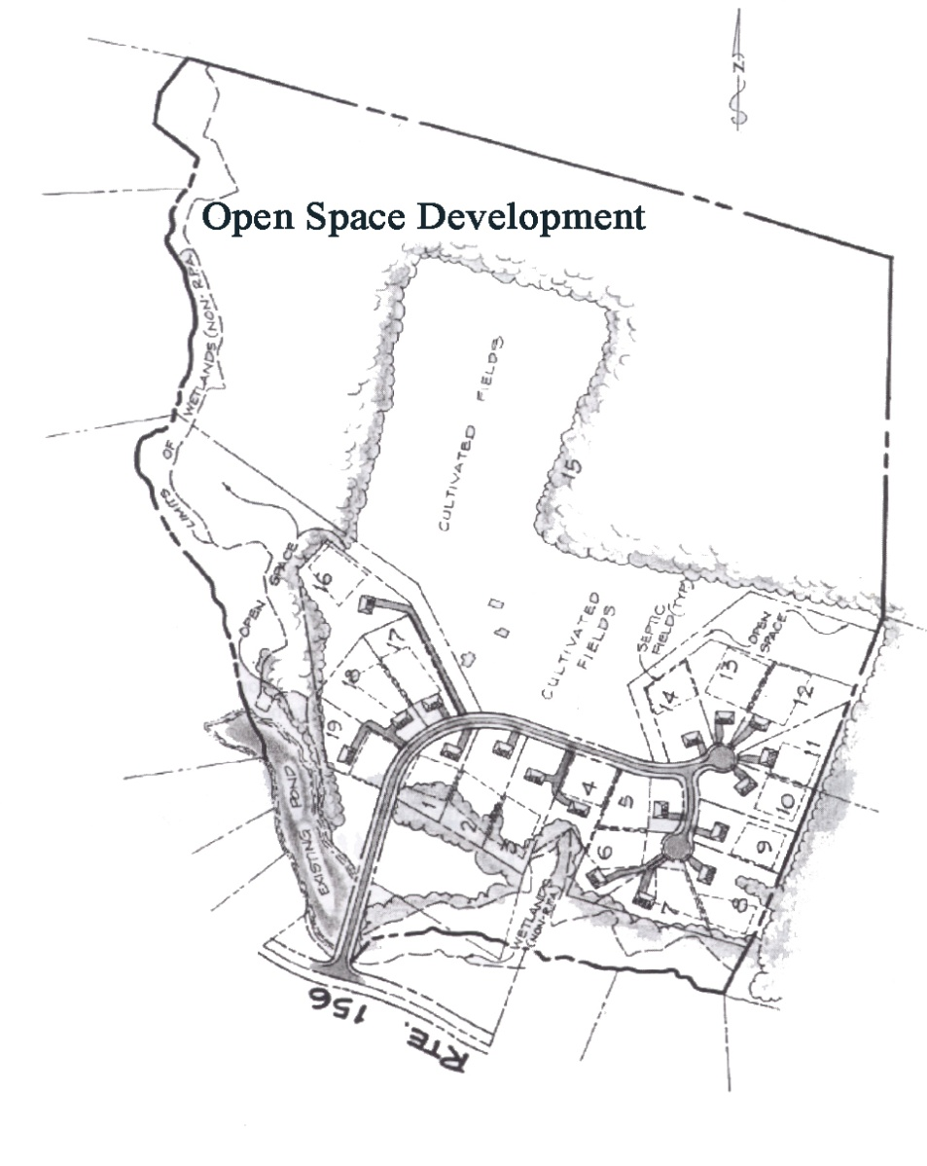
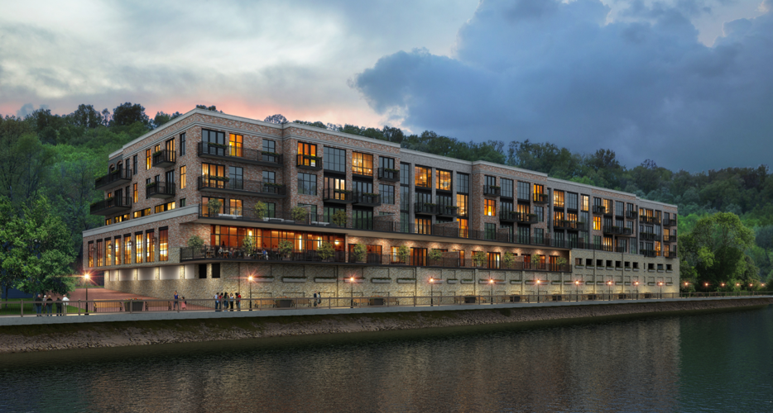
Land Development Requirements
Better Site Design- minimize impervious cover

Slide 16
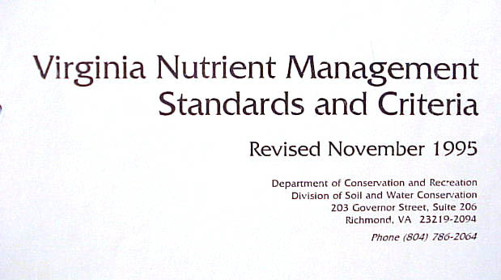
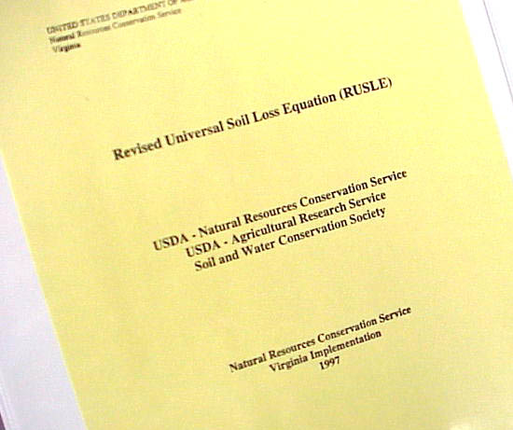
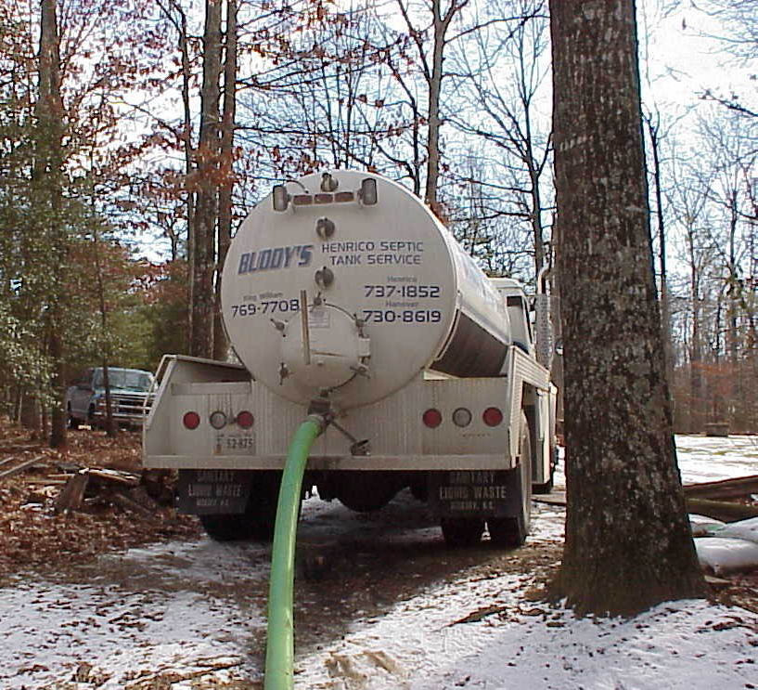
Revised Agricultural Requirements
Soil & Water Quality Conservation Assessment and/or Conservation Plan
Septic Pump-out Requirements

Slide 17
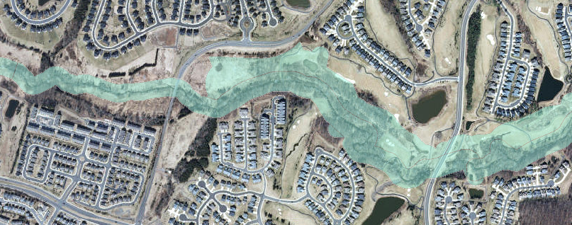
Chesapeake Bay Preservation Areas: 10 performance criteria for development:
Minimize land disturbance
Preserve indigenous vegetation
Requires Plan of Development review process
Minimize impervious cover
E&S for development >2,500 sq. ft.
Chesapeake Bay Preservation Act land-disturbing activity shall comply with stormwater regulations (>2,500 sq. ft. < 1 acre)
Septic pump-out and reserve drain field
Agricultural conservation assessments
Silviculture exemption
Wetlands permits

Slide 18
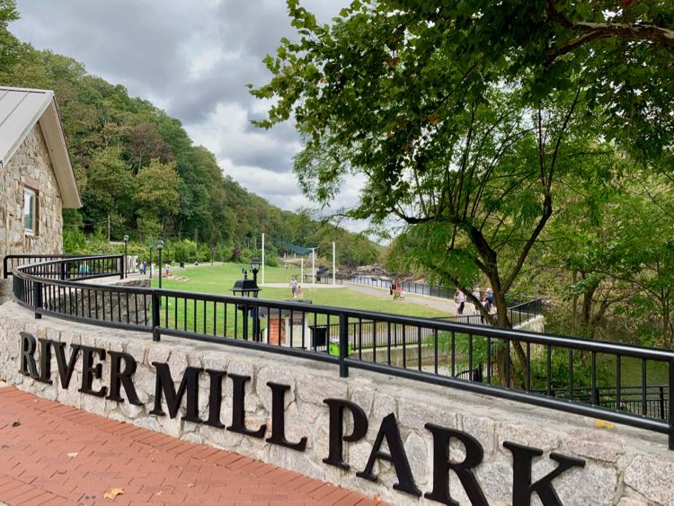
Chesapeake Bay Preservation Areas - RMA
Resource Management Areas (RMAs)
Required along the entire edge of the RPA;
Highly permeable soils;
100-year floodplains;
Highly erodible soils,
Nontidal wetlands not included as RPA features
60 localities have jurisdiction wide RMAs

Slide 19
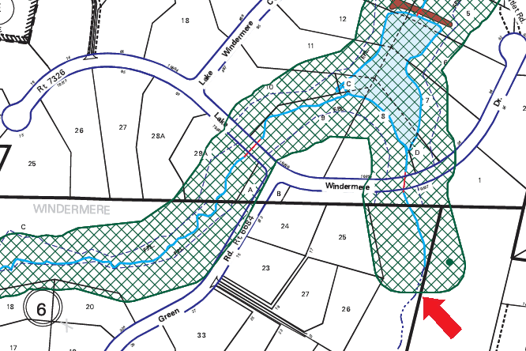
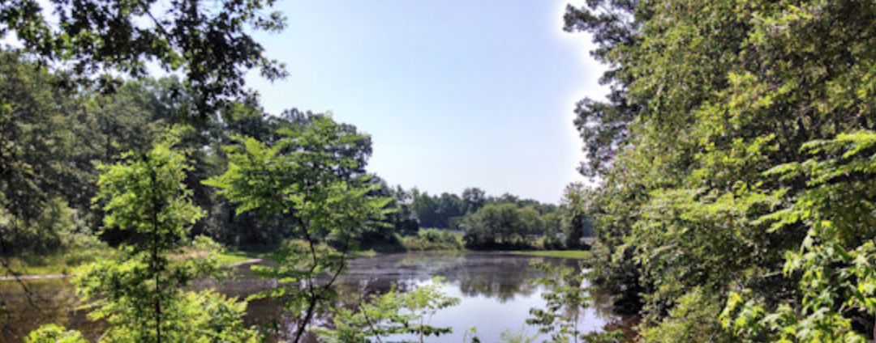
Resource Protection Areas
Tidal Wetlands
Non-tidal Wetlands connected by surface flow and contiguous to tidal wetlands or water bodies with perennial flow
Tidal Shores
100’ Vegetated Buffer landward of any of these features and water bodies with perennial flow

Slide 20
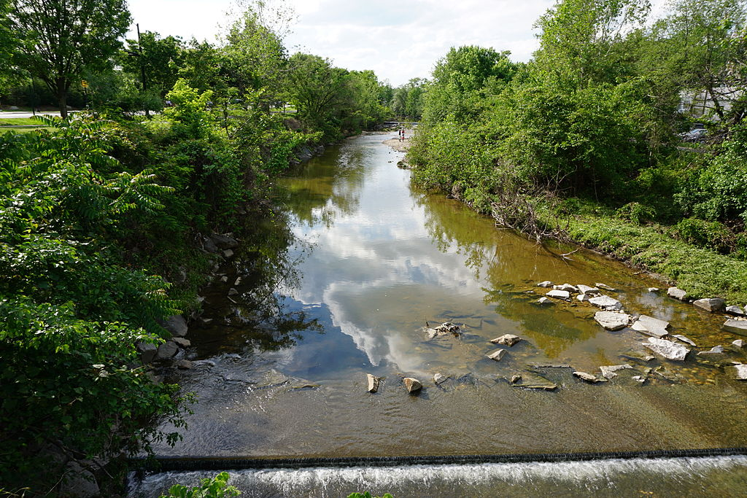
Criteria for development in the RPA
The 100-foot RPA buffer is never reduced
A Water Quality Impact Assessment (WQIA) is required for all proposed RPA land disturbance
Site specific RPA delineation based on current conditions is required for any proposed development in RPAs

Slide 21
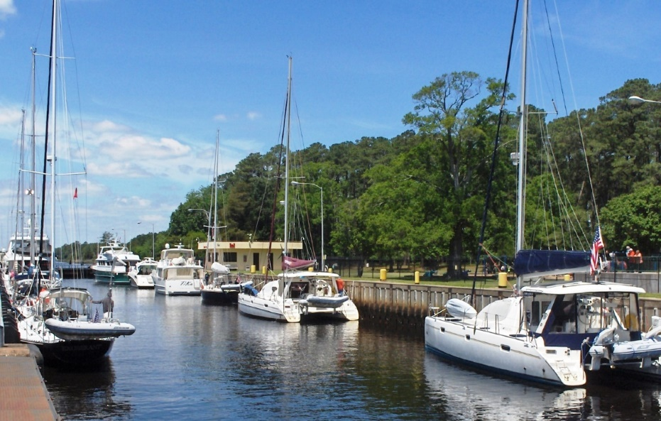
Permitted Uses within RPA
New or expanded water dependent uses – but not non-water dependent components such as pools and club houses
Redevelopment of existing buildings within existing footprints
Roads and drives
Flood control and SWM facilities
All are conditioned and require local approval
Notes:
Water dependent uses also must not conflict with the Comp Plan, and any non-water dependent components must be outside of the RPA. Access must be provided with minimum disturbance necessary, preferably with a single point of access.
Redevelopment no increase in the amount of the impervious cover and there is no further encroachment within the RPA – redevelopment has to be within the original footprint of the pre-BA structure
Roads/drives no reasonable alternative, alignment and design is optimized, RPA encroachment is minimized
SWM/Flood control – regional facilities, not single parcel
Uses and activities within the RPA must comply with the GPC and require certain conditions for development, such as compliance with E&S and stormwater requirements. In addition, any LD within the RPA requires submission of a WQIA, with mitigation.

Slide 22
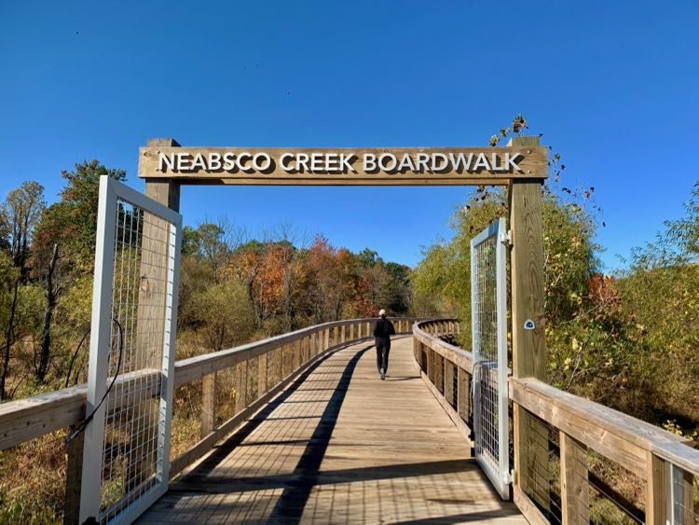
Ex
Exempt Uses
Public Roads Public Utilities Railroads
Historic preservation &
archaeological activities
Water wells
Boardwalks & access paths
PROVIDED:
Administrative review and approval
Compliance with E&S and stormwater requirements
Notes:
Exempt, with conditions, and require local government approval. Water wells, boardwalks trails pathways, hist pres and archaeological projects require E&S. Public utilities, railroads, public roads, must minimize RPA impact and comply with E&S and stormwater

Slide 23
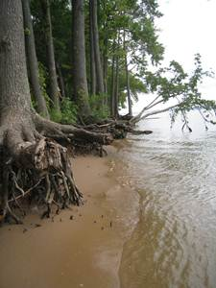
RPA Buffer Modifications (no structures, generally)
Sight lines and vistas
Access paths
General woodlot management
Shoreline erosion control projects
Agricultural and Silvicultural modifications permitted w/ BMPs and re-establishment of the full 100’ buffer with a land use conversion
Land disturbance w/i RPA requires WQIA and vegetative mitigation
Notes:
Permitted modifications require administrative approval
The Buffer Manual provides guidance for design of and mitigation for access paths and other buffer encroachments and modifications

Slide 24
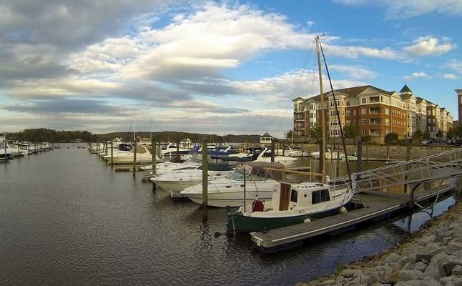
Limits on Permitted RPA Activities
Certain “by-right” uses
Exempted uses
Permitted buffer modifications
Approved RPA encroachments
Projects permitted through the exceptions process
Notes:
In order to protect sensitive environmental features and preserve functionality of the buffer, the Regulation strictly controls what types of land uses and development can occur within the RPA.
All development permitted in the RPA is conditioned, and approval is required, either administrative by locality staff, or formal, by a duly appointed board or commission.

Slide 25
RPA Buffer Encroachments (structures)
Administrative Waivers (Local Staff approval):
New development of a principal structure and utilities on pre-Bay Act lots (recorded before 10/1/89*) provided:
Minimum necessary to achieve reasonable buildable area
Mitigation consists of vegetated area equal to encroachment
Encroachment within the seaward 50’ of the buffer is not allowed
Expansion of non-conforming structures – approval is contingent upon meeting required findings (same as exceptions)
Administrative approval by local staff, no public hearing requirement
* Lots recorded after October 1, 1989 are required to include sufficient buildable area outside RPA.
Notes:
Regulatory relief from the RPA development criteria is available under certain conditions and may be approved either administratively for the scenarios listed on this slide, or a formal exception process.
All proposed land disturbance within the RPA must still meet the GPC, received approval from the local govt, requires submission of a WQIA, vegetative mitigation for the proposed disturbance per the Buffer Manual, and appropriate conditions for approval.

Slide 26
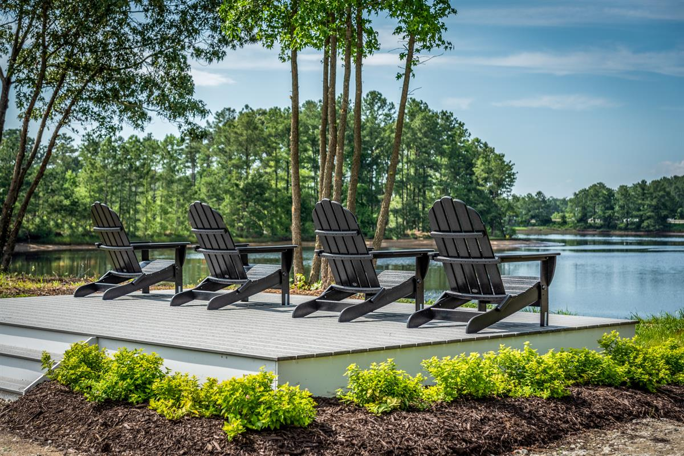
RPA Buffer Encroachments (structures)
Formal Exceptions (CBPA Review Board):
Relief from performance criteria for
Accessory structures & uses: detached decks or garages, pools, gazebos, patios, sheds, etc.
Encroachment into the seaward 50’ of the buffer
May be granted by the CBPA Review Board
Must meet the required findings* and be approved with reasonable conditions, including mitigation
Requires public notice and public hearing
Minimum necessary to afford relieve 2. Exception granted will not confer special privileges denied to others
Exception is in harmony w/ purpose & intent 4. Not based on conditions/circumstances self-created or self-imposed
Reasonable and appropriate conditions are imposed as warranted

Slide 27
Waiver & Exception Considerations
During the review process, staff and the Bay Board should consider:
Is there sufficient buildable area outside of the RPA?
Can the house be placed further away from the shoreline?
Can required setbacks be reduced in order to minimize encroachment into the RPA?
Can an adequate amount of vegetation be planted to replace what is lost and mitigate for increased stormwater runoff?
Can a proposed expansion be placed over existing impervious surface?
Is there existing impervious surface within the RPA that can be removed and revegetated?
Notes:
When reviewing an application, City staff and the Bay Board should consider:
Alternatives for location, sizing, and orientation of the proposed development
Water quality impacts and adequacy of the proposed mitigation
Suitability of the parcel for the desired project, given limitations imposed by the Bay Act

Slide 28
Regulatory Jurisdictions
Bay Board Jurisdiction
RPA Features
(Tidal and Nontidal Wetlands)
ACOE Jurisdiction
VMRC Jurisdiction
Wetlands Board Jurisdiction
MLW
Approval of a VWP or wetlands permit does not negate a locality’s obligation to implement and enforce Bay Act requirements for encroachments or modifications to the RPA made necessary by the proposed project.
Notes:
This diagram illustrates a typical RPA cross-section, and identifies areas of jurisdictional overlap between Bay Boards and Wetland Boards. Any land disturbance in the RPA requires submission of a WQIA, mitigation, and approval by local govt.
Please note that APPROVAL OF A VWP PERMIT OR WETLANDS BOARD PERMIT DOES NOT EXEMPT OR DISMISS A PROJECT FROM COMPLIANCE WITH BAY ACT REQUIREMENTS.

Slide 29
2020 Regulatory Amendment
Coastal Resiliency
Virginia Code § 62.1-44.15:72 required the State Water Control Board (Board) to develop criteria enabling local governments to encourage and promote “coastal resilience and adaptation to sea-level rise and climate change” through their Bay Act programs by requiring a resiliency assessment be conducted to understand the impacts of climate change and sea level rise on any proposed land development within RPAs, based on a potential impact range of Localities “shall assess the impacts of climate change and sea level rise on proposed land development in the RPA…”
Incorporated into the plan of development or project review process
Based upon RPA as delineated at time of proposed development
Based upon a period of 30 years, or lifespan of the project
Use a model or forecast developed by or on behalf of Commonwealth
Assess potential impacts on buffer function in light of proposed project
Identify conditions, alterations or adaptation measures to address potential impacts
Effective: 9/29/2021, requires local ordinance adoption by 9/29/24

Slide 30
2020 Statutory Amendment
Mature Trees
Virginia Code § 62.1-44.15:72 required DEQ to develop criteria enabling local governments to encourage and promote the “preservation of mature trees or planting of trees as a water quality protection tool and as a means of providing other natural resource benefits” through their Bay Act program:
Providing definitions for mature trees, canopy and understory trees
Requiring protection during development
Encouraging preservation and trimming/limbing up
Removal limited to fewest trees feasible and consistent with the best available technical advice
Requiring replacement for removal with trees in a number and location appropriate to site conditions and maximizing the buffer function of protecting water quality.
Inclusion of native species in tree replanting is preferred.
Effective: 9/29/2021, local ordinance adoption by 9/29/24
Mature Trees
Virginia Code § 62.1-44.15:72 required DEQ to develop criteria enabling local governments to encourage and promote the “preservation of mature trees or planting of trees as a water quality protection tool and as a means of providing other natural resource benefits” through their Bay Act program:
Providing definitions for mature trees, canopy and understory trees
Requiring protection during development
Encouraging preservation and trimming/limbing up
Removal limited to fewest trees feasible and consistent with the best available technical advice
Requiring replacement for removal with trees in a number and location appropriate to site conditions and maximizing the buffer function of protecting water quality.
Inclusion of native species in tree replanting is preferred.
Effective: 9/29/2021, local ordinance adoption by 9/29/24
Mature Trees
Virginia Code § 62.1-44.15:72 required DEQ to develop criteria enabling local governments to encourage and promote the “preservation of mature trees or planting of trees as a water quality protection tool and as a means of providing other natural resource benefits” through their Bay Act program:
Providing definitions for mature trees, canopy and understory trees
Requiring protection during development
Encouraging preservation and trimming/limbing up
Removal limited to fewest trees feasible and consistent with the best available technical advice
Requiring replacement for removal with trees in a number and location appropriate to site conditions and maximizing the buffer function of protecting water quality.
Inclusion of native species in tree replanting is preferred.
Effective: 9/29/2021, local ordinance adoption by 9/29/24

Slide 31
2020 Statutory Amendment
Local Bay Act Program Website
Amended Virginia Code § 62.1-44.15:67 requiring each local government in Tidewater Virginia to publish on its website “the elements and criteria adopted to implement its local plan as required by this article, including those elements and criteria required by 9 VAC 25-830-60 for local programs.”
At a minimum, the locality website must provide information on the local Bay Act program, including access to the CBPA map, comprehensive plan, and ordinances containing performance criteria, including the plan of development process.
Guidance under development recommends inclusion of all forms and applications for use when applying for projects located on parcels within the designated CBPAs
Effective: 8/31/2022

Slide 32
Amendment Implementation Timetable and Next Steps
Coastal Resiliency guidance developed by DEQ, William & Mary Coastal Policy Center (CPC) and VIMS Center for Coastal Resources Management (CCRM)
Stakeholder Advisory Group meeting and review – April 2022
Draft guidance informal public comment period closed 10/7/22. Guidance is currently being updated with a second formal public comment period scheduled for Summer 2023.
Graphics and example scenarios developed in conjunction with guidance
Model Training / User Guide
Developing with VIMS CCRM staff
Summer 2023 - virtual training event (recorded)
Fall 2023 - in-person training event at VIMS
Buffer Manual update to address Mature Trees amendment – Late 2023
CBPA Website guidance formal public comment period 11/21/22 - 12/21/22
Developing model ordinance language to address all amendments – Early 2023

Slide 33
Daniel Moore
Principal Environmental Planner
Office of Watersheds and Local Government Assistance Programs
(804) 774-9577
daniel.moore@deq.virgina.gov

