Slide 1
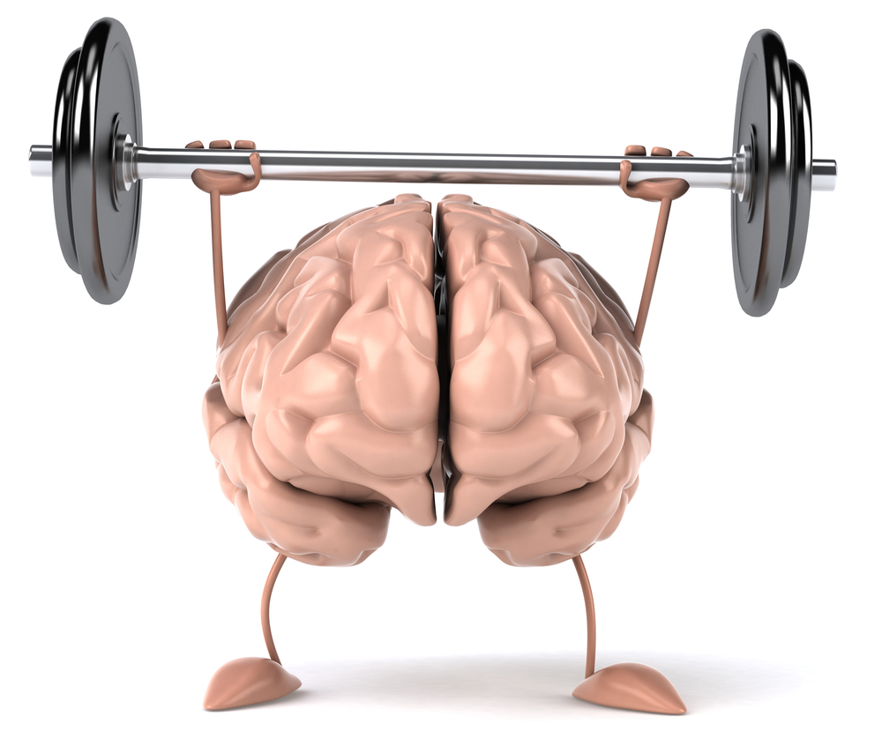
Six (6) Things Mentally Strong
People Do
By Life Learned Feelings

Slide 2

#1
They move on. They don't waste time feeling sorry for themselves
BBV2M LLC
Notes:
2

Slide 3
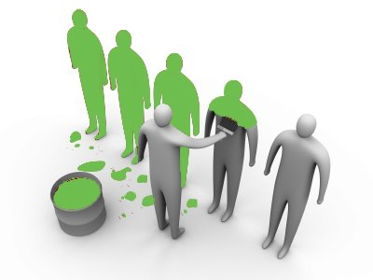
#2
They embrace Change. They welcome Challenges
BBV2M LLC
Notes:
3

Slide 4

#3
They stay happy. They don't waste energy on things they can't control.
BBV2M LLC
Notes:
4

Slide 5

#4
They are kind, fair and unafraid to speak up.
BBV2M LLC
Notes:
5

Slide 6

#5
They are willing to take calculated risks.
BBV2M LLC
Notes:
6

Slide 7

#6
They celebrate other peoples success. They don't resent that success
BBV2M LLC
Notes:
7

Slide 8

BBV2M-BrothersBrooksVision2MissionLLC.com
BBV2M@gmail.com
Notes:
8

